Slide 1
Law of Demand: Why Price Matters
When the price goes up, we buy less - and here is exactly why.
© More Lessons Less Planning | morelessonslessplanning.com
Notes:
Open with the everyday version: when your favorite snack goes on sale, you buy more; when gas spikes, you drive less. That instinct IS the law of demand. Today we name it, graph it, and explain the two reasons behind it (substitution effect and income effect).

Slide 2
Learning Targets
State the LAW OF DEMAND and read a demand curve and demand schedule
★
Tell a MOVEMENT ALONG the curve apart from the SUBSTITUTION and INCOME effects
★
Use a real demand schedule to predict quantity demanded when price changes
★
© More Lessons Less Planning | morelessonslessplanning.com
Notes:
Read the three targets aloud. Target 1 is the rule + the two ways to display it (table and graph). Target 2 is the WHY (substitution effect and income effect). Target 3 is the application (read the schedule, predict quantity demanded).

Slide 3
What Is the Law of Demand?
The Rule in One Sentence
You Already Live This
Price UP - quantity demanded DOWN
Price DOWN - quantity demanded UP
Price and quantity move in OPPOSITE directions
This is called an INVERSE relationship
Snack on sale - you buy MORE
Gas hits $5 - you drive LESS
Concert tickets double - fewer people go
Coffee shop raises prices - some switch to tea
Key Concept: The law of demand says price and quantity demanded move in OPPOSITE directions, all else equal.
© More Lessons Less Planning | morelessonslessplanning.com
Notes:
State the law of demand cleanly. Stress INVERSE relationship (opposite directions). Ground it in everyday experience so the formal rule feels obvious.

Slide 4
Demand vs Quantity Demanded
DEMAND
The WHOLE relationship - the quantity buyers want at EVERY price; the entire demand curve or schedule, not one number
QUANTITY DEMANDED
ONE amount at ONE specific price; a single point on the demand curve (e.g., 600 tickets at $8)
Why it matters
A price change moves QUANTITY DEMANDED along the curve; it does NOT change DEMAND (the whole curve stays put)
Quick test
If a sentence names a specific price, it is talking about QUANTITY DEMANDED, not demand
Warning: Demand is the whole curve; quantity demanded is one point on it. Mixing them up is the #1 error in this unit.
© More Lessons Less Planning | morelessonslessplanning.com
Notes:
This vocabulary distinction is the single biggest source of student error in Unit 2. Drill it now. Demand = the whole curve. Quantity demanded = one point at one price.

Slide 5
The Demand Schedule - A Table of Price and Quantity
Price per Ticket | Quantity Demanded (tickets/week)
$16 | 200
$12 | 400
$8 | 600
$4 | 1000
Did You Know: A demand schedule is just a table - each row is one price and its quantity demanded. As price FALLS, quantity demanded RISES.
© More Lessons Less Planning | morelessonslessplanning.com
Notes:
Introduce the running example: movie tickets. The demand schedule is the table form of the law of demand. As price drops from $16 to $4, quantity demanded climbs from 200 to 1000. These exact numbers reappear on the demand-curve chart and in the activity.

Slide 6
The Demand Curve - The Schedule Drawn as a Graph
How to Read the Axes
What the Next Slide Shows
PRICE goes on the vertical (Y) axis
QUANTITY DEMANDED goes on the horizontal (X) axis
Each schedule row becomes one plotted POINT
Connect the points and you get the demand curve
The curve slopes DOWNWARD left to right
At $16 the curve reads 200 tickets
At $8 the curve reads 600 tickets
Downward slope = the law of demand, drawn
Tip: The demand curve slopes DOWN for one reason - the law of demand. Higher price, lower quantity demanded. Lower price, higher quantity demanded.
© More Lessons Less Planning | morelessonslessplanning.com
Notes:
Set up the demand-curve chart on the next slide BEFORE flipping. Price on Y, quantity demanded on X. Pre-load the points (200 at $16, 600 at $8) so students can verify on the chart. The downward slope IS the law of demand.

Slide 7
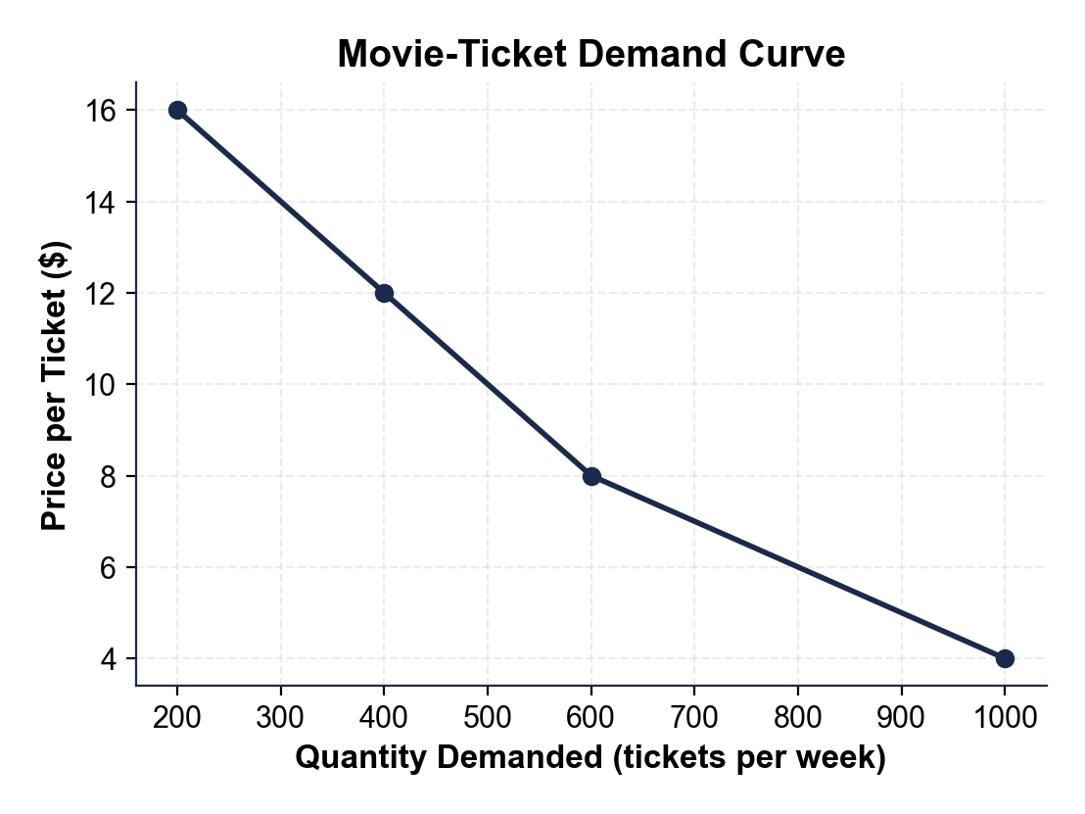
The Movie-Ticket Demand Curve
The demand curve slopes downward.
© More Lessons Less Planning | morelessonslessplanning.com
Notes:
Point to the top-left of the curve ($16, 200 tickets) and the bottom-right ($4, 1000 tickets). Trace the downward slope with a finger. Every point on this curve is one row of the demand schedule.
Reference labels (point to these chart features when teaching): $16 = 200 tickets; $4 = 1000 tickets

Slide 8
Same Data, Different Picture - The Bar Chart
A demand schedule can be drawn as BARS, not just a curve
Each bar = quantity demanded at one price
Taller bar = more tickets bought at that price
On the next slide: $12, $8, and $4 side by side
Watch the bars GROW as the price drops
Note: Curve or bars, the message is identical - lower price, higher quantity demanded. The picture changes; the law of demand does not.
© More Lessons Less Planning | morelessonslessplanning.com
Notes:
Set up the bar-chart view of the same demand schedule. The point is to show students the same data displayed two ways. The bars climb as price falls. Pre-load: at $12 -> 400, at $8 -> 600, at $4 -> 1000.

Slide 9
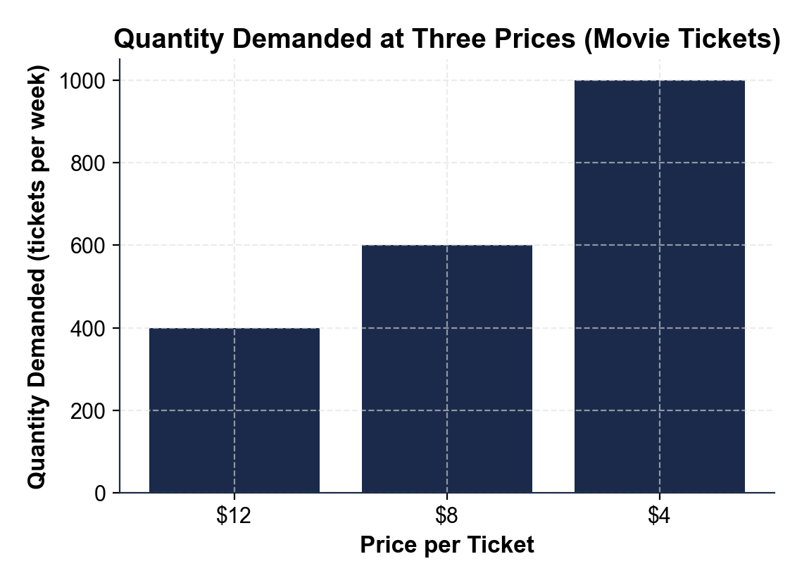
Quantity Demanded at Three Prices
Bars grow as price drops.
© More Lessons Less Planning | morelessonslessplanning.com
Notes:
Point to each bar. The $12 bar is shortest (400), the $4 bar is tallest (1000). The bars grow as the price falls - the law of demand shown as height.
Reference labels (point to these chart features when teaching): $12 = 400 tickets; $4 = 1000 tickets

Slide 10
WHY Does the Law of Demand Hold?
Two Reasons, Always Together
The Big Picture
Reason 1: the SUBSTITUTION effect
Reason 2: the INCOME effect
Both push the SAME direction
Together they bend the curve downward
Price rises - buyers switch away (substitution)
Price rises - each dollar buys less (income)
Both shrink quantity demanded
Next two slides take them one at a time
Big Idea: Two forces - the substitution effect and the income effect - explain WHY higher prices shrink quantity demanded.
© More Lessons Less Planning | morelessonslessplanning.com
Notes:
Preview the two reasons before taking them one at a time. Both the substitution effect and the income effect push quantity demanded the same direction, which is why the demand curve always slopes down.

Slide 11
Reason 1: The Substitution Effect
1
2
The rule
Coke up
A good gets pricier, so buyers SWITCH to a cheaper substitute - quantity demanded falls.
When Coke's price rises, some buyers switch to Pepsi.
3
4
Beef up
Gas up
When beef's price rises, some buyers switch to chicken.
When gas's price rises, some buyers take the bus or carpool.
Try this: If your favorite pizza place doubled its price, what would you buy instead? That switch IS the substitution effect.
© More Lessons Less Planning | morelessonslessplanning.com
Notes:
The substitution effect: when one good's price rises, buyers move to a cheaper substitute. Use concrete pairs (Coke/Pepsi, beef/chicken, gas/bus). Quantity demanded of the pricier good falls because some buyers leave for the substitute.

Slide 12
Reason 2: The Income Effect
When a good gets more expensive, each dollar of your income buys LESS
Your money income did not change - but your REAL income (buying power) fell
Feeling poorer, buyers purchase less of the pricier good
Example: rent jumps $200 - you have less left for everything else
Result: quantity demanded falls because real buying power dropped
Key Concept: The income effect is about BUYING POWER - a higher price makes your same paycheck stretch less far, so you buy less.
© More Lessons Less Planning | morelessonslessplanning.com
Notes:
The income effect: a higher price lowers REAL income (buying power) even though money income is unchanged. Feeling poorer, buyers cut back. Distinguish money income (the number on the paycheck) from real income (what it actually buys).

Slide 13
Ceteris Paribus - Holding All Else Equal
What It Means
Why We Need It
Latin for 'all else equal'
Hold EVERYTHING constant except price
Lets us isolate how PRICE alone affects quantity demanded
Income, tastes, substitute prices - all frozen
Real markets change many things at once
Ceteris paribus strips it down to one variable
Then we can draw a single, fixed demand curve
Change anything else and the WHOLE curve would shift
Remember: The law of demand only works 'ceteris paribus' - all else equal. We freeze everything except price so we can see price's effect by itself.
© More Lessons Less Planning | morelessonslessplanning.com
Notes:
Ceteris paribus is the assumption that makes the law of demand precise. Hold everything constant except price. This is what lets us draw ONE demand curve and slide along it. Changing anything else (income, tastes, substitute prices) shifts the whole curve - a TK 16 topic.

Slide 14
Movement ALONG the Curve - Only Price Moves You
A movement along the curve is caused ONLY by the good's OWN price
You slide from one point to another on the SAME curve
Price down - slide to a bigger quantity demanded
Price up - slide to a smaller quantity demanded
A price change does NOT shift the whole curve - only non-price factors do
Warning: A price change moves you ALONG the curve. It does NOT shift the curve - only non-price factors do that.
© More Lessons Less Planning | morelessonslessplanning.com
Notes:
Movement along the curve is caused ONLY by the good's own price changing. You slide from point to point on the same curve. Contrast briefly with a shift (non-price factors) but keep the focus on movement - shifts are TK 16.

Slide 15
Putting It Together - Price Is the Key Variable
Step 1 - Start with the law
Price up = quantity demanded down; price down = quantity demanded up (inverse relationship)
✔
Step 2 - Read it two ways
The demand schedule (table) and the demand curve (graph) carry the SAME information
✔
Step 3 - Know WHY
The substitution effect and the income effect both shrink quantity demanded when price rises
✔
Step 4 - Hold all else equal
Ceteris paribus freezes everything but price, so a price change moves you ALONG one fixed curve
✔
Big Idea: In the law of demand, PRICE is the one variable in the spotlight. Hold all else equal, and price alone slides you along the demand curve.
© More Lessons Less Planning | morelessonslessplanning.com
Notes:
Synthesis slide. Walk the four steps: the rule, the two ways to display it, the two reasons it holds, and ceteris paribus. Price is the key variable - everything else is held constant.

Slide 16
Law of Demand Vocabulary (1 of 3)
Law of demand
All else equal, when price rises quantity demanded falls and when price falls quantity demanded rises.
Quantity demanded
The amount buyers will purchase at ONE specific price - a single point on the demand curve.
Demand curve
The downward-sloping graph of quantity demanded at every price; it slopes down by the law of demand.
Note: Every term on this slide appears in Activity Part 2 (the Reference Guide) and on the Quiz - learn them here.
© More Lessons Less Planning | morelessonslessplanning.com
Notes:
Walk the three terms. LAW OF DEMAND: all else equal, price up means quantity demanded down and price down means quantity demanded up - an inverse relationship. QUANTITY DEMANDED: the amount buyers purchase at ONE specific price - a single point on the demand curve. DEMAND CURVE: the downward-sloping graph of quantity demanded at every price; it slopes down because of the law of demand.

Slide 17
Law of Demand Vocabulary (2 of 3)
1
2
3
Substitution effect
Income effect
Demand schedule
A good gets pricier, so buyers switch to a cheaper substitute - quantity demanded falls.
A good gets pricier, so real buying power falls and buyers buy less of it.
A table of price and quantity demanded - the demand curve drawn as a table.
Note: These three terms appear in Activity Part 2 and on the Quiz - the two effects explain WHY the law holds.
© More Lessons Less Planning | morelessonslessplanning.com
Notes:
Walk the three terms. SUBSTITUTION EFFECT: when a good gets pricier, buyers switch to cheaper substitutes, so quantity demanded of the pricier good falls. INCOME EFFECT: when a good gets pricier, real buying power falls, so buyers purchase less of it. DEMAND SCHEDULE: a table listing the quantity demanded at each price - the demand curve drawn as a graph.

Slide 18
Law of Demand Vocabulary (3 of 3)
Ceteris paribus
Latin for 'all else equal' - hold everything constant except price to isolate price's effect.
Movement along the curve
A change in quantity demanded caused ONLY by the good's own price change; you slide along it.
Inverse relationship
When two variables move in opposite directions; price and quantity demanded are inversely related.
Note: These three terms also appear in Activity Part 2 and on the Quiz - drill ceteris paribus and movement-along.
© More Lessons Less Planning | morelessonslessplanning.com
Notes:
Walk the three terms. CETERIS PARIBUS: Latin for 'all else equal' - hold everything constant except price to isolate price's effect. MOVEMENT ALONG THE CURVE: a change in quantity demanded caused ONLY by the good's own price change; you slide along the same curve. INVERSE RELATIONSHIP: when two variables move in opposite directions; price and quantity demanded are inversely related.

Slide 19
Key Takeaways
Law of demand: price UP = quantity demanded DOWN (inverse relationship)
Demand = the whole curve; quantity demanded = one point on it
Schedule (table) and curve (graph) carry the SAME information
WHY it holds: the substitution effect AND the income effect
Ceteris paribus: a price change moves you ALONG one fixed curve
Takeaway: When price changes, quantity demanded moves the opposite way along the curve - buyers substitute away and real buying power falls.
© More Lessons Less Planning | morelessonslessplanning.com
Notes:
Cycle through the five takeaways. Each maps to one part of the activity: the rule (Part 1), reference vocabulary (Part 2), schedule/curve reading (Part 3), the two effects across scenarios (Part 4), and the prediction memo (Part 5).

