Slide 1
Knights and the Code of Chivalry
Learn the knightly ideal of courage, loyalty, and honor - and how far the real medieval warrior often lived from it.
© More Lessons Less Planning | morelessonslessplanning.com
Notes:
Opening slide. Chivalry was the code of conduct medieval knights were supposed to follow: courage, loyalty, and honor. It was an ideal that was taught and celebrated, but knights often broke it in practice. Students will learn what chivalry was, where it came from, how a boy became a knight, and the gap between the ideal and reality - then analyze The Song of Roland as a primary source.

Slide 2
Learning Targets
Define chivalry and its core virtues: courage, loyalty, and honor.
★
Explain where the code came from: feudal duty and the Church.
★
Describe becoming a knight: page, squire, and dubbing.
★
Analyze the gap between the chivalric ideal and reality.
★
© More Lessons Less Planning | morelessonslessplanning.com
Notes:
Read the four learning targets. Today combines a definition (what chivalry was), a cause (where it came from), a process (becoming a knight), and a history skill (using a primary source to test ideal against reality).

Slide 3
What Was Chivalry?
Chivalry
The medieval code of conduct for knights, calling for courage, loyalty, and honor.
Knight
A mounted warrior of the feudal elite, trained from boyhood and bound by the code of chivalry.
Key Concept: CHIVALRY was the code of conduct for knights, calling for courage, loyalty, and honor.
© More Lessons Less Planning | morelessonslessplanning.com
Notes:
CHIVALRY was the medieval code of conduct for knights, calling for courage, loyalty, and honor. A KNIGHT was a mounted warrior of the feudal elite, trained from boyhood and bound by that code. The word chivalry comes from the French 'cheval,' meaning horse, because knights fought on horseback. Chivalry was an IDEAL - a picture of how a knight was supposed to act - not a guarantee of how every knight really behaved.

Slide 4
Where Chivalry Came From
Feudalism
Lords granted land to vassals in exchange for military service and loyalty.
✔
Vassal
A person who received land from a lord and owed him loyalty and military service.
✔
A violent reality
Heavily armed knights often pillaged and fought, which the code tried to restrain.
✔
Key Concept: FEUDALISM tied a knight to his lord as a VASSAL who owed loyalty and military service.
© More Lessons Less Planning | morelessonslessplanning.com
Notes:
Chivalry grew out of FEUDALISM, the medieval system in which lords granted land to VASSALS in exchange for military service and loyalty. A VASSAL was a person who received land from a lord and owed him loyalty and military service in return. Because knights were heavily armed and often used violence to pillage and settle disputes, the code of chivalry and the Church both tried to give these warriors rules to live by.

Slide 5
The Church Steps In: Peace and Truce of God
Peace of God
Church rules that protected non-combatants like peasants, clergy, and merchants from knightly violence.
Truce of God
Church rules that banned fighting on holy days and certain seasons to limit knightly violence.
Key Concept: The TRUCE OF GOD limited knightly violence by banning fighting on holy days and protecting non-combatants.
© More Lessons Less Planning | morelessonslessplanning.com
Notes:
Because knights so often pillaged and fought, the Church tried to restrain them. The Peace of God protected non-combatants - peasants, clergy, and merchants - from knightly violence. The TRUCE OF GOD banned fighting on holy days and during certain seasons. These Church rules show that chivalry was needed precisely because real knights frequently broke the ideal. The Church also tried to redirect knightly violence outward, which fed into movements like the Crusades.

Slide 6
Becoming a Knight: Page, Squire, Dubbing
Page
A boy of about seven who began training by serving in a noble household.
✔
Squire
A teenager who served a knight while learning weapons and horsemanship.
✔
Dubbing
The ceremony, often a sword tap on the shoulder, that made a squire a knight.
✔
Key Concept: A boy became a knight in stages: PAGE, then SQUIRE, then DUBBING made him a knight.
© More Lessons Less Planning | morelessonslessplanning.com
Notes:
Knighthood was not open to all - it was tied to the feudal landholding elite, and training began young. A PAGE was a boy of about seven who began knightly training by serving in a noble household, learning manners and basic skills. A SQUIRE was a teenage knight-in-training who served and attended a knight while learning weapons and horsemanship. Finally, DUBBING was the ceremony - often a tap on the shoulder with a sword - that made a squire into a knight. The next slide shows a dubbing ceremony from a medieval manuscript.

Slide 7
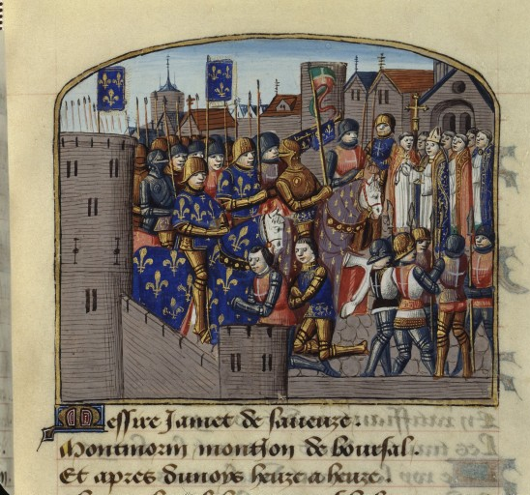
A Knight Is Dubbed
A 15th-century French manuscript pictures a knighting ceremony (adoubement).
© More Lessons Less Planning | morelessonslessplanning.com
Notes:
Real public-domain medieval manuscript illumination (Vigiles de Charles VII, fol. 223) of a knighting ceremony. Give students a moment to see how medieval artists pictured the making of a knight.
Reference labels (point to these chart features when teaching): Armored knights; Fleur-de-lis banners

Slide 8
The Core Virtues of a Knight
Courage
Bravery in battle and willingness to face danger without running.
Loyalty
Faithful service and obedience to one's lord and companions.
Honor
A knight's reputation for keeping his word, staying loyal, and showing courage.
Courtesy
Good manners and respect, especially the later ideal of protecting the weak.
Key Concept: HONOR was a knight's reputation for keeping his word, staying loyal, and showing courage.
© More Lessons Less Planning | morelessonslessplanning.com
Notes:
The code of chivalry was built on core virtues. Courage meant bravery in battle. Loyalty meant faithful service to one's lord and companions. HONOR was a knight's reputation for keeping his word, staying loyal, and showing courage - losing honor was a knight's greatest fear. Courtesy meant good manners and, in the later ideal, protecting the weak. These virtues were the ideal; whether a knight lived up to them was another matter.

Slide 9
Tournaments and Training
A tournament was a staged combat event where knights practiced fighting.
Jousting pitted two mounted knights against each other with lances.
Tournaments let knights display skill, win prizes, and build reputation.
They could be dangerous, and knights were sometimes badly hurt or killed.
Tournaments kept knights ready for real war between campaigns.
Key Concept: A TOURNAMENT was a staged combat event where knights practiced and displayed their fighting skills.
© More Lessons Less Planning | morelessonslessplanning.com
Notes:
A TOURNAMENT was a staged combat event where knights practiced and displayed their fighting skills. Jousting - two mounted knights charging with lances - was the most famous event. Tournaments let knights show off, win prizes, and build the reputation that was part of their honor. They were also dangerous: knights were sometimes seriously hurt or killed. Between real wars, tournaments kept knights trained and ready for battle.

Slide 10
The Ideal and the Reality
The Ideal
The Reality
Protect the weak and the poor.
Stay loyal to your lord and keep your word.
Show courage and mercy in battle.
Knights often pillaged villages and robbed travelers.
Wars were brutal, and prisoners were killed for ransom or revenge.
The Church's Peace and Truce of God tried to limit the violence.
Key Concept: Chivalry was an IDEAL knights were taught, but real warrior life often fell far short of it.
© More Lessons Less Planning | morelessonslessplanning.com
Notes:
Chivalry was an ideal, and the reality was often very different. The ideal said knights should protect the weak, stay loyal, keep their word, and show mercy. In reality, knights often pillaged villages, robbed travelers, and killed prisoners, and medieval warfare was brutal. The very existence of the Peace and Truce of God shows that the Church had to step in because knights so often broke the code. Chivalry is best understood as a goal that was taught and celebrated, not a description of how knights actually behaved.

Slide 11
The Song of Roland
The Song of Roland is a medieval epic poem, not an eyewitness history.
It tells of the knight Roland's last stand at the pass of Roncevaux.
Roland shows loyalty and honor by dying for his king, Charlemagne.
The poem idealizes and exaggerates the real 778 battle to teach the code.
Songs like this taught boys the chivalric ideal of the loyal, honorable knight.
Note: The Song of Roland is an epic poem that idealizes a real battle - it teaches the ideal, it is not a factual record.
© More Lessons Less Planning | morelessonslessplanning.com
Notes:
The Song of Roland is a medieval epic poem - a chanson de geste - not an eyewitness account. It tells how the knight Roland made a heroic last stand at the mountain pass of Roncevaux and died loyal to his king, Charlemagne. The poem is based on a real ambush in 778, but it idealizes and exaggerates the event to teach the chivalric ideal (the real attackers were Basques, not the Muslim 'Saracens' of the poem). Songs like this were performed in halls to teach knights-in-training the ideal of loyalty and honor. The next slide shows Roland at Roncevaux from a medieval manuscript.

Slide 12
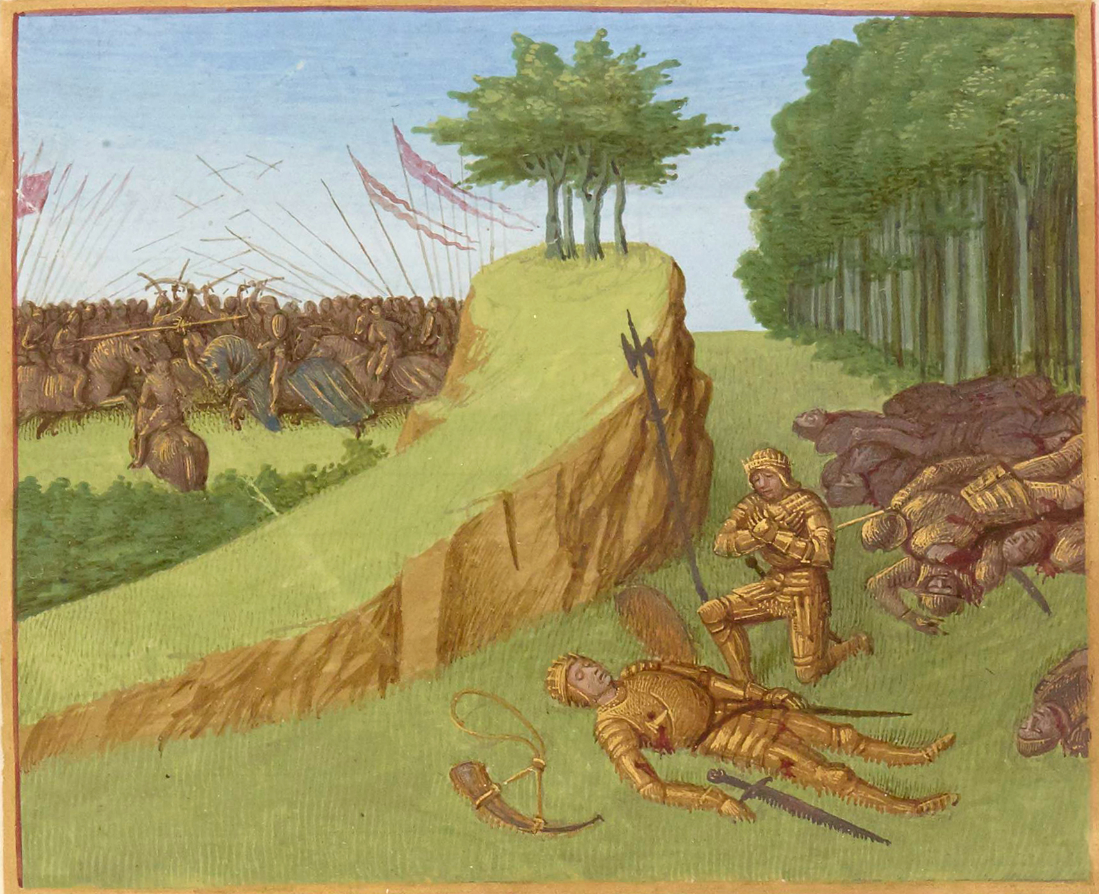
Roland's Last Stand at Roncevaux
A medieval manuscript pictures Roland's last stand at the pass of Roncevaux.
© More Lessons Less Planning | morelessonslessplanning.com
Notes:
Real public-domain medieval manuscript illumination of Roland at Roncevaux. Point out how medieval artists pictured the ideal loyal knight in battle.
Reference labels (point to these chart features when teaching): Roland in armor; Battle at the mountain pass

Slide 13
The Legacy of Chivalry
A lasting ideal
Chivalry shaped later ideas of the gentleman, courtesy, and fair play.
✔
Still an ideal
It remained a goal to aim for, even though real knights often fell short.
✔
How we know
Historians use songs, laws, and Church rules to reconstruct the code and its gaps.
✔
Key Concept: Chivalry outlived the knights, shaping later ideals of the gentleman, courtesy, and fair play.
© More Lessons Less Planning | morelessonslessplanning.com
Notes:
Chivalry outlived the age of knights. Its ideals of courtesy, loyalty, and protecting the weak shaped later ideas of the gentleman and of fair play, and echo in words like 'chivalrous' today. But it always remained an ideal to aim for, not a description of how warriors behaved. Historians reconstruct both the code and the gap between ideal and reality by combining sources: epic songs like The Song of Roland, feudal law, and Church rules such as the Peace and Truce of God.

Slide 14
Key Takeaways
Chivalry was the knightly code of courage, loyalty, and honor.
★
It grew from feudal duty and Church rules like the Truce of God.
★
A boy became a knight through page, squire, and dubbing.
★
The ideal was often broken - real warrior life fell far short.
★
© More Lessons Less Planning | morelessonslessplanning.com
Notes:
Recap the four takeaways. The big idea: chivalry was an ideal that was taught and celebrated, and part of studying it as a historian is recognizing the gap between that ideal and the messier reality of medieval warrior life.

