Slide 1
Knights and Samurai
Two warrior worlds compared - loyalty, honor, and skill in combat in medieval Europe and feudal Japan.
© More Lessons Less Planning | morelessonslessplanning.com
Notes:
Opening slide. This is a compare-and-contrast lesson. The European KNIGHT and the Japanese SAMURAI were each an elite class of mounted, armored warriors who served a lord and lived by a demanding code. The lesson traces how strikingly similar the two codes were - loyalty, honor, and combat skill - while being honest about two things: the two cultures arose independently with no contact, so the similarities are genuine parallels rather than copying; and chivalry and bushido were ideals of how a warrior should act, not descriptions of how every warrior behaved.

Slide 2
Learning Targets
Explain who knights and samurai were and how each fit his feudal society.
★
Compare chivalry and bushido: shared loyalty, honor, and combat skill.
★
Explain that the two arose independently - genuine parallels, not copying.
★
Analyze a primary source: Ramon Llull's handbook on the ideal of the knight.
★
© More Lessons Less Planning | morelessonslessplanning.com
Notes:
Learning targets. Target 1 places both warriors in their feudal systems. Target 2 is the heart of the compare - the shared code values. Target 3 is the key honesty point: knights and samurai never met, so their similar codes are independent parallels. Target 4 practices sourcing on a handbook of the ideal (Ramon Llull's Book of the Order of Chivalry), which describes how a knight should act, not how every knight did.

Slide 3
Two Warrior Worlds
Medieval Europe and feudal Japan each produced elite MOUNTED, armored warriors.
In Europe they were KNIGHTS; in Japan they were SAMURAI.
Both served a lord and were bound by a demanding warrior code.
The two worlds developed INDEPENDENTLY - opposite ends of the earth, no contact.
Their striking similarities are genuine PARALLELS, not one copying the other.
Big idea: Knights and samurai were parallel MOUNTED warrior elites that arose INDEPENDENTLY - similar codes, separate worlds.
© More Lessons Less Planning | morelessonslessplanning.com
Notes:
Set up the whole compare. Medieval Europe and feudal Japan each produced an elite class of MOUNTED, armored warriors: the KNIGHT in Europe and the SAMURAI in Japan. Both served a lord and lived by a demanding warrior code of loyalty, honor, and combat skill. The crucial framing for students: the two worlds developed INDEPENDENTLY, on opposite sides of the earth, with no contact or influence between them. So when we see how similar their codes were, that is a genuine PARALLEL - two cultures arriving at similar answers to a similar problem - not one culture copying the other.

Slide 4
The European Knight
The Knight
A mounted, armored WARRIOR of medieval Europe who served a lord in exchange for land.
✔
Training
Trained for years in horsemanship, the sword, and the lance, often from boyhood as a page then squire.
✔
Rank
Knighthood was tied to noble BIRTH and to the code of chivalry that a knight swore to uphold.
✔
Key Concept: A KNIGHT was a mounted, armored warrior of medieval Europe who served a lord and lived by the code of chivalry.
© More Lessons Less Planning | morelessonslessplanning.com
Notes:
The European KNIGHT was a mounted, armored WARRIOR of medieval Europe who served a lord in war in exchange for land, and who was bound by the code of chivalry. A boy of noble family often trained for years - first as a page, then a squire - in horsemanship, the sword, and the lance before being knighted. Knighthood was tied to noble BIRTH and rank: it marked a man as part of the warrior elite. The next slide shows a real medieval manuscript illumination of a knight in armor.

Slide 5
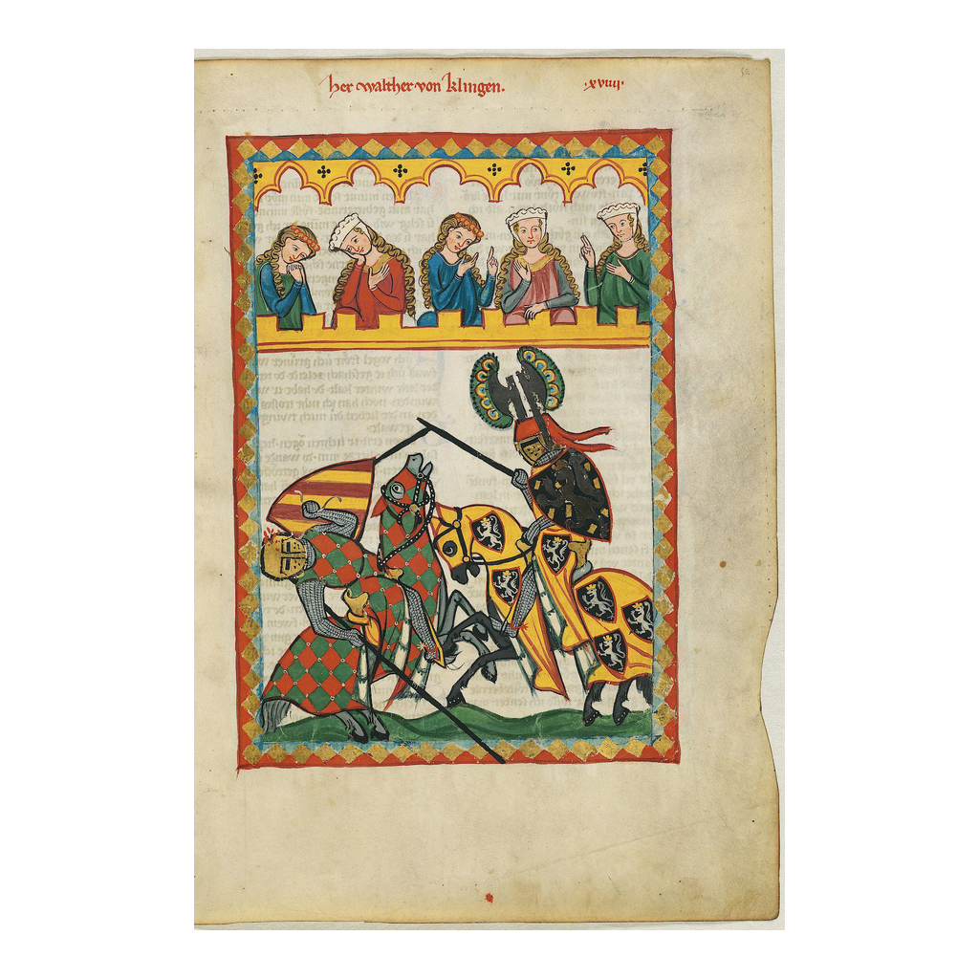
A Knight in Armor
A European knight in armor, mounted for battle (Codex Manesse, c. 1300-1340).
© More Lessons Less Planning | morelessonslessplanning.com
Notes:
A manuscript illumination from the Codex Manesse (Zurich, about 1300-1340), showing a European knight in mail armor, surcoat, and great helm, mounted on his horse with shield and weapon. Point out for students that this is a medieval artist's own picture of a knight of his own age - so it shows how Europeans of the time pictured the ideal armored knight. Note the mail, the helm, the shield, and above all the horse: the knight's power came from the mounted charge, just as the samurai fought from horseback. This knight is from roughly the same centuries as the samurai armor on the next-but-one slide, which makes the comparison fair.
Reference labels (point to these chart features when teaching): Helmet and shield; Mounted on horseback

Slide 6
The Japanese Samurai
The SAMURAI were the hereditary WARRIOR class of feudal Japan.
A samurai served a DAIMYO - a powerful LANDHOLDING lord - for land or income.
Samurai trained from childhood in the sword, the bow, and horsemanship.
Their status was hereditary, passed from father to son.
Like knights, they were a small armed elite, not most of the people.
Key Concept: The SAMURAI were feudal Japan's hereditary warrior class, serving a DAIMYO - a landholding lord.
© More Lessons Less Planning | morelessonslessplanning.com
Notes:
The SAMURAI were the hereditary WARRIOR class of feudal Japan - the Japanese parallel to the European knight. A samurai served a DAIMYO, a powerful LANDHOLDING lord, in exchange for land, income, or protection, much as a knight served his lord. Samurai trained from childhood in the sword, the bow, and horsemanship, and their status was hereditary, passed from father to son. Like knights, samurai were a small armed elite, not the majority of ordinary farmers, artisans, and merchants. The next slide shows a real suit of samurai armor from the same medieval era as the knight you just saw.

Slide 7
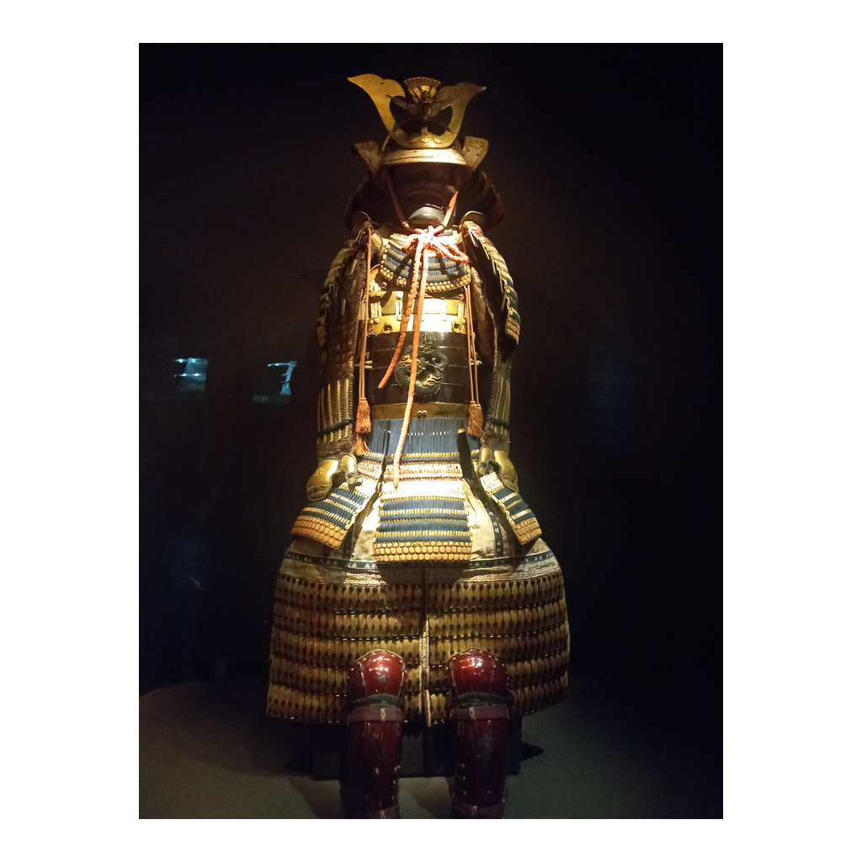
A Samurai's Armor
A suit of samurai o-yoroi armor, Kamakura period (surviving Japanese armor).
© More Lessons Less Planning | morelessonslessplanning.com
Notes:
A museum photograph of a Japanese o-yoroi ('great armor') of the Kamakura period - the laced lamellar armor worn by mounted samurai in the same centuries as the Codex Manesse knight. Point out the construction for students: small plates or scales laced together in rows to make a flexible shell, a distinctive helmet, and broad shoulder guards. Invite a direct comparison with the knight's armor two slides back: both are heavy protective suits for a mounted warrior, but one is riveted mail and plate, the other laced lamellar. Same problem - protect a horseman in close combat - solved two different ways in two separate worlds.
Reference labels (point to these chart features when teaching): Laced lamellar plates; Helmet and shoulder guards

Slide 8
Feudal Systems Compared
Feudalism
A system in which lords granted LAND to warriors in return for military service and loyalty; both Europe and Japan built forms of it.
Vassal
A warrior or lesser lord who pledged loyalty and service to a greater lord in return for land and protection.
Fief
The land grant a lord gave a knight for service; Japan's rough parallel was the shoen, a landed estate.
Big idea: Under FEUDALISM, a lord granted LAND (a FIEF) to a VASSAL in return for loyalty and military service.
© More Lessons Less Planning | morelessonslessplanning.com
Notes:
Both worlds ran on a version of FEUDALISM: a system in which lords granted LAND to warriors in return for military service and loyalty. In Europe, a VASSAL - a warrior or lesser lord - pledged loyalty and service to a greater lord and received a FIEF, a grant of land, in return for protection. Feudal Japan worked on a similar land-for-service bargain: a samurai served his daimyo and might hold or draw income from a landed estate called a shoen, the rough parallel to a fief. Stress the parallel for students: two separate societies each bound their warriors to their lords by exchanging land for loyal service.

Slide 9
Loyalty - The Shared Core Value
LOYALTY - faithful SERVICE to one's lord - was the CORE value of both codes.
A knight swore loyalty to his lord; a samurai owed the same to his daimyo.
Betraying one's lord was the deepest disgrace in either world.
Loyalty was PERSONAL - sworn to a specific lord, not to an abstract nation.
In both codes the bond ran both ways - protection in return for service.
Key Concept: LOYALTY - faithful service to one's lord - was the shared CORE value of both the knight's and the samurai's codes.
© More Lessons Less Planning | morelessonslessplanning.com
Notes:
The first shared value is LOYALTY - faithful SERVICE to one's lord - the CORE value of both the knight's and the samurai's codes. A knight swore a solemn oath of loyalty to his lord; a samurai owed the same faithful service to his daimyo. In both worlds, betraying one's lord was the deepest disgrace a warrior could suffer. Stress one shared nuance: this loyalty was PERSONAL, sworn to a specific lord - a particular person - not to an abstract nation or flag the way modern patriotism works. And in both codes the bond ran both ways: in return for the warrior's loyal service, the lord owed him land, protection, and reward.

Slide 10
Honor in Both Worlds
Honor
A warrior's personal REPUTATION and dignity - prized by knights and samurai alike.
✔
Defended at any cost
In both worlds a warrior would defend his honor even at the cost of his life.
✔
A public thing
Honor was PUBLIC - won by brave conduct and lost by cowardice or betrayal.
✔
Key Concept: HONOR - a warrior's personal reputation and dignity - was defended even at the cost of life in both cultures.
© More Lessons Less Planning | morelessonslessplanning.com
Notes:
The second shared value is HONOR - a warrior's personal REPUTATION and dignity - prized by knights and samurai alike. In both worlds the ideal held that honor was worth more than life and should be defended even at the cost of one's life. Help students see that honor was a PUBLIC thing in both cultures: it was won by brave and correct conduct and lost by cowardice, dishonesty, or betrayal, in the eyes of other warriors. A dishonored knight or samurai lost face, and his disgrace could shame his whole family and lord. Honor and loyalty worked together in both codes: a loyal warrior gained honor, and a betrayer lost it.

Slide 11
Skill in Combat - Lance and Katana
The Knight
The Samurai
Trained for years with the LANCE and sword on horseback.
The mounted charge with a couched lance was his signature tactic.
Wore mail and, later in the Middle Ages, full plate armor.
Trained in swordsmanship, archery, and riding.
The KATANA, a curved sword, was his signature weapon.
Wore laced lamellar armor and prized skill with the bow.
Fact: Both warriors were judged by skill in COMBAT - the knight with LANCE and sword, the samurai with KATANA and bow.
© More Lessons Less Planning | morelessonslessplanning.com
Notes:
The third shared value is skill in COMBAT - both the knight and the samurai were expected to be masters of war. The KNIGHT trained for years with the LANCE and sword on horseback; his signature tactic was the mounted charge with a couched lance, and he wore mail and later full plate armor. The SAMURAI trained in swordsmanship, archery, and riding; his signature weapon was the KATANA, the curved sword, and he especially prized skill with the bow. The parallel is clear: two elite mounted warriors, each judged by courage and skill in battle, each with a signature weapon - the knight's lance, the samurai's katana.

Slide 12
Chivalry - The Knight's Code
Chivalry
The medieval European ideal code of knightly CONDUCT - courage, loyalty, honor, and protecting the weak.
✔
Written in handbooks
Writers like Ramon Llull set the ideal down in handbooks that taught young men how to be knights.
✔
An ideal, not a record
Chivalry was a PRESCRIPTIVE ideal - how a knight SHOULD act, not how every knight really did.
✔
Key Concept: CHIVALRY was the medieval European ideal code of knightly conduct - courage, loyalty, honor, and protecting the weak.
© More Lessons Less Planning | morelessonslessplanning.com
Notes:
CHIVALRY was the medieval European ideal code of knightly CONDUCT: courage, loyalty, honor, and the duty to protect the weak - women, widows, orphans, and the helpless. Writers like Ramon Llull, whose handbook students analyze in the Activity, set this ideal down in books that taught young men what a true knight should be, and the Church added a religious duty to defend the faith. Teach one point carefully: chivalry was a PRESCRIPTIVE ideal - it describes how a knight SHOULD act, not how every knight really behaved. Many real knights fell far short of it. That distinction - the ideal versus the reality - is one students will use on both the knight and the samurai sides of this lesson.

Slide 13
Bushido - A Name Added Later
Bushido
'The way of the warrior' - the later NAME for the samurai code of loyalty, honor, and courage.
✔
Same values as chivalry
Bushido prized the same core values as chivalry: loyalty, honor, and skill in combat.
✔
Written down later
The named, written code came CENTURIES later - the peaceful Tokugawa era and Nitobe's 1900 book.
✔
Important: BUSHIDO is the LATER name for the samurai code - the values were lived custom long before the word was written down.
© More Lessons Less Planning | morelessonslessplanning.com
Notes:
BUSHIDO means 'the way of the warrior,' and it is the later NAME for the samurai code of loyalty, honor, and courage - the Japanese counterpart to chivalry, prizing the same core values. But teach the same honesty point students met with chivalry, in reverse: the WORD bushido and the neat written codes came CENTURIES later than the medieval samurai. Formal writings appeared mostly in the peaceful Tokugawa era (from the 1600s on), and the single most important reason the world knows the word today is Nitobe Inazo's 1900 English book Bushido. So in the samurai's early wars the values were lived custom, not a rulebook titled 'bushido' - just as chivalry was an ideal knights aspired to rather than a law they all obeyed.

Slide 14
Same Values, Separate Worlds
Knights and samurai never met - the two worlds had no contact or influence.
Their similar codes arose SEPARATELY, from similar needs, not from copying.
Both answered the same problem - how to bind mounted warriors to their lords.
Historians call this a genuine PARALLEL, not borrowing between cultures.
Seeing the parallel helps us understand feudal societies around the world.
Important: The two codes arose SEPARATELY - a genuine PARALLEL, not copying. Similar problems can produce similar answers.
© More Lessons Less Planning | morelessonslessplanning.com
Notes:
This is the honesty payoff of the whole compare. Knights and samurai never met: medieval Europe and feudal Japan had no contact or influence between them. Their strikingly similar codes arose SEPARATELY, from similar needs, not from one culture copying the other. Both were answers to the same problem - how to bind a class of mounted, armored warriors to their lords with land, loyalty, and honor. Historians call this a genuine PARALLEL, or convergence, rather than borrowing. Make sure students take the reasoning skill with them: when two distant cultures look alike, do not assume contact - similar problems and conditions can produce similar answers on their own.

Slide 15
The Ideal and the Reality
The ideal
Chivalry and bushido describe how a warrior SHOULD behave - loyal, honorable, and brave.
✔
The reality
Real knights and samurai could be greedy, cruel, or disloyal - the codes were often broken.
✔
Read critically
Treat the codes as IDEALS the cultures admired, not proof that every warrior lived up to them.
✔
Warning: Chivalry and bushido were IDEALS - real knights and samurai did not always live up to them.
© More Lessons Less Planning | morelessonslessplanning.com
Notes:
Now hold both codes to the same honest standard. Chivalry and bushido describe how a warrior SHOULD behave - loyal, honorable, brave, protecting the weak. But real knights and samurai were human: many were greedy, cruel, ambitious, or disloyal, and the codes were often broken in practice. The right move for students is to treat chivalry and bushido as IDEALS that these cultures admired and measured warriors against - not as proof that every knight or samurai actually lived up to them. This is exactly why the primary source in the Activity matters: Llull's handbook tells us what Europeans thought a knight SHOULD be, which is real and useful evidence, even though it is not a record of how knights truly behaved.

Slide 16
How Do We Know?
Much of what we know comes from HANDBOOKS like Llull's and from war tales.
A handbook teaches the ideal; it does not report what every knight actually did.
War tales inspire and idealize their heroes rather than report neutral fact.
Historians CROSS-CHECK these against court records, laws, and letters.
Always ask what a source is FOR before trusting its every detail.
Tip: Handbooks and war tales teach the IDEAL - historians CROSS-CHECK them against records, laws, and letters.
© More Lessons Less Planning | morelessonslessplanning.com
Notes:
This sourcing slide sets up the Primary Source Spotlight. Much of what we know about the ideals of knights and samurai comes from HANDBOOKS like Ramon Llull's Book of the Order of Chivalry and from war tales like Japan's Tale of the Heike. But each has a purpose: a handbook teaches the ideal of the knight, and a war tale inspires and idealizes its heroes - neither is a neutral report of what every warrior actually did. That is why historians CROSS-CHECK such sources against court records, laws, letters, and accounts of real events. The master habit to teach is to ask what a source is FOR before trusting its every detail - an ideal handbook is for teaching virtue, not for recording behavior.

Slide 17
Key Takeaways
KNIGHTS (Europe) and SAMURAI (Japan) were parallel mounted warrior elites.
★
Both served a lord under FEUDALISM and lived by a warrior code.
★
CHIVALRY and BUSHIDO shared loyalty, honor, and skill in combat.
★
The two arose INDEPENDENTLY - genuine parallels, not one copying the other.
★
The codes were IDEALS - real knights and samurai did not always live up to them.
★
'Bushido' as a written name came centuries after the samurai's rise.
★
© More Lessons Less Planning | morelessonslessplanning.com
Notes:
Close the loop. If students remember one thing, make it the parallel: KNIGHTS in Europe and SAMURAI in Japan were both mounted warrior elites who served a lord under a form of FEUDALISM and lived by a code that prized loyalty, honor, and skill in combat - CHIVALRY in Europe, BUSHIDO in Japan. Then make them hold the two honesty frames: the similarities are genuine parallels because the two worlds arose INDEPENDENTLY with no contact; and both codes were IDEALS that real warriors did not always live up to. A good history student compares the two fairly, admires the ideals, and reads them critically.

