Slide 1
Justinian and Byzantine Law
How Emperor Justinian rebuilt Rome's laws into a single lasting code - the Corpus Juris Civilis - from Constantinople.
© More Lessons Less Planning | morelessonslessplanning.com
Notes:
Opening slide and the first lesson of the Byzantium unit. When the western Roman Empire fell in 476 CE, its eastern half lived on for centuries as what historians call the Byzantine Empire, ruled from Constantinople. Its greatest emperor, Justinian, is remembered above all for law: he ordered Rome's tangled, contradictory laws collected and rewritten into a single organized code, the Corpus Juris Civilis, whose influence still shapes legal systems today. Set the frame from the first minute: this lesson is about how a written, unified law code was built, and why that mattered - not a story of one man writing laws alone, but of an emperor authorizing a commission of experts to preserve and organize centuries of Roman law.

Slide 2
Learning Targets
Explain what the Byzantine Empire was and how it continued Rome in the east.
★
Describe how Justinian and Tribonian's commission codified Roman law.
★
Identify the four parts of the Corpus Juris Civilis and why it mattered.
★
Read an excerpt from the Institutes of Justinian as a primary source.
★
© More Lessons Less Planning | morelessonslessplanning.com
Notes:
Read the four learning targets. Today's lesson opens the Byzantium unit by studying one enormous achievement: the rebuilding of Roman law under Justinian. Keep two anchors in mind throughout. First, the Byzantine Empire was the eastern continuation of Rome, not a brand-new empire - its people still thought of themselves as Romans. Second, Justinian ordered and authorized the code, but a commission led by the jurist Tribonian did the actual gathering and editing. Pay special attention to target three (the four parts of the Corpus Juris Civilis and why a written code mattered) and target four (reading the Institutes as a primary source), because they anchor the activity.

Slide 3
The Byzantine Empire: Rome's Eastern Half
Rome's eastern half survives
Centered at Constantinople
When the western Roman Empire fell in 476 CE, the eastern half lived on.
Historians call this eastern Roman state the Byzantine Empire.
'Byzantine' is a later label; its own people still called themselves Romans.
Its capital was Constantinople, on the strait between Europe and Asia.
It was a great Christian trading city founded by the emperor Constantine.
From here emperors ruled a wealthy, Greek-speaking Roman world.
Key Concept: The BYZANTINE EMPIRE was the eastern continuation of Rome, centered at CONSTANTINOPLE; its people called themselves Romans.
© More Lessons Less Planning | morelessonslessplanning.com
Notes:
Start with the setting. The Byzantine Empire was the eastern continuation of the Roman Empire, centered at Constantinople, which lasted for centuries after the western Roman Empire fell in 476 CE. Be precise about an honesty point students often get wrong: 'Byzantine' is a LATER scholarly label invented by historians long afterward; the empire's own people did not call themselves Byzantines - they called themselves Romans and saw their state as Rome continuing on. Its capital, Constantinople, was a great Christian trading city on the narrow strait between Europe and Asia, founded by the emperor Constantine; from there emperors ruled a wealthy, mostly Greek-speaking Roman world. This is the empire in which Justinian will rebuild Roman law.

Slide 4
Emperor Justinian (527-565 CE)
An ambitious emperor
What his reign is known for
Justinian became Byzantine emperor in 527 CE and ruled until 565 CE.
He dreamed of restoring the glory of the old Roman Empire.
His greatest project was to rebuild Rome's tangled laws into one code.
He rebuilt Constantinople, including the great church Hagia Sophia.
He ordered a fresh, organized collection of Roman law.
He authorized the work but did not write the laws himself.
Key Concept: Emperor JUSTINIAN (527-565 CE) ordered Rome's scattered laws collected and rewritten into a single organized code.
© More Lessons Less Planning | morelessonslessplanning.com
Notes:
Now meet the emperor. Justinian ruled the Byzantine Empire from 527 to 565 CE, and he dreamed of restoring the glory of the old Roman Empire. His single most lasting project was legal: he ordered Rome's scattered, contradictory laws collected and rewritten into one organized code. Note the honesty anchor carefully - Justinian AUTHORIZED and ordered this enormous work and gave it his name, but he did not personally write the laws himself; a commission of experts did the actual work (next slides). His reign is also known for grand building, including the great church of Hagia Sophia in Constantinople. The next slide shows a famous mosaic portrait of Justinian made during his own lifetime.

Slide 5
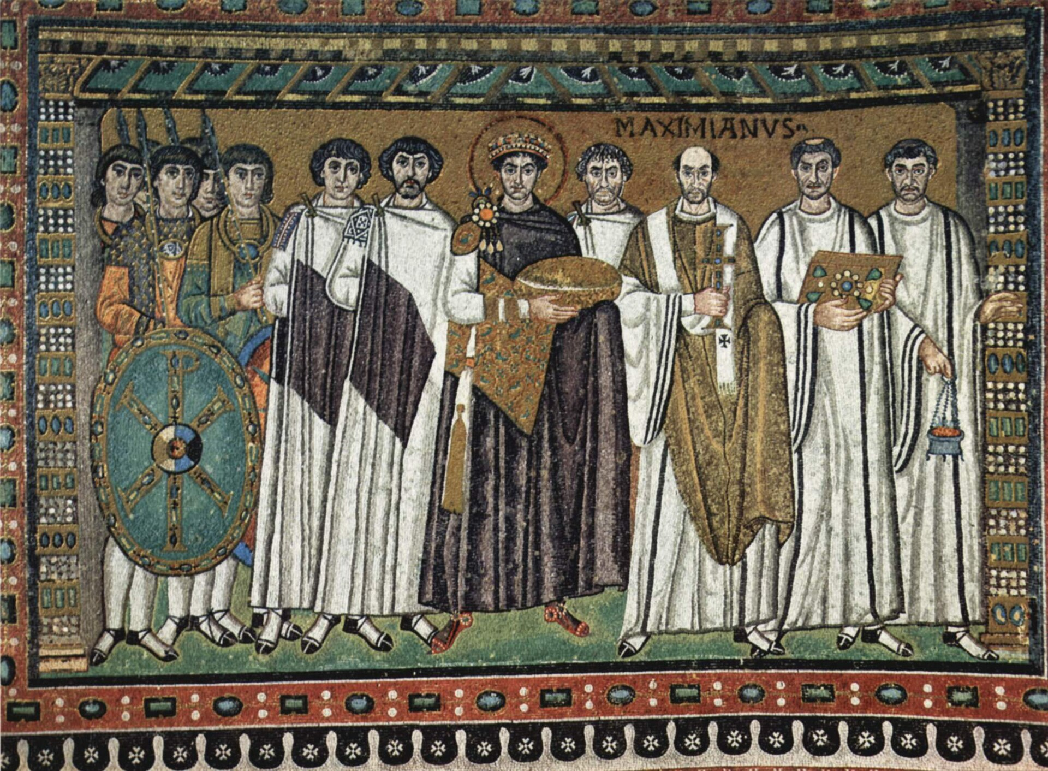
A Mosaic Portrait of Justinian
Emperor Justinian I mosaic, San Vitale, Ravenna, c. 547 CE (public domain).
© More Lessons Less Planning | morelessonslessplanning.com
Notes:
A real public-domain mosaic portrait of Emperor Justinian I from the Basilica of San Vitale in Ravenna, made around 547 CE during his own reign. Use it purely as a reference image to make the previous slide concrete: this is how Justinian's own age portrayed him, crowned and haloed among his court. Describe it academically as a genuine 6th-century artifact; students are not asked to decode the image as evidence. Image: mosaic, Basilica of San Vitale, Ravenna, c. 547 CE, public domain (via Wikimedia Commons).

Slide 6
Empress Theodora
Justinian's empress and adviser
Theodora was Justinian's empress and his closest adviser, who rose from a humble background to become a powerful voice at court.
✔
Trusted counsel
Justinian trusted her judgment on politics and government, and her influence shaped his rule.
✔
Holding the throne
In 532 CE the Nika riots nearly overthrew Justinian; Theodora urged him to stay and fight rather than flee.
✔
Key Concept: THEODORA, Justinian's empress and adviser, influenced his decisions and urged him to hold the throne during the Nika riots of 532 CE.
© More Lessons Less Planning | morelessonslessplanning.com
Notes:
Justinian did not rule alone. Theodora was his empress and closest adviser, a powerful figure at court who influenced his decisions. She had risen from a humble background, and Justinian trusted her judgment on politics and government. Her most famous moment came in 532 CE, when the Nika riots in Constantinople nearly toppled Justinian and he considered fleeing the city. Theodora is remembered for urging him to stay and fight rather than run - advice that helped save his reign. Present her academically as an unusually influential empress whose counsel shaped one of history's most consequential rulers. The next slide shows a mosaic portrait of Theodora from the same church in Ravenna.

Slide 7
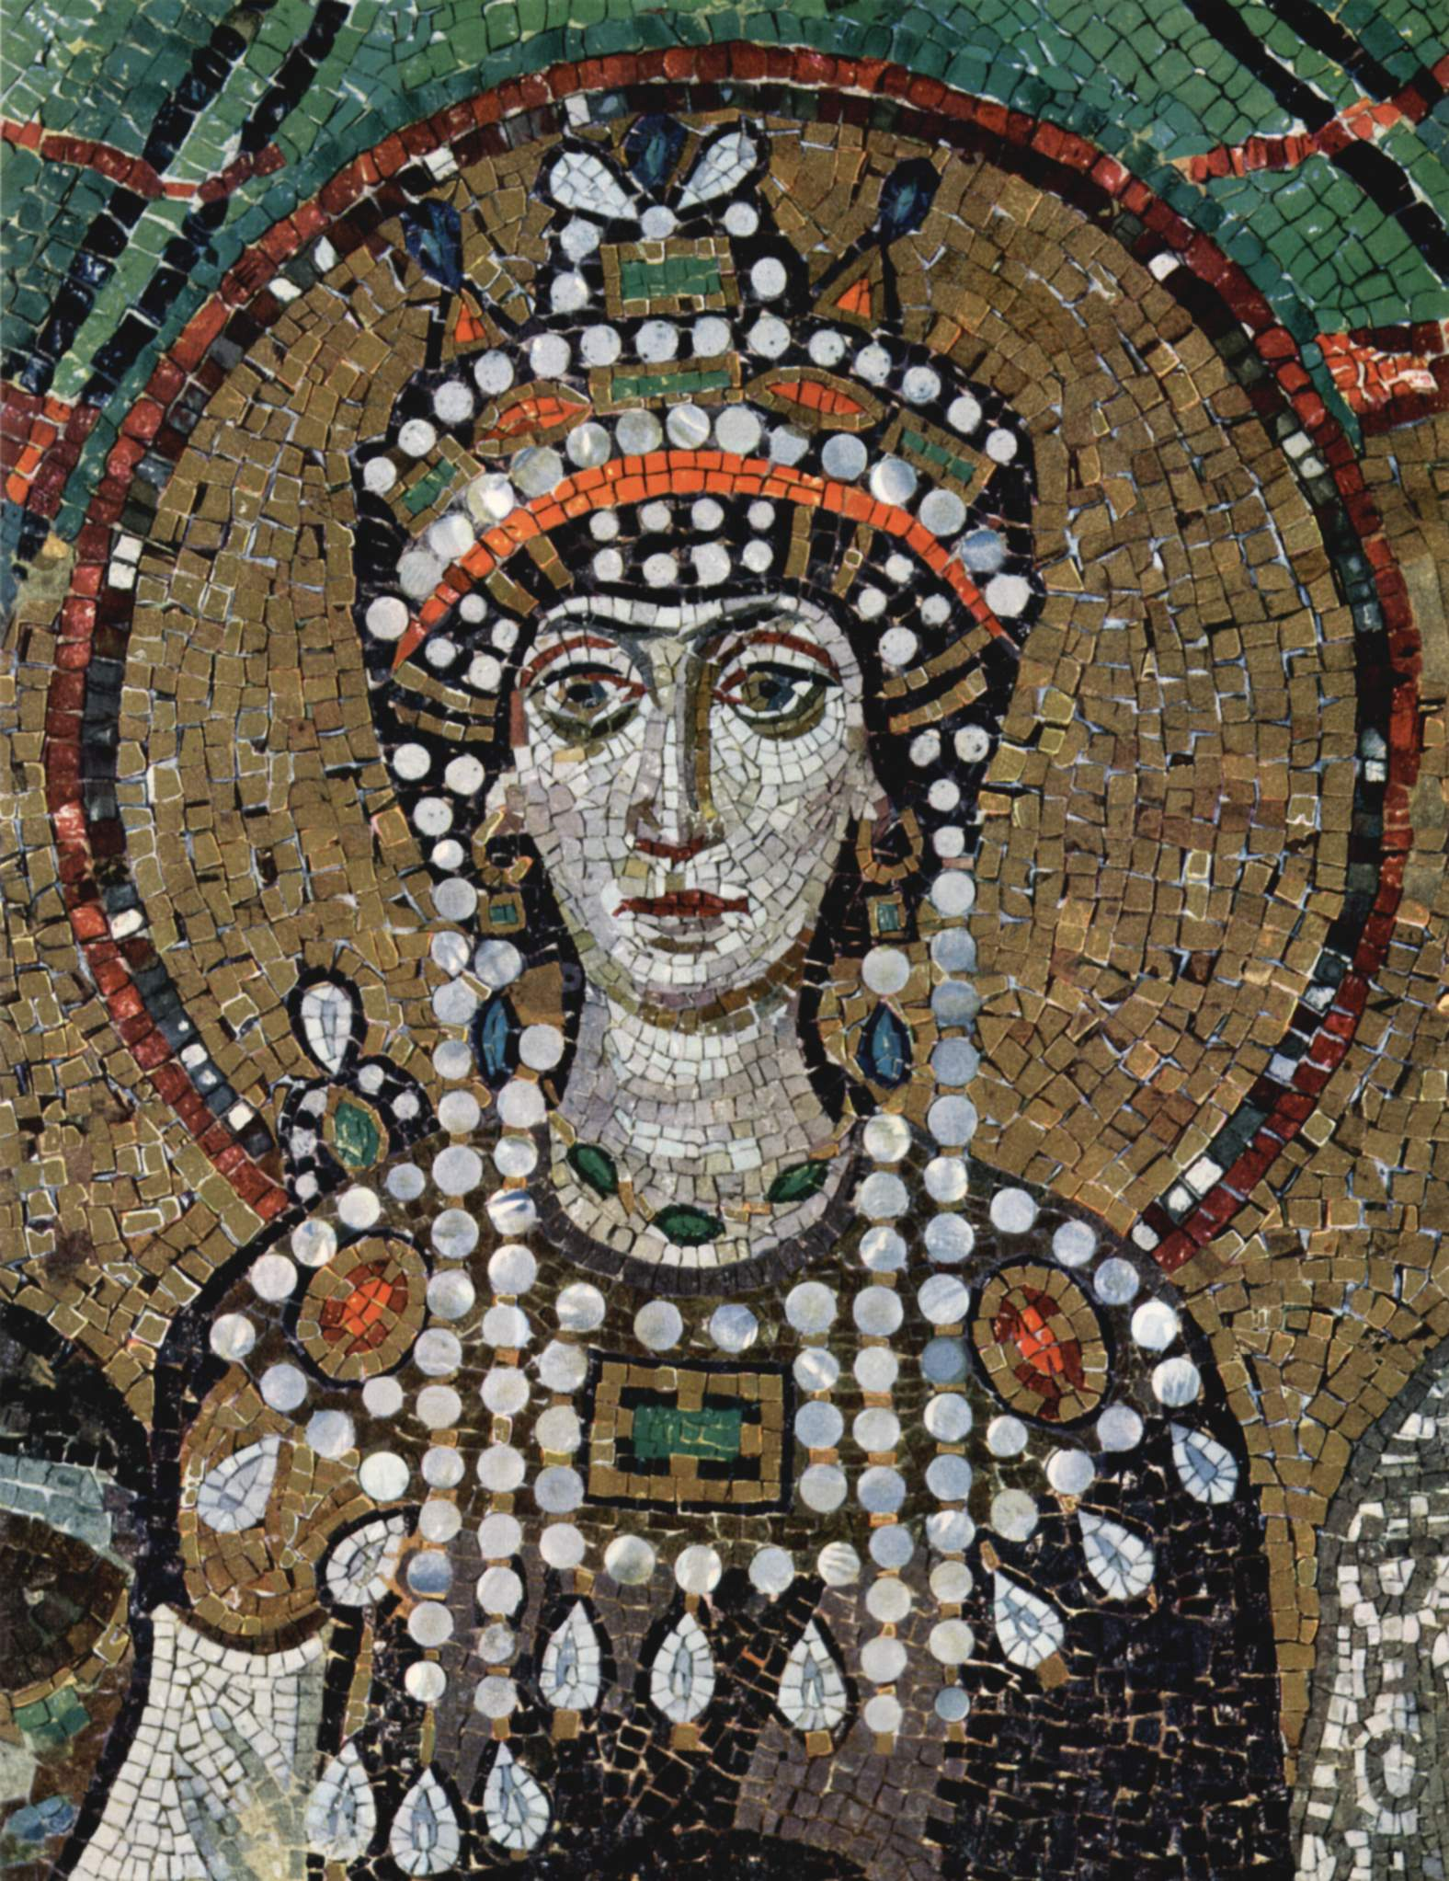
A Mosaic Portrait of Theodora
Empress Theodora mosaic, San Vitale, Ravenna, c. 547 CE (public domain).
© More Lessons Less Planning | morelessonslessplanning.com
Notes:
A real public-domain mosaic portrait of Empress Theodora from the Basilica of San Vitale in Ravenna, made around 547 CE, facing the Justinian panel across the same church. Use it purely as a reference image to make the previous slide concrete: this is how Theodora was portrayed in her own age, crowned and jeweled among her attendants. Describe it academically as a genuine 6th-century artifact; students are not asked to decode the image as evidence. Image: mosaic, Basilica of San Vitale, Ravenna, c. 547 CE, public domain (via Wikimedia Commons).

Slide 8
Rebuilding Rome's Laws: Tribonian's Commission
A tangle of old laws
Roman law had piled up for centuries - thousands of statutes, rulings, and expert opinions that often contradicted each other.
✔
Tribonian's commission
Justinian appointed a commission of jurists (legal experts) led by Tribonian to gather, edit, and organize all of it.
✔
Codification
Codification is collecting scattered laws and organizing them into a single, written, systematic code.
✔
Key Concept: A commission led by the jurist TRIBONIAN carried out the CODIFICATION - collecting centuries of Roman law into one written code.
© More Lessons Less Planning | morelessonslessplanning.com
Notes:
Here is how the code was actually built. By Justinian's day, Roman law had piled up for centuries into thousands of statutes, imperial rulings, and the opinions of legal experts - a tangle that often contradicted itself, so that no one could be sure what the law truly was. Justinian's solution was to appoint a COMMISSION of jurists (legal experts) led by Tribonian, a brilliant legal official, to gather all of it, throw out what was outdated or contradictory, and organize what remained. This process - collecting scattered laws and organizing them into a single, written, systematic code - is called CODIFICATION. Reinforce the honesty anchor: Justinian ordered and authorized this, but it was Tribonian's commission that did the real gathering and editing. Tribonian is the key working figure behind the Corpus Juris Civilis.

Slide 9
The Corpus Juris Civilis: Four Parts
The Body of Civil Law
Learning and updating the law
The whole collection is the Corpus Juris Civilis - the 'Body of Civil Law.'
The Code (Codex) gathered the emperors' laws still in force.
The Digest organized the writings and opinions of earlier legal experts.
The Institutes was a textbook to teach the basics of law to students.
The Novels were the new laws Justinian issued after the rest.
Four parts in all: Code, Digest, Institutes, and Novels.
Key Concept: The CORPUS JURIS CIVILIS had four parts - Code, DIGEST, INSTITUTES, and Novels; the Institutes was the student textbook.
© More Lessons Less Planning | morelessonslessplanning.com
Notes:
Now the code itself. The complete collection produced under Justinian is the Corpus Juris Civilis - Latin for the 'Body of Civil Law.' Be precise: it has FOUR distinct parts, and students should not conflate them. The Code (Codex) gathered the emperors' laws that were still in force. The Digest (also called the Pandects) organized the writings and legal opinions of earlier Roman experts into one authoritative reference. The Institutes was a short textbook written to teach the basics of law to beginning students - it is the part your activity's primary source comes from. The Novels were the new laws Justinian issued after the rest was finished. Together, these four parts made up the great code. Emphasize the four-part structure clearly, and note that the Institutes was specifically the student textbook.

Slide 10
Why a Written, Unified Code Mattered
One law for the empire
A single written code meant the same rules applied everywhere, instead of judges guessing among contradictory old laws.
✔
Clear and teachable
Because it was written down and organized, the law could be studied, taught, and applied consistently.
✔
Preserved for the future
Writing the law down saved Roman legal thinking for later ages, long after the empire itself shrank.
✔
Key Concept: A single WRITTEN, unified code made the law clear, consistent, teachable, and preserved for the future.
© More Lessons Less Planning | morelessonslessplanning.com
Notes:
Why did all this effort matter? Before codification, Roman law was a scattered, contradictory mess, and outcomes could depend on which old ruling a judge happened to cite. A single WRITTEN, unified code changed that in three ways. First, one law for the empire: the same rules applied everywhere, instead of judges guessing among contradictory laws. Second, clear and teachable: because it was written down and organized, the law could be studied in schools, taught to new students (that is what the Institutes was for), and applied consistently. Third, preserved for the future: writing the law down saved Roman legal thinking for later ages, long after the empire itself shrank - which is exactly why the code still mattered centuries later. Stress that the power of the code came from being written, organized, and unified.

Slide 11
Reconquering the West: Belisarius
Winning back the west
But it did not last
Justinian also tried to reunite the old Roman Empire.
His general Belisarius reconquered parts of Italy, North Africa, and the coast.
For a time, the Mediterranean was again ruled from Constantinople.
The wars were long, costly, and exhausting for the empire.
The reconquest was only partial and did not durably last.
It did not restore the whole Roman Empire; much was soon lost again.
Key Concept: Justinian's general BELISARIUS reconquered PART of the west, but the gains were partial and did not last.
© More Lessons Less Planning | morelessonslessplanning.com
Notes:
Justinian's ambitions were not only legal. He also tried to reunite the old Roman Empire by reconquering the western lands Rome had lost. His talented general Belisarius led campaigns that took back parts of Italy, North Africa, and the Mediterranean coast, so that for a time the sea was again ruled from Constantinople. But be careful and honest about the outcome: the reconquest was only PARTIAL, and it did not durably last. The wars were long, costly, and exhausting; they drained the treasury and the army, and much of the reconquered land was soon lost again. Justinian did NOT restore the whole Roman Empire. This is why his lasting achievement is the law code, not the reconquest - the code outlived the brief military gains by more than a thousand years.

Slide 12
The Lasting Legacy: Civil Law
Rediscovered in Europe
Centuries later, European scholars rediscovered Justinian's code in the first universities.
✔
The basis of civil law
Civil law is a legal system based on a comprehensive written code. Most of continental Europe built its law on Justinian's Roman tradition.
✔
Not English common law
England followed common law (judges' past decisions), so Justinian's main influence is continental civil law.
✔
Key Concept: Justinian's code became the foundation of CIVIL LAW across continental Europe and Latin America - not the English common-law tradition.
© More Lessons Less Planning | morelessonslessplanning.com
Notes:
Finish with the code's lasting legacy - the real reason we study it. For centuries after Justinian, his code was largely forgotten in the west, but around the 1000s-1100s European scholars rediscovered the Corpus Juris Civilis and began studying it intensely in the first universities. From that study grew CIVIL LAW: a legal system based on a comprehensive written code of rules. Most of continental Europe - and later Latin America and other regions - built their civil law on the Roman tradition that Justinian's code preserved. Make one honest distinction clear: England went a different way, developing common law built on judges' accumulated past decisions rather than one master code, so Justinian's biggest influence is on CONTINENTAL civil law systems, NOT the English common-law tradition (or the parts of the United States shaped by it). One emperor's project to organize old laws ended up shaping how much of the world writes law today.

Slide 13
Key Takeaways
The Byzantine Empire was Rome's eastern half, centered at Constantinople.
★
Tribonian's commission codified Rome's laws into the Corpus Juris Civilis.
★
The code's four parts made the law written, unified, and teachable.
★
Justinian's code became the foundation of continental civil law.
★
© More Lessons Less Planning | morelessonslessplanning.com
Notes:
Let's recap what you now know about Justinian and Byzantine law. First, the setting: the Byzantine Empire was the eastern continuation of the Roman Empire, centered at Constantinople, and its people still called themselves Romans. Second, the achievement: Justinian ordered and authorized the rebuilding of Roman law, but a commission led by the jurist Tribonian did the actual codification, producing the Corpus Juris Civilis. Third, the code: it had four parts - the Code, the Digest, the Institutes (the student textbook), and the Novels - and being written, unified, and organized made the law clear, consistent, teachable, and preserved. Fourth, the results: Justinian's general Belisarius briefly reconquered part of the west, but that gain was partial and did not last, while the code endured. Its greatest legacy is on continental European civil law, not English common law - which is why we still study it today.

