Slide 1
Judaism: Covenant and Diaspora
How a tradition built on a covenant between God and the Israelites survived for centuries without a homeland - Abraham and Moses, the Ten Commandments and the Torah, and the Diaspora.
© More Lessons Less Planning | morelessonslessplanning.com
Notes:
Opening slide. This lesson studies Judaism academically - describing what the tradition teaches, never judging it as true or false. Students learn that Judaism is one of the earliest enduring monotheistic traditions, that its central idea is the covenant (a reciprocal agreement the tradition describes between God and the Israelites), and that its most striking historical feature is survival: for centuries Jewish communities kept the tradition alive without a central homeland or temple, through the Diaspora. Set a respectful, neutral tone from the first minute: we describe what Jews believe and practice; we do not rank or judge, and we keep the ancient tradition separate from modern politics.

Slide 2
Learning Targets
Explain the idea of the covenant and describe Judaism's monotheism.
★
Describe Abraham, Moses, Mount Sinai, and the Ten Commandments.
★
Identify the Torah as the first five books of the Hebrew Bible.
★
Explain how the Diaspora tested the tradition - and how it survived.
★
© More Lessons Less Planning | morelessonslessplanning.com
Notes:
Read the four learning targets. Today pairs a big idea - the covenant between God and the Israelites - with a concrete historical question: how did a tradition survive for centuries without a homeland? Keep the neutral, academic stance in mind throughout: our goal is to understand and describe what the tradition teaches, not to decide whether it is right, and to keep the history separate from modern politics.

Slide 3
The Origins of Judaism: Abraham and the Covenant
A people and a promise
What a covenant is
The tradition traces its origins to Abraham, identified as the first patriarch.
According to the tradition, God first made the covenant with Abraham.
His descendants are known as the Israelites, the early people of the tradition.
A covenant is a reciprocal agreement between God and the Israelites.
In it, God promises to protect them; they promise to follow God's law.
This two-way agreement is the organizing idea of the whole tradition.
Key Concept: A COVENANT is the reciprocal agreement between God and the Israelites; the tradition says God first made it with ABRAHAM.
© More Lessons Less Planning | morelessonslessplanning.com
Notes:
Let's begin with origins. The Jewish tradition traces its beginnings to ABRAHAM, whom it identifies as the first patriarch - the founding ancestor. According to the tradition, God first made a COVENANT with Abraham, and his descendants became known as the ISRAELITES, the early people of the tradition. The key idea to define here is the covenant itself: a covenant is a reciprocal agreement, or relationship, between God and the Israelites - God promises to protect them and make them a great people, and they promise to follow God's law. Describe this neutrally, as what the tradition teaches. The covenant is the single most important organizing idea in Judaism, and every later part of the lesson - Moses, Mount Sinai, the Ten Commandments, and even the Diaspora - connects back to it.

Slide 4
Monotheism: The Belief in One God
What monotheism is
Monotheism is the belief in a single, all-powerful God, rather than in many gods.
✔
Why it stood out
Many ancient peoples worshiped many gods; Judaism is described as one of the earliest enduring monotheistic traditions.
✔
A careful claim
Historians say 'one of the earliest,' not 'the first' - the exact origins of monotheism are debated.
✔
Key Concept: MONOTHEISM is belief in one God. Judaism is one of the earliest enduring monotheistic traditions - not simply 'the first.'
© More Lessons Less Planning | morelessonslessplanning.com
Notes:
A defining feature of Judaism is MONOTHEISM: the belief in a single, all-powerful God, rather than in many gods. This is worth pausing on, because many ancient peoples around the Israelites worshiped many gods. Judaism is described as one of the earliest enduring monotheistic traditions. Notice the careful wording: we say 'one of the earliest,' not simply 'the first.' Historians debate the exact origins of monotheism, so it would be an overclaim to call Judaism flatly 'the first religion' or 'the first monotheism.' What we can say accurately is that it is among the earliest monotheistic traditions that has continued to the present. Describe this academically - as the tradition's belief and as a careful historical statement - not as a ranking of religions.

Slide 5
Moses and the Exodus from Egypt
The traditional story
Why Moses matters
The tradition holds the Israelites were enslaved in Egypt.
Moses is the figure the tradition says led them out of slavery.
This departure from Egypt is remembered as the Exodus.
Moses becomes the tradition's great leader and lawgiver.
The tradition says he led the people toward Mount Sinai.
There, in the tradition, the covenant with God is renewed.
Key Concept: MOSES is the leader the tradition says led the Israelites out of Egypt (the Exodus) and received the law at Mount Sinai.
© More Lessons Less Planning | morelessonslessplanning.com
Notes:
The next central figure is MOSES. According to the tradition, the Israelites were enslaved in Egypt, and Moses is the leader the tradition says led them out of slavery - a departure remembered as the Exodus. We describe this as the tradition's account. Moses matters because he becomes the tradition's great leader and lawgiver: the tradition holds that he led the people through the wilderness toward MOUNT SINAI, and it is there that the covenant with God is renewed and the law is given. So Moses is the bridge between the covenant first made with Abraham and the giving of the law on the next slide. Keep the framing academic: these are the events as the tradition tells them, central to how Judaism understands its own history.

Slide 6
The Covenant at Sinai and the Ten Commandments
Where
The tradition teaches that God gave the law to Moses at Mount Sinai, a mountain in the wilderness.
✔
What
The most famous part is the Ten Commandments - a set of laws central to the covenant.
✔
Why it matters
At Sinai the covenant is renewed: the people agree to follow God's law in exchange for God's protection.
✔
Key Concept: At MOUNT SINAI the tradition says God gave Moses the law, including the TEN COMMANDMENTS, central to the covenant.
© More Lessons Less Planning | morelessonslessplanning.com
Notes:
Now we reach the heart of the tradition's story of its law: the covenant at MOUNT SINAI. Mount Sinai is the mountain where, according to the tradition, God gave the law to Moses. The most famous part of that law is the TEN COMMANDMENTS - a set of laws the tradition teaches God gave to Moses, and which are central to the covenant. Think of Sinai as the moment the covenant is renewed and made concrete: the people agree to follow God's law, and in return God promises to be their God and protect them. This is the passage students will read in the Activity - a passage from the Book of Exodus describing the covenant offer and the Ten Commandments. Describe it academically, as a historically pivotal religious document. Frame the Ten Commandments as laws the tradition holds are given by God - presented as belief, not asserted as fact.

Slide 7
The Torah: The Heart of Jewish Teaching
What the Torah is
Who teaches it
The Torah is the first five books of the Hebrew Bible (the Pentateuch).
It contains Jewish law, teaching, and history - including the covenant story.
It is traditionally handwritten on a scroll and read aloud in community.
A rabbi is a Jewish teacher and interpreter of the Torah and Jewish law.
Study and interpretation of the Torah are central to Jewish practice.
Because it is a text, the Torah can travel anywhere the community goes.
Key Concept: The TORAH is the first five books of the Hebrew Bible (the Pentateuch). A RABBI is a teacher and interpreter of the Torah.
© More Lessons Less Planning | morelessonslessplanning.com
Notes:
If the covenant is the central idea, the TORAH is the central text. The Torah is the first five books of the Hebrew Bible - together called the Pentateuch. Be precise here: the Torah refers specifically to those first five books, which contain Jewish law, teaching, and history, including the covenant story we have been tracing. It is traditionally handwritten on a scroll and read aloud when the community gathers. The person who teaches and interprets the Torah and Jewish law is a RABBI, a Jewish teacher; study and interpretation of the Torah are central to Jewish practice. Notice one detail that will matter greatly later: because the Torah is a TEXT, it can travel anywhere the community goes. That portability becomes the key to survival in the Diaspora. Describe all of this academically, as the tradition's central text and teaching role.

Slide 8
Exile and the Loss of the Homeland
A homeland and a Temple
In antiquity the Israelites built kingdoms with a central Temple in Jerusalem as the focus of worship.
✔
Conquest and exile
Powerful empires conquered these kingdoms; the Temple was destroyed and many people were forced into exile.
✔
The problem this created
With no Temple and no homeland, how could the tradition, centered on the covenant, possibly survive?
✔
Key Concept: The Israelites' central TEMPLE in Jerusalem was destroyed by conquest, and many people were forced into exile.
© More Lessons Less Planning | morelessonslessplanning.com
Notes:
To understand the Diaspora, we first need the problem it created. In antiquity, the Israelites built kingdoms in their historical homeland, with a central TEMPLE in Jerusalem as the focus of worship and sacrifice. But over the centuries, powerful empires - such as Babylon and, later, Rome - conquered these kingdoms. The Temple was destroyed, and many people were forced from their homeland into exile. This is a purely historical account, and it is important to keep it separate from any modern politics. The destruction of the Temple created a crisis: if the tradition centered on one Temple in one homeland, and both the Temple and the homeland were gone, how could Judaism possibly survive? That question sets up the next two slides - the Diaspora and the portable practices that answered it. Describe this as history, neutrally.

Slide 9
The Diaspora: Scattered but Surviving
What the Diaspora is
The surprising outcome
The Diaspora is the dispersion, or scattering, of Jewish communities.
It means Jewish communities living outside their historical homeland.
Communities settled across the Middle East, Europe, and beyond.
Being scattered did NOT end the tradition.
Judaism continued for centuries with no central homeland or Temple.
The next slide explains HOW - through portable practices.
Key Concept: The DIASPORA is the dispersion of Jewish communities outside their historical homeland - yet the tradition survived.
© More Lessons Less Planning | morelessonslessplanning.com
Notes:
The word for this scattering is the DIASPORA. The Diaspora is the dispersion of Jewish communities outside their historical homeland - Jewish communities living, over the centuries, across the Middle East, Europe, North Africa, and beyond, far from the land the tradition came from. Here is the surprising and important part: being scattered did NOT end the tradition. Unlike many ancient peoples who lost their homeland and gradually disappeared as a distinct group, Jewish communities continued to practice Judaism for centuries with no central homeland and no Temple. That is the historical puzzle this lesson is built around - and the answer is not luck. It is a set of portable practices that we will examine on the next slide. Describe the Diaspora as a historical experience, neutrally, and hold the payoff for the next slide.

Slide 10
How Judaism Survived Without a Homeland
The synagogue
A synagogue is a Jewish house of worship and study - a portable center of community life that can be built anywhere.
✔
The portable Torah
Because the Torah is a text, communities could copy it, read it, and study it far from any homeland.
✔
Shared law and holidays
Following the same law and keeping the same holidays kept scattered communities united across great distances.
✔
Key Concept: Judaism survived the Diaspora through PORTABLE practices - the SYNAGOGUE, study of the portable Torah, and shared law.
© More Lessons Less Planning | morelessonslessplanning.com
Notes:
Here is the payoff of the whole lesson: HOW Judaism survived the Diaspora. The answer is a set of PORTABLE practices - things a community can carry and do anywhere, without a central Temple or homeland. First, the SYNAGOGUE: a synagogue is a Jewish house of worship and study, a portable center of community life that can be established wherever Jews live. Instead of one Temple in one place, every community could have its own gathering place. Second, the portable TORAH: because the Torah is a text, communities could copy it, read it, and study it anywhere - the teaching traveled with the people. Third, shared LAW and HOLIDAYS: following the same commandments and keeping the same festivals kept scattered communities recognizably united across huge distances. Notice how this connects back to the covenant: the agreement was to follow God's law - and the law, unlike a building, could go anywhere. Describe this as the historical explanation for a remarkable survival.

Slide 11
A Closer Look: The Book of Exodus
What it is
How we read it
The Book of Exodus describes the covenant at Sinai and the Ten Commandments.
Exodus tells of the departure from Egypt and the journey to Mount Sinai.
It is a foundational text of the Jewish tradition.
In the Activity you read a passage in the King James Version (1611).
Read it as a historically pivotal religious document.
Notice how it frames the covenant and lists the law - not as a call to belief.
Key Concept: The covenant and Ten Commandments are described in the Book of EXODUS; the Activity analyzes a passage (King James Version, 1611).
© More Lessons Less Planning | morelessonslessplanning.com
Notes:
The text students will analyze in the Activity comes from the biblical Book of EXODUS. Exodus is the book that tells the story of the departure from Egypt, the journey to Mount Sinai, and the giving of the covenant and the Ten Commandments - the events from earlier in this lesson. In the Activity, students will read a passage from Exodus in the King James Version, an English translation first published in 1611 and famous for its language. It is important to read this academically: we treat the passage as a historically pivotal religious DOCUMENT, and we notice how it frames the covenant - as a two-way 'if... then' agreement - and how it lists the law in the Ten Commandments. We are not reading it as a call to belief; we are analyzing how the tradition presents its central agreement. Model the sourcing question here: What is this text, who translated this version, and what is it for?

Slide 12
Jewish Sacred Sites: The Western Wall
What it is
The Western Wall, or Kotel, in Jerusalem is a surviving section of the retaining wall of the ancient Temple complex.
✔
Why it matters
After the Temple was destroyed, the Wall became a focus of prayer and a link to the historical homeland.
✔
A living connection
Across the Diaspora, it stood as a reminder of the tradition's long history and its continuing memory of the Temple.
✔
Key Concept: The WESTERN WALL (the Kotel) in Jerusalem is a surviving section of the ancient Temple's wall and a focus of Jewish prayer.
© More Lessons Less Planning | morelessonslessplanning.com
Notes:
Judaism's history is expressed not only in texts but in places. A famous example is the WESTERN WALL in Jerusalem, known in Hebrew as the Kotel. It is a surviving section of the massive retaining wall that once supported the ancient Temple complex - one of the few parts left standing after the Temple was destroyed. Because it is a physical link to the ancient Temple, over the centuries the Western Wall became an important focus of Jewish prayer and a connection to the historical homeland, even for communities scattered across the Diaspora. On the next slide you will see a real photograph of it, taken about a century ago. Describe it respectfully, as a holy site of a living tradition and as historical evidence of a continuing connection to the past - and, as always, keep this separate from any modern political questions.

Slide 13
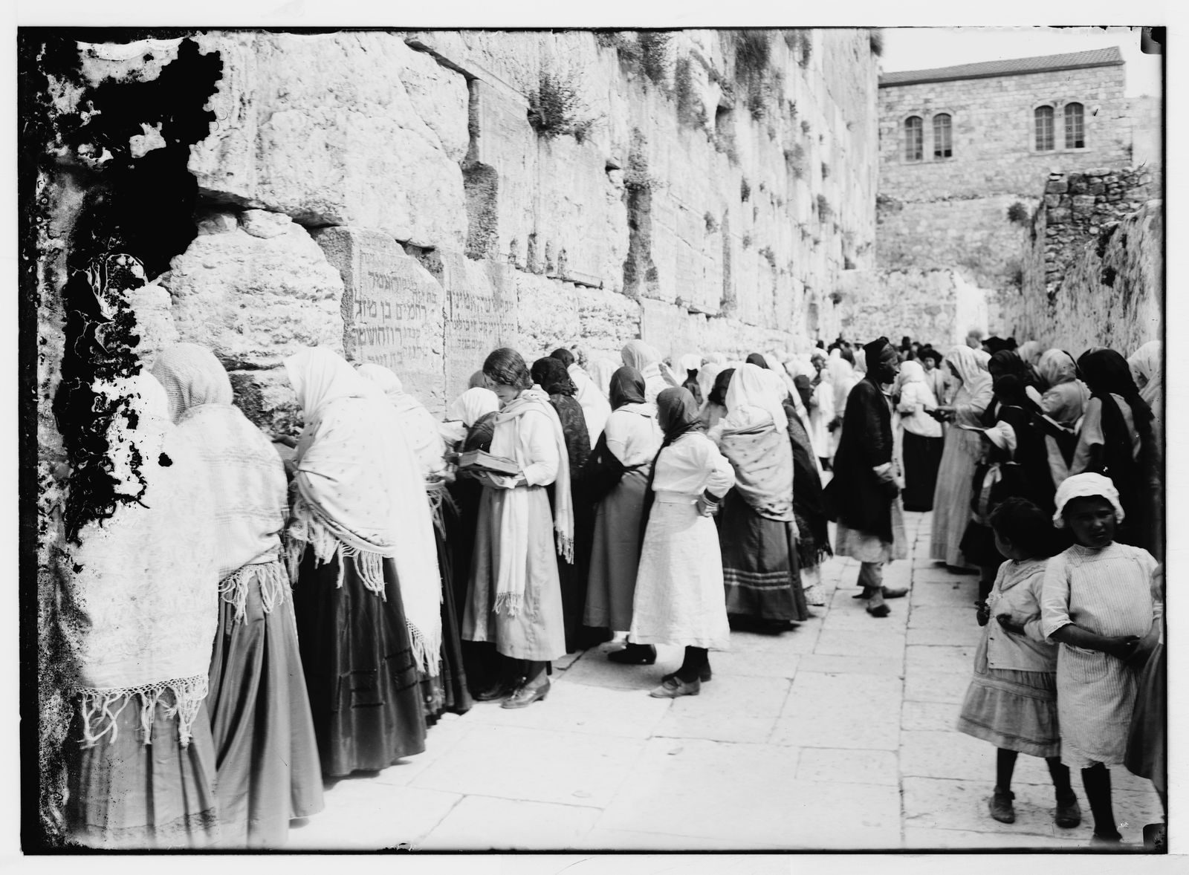
The Western Wall (Kotel) in Jerusalem
Western Wall (Kotel), Jerusalem - LOC Matson Collection, c. 1898-1946.
© More Lessons Less Planning | morelessonslessplanning.com
Notes:
Public-domain photograph of the Western Wall (Kotel) in Jerusalem from the Library of Congress / Matson (American Colony) Photograph Collection, c. 1898-1946 (via Wikimedia Commons; LOC matpc.04802, public domain). Use it purely as a reference image to make the previous slide's point concrete: a surviving section of the ancient Temple's retaining wall that became a focus of Jewish prayer. Describe it respectfully as a holy site of a living tradition, kept separate from modern politics. Students are not asked to decode the image as evidence.

Slide 14
Key Takeaways
The covenant is a reciprocal agreement between God and the Israelites.
★
Judaism is one of the earliest enduring monotheistic traditions.
★
The tradition traces its law to Moses and the Ten Commandments at Sinai.
★
Portable practices let Judaism survive the Diaspora without a homeland.
★
© More Lessons Less Planning | morelessonslessplanning.com
Notes:
Let's recap what you now know about Judaism, described academically. First, the central idea is the COVENANT: a reciprocal agreement the tradition describes between God and the Israelites - God promises protection, they promise to follow God's law. The tradition traces it to Abraham and renews it, through Moses, at Mount Sinai. Second, Judaism is one of the earliest enduring MONOTHEISTIC traditions - the belief in one God - stated carefully, not as 'the first.' Third, the tradition's law is expressed in the TEN COMMANDMENTS given at Sinai and collected, with much more, in the TORAH, the first five books of the Hebrew Bible. Fourth, and most striking: when the Temple was destroyed and the people scattered in the DIASPORA, the tradition survived without a homeland through PORTABLE practices - synagogue worship, Torah study, and shared law and holidays. You also analyzed a passage from the Book of Exodus. Throughout, we described what the tradition teaches with respect, never judging it and never confusing the ancient story with modern politics.

