Slide 1
John Locke and Natural Rights
How Locke argued that government exists to protect life, liberty, and property, and rests on the consent of the governed
© More Lessons Less Planning | morelessonslessplanning.com
Notes:
Open with the lesson question: where do a person's rights come from, and what is government for? Preview Locke's answer: people are born with natural rights, and government exists to protect them, with its power resting on the consent of the governed.

Slide 2
Learning Targets
Explain Locke's natural rights: life, liberty, and property
★
Explain that government exists to protect natural rights
★
Explain that legitimate power rests on the consent of the governed
★
Describe the state of nature, law of nature, and social contract
★
Explain how Locke's ideas influenced the Declaration of Independence
★
© More Lessons Less Planning | morelessonslessplanning.com
Notes:
The five targets keep the lesson centered on Locke's argument: what natural rights are, what government is for, why consent makes power legitimate, the key terms, and Locke's accurate influence on the American Declaration.

Slide 3
Who Was John Locke?
John Locke was an English philosopher who lived from 1632 to 1704.
He is often called the Father of Liberalism.
Locke argued that all people are born with natural rights.
He believed government should protect the people, not rule over them.
His ideas shaped modern democracy.
Key Concept: John Locke argued that people are born with natural rights and that government exists to protect them.
© More Lessons Less Planning | morelessonslessplanning.com
Notes:
John Locke was an English philosopher who lived from 1632 to 1704, often called the Father of Liberalism. He argued that all people are born with natural rights, and that government should protect the people rather than rule over them. This claim is the thread of the whole lesson.

Slide 4
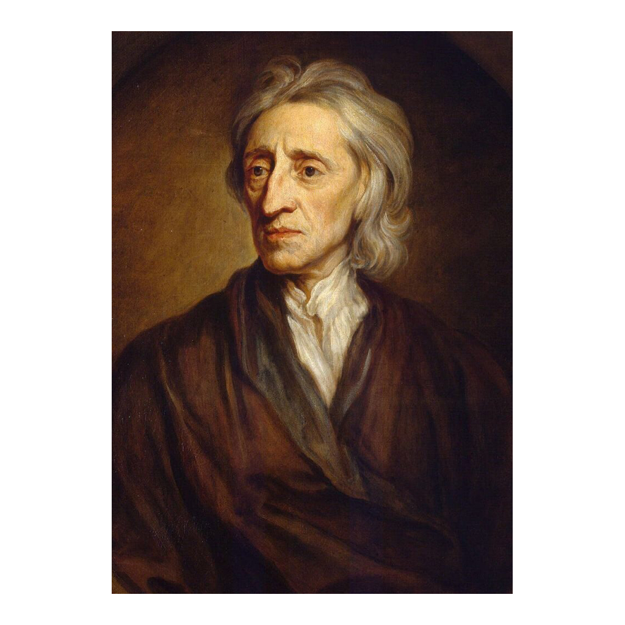
John Locke, portrait by Godfrey Kneller (1697)
John Locke, painted by Godfrey Kneller, 1697
© More Lessons Less Planning | morelessonslessplanning.com
Notes:
This is a period portrait of John Locke painted by Godfrey Kneller in 1697. Use it as a historical reference image, not as evidence for any claim beyond identifying Locke.

Slide 5
England in 1689
Kings vs. Parliament
A Turning Point
Locke lived during conflict between kings and Parliament
Many kings claimed the divine right of kings
Divine right meant God gave the king absolute power
In 1688 the Glorious Revolution limited royal power
Locke published his Two Treatises of Government in 1689
He argued power comes from the people, not from God-given kingship
Key Concept: Locke rejected the divine right of kings and argued that political power comes from the people.
© More Lessons Less Planning | morelessonslessplanning.com
Notes:
Locke lived during a long conflict between kings and Parliament in England. Many kings claimed the divine right of kings, meaning God gave them absolute power. In 1688 the Glorious Revolution placed limits on royal power, and in 1689 Locke published his Two Treatises of Government, arguing that power comes from the people rather than from God-given kingship.

Slide 6
The State of Nature and the Law of Nature
The state of nature is how Locke pictured life before any government existed.
In the state of nature, all people are free and equal.
A law of nature governs it: reason teaches that no one should harm another.
No one ought to harm another in his life, health, liberty, or possessions.
People have rights even before any government is created.
Key Concept: In the state of nature people are free and equal, and the law of nature says no one should harm another's life, liberty, or possessions.
© More Lessons Less Planning | morelessonslessplanning.com
Notes:
The state of nature is how Locke imagined people living before any government existed, where all people are free and equal. A law of nature governs this state: reason teaches that no one ought to harm another in his life, health, liberty, or possessions. This shows that, for Locke, people have rights even before any government is created.

Slide 7
Natural Rights: Life, Liberty, and Property
Rights You Are Born With
Why They Matter
Natural rights belong to every person simply because they are human
Locke named three: life, liberty, and property
These rights are not granted by any king or government
Because people are born with them, no government can take them away fairly
Locke sometimes used property to mean lives, liberties, and estates together
Protecting these rights becomes the whole purpose of government
Key Concept: Locke's three natural rights are life, liberty, and property; they belong to people, not the government.
© More Lessons Less Planning | morelessonslessplanning.com
Notes:
Natural rights belong to every person simply because they are human. Locke named three: life, liberty, and property. These rights are not granted by any king or government, so no government can take them away fairly. Locke sometimes used the word property broadly to mean lives, liberties, and estates together.

Slide 8
The Second Treatise of Government (1689)
In 1689 Locke published the Two Treatises of Government.
The Second Treatise explains where government comes from and what it is for.
Locke argued that people set up government through a social contract.
A social contract is an agreement to form a government that protects rights.
Government gets its power from the consent of the people, not from force.
Key Concept: In the Second Treatise (1689), Locke argued that people create government through a social contract to protect their rights.
© More Lessons Less Planning | morelessonslessplanning.com
Notes:
In 1689 Locke published the Two Treatises of Government. The Second Treatise explains where government comes from and what it is for. Locke argued that people set up government through a social contract, an agreement to form a government that protects rights, and that government gets its power from the consent of the people rather than from force.

Slide 9
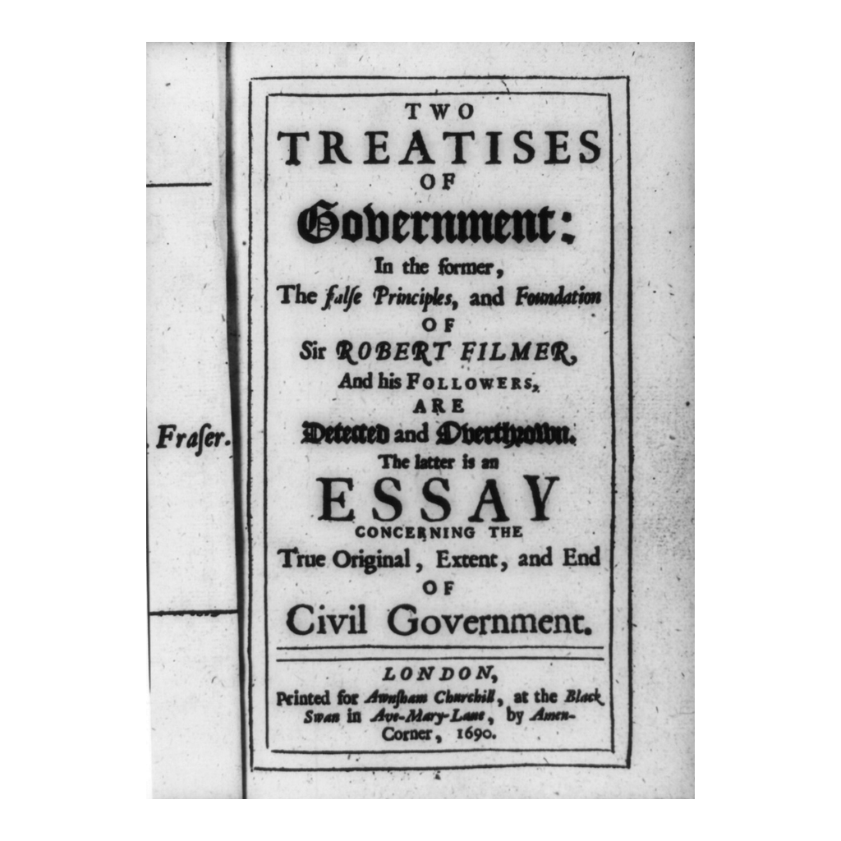
Title Page of Locke's Two Treatises of Government
Title page of Two Treatises of Government, first edition (published 1689)
© More Lessons Less Planning | morelessonslessplanning.com
Notes:
This is the title page of the first edition of Locke's Two Treatises of Government, published in 1689 (the title page is dated 1690). Locke first published it anonymously. Use it as a historical reference to the book at the center of the lesson.
Reference labels (point to these chart features when teaching): Two Treatises of Government; Published 1689

Slide 10
Why Government Exists: To Protect Rights
According to Locke, government exists to protect the people's natural rights.
The main purpose of government is to protect life, liberty, and property.
Government is a tool that serves the people.
If rulers protect these rights, their power is legitimate.
A legitimate government has power that is justified because it protects rights.
Key Concept: Government exists to protect natural rights; a government that does this is legitimate.
© More Lessons Less Planning | morelessonslessplanning.com
Notes:
According to Locke, government exists to protect the people's natural rights. Its main purpose is to protect life, liberty, and property, which makes government a tool that serves the people. If rulers protect these rights, their power is legitimate; a legitimate government is one whose power is justified because it protects rights.

Slide 11
Consent of the Governed
Power From the People
The People Decide
Government's power comes from the consent of the governed
Consent of the governed means the people agree to be ruled
No one can be ruled without his own consent
The people give power to government and can take it back
The people are the true source of political power
This is why consent makes power legitimate
Key Concept: Legitimate power rests on the consent of the governed - the people agree to be ruled.
© More Lessons Less Planning | morelessonslessplanning.com
Notes:
Locke said government's power comes from the consent of the governed, meaning the people agree to be ruled. No one can be ruled by a government without his own consent. The people give power to the government and can take it back, which makes the people the true source of political power.

Slide 12
The Right of Revolution
When Government Fails
What the People May Do
Locke said people may change a government that fails to protect their rights
This is called the right of revolution
A government that destroys rights breaks the social contract
A government that breaks the contract loses its legitimacy
The people may then replace it with a new government
Power returns to the people, its true source
Key Concept: If a government fails to protect rights, the people have the right of revolution to replace it.
© More Lessons Less Planning | morelessonslessplanning.com
Notes:
Locke said people may change a government that fails to protect their rights, which is called the right of revolution. If a government destroys people's rights, it breaks the social contract and loses its legitimacy. The people may then replace it with a new government, and power returns to the people as its true source.

Slide 13
Locke's Influence on the American Revolution
Locke's ideas spread across Europe and to the American colonies.
Thomas Jefferson used Locke's ideas in the Declaration of Independence (1776).
Jefferson wrote of life, liberty, and the pursuit of happiness.
This phrase adapts Locke's life, liberty, and property.
The Declaration says government power comes from the consent of the governed.
Key Concept: Jefferson adapted Locke's 'life, liberty, and property' into 'life, liberty, and the pursuit of happiness.'
© More Lessons Less Planning | morelessonslessplanning.com
Notes:
Locke's ideas spread across Europe and to the American colonies. In 1776 Thomas Jefferson used Locke's ideas in the Declaration of Independence, writing of life, liberty, and the pursuit of happiness. This phrase adapts, rather than copies, Locke's life, liberty, and property. The Declaration also states that governments get their power from the consent of the governed. Keep the distinction clear: Jefferson borrowed and reworded Locke's ideas.

Slide 14
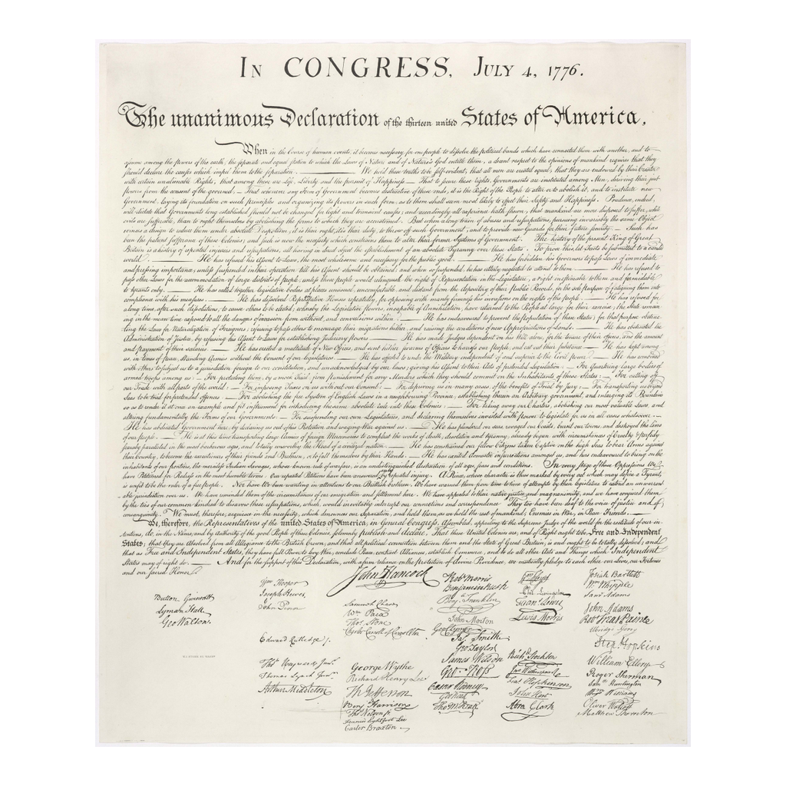
The Declaration of Independence (1776)
The Declaration of Independence, from the 1823 William Stone engraving
© More Lessons Less Planning | morelessonslessplanning.com
Notes:
This is the United States Declaration of Independence, shown from the 1823 William Stone engraving. Use it to picture where Locke's ideas reappear, in adapted form, in an American founding document. It is a reference image, not a reading task.
Reference labels (point to these chart features when teaching): Consent of the governed; Adapted from Locke

Slide 15
Reference Guide: Locke's Core Ideas
natural rights
Rights that belong to every person simply because they are human, not granted by any government.
life, liberty, and property
The three natural rights Locke said every person is born with.
state of nature
Locke's idea of how people live, free and equal, before any government exists.
law of nature
The moral rule that no one ought to harm another in his life, health, liberty, or possessions.
consent of the governed
The idea that a government's power is legitimate only when the people agree to be ruled.
Tip: These five terms name Locke's rights, his starting point, and the source of a government's legitimacy.
© More Lessons Less Planning | morelessonslessplanning.com
Notes:
Review the five terms exactly as defined: natural rights, life, liberty, and property, state of nature, law of nature, and consent of the governed. Students use these definitions to complete the Reference Guide in the Activity.

Slide 16
Reference Guide: Government by Consent
social contract
An agreement in which people form a government to protect their rights.
legitimate government
A government whose power is justified because it protects rights and rests on the people's consent.
Second Treatise of Government
Locke's 1689 book arguing that government exists to protect natural rights.
right of revolution
Locke's idea that people may replace a government that fails to protect their rights.
John Locke
The English philosopher (1632-1704) who argued for natural rights and government by consent.
Tip: These five terms name the agreement behind government, what makes it legitimate, Locke's book, and the people's last resort.
© More Lessons Less Planning | morelessonslessplanning.com
Notes:
Review the five terms exactly as defined: social contract, legitimate government, Second Treatise of Government, right of revolution, and John Locke. Students use these definitions to complete the Reference Guide in the Activity.

Slide 17
Key Takeaways
Locke argued people are born with natural rights: life, liberty, and property.
★
Government exists to protect those rights, not to rule over people.
★
Legitimate power rests on the consent of the governed.
★
If a government fails to protect rights, people have the right of revolution.
★
Locke's ideas influenced the Declaration of Independence and modern democracy.
★
© More Lessons Less Planning | morelessonslessplanning.com
Notes:
Close with the essential question. Each takeaway connects Locke's natural rights to the purpose of government, the role of consent, and the accurate account of his influence on the American Declaration.

