Slide 1
Jerome Powell: The Most Powerful Person You've Never Heard Of
One lawyer with no PhD now sets the cost of money for the entire global economy.
© More Lessons Less Planning | morelessonslessplanning.com
Notes:
Open with the hook. Most students cannot name the Fed Chair. But every credit card APR, every mortgage rate, every car loan, every business loan, and every U.S. Treasury yield in the world responds to what this one person says at FOMC meetings. Jerome Powell took office in February 2018 and has navigated three crises - the 2018-2019 trade war, the 2020 COVID shock, and the 2021-2024 inflation surge - over eight years. Today: who he is, how he got the job, what he has actually done, and the question of whether one person should have this much influence.

Slide 2
Learning Targets
Identify Jerome Powell's role and how he became Fed Chair
★
Trace key Powell decisions: COVID response, 2022 hike pivot, 2024 cuts
★
Evaluate the influence of one person on the global economy
★
© More Lessons Less Planning | morelessonslessplanning.com
Notes:
Read the three targets aloud. T1 (identify) is the foundational frame - role, background, appointment path. T2 (trace) is the substantive content - three crises, three responses. T3 (evaluate) is the cognitive payoff - students will judge in the Part 5 memo whether one person should have this much economic power.

Slide 3
Who Is Jerome Powell?
The Basics
The Career Arc
Fed Chair, Feb 2018-2026
Born 1953, Washington DC; age 73 in 2026
Princeton 1975 (political science), Georgetown Law 1979
First non-economist Fed Chair since G. William Miller (1978)
Investment banking and law at Dillon Read 1984-1990
Treasury undersecretary for domestic finance 1992-1993
Partner at The Carlyle Group 1997-2005 (private equity)
Fed Governor since 2012; nominated Chair in Nov 2017
Key Concept: Powell is unusual - a lawyer, not a PhD economist. His expertise is capital markets and crisis management, not academic monetary theory.
© More Lessons Less Planning | morelessonslessplanning.com
Notes:
Jerome Powell took office as the 16th Chair of the Federal Reserve on February 5, 2018. He was born in 1953 in Washington DC and is 72 in 2026. His undergraduate degree is from Princeton (1975, political science), and his law degree is from Georgetown (1979). He is the first non-economist Fed Chair since G. William Miller (1978-1979) - every Chair from Volcker through Yellen had an economics PhD. Powell's career arc is investment banking and private equity, not academic economics. He worked at Dillon Read (investment bank) from 1984-1990, served as Treasury Undersecretary for Domestic Finance under George H.W. Bush (1992-1993), was a partner at The Carlyle Group (1997-2005), and joined the Fed Board of Governors in 2012. His expertise is capital markets and crisis management - which turned out to be exactly the right toolkit for the 2020 COVID shock.

Slide 4
How Fed Chairs Are Appointed
1. President nominates
Picks a Fed governor; 4-year Chair term
✔
2. Senate hearings
4-8 weeks of testimony
✔
3. Full Senate confirms
2018: 84-13; 2022: 80-19
✔
4. Sworn in
First: Feb 5, 2018. Second: May 23, 2022
✔
Removal protection
14-yr governor term; removable only for cause
✔
Key Concept: Powell was nominated by Trump (2017) and renominated by Biden (2021) - a bipartisan record that is rare in modern politics.
© More Lessons Less Planning | morelessonslessplanning.com
Notes:
Fed Chairs are appointed in four steps. Step 1: the President picks someone - usually an existing Fed Governor - and announces the nomination. The Chair term is four years, separate from the 14-year underlying governor term. Step 2: the Senate Banking Committee holds confirmation hearings, typically 4-8 weeks of testimony covering monetary policy views, banking regulation positions, and prior business conduct. Step 3: the full Senate votes; a simple majority confirms. Powell's first confirmation vote in 2018 was 84-13 (overwhelmingly bipartisan); his 2022 renomination vote was 80-19 (still bipartisan, but with more Republican dissent). Step 4: the new Chair is sworn in. Powell's first term began February 5, 2018; his second term began May 23, 2022. CRITICAL: Fed governors serve 14-year non-renewable terms and can only be removed for cause - meaning the President cannot fire a Fed Chair over a policy disagreement.

Slide 5
Powell's First Term (2018-2022) - Three Tests Before COVID
Test 1: 2018 Hike Cycle
Test 2: 2019 Mid-Cycle Cuts
Test 3: 2020 COVID Crisis
Powell continued Yellen's gradual hike path
4 hikes in 2018; rate hit 2.25-2.50% by Dec 2018
December 2018 S&P 500 sell-off; Powell pivoted dovish
Trade war fears + global slowdown
3 insurance cuts to 1.50-1.75% by Oct 2019
Powell called them an 'insurance adjustment'
March 3 surprise 50 bp emergency cut
March 15 weekend 100 bp cut to 0.00-0.25%
Fastest emergency cut since the 2008 crisis
Key Concept: Powell's first term tested every Fed tool - hikes, cuts, and zero-bound emergency action - in just four years.
© More Lessons Less Planning | morelessonslessplanning.com
Notes:
Powell's first term (Feb 2018 - May 2022) tested every Fed tool. TEST 1 (2018 hike cycle): Powell continued the gradual hike path Yellen had set, with 4 hikes in 2018 taking the federal funds rate to 2.25-2.50% by December. But the December 2018 S&P 500 sell-off - which Trump publicly blamed on Powell - prompted Powell to pivot dovish at the January 2019 FOMC meeting. TEST 2 (2019 mid-cycle cuts): trade war fears with China plus global slowdown signs led the Fed to cut three times to 1.50-1.75% by October 2019. Powell called these 'insurance cuts' - not the start of a cutting cycle. TEST 3 (2020 COVID crisis): on March 3, 2020 Powell delivered a surprise 50 bp inter-meeting cut. Twelve days later on Sunday March 15 the FOMC met by phone and cut another 100 bp - taking the federal funds rate from 1.50-1.75% all the way to 0.00-0.25% in two weeks. The fastest emergency cuts since the 2008 financial crisis.

Slide 6
The COVID Emergency Cuts (March 2020)
12 days
$2.3T
13
From 1.50% to 0.25%
QE balance sheet jump
Emergency facilities
Did You Know? The March 15, 2020 cut was the largest single-meeting cut in Fed history - and it happened on a Sunday by emergency phone vote.
© More Lessons Less Planning | morelessonslessplanning.com
Notes:
March 2020 was Powell's defining moment. As COVID lockdowns began, financial markets seized up. Powell moved at unprecedented speed. March 3, 2020: surprise 50 bp inter-meeting cut to 1.00-1.25% (the first emergency cut since 2008). March 15, 2020 (Sunday): emergency phone FOMC meeting cut another 100 bp to 0.00-0.25% AND announced $700 billion in QE asset purchases. March 23, 2020: announced 13 emergency lending facilities (commercial paper, money markets, municipal bonds, corporate bonds, Main Street loans for small businesses). The Fed's balance sheet jumped from $4.2 trillion (Feb 2020) to $7 trillion (Jun 2020) - a $2.3 trillion injection. Outcome: the 2020 recession officially ended in April 2020 after just two months - the shortest U.S. recession on record. In August 2020 Powell announced a major framework shift at Jackson Hole: Average Inflation Targeting (AIT), tilting the Fed slightly toward maximum employment by allowing inflation to run above 2% to make up for years below. See the federal funds rate chart on the next slide.

Slide 7
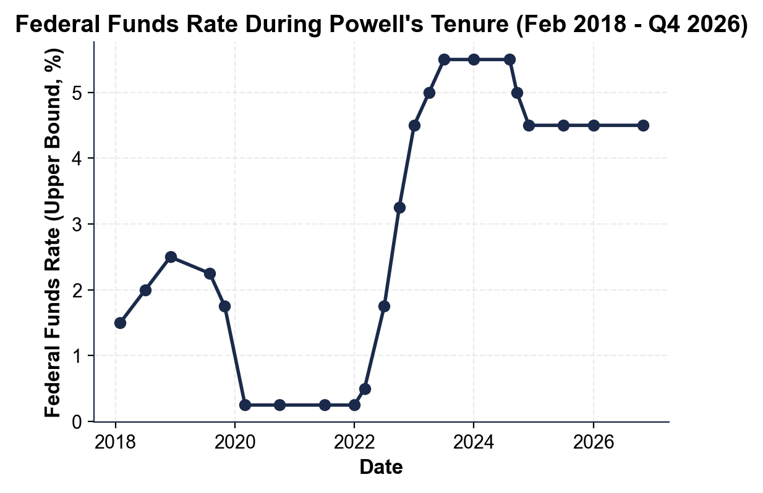
Note: Fed Funds Rate - Powell Tenure
Powell rate path: 2018 hikes, COVID cut, 2022 cycle, 2024 cut start.
© More Lessons Less Planning | morelessonslessplanning.com
Notes:
Have students trace the rate path on the chart. Starting point: 1.50% in Feb 2018 (when Powell took office). First-term peak: 2.50% in Dec 2018. Mid-cycle cuts to 1.75% by Oct 2019. The COVID cliff: 0.25% by March 2020 - the sharp downward gap that dominates the left half of the chart. Two-year hold at 0.25% through March 2022. Then the steep climb: 11 hikes in 16 months from 0.25% to 5.50% by July 2023. The peak: 5.50% held for 13 months through August 2024. The current cycle: 50 bp cut in September 2024 to 5.00%; further cuts to about 4.50% by Q4 2026.
Reference labels (point to these chart features when teaching): Mar 2020 COVID cut to 0.25%; Jul 2023 peak 5.50%

Slide 8
The 2022 Hawkish Pivot - Powell Becomes Volcker
The Setup (2021)
The Pivot (2022)
CPI hit 5% in May 2021, 7% by Dec 2021
Powell called inflation 'transitory' through Nov 2021
December 2021: dropped 'transitory'; tapered QE
Critics: Fed was a year LATE to hike
March 2022: first hike (25 bp) to 0.50%
Jun-Nov 2022: four straight 75 bp hikes
Aug 2022 Jackson Hole: cited Volcker directly
Jul 2023: rate at 5.50% - fastest cycle since Volcker
Key Concept: Powell's Aug 2022 Jackson Hole speech (8 min) committed the Fed to 'pain' - clearest signal since Volcker.
© More Lessons Less Planning | morelessonslessplanning.com
Notes:
The 2022 hawkish pivot is the most contested period of Powell's tenure. THE SETUP (2021): CPI inflation hit 5% in May 2021 and 7% by December 2021. Powell publicly called the inflation 'transitory' (caused by COVID supply chain bottlenecks that would resolve themselves) through November 2021. Critics now argue the Fed was a year late to hike - it should have started in mid-2021 when inflation first crossed 5%. THE PIVOT (2022): March 2022 brought the first hike (25 basis points to 0.25-0.50%). Then Jun, Jul, Sep, Nov 2022 saw four straight historic 75 bp hikes. By July 2023 the federal funds rate was at 5.25-5.50% - 5.25 percentage points of tightening in 16 months, the fastest hike cycle since Volcker (1980-1981). At the August 2022 Jackson Hole conference, Powell delivered an unusually short 8-minute speech committing the Fed to 'pain' for households and businesses to bring inflation down. He explicitly cited Volcker: 'we must keep at it until the job is done.' That speech triggered an immediate S&P 500 sell-off.

Slide 9
The 2024 Cut Cycle Begins
The Data That Justified the Cut
The Pivot to Easing
CPI fell from 9.1% (Jun 2022) to 2.5% (Aug 2024)
Unemployment ticked up to 4.2% (Aug 2024)
PCE core inflation at 2.7% - within striking distance of 2%
Labor market 'rebalancing' - hiring slowed
Sept 18, 2024: 50 bp cut to 4.75-5.00%
Nov + Dec 2024: two more 25 bp cuts to 4.25-4.50%
2025-2026: gradual cuts to ~4.50% upper bound
Soft landing held: no recession through 2026
Key Concept: The 50 bp opening cut was unusual - the Fed normally starts cycles with 25 bp. Signaled urgency on jobs.
© More Lessons Less Planning | morelessonslessplanning.com
Notes:
By mid-2024 the inflation data justified the start of a cutting cycle. CPI had fallen from 9.1% (Jun 2022) to 2.5% (Aug 2024). PCE core inflation was at 2.7% - within striking distance of the 2% target. Unemployment had ticked up modestly to 4.2% (Aug 2024) - the labor market was rebalancing rather than cratering. THE PIVOT TO EASING: at the September 18, 2024 FOMC meeting, the committee cut 50 basis points to 4.75-5.00%. The unusually large opening cut (the Fed normally starts cycles with 25 bp moves) signaled that the Fed saw rising unemployment risk and felt comfortable that inflation was contained. November and December 2024 brought two more 25 bp cuts to 4.25-4.50%. Through 2025 and into 2026 the Fed has continued gradual cuts to about 4.50% upper bound. The soft landing held: no recession, unemployment stayed below 4.5%, and CPI inflation settled around 2.4%. See the S&P 500 chart on the next slide.

Slide 10
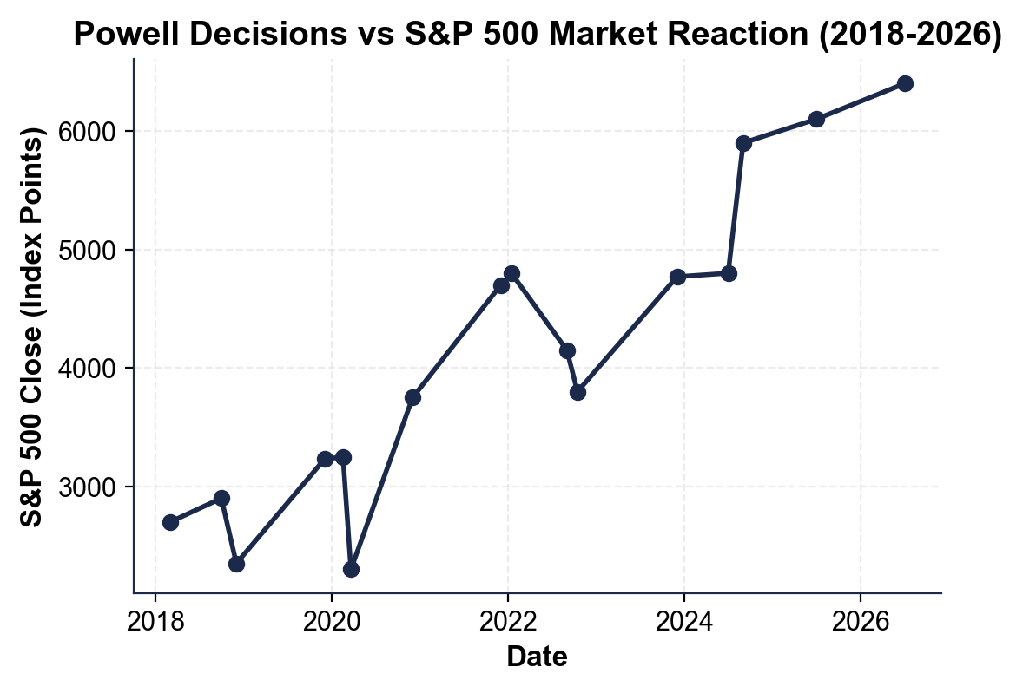
Note: Powell Decisions vs S&P 500
Markets react to Powell pivots: Dec 2018, Mar 2020, Oct 2022, Sept 2024.
© More Lessons Less Planning | morelessonslessplanning.com
Notes:
Have students locate four key inflection points on the chart. (1) December 2018 sell-off to 2,350: Powell's hawkish guidance triggered a sharp sell-off; this is what prompted his January 2019 dovish pivot. (2) March 2020 COVID low at 2,300: the steepest one-month drop in modern history; Powell's emergency cuts and QE drove the recovery to 3,750 by December 2020 - one of the fastest market recoveries on record. (3) October 2022 low at 3,800: during the hawkish pivot, markets feared a Volcker-style hard landing. (4) September 2024 surge to 5,900: anticipation of and reaction to the 50 bp cut. The chart visually proves how powerful Powell's public communication is - a single sentence at Jackson Hole or in an FOMC press conference can move trillions of dollars.
Reference labels (point to these chart features when teaching): Mar 2020 COVID low 2,300; Sept 2024 cut surge 5,900

Slide 11
The Political Pressure Question - Independence vs Accountability
The Pressure on Powell
Why Independence Matters
Trump 2018-2019: publicly attacked Powell on Twitter
Biden 2022: pressured Powell on inflation publicly
Trump 2025-2026: renewed public attacks on rates
Each time: Powell did NOT change course
Short-run political pressure pushes for low rates
Long-run stability needs occasional unpopular hikes
1972 Burns Fed: caved to Nixon - 1970s inflation followed
1980 Volcker Fed: defied Carter and Reagan; broke inflation
Key Concept: The Fed Chair's 4-year term overlaps presidential terms by design - so one President cannot replace the Fed.
© More Lessons Less Planning | morelessonslessplanning.com
Notes:
The central tension of Powell's tenure is independence vs accountability. THE PRESSURE: every President since Trump 2018 has publicly pressured Powell. Trump in 2018-2019 repeatedly attacked Powell on Twitter for raising rates - 'crazy,' 'loco,' a 'bigger enemy than Xi.' Biden in 2022 publicly pressured Powell to bring inflation down faster. Trump in 2025-2026 has renewed the public attacks calling for rate cuts. EACH TIME: Powell did NOT change course. He has cited the Fed's statutory independence in nearly every press conference. WHY INDEPENDENCE MATTERS: short-run political pressure almost always pushes for LOWER interest rates (cheaper credit, more spending, electoral popularity). But long-run economic stability sometimes requires UNPOPULAR rate hikes to prevent runaway inflation. The 1972 Arthur Burns Fed caved to Nixon's pressure to keep rates low - which contributed to the 1970s inflation crisis. The 1980 Volcker Fed defied Carter AND Reagan on rates, drove unemployment to 10.8%, but broke inflation. Powell's pattern looks closer to Volcker.

Slide 12
Key Takeaways
Powell took office Feb 2018; first non-economist Chair since 1978
★
Three crises: 2018 hikes, 2020 COVID cuts, 2022 pivot, 2024 cuts
★
Defining moment Mar 2020: 1.50% to 0.25% in 12 days + $2.3T in QE
★
Aug 2022 Jackson Hole: 8-min Volcker-style commitment to fight inflation
★
Powell has not changed course under pressure from any President
★
© More Lessons Less Planning | morelessonslessplanning.com
Notes:
Read each takeaway and connect to learning targets. T1 (identify Powell + appointment) -> takeaways 1. T2 (trace key decisions) -> takeaways 2, 3, 4. T3 (evaluate influence + political pressure) -> takeaway 5. Tell students the activity puts them in Avery Chen's seat as a junior Fed Board research analyst in October 2026 drafting a Powell Tenure Retrospective brief for the Chair's office.

