Slide 1
Islam: Muhammad and the Five Pillars
An academic look at who Muslims believe the Prophet Muhammad was, and how the Five Pillars - faith, prayer, charity, fasting, and pilgrimage - form the practical framework of Muslim daily life.
© More Lessons Less Planning | morelessonslessplanning.com
Notes:
Opening slide. This lesson studies Islam academically - describing what the tradition teaches and how Muslims practice their faith, never judging any belief as true or false and never ranking religions. Students learn that Islam is a monotheistic religion centered on the Quran and on Muhammad, whom Muslims describe as the final prophet, and that daily practice is organized around the Five Pillars: the Shahada (declaration of faith), Salat (five daily prayers), Zakat (almsgiving), Sawm (fasting in Ramadan), and Hajj (pilgrimage to Mecca). Set a respectful, neutral tone from the first minute: we describe what Muslims believe and do, framing beliefs as beliefs ('Muslims believe...', 'Islam teaches...'), and we do not judge or rank religions.

Slide 2
Learning Targets
Explain who Muhammad was and what Muslims believe about his role.
★
Name the Five Pillars of Islam and what each one requires.
★
Explain how the Pillars structure daily, yearly, and lifetime practice.
★
Read an 18th-century description of Islamic practice as a primary source.
★
© More Lessons Less Planning | morelessonslessplanning.com
Notes:
Read the four learning targets. Today pairs a person - Muhammad, whom Muslims describe as the final prophet - with a system of practice, the Five Pillars, that gives Muslim life its daily and yearly rhythm. Keep the neutral, academic stance in mind throughout: our goal is to understand and describe the beliefs and practices accurately, framing beliefs as beliefs, not to decide whether the religion is right. Pay special attention to naming all five Pillars correctly and to describing each one precisely - the declaration of faith, five daily prayers, almsgiving, fasting in Ramadan, and pilgrimage to Mecca.

Slide 3
Who Was Muhammad, and What Is Islam?
Muhammad, described in Islam
Islam, a monotheistic religion
Muhammad lived from about 570 to 632 CE in Arabia.
In Islam, he is described as the final prophet, or messenger, of God (Allah).
Muslims believe he received revelations from God beginning around 610 CE.
Islam is a monotheistic religion - it teaches belief in one God.
The word Islam means submission to the will of God (Allah).
A follower of Islam is called a Muslim.
Key Concept: ISLAM is a monotheistic religion centered on God (Allah) and on MUHAMMAD, described in Islam as the final prophet.
© More Lessons Less Planning | morelessonslessplanning.com
Notes:
Let's begin with the person and the religion, described academically. MUHAMMAD lived from about 570 to 632 CE in Arabia. In Islam, he is described as the final prophet, or messenger, of God - and Muslims believe he received revelations from God (Allah) beginning around 610 CE. Notice the careful wording: we say 'Muslims believe' and 'is described in Islam as,' because we are reporting what the tradition teaches, not stating it as historical fact. ISLAM is a monotheistic religion, meaning it teaches belief in one God; the word Islam means submission to the will of God (Allah). A follower of Islam is called a Muslim. Establish this neutral framing now and hold it all lesson: we describe beliefs as beliefs.

Slide 4
The Quran and Belief in One God
The Quran
Muslims believe the Quran is the holy book of Islam - the word of God (Allah) as revealed to Muhammad beginning around 610 CE.
✔
Allah: the one God
Allah is simply the Arabic word for God. Islam teaches there is only one God, worshipped by Muslims, Jews, and Christians alike.
✔
A message to live by
The Quran gives Muslims guidance for belief and daily life, including the practices known as the Five Pillars.
✔
Key Concept: Muslims believe the QURAN is the word of God (ALLAH), revealed to Muhammad; ALLAH is the Arabic word for God.
© More Lessons Less Planning | morelessonslessplanning.com
Notes:
At the center of Islam are a holy book and a single God. The QURAN is the holy book of Islam; Muslims believe it is the word of God (Allah) as revealed to Muhammad beginning around 610 CE. Describe this as belief: Muslims believe the Quran records God's revelations. ALLAH is simply the Arabic word for God - not a different god, but the one God. Islam teaches strict monotheism: there is only one God, the same God worshipped in Judaism and Christianity. The Quran is not only a statement of belief; Muslims look to it for guidance in daily life, including the practices we call the Five Pillars, which we turn to next. Keep the tone academic and respectful throughout.

Slide 5
The Five Pillars: A Framework for Life
What the Pillars are
Why 'pillars'?
The Five Pillars of Islam are five core practices of Muslim life.
They are: Shahada, Salat, Zakat, Sawm, and Hajj.
Together they form the practical framework of Muslim religious life.
A pillar holds up a building; these five practices support Muslim life.
Each Pillar is an action a Muslim is expected to carry out.
The next slides define each Pillar one at a time.
Key Concept: The FIVE PILLARS OF ISLAM are five core practices - Shahada, Salat, Zakat, Sawm, and Hajj - that frame Muslim life.
© More Lessons Less Planning | morelessonslessplanning.com
Notes:
Now we reach the heart of the lesson: the FIVE PILLARS OF ISLAM. These are the five core practices that form the framework of Muslim religious life. The five are the Shahada, Salat, Zakat, Sawm, and Hajj - we will define each one on the coming slides. Why call them 'pillars'? Because just as pillars hold up a building, these five practices support and structure a Muslim's life of faith. Each Pillar is not just a belief but an action a Muslim is expected to carry out - to declare, to pray, to give, to fast, and to make a pilgrimage. Keep the framing academic: we are describing the practices Muslims observe, in order and by name.

Slide 6
Pillar 1 and 2: Shahada and Salat
Shahada - declaration of faith
The Shahada is the declaration of faith: 'There is no god but God, and Muhammad is the messenger of God.'
✔
Salat - five daily prayers
Salat is the practice of five daily prayers, which Muslims perform facing the city of Mecca.
✔
Faith, then practice
The Shahada states the core belief; Salat turns that belief into a daily rhythm of prayer.
✔
Key Concept: The SHAHADA is the declaration of faith; SALAT is the five daily prayers Muslims perform facing Mecca.
© More Lessons Less Planning | morelessonslessplanning.com
Notes:
Let's define the first two Pillars. The SHAHADA is the declaration of faith - the statement 'There is no god but God, and Muhammad is the messenger of God.' To declare the Shahada sincerely is, in Islam, to become a Muslim; it states the core belief of the whole religion. The second Pillar is SALAT, the five daily prayers. Muslims perform Salat five times a day - at set times - turning to face the city of Mecca wherever they are. Notice the pattern that runs through all the Pillars: the Shahada states a belief, and Salat turns that belief into a daily practice repeated five times a day. Describe both precisely and neutrally, as the practices Muslims observe.

Slide 7
Pillar 3 and 4: Zakat and Sawm
Zakat - almsgiving
Sawm - fasting in Ramadan
Zakat is almsgiving, or charity, given to those in need.
It is commonly about 2.5 percent of a person's accumulated wealth.
It is given each year, not just when a person feels like it.
Sawm is fasting from dawn to sunset during the holy month of Ramadan.
Those fasting abstain from food and drink during daylight hours.
After sunset, the fast is broken, often with family and community.
Key Concept: ZAKAT is almsgiving (commonly ~2.5% of wealth) given yearly; SAWM is fasting dawn to sunset during Ramadan.
© More Lessons Less Planning | morelessonslessplanning.com
Notes:
The third and fourth Pillars connect faith to how Muslims treat others and their own bodies. ZAKAT is almsgiving - charity given to those in need. It is commonly about 2.5 percent of a person's accumulated wealth, given each year; it is treated as a required duty, not just optional generosity. Zakat ties the individual's faith to the well-being of the wider community. SAWM is fasting from dawn to sunset during the holy month of Ramadan. During the daylight hours of that month, those observing the fast abstain from food and drink; after sunset the fast is broken, often shared with family and community. Describe both accurately and respectfully as practices Muslims observe, and note the shared theme: both Pillars ask believers to practice self-discipline and care for others.

Slide 8
Pillar 5: Hajj, the Journey to Mecca
Hajj - pilgrimage to Mecca
Hajj is the pilgrimage to the city of Mecca that Muslims who are able are expected to make at least once in their lifetime.
✔
The heart of the journey
Pilgrims travel to the Great Mosque at Mecca and its central shrine, the Kaaba, which Muslims turn to face in prayer.
✔
Once in a lifetime
The Hajj is expected once in a lifetime for those able; the sick or the poor who cannot make the journey may be excused.
✔
Key Concept: HAJJ is the journey to Mecca that Muslims who are able are expected to make at least once in their lifetime.
© More Lessons Less Planning | morelessonslessplanning.com
Notes:
The fifth Pillar is HAJJ, the pilgrimage to the city of Mecca. Muslims who are able are expected to make this pilgrimage at least once in their lifetime. Pilgrims travel from all over the world to the Great Mosque at Mecca and its central shrine, the Kaaba - the cube-shaped building that Muslims everywhere turn to face when they pray. The Hajj gathers Muslims of every background in one place at one time, which is why many describe it as a powerful experience of unity. Notice the careful, academic wording of the duty: the Hajj is expected once in a lifetime for those who are ABLE - the sick or the poor who cannot make the journey may be excused. On the next slide you will see a real photograph of the Kaaba. Describe all of this respectfully; students are not asked to decode the image as evidence.

Slide 9
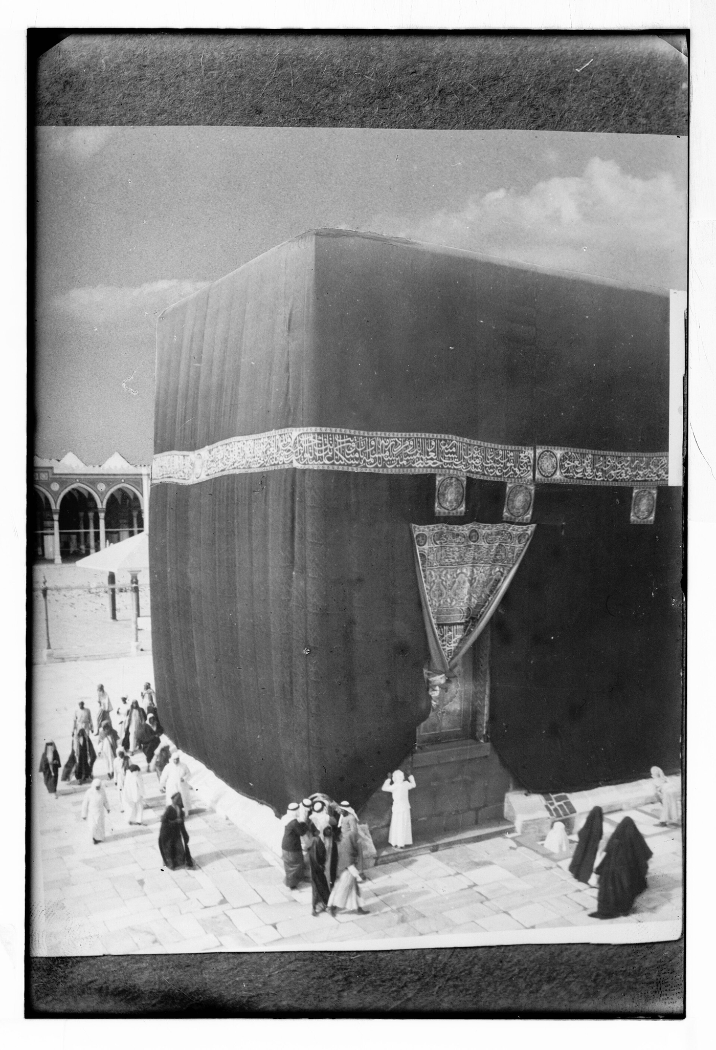
The Kaaba at Mecca
The Kaaba at Mecca, around 1910 (Library of Congress).
© More Lessons Less Planning | morelessonslessplanning.com
Notes:
Public-domain photograph of the Kaaba at the Great Mosque of Mecca, from the Library of Congress Matson (G. Eric and Edith) Photograph Collection, ca. 1910 (LOC matpc.04658; public domain by age). Use it purely as a reference image to make the previous slide's point concrete: the Hajj brings pilgrims to Mecca and its central shrine, the Kaaba, which Muslims turn to face in prayer. Describe it respectfully and academically as an architectural, documentary photograph. NO figural depiction of the Prophet Muhammad appears; students are not asked to decode the image as evidence.

Slide 10
How the Pillars Shape Daily and Yearly Life
Different rhythms of time
Woven through life
Daily: Salat means Muslims pray five times every single day.
Yearly: Sawm means fasting each year during the month of Ramadan.
Once in a lifetime: the Hajj pilgrimage, for those who are able.
The Shahada is declared and repeated throughout a believer's life.
Zakat is given each year as a steady duty of charity.
Together the Pillars structure a Muslim's day, year, and lifetime.
Key Concept: The Pillars structure time - daily prayer (Salat), the yearly fast (Sawm/Ramadan), and the once-in-a-lifetime Hajj.
© More Lessons Less Planning | morelessonslessplanning.com
Notes:
Step back and notice how the Five Pillars organize time itself. Some Pillars repeat daily: Salat means a Muslim prays five times every single day. Some repeat yearly: Sawm means fasting each year during the month of Ramadan, and Zakat is given each year as a steady duty of charity. And one, the Hajj pilgrimage, is expected just once in a lifetime for those who are able. The Shahada, the declaration of faith, is declared and repeated throughout a believer's life. Put together, the Pillars give Muslim life a clear structure across the day, the year, and the whole lifetime - which is exactly why they are called the framework, or 'pillars,' of the faith. Describe this as the practical rhythm of the tradition, neutrally and with respect.

Slide 11
A Shared Root with Judaism and Christianity
One God
Islam is a monotheistic religion - it teaches belief in one God, the same God worshipped in Judaism and Christianity.
✔
Shared figures and stories
Islam honors many prophets shared with Judaism and Christianity, such as Abraham, Moses, and Jesus.
✔
A distinct tradition
Islam is also its own distinct religion, centered on the Quran and on Muhammad as the final prophet.
✔
Key Concept: Islam is MONOTHEISTIC and shares a root with Judaism and Christianity, while remaining its own distinct tradition.
© More Lessons Less Planning | morelessonslessplanning.com
Notes:
Because this is a unit on world religions, it helps to place Islam beside the traditions we have already studied. Islam is a MONOTHEISTIC religion - it teaches belief in one God - and Muslims understand that God to be the same God worshipped in Judaism and Christianity. Islam also honors many prophets shared with those traditions, such as Abraham, Moses, and Jesus, whom Muslims respect as earlier prophets. At the same time, Islam is its own distinct religion, centered on the Quran and on the belief that Muhammad is the final prophet. Describe these connections and differences neutrally: we are noting shared roots and distinct beliefs to understand the traditions accurately, not to rank them or to say one is truer than another.

Slide 12
Key Takeaways
Islam is monotheistic; Muslims describe Muhammad as the final prophet.
★
Muslims believe the Quran is the word of God (Allah) revealed to Muhammad.
★
The Five Pillars are Shahada, Salat, Zakat, Sawm, and Hajj.
★
The Pillars structure Muslim life across the day, the year, and a lifetime.
★
© More Lessons Less Planning | morelessonslessplanning.com
Notes:
Let's recap what you now know about Islam, described academically. First, the religion and the person: Islam is a monotheistic religion centered on God (Allah), and Muslims describe Muhammad (c. 570-632 CE) as the final prophet, who they believe received revelations from God recorded in the Quran. Second, the framework of practice: the Five Pillars are the Shahada (declaration of faith), Salat (five daily prayers), Zakat (almsgiving), Sawm (fasting in Ramadan), and Hajj (pilgrimage to Mecca). Third, how they work: the Pillars structure Muslim life across the day, the year, and a whole lifetime, and Islam shares a monotheistic root with Judaism and Christianity while remaining its own distinct tradition. You also read an 18th-century description of Islamic practice as a primary source. Throughout, we described the beliefs and practices with respect, framing beliefs as beliefs and never ranking religions.

