Slide 1
Interest Rates: The Fed's Main Tool
How the FOMC moves one number - and why it reshapes your mortgage, your credit card, and the whole economy.
© More Lessons Less Planning | morelessonslessplanning.com
Notes:
Open with the hook. Almost every economic story you read - mortgage rates, credit-card APRs, the job market, the stock market - traces back to a number the FOMC sets eight times a year. Today's lesson: what that number is, how the Fed moves it, how it travels out to your wallet, and what hikes vs cuts are really trying to do.

Slide 2
Learning Targets
Define the federal funds rate and explain how the FOMC sets it
★
Trace transmission from the federal funds rate to mortgage and credit card rates
★
Predict the effects of rate hikes vs rate cuts on inflation, jobs, and borrowing
★
© More Lessons Less Planning | morelessonslessplanning.com
Notes:
Read the three targets. Tell students Part 3 of today's activity will literally use a real chart of the federal funds rate to test target 1 and target 3.

Slide 3
What Is the Federal Funds Rate?
The Definition
Why Banks Lend to Each Other
Interest rate banks charge each other
For OVERNIGHT loans of reserves
Set by the FOMC as a 0.25-point range
The Fed's primary monetary policy tool
Banks must hold reserves at the Fed
Some end the day short, others long
Short banks borrow overnight from long banks
The rate they charge each other = fed funds
Key Concept: The Fed does NOT set your mortgage rate. It sets the bank-to-bank overnight rate; everything else moves in response.
© More Lessons Less Planning | morelessonslessplanning.com
Notes:
Make the definition concrete. Banks legally must hold reserves at the Fed; at the end of each day, some banks have too few (and borrow), others have too many (and lend). The price of that overnight money is the federal funds rate. The FOMC's job is to push that price to its target.

Slide 4
How the FOMC Sets the Rate
✔
8 meetings per year
Roughly every 6 weeks; Jerome Powell chairs
✔
12 voting members
7 Board Governors + NY Fed President + 4 rotating regional Presidents
✔
Reviews data first
Inflation (PCE), jobs report, GDP, wages, surveys
✔
Votes on a target range
e.g. 5.25% to 5.50% - a 25 basis-point range
✔
Issues a statement
Public release at 2pm ET; markets react within seconds
✔
Powell holds a press conference
30 minutes later, explains the decision and answers questions
Did You Know? A 0.25-percentage-point move is called '25 basis points' or '25 bps' - Fed jargon for one quarter of one percent.
© More Lessons Less Planning | morelessonslessplanning.com
Notes:
Walk through the meeting cadence. The 8 meetings per year are scheduled years in advance. Each meeting produces a statement, an economic projection (the dot plot), and a Powell press conference. Investors trade based on every word.

Slide 5
How the Fed Actually Moves the Rate
Open market operations
Fed buys/sells Treasury bonds to push fed funds toward target
Buying bonds
Adds reserves to the banking system - pushes the fed funds rate DOWN
Selling bonds
Drains reserves from the banking system - pushes the fed funds rate UP
IORB
Interest on Reserve Balances - the floor the Fed pays banks (banks won't lend below it)
Discount rate
Higher rate the Fed charges banks that borrow directly from the Fed (ceiling)
Tip: Since 2008 the Fed uses IORB to set the floor - banks won't lend overnight below what they earn risk-free at the Fed.
© More Lessons Less Planning | morelessonslessplanning.com
Notes:
The Fed has a price-setting toolkit. Pre-2008 it relied almost entirely on open market operations. Post-2008 it added IORB as a more direct floor. Today the Fed announces the target range; IORB sets the floor, and the discount rate sets the ceiling.

Slide 6
The Transmission Mechanism
Step 1: Banks
Step 2: Short-term consumer
Step 3: Long-term consumer
Step 4: Economy
Bank-to-bank overnight rate moves
Banks reprice their lending costs
Internal cost of funds resets
Prime rate = fed funds + 3 points
Credit card APRs move with prime
Auto loans and HELOCs move quickly
10-year Treasury yield shifts on expectations
30-year mortgages track 10-year Treasury
Move is slower and partial
Borrowing slows or speeds up
Spending, hiring, prices respond
Full effect takes 6-12 months
Warning: Mortgages don't follow fed funds 1-for-1. Chart on next slide shows fed funds near 0.25% during 2009-2015 and a peak of 5.5% in 2023.
© More Lessons Less Planning | morelessonslessplanning.com
Notes:
This is the cognitive backbone of the lesson. Walk students through all four steps. The transmission is fast for credit cards (days), medium for auto loans (weeks), and slow for mortgages (months) - because mortgages key off long-term Treasury yields, which move on Fed expectations.

Slide 7
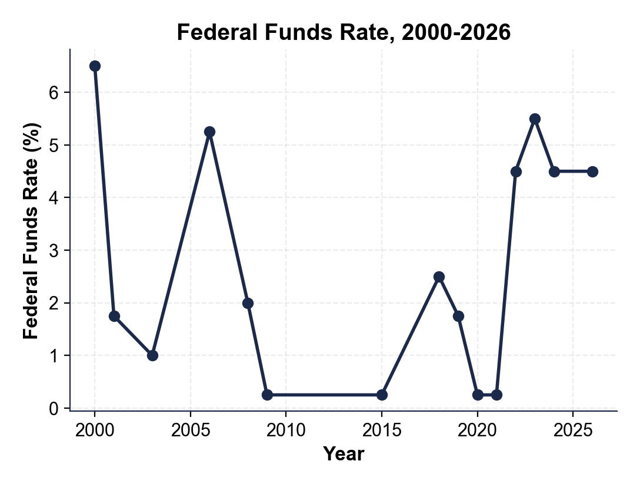
Note: Fed Funds Rate, 2000-2026
chart_fed_funds_rate_2000_2026
© More Lessons Less Planning | morelessonslessplanning.com
Notes:
Have students point to the two zero-lower-bound periods (post-2008 and post-COVID) and the 2022-2023 hike cycle. Ask: which two cycles look like recession-fighting cuts, and which is the inflation-fighting hike?

Slide 8
Prime Rate, Credit Cards, and Auto Loans
Prime rate
Banks' rate for best customers; ALWAYS = fed funds + 3.00 points
Credit card APR
Usually prime + 10-18 points; moves within 1-2 billing cycles
Auto loan
Prime + 0-6 points for new cars; resets on new loans within weeks
HELOC
Home equity line of credit; floats with prime - payment changes monthly
Personal loan
Fixed at origination, but new loan rates track prime
SOFR
Benchmark that replaced LIBOR in 2023 for adjustable-rate loans and derivatives
Did You Know? The 2022-2023 hike pushed prime from 3.25% to 8.5% (8.50%) - and credit card APRs hit 21% in 2024.
© More Lessons Less Planning | morelessonslessplanning.com
Notes:
Make the math explicit: prime is mechanically tied to fed funds. When the Fed hikes 25 bps, prime hikes 25 bps the same day, every major bank announces it. Credit card APRs follow within one billing cycle. This is the FASTEST part of transmission.

Slide 9
30-Year Mortgages and the Treasury Link
The Indirect Path
Why the Lag Is Bigger
Mortgages do NOT follow fed funds directly
They track 10-year Treasury yields
10-year Treasury moves on EXPECTED fed funds
Typical spread: mortgage ~2-3 pts above 10-yr
Markets price in the next 1-3 years of Fed moves
Mortgages can move BEFORE the Fed actually cuts
Or stay high if markets expect more hikes
Refinance demand surges when rates drop
Key Concept: Mortgages price in EXPECTED Fed moves. Chart on next slide: 30-yr mortgage hit a low of 3% in 2021 and peaked near 7% in 2023.
© More Lessons Less Planning | morelessonslessplanning.com
Notes:
The mortgage transmission is the trickiest part for students. Mortgages live in the 10-year Treasury world, not the overnight fed funds world. So mortgages move on EXPECTATIONS. When markets expect Fed cuts, mortgages drop even before the Fed acts. When markets expect more hikes, mortgages stay elevated even if the Fed holds steady.

Slide 10
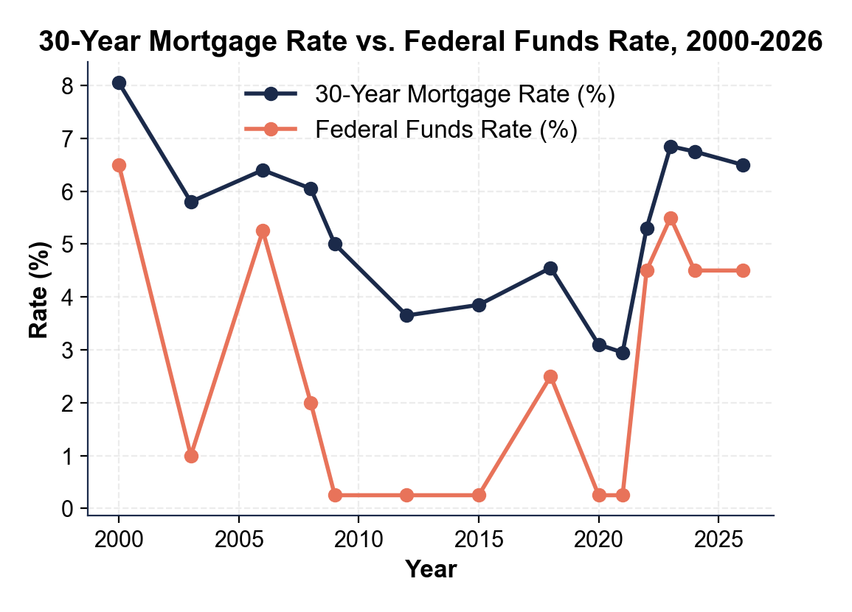
Note: 30-Yr Mortgage vs Fed Funds
chart_mortgage_vs_fed_funds
© More Lessons Less Planning | morelessonslessplanning.com
Notes:
Have students trace both lines from 2000 to 2026. The mortgage line stays ABOVE the fed funds line in every year - that's the spread. Point at 2021 (mortgages near 3%) and 2023 (mortgages near 7%). Ask: in which year would you have wanted to buy a house?

Slide 11
Raising Rates: Fighting Inflation
Why hike?
Inflation is above the Fed's 2% target
✔
Mechanism A: Borrowing
Higher rates make loans more expensive - people borrow less, spend less
✔
Mechanism B: Saving
Higher rates make saving more attractive - more money out of circulation
✔
Mechanism C: Jobs
Slower spending means fewer hires - wage growth cools - price pressure eases
✔
The risk
Hike too much or too fast and you cause a recession
✔
Warning: Hiking rates does NOT directly cut prices at the store - it cools the demand that drives prices up. The lag is 6-12 months.
© More Lessons Less Planning | morelessonslessplanning.com
Notes:
This is the inflation-fighting playbook. Higher rates -> less borrowing, more saving, fewer hires, slower wage growth, weaker demand, easing prices. Every step takes time. The Fed has to PREDICT inflation 12 months ahead, not react to it.

Slide 12
Lowering Rates: Fighting Recession
Why cut?
Unemployment is rising or GDP is falling
✔
Mechanism A: Borrowing
Cheaper loans make mortgages, cars, and business investment more attractive
✔
Mechanism B: Refinancing
Homeowners refinance (refi) to lower payments - extra cash flows into spending
✔
Mechanism C: Stock market
Lower rates push investors toward stocks; rising portfolios fuel spending
✔
The risk
Cut too aggressively and you reignite inflation
✔
Did You Know? After the 2008 crash, the Fed cut to ~0% and held there for SEVEN YEARS (2008-2015) - the longest near-zero stretch in U.S. history.
© More Lessons Less Planning | morelessonslessplanning.com
Notes:
The recession-fighting playbook. Lower rates -> cheaper borrowing, refi savings, rising stock prices, restored confidence, more hiring. The COVID-era was a textbook case: Fed cut to ~0.25% in March 2020 and held there until 2022.

Slide 13
The 2022-2024 Hike Cycle: A Real Case Study
Date | FOMC Move | Cumulative Fed Funds | 30-Yr Mortgage | Inflation (CPI)
March 2022 | +25 bps (first hike) | 0.50% | ~4.4% | 8.5%
June 2022 | +75 bps (biggest single move) | 1.75% | ~5.8% | 9.1% (peak)
Dec 2022 | +50 bps | 4.50% | ~6.4% | 6.5%
July 2023 | +25 bps (final hike) | 5.50% (peak) | ~6.9% | 3.2%
Sept 2024 | -50 bps (first cut) | 5.00% | ~6.2% | 2.4%
Nov 2024 | -25 bps | 4.75% | ~6.8% | 2.7%
Dec 2024 | -25 bps | 4.50% | ~6.7% | 2.9%
Key Concept: 525 bps hiked (Mar 2022 - Jul 2023) to 5.50% peak; then 100 bps cut across Sept/Nov/Dec 2024 to 4.50%.
© More Lessons Less Planning | morelessonslessplanning.com
Notes:
Walk the table date by date. Highlight (1) the speed - 5.25 points in 16 months, (2) the inflation drop from 9.1% to 3.2%, (3) the mortgage move from ~3% in 2021 (off the chart) to ~6.9% in 2023, and (4) the FULL 2024 cut sequence: -50 bps Sept, -25 bps Nov, -25 bps Dec, ending at 4.50%. The November cut is the one students most often miss in headline coverage.

Slide 14
How to Read an FOMC Announcement
Statement
Press release at 2pm ET (2 pm / 2:00 pm); one page of carefully worded text
'Strong' jobs language
Hint that the Fed sees room to hike or hold
'Easing' inflation language
Hint that cuts may be coming
Dot plot
Chart of each Fed official's expected rate path - released quarterly
Press conference
30 minutes after the statement; Powell answers reporter questions
'Data dependent'
Most common Fed phrase: 'we will decide future moves based on incoming data'
Tip: Markets move on what the Fed SAYS about future moves more than on what it does at any single meeting. Forward guidance > current move.
© More Lessons Less Planning | morelessonslessplanning.com
Notes:
Show the structure of a real FOMC statement. The first paragraph is always a snapshot of the economy. The second is the decision. The third is the forward guidance. Investors highlight every changed word from the previous statement.

Slide 15
Lags and Uncertainty
Full effect of a rate change takes 6-12 months
The Fed has to PREDICT what the economy will look like in a year
Predictions are often wrong - the Fed has missed major turns
Dual mandate = maximum employment AND stable prices (the Fed's two goals)
The two goals can conflict - fighting inflation can raise unemployment
Hiking too late = inflation gets entrenched (1970s)
Cutting too late = recession deepens (2007-2008)
Hiking too much = unnecessary recession (2024 debate)
Cutting too much = inflation returns (current 2025 risk)
Warning: There is no perfect rate. The Fed is always navigating between two errors - and the right answer only becomes clear years later.
© More Lessons Less Planning | morelessonslessplanning.com
Notes:
Close the lesson with humility. Monetary policy is decision-making under uncertainty with a 6-12 month feedback loop. The Fed has been wrong - in the 1970s (too late to hike), in 2007-2008 (too late to cut), and arguably in 2021 (too late to recognize inflation). The dual mandate (jobs + prices) often points in opposite directions.

Slide 16
Key Takeaways
Fed funds = overnight bank-to-bank rate; FOMC sets it 8x/year
★
Credit cards reprice fast; mortgages lag via 10-yr Treasury
★
Hike to fight inflation; cut to fight recession (6-12 mo lag)
★
2022-2024: fastest hike since 1980s; CPI 9.1% -> ~3%
★
Forward guidance moves markets more than the rate decision
★
© More Lessons Less Planning | morelessonslessplanning.com
Notes:
Read each takeaway. Connect back to the three learning targets: definition (T1), transmission (T2), hikes vs cuts (T3). Tell students the activity will put them in the seat of Devin Park, a junior Fed analyst, deciding what the Fed should do next.

