Slide 1
Interest Explained: Simple vs Compound
The same rate can grow money very differently: learn why simple interest stays flat while compound interest earns interest on interest.
© More Lessons Less Planning | morelessonslessplanning.com
Notes:
Open with the big idea: interest is the price of using money, and there are two ways to figure it. SIMPLE INTEREST is figured only on the original principal, so it adds the same dollar amount every year. COMPOUND INTEREST is figured on the principal PLUS all the interest already earned, so the amount it adds grows each year - that is interest on interest. Students follow Priya Nair, who puts $1,000 into two accounts that both pay 8% a year: one simple, one compound. After 1 year they are identical ($1,080). After 3 years simple is $1,240 but compound is $1,259.71, and over 20 years simple reaches $2,600 while compound reaches $4,660.96. Students will learn both formulas as foundational models (I = P x r x t and A = P(1 + r/n)^(nt)), calculate each one, and use the Rule of 72 to estimate how fast money doubles. As the second toolkit of Unit 5, this lesson explains why compound interest is the most important idea in personal finance: it works against you on debt but for you on savings.

Slide 2
Learning Targets
Define simple interest and compound interest and tell the difference
★
Calculate simple interest with I = P x r x t
★
Calculate compound interest with A = P(1 + r/n)^(nt), reasoning year by year
★
Explain why compound grows faster and use the Rule of 72 for doubling time
★
© More Lessons Less Planning | morelessonslessplanning.com
Notes:
Read the four targets aloud. Tell students the lesson follows Priya Nair, who compares a $1,000 simple-interest account and a $1,000 compound-interest account that both pay 8%. Target 1 is the definition: simple interest is figured only on the principal; compound interest is figured on the principal plus the interest already earned. Target 2 is the simple formula, I = P x r x t, a foundational model where P is the principal, r is the rate as a decimal, and t is the years. Target 3 is the compound formula, A = P(1 + r/n)^(nt), a foundational model where n is how many times a year interest compounds (this lesson uses n = 1, once a year, so the per-year reasoning stays clean). Target 4 is the payoff: compound grows faster because it earns interest on interest, which hurts you on debt and helps you on savings, and the Rule of 72 (years to double is about 72 / rate%) estimates how fast money doubles - at 8%, about 9 years.

Slide 3
The Cost of Borrowing
Interest is the price of using money
INTEREST is what you pay to borrow money, or what you earn for lending or saving it - the price of using someone's money for a while
✔
It always starts with the PRINCIPAL
The PRINCIPAL is the original amount you borrow or deposit, before any interest is added - for Priya, the $1,000 she puts in each account
✔
The INTEREST RATE sets the price
The INTEREST RATE is the percent charged or earned per year; in the formulas you write it as a decimal, so 8% becomes 0.08
✔
Two ways to figure it
The same rate can be figured two ways - SIMPLE interest (on the principal only) or COMPOUND interest (on the principal plus past interest)
✔
Key Concept: INTEREST is the price of using money, figured on the PRINCIPAL at an INTEREST RATE (a decimal) - as simple or compound interest.
© More Lessons Less Planning | morelessonslessplanning.com
Notes:
Set up the whole lesson by defining the building blocks. INTEREST is the price of using money: you pay it to borrow, and you earn it when you lend or save. It always starts with the PRINCIPAL - the original amount you borrow or deposit before any interest is added. For Priya Nair, the principal is the $1,000 she puts into each of two accounts. The INTEREST RATE is the percent charged or earned per year; in every formula you write the rate as a decimal, so 8% becomes 0.08. The key idea of this lesson: the very same rate can be figured two different ways. SIMPLE interest is figured only on the principal, so it adds the same amount every year. COMPOUND interest is figured on the principal PLUS the interest already earned, so the amount it adds grows. Both Priya's accounts pay 8%, but the way the interest is figured is what makes them grow apart.

Slide 4
The Simple Interest Formula
I = P x r x t (a foundational model)
Priya's $1,000 at 8%, Simple
SIMPLE INTEREST is figured only on the original PRINCIPAL
I = P x r x t: Interest = Principal x rate (as a decimal) x time in years
Because it ignores past interest, it adds the SAME amount every year
The balance is the principal plus the interest: A = P + I
Year 1: I = $1,000 x 0.08 x 1 = $80, so balance = $1,080
Year 3: I = $1,000 x 0.08 x 3 = $240, so balance = $1,240
Every year adds the same $80 (always 8% of the original $1,000)
Simple interest grows in a straight line
Key Concept: SIMPLE INTEREST uses the foundational model I = P x r x t - interest on the principal only - so it adds the same amount yearly.
© More Lessons Less Planning | morelessonslessplanning.com
Notes:
Teach the first formula as a foundational model. SIMPLE INTEREST is figured only on the original PRINCIPAL - it ignores any interest already earned. The foundational model is I = P x r x t: the Interest equals the Principal times the rate (written as a decimal) times the time in years. Once you have the interest, the balance is just the principal plus the interest, A = P + I. Walk Priya's $1,000 simple account at 8%. In Year 1, I = $1,000 x 0.08 x 1 = $80, so her balance is $1,080. In Year 3, I = $1,000 x 0.08 x 3 = $240, so her balance is $1,240. The pattern students must see: every single year adds the SAME $80, because simple interest is always 8% of the original $1,000 - it never grows. That is why simple interest grows in a straight line. Reminder for students: change the percent to a decimal first (8% = 0.08), and time is in years.

Slide 5
The Compound Interest Formula
A = P(1 + r/n)^(nt) (a foundational model)
Priya's $1,000 at 8%, Compound
COMPOUND INTEREST is figured on principal PLUS interest already earned
A is the FUTURE VALUE; n tells how often interest is added each year
Here n = 1, so A = P(1 + r)^t: take the rate on each new balance
Year 1: $1,000 + 8% = $1,080; Year 2: $1,080 + 8% = $1,166.40
Year 3: $1,166.40 + 8% = $1,259.71
Yearly interest grows: $80, then $86.40, then $93.31
Key Concept: COMPOUND INTEREST uses A = P(1 + r/n)^(nt); compounding once a year, each year's interest is figured on the new balance, so it grows.
© More Lessons Less Planning | morelessonslessplanning.com
Notes:
Teach the second formula as a foundational model, and use it to name three terms students need. COMPOUND INTEREST is figured on the principal PLUS all the interest already earned. The foundational model is A = P(1 + r/n)^(nt). This is an INTEREST FORMULA - a rule for calculating interest; simple uses I = P x r x t, and compound uses A = P(1 + r/n)^(nt). In the compound formula, A is the FUTURE VALUE - what an amount of money will grow to after interest is applied for a set number of years (the A in the formulas); P is the principal; r is the rate as a decimal; and n is the COMPOUNDING PERIOD - how often interest is added to the balance, the number of times per year (yearly n = 1, monthly n = 12). This lesson compounds ONCE A YEAR, so n = 1 and the formula simplifies to A = P(1 + r)^t - which is the same as taking the rate on the new, bigger balance each year. Walk Priya's $1,000 compound account at 8% year by year. Year 1: 8% of $1,000 = $80, balance $1,080 - identical to simple so far. Year 2: 8% of $1,080 = $86.40, balance $1,166.40. Year 3: 8% of $1,166.40 = $93.31, balance $1,259.71. The pattern students must see: the yearly interest GROWS - $80, then $86.40, then $93.31 - because each year you earn interest on a bigger balance, including the interest already added. That is interest on interest. After 3 years compound has earned $259.71 vs simple's $240. The next slide explains why compound pulls ahead, and the chart that follows shows the two paths.

Slide 6
Why Compound Costs More
Interest on interest
INTEREST ON INTEREST is the extra growth in a compound account - you earn interest on the interest already added, not just on the principal
The gap widens
Simple and compound start equal, but the compound balance pulls ahead a little more every year: $19.71 ahead at year 3, $358.92 ahead at year 10
Time makes it bigger
The longer the money sits, the larger the gap; at year 20 simple is $2,600 but compound is $4,660.96 - over $2,000 more from the same rate
A double-edged sword
Compounding works FOR you on savings and investments, but AGAINST you on debt like credit cards, where the balance you owe compounds too
Key Concept: Compound beats simple because of INTEREST ON INTEREST; the gap widens with time, helping savers but hurting borrowers.
© More Lessons Less Planning | morelessonslessplanning.com
Notes:
Explain why compound interest pulls ahead, using Priya's two accounts. The reason is INTEREST ON INTEREST: in the compound account she earns interest on the interest already added, not just on the original principal, so the amount added grows every year. That is why the two accounts pull apart. They start exactly equal - both add $80 in Year 1 - but the compound balance pulls ahead a little more each year: it is $19.71 ahead at year 3 and $358.92 ahead at year 10. Time makes the gap bigger and bigger: at year 20, simple has grown to $2,600 but compound has grown to $4,660.96 - over $2,000 more from the very same 8% rate, just figured differently. The big lesson: compounding is a double-edged sword. It works FOR you when you are the saver or investor earning the interest, but it works AGAINST you when you are the borrower - a credit-card balance compounds too, so unpaid debt grows the same way Priya's savings did. The next slide shows the two paths as a chart so students can see the straight line and the curve.

Slide 7
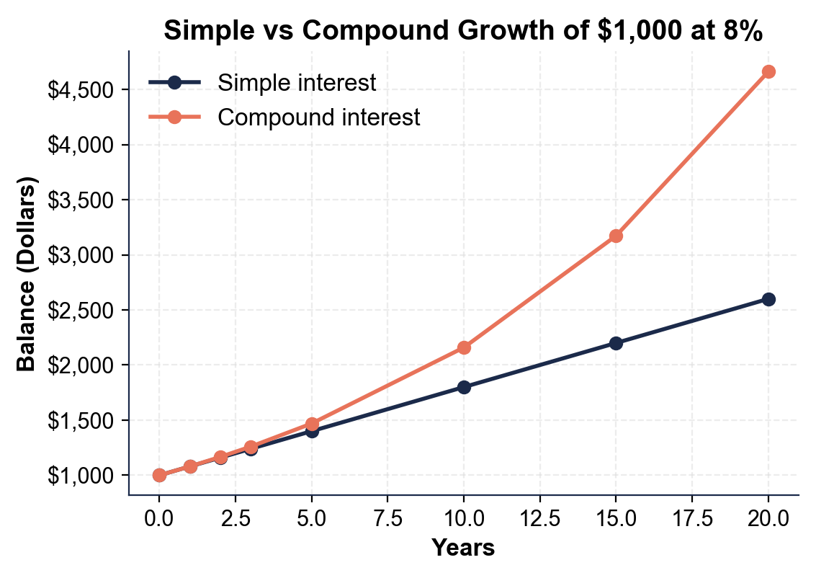
Simple vs Compound Growth of $1,000 at 8%
Same $1,000 at 8%: simple stays straight, compound curves up and away.
© More Lessons Less Planning | morelessonslessplanning.com
Notes:
Have students read the two-line chart. The x-axis is years (0 to 20) and the y-axis is the balance in dollars, both for the same $1,000 at 8%. The straight, lower line is SIMPLE interest: it rises by the same $80 every year and reaches $2,600 at year 20. The curved, upper line is COMPOUND interest: it starts right on top of the simple line, then curves UP and away as it earns interest on interest, reaching $4,660.96 at year 20. The picture makes the lesson obvious: same starting money, same rate, but the compound line bends upward while the simple line stays straight - and the space between the two lines is the interest on interest. The longer the time, the wider that gap. This is the chart Activity Part 3 reads.
Reference labels (point to these chart features when teaching): Simple (straight): $2,600; Compound (curves up): $4,661

Slide 8
Interest on Loans vs Savings
Compound AGAINST You (Debt)
Compound FOR You (Savings)
On a loan or credit card, YOU pay the interest to the lender
Unpaid balances compound, so the amount you owe grows on its own
A credit-card balance left unpaid can compound monthly (n = 12)
Compounding debt is why a small balance can balloon over time
In savings or investments, YOU earn the interest from the bank
Your balance compounds, so your money grows on its own
The earlier you start, the more years compounding has to work
Compounding savings is why starting young beats starting rich
Key Concept: The SAME compounding that grows your savings also grows your debt - it earns money for savers but costs money for borrowers.
© More Lessons Less Planning | morelessonslessplanning.com
Notes:
Show students that compound interest is the same math whether it is helping or hurting - the only difference is which side you are on. On the debt side, when you take a loan or carry a credit-card balance, YOU pay the interest to the lender. Unpaid balances compound, so the amount you owe grows on its own even if you buy nothing new - and a credit card often compounds monthly (n = 12), faster than once a year. That is why a small balance left unpaid can balloon over time. On the savings side, when you put money in a savings account or an investment, YOU earn the interest from the bank. Your balance compounds, so your money grows on its own - and the earlier you start, the more years compounding has to work, which is why starting young with small amounts often beats starting later with more. The takeaway students must leave with: the exact same compounding that makes Priya's savings curve upward is what makes credit-card debt spiral - it earns money for savers but costs money for borrowers.

Slide 9
The Rule of 72 Preview
A shortcut for doubling time
The RULE OF 72 estimates how many years it takes money to double: years to double is about 72 divided by the interest rate percent
✔
At 8%, money doubles in about 9 years
72 / 8 = 9, so Priya's compound account roughly doubles in 9 years - and her real compound balance does cross $2,000 near year 9
✔
A higher rate doubles faster
At 6%: 72 / 6 = 12 years; at 9%: 72 / 9 = 8 years; at 12%: 72 / 12 = 6 years - the higher the rate, the shorter the doubling time
✔
It works because of compounding
The Rule of 72 is a quick estimate for COMPOUND interest; simple interest takes longer to double because it never earns interest on interest
✔
Key Concept: The RULE OF 72 estimates doubling time - years to double is about 72 / rate%; at 8%, money about doubles in 9 years.
© More Lessons Less Planning | morelessonslessplanning.com
Notes:
Give students a mental shortcut they will use for the rest of the unit. The RULE OF 72 estimates how long it takes money to double at a given rate: years to double is about 72 divided by the interest rate as a percent. For Priya's 8% compound account, 72 / 8 = 9, so her money roughly doubles in 9 years - and the real compound balance does cross $2,000 (double the $1,000 principal) right around year 9, which shows the rule works. The rule also shows that a higher rate doubles money faster: at 6% it takes about 12 years (72 / 6), at 9% about 8 years (72 / 9), and at 12% about 6 years (72 / 12). Why 72? It is a quick estimate that works because of COMPOUNDING - it assumes you keep earning interest on interest. Simple interest takes longer to double because it never compounds; to double $1,000 with simple interest at 8% you would need to add $80 a year for 12.5 years. The Rule of 72 is a fast way to see the power of compounding without a calculator, and it is previewed here because students meet it again in the saving and investing unit.

Slide 10
Calculate Simple vs Compound
Steps to Calculate
Worked: $2,000 at 6% for 4 years
SIMPLE: change the rate to a decimal, then I = P x r x t, then add to P
COMPOUND (once a year): take the rate on the balance, add it, repeat each year
Always turn the percent into a decimal first (8% = 0.08)
Compare the two balances to see the interest on interest
SIMPLE: I = $2,000 x 0.06 x 4 = $480, total = $2,480
COMPOUND: $2,000(1.06)^4 = $2,524.95, interest = $524.95
Compound earns $44.95 more than simple over the same 4 years
Same principal, same rate - compounding made the difference
Key Concept: To compare, calculate simple with I = P x r x t and compound year by year; over $2,000 at 6% for 4 years, compound earns $44.95 more.
© More Lessons Less Planning | morelessonslessplanning.com
Notes:
Pull the whole lesson together with a clean worked comparison students will repeat in the Activity. Lay out the steps. For SIMPLE interest: change the rate to a decimal, use I = P x r x t, then add the interest to the principal. For COMPOUND interest once a year: take the rate on the current balance, add it, and repeat for each year; or use A = P(1 + r)^t directly. The step everyone forgets: turn the percent into a decimal first (8% = 0.08, 6% = 0.06). Now work a fresh example - $2,000 at 6% for 4 years. SIMPLE: I = $2,000 x 0.06 x 4 = $480, so the total is $2,480. COMPOUND: $2,000 x (1.06) to the 4th power = $2,524.95, so the interest is $524.95. Compare them: compound earned $524.95 vs simple's $480 - that is $44.95 more, from the same principal and the same 6% rate, just because compound earns interest on interest. This is exactly the calculate-and-compare students do for Priya in Part 4.

Slide 11
Key Takeaways
SIMPLE interest (I = P x r x t) is figured on the principal only
★
COMPOUND interest (A = P(1 + r/n)^(nt)) earns interest on interest
★
Same $1,000 at 8% reaches $2,600 simple but $4,660.96 compound at year 20
★
Compounding works FOR you on savings but AGAINST you on debt like credit cards
★
RULE OF 72: years to double is about 72 / rate% (at 8%, about 9 years)
★
© More Lessons Less Planning | morelessonslessplanning.com
Notes:
Read each takeaway and connect it to the learning targets. T1/T2 (define and calculate) -> SIMPLE interest uses I = P x r x t on the principal only and adds the same amount every year, while COMPOUND interest uses A = P(1 + r/n)^(nt) on the principal plus past interest and earns interest on interest. T3 (calculate compound) -> compound grows faster and the gap widens with time, so the same $1,000 at 8% reaches $2,600 under simple but $4,660.96 under compound by year 20. T4 (explain and Rule of 72) -> compounding is a double-edged sword that works FOR you on savings and investments but AGAINST you on debt like credit cards, and the RULE OF 72 (years to double is about 72 / rate%) estimates how fast money doubles - about 9 years at 8%. The spine of the lesson: the same rate figured two different ways gives very different results, and over time compound interest is the most powerful force in personal finance. As the second toolkit of Unit 5, this lesson sets up the rest of the loans-and-debt work and the saving-and-investing unit ahead.

