Slide 1
Indian Mathematics and the Invention of Zero
How Indian mathematicians turned zero into a number and built the place-value decimal system the whole world now uses - and why even a breakthrough thinker got one rule wrong.
© More Lessons Less Planning | morelessonslessplanning.com
Notes:
Opening slide. In classical India, mathematicians did something no one had fully done before: they treated zero as a true number you can calculate with, and they refined the place-value decimal system that lets any number be written with just ten digits. In 628 CE Brahmagupta wrote the first known rules for zero and negative numbers. Students will learn these real breakthroughs AND practice historical honesty - some of Brahmagupta's rules (dividing by zero) were later shown to be wrong, and the story of how zero 'spread' is more tangled than a single invention date.

Slide 2
Learning Targets
Explain the difference between zero as a placeholder and zero as a true number.
★
Describe the decimal place-value system and its ten digits, 0 through 9.
★
Explain Brahmagupta's rules for zero - and the one modern math shows is wrong.
★
Trace how Indian numerals spread to Europe as 'Arabic numerals.'
★
© More Lessons Less Planning | morelessonslessplanning.com
Notes:
Read the four learning targets. Today combines an impressive story - how a symbol for 'nothing' became one of the most powerful ideas in mathematics - with a history skill: reading evidence carefully, including a primary source in which a brilliant mathematician states a rule we now know is wrong.

Slide 3
Numbers Before Zero
Place value
The idea that a digit's value depends on its position in a number, so the 2 in 205 means two hundred while the 2 in 25 means twenty.
Roman numerals
An older number system (I, V, X, L, C) with no symbol for nothing and no place value, which made large numbers and arithmetic clumsy.
Key Concept: In a PLACE VALUE system a digit's worth depends on its position; ROMAN NUMERALS had no symbol for nothing and no place value.
© More Lessons Less Planning | morelessonslessplanning.com
Notes:
To see why zero mattered, picture numbers WITHOUT it. In a PLACE VALUE system, the value of a digit depends on its position in the number: the 2 in 205 means two hundred, while the 2 in 25 means twenty. Older systems such as ROMAN NUMERALS (I, V, X, L, C) had no symbol for nothing and no place value, so large numbers were clumsy to write and very hard to calculate with. Try multiplying two Roman numerals and you feel the problem instantly. A number system needs a way to show an empty position - and, even more powerfully, a number for 'nothing.'

Slide 4
The Decimal System
Decimal system
The base-10 number system that writes any number using place value and just ten digits, 0 through 9; developed in India and now used worldwide.
Ten digits
The decimal system needs only ten symbols - 0, 1, 2, 3, 4, 5, 6, 7, 8, 9 - to write any number, no matter how large.
Key Concept: The DECIMAL SYSTEM writes any number using place value and just TEN digits (0 through 9), and it was developed in India.
© More Lessons Less Planning | morelessonslessplanning.com
Notes:
Indian mathematicians refined the DECIMAL SYSTEM - the base-10 system that writes any number using place value and just ten digits, 0 through 9. This is the same basic system almost the whole world uses today. Its power is efficiency: you need only TEN symbols to write any number, no matter how large, because each position stands for a power of ten (ones, tens, hundreds, thousands). Zero is the key that makes it work, because it marks an empty position and keeps every other digit in its correct place. This elegant system, developed in India, later spread across the world.

Slide 5
Placeholder or Number? Two Jobs for Zero
Zero as a placeholder
Zero as a number (India's leap)
A placeholder holds an empty position, like the 0 in 205.
Babylonians and the Maya used placeholder marks.
It keeps the other digits in their correct place value.
India treated zero as a true number, not just a gap.
You can add, subtract, and multiply with zero.
This is a separate milestone from the placeholder.
Key Concept: A PLACEHOLDER holds an empty position (the 0 in 205); India's great leap was treating ZERO as a true NUMBER you can compute with.
© More Lessons Less Planning | morelessonslessplanning.com
Notes:
Zero does two different jobs, and telling them apart is the heart of this lesson. First, a PLACEHOLDER is a symbol that holds an empty position in a number, like the 0 in 205, so the other digits keep their correct place value. Earlier peoples - the Babylonians and the Maya - already used placeholder marks. But India's great leap was different: Indian mathematicians treated ZERO as a true NUMBER, not just an empty gap - a quantity you can add, subtract, and multiply. Zero as a placeholder and zero as a number are two separate milestones. Many cultures reached the first; treating zero as a number was India's distinct contribution.

Slide 6
Brahmagupta Makes Zero a Number
Brahmagupta
The Indian mathematician who, in 628 CE, wrote the first known rules for calculating with zero and with negative numbers.
Brahmasphutasiddhanta
Brahmagupta's 628 CE book on astronomy and mathematics, in which he first treated zero as a number with its own arithmetic rules.
Key Concept: In 628 CE BRAHMAGUPTA, in his book the BRAHMASPHUTASIDDHANTA, wrote the first known rules for calculating with ZERO as a number.
© More Lessons Less Planning | morelessonslessplanning.com
Notes:
The person who turned zero into a number with rules was BRAHMAGUPTA, an Indian mathematician and astronomer. In 628 CE he wrote the first known rules for doing arithmetic with zero and with negative numbers. He set them out in his book the BRAHMASPHUTASIDDHANTA, a work on astronomy and mathematics, where he treated ZERO as a number with its own arithmetic rules: a number plus or minus zero is unchanged, and a number multiplied by zero is zero. For the first time, 'nothing' had a place in calculation. This was a genuine turning point in the history of mathematics.

Slide 7
His Rules - and One He Got Wrong
Rules that still work
Right: a number plus or minus zero is unchanged, and a number times zero is zero.
✔
Negative numbers too
He also wrote rules for negative numbers - numbers less than zero, pictured as debts.
✔
The rule he got wrong
Wrong: his rules for dividing by zero. In modern math, division by zero is undefined.
✔
Key Concept: Brahmagupta's rules for zero and NEGATIVE NUMBERS were a breakthrough, but his rule for DIVIDING by zero was wrong.
© More Lessons Less Planning | morelessonslessplanning.com
Notes:
Being first does not mean being perfect, and that makes the story more interesting. Brahmagupta got many rules right: a number plus or minus zero is unchanged, and a number multiplied by zero is zero. He also wrote rules for NEGATIVE NUMBERS - numbers less than zero, which he pictured as debts. But his rules for DIVIDING by zero were wrong. He claimed, for example, that zero divided by zero is zero; in modern mathematics, division by zero is undefined. This was such a hard problem that Bhaskara II, another great Indian mathematician about 500 years later, revisited it and still could not fully solve it. The honest lesson: a thinker can be a pioneer AND make a mistake.

Slide 8
The Bakhshali Manuscript
Bakhshali manuscript
An ancient Indian mathematical text, written on birch bark, that contains one of the oldest recorded uses of a zero symbol.
✔
Zero as a dot
In it, zero is written as a small solid dot used to mark an empty place in a number.
✔
A debated date
Its exact date is debated: a 2017 carbon-dating of some pages to the 3rd-4th century CE is disputed, and many scholars date the text later.
✔
Key Concept: The BAKHSHALI MANUSCRIPT holds one of the oldest recorded uses of a zero symbol - a DOT - though its exact DATE is debated.
© More Lessons Less Planning | morelessonslessplanning.com
Notes:
One of the oldest physical traces of zero comes from the BAKHSHALI MANUSCRIPT, an ancient Indian mathematical text written on birch bark and found in 1881. It contains one of the oldest recorded uses of a zero symbol, written as a small solid DOT that marks an empty place in a number. But historians must be careful about its DATE. In 2017 the Bodleian Library carbon-dated some of its pages to the 3rd-4th century CE, but that early date is disputed, and many scholars argue the manuscript is later (roughly the 8th-12th century). So we can say it holds one of the oldest recorded zero symbols without claiming a single settled date. The next slide shows a page of the manuscript.

Slide 9
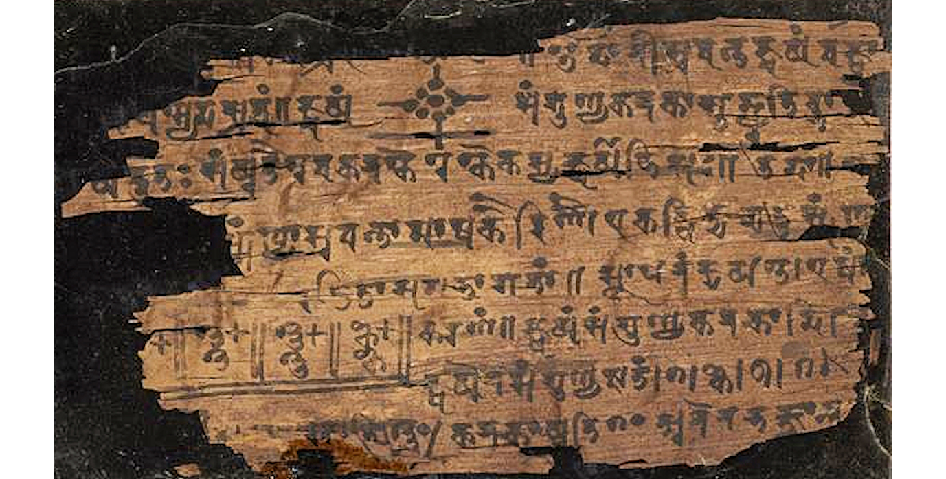
A Page of the Bakhshali Manuscript
Folios of the Bakhshali manuscript, an ancient Indian birch-bark text.
© More Lessons Less Planning | morelessonslessplanning.com
Notes:
Public-domain photograph of folios of the Bakhshali manuscript (Bodleian Library). Point out the fragile birch-bark pages and the handwritten Indian numerals; explain that within this text zero appears as a small dot. Use it purely as a reference visual for the ancient manuscript taught on the previous slide - students are not asked to read or analyze the writing.
Reference labels (point to these chart features when teaching): Birch-bark folios; Handwritten numerals

Slide 10
From India to the World
How the numerals traveled
A misleading name
Indian numerals and the decimal system spread west.
The Persian mathematician al-Khwarizmi wrote books using them.
Fibonacci helped popularize them in Europe in the 1200s.
In Europe the digits became known as 'Arabic numerals.'
But they were really invented in India.
The name credits the messengers, not the inventors.
Key Concept: Indian numerals spread through the Islamic world (AL-KHWARIZMI) to Europe, where they are wrongly called ARABIC NUMERALS.
© More Lessons Less Planning | morelessonslessplanning.com
Notes:
Great ideas travel. Indian numerals and the decimal system spread west into the Islamic world, where the Persian mathematician AL-KHWARIZMI wrote influential books using them around 820 CE - his name is also the root of the word 'algorithm.' From there the digits reached Europe, helped along by the Italian mathematician FIBONACCI in the 1200s. In Europe they became known as ARABIC NUMERALS, because Europeans learned them from Arabic-speaking scholars - even though they were really invented in India. The name credits the messengers who carried the idea, not the mathematicians who created it. Today these digits, 0 through 9, are used almost everywhere on Earth.

Slide 11
Why Zero Changed Everything
Zero unlocked algebra
Treating zero as a number made possible algebra, the branch of math that uses symbols and equations to solve for unknowns.
✔
The world's number system
The decimal system and zero became the number system used almost everywhere on Earth.
✔
The base of modern life
Today zero and the decimal system are the foundation of computers, science, banking, and everyday math.
✔
Key Concept: By making zero a number, Indian mathematicians unlocked ALGEBRA and the DECIMAL SYSTEM that powers modern science and computers.
© More Lessons Less Planning | morelessonslessplanning.com
Notes:
Why does a symbol for 'nothing' matter so much? Because treating zero as a number made possible ALGEBRA - the branch of mathematics that uses symbols and equations to solve for unknowns - and far more advanced math beyond it. The DECIMAL SYSTEM and zero became the number system used almost everywhere on Earth. Today zero and the decimal system are the quiet foundation of computers (which run on the digits 0 and 1), science, banking, and the everyday math students do without thinking. A single idea from classical India still shapes daily life across the whole world.

Slide 12
Key Takeaways
India's leap was treating zero as a true number, not just a placeholder mark.
★
The decimal system writes any number with place value and just ten digits, 0-9.
★
Brahmagupta (628 CE) wrote the first rules for zero - but got division wrong.
★
Indian numerals spread to Europe as 'Arabic numerals' and now power modern math.
★
© More Lessons Less Planning | morelessonslessplanning.com
Notes:
Recap the four takeaways. The big ideas: many cultures used a placeholder, but India treated zero as a true number; the decimal place-value system needs only ten digits; Brahmagupta wrote the first rules for zero and negative numbers in 628 CE, yet his division-by-zero rules were wrong; and these Indian numerals spread through the Islamic world to Europe, where they are mislabeled 'Arabic numerals,' and now underpin modern mathematics and technology.

