Slide 1
Impulse Buying: How Stores Trick You
The fifth lesson of Unit 10 - spot the tactics stores use to trigger unplanned buys, and keep that money.
© More Lessons Less Planning | morelessonslessplanning.com
Notes:
This is the fifth lesson of Unit 10 (Smart Consumer & Financial Safety). Stores are designed on purpose to get you to spend more than you planned: the candy by the register, the giant display at the end of the aisle, the 'sale ends tonight' sign, the one-tap buy button online. Each little unplanned buy feels harmless, but together they can add up to well over a thousand dollars a year. This lesson teaches students what an impulse buy is, the marketing tactics and store psychology behind it, how to calculate their impulse spending (actual minus planned), and how to beat the tricks with a shopping plan and the 24-hour rule. Everything is worked through the coach Renata Ellis, a consumer psychologist and smart-shopping coach, and the recurring case of Diego, a student who keeps going over plan when he shops. By the end, students can spot the tricks and keep the money.

Slide 2
Learning Targets
Explain what an impulse buy is and how it differs from a planned purchase
★
Identify the marketing tactics and store psychology that trigger impulse buys
★
Calculate impulse spending (actual minus planned) and how it adds up in a year
★
Use the 24-hour rule and a shopping plan to resist impulse buys
★
© More Lessons Less Planning | morelessonslessplanning.com
Notes:
Read the four targets and connect them to the arc of the lesson. Target 1 is the foundation: know what an impulse buy is and how it differs from a purchase you planned. Target 2 is the core content: identify the marketing tactics and store psychology - endcaps, checkout-lane placement, scarcity, one-click buying, loss leaders, sensory cues - that stores use to trigger impulse buys. Target 3 is the math skill: calculate impulse spending by subtracting what you planned to spend from what you actually spent, and see how a month of impulse buys becomes a big yearly number. Target 4 is the payoff skill: use the 24-hour rule and a shopping plan to resist impulse buys and keep the money. By the end, students can spot the tricks and beat them.

Slide 3
How Stores Trick You
Impulse buy
An IMPULSE BUY is an unplanned purchase you make on the spot without thinking it through
Marketing tactic
A MARKETING TACTIC is a method a store uses to influence what and how much you buy
Planned vs. unplanned
A planned purchase is on your list; an impulse buy is the one that jumps into your cart at the last second
It is on purpose
Stores design their layout, displays, and prices as marketing tactics to trigger impulse buys
Key Concept: An IMPULSE BUY is an unplanned purchase - and stores use MARKETING TACTICS on purpose to trigger them.
© More Lessons Less Planning | morelessonslessplanning.com
Notes:
Frame the whole lesson. An IMPULSE BUY is an unplanned purchase you make on the spot without thinking it through - the candy bar you grab at the register, the gadget you did not know you wanted until you saw it. Contrast it with a planned purchase: something on your list that you decided to buy before you walked in. The reason impulse buys happen so often is that stores make them happen. A MARKETING TACTIC is a method a store uses to influence what and how much you buy - and stores design their whole layout, their displays, their signs, and their prices as marketing tactics to trigger impulse buys. This is not an accident; it is the store's job. Introduce the running case: Diego walks into a store planning to spend $150 this month, but the tricks keep talking him into buys he did not plan. Over the lesson, students help Renata Ellis show Diego how the tricks work. Key terms - Impulse buy: an unplanned purchase you make on the spot. Marketing tactic: a method a store uses to influence what and how much you buy.

Slide 4
Store Layout and Psychology
Endcap
An ENDCAP is a display at the end of a store aisle used to grab attention and drive sales
✔
Checkout-lane placement
CHECKOUT-LANE PLACEMENT is small, cheap items placed by the register to trigger last-second impulse buys
✔
Loss leader
A LOSS LEADER is an item priced very low to pull you into the store, where you buy more
✔
Sensory cue
A SENSORY CUE is music, lighting, or scent a store uses to put you in a buying mood
✔
Key Concept: ENDCAPS, CHECKOUT-LANE PLACEMENT, LOSS LEADERS, and SENSORY CUES are store tactics built to trigger impulse buys.
© More Lessons Less Planning | morelessonslessplanning.com
Notes:
Teach the store tactics students will see every time they shop. First, the ENDCAP: a display at the end of a store aisle used to grab attention and drive sales - the big stack of chips or soda at the end of the row that you never planned to buy. Second, CHECKOUT-LANE PLACEMENT: small, cheap items placed by the register - candy, gum, drinks, phone chargers - placed there to trigger last-second impulse buys while you wait in line. Third, the LOSS LEADER: an item priced very low, sometimes below cost, to pull you into the store, where you end up buying more full-price things. Fourth, the SENSORY CUE: music, lighting, or scent a store uses to put you in a buying mood - slow music that makes you linger, warm lighting, the smell of fresh bread near the door. Name the pattern: none of this is random. Every one of these is a marketing tactic designed to turn a quick trip into a bigger cart. Tie it to the case: Diego grabs a soda from the endcap and a candy bar at the register - two impulse buys the store set up for him. Key terms - Endcap: a display at the end of an aisle. Checkout-lane placement: cheap items by the register. Loss leader: a very low price to pull you in. Sensory cue: music, lighting, or scent that puts you in a buying mood.

Slide 5
Limited-Time Pressure
Scarcity
SCARCITY is the feeling that something is running out that pressures you to buy right now
The signs that create it
'Limited time,' 'only 2 left,' 'sale ends tonight,' and countdown timers are all scarcity tactics
Why it works
Scarcity makes you afraid of missing out, so you buy now instead of taking time to think
Slow it down
A real deal is still there tomorrow - if a sign says buy now, that pressure is the tactic
Key Concept: SCARCITY - 'limited time,' 'only 2 left' - pressures you to buy now instead of taking time to think.
© More Lessons Less Planning | morelessonslessplanning.com
Notes:
Teach one of the most powerful tactics: scarcity. SCARCITY is the feeling that something is running out that pressures you to buy right now. Stores create it with signs and language students see constantly: 'limited time,' 'only 2 left,' 'sale ends tonight,' flash sales, and countdown timers on websites. Explain why it works: scarcity makes you afraid of missing out (FOMO), so you buy now instead of taking time to think about whether you actually want it - and 'now' is exactly when you are most likely to make an impulse buy. Give students the counter-move: a real deal is almost always still there tomorrow, and if a sign is pushing you to buy this second, that pressure IS the tactic. When you feel rushed, that is your signal to slow down. Tie it to the case: Diego sees a 'today only' sale on a $35 jacket he did not plan to buy and feels the pressure to grab it before it is gone. Key term - Scarcity: the feeling that something is running out that pressures you to buy right now.

Slide 6
Online One-Click Traps
One-click buying
ONE-CLICK BUYING is online checkout so fast it removes the pause that lets you reconsider
✔
Saved cards and addresses
When your card and address are saved, buying takes one tap - there is no moment to change your mind
✔
'Customers also bought'
Suggested add-ons and 'customers also bought' rows push extra impulse buys into your cart
✔
Add friction back
Do not save your card, leave items in the cart overnight, and the pause helps you reconsider
✔
Key Concept: ONE-CLICK BUYING removes the pause that lets you reconsider - add the pause back to beat online impulse buys.
© More Lessons Less Planning | morelessonslessplanning.com
Notes:
Teach how impulse buying works online, where it is even easier. ONE-CLICK BUYING is online checkout so fast it removes the pause that lets you reconsider - one tap and it is bought and shipped. The reason it is so dangerous is speed: when your card, address, and login are all saved, buying takes a single tap, so there is no moment between wanting something and owning it - and that moment is exactly when you would normally stop yourself. Add the second online tactic: suggested add-ons and 'customers also bought' rows are designed to push extra impulse buys into your cart right as you check out. Give students the fix: add friction back. Do not save your card so you have to type it in, leave items in your cart overnight, and use that pause to reconsider - most of the time you will find you did not really want it. Tie it to the case: Diego adds a $45 gadget with one tap because a 'customers also bought' row suggested it, a buy he never planned. Key term - One-click buying: online checkout so fast it removes the pause that lets you reconsider.

Slide 7
Impulse Spending Adds Up
Impulse spending
IMPULSE SPENDING is the money you spend on unplanned purchases
The formula
IMPULSE SPENDING = ACTUAL SPENDING - PLANNED SPENDING
Diego's month
Diego planned to spend $150 but actually spent $290, so his impulse spending was $290 - $150 = $140
Nearly half
That $140 is nearly half of what Diego spent - money the store tricks talked him into
Key Concept: IMPULSE SPENDING = ACTUAL SPENDING - PLANNED SPENDING. Diego planned $150, spent $290, so $140 was impulse.
© More Lessons Less Planning | morelessonslessplanning.com
Notes:
This is the core math idea of the lesson: put a number on the tricks. IMPULSE SPENDING is the money you spend on unplanned purchases. Put the labeled formula on the board: IMPULSE SPENDING = ACTUAL SPENDING - PLANNED SPENDING. Work the case: Diego planned to spend $150 this month, but when he added up his receipts he had actually spent $290. His impulse spending was 290 - 150 = $140 - the money the store tricks talked him into. Make the size real: that $140 is nearly half of everything Diego spent this month, and it went to buys that were not on his plan. The next slide breaks Diego's month into five categories so students can see exactly where the impulse money went - what he planned versus what he spent on impulse in each one; Activity Part 4 reads that chart. Key term - Impulse spending: the money you spend on unplanned purchases (actual spending minus planned spending).

Slide 8
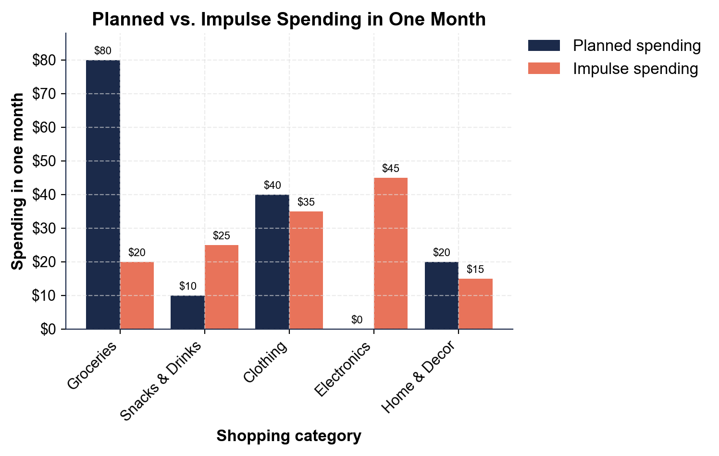
Planned vs. Impulse Spending in One Month
Diego planned $150, but impulse buys added $140 more across five categories.
© More Lessons Less Planning | morelessonslessplanning.com
Notes:
Give students a moment to read the paired bars before discussing. The grouped bar chart shows Diego's Planned versus Impulse spending in one month across five categories. For each category there is a navy PLANNED bar and a coral IMPULSE bar: Groceries planned $80 / impulse $20; Snacks & Drinks planned $10 / impulse $25; Clothing planned $40 / impulse $35; Electronics planned $0 / impulse $45; Home & Decor planned $20 / impulse $15. Work the takeaways live. Electronics is the biggest impulse bar at $45 - and notice he planned to spend $0 there, so it is entirely unplanned (that one-click gadget). Home & Decor is the smallest impulse bar at $15. The difference between the biggest and smallest impulse is 45 - 15 = $30. Point out the pattern: in Snacks & Drinks, his impulse ($25) is more than double what he planned ($10) - checkout-lane placement at work. Then reveal the totals: his planned bars add up to $150, his impulse bars add up to $140, so he actually spent $290. That $140 a month in impulse buys is $1,680 a year. This is the chart Activity Part 4 reads. These are realistic, illustrative teaching amounts, not any one real shopper's budget.
Reference labels (point to these chart features when teaching): Impulse total: $140/mo; Electronics impulse: $45

Slide 9
The 24-Hour Rule
24-hour rule
The 24-HOUR RULE is waiting a day before a non-essential purchase to see if you still want it
✔
Why a day works
The urge to impulse buy fades fast, so if you still want it tomorrow it is probably a real want
✔
Beats scarcity
Waiting a day beats scarcity pressure - a real deal is still there, and most urges are gone by then
✔
Use it online too
Leave the item in your cart overnight instead of using one-click, then decide in the morning
✔
Key Concept: The 24-HOUR RULE - wait a day before a non-essential buy. If you still want it tomorrow, it is a real want.
© More Lessons Less Planning | morelessonslessplanning.com
Notes:
Teach the single most useful habit for beating impulse buys. The 24-HOUR RULE is waiting a day before a non-essential purchase to see if you still want it. Explain why a day is enough: the urge to impulse buy is strong but fades fast, so if you still want the item tomorrow, it is probably a real want and not just the store's trick working on you. Point out how it beats the tactics from earlier slides: the 24-hour rule beats scarcity pressure, because a real deal is almost always still there the next day and most of the urge is gone by then. And it works online too - instead of using one-click buying, leave the item in your cart overnight and decide in the morning. This one rule neutralizes the endcap grab, the checkout candy, the 'sale ends tonight' sign, and the one-tap add-on all at once, because every one of those depends on you buying NOW. Tie it to the case: if Diego waits a day on the $35 'today only' jacket, he realizes he did not really want it - and keeps the $35. Key term - 24-hour rule: waiting a day before a non-essential purchase to see if you still want it.

Slide 10
Make a Plan and Beat the Tricks
Monthly impulse total
MONTHLY IMPULSE TOTAL = the sum of every category's impulse spending - Diego's was $140
Annual impulse
ANNUAL IMPULSE = monthly impulse total x 12, so Diego's $140 a month is $1,680 a year
A plan is the fix
A shopping list and a budget turn 'buy now' into 'is this on my plan?' - and cut the impulse total
Cutting it in half
The 24-hour rule can cut impulse buys in half - saving Diego $70 a month, $840 a year
Key Concept: MONTHLY IMPULSE TOTAL x 12 = your yearly impulse. Diego's $140 a month is $1,680 a year - a plan cuts it.
© More Lessons Less Planning | morelessonslessplanning.com
Notes:
Bring the whole lesson together with the second labeled model and the fix. MONTHLY IMPULSE TOTAL = the sum of every category's impulse spending; add up Diego's five impulse bars ($20 + $25 + $35 + $45 + $15) and you get $140 for the month. Then annualize it: ANNUAL IMPULSE = monthly impulse total x 12, so Diego's $140 a month is 140 x 12 = $1,680 a year going to buys he never planned. Make the point land: the tricks are not tiny - that is nearly $1,700 a year the store talked out of him. Then teach the fix so students leave with a tool, not just a warning. A plan is the fix: a shopping list and a budget turn every 'buy now' moment into a simple question - 'is this on my plan?' - and if it is not, you skip it. Add the 24-hour rule on top: it can cut impulse buys roughly in half, saving Diego about $70 a month, which is $840 a year. Frame it as a raise: the money you do not spend on tricks is money you keep. This is exactly what students calculate and plan in Activity Parts 4 and 5. Key model - Monthly impulse total: the sum of every category's impulse spending (times 12 for the year).

Slide 11
Scenario: Resist an Impulse Buy
Name the tactic
For any shopping moment, name the store tactic in play - endcap, checkout lane, scarcity, one-click
✔
Do the math
Find the impulse spending - what you would spend minus what you planned - and what it is in a year
✔
Use the rule
Apply the 24-hour rule and your shopping plan: is this on my plan, and will I still want it tomorrow?
✔
Keep the money
Decide plan or skip - the money you do not spend on the tricks stays in your pocket
✔
Key Concept: Name the tactic, do the impulse math, use the 24-hour rule and your plan, and keep the money.
© More Lessons Less Planning | morelessonslessplanning.com
Notes:
Set up the Activity capstone: helping Diego resist impulse buys. Teach the repeatable move students will use: for any shopping moment, first name the store tactic in play - is this an endcap, checkout-lane placement, scarcity, a loss leader, or one-click buying? Second, do the math: find the impulse spending (what you would spend minus what you planned) and, when it repeats, what that is in a year. Third, use the rule: apply the 24-hour rule and your shopping plan by asking two questions - 'is this on my plan?' and 'will I still want it tomorrow?' Fourth, decide plan or skip, and keep the money you would have spent on the trick. Tell students the Activity ends with taking Diego's shopping situations, naming the tactic behind each one, calculating his impulse spending, deciding resist or allow for each, and writing a beat-the-tricks action plan a real person could follow. Everything they need is on the slides, in their Guided Notes, and on the planned-vs-impulse chart.

Slide 12
Key Takeaways
An IMPULSE BUY is unplanned - stores use MARKETING TACTICS to trigger it
★
ENDCAPS, checkout lanes, SCARCITY, and ONE-CLICK buying make you buy now
★
IMPULSE SPENDING = ACTUAL - PLANNED - Diego's was $140 a month, $1,680 a year
★
The 24-HOUR RULE beats the tricks - wait a day and the urge usually fades
★
A shopping plan turns 'buy now' into 'is this on my plan?' - and keeps the money
★
© More Lessons Less Planning | morelessonslessplanning.com
Notes:
Read each takeaway and connect it back to the learning targets. T1 (the foundation) -> an impulse buy is an unplanned purchase, and stores use marketing tactics on purpose to trigger them. T2 (the tactics) -> endcaps, checkout-lane placement, scarcity, loss leaders, sensory cues, and one-click buying are all tricks designed to make you buy right now. T3 (the math) -> impulse spending = actual spending - planned spending, and Diego's $140 a month adds up to $1,680 a year. T4 (the habit) -> the 24-hour rule beats the tricks, because if you still want something tomorrow it is a real want, not just the store's pressure working. T5 (the plan) -> a shopping list and budget turn every 'buy now' moment into 'is this on my plan?' and keep the money in your pocket. Close by returning to the case: students can now show Diego exactly how the tricks work, calculate what they cost him, and give him the tools to keep the money - which they practice in the Activity.

