Slide 1
Ice Age Cave Art
Read the painted walls of Ice Age caves to discover what early humans hunted, how they lived, and what they may have believed.
© More Lessons Less Planning | morelessonslessplanning.com
Notes:
Opening slide. Tens of thousands of years ago, during the Ice Age, early humans painted and engraved animals deep inside caves across Europe. These paintings are some of the oldest art in the world, and they are a window into how Ice Age people lived and what they believed.

Slide 2
Learning Targets
Describe Ice Age cave art and how it was made.
★
Explain what cave art reveals about daily life and hunting.
★
Analyze what the art suggests about belief and ritual.
★
Use cave art as a primary source to reconstruct the past.
★
© More Lessons Less Planning | morelessonslessplanning.com
Notes:
Read the four learning targets. Today we describe cave art, then use it as evidence to infer how Ice Age people lived and what they may have believed.

Slide 3
What Is Cave Art?
Cave art
Paintings, drawings, and engravings that Ice Age people made on the walls of caves.
Ice Age
A long, cold period when much of Earth was covered in ice and early humans made cave art.
Paleolithic
The Old Stone Age, when humans used stone tools and made cave art.
Key Concept: CAVE ART is the paintings, drawings, and engravings Ice Age people made on cave walls during the PALEOLITHIC, or Old Stone Age.
© More Lessons Less Planning | morelessonslessplanning.com
Notes:
CAVE ART is the paintings, drawings, and engravings that Ice Age people made on the walls of caves. It was made during the ICE AGE, a long, cold period when much of Earth was covered in ice. This time is also called the PALEOLITHIC, or Old Stone Age, when humans used chipped stone tools. The oldest cave art is over 30,000 years old and is found in caves across Europe, especially in France and Spain.

Slide 4
Making the Paint
Ochre
A natural earth pigment, usually red or yellow, used to paint animals.
✔
Pigment
A colored material, such as ochre or charcoal, used to make paint.
✔
Charcoal
Burnt wood used to draw black lines and shade the figures.
✔
Key Concept: Ice Age artists ground OCHRE and charcoal into PIGMENT to paint and draw the animals.
© More Lessons Less Planning | morelessonslessplanning.com
Notes:
Ice Age artists made their own paint. OCHRE is a natural earth pigment, usually red or yellow, that they ground into powder. Charcoal, or burnt wood, gave them black. A PIGMENT is any colored material, such as ochre or charcoal, used to make paint. They mixed the powder with water, animal fat, or saliva, then applied it with fingers, a chewed twig or moss brush, or by blowing it through a hollow bone.

Slide 5
Painting and Engraving
Engraving
A figure carved or scratched into rock or bone instead of painted.
Hand stencil
A hand print made by pressing a hand on the wall and blowing pigment around it.
Key Concept: Besides painting, artists made ENGRAVINGS carved into rock and HAND STENCILS by blowing pigment around a hand.
© More Lessons Less Planning | morelessonslessplanning.com
Notes:
Cave artists did more than paint. An ENGRAVING is a figure carved or scratched into rock or bone instead of painted, often cut with a sharp flint tool. A HAND STENCIL is a print made by pressing a hand flat on the wall and blowing pigment around it, leaving the shape of the hand. Some engravings were also made on small pieces of bone and antler that people could carry.

Slide 6
What They Painted
Most cave art shows large animals: horses, bison, deer, aurochs, and mammoths.
These were the very animals Ice Age people hunted for food.
Very few humans appear; instead there are dots, lines, and other signs.
The next slide shows the famous painted bison of Altamira Cave in Spain.
Key Concept: Ice Age cave art mostly shows the large animals people hunted, painted with close, careful observation.
© More Lessons Less Planning | morelessonslessplanning.com
Notes:
Most Ice Age cave art shows large animals - horses, bison, deer, aurochs, and mammoths - the very animals people hunted for food. The animals are painted with surprising realism, showing that the artists watched them closely. Very few humans are ever shown. Instead, there are also dots, lines, and other abstract signs whose meaning is still debated. The next slide shows the famous painted bison of Altamira.

Slide 7
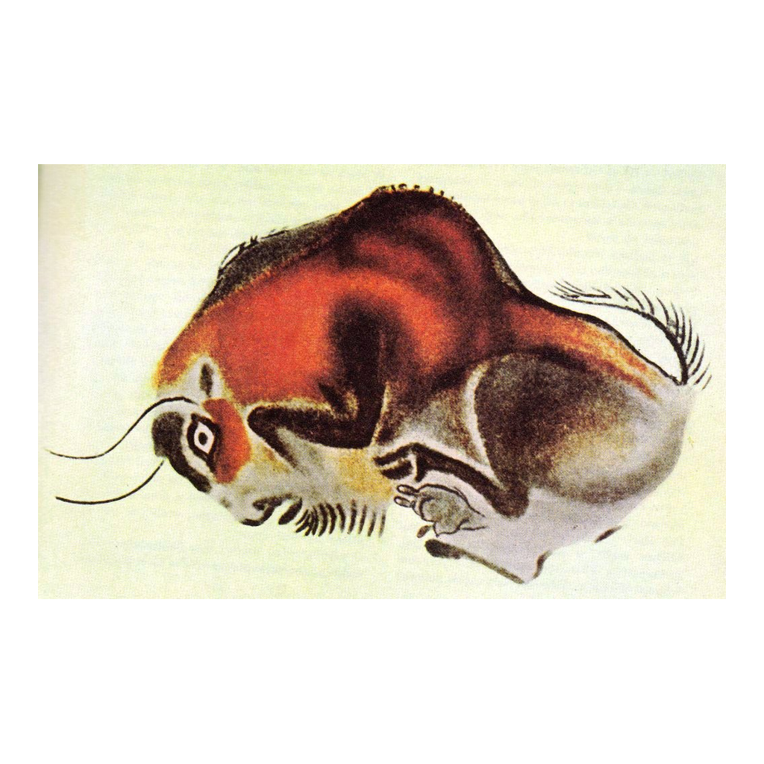
The Painted Bison of Altamira
A bison painted on the Altamira cave ceiling in red ochre and black pigment.
© More Lessons Less Planning | morelessonslessplanning.com
Notes:
Real public-domain photograph of a painted bison from the ceiling of the Cave of Altamira, Spain. Give students a quiet moment to observe the shape, color, and lifelike detail before discussing what it reveals about the artist's skill and observation.
Reference labels (point to these chart features when teaching): Painted bison; Red and black pigment

Slide 8
Why Did They Paint? Belief and Ritual
Sympathetic magic
The belief that making an image of an animal could give hunters power over the real animal.
Ritual and belief
Many painted caves are deep and dark, suggesting the art was made for ceremonies, not decoration.
Key Concept: Many historians think cave art was tied to belief - like SYMPATHETIC MAGIC to gain power over the animals people hunted.
© More Lessons Less Planning | morelessonslessplanning.com
Notes:
No one knows for certain why Ice Age people painted, but there are strong theories. One is SYMPATHETIC MAGIC - the belief that making an image of an animal could give hunters power over the real animal. Because many painted caves are deep and dark, far from where people lived, historians think the art was made for ceremonies or rituals, not just decoration. The paintings may have been used to teach, to tell stories, or to connect with a spirit world.

Slide 9
What Cave Art Reveals About Daily Life
The animals painted tell us what Ice Age people hunted and ate.
Careful, lifelike details show how closely they observed the natural world.
Painting deep inside dark caves required firelight, planning, and teamwork.
Cave art shows early humans could think in symbols and share ideas.
Key Concept: Cave art reveals Ice Age DAILY LIFE - what people hunted, how they observed nature, and how they worked together.
© More Lessons Less Planning | morelessonslessplanning.com
Notes:
Cave art is evidence about daily life. The animals painted tell us what Ice Age people hunted and ate. The careful, lifelike details show how closely they observed the natural world. Painting deep inside dark caves required firelight, planning, and teamwork - so the art also shows cooperation. Above all, cave art proves early humans could think in symbols and share ideas, a huge step in human development.

Slide 10
Studying Cave Art
Archaeologist
A scientist who studies the human past by digging up and analyzing physical remains.
✔
Primary source
A record or object from the time studied, like a cave painting or an eyewitness account.
✔
Key Concept: An ARCHAEOLOGIST studies cave art as a PRIMARY SOURCE - direct evidence made by Ice Age people themselves.
© More Lessons Less Planning | morelessonslessplanning.com
Notes:
An ARCHAEOLOGIST is a scientist who studies the human past by digging up and analyzing physical remains. Archaeologists date cave art by testing the charcoal used to draw it and by studying the layers of the cave floor. To a historian, a cave painting is a PRIMARY SOURCE - a record or object from the time being studied, made directly by Ice Age people themselves, not written down later by someone else.

Slide 11
Reconstructing Ice Age Life
The art itself
Cave paintings are a primary source made by Ice Age people.
Scientific study
Dating, excavation, and comparison add what the images alone cannot tell.
Key Concept: Historians reconstruct Ice Age life by combining the cave art itself with the archaeologist's scientific study.
© More Lessons Less Planning | morelessonslessplanning.com
Notes:
To reconstruct Ice Age life, historians combine two things. The first is the cave art itself, a PRIMARY SOURCE made by Ice Age people, which shows what they painted and hints at what they believed. The second is scientific study - dating, excavation, and comparison of many sites - which adds what the images alone cannot tell, such as their age. Neither alone is enough; together they give the fullest picture of Ice Age daily life and belief.

Slide 12
Key Takeaways
Ice Age people made cave art - painted and engraved animals - across Europe.
★
They made paint from ochre and charcoal and even blew hand stencils.
★
Cave art suggests belief and ritual, like sympathetic magic over hunted animals.
★
Archaeologists read cave art as a primary source to reconstruct daily life.
★
© More Lessons Less Planning | morelessonslessplanning.com
Notes:
Recap the four takeaways. The big skill: cave art is a primary source that, combined with scientific study, lets historians reconstruct what Ice Age people hunted, how they lived, and what they may have believed.

