Slide 1
Hyperinflation: Weimar, Zimbabwe, Venezuela
When governments print money to pay their bills, prices stop meaning anything
© More Lessons Less Planning | morelessonslessplanning.com
Notes:
Open with the visual hook. A 100 trillion Zimbabwean dollar note (printed January 2009) was worth about $5 U.S. when it was issued and worthless within weeks. A 1923 German worker carried wages home in a wheelbarrow because the value of paper marks fell faster than they could spend them. A 2018 Venezuelan grocery price tag changed twice a day. Three countries, three currencies, one pattern: government prints money to cover its bills, prices spiral past 50% per MONTH, and the currency dies. Today: what hyperinflation is, three classic cases, the one common cause, the human cost, and why the U.S. is unlikely to follow.

Slide 2
Learning Targets
Define hyperinflation (Cagan threshold 50%+/month) and name the three cases
★
Trace common causes across Weimar, Zimbabwe, and Venezuela
★
Evaluate consequences for savings, contracts, and political stability
★
© More Lessons Less Planning | morelessonslessplanning.com
Notes:
Read the three targets aloud. T1 (define + name three cases) is the conceptual anchor - students need the Cagan 50% monthly threshold AND the Weimar/Zimbabwe/Venezuela trio. T2 (trace common causes) is the analytical work - all three cases trace back to printing money to fund fiscal deficits. T3 (evaluate consequences) is the cognitive payoff - students judge how hyperinflation destroys savings and political stability.

Slide 3
Hyperinflation Defined - The Cagan Threshold
The 50% Monthly Rule
Why a Monthly Rule?
Hyperinflation = 50%+ inflation per MONTH
Defined by Phillip Cagan in his 1956 paper
Annualized that is about 12,875% per year
Prices roughly double every 51 days at 50% monthly
Normal inflation: 2-3% PER YEAR (Fed target)
Bad inflation: 9.1% per YEAR (June 2022 peak)
Hyperinflation: 50% per MONTH - a 1000 times scale jump
Once prices change weekly, money stops working
Key Concept: Cagan threshold = 50%+ inflation per MONTH, about 12,875% per year. Only about 60 episodes in modern history meet this bar.
© More Lessons Less Planning | morelessonslessplanning.com
Notes:
The Cagan threshold is the standard economist definition of hyperinflation: 50%+ inflation per MONTH, set by Phillip Cagan in his 1956 paper 'The Monetary Dynamics of Hyperinflation.' Annualized, 50% monthly compounds to about 12,875% per year - about 1000x the 2022 U.S. CPI peak of 9.1% annual. At 50% monthly inflation, prices roughly DOUBLE every 51 days (the Rule of 72 in reverse). Only about 60 episodes in modern world history meet this bar - the three on this slide deck are the most studied. Why a monthly threshold? Because at that pace, prices change FAST ENOUGH that money stops functioning. Workers want to be paid daily; stores reprice twice a day; long-term contracts become impossible.

Slide 4
Weimar Germany 1923 - Wheelbarrows of Marks
29,500%
1 trillion to 1
4.2 trillion marks
Peak monthly inflation, Nov 1923
Mark-to-Rentenmark conversion
= $1 USD in Nov 1923
Did You Know? In Nov 1923 Germany used 30 paper mills, 29 photoengraving plants, and 132 printing works just to make money.
© More Lessons Less Planning | morelessonslessplanning.com
Notes:
The Weimar hyperinflation is the textbook case. Trigger: the 1919 Treaty of Versailles forced Germany to pay enormous war reparations in gold-backed currency. Germany struggled to pay throughout 1921-1922. In January 1923 French and Belgian troops occupied the Ruhr industrial region after Germany defaulted on a coal-and-timber installment. The German government called for passive resistance - workers stopped working - and printed money to pay them. Peak monthly inflation hit about 29,500% in November 1923. At the peak, 4.2 trillion paper marks bought $1 U.S. Workers were paid twice a day so they could buy bread before prices rose again. The famous 'wheelbarrow' images come from this period - paper money was so light per unit of value that hauling daily wages required a wheelbarrow. The end came in November 1923 when the new Rentenmark - backed by mortgages on German land - replaced the papiermark at a rate of 1 trillion to 1. The Rentenmark held, the panic ended within weeks, and the Reichsmark took over in 1924. See chart_weimar_inflation_log on the next slide (Jan 1922 - Nov 1923 monthly inflation, log10 scale).

Slide 5
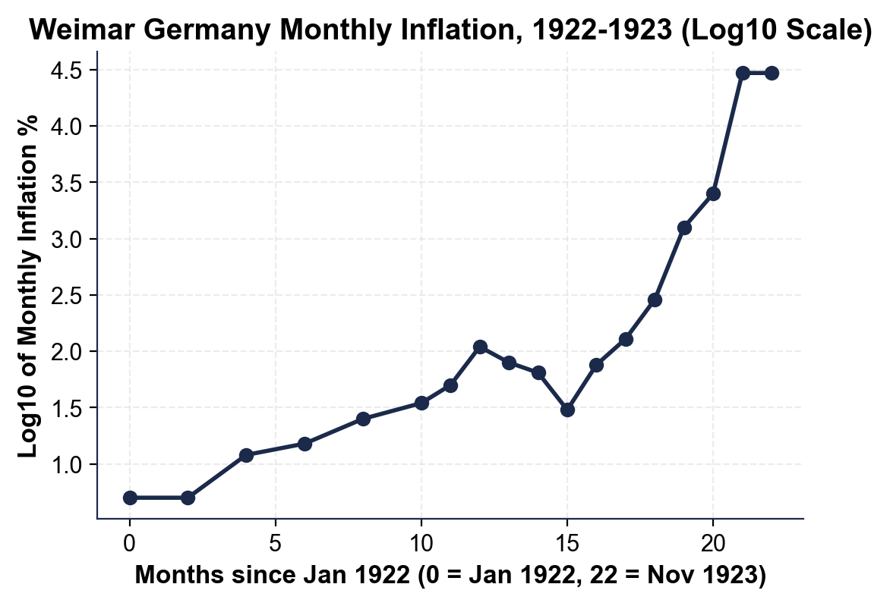
Note: Weimar Monthly Inflation 1922-1923
Rose from ~5%/month in early 1922 to 29,500% by Nov 1923. LOG10 axis.
© More Lessons Less Planning | morelessonslessplanning.com
Notes:
Have students trace the inflation rate from January 1922 (about 5% monthly) through November 1923 (about 29,500% monthly). The log y-axis is what makes the chart readable: a linear axis would show January-July 1923 as a flat line at the bottom and only the November spike as visible. Drive home the acceleration: each major step up coincides with a fiscal event. Jan 1923: Ruhr occupation begins. April 1923: passive resistance is in full swing. August 1923: printing-press capacity expands. November 1923: peak, then Rentenmark introduction crashes inflation back to near-zero within weeks.
Reference labels (point to these chart features when teaching): Pre-Ruhr (1922): 5-50%/mo; Peak Nov 1923: 29,500%/mo

Slide 6
Zimbabwe 2008 - The 100 Trillion Dollar Note
The Numbers
The Trigger and Cure
Peak monthly inflation: ~79.6 billion % (Nov 2008)
Largest Zimbabwe note ever issued: 100 trillion
Value of 100T note on issue day: about $5 USD
Prices doubled roughly every 24 hours at peak
Trigger: 2000-2003 violent land reform collapsed farms
Agricultural exports and tax revenue cratered
Robert Mugabe printed money to pay civil service
Apr 2009: Zimbabwe abandoned the Zim dollar; USD took over
Did You Know? The 100 trillion Zim dollar note today sells for $30+ on eBay - more than it ever bought in Zimbabwe.
© More Lessons Less Planning | morelessonslessplanning.com
Notes:
Zimbabwe's 2007-2009 hyperinflation is the largest in modern peacetime history. Trigger: the 2000-2003 violent land reform. President Robert Mugabe seized white-owned commercial farms, which had been the backbone of Zimbabwe's agricultural exports (tobacco, maize, sugar). Production collapsed; exports collapsed; tax revenue collapsed; the government printed Zim dollars to pay the civil service and the army. Hyperinflation began in 2007 and accelerated through 2008. The Cato Institute Hanke-Kwok estimate puts the peak monthly inflation at about 79.6 BILLION percent in November 2008 - prices doubling roughly every 24 HOURS. The 100 trillion Zimbabwean dollar note was issued in January 2009 and was worth about $5 U.S. on issue day. By April 2009 the government formally abandoned the Zim dollar and switched to the U.S. dollar and South African rand. The country has used foreign currencies (mostly USD) ever since. See chart_zimbabwe_inflation_log on the next slide (Jan 2007 - Nov 2008 monthly inflation, log10 scale).

Slide 7
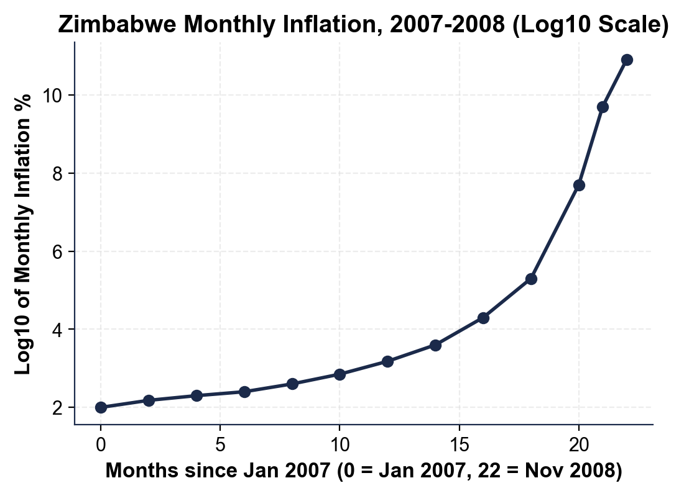
Note: Zimbabwe Monthly Inflation 2007-2008
Rose from 100%/mo in early 2007 to 79.6 BILLION% by Nov 2008. LOG10 axis.
© More Lessons Less Planning | morelessonslessplanning.com
Notes:
Have students trace the inflation rate from January 2007 (about 100% monthly - already extreme) through November 2008 (about 79.6 BILLION percent monthly). The log y-axis is mandatory - the data spans 9+ orders of magnitude. Drive home that Zimbabwe was ALREADY in hyperinflation territory at the start of 2007 (100% monthly far exceeds the 50% Cagan threshold). The acceleration through 2008 took it from there to 79.6 billion percent. Compare side-by-side with the Weimar chart on slide 5: Weimar peaked at 29,500% monthly; Zimbabwe peaked at roughly 2.7 million times worse than that.
Reference labels (point to these chart features when teaching): Early 2007: ~100%/mo; Peak Nov 2008: ~79.6B%/mo

Slide 8
Venezuela 2016-Present - The Bolivar Collapse
65,374%
99.99999%
5.4 million
Peak annual inflation, 2018
Bolivar value lost since 2016
Venezuelans who emigrated since 2015
Did You Know? Venezuela holds the world's largest proven oil reserves - more than Saudi Arabia. Hyperinflation happened anyway.
© More Lessons Less Planning | morelessonslessplanning.com
Notes:
Venezuela's hyperinflation is the third classic case and the most recent. Trigger: the 2014-2016 collapse in global oil prices from over $100/barrel to under $30/barrel. Venezuela was a petrostate - over 95% of export earnings came from oil. Government revenue crashed. Rather than cut spending or borrow internationally (impossible because of bond defaults and U.S. sanctions), the government printed bolivars to keep paying the civil service and military. Inflation accelerated through 2016, crossed 50% monthly in November 2017, and peaked in 2018 with the IMF estimating annual inflation at 65,374% (the central bank stopped publishing official data). Compounding factors: long-standing price controls created shortages and a parallel black market; U.S. sanctions cut off Venezuela from international finance; sovereign default in November 2017 ended bond-market access. Over 5.4 million Venezuelans have emigrated since 2015 - the largest refugee crisis in the Western Hemisphere. Inflation slowed but did not stop: 2022 annual inflation was about 234%. See chart_venezuela_inflation_log on the next slide (2013 - 2022 annual inflation, log10 scale).

Slide 9
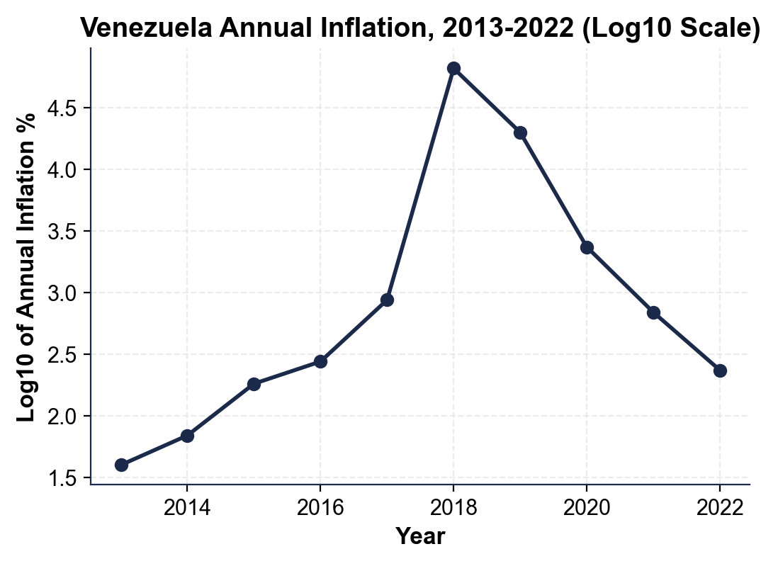
Note: Venezuela Annual Inflation 2013-2022
Rose from 40% in 2013 to 65,374% in 2018, then slowly fell to 234% by 2022.
© More Lessons Less Planning | morelessonslessplanning.com
Notes:
Have students trace the annual inflation rate from 2013 (40%) through the 2018 peak (65,374%) and the slow decline through 2022 (234%). The log y-axis is mandatory - the data spans 4+ orders of magnitude. Note the trajectory differs from Weimar and Zimbabwe: Venezuela's hyperinflation built up over years (2013-2018), not months, and has been receding for years rather than ending abruptly. Why no Rentenmark-style currency reform? Because the Maduro government cannot credibly commit to ending money-printing - the same political incentives that caused the inflation are still in place.
Reference labels (point to these chart features when teaching): 2013-2014: 40-69% annual; 2018 peak: 65,374% annual

Slide 10
The Common Cause - Printing Money for Deficits
1. Fiscal pressure
Must pay civil service, military, benefits
✔
2. Lost normal revenue
Weimar: gold; Zimbabwe: farm taxes; Venezuela: oil
✔
3. Lost bond-market access
Cannot borrow at sustainable rates
✔
4. Spending cuts impossible
Cuts risk losing power
✔
5. Print money instead
Doom loop: printing -> inflation -> more printing
✔
Key Concept: Hyperinflation begins when a government prints money to fund an uncloseable fiscal deficit.
© More Lessons Less Planning | morelessonslessplanning.com
Notes:
Three different countries, three different decades, three different triggers - but ONE common cause. In every case the government faced a fiscal squeeze. Weimar lost gold reserves to reparations; Zimbabwe lost agricultural tax revenue after land reform; Venezuela lost oil revenue after the 2014-2016 price collapse. In every case the government could not borrow internationally at a sustainable rate (Versailles barred Germany; Zimbabwe was under sanctions; Venezuela had defaulted). In every case spending cuts were politically impossible - civil service and military pay was the political base of the regime. So the government printed money instead. Once printing starts, the dynamic accelerates: more printing causes inflation, which forces wages and civil service pay up, which creates demand for MORE printing. Phillip Cagan called this the doom loop. Hyperinflation ends only when the government either (a) loses power (Weimar's coalition shifted, allowing Rentenmark), (b) abandons its currency entirely (Zimbabwe), or (c) faces external pressure strong enough to force fiscal reform (rare).

Slide 11
The Human Consequences - Savings, Contracts, Politics
Savings Wiped Out
Contracts Break
Politics Destabilizes
Cash savings vanish within weeks
Bonds, pensions, and life insurance lose value
Land, gold, and USD hold value
Middle class is destroyed; wealthy adapt
Long-term contracts (mortgages, leases) become impossible
Wage indexation lags inflation - real wages fall
Business planning collapses to days
Barter and foreign currency take over
Weimar inflation aided the Nazi rise (1923-1933)
Zimbabwe: 5+ million emigrated; regime weakened
Venezuela: largest Western Hemisphere refugee crisis
Trust in government and money never fully recovers
Key Concept: Hyperinflation transfers wealth from savers to debtors, destroys the middle class, and reshapes politics for decades.
© More Lessons Less Planning | morelessonslessplanning.com
Notes:
The economic numbers conceal a deeper human cost. SAVINGS: anyone holding cash, bonds, pensions, or life insurance is wiped out within months. Only physical assets (land, gold, foreign currency) hold value. The middle class - the people most reliant on savings and stable incomes - is destroyed. The wealthy and the well-connected can transfer assets out before the collapse. CONTRACTS: long-term contracts become impossible because nobody can price three years out when prices change weekly. Mortgages, leases, employment contracts, pensions - all break. Wage indexation lags inflation, so real wages fall through the floor. Business planning collapses to days, sometimes hours. Barter and foreign currency take over informal commerce. POLITICS: hyperinflation reshapes politics for decades. Weimar's 1923 inflation helped fuel the Nazi rise to power - middle-class voters who lost everything became politically radicalized. Zimbabwe's inflation drove 5+ million people to emigrate. Venezuela's collapse triggered the largest refugee crisis in Western Hemisphere history. Trust in government and money - both - never fully recovers in a single generation.

Slide 12
Why the U.S. Is Unlikely to Follow
What Would Have to Break
What Makes the U.S. Different
Fed independence (Congress would have to override)
USD's reserve currency status (about 60% of global reserves)
Deep Treasury market lets U.S. borrow at low rates
Strong institutions enforce contracts and audits
Fed Chair can refuse Treasury orders to print
USD demand globally absorbs new dollars
U.S. issues debt instead of printing for deficits
Independent judiciary blocks fiscal-financial fusion
Key Concept: Four U.S. shields - Fed independence, USD reserve status, deep Treasury market, independent courts - would all have to fail.
© More Lessons Less Planning | morelessonslessplanning.com
Notes:
Hyperinflation requires a specific institutional collapse: a government that controls its central bank, lacks access to international borrowing, and cannot politically cut spending. The U.S. has FOUR shields against this path. (1) Fed independence: the Federal Reserve is structurally independent. The Fed Chair can - and historically has - refused Treasury pressure to print money. Congress would have to pass new legislation to override Fed independence. (2) USD reserve currency status: the U.S. dollar is about 60% of global central bank reserves and the world's invoice currency for trade. Demand for dollars globally absorbs new dollars the U.S. issues - giving the U.S. uniquely large room to run deficits. (3) Deep Treasury bond market: the U.S. can ISSUE DEBT to fund deficits instead of printing money. Treasury bonds trade at the world's lowest sustained interest rates because demand is so deep. (4) Independent judiciary and audit institutions: contracts are enforced, federal accounts are audited, and government cannot quietly fuse fiscal and central-bank functions. All four would have to fail at once for hyperinflation to take hold in the U.S. - a very high institutional bar.

Slide 13
Key Takeaways
Hyperinflation = 50%+ per MONTH (Cagan threshold) - about 1000x normal
★
Weimar 1923, Zimbabwe 2008, Venezuela 2016-present - three classic cases
★
Common cause: government prints money to fund fiscal deficits it cannot close
★
Consequences: savings wiped out, contracts break, politics destabilizes
★
U.S. has FOUR institutional shields - all four would have to fail at once
★
© More Lessons Less Planning | morelessonslessplanning.com
Notes:
Read each takeaway and connect to learning targets. T1 (define + name three cases) -> takeaways 1 and 2. T2 (trace common causes) -> takeaway 3. T3 (evaluate consequences) -> takeaways 4 and 5. Tell students the activity puts them in the IMF advisor seat - their job is to brief a fictional finance minister whose country just crossed the 30%-monthly mark on whether it can be stopped before it becomes another Weimar/Zimbabwe/Venezuela.

