Slide 1
How We Know What Happened: The Evidence Record
Check the Source. Follow the Evidence.
© More Lessons Less Planning | morelessonslessplanning.com
Notes:
Open by asking how anyone could know what happened on a day that cannot be rerun. Set the frame: this lesson teaches the METHOD investigators use, not a retelling of the day itself.

Slide 2
Learning Targets
Sort evidence into three kinds: things, records, and words.
★
Explain why a second source makes a claim stronger.
★
Describe how a lab test checks an event no one can repeat.
★
Put events in order using time stamps on photos.
★
Explain why a good report says what it left out.
★
© More Lessons Less Planning | morelessonslessplanning.com
Notes:
Read target two aloud twice - corroboration is the hinge concept the rest of the lesson builds on.

Slide 3
A Day That Cannot Be Rerun
A Scientist
An Investigator
Can rerun a test to check a result.
Repeats a trial until a pattern holds.
Controls conditions to isolate one cause.
September 11, 2001 happened once, and only once.
That day brought enormous loss.
An investigator cannot rerun a day that has already happened.
Key Concept: When an event happens once, evidence has to be gathered, tested, and questioned after the fact.
© More Lessons Less Planning | morelessonslessplanning.com
Notes:
State the loss once, plainly, and move on - the lesson is about method, not the day's events.

Slide 4
Gathering What Survives
1
2
Materials
Paperwork
Things recovered and preserved for direct examination.
Made at the time, before anyone knew what would matter later.
3
4
Accounts
A timeline
What people say, collected afterward through questions.
When each piece happened, fixed against a reliable clock.
Note: An investigation is built from many small, checkable pieces, not one big story.
© More Lessons Less Planning | morelessonslessplanning.com
Notes:
A bridge slide: previews the strands the next two slides define by name, without naming them yet.

Slide 5
How Investigators Sort What Survives
The first two strands: something you can touch, something written down.
Physical evidence is an object you can hold, weigh, or test in a lab.
A documentary record is a log, tape, memo, or file made when an event happened.
Example: a recovered steel sample is one kind; a security recording is another.
Neither kind proves a claim alone - investigators build a case from many pieces.
Tip: An investigator tests each piece differently, checking what it can and cannot prove.
© More Lessons Less Planning | morelessonslessplanning.com
Notes:
Both terms sit on the Activity Reference Guide. Hold the line that no single object or record settles a claim by itself.

Slide 6
What People Can Tell Investigators
Testimony is what a witness says happened, given in answer to questions.
A primary source is a document someone made with direct knowledge of the event.
Strength: a person may notice something no paper record captured.
Limit: a person's memory is one moment, recalled later, and it can drift.
Investigators weigh both strengths and limits before trusting an account.
Note: A person's memory and a written record rarely match perfectly - checking both is the point.
© More Lessons Less Planning | morelessonslessplanning.com
Notes:
Both terms sit on the Activity Reference Guide. Hold the line on the limit: recalled-later is not the same as recorded-at-the-time.

Slide 7
What 236 Pieces of Steel Could Show
Steel Record | Figure | What It Establishes
Pieces analyzed | 236 pieces | Confirms which recovered material was tested
Share of tower steel | 0.25% to 0.5% | Why NIST could not claim a complete survey
Total tower steel | 200,000 tons | The scale investigators worked against
How a piece was placed | Stamped markings | Method for tracing a piece's likely location
Remember: A small, honestly labeled sample beats a claim of finding everything.
© More Lessons Less Planning | morelessonslessplanning.com
Notes:
Teach honestly what a partial sample can and cannot establish. The figures come from NIST NCSTAR 1.

Slide 8
Knowing Where a Thing Came From
Investigators cannot use an object until they know where it came from.
Provenance is the traceable origin of an object, showing where it came from.
Chain of custody is the written trail of who held an item and when they held it.
A piece with no traceable origin cannot support a conclusion about where it sat.
Both records travel with the object, from recovery to the final report.
Warning: An untraceable object is not proof of nothing - it is simply unusable as proof of anything.
© More Lessons Less Planning | morelessonslessplanning.com
Notes:
Both terms sit on the Activity Reference Guide. Tie directly back to the steel: a piece with no traceable origin cannot support a location claim.

Slide 9
An Archive Built From the Public
1
2
6,977 video segments
6,899 photographs
Collected from many sources into one searchable archive.
Contributed by at least 200 photographers, not one office.
3
4
Many contributors
Publicly supplied
Media outlets, public agencies, and individual photographers all took part.
Much of the material came from the public, not federal files alone.
Did You Know: Investigators did not already have this archive - they built it, submission by submission.
© More Lessons Less Planning | morelessonslessplanning.com
Notes:
The point: the record was ASSEMBLED, not found ready-made. The figures come from NIST NCSTAR 1.

Slide 10
How Investigators Fixed the Time
Anchor one moment
Fixed 9:02:59 a.m. using satellite- and atomic-clock-verified time stamps.
✔
Extend outward
Matched smoke plumes, shadows, and falling objects across many recordings.
✔
Cross-check the archive
Applied the same method across thousands of items, not just one recording.
✔
Report the accuracy
3,032 photographs and 2,673 clips reached 3 seconds of accuracy or better.
✔
Key Concept: One well-timed clip anchors the whole timeline; everything else is measured against it.
© More Lessons Less Planning | morelessonslessplanning.com
Notes:
The mechanism, not just the result, is the teaching point. The figures come from NIST NCSTAR 1.

Slide 11
Why a Second Source Matters
One source can be honestly wrong; a second source is how investigators check it.
Corroboration is a check that finds the same fact in a second, separate source.
Independence is the whole point - a copy of the first source proves nothing new.
Two accounts that were compared beforehand are not two independent sources.
A claim that survives an independent check is stronger than one that has not.
Tip: Ask where the second source came from before counting it as a second source at all.
© More Lessons Less Planning | morelessonslessplanning.com
Notes:
Independence is the whole point. Use a method example only - never a contested claim about the day itself.

Slide 12
A Second Investigation, A Different Question
NIST
The 9/11 Commission
Asked how the buildings behaved.
A technical, engineering investigation.
Reported its findings in 2005.
Asked what the government knew and did.
Created by Public Law 107-306, Nov. 27, 2002.
Ten members, five from each party; reported without dissent in 2004.
Note: Two investigations, two different questions - neither one answers the other's question.
© More Lessons Less Planning | morelessonslessplanning.com
Notes:
No partisan framing; state the balanced membership plainly. The details come from the 9/11 Commission Report.

Slide 13
The Commission Working Method
Documents Reviewed
People Interviewed
Public Hearings
More than 2.5 million pages examined.
Pulled from many agencies and sources.
A written trail others can re-check.
More than 1,200 individuals interviewed.
Interviews reached across ten countries.
Included officials and private citizens.
19 days of hearings held in public.
160 witnesses gave public testimony.
Anyone could check what was actually said.
Remember: Public hearings are a method too - testimony given where anyone can check it.
© More Lessons Less Planning | morelessonslessplanning.com
Notes:
Public hearings are themselves a method: testimony given where anyone can check it. The figures come from the 9/11 Commission Report.

Slide 14
Testing What You Cannot Repeat
NIST could not rerun the event, so it could not observe the real fires directly.
Reconstruction - a rebuilt copy of conditions, used to test what could happen.
NIST rebuilt office conditions at full scale and burned them under instruments.
Measured results replace guesswork about how the real fires behaved.
NIST reported openly that the usual physical traces were scarce.
Key Concept: When you cannot rerun the real event, you rebuild its conditions and measure them instead.
© More Lessons Less Planning | morelessonslessplanning.com
Notes:
NIST could not rerun the event, so it rebuilt office conditions and measured them under instruments. This slide sets up the next, image-only slide.

Slide 15
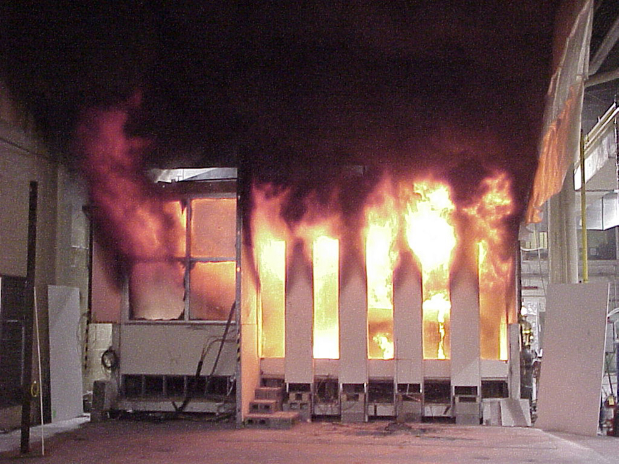
Reconstruction in the Laboratory
NIST rebuilt WTC office conditions at full scale and burned them, 2005.
© More Lessons Less Planning | morelessonslessplanning.com
Notes:
A laboratory test, not the site itself. No people, no casualties, no remains - a controlled office-compartment burn under instrumentation.
Reference labels (point to these chart features when teaching): Full-scale test compartment; Instrument panels

Slide 16
From Test to Model
The Physical Test
The Computer Model
Real conditions, burned under instruments.
Produces hard, measured data.
Must reproduce what the test measured.
Then explores conditions the test could not reach.
Did You Know: A model earns trust only after it matches a real, instrumented test - never before.
© More Lessons Less Planning | morelessonslessplanning.com
Notes:
Validation is the teaching point: a model is trusted only once it reproduces what a real, instrumented test measured. Sets up the next, image-only slide.

Slide 17
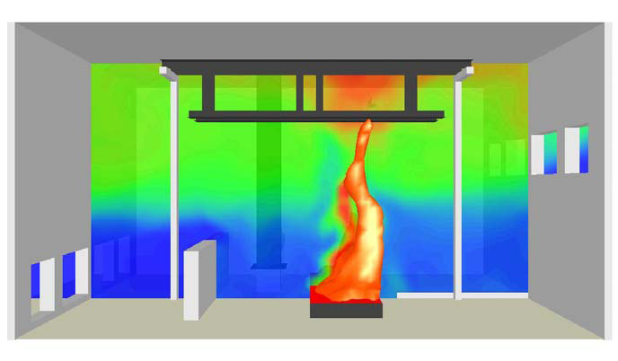
A Model Checked Against a Test
NIST modeled fire reaching a steel truss; blue is cool, red is hot.
© More Lessons Less Planning | morelessonslessplanning.com
Notes:
Color encodes temperature; state that in words so the meaning survives grayscale printing. No people, no site imagery.
Reference labels (point to these chart features when teaching): Cool zone, blue tones; Hot zone, red tones

Slide 18
Claims You Can Actually Check
Some claims about an event are so vague that nothing could prove them wrong.
Falsifiable: stated exactly enough that a finding could prove it wrong.
Vague: 'It explains everything.' Precise: 'Accurate to three seconds.'
A precise claim names the exact test or finding that would settle it.
If nothing could ever count against a claim, it is not a claim you can check.
Warning: A claim that cannot be tested cannot be checked - and a claim that cannot be checked proves nothing.
© More Lessons Less Planning | morelessonslessplanning.com
Notes:
Contrast a vague claim with a precise one and ask what finding would settle it. METHOD examples only.

Slide 19
What the Investigators Said They Did Not Do
We have not interviewed every knowledgeable person or found every relevant piece of paper. New information inevitably will come to light.
— 9/11 Commission Report, Preface, p. xvii
A stated limitation is a report's own note about what it did not examine.
Key Concept: Naming your own limits is not weakness - it is what makes a finding trustworthy.
© More Lessons Less Planning | morelessonslessplanning.com
Notes:
Teach this as a MARK OF CREDIBILITY, not as a weakness. The Commission wrote this about its own final report.

Slide 20
A Checklist You Can Use
What kind is it?
Something physical, something recorded, or someone's account?
✔
Where did it come from?
Can its origin and its handling be traced and checked?
✔
Who confirms it?
Does a separate, independent source find the same thing?
✔
What would prove it wrong?
Name the exact finding that would show the claim false.
✔
Note: You watched NIST and the 9/11 Commission apply each of these four questions in this lesson.
© More Lessons Less Planning | morelessonslessplanning.com
Notes:
The transferable skill: four questions to ask of any claim about any event. Media-literacy framing, generalizable beyond this topic.

Slide 21
Key Takeaways
Evidence sorts into three kinds: things, records, and words.
★
A second, truly independent source is what makes corroboration meaningful.
★
A small, traceable sample beats a claim of finding everything.
★
Investigators fixed a timeline by anchoring one moment, then extending outward.
★
A report that states its own limits is more trustworthy, not less.
★
© More Lessons Less Planning | morelessonslessplanning.com
Notes:
Close on the last takeaway - naming a report's limits is a mark of credibility, and it is the habit students should carry forward.

