Slide 1
How Banks Make Money: The Spread Explained
Banks borrow cheap from depositors and lend expensive to borrowers - the gap is the spread.
© More Lessons Less Planning | morelessonslessplanning.com
Notes:
Open the lesson with the framing question: 'You deposit $1,000 in a savings account that pays you 1.5 percent. The bank then lends your $1,000 to a small business at 6 percent. Where did the 4.5 percent gap go?' Answer: that gap is the SPREAD - it pays the bank's salaries, branch rent, technology, deposit insurance, and profit. Today's lesson is how that spread works, how big it typically is, and how to compute the total revenue of a real-size community bank.

Slide 2
Learning Targets
Explain how banks earn money through the interest rate spread.
★
Identify the other revenue streams: fees, services, investments.
★
Apply the spread concept to compute a $1B bank's annual revenue.
★
© More Lessons Less Planning | morelessonslessplanning.com
Notes:
Read each target aloud. Target 1 is the core concept (the spread). Target 2 expands the picture (fees plus investment income complete the revenue mix). Target 3 is application - students compute Liberty Community Bank's revenue from numerical data in the activity.

Slide 3
The Bank as Middleman
Banks stand BETWEEN savers (depositors) and borrowers
Savers want safety, liquidity, and a small return on idle cash
Borrowers want capital - mortgages, business loans, auto loans
Bank's job: aggregate small deposits and recycle them as larger loans
Profit comes from the GAP between what loans earn and what deposits cost
Big Idea: A bank is a MIDDLEMAN. It borrows cheap from many depositors and lends expensive to fewer borrowers - the gap is profit.
© More Lessons Less Planning | morelessonslessplanning.com
Notes:
Set up the basic banking business model. A bank is a financial INTERMEDIARY - it stands between savers (who have idle cash and want safety, liquidity, and a small yield) and borrowers (who need capital for homes, cars, businesses, and credit-card purchases). The bank's job is to AGGREGATE many small deposits and RECYCLE them as larger loans. The deposits pay a LOW interest rate (because they are safe and liquid). The loans charge a HIGH interest rate (because they are illiquid and carry default risk). The gap between the two is the SPREAD - the bank's main source of revenue.

Slide 4
Deposits: Cheap Money In
What deposits are
Customer money the bank holds - checking, savings, money market, CDs.
Why customers accept low rates
Safety (FDIC up to $250K per depositor, per insured bank, per ownership category), liquidity (withdraw anytime), convenience.
Typical cost
0.01 to 2 percent average rate paid by community banks in 2024.
Why this matters
Deposits are the cheapest funding banks can get - cheaper than borrowing from the Fed or bond markets.
Tip: Deposits average 1 to 2 percent annual cost at community banks - banks compete on convenience and FDIC safety, not yield.
© More Lessons Less Planning | morelessonslessplanning.com
Notes:
Deposits are the cheap raw material. Customers accept very low interest rates on checking and savings accounts (often 0.01 to 0.5 percent at large national banks; 0.5 to 2 percent at community banks competing for deposits) because deposits offer something else of value: SAFETY (FDIC insurance up to $250,000 per depositor per insured bank per ownership category), LIQUIDITY (you can withdraw anytime), and CONVENIENCE (ATMs, mobile apps, direct deposit, bill pay). The bank pockets the cost difference: it pays you 1.5 percent on your savings but uses your money to make 6 percent loans.

Slide 5
Loans: Expensive Money Out
What loans are
Money the bank lends to a borrower - mortgages, auto, business, credit cards.
Why borrowers pay high rates
They need capital now; the bank carries default risk and ties up funds for years.
Typical yield
5 to 8 percent average yield on community-bank loan portfolios in 2024.
Why this matters
Loans are the bank's highest-earning asset - the revenue side of the spread.
Key Concept: Loan portfolios yield 5 to 8 percent at community banks - much higher than deposit costs, which is what makes the spread positive.
© More Lessons Less Planning | morelessonslessplanning.com
Notes:
Loans are the revenue side. Borrowers pay HIGH interest rates (mortgages 6 to 7 percent in 2024; small business loans 7 to 9 percent; auto loans 6 to 9 percent; credit cards 18 to 24 percent) because they need capital NOW and the bank carries default risk and ties up funds for years. The typical community-bank loan portfolio earns a 5 to 8 percent average yield. Multiply that yield by the loan portfolio size to get total interest income. For Liberty Community Bank: $700M loan portfolio times 6 percent yield equals $42M interest income per year.

Slide 6
The Spread: Bank Profit
The Spread Formula
Why It Matters
Spread = avg loan yield MINUS avg deposit cost
Example: 6% loan yield - 1.5% deposit cost = 4.5%
Spread x earning assets = Net Interest Income
Typical community-bank spread: 3 to 5 points
NII is the largest line on the income statement
Drives 70-80% of community-bank revenue
Compression of 0.5 point can wipe out 10% of revenue
Spread is the engine of bank profitability
Big Idea: The SPREAD is the gap between loan yields and deposit costs - the bank's main profit engine.
© More Lessons Less Planning | morelessonslessplanning.com
Notes:
Define the spread precisely. The INTEREST RATE SPREAD is the difference between the average yield the bank earns on its loan portfolio (6 percent for Liberty) and the average rate it pays on its deposits (1.5 percent for Liberty). For Liberty: 6 percent minus 1.5 percent equals 4.5 percentage points of spread. Now multiply the spread (in dollar terms, as gross interest income minus gross interest expense) to get NET INTEREST INCOME (NII): $42M (loan interest) minus $12.75M (deposit interest) equals $29.25M NII. NII is the engine of bank profitability - typically 70 to 80 percent of total revenue at community banks.

Slide 7
Fees: The Second Revenue Stream
Service charges and fees - not interest income
Overdraft fees ($30-35 each) - the largest consumer-fee category
ATM fees, wire-transfer fees, account-maintenance fees
Commercial cash-management fees (lockbox, ACH, treasury services)
Typically 10 to 15 percent of community-bank revenue
Tip: Fees are typically 10-15% of community-bank revenue - smaller than the spread but steady and not interest-rate-dependent.
© More Lessons Less Planning | morelessonslessplanning.com
Notes:
Fees are the second revenue stream. They are NON-INTEREST INCOME - the bank collects them by charging customers for services and account events rather than by earning interest. The largest single category is OVERDRAFT FEES ($30 to $35 each time a customer's account goes negative). Banks also charge ATM fees, wire-transfer fees ($25 to $50), account-maintenance fees ($5 to $15 per month if balance falls below a minimum), and commercial cash-management fees (lockbox, ACH origination, treasury services for business customers). Total fee income is typically 10 to 15 percent of revenue at community banks - smaller than NII but steady and not interest-rate-dependent.

Slide 8
Investment Income
What it is
Interest + dividends earned on the bank's securities portfolio.
Main holdings
Treasuries, agency MBS (Fannie Mae, Freddie Mac), high-grade munis.
Why banks hold them
Yield on un-lent deposits, liquidity, regulatory requirements.
Typical share
5 to 8 percent of community-bank revenue.
Key Concept: Investment income earns yield on deposits not lent, while keeping cash liquid for withdrawals.
© More Lessons Less Planning | morelessonslessplanning.com
Notes:
Investment income is the third revenue stream. Banks do not lend out 100 percent of deposits - they hold a SECURITIES portfolio (Treasuries, agency bonds like Fannie Mae and Freddie Mac mortgage-backed securities, and high-grade municipal bonds) to (a) earn yield on the portion of deposits not lent, (b) maintain liquidity (securities can be sold for cash faster than loans), and (c) meet regulatory liquidity requirements. Yields are lower than loans (3 to 5 percent on Treasuries; 4 to 6 percent on municipals) but the credit risk is much lower. Total investment income is typically 5 to 8 percent of community-bank revenue.

Slide 9
The Three Revenue Streams - Community Bank Mix
Three main revenue streams: net interest income, fees, investment income
Net interest income (the spread): about 78 percent of revenue
Service charges and fees: about 14 percent of revenue
Investment income: about 6 percent of revenue
Other income (loan sales, mortgage servicing): about 2 percent
Big Idea: About 4 of every 5 dollars a community bank earns comes from the SPREAD - fees and investments are smaller streams.
© More Lessons Less Planning | morelessonslessplanning.com
Notes:
Summarize the three-stream revenue model with realistic FDIC-style proportions for a typical community bank. NET INTEREST INCOME (the spread): about 78 percent of total revenue - the engine. SERVICE CHARGES AND FEES: about 14 percent - the second stream. INVESTMENT INCOME: about 6 percent - the third stream. OTHER INCOME (loan-sale gains, mortgage-servicing fees, miscellaneous): about 2 percent. The single biggest takeaway: roughly four of every five dollars a community bank earns comes from the spread between loan yields and deposit costs. This is why bank executives spend more time worrying about the spread than about any other single number.

Slide 10
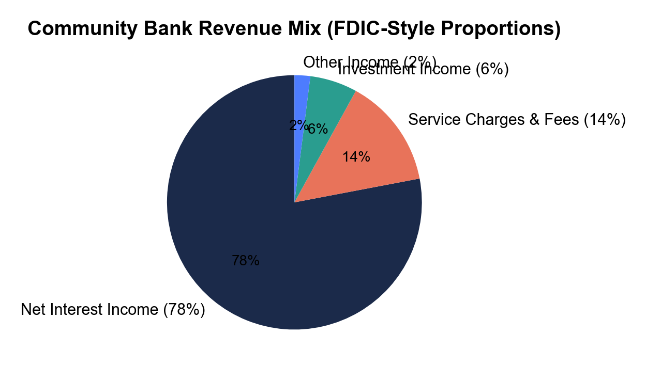
Community Bank Revenue Mix
FDIC-style proportions.
© More Lessons Less Planning | morelessonslessplanning.com
Notes:
Display the bank revenue mix pie chart. Four slices: Net Interest Income 78 percent (the largest slice, the spread engine), Service Charges and Fees 14 percent (the second-largest slice), Investment Income 6 percent (the third slice), Other Income 2 percent (the smallest slice). Two visual anchors: (1) the dominance of NII (almost 4/5 of the pie); (2) the relatively small fee slice (14 percent) - many students assume banks make most of their money on fees, but the chart shows the spread dominates.
Reference labels (point to these chart features when teaching): Spread dominates

Slide 11
Do the Math: A $1B Community Bank's Revenue
Item | Inputs | Result
Interest income on loans | $700M loans times 6.0% yield | $42,000,000
Interest expense on deposits | $850M deposits times 1.5% cost | $12,750,000
Net interest income (the spread) | $42M minus $12.75M | $29,250,000
Service charges and fees | Liberty 2024 reported | $5,250,000
Investment income | $150M securities times 4.0% yield | $6,000,000
TOTAL REVENUE | Sum of NII + fees + investment | $40.5 million ($40,500,000)
Tip: NII / Total = $29.25M / $40.5M = 72%. Net Interest Margin (NIM) = 3.44%; Loan-to-Deposit Ratio = 82%.
© More Lessons Less Planning | morelessonslessplanning.com
Notes:
Walk students through the Liberty Community Bank revenue calculation step by step. (1) INTEREST INCOME: $700M loan portfolio times 6.0 percent yield equals $42 million. (2) INTEREST EXPENSE: $850M deposit base times 1.5 percent average cost equals $12.75 million. (3) NET INTEREST INCOME: $42M minus $12.75M equals $29.25 million - the spread in dollars. (4) FEE INCOME: $5.25 million reported for 2024. (5) INVESTMENT INCOME: $150M securities portfolio times 4.0 percent yield equals $6 million. (6) TOTAL REVENUE: $29.25M plus $5.25M plus $6M equals $40.5 million. Now compute the share: $29.25M NII divided by $40.5M total equals 72 percent - close to the industry-typical 78 percent. Liberty earns slightly more on fees and investment than the typical community bank. Two additional analyst ratios drop out of the same data: NET INTEREST MARGIN (NIM) equals net interest income divided by total earning assets, expressed as a percent. Liberty NIM = $29.25M / $850M earning assets = 3.44 percent (typical community-bank NIM range is 3.0 to 3.5 percent). LOAN-TO-DEPOSIT RATIO equals total loans divided by total deposits. Liberty Loan-to-Deposit Ratio = $700M / $850M = 82 percent (typical community-bank range is 75 to 90 percent). NIM normalizes the spread across banks of different sizes; the Loan-to-Deposit Ratio measures how much of the spread is being captured.

Slide 12
Key Takeaways
Banks are MIDDLEMEN - borrow cheap from depositors, lend expensive to borrowers
The SPREAD (loan yield minus deposit cost) is the bank's main revenue engine
Net interest income is about 78 percent of community-bank revenue
Fees are 14 percent; investment income 6 percent; other 2 percent
Liberty example: $29.25M NII, $40.5 million total revenue (NII 72%)
Remember: Spread = loan yield minus deposit cost. Multiply by earning assets to get net interest income.
© More Lessons Less Planning | morelessonslessplanning.com
Notes:
Close the lesson by drilling the five takeaways. Have students state the spread formula aloud: 'Spread equals average loan yield minus average deposit cost.' Then state the income calculation: 'Net interest income equals interest income from loans minus interest expense on deposits.' Then the revenue mix: '78 percent net interest income, 14 percent fees, 6 percent investment, 2 percent other.' These three mantras are the entire toolkit in three sentences. The activity reinforces them with the full Liberty Community Bank calculation.

