Slide 1
Hourly vs Salary: Which Job Actually Pays More?
What separates an hourly wage from a salary, how overtime and time-and-a-half work, how to annualize hourly pay, and how to compare two real job offers and decide which one truly pays more.
© More Lessons Less Planning | morelessonslessplanning.com
Notes:
Open with the hook: two job offers can look almost the same on paper - one hourly, one salaried - yet pay very different amounts once you account for hours and overtime. By the end of class students can run the numbers and decide.

Slide 2
Learning Targets
Explain the difference between an hourly wage and a salary
★
Calculate overtime pay using time-and-a-half for hours over 40
★
Annualize an hourly wage and convert a salary to an hourly equivalent
★
Compare two job offers and decide which one actually pays more
★
© More Lessons Less Planning | morelessonslessplanning.com
Notes:
Read the four targets aloud. Tell students the activity puts them in the role of Jordan Reyes comparing two real offers - an hourly warehouse job and a salaried office job - and running the math to decide.

Slide 3
Hourly Pay Basics
How Hourly Pay Works
Example: $20 per Hour
An hourly wage is a fixed amount for each hour you work
Your paycheck rises and falls with the number of hours
Gross pay = hourly wage x hours (your pay before taxes)
Most hourly jobs are non-exempt, so they earn overtime
Work 40 hours: 40 x $20 = $800 gross for the week
Work 30 hours: 30 x $20 = $600 gross for the week
Your pay moves up and down with your schedule
You are paid for every hour you actually work
Key Concept: With an hourly wage your paycheck is hours x rate, so it changes every week your hours change.
© More Lessons Less Planning | morelessonslessplanning.com
Notes:
Define hourly pay: a fixed amount per hour, gross = rate x hours. Show $20/hr at 40 hours = $800 and at 30 hours = $600. Stress the paycheck rises and falls with hours and that most hourly jobs earn overtime.

Slide 4
Salary Pay Basics
How a Salary Works
Example: $45,000 per Year
You are paid a fixed amount for the whole year
That yearly pay is split evenly across each paycheck
Your check is the same whether you work 38 or 48 hours
Many salaried jobs are exempt, so they earn no overtime
Paid biweekly: $45,000 / 26 = about $1,730 per check
Paid monthly: $45,000 / 12 = $3,750 per check
Steady, predictable pay no matter the week
Extra hours usually bring no extra pay
Did You Know? A salary is the same each payday - that predictability is its biggest perk and, on busy weeks, its biggest drawback.
© More Lessons Less Planning | morelessonslessplanning.com
Notes:
Define salary: a fixed yearly amount split evenly across paychecks. Show $45,000 = about $1,730 biweekly or $3,750 monthly. Stress the paycheck is steady regardless of hours and that exempt salaried workers usually get no overtime.

Slide 5
Overtime and Time-and-a-Half
Overtime threshold = the 40-hour line
The overtime threshold is the 40-hour-per-week line; only hours ABOVE it earn the overtime rate
✔
Overtime = extra-rate pay over 40
Overtime is the extra-rate pay for hours worked beyond 40 in a week, paid at a higher rate than your normal wage
✔
Time-and-a-half = 1.5x your wage
Each overtime hour pays 1.5 times your normal rate. At $20/hr, overtime pays $30/hr
✔
Worked example: a 47-hour week
40 hrs x $20 = $800, plus 7 OT hrs x $30 = $210 = $1,010 gross pay (total pay before taxes or deductions)
✔
Key Concept: Overtime only applies to hours OVER 40, and each of those hours pays time-and-a-half - 1.5 times your normal wage.
© More Lessons Less Planning | morelessonslessplanning.com
Notes:
Teach overtime: only hours over 40 per week qualify (the overtime threshold), paid at time-and-a-half (1.5x). Walk the 47-hour example: 40 x $20 = $800 plus 7 x $30 = $210, totaling $1,010 gross.

Slide 6
Who Earns Overtime: Exempt vs Non-Exempt
Non-Exempt Employee
Exempt Employee
Usually an hourly worker
Legally OWED overtime pay for hours over 40 in a week
Earns time-and-a-half on those extra hours
Job A (the hourly warehouse job) is non-exempt
Usually a salaried worker
NOT legally owed overtime pay
Extra hours bring no extra pay
Job B (the salaried office job) is often exempt
Note: A non-exempt employee earns overtime for hours over 40; an exempt employee does not, so long weeks bring them no extra pay.
© More Lessons Less Planning | morelessonslessplanning.com
Notes:
Distinguish the two worker types. A non-exempt employee (usually hourly) is legally owed overtime for hours over 40. An exempt employee (usually salaried) is not, so extra hours bring no extra pay. This is why Job A can earn overtime but Job B usually cannot.

Slide 7
Annualizing an Hourly Wage
What annualizing means
Estimating yearly pay from an hourly wage: hourly wage x hours per week x 52 weeks
Job A at 40 hours
$20/hr x 40 hours x 52 weeks = $41,600 per year (no overtime, steady 40-hour weeks)
Compare to a salary
$41,600 annualized is LESS than Job B's $45,000 salary - at a steady 40 hours the salary wins
Salary to hourly equivalent
Go the other way: $45,000 / (40 hours x 52 weeks) = about $21.63 per hour effective
Tip: To compare an hourly job and a salary fairly, put both on the same yearly footing - annualize the wage, or break the salary into an hourly rate.
© More Lessons Less Planning | morelessonslessplanning.com
Notes:
Teach annualizing: wage x hours/week x 52. Job A at 40 hours = $41,600, which is less than Job B's $45,000. Show the reverse conversion too: $45,000 / 2,080 hours = about $21.63/hr effective. Both methods put the offers on equal footing.

Slide 8
Which Pays More? It Depends on the Hours
Hours/week | Job A: Hourly ($20 + OT) | Job B: Salary
35 hrs | $36,400/yr | $45,000/yr
40 hrs | $41,600/yr | $45,000/yr
45 hrs | $49,400/yr | $45,000/yr
50 hrs | $57,200/yr | $45,000/yr
Did You Know? Job B's salary never changes, but Job A's hourly pay climbs with overtime - so hourly passes salary between 40 and 45 hours a week.
© More Lessons Less Planning | morelessonslessplanning.com
Notes:
Show the annual-pay table: salary is flat $45,000 while hourly rises with hours and overtime ($36,400 at 35h up to $57,200 at 50h). The crossover is between 40 and 45 hours per week. The next slide shows this as a grouped bar chart students analyze in Activity Part 3.

Slide 9
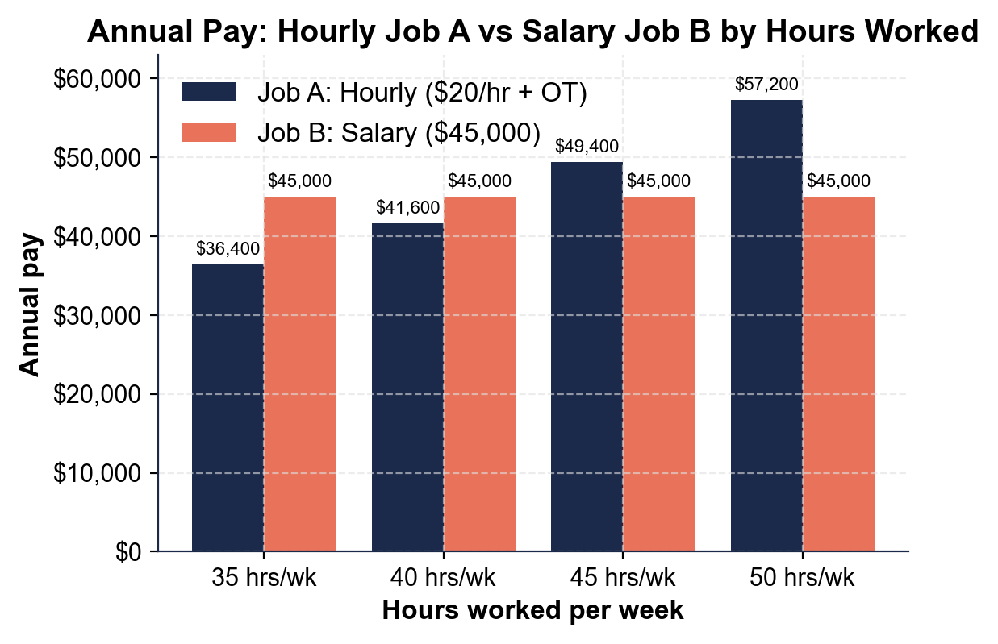
Note: Annual Pay - Hourly Job A vs Salary Job B
Annual pay by hours worked.
© More Lessons Less Planning | morelessonslessplanning.com
Notes:
Have students read the grouped bars: salary stays flat at $45,000 across all four hour levels while hourly rises from $36,400 (35h) to $57,200 (50h). Hourly overtakes salary between 40 and 45 hours. This is the chart students extract values from in Activity Part 3.
Reference labels (point to these chart features when teaching): Salary: flat $45,000; Hourly: rises with OT

Slide 10
Pros and Cons of Each
Hourly Pay
Salary Pay
Pro: overtime pay rewards extra hours
Pro: you are paid for every hour you work
Con: your paycheck shrinks when hours are cut
Con: income can be unpredictable week to week
Pro: steady, predictable paycheck every period
Pro: often comes with benefits and paid time off
Con: usually no overtime for long weeks
Con: extra hours can lower your real hourly rate
Warning: Pay is only part of an offer - weigh benefits, hours, and stability. A lower salary with health insurance can beat a higher wage without it.
© More Lessons Less Planning | morelessonslessplanning.com
Notes:
Compare tradeoffs. Hourly: overtime rewards extra hours and you are paid for all hours, but pay is unpredictable and shrinks when hours are cut. Salary: steady and often comes with benefits, but usually no overtime and long weeks lower the real hourly rate. Remind students benefits matter too.

Slide 11
Compare Two Job Offers (Worked Example)
Step 1: Put both on a yearly footing
Job A at 40 hrs annualizes to $41,600; Job B is a $45,000 salary - at 40 hours the salary pays more
✔
Step 2: Ask how many hours are realistic
If Job A regularly hits 45-hour weeks, overtime pushes it to $49,400 - now hourly pays more
✔
Step 3: Factor in overtime and benefits
Hourly can earn time-and-a-half; salary may include benefits worth thousands a year
✔
Step 4: Decide for YOUR situation
There is no single right answer - it depends on the hours you will work and what you value
✔
Remember: Annualize the hourly wage at the hours you will REALISTICALLY work, then weigh overtime and benefits - not just the headline pay.
© More Lessons Less Planning | morelessonslessplanning.com
Notes:
Give the four-step method to compare offers: (1) annualize both, (2) estimate realistic hours, (3) factor overtime and benefits, (4) decide for your situation. Reinforce that the answer depends on hours worked - exactly what Activity Part 4 walks students through with Jordan's two offers.

Slide 12
Key Takeaways
Hourly pay = rate x hours, so the paycheck changes with the schedule
★
A salary is fixed yearly pay split evenly, the same every payday
★
Overtime pays time-and-a-half (1.5x) for hours over 40 in a week
★
Annualize a wage (rate x hours x 52) to compare it with a salary
★
Which job pays more depends on the hours worked and the benefits
★
© More Lessons Less Planning | morelessonslessplanning.com
Notes:
Read each takeaway and tie it to the targets. T1 (hourly vs salary) -> Parts 1, 2. T2 (overtime) -> Part 4. T3 (annualizing) -> Part 4. T4 (compare offers) -> Parts 3, 5. The activity puts students in Jordan's shoes comparing two real offers and deciding which pays more.

