Slide 1
Homer and the Oral Tradition
How the Iliad and the Odyssey survived 400 years with no writing - kept alive by memory and performance.
© More Lessons Less Planning | morelessonslessplanning.com
Notes:
Open the mystery. The Iliad and the Odyssey are among the most famous stories ever told - but for centuries no one wrote them down, because the Greeks had no writing to use. This lesson asks a genuinely puzzling question: how does a poem as long as the Odyssey survive for roughly 400 years with nothing on paper? The answer is the ORAL TRADITION - trained singers called bards who performed the epics aloud from memory, generation after generation, using clever memory tools. Along the way students will meet a second honest mystery, the Homeric Question: we do not actually know who 'Homer' was. Set the tone now: this is a lesson about how stories travel through time by voice, and about being honest when the evidence runs out.

Slide 2
Learning Targets
How the Iliad and Odyssey survived 400 years with no writing
★
The poet's memory tools: formulas and epithets, and how writing was lost
★
Why the Homeric Question - who 'Homer' was - is genuinely open
★
© More Lessons Less Planning | morelessonslessplanning.com
Notes:
Read each target aloud. Target 1 maps to slides 3-7 (what an oral tradition is, the loss of Linear B, and the Greek Dark Age). Target 2 maps to slides 8-10 (formulas, epithets, meter, and the return of the alphabet). Target 3 maps to slides 11-14 (the Homeric Question, the bard Demodokos, why the tradition matters, and the honest verdict) and drives the Primary Source Spotlight, where students read the Odyssey's own scene of a bard performing. Stress that Target 3 is a critical-thinking skill: holding an honest 'we do not know' about who Homer was, instead of forcing a neat answer.

Slide 3
What Is an Oral Tradition?
Stories Kept Alive by Voice
The Iliad and the Odyssey
An ORAL TRADITION passes poems by spoken performance and memory, not writing
For centuries the Greek epics lived only in performance, never on a page
A BARD (Greek aoidos) sang long poems from memory, often to a lyre or kithara
The Iliad and the Odyssey are long EPIC poems of heroes, gods, and war
They were composed and performed aloud, not written by a lone author at a desk
Audiences HEARD the poems; they survived centuries before any text existed
Key Concept: An ORAL TRADITION passes epics by spoken performance and memory; a BARD sang them aloud from memory, often to the lyre.
© More Lessons Less Planning | morelessonslessplanning.com
Notes:
Define the core idea. An ORAL TRADITION is the passing of stories, poems, and knowledge by spoken performance and memory - out loud, person to person - without writing them down. For centuries the Iliad and the Odyssey lived ONLY this way: in performance, never on a page. The performer was a BARD, from the Greek word aoidos, a trained singer-poet who could perform enormous poems from memory before a live audience, usually accompanying himself on a lyre or kithara (a large lyre). Stress the strangeness for modern students: the audience HEARD these poems; they did not read them. There was no book to check. An EPIC is a long narrative poem about heroes, gods, and great deeds - and both Greek epics were built to be sung aloud, not read silently. The next slide shows an ancient Greek vase of a singer performing so students can picture it.

Slide 4
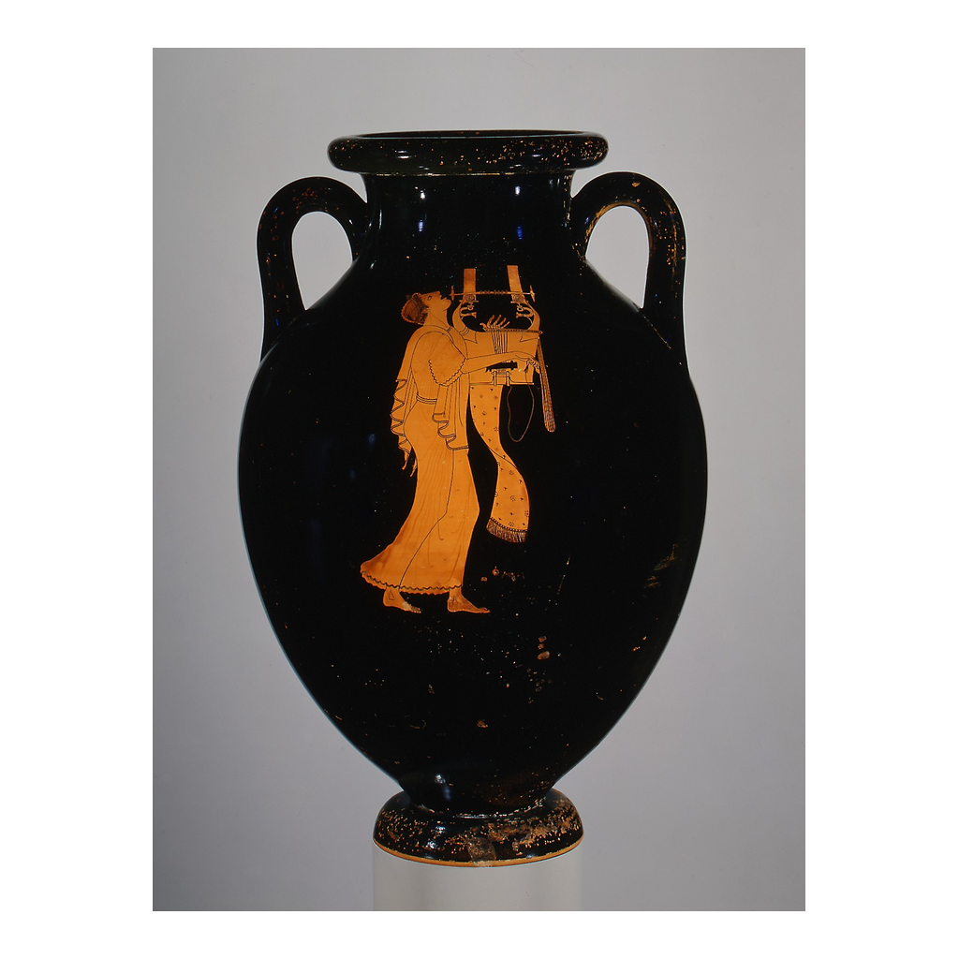
An Ancient Greek Singer and His Kithara
Attic red-figure vase: a singer performs with a kithara (a large lyre)
© More Lessons Less Planning | morelessonslessplanning.com
Notes:
This is a real ancient Greek red-figure vase showing a singer performing with a kithara, a large lyre. Have students notice the performer and the stringed instrument held against the body. Connect it to the previous slide: this is what the oral tradition looked like - a live singer holding a lyre, performing from memory to an audience, not reading from any book. Point out that images like this, painted on pottery, are part of how we know bards performed to the lyre. The photo makes the oral performance concrete without any modern or film imagery.
Reference labels (point to these chart features when teaching): the singer or bard; the kithara (lyre)

Slide 5
The Lost Script: Linear B and the Bronze Age Collapse
Greece Once Had Writing
The Bronze Age Collapse
The Mycenaean Greeks kept records in LINEAR B, a syllable-based script
Linear B was used mainly for palace lists and records, not stories
It was written by trained palace scribes
Then, around 1200 BCE, that world fell apart
Around 1200 BCE the BRONZE Age collapse destroyed the Mycenaean palaces
When the palaces fell, LINEAR B writing was lost with them
Greece was left with no writing system at all
The next slide shows a real Linear B tablet
Key Concept: The Mycenaean Greeks wrote in LINEAR B, but that script was lost when the palaces fell in the BRONZE Age collapse around 1200 BCE.
© More Lessons Less Planning | morelessonslessplanning.com
Notes:
Set up the central problem: Greece LOST its writing. Long before the Dark Age, the Mycenaean Greeks did have a script called LINEAR B - a syllable-based writing system used mainly for palace records like lists of goods, workers, and livestock, written by trained scribes. It was not used for poetry or stories. Then, around 1200 BCE, the whole Mycenaean world came apart in the BRONZE Age collapse, a wave of destruction that toppled the palaces across the region. Here is the key point: when the palaces fell, Linear B fell with them. Writing depended on the palace scribes and their system, and once that world was gone, Greeks stopped writing entirely. Greece was left with no writing at all. That loss is what makes the survival of the epics so remarkable - and it is exactly the gap the oral tradition had to bridge. The next slide shows a real Linear B clay tablet.

Slide 6
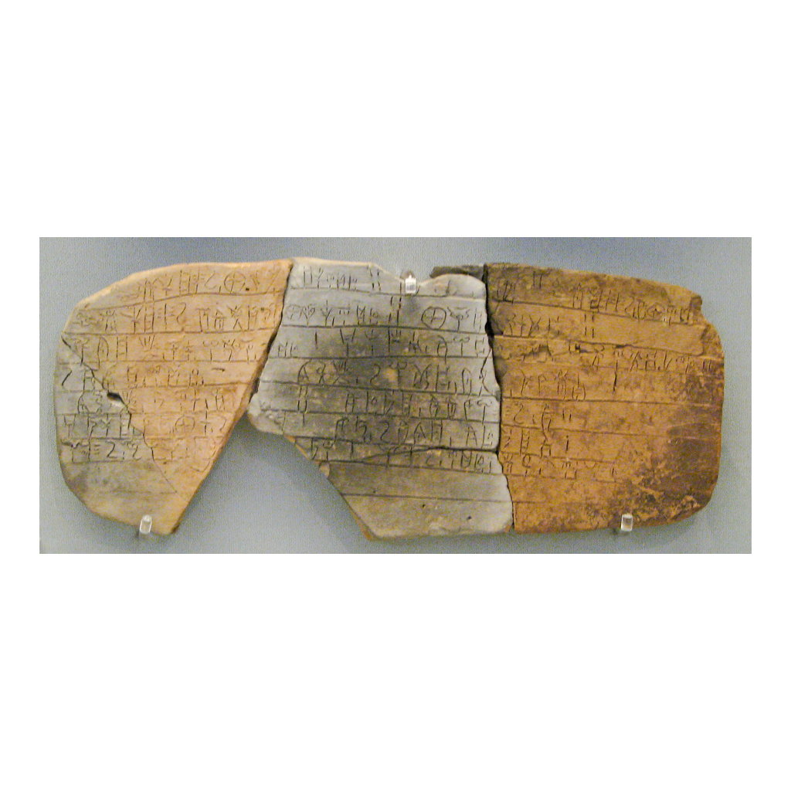
A Mycenaean Linear B Clay Tablet
A Mycenaean Linear B clay tablet - a script lost around 1200 BCE
© More Lessons Less Planning | morelessonslessplanning.com
Notes:
This is a real photograph of a Mycenaean Linear B clay tablet. Have students notice the rows of small incised signs pressed into the clay - this is the syllable-based script the Mycenaean palaces used for records. Connect it to the previous slide: writing like this existed in Greece before 1200 BCE, but it was lost in the Bronze Age collapse when the palaces fell. Point out that these tablets survived by accident - many were baked hard in the fires that destroyed the palaces - which is why we can still read Mycenaean records today even though the living writing tradition died out. Use it to make the loss of writing concrete.
Reference labels (point to these chart features when teaching): the incised sign-script; the clay tablet

Slide 7
The Greek Dark Age: 400 Years Without Writing
Greek Dark Age
The GREEK DARK AGE is the roughly 400-year period (about 1100-800 BCE) after the Bronze Age collapse when Greeks had no writing at all.
No written records
With Linear B gone, no one wrote anything down for centuries - no histories, no letters, and no poems on any page.
Yet the epics survived
The Iliad and the Odyssey lived through this whole gap because bards kept performing them ALOUD from memory.
Living in performance
The poems existed only in performance - sung and heard, never read - passed from one generation of bards to the next.
Key Concept: For about 400 years (the GREEK DARK AGE) Greece had no writing, yet the epics survived because bards performed them aloud from memory.
© More Lessons Less Planning | morelessonslessplanning.com
Notes:
This is the heart of the whole lesson, and the number is load-bearing: after the Bronze Age collapse, Greece entered the GREEK DARK AGE - roughly 400 years, from about 1100 to 800 BCE, with no writing at all. With Linear B gone, no one wrote anything down: no histories, no letters, no poems on any page. Now pose the puzzle plainly to students: if there was no writing for 400 years, how did the Iliad and the Odyssey survive? The answer is the oral tradition. The epics lived through the entire gap because bards kept performing them ALOUD from memory, passing them from one generation of singers to the next. The poems existed only in performance - sung and heard, never read. Make sure students can state both halves: 400 years, no writing, AND the epics still survived - by voice. That paradox is exactly what the memory tools on the next slides explain.

Slide 8
Formulas and Epithets: The Poet's Toolkit
Formula
A FORMULA is a repeated, ready-made phrase or line a bard could reuse to fit the poem's rhythm and help him compose and remember during performance.
Epithet
An EPITHET is a fixed descriptive tag attached to a person or thing, such as 'rosy-fingered Dawn' or 'swift-footed Achilles.'
Building blocks, not memorized words
Bards did NOT memorize every line word-for-word; they re-composed the poem live, dropping in formulas and epithets as needed.
Recomposition in performance
Each performance was freshly rebuilt from these ready-made pieces, so no two tellings were exactly the same.
Key Concept: A FORMULA is a reusable ready-made phrase and an EPITHET is a fixed descriptive tag - bards' building blocks to re-compose epics live.
© More Lessons Less Planning | morelessonslessplanning.com
Notes:
Now explain HOW a bard could perform a poem thousands of lines long without a script - and correct the biggest misconception. Bards did NOT memorize the epics word-for-word like an actor learning lines. Instead they used a toolkit of ready-made pieces. A FORMULA is a repeated, ready-made phrase or line a bard could reuse to fit the poem's rhythm - and reusing it helped him both compose and remember as he went. An EPITHET is a fixed descriptive tag attached to a person or thing, like 'rosy-fingered Dawn' or 'swift-footed Achilles.' These were the bard's building blocks: instead of recalling every exact word, he re-composed the poem live, dropping in the right formula or epithet wherever the rhythm needed it. This is called recomposition in performance, and it means each telling was freshly rebuilt - so no two performances were exactly identical. This is established scholarship about how oral poetry works. The next slide shows real epithets and the meter they fit.

Slide 9
Epithets and Meter: 'Rosy-Fingered Dawn'
Famous Homeric Epithets
Why They Fit the Beat
'Rosy-fingered Dawn' - a fixed EPITHET for the sunrise
The 'wine-dark sea' - a repeated tag for the ocean
'Swift-footed Achilles' - a fixed tag for the hero
The same tags return again and again across the poems
Greek epic has a steady six-beat rhythm called DACTYLIC hexameter
Each epithet was shaped to fit that beat
A bard could slot a ready-made tag into the meter instantly
The rhythm itself helped carry the singer's memory
Key Concept: Fixed EPITHETS like 'rosy-fingered Dawn' were shaped to fit the six-beat DACTYLIC hexameter so a bard could slot them in.
© More Lessons Less Planning | morelessonslessplanning.com
Notes:
Make the memory tools concrete with real examples students will recognize. Homer's poems are full of fixed EPITHETS that return again and again: 'rosy-fingered Dawn' for the sunrise, the 'wine-dark sea' for the ocean, and 'swift-footed Achilles' for the hero. These are authentic, repeated tags from the epics - safe to teach as real Homeric usage. Now explain WHY they work: Greek epic poetry has a steady rhythm, a six-beat line called DACTYLIC hexameter (the meter). Every one of those epithets was shaped to fit that beat, so a bard performing at speed could slot the ready-made tag into the line instantly, without breaking the rhythm. The meter itself became a memory aid: the steady beat carried the singer forward and told him when a phrase 'fit.' Tie it back: formulas and epithets plus the meter are exactly the toolkit that let bards perform enormous poems live from memory for 400 years. This is how the puzzle from the last slide gets solved.

Slide 10
The Alphabet Returns
Borrowing from the Phoenicians
The Epics Are Written Down
Around 800 BCE Greeks adapted the PHOENICIAN alphabet
They reshaped it into the first true Greek alphabet
This ended the roughly 400-year Dark Age of no writing
Now Greeks could write down speech, including poetry
The epics were eventually written down, roughly 750-700 BCE
The exact author and date are DEBATED, not settled
Writing preserved a version, but the poems came from oral tradition first
The living tradition came before any text
Key Concept: Greeks adapted the PHOENICIAN alphabet around 800 BCE; the epics were written down roughly 750-700 BCE - author and date debated.
© More Lessons Less Planning | morelessonslessplanning.com
Notes:
Explain how writing came back - and stay honest about what we do and do not know. Around 800 BCE, Greek traders in contact with the Phoenicians borrowed and adapted the PHOENICIAN alphabet, reshaping it into the first true Greek alphabet (adding signs for vowels). This ended the roughly 400-year Dark Age: Greeks could write down speech again, including poetry. Sometime after that - roughly 750 to 700 BCE - the Iliad and the Odyssey were eventually written down. Be careful and precise here, because this is an honesty anchor: we should NOT say 'Homer wrote them down in 750 BCE' as a settled fact. Both the exact author and the exact date are DEBATED. What we can say confidently is that the poems came out of the oral tradition FIRST and were only later fixed in writing. Writing preserved a version of poems that had already lived for centuries in performance. The living tradition came before any text - that order matters.

Slide 11
The Homeric Question: Who Was Homer?
Homeric Question
The HOMERIC QUESTION is the unresolved debate over who 'Homer' was and how the epics were composed.
Three honest possibilities
'Homer' may have been a single gifted poet, several poets, or simply a name later attached to a long oral tradition.
Why it stays open
The poems grew from centuries of oral performance before anyone wrote them down, and no reliable record of a single author survives.
What we should NOT claim
We should NOT assert that Homer was definitely one person, or definitely never existed - honestly, we do not know.
Big Idea: The HOMERIC QUESTION is genuinely open - 'Homer' may have been one poet, several poets, or a name attached to a tradition. We do not know.
© More Lessons Less Planning | morelessonslessplanning.com
Notes:
This is the lesson's honesty centerpiece, and it must be handled with real care. The HOMERIC QUESTION is the long-running, still-unresolved debate over who 'Homer' actually was and how the epics were composed. Give students the three honest possibilities and hold all of them: 'Homer' may have been (1) a single gifted poet who shaped the epics, (2) several different poets whose work was combined, or (3) simply a name later attached to a long oral tradition of many singers. Then explain WHY the question stays open: the poems grew out of centuries of oral performance before anyone wrote them down, and no reliable record of a single author survives. Be explicit about the two things we must NOT claim: do not say Homer was definitely one real person, and do not say he definitely never existed. The honest, historian's answer is: we do not know - and that uncertainty is itself the correct answer to teach. Model comfort with an open question.

Slide 12
The Bard Within the Epic: Demodokos
A Singer Inside the Story
The Tradition Picturing Itself
In the Odyssey, a blind bard named DEMODOKOS performs at a royal feast
He sings the tale of the Trojan Horse from memory
The Phaeacians listen; no one reads a text
It is an oral performance shown INSIDE the epic
The disguised hero Odysseus weeps to hear his own story sung
DEMODOKOS does exactly what real Greek bards did
The poem shows us how poems like it survived
Students read this scene in the Primary Source Spotlight
Key Concept: DEMODOKOS is the blind bard in the Odyssey who sings the Trojan Horse tale from memory - the oral tradition inside the epic.
© More Lessons Less Planning | morelessonslessplanning.com
Notes:
Bring the whole lesson together with a remarkable detail: the Odyssey shows a bard performing INSIDE the story. At the court of the Phaeacian king Alcinous, a blind singer named DEMODOKOS performs at a feast, and the disguised hero Odysseus asks him to sing the tale of the wooden horse of Troy. Demodokos sings it from memory, and the guests listen - no one reads a text. Then comes the moving turn: Odysseus, still in disguise, weeps to hear his own story sung back to him. Point out what makes this so useful: Demodokos is doing exactly what real Greek bards did - performing a long epic aloud from memory to a live audience. The poem is picturing its own tradition; the Odyssey shows us how poems like the Odyssey survived. Tell students they will read this very scene, in Samuel Butler's 1900 translation, in the Primary Source Spotlight - and that Butler uses the Roman names, calling Odysseus 'Ulysses.'

Slide 13
Why the Oral Tradition Matters
Memory can carry history
The oral tradition shows that a society with no writing can still preserve enormous, detailed stories for centuries.
The poems changed as they traveled
Because each performance was recomposed, the epics grew and shifted over generations before being written down.
Read the Iliad and Odyssey carefully
Knowing the poems came from oral tradition reminds us they are literature shaped over time, not a single eyewitness report.
A model for many cultures
Oral tradition is not unique to Greece; many cultures preserved epics, laws, and histories by memory and performance.
Big Idea: The oral tradition shows memory and performance can carry huge stories for centuries - the epics are literature shaped over time.
© More Lessons Less Planning | morelessonslessplanning.com
Notes:
Draw out why this matters beyond a fun fact. First, the oral tradition proves something powerful: a society with no writing can still preserve enormous, detailed stories for centuries, purely through memory and performance. That should change how students think about 'primitive' or 'illiterate' societies - the Dark Age Greeks carried the Iliad and Odyssey in their heads. Second, because each performance was recomposed rather than copied, the epics grew and shifted over generations before anyone wrote them down. That means we should read the Iliad and the Odyssey as literature shaped over a long time, NOT as a single eyewitness's report of the Trojan War. Third, connect outward: oral tradition is not unique to Greece - many cultures around the world preserved epics, laws, genealogies, and histories the same way, by memory and performance. The Greek case is famous, but the human skill behind it is worldwide.

Slide 14
Weighing the Evidence: What We Can and Cannot Say
What we CAN say
The epics survived roughly 400 years of no writing through oral performance, using formulas and epithets that fit the meter.
What we CAN say
Linear B was lost around 1200 BCE, and the Greek alphabet was adapted from the Phoenician alphabet around 800 BCE.
What we must NOT say
We must NOT say we know Homer was one poet, or that he never existed, or that he wrote the epics in exactly 750 BCE.
The honest verdict
Be confident about HOW the epics survived, and honest that we do not know WHO 'Homer' was - both at once.
Big Idea: Be confident about HOW the epics survived (oral performance, formulas, epithets) and honest that we do not know WHO 'Homer' was.
© More Lessons Less Planning | morelessonslessplanning.com
Notes:
Close by separating what the evidence supports from what it does not - the same honest-historian move that runs through the whole unit. State clearly what we CAN say with confidence: the Iliad and the Odyssey survived roughly 400 years with no writing through oral performance, using formulas and fixed epithets shaped to fit the meter; Linear B was lost around 1200 BCE; and the Greek alphabet was adapted from the Phoenician alphabet around 800 BCE. Then state just as clearly what we must NOT say: we do not know that Homer was a single poet, we cannot say he never existed, and we should not claim he wrote the epics in exactly 750 BCE. The honest verdict holds both halves at once: be confident about HOW the epics survived - the mechanics of the oral tradition are well understood - and be honest that we do not know WHO 'Homer' was. Teaching students to hold that combination, confident where the evidence is strong and humble where it runs out, is the real goal of the lesson.

Slide 15
Key Takeaways
The Iliad and Odyssey survived ~400 years of no writing by ORAL performance
★
FORMULAS and EPITHETS ('rosy-fingered Dawn') fit the meter and aided memory
★
LINEAR B lost ~1200 BCE; Greek alphabet adapted from PHOENICIAN ~800 BCE
★
The HOMERIC QUESTION is open - was 'Homer' one poet, several, or a tradition?
★
© More Lessons Less Planning | morelessonslessplanning.com
Notes:
Close the lesson. Review the four takeaways aloud. Students should be able to (a) explain that the Iliad and the Odyssey survived roughly 400 years of no writing through ORAL performance by bards; (b) name the memory tools - FORMULAS and fixed EPITHETS like 'rosy-fingered Dawn' - and explain they were shaped to fit the meter so bards could perform from memory; (c) state the writing timeline: LINEAR B was lost around 1200 BCE and the Greek alphabet was adapted from the PHOENICIAN alphabet around 800 BCE, with the epics written down roughly 750-700 BCE; and (d) explain that the HOMERIC QUESTION is genuinely open - we do not know whether 'Homer' was one poet, several poets, or a name attached to a tradition. The Primary Source Spotlight asks them to read the Odyssey's own scene of the bard Demodokos performing and connect it to everything above.

