Slide 1
Hinduism: Origins and Beliefs
How a text-based tradition with no single founder grew from the Vedas - and how its core beliefs about the self, action, and rebirth fit together.
© More Lessons Less Planning | morelessonslessplanning.com
Notes:
Opening slide. This lesson studies Hinduism academically - describing what the tradition teaches, never judging it as true or false. Students learn that Hinduism has no single founder but developed as a synthesis over many centuries, that its oldest texts are the Vedas, and that later texts (the Upanishads and the Bhagavad Gita) developed its ideas further. The heart of the lesson is a set of connected core concepts: Brahman (ultimate reality), atman (the self), samsara (the cycle of rebirth), karma (the moral law that drives rebirth), dharma (righteous duty), and moksha (release from the cycle). Set a respectful, neutral tone from the first minute: we describe what Hindus believe and practice; we do not rank or judge.

Slide 2
Learning Targets
Explain Hinduism's origins as a synthesis with no single founder.
★
Order the major texts: the Vedas (oldest), the Upanishads, the Bhagavad Gita.
★
Define and connect Brahman, atman, samsara, karma, dharma, and moksha.
★
Analyze a passage from the Bhagavad Gita academically.
★
© More Lessons Less Planning | morelessonslessplanning.com
Notes:
Read the four learning targets. Today pairs a big idea - that Hinduism is an ancient, text-based tradition that grew over centuries - with a concrete set of core concepts students can define and connect. Keep the neutral, academic stance in mind throughout: our goal is to understand and describe what the tradition teaches, not to decide whether it is right. The core concepts and the primary-source skill are things students will reuse as the unit continues across other traditions.

Slide 3
The Origins of Hinduism
No single founder
Roots in ancient India
Hinduism has no single founder and no one founding date.
It developed as a synthesis of traditions over many centuries.
It is one of the world's oldest living religious traditions.
Roots in the Indus Valley civilization of ancient India.
And in the Vedic tradition of the Indo-Aryan peoples.
These streams blended gradually into what we call Hinduism.
Key Concept: Hinduism has no single FOUNDER; it developed as a SYNTHESIS of the Indus Valley and VEDIC traditions over many centuries.
© More Lessons Less Planning | morelessonslessplanning.com
Notes:
Let's begin with origins. Unlike traditions that name one founder, Hinduism has no single founder and no single founding date. Instead, historians describe it as a SYNTHESIS - a blending of traditions that developed gradually over many centuries, which makes it one of the world's oldest living religions. Its roots lie in two ancient streams in the Indian subcontinent: the Indus Valley civilization, one of the earliest urban civilizations, and the VEDIC tradition brought and developed by Indo-Aryan peoples, whose sacred hymns became the Vedas. Over a long span these streams blended into the family of beliefs and practices we now call Hinduism. Describe this neutrally: the point is that Hinduism grew and changed over time rather than starting at one moment with one person.

Slide 4
The Vedas: The Oldest Texts
What they are
The Vedas are the oldest Hindu sacred texts - the foundational layer of Hindu scripture.
✔
When and how
Composed and passed down orally in Sanskrit around 1500-1200 BCE, long before they were written down.
✔
What they contain
Hymns, prayers, and ritual instructions addressed to many deities.
✔
Key Concept: The VEDAS are the OLDEST Hindu sacred texts, composed orally in Sanskrit around 1500-1200 BCE.
© More Lessons Less Planning | morelessonslessplanning.com
Notes:
The oldest layer of Hindu scripture is the VEDAS. The Vedas are the oldest Hindu sacred texts, and they are the foundation on which later Hindu writing builds. They were composed and passed down ORALLY in Sanskrit, roughly between 1500 and 1200 BCE, generations before they were ever written down - priests memorized them with great precision. The Vedas contain hymns, prayers, and instructions for rituals, addressed to many deities. Fix this date in mind, because it matters for the rest of the lesson: the Vedas come first. Later Hindu texts, including the Upanishads and the Bhagavad Gita, came centuries afterward and built on this Vedic foundation. When we study Hinduism's texts, we always start here.

Slide 5
From the Vedas to the Gita: The Sacred Texts
The texts in order
What the later texts add
1. The Vedas - the oldest texts (c. 1500-1200 BCE).
2. The Upanishads - later philosophical texts.
3. The Bhagavad Gita - a later text, part of the Mahabharata.
The Upanishads explore Brahman, atman, and liberation.
The Bhagavad Gita records Krishna counseling Arjuna on dharma.
The Gita is part of the epic Mahabharata (c. 200 BCE-200 CE).
Key Concept: Hindu texts developed over time: the VEDAS (oldest), then the UPANISHADS, then the BHAGAVAD GITA (later, part of the Mahabharata).
© More Lessons Less Planning | morelessonslessplanning.com
Notes:
Hindu scripture developed in layers over a long time, so the order matters. First come the VEDAS, the oldest texts, from around 1500-1200 BCE. Later come the UPANISHADS - philosophical texts that turn from ritual toward deeper questions, exploring Brahman (ultimate reality), atman (the self), and how a person might reach liberation. Later still comes the BHAGAVAD GITA, a text set within the great epic called the Mahabharata, composed roughly between 200 BCE and 200 CE. In the Gita, the god Krishna counsels the warrior Arjuna about his dharma, or duty. Notice the honest chronology: the Vedas are the oldest Hindu scripture, and the Bhagavad Gita - though very famous - is a LATER text, not the oldest. Keeping this order straight is part of studying the tradition accurately.

Slide 6
Brahman and Atman
Brahman
The single ultimate reality, or universal spirit, that Hindu tradition teaches underlies all things.
atman
The eternal self or soul within each living being.
Key Concept: Hindu tradition teaches that BRAHMAN is the one ultimate reality, and ATMAN is the eternal self, or soul, within each being.
© More Lessons Less Planning | morelessonslessplanning.com
Notes:
Two connected ideas sit at the center of Hindu thought, especially in the Upanishads. The first is BRAHMAN - the single ultimate reality, or universal spirit, that the tradition teaches underlies everything that exists. The second is ATMAN - the eternal self, or soul, within each living being. A major theme the Upanishads explore is the relationship between the two: many Hindu teachings hold that the atman, the self within, is deeply connected to Brahman, the ultimate reality beyond. Describe these as what the tradition teaches - 'Hindus understand Brahman as...', 'the tradition teaches that the atman...'. We are not asked to decide whether these ideas are correct; we are learning to describe them accurately, because atman and its journey through rebirth are central to the concepts on the next slides.

Slide 7
Samsara: The Cycle of Rebirth
Samsara
The continuous cycle of birth, death, and rebirth that Hindu tradition teaches every soul travels through.
✔
Reincarnation
Within that cycle, the rebirth of the atman - the soul - into a new body.
✔
Key Concept: SAMSARA is the cycle of birth, death, and rebirth; REINCARNATION is the rebirth of the atman into a new body.
© More Lessons Less Planning | morelessonslessplanning.com
Notes:
Because the tradition teaches that the atman is eternal, it also teaches that the self is not born only once. SAMSARA is the continuous cycle of birth, death, and rebirth that Hindu tradition holds every soul travels through. The rebirth itself - the atman, or soul, moving into a new body - is called REINCARNATION. So samsara names the whole cycle, and reincarnation names each rebirth within it. Picture it as a wheel that keeps turning: a being lives, dies, and is born again into a new life. This idea only makes sense given the last slide - the eternal atman is what continues from one life to the next. On the following slides we will see what the tradition teaches DRIVES this cycle (karma) and how a soul might finally be released from it (moksha).

Slide 8
Karma: The Moral Law
What karma is
How the tradition describes it
Karma is the moral law of cause and effect.
A person's actions shape their future rebirths.
It is a moral principle, not blind fate.
Good, dutiful actions lead toward better rebirths.
Harmful actions lead toward more difficult ones.
Karma links how one lives now to the life to come.
Key Concept: KARMA is the moral law of cause and effect - a person's actions shape their future rebirths (it is not blind fate).
© More Lessons Less Planning | morelessonslessplanning.com
Notes:
What does the tradition teach drives the cycle of samsara? The answer is KARMA - the moral law of cause and effect. Karma means that a person's actions have moral consequences that shape their future rebirths within the cycle. It is important to be precise here: karma is not the same as blind fate or luck. It is a moral principle - the tradition teaches that dutiful, good actions tend toward better future rebirths, while harmful actions tend toward more difficult ones. In this way karma links how a person lives now to the life that comes next, and it is what keeps the wheel of samsara turning. Describe this neutrally as what the tradition teaches. Karma, together with samsara, sets up the final concept - the release that the tradition calls moksha.

Slide 9
Moksha: Release from the Cycle
Moksha
Liberation or release from the cycle of samsara - the ultimate spiritual goal the tradition describes.
✔
What it means
The tradition teaches the soul is freed from rebirth and realizes its unity with Brahman.
✔
Key Concept: MOKSHA is liberation, or release, from the cycle of samsara - the ultimate spiritual goal the tradition describes.
© More Lessons Less Planning | morelessonslessplanning.com
Notes:
If samsara is the cycle and karma keeps it turning, what does the tradition present as the final goal? That goal is MOKSHA - liberation, or release, from the cycle of samsara. The tradition teaches that the ultimate aim is not simply a better next life but eventually to be freed from the cycle of rebirth altogether. In moksha, many Hindu teachings hold, the atman - the eternal self - is released from samsara and realizes its unity with Brahman, the ultimate reality. Different Hindu paths describe different ways to move toward moksha, such as devotion, knowledge, or the faithful performance of one's duty. Describe moksha as the tradition's own stated ultimate goal - the release that gives the whole system of atman, samsara, and karma its direction.

Slide 10
Dharma: Righteous Duty
What dharma is
Dharma depends on context
Dharma is one's righteous duty and right conduct.
It is also the moral order that sustains the universe.
Living one's dharma shapes good karma.
A person's dharma depends on their role and stage of life.
A student, parent, or ruler each has a different duty.
Doing one's own duty well is central to Hindu ethics.
Key Concept: DHARMA is one's righteous duty and the moral order that sustains the universe; it depends on a person's role and stage of life.
© More Lessons Less Planning | morelessonslessplanning.com
Notes:
The last core concept ties belief to daily life: DHARMA. Dharma is a rich word, but for our purposes it means two connected things: a person's righteous duty and right conduct, and the larger moral order that the tradition teaches sustains the universe. Crucially, dharma is not one identical rule for everyone - a person's dharma depends on their role and stage of life. A student, a parent, and a ruler each has a different duty to fulfill. Faithfully performing one's own dharma is central to Hindu ethics, and it connects to the earlier concepts: doing one's duty well is one way the tradition teaches a person builds good karma and moves toward moksha. Note that dharma means righteous duty and moral order - it does not simply mean 'religion.' We will see dharma in action in the Activity, where Krishna counsels the warrior Arjuna about his duty.

Slide 11
Sacred Architecture: The Kailasa Temple
What it is
The Kailasa Temple at Ellora, in western India, is a Hindu temple dedicated to the god Shiva.
✔
How it was made
It was carved downward from a single mass of solid rock around the 8th century CE.
✔
Why it matters
It shows how the tradition expressed its beliefs in monumental art and spaces for worship and practice.
✔
Key Concept: The Kailasa Temple at ELLORA is a rock-cut Hindu temple (c. 8th century CE).
© More Lessons Less Planning | morelessonslessplanning.com
Notes:
Hindu belief is not only found in texts; it is expressed in art, architecture, and practice. A striking example is the Kailasa Temple at ELLORA, in the western Indian state of Maharashtra. This Hindu temple, dedicated to the god Shiva, is remarkable for how it was made: rather than being built up from blocks, it was carved downward out of a single mass of solid basalt rock around the 8th century CE, making it one of the largest rock-cut monuments in the world. On the next slide you will see a photograph of it. Study it as evidence of devotion and craft: temples like this were, and remain, spaces where the tradition's beliefs are expressed through worship and practice. We describe it respectfully, as a sacred site of a living tradition, not as a curiosity.

Slide 12
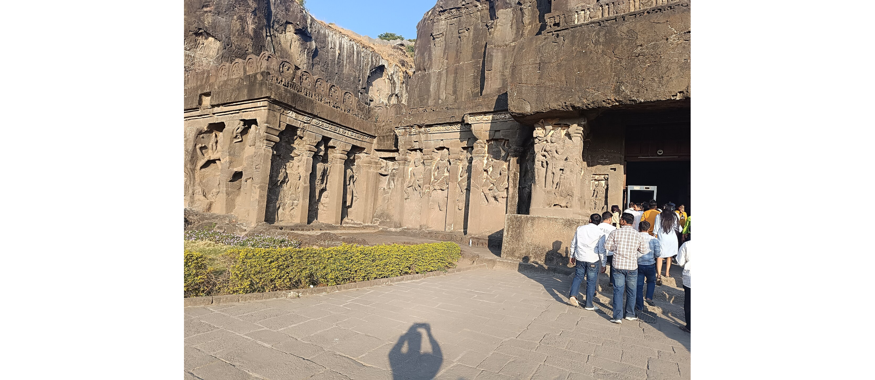
The Kailasa Temple at Ellora
The Kailasa Temple at Ellora, carved from a single rock (c. 8th century CE).
© More Lessons Less Planning | morelessonslessplanning.com
Notes:
Public-domain (CC0) color photograph of the Kailasa Temple, Cave 16, Ellora Caves (Wikimedia Commons), a rock-cut Hindu temple dedicated to Shiva. Use it purely as a reference image to make the previous slide's point concrete: an entire temple carved from solid rock. Describe it respectfully as a sacred site of a living tradition. Students are not asked to decode the image as evidence.

Slide 13
A Closer Look: The Bhagavad Gita
What it is
The Bhagavad Gita is a later Hindu text set within the great epic the Mahabharata.
✔
The scene
On the eve of battle at Kurukshetra, the warrior Arjuna hesitates to fight, and the god Krishna counsels him.
✔
The lesson
Krishna teaches Arjuna about dharma - his duty - and the eternal nature of the atman, the self.
✔
Key Concept: In the BHAGAVAD GITA, Krishna counsels the warrior ARJUNA on his dharma and the eternal atman.
© More Lessons Less Planning | morelessonslessplanning.com
Notes:
Let's look more closely at the text students will analyze in the Activity: the BHAGAVAD GITA. Remember its place in the timeline - it is a LATER text, set within the great epic called the Mahabharata, not the oldest Hindu scripture. Its famous scene takes place on the eve of a great battle at Kurukshetra. The warrior-prince ARJUNA looks across the field, sees relatives and teachers on the other side, and hesitates to fight. His charioteer is the god Krishna, who counsels him. In their dialogue, Krishna teaches Arjuna about his DHARMA - his duty as a warrior in a just cause - and about the ATMAN, the eternal self that, the tradition teaches, is never truly destroyed. On the next slide is a manuscript image of this scene. In the Activity, you will read a passage from Sir Edwin Arnold's 1885 English translation and analyze how the tradition teaches these ideas.

Slide 14
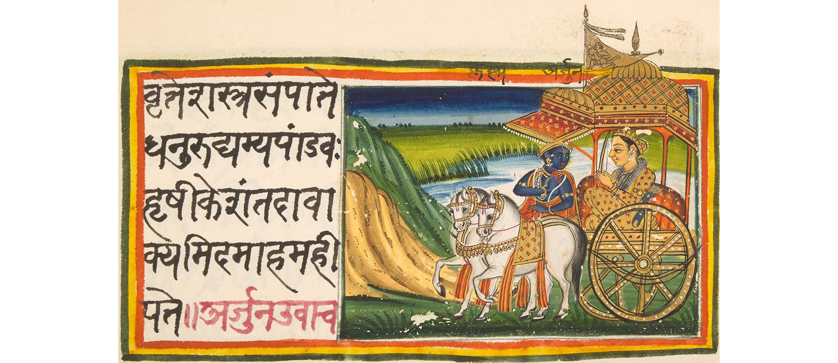
A Bhagavad Gita Manuscript
A 19th-century illustrated Bhagavad Gita manuscript (Kurukshetra scene).
© More Lessons Less Planning | morelessonslessplanning.com
Notes:
Public-domain 19th-century illustrated Sanskrit manuscript folio of the Bhagavad Gita, Chapter 1 (Wikimedia Commons), depicting Krishna and Arjuna on the battlefield of Kurukshetra. Use it purely as a reference image to put a face to the text and scene students analyze in the Primary Source Spotlight. Students are not asked to decode the manuscript as evidence.

Slide 15
Key Takeaways
Hinduism has no single founder; it grew as a centuries-long synthesis.
★
Texts in order: the Vedas (oldest), the Upanishads, then the Bhagavad Gita.
★
Core concepts connect: Brahman, atman, samsara, karma, dharma, and moksha.
★
The Bhagavad Gita teaches dharma and the eternal atman via Krishna and Arjuna.
★
© More Lessons Less Planning | morelessonslessplanning.com
Notes:
Let's recap what you now know about Hinduism, described academically. First, Hinduism has no single founder; it developed as a synthesis over many centuries, and its oldest texts are the Vedas, composed around 1500-1200 BCE. Second, its scripture developed in order: the Vedas first, then the philosophical Upanishads, then the later Bhagavad Gita, which sits within the epic Mahabharata. Third, the tradition's core concepts form one connected system: Brahman is the ultimate reality, atman is the eternal self, samsara is the cycle of rebirth, karma is the moral law that drives that cycle, dharma is righteous duty, and moksha is release from the cycle. Fourth, the Bhagavad Gita teaches dharma and the eternal atman through Krishna's counsel to Arjuna - the passage you analyzed as a primary source. Throughout, we described what the tradition teaches with respect, never judging it as true or false.

