Slide 1
Hieroglyphics and the Rosetta Stone
How Egypt's picture-writing worked - and how we learned to read it again.
© More Lessons Less Planning | morelessonslessplanning.com
Notes:
Open with the hook. For over 3,000 years the ancient Egyptians wrote in hieroglyphics, a beautiful picture-writing carved on temples and tombs. Then the knowledge of how to read it was completely lost for nearly 1,500 years. Today students learn how hieroglyphics actually worked - word-signs, sound-signs, silent determinatives, and the oval cartouches that ringed royal names - and how a single broken slab, the Rosetta Stone, gave scholars the key to crack the code in 1822. The lesson ends with the words of E.A. Wallis Budge, a British Museum scholar, describing the stone's three scripts.

Slide 2
Learning Targets
Explain how hieroglyphics worked: word-signs, sound-signs, and cartouches
★
Describe what the Rosetta Stone is and why its three scripts were the key
★
Analyze how Champollion deciphered hieroglyphics using the Rosetta Stone
★
© More Lessons Less Planning | morelessonslessplanning.com
Notes:
Read each target aloud. Target 1 maps to slides 3-7 (what hieroglyphics were and the four sign-types). Target 2 maps to slides 8-10 (the lost script and the Rosetta Stone's three parallel scripts). Target 3 maps to slides 11-13 (Champollion, how the decipherment worked, and why it mattered) and drives the Primary Source Spotlight on E.A. Wallis Budge. The quiz and activity test all three.

Slide 3
What Hieroglyphics Were
The Sacred Picture-Writing
Who Wrote It
HIEROGLYPHICS = the sacred picture-writing of ancient Egypt
Made of hundreds of small picture-signs
Signs could stand for objects, sounds, or ideas
Carved on temples, tombs, and monuments
A SCRIBE was a specially trained person who could read and write
Scribes kept records on PAPYRUS and on stone
PAPYRUS = a paper-like material made from a river reed
Hieroglyphics were used for over 3,000 years
Key Concept: HIEROGLYPHICS were the sacred picture-writing of ancient Egypt - hundreds of small signs that could stand for objects, sounds, or ideas.
© More Lessons Less Planning | morelessonslessplanning.com
Notes:
Define the central term. HIEROGLYPHICS were the sacred picture-writing of ancient Egypt, made of hundreds of small picture-signs. Unlike our alphabet of 26 letters, hieroglyphics used a large set of signs, and a single sign could stand for an object, a sound, or an idea. They were carved on temples, tombs, and monuments and written on papyrus. A SCRIBE was a specially trained person who could read and write; only a small trained class ever learned the system. Scribes kept records on PAPYRUS, a paper-like material made from a reed that grew along the Nile, and on stone. Hieroglyphics were used for over 3,000 years - one of the longest-lived writing systems in history.

Slide 4
Word-Signs: Logograms
Logogram
A LOGOGRAM was a hieroglyphic sign that stood for a whole word or idea, such as a sun-sign meaning 'sun' or 'day'.
One sign, one word
A picture of the sun could mean the word 'sun' - or the related idea 'day'
The problem
There are far more words than anyone could draw as separate pictures
The clue
Egyptians needed signs that could stand for SOUNDS, not just whole words
Key Concept: A LOGOGRAM is a hieroglyphic sign that stands for a whole word or idea.
© More Lessons Less Planning | morelessonslessplanning.com
Notes:
Introduce the first kind of sign. A LOGOGRAM was a hieroglyphic sign that stood for a whole word or idea. A picture of the sun could mean the word 'sun' - or the closely related idea 'day'. This is a real writing system, but it has a built-in problem: there are far more words than anyone could ever draw as separate pictures, and many ideas (like 'promise' or 'yesterday') have no obvious picture at all. That problem is the clue to the next slide: the Egyptians also needed signs that could stand for SOUNDS, not just whole words.

Slide 5
Sound-Signs: Phonograms
Signs That Stand for Sounds
Why It Mattered
PHONOGRAM = a hieroglyphic sign that stood for a sound
A sound-sign works like a letter in our alphabet
Sound-signs could spell out spoken words and names
They could spell any word, even a foreign name
This let hieroglyphics record real spoken language
Not just objects, but actions, names, and ideas
Egyptian writing used logograms AND phonograms together
Key Concept: A PHONOGRAM is a sign that stands for a sound - it let scribes spell out spoken words and names.
© More Lessons Less Planning | morelessonslessplanning.com
Notes:
Introduce the second kind of sign - the breakthrough. A PHONOGRAM was a hieroglyphic sign that stood for a sound, like a letter. Once signs could stand for sounds, scribes could combine them to spell any word, even a foreign name that had no Egyptian picture. This is what let hieroglyphics record real spoken language, not just objects. Crucially, Egyptian writing did not throw out the old signs - it used logograms AND phonograms together in the same text, mixing word-signs and sound-signs. Remember this sound-sign idea: it is exactly what Champollion will exploit to crack the code at the end of the lesson.

Slide 6
Determinatives: The Silent Signs
Determinative
A DETERMINATIVE was a silent hieroglyphic sign added to the end of a word to show its category and clear up its meaning.
A silent helper
It was not spoken aloud - it only told the reader what kind of thing the word was
Why it was needed
Egyptian had many words that sounded alike, so readers needed a hint
Example idea
The same sounds could mean different things; a determinative showed which one was meant
Note: A DETERMINATIVE is a silent sign added to the end of a word to show its category and clear up its meaning.
© More Lessons Less Planning | morelessonslessplanning.com
Notes:
Introduce the third kind of sign. A DETERMINATIVE was a silent hieroglyphic sign added to the end of a word to show its category and clear up its meaning. It was NOT spoken aloud - it only told the reader what kind of thing the word was. Why was this needed? Egyptian, like many languages, had many words that sounded alike, so a reader could be unsure which one was meant. A determinative at the end acted like a hint: it might show that a word was a kind of person, a place, or an action. The same string of sounds could mean different things, and the determinative showed which one was meant. This makes the point that hieroglyphics were a clever, layered system, not just decoration.

Slide 7
Cartouches: Royal Names in a Ring
Royal Names in a Ring
Why It Mattered Later
CARTOUCHE = an oval ring drawn around a royal name
The ring showed the signs inside spell a king or queen
It set the ruler's name apart from ordinary writing
Cartouches were easy to spot on the Rosetta Stone
Scholars guessed each ring held a known royal name
That guess became a key to cracking the code
Key Concept: A CARTOUCHE is an oval ring drawn around a group of signs to show they spell a royal name, such as a king or queen.
© More Lessons Less Planning | morelessonslessplanning.com
Notes:
Introduce the fourth kind of sign feature - the one that becomes the decoding key. A CARTOUCHE was an oval ring drawn around a group of signs to show that those signs spell a royal name. The ring told any reader: the signs inside spell a king or queen. It set the ruler's name apart from ordinary writing, almost like a highlighter. This matters enormously later: because cartouches were so easy to spot on the Rosetta Stone, scholars could guess that each ring held a known royal name - like Ptolemy - and use the Greek text to figure out which name. That guess became one of the keys that cracked the whole code, which the decipherment slides will show.

Slide 8
A Language That Was Lost
The script fades
As Egypt was ruled by Greeks then Romans, fewer people learned hieroglyphics
The last writers
By about 1,500 years ago, the last people who could read hieroglyphics had died out
Completely forgotten
For centuries the signs on temples were a mystery no one could read
A wrong idea
Many wrongly believed each sign was only a magic symbol, not real writing
Note: For centuries hieroglyphics were completely forgotten - no living person could read a single sign.
© More Lessons Less Planning | morelessonslessplanning.com
Notes:
Explain how the script died out. Hieroglyphics lasted more than 3,000 years, but nothing lasts forever. As Egypt was ruled first by Greeks and then by Romans, and as simpler scripts and new religions spread, fewer and fewer people bothered to learn the difficult sign system. By about 1,500 years ago, the last people who could read hieroglyphics had died out, and the knowledge was completely lost. For centuries afterward, the signs carved on Egypt's temples were a total mystery no one could read. Worse, many scholars had a wrong idea: they believed each sign was only a magic symbol standing for a whole mystical idea, not real writing that recorded sounds and words. That wrong idea held decoding back for a long time - and setting up that mystery makes the Rosetta Stone's arrival on the next slide so dramatic.

Slide 9
The Rosetta Stone: Three Scripts, One Message
What It Is
The Three Scripts
ROSETTA STONE = a stone slab found in 1799
Carved with the same decree in three scripts
The decree honored King Ptolemy V, in 196 BCE
Top: HIEROGLYPHICS, the sacred Egyptian script
Middle: DEMOTIC, the everyday Egyptian script
Bottom: GREEK, the language of Egypt's rulers
DEMOTIC = the everyday running script ordinary Egyptians used
Big Idea: The ROSETTA STONE carries the SAME message in three scripts - hieroglyphic, demotic, and Greek - which is what made it the key to the code.
© More Lessons Less Planning | morelessonslessplanning.com
Notes:
Introduce the star object. The ROSETTA STONE is a stone slab found in Egypt in 1799 by French soldiers. It is carved with the same decree - an official order from Egypt's priests - written three times, in three different scripts. The decree honored the young king Ptolemy V and dates to 196 BCE. The three scripts are stacked: hieroglyphics at the top (the sacred picture-writing), DEMOTIC in the middle (the everyday running script that ordinary Egyptians used for daily writing), and GREEK at the bottom (the language of the kings who then ruled Egypt). Because all three say the same thing, and because scholars could still read Greek, the stone was a built-in translation - the key that could unlock the two forgotten Egyptian scripts. The next slide shows a real photograph of the stone.

Slide 10
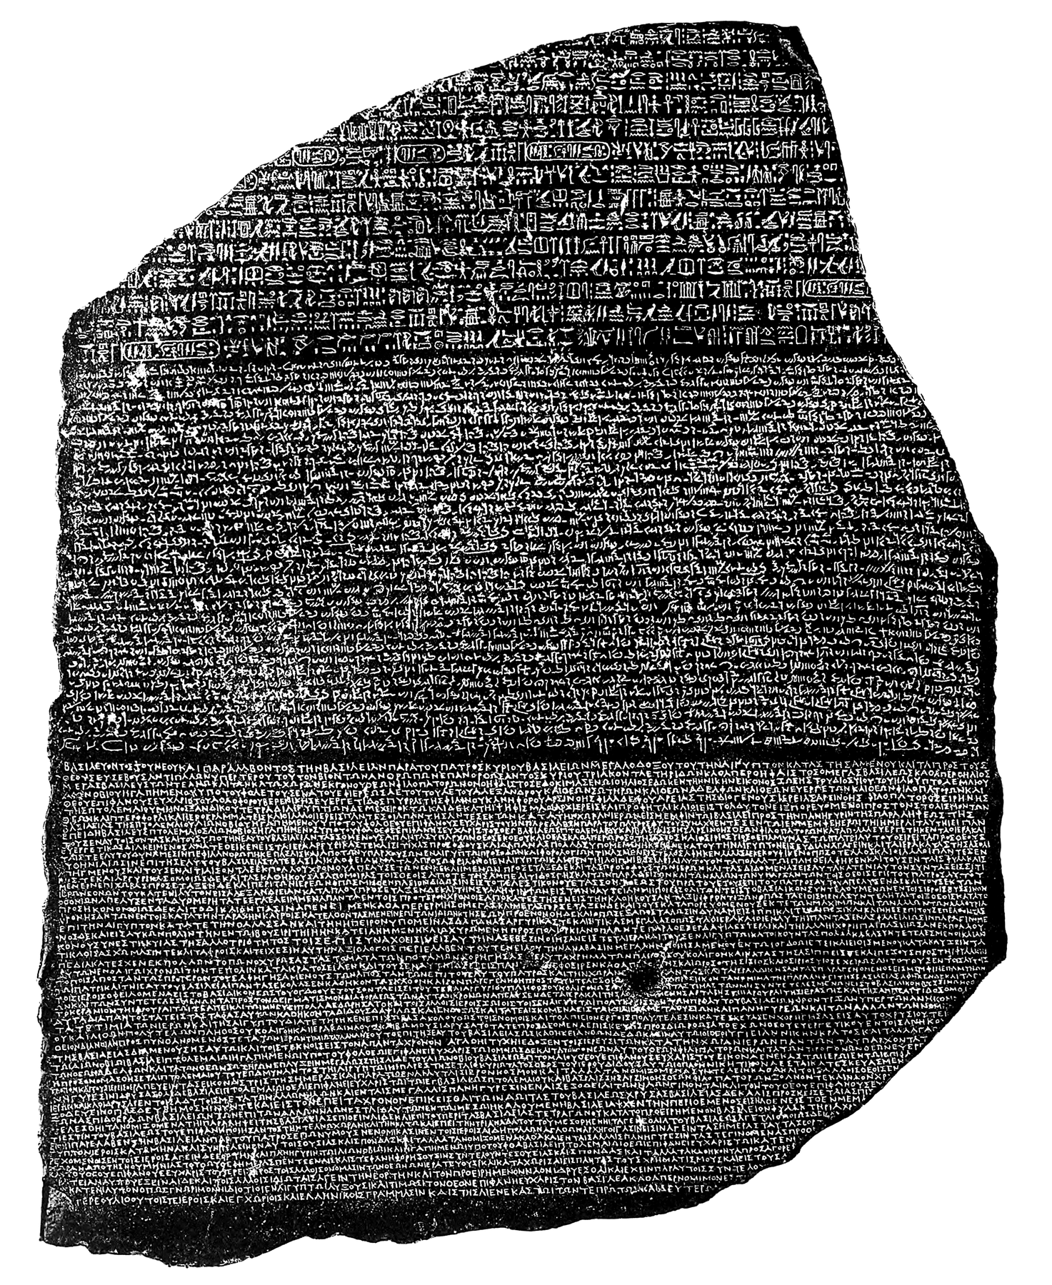
The Rosetta Stone, Up Close
The Rosetta Stone: one decree in three scripts (hieroglyphic, demotic, Greek)
© More Lessons Less Planning | morelessonslessplanning.com
Notes:
Show the real stone. This is a photograph of the actual Rosetta Stone, a dark slab about the height of a person's torso, now in the British Museum. Have students notice that the writing is arranged in three horizontal bands from top to bottom - the hieroglyphics at the top are the most damaged, the demotic fills the wide middle, and the Greek runs along the bottom. Every one of those bands says the same thing. This is the object that gave scholars a known language (Greek) next to two lost ones, and it connects directly to the previous slide. The photograph comes from E.A. Wallis Budge's own book on the stone - the same scholar whose words students analyze in the activity.
Reference labels (point to these chart features when teaching): three bands of text; hieroglyphics at top

Slide 11
Champollion Cracks the Code
Who He Was
His Breakthrough
CHAMPOLLION: Jean-Francois Champollion, a French scholar
He could already read Greek and Coptic (late Egyptian)
He spent years studying copies of the Rosetta Stone
In 1822 he announced he had cracked the code
He read the Greek to learn what the decree said
He found the cartouche holding the name Ptolemy
He matched the ring's signs to the sounds P-T-O-L
The signs stood for SOUNDS - hieroglyphics could be read
Did You Know: In 1822 CHAMPOLLION deciphered Egyptian hieroglyphics using the Rosetta Stone.
© More Lessons Less Planning | morelessonslessplanning.com
Notes:
Introduce the code-breaker. CHAMPOLLION - Jean-Francois Champollion - was a brilliant French scholar who could already read Greek and Coptic, a late form of the Egyptian language written in Greek letters. He spent years studying copies of the Rosetta Stone. His breakthrough came from putting the pieces together: he read the GREEK text to learn what the decree said, then found the cartouche - the oval ring - that held the royal name Ptolemy. Because a name spells out by sound, he matched the signs inside the ring to the sounds of the name (P-T-O-L and so on). That proved the signs stood for SOUNDS, not just magic ideas - and once that was clear, hieroglyphics could finally be read again. In 1822 Champollion announced he had cracked the code.

Slide 12
How the Code Was Broken
Decipherment
DECIPHERMENT is the process of figuring out how to read a lost or unknown script, as Champollion did with hieroglyphics.
Start with the known
Scholars could read the GREEK, so they already knew what the decree said
Use the cartouches
Rings around royal names showed exactly where to find known words like Ptolemy
Match signs to sounds
Champollion matched the signs inside the ring to the sounds of the name
Key Concept: DECIPHERMENT means cracking a lost script - the Greek text and the cartouches were the keys.
© More Lessons Less Planning | morelessonslessplanning.com
Notes:
Lay out the decoding method in plain steps. DECIPHERMENT is the process of figuring out how to read a lost or unknown script, and Champollion's success is the classic example. Step one: start with the known. Scholars could read the GREEK band, so they already knew what the decree said - that told them roughly what the hieroglyphics must also say. Step two: use the cartouches. The oval rings around royal names showed exactly where to find known words like Ptolemy in the hieroglyphic text. Step three: match signs to sounds. Champollion matched the signs inside the ring to the sounds of the name, proving the signs were phonograms. From that foothold, scholars slowly matched more and more signs to sounds until the whole script could be read. The lesson: a known language plus a labeled name is a doorway into an unknown script.

Slide 13
Why the Rosetta Stone Matters
What It Unlocked
The Lesson of the Stone
The lost language of ancient Egypt could be read again
Thousands of temple and tomb texts could finally be understood
Egypt could tell its own story in its own words
A bilingual object was the key to a lost script
The known Greek unlocked the unknown hieroglyphics
The same trick later helped decode other lost scripts
Big Idea: A single object with a known language beside an unknown one can unlock a script lost for 1,500 years.
© More Lessons Less Planning | morelessonslessplanning.com
Notes:
Frame the significance. Once Champollion cracked the code, the payoff was enormous. The lost language of ancient EGYPT could be read again, which meant that thousands of texts carved on temples and tombs and written on papyrus could finally be understood. Egypt could tell its own story in its own words, instead of only through what later peoples said about it. Just as important is the general lesson of the stone: a bilingual object - one that carries a known language beside an unknown one - can be the key to a lost script. The known Greek unlocked the unknown hieroglyphics. That same trick, a known language beside an unknown one, later helped scholars decode other lost scripts around the world, which is why the Rosetta Stone's name is now used for anything that unlocks a mystery.

Slide 14
Key Takeaways
HIEROGLYPHICS mixed word-signs (LOGOGRAMS) and sound-signs (PHONOGRAMS)
★
DETERMINATIVES were silent signs; CARTOUCHES ringed royal names
★
The ROSETTA STONE carried one decree in hieroglyphic, DEMOTIC, and Greek
★
CHAMPOLLION used the Greek and the cartouches to reach DECIPHERMENT in 1822
★
© More Lessons Less Planning | morelessonslessplanning.com
Notes:
Close the lesson. Review the four takeaways aloud. Students should be able to (a) explain how hieroglyphics worked - logograms for words, phonograms for sounds, silent determinatives, and cartouches around royal names; (b) describe the Rosetta Stone and why its three parallel scripts mattered; and (c) explain how Champollion used the Greek text and the cartouches to decipher the script in 1822. The activity's Primary Source Spotlight asks students to analyze E.A. Wallis Budge's account of the stone's three scripts - the moment a lost language became readable again.

