Slide 1
Hagia Sophia and Byzantine Culture
How one great domed church captured Byzantine wealth, engineering, and Orthodox Christian faith in Constantinople.
© More Lessons Less Planning | morelessonslessplanning.com
Notes:
Opening slide. Hagia Sophia - Greek for 'Holy Wisdom' - was the greatest church of the Byzantine Empire, built in Constantinople under Emperor Justinian in just five years (532-537 CE). For almost a thousand years it was the largest enclosed space in the world and the spiritual heart of Orthodox Christianity. Set the frame from the first minute: this lesson uses one building to understand a whole culture - its enormous wealth, its daring engineering, and its Orthodox Christian identity - and it ends by reading the awe-struck words of an eyewitness, Procopius, while learning to read those words critically.

Slide 2
Learning Targets
Explain what Hagia Sophia was and what it meant to Byzantine Constantinople.
★
Describe the dome, the pendentives, and the 'floating dome' effect.
★
Explain how the building reflected Byzantine wealth, engineering, and faith.
★
Read Procopius's Buildings as a primary source - and read it critically.
★
© More Lessons Less Planning | morelessonslessplanning.com
Notes:
Read the four learning targets. Keep two anchors in mind throughout. First, Hagia Sophia was the Orthodox Christian cathedral at the heart of Constantinople, and we study its religion academically, as historians. Second, when we read the eyewitness Procopius near the end, we will read him critically: his book Buildings was written to praise Justinian, so its glowing description is evidence of how the church was meant to impress, not a neutral report. Pay special attention to target two (the engineering of the dome) and target four (reading Procopius), because they anchor the activity.

Slide 3
What Is Hagia Sophia?
'Holy Wisdom'
The heart of Constantinople
Hagia Sophia is Greek for 'Holy Wisdom.'
It was the great domed cathedral of the Byzantine Empire.
It was the chief church of Orthodox Christianity in the east.
It stood in Constantinople, the wealthy Byzantine capital.
Constantinople sat on the strait between Europe and Asia.
The building was the spiritual center of the whole empire.
Key Concept: HAGIA SOPHIA ('Holy Wisdom') was the Orthodox Christian cathedral at the heart of CONSTANTINOPLE, the Byzantine capital.
© More Lessons Less Planning | morelessonslessplanning.com
Notes:
Start with the basics. Hagia Sophia is Greek for 'Holy Wisdom,' and it was the greatest church of the Byzantine Empire - the eastern, Greek-speaking continuation of Rome. It served as the cathedral of Orthodox Christianity, the Christian tradition of the Byzantine east, and it was the spiritual center of the whole empire. It stood in Constantinople, the wealthy Byzantine capital on the narrow strait between Europe and Asia. Present its religious role academically, as historians: this was the most important church in the Orthodox Christian world, the place where the empire's faith and its rulers met. This is the building whose construction and meaning we will trace today.

Slide 4
Justinian Builds a Wonder (532-537 CE)
After the Nika riots
The earlier church burned in the Nika riots of 532 CE, a violent revolt; Justinian chose to rebuild grander.
✔
Built in five years
Emperor Justinian ordered the new church built, and it rose in only about five years (532-537 CE).
✔
Mathematicians, not just builders
Justinian chose Anthemius and Isidore, mathematicians (of Tralles and Miletus), not just builders.
✔
Key Concept: Emperor JUSTINIAN had Hagia Sophia built in 532-537 CE after the NIKA RIOTS, choosing mathematicians ANTHEMIUS AND ISIDORE to design it.
© More Lessons Less Planning | morelessonslessplanning.com
Notes:
Here is how the wonder was built. In 532 CE, a violent revolt called the Nika riots swept Constantinople and burned down the church that stood on the site. Rather than simply repair it, Emperor Justinian seized the chance to build something far grander. He ordered a new Hagia Sophia, and remarkably it was finished in only about five years, from 532 to 537 CE. Emphasize one honesty anchor here: Justinian chose as his designers not ordinary master builders but Anthemius of Tralles and Isidore of Miletus, who were mathematicians and geometers. They approached the church as a problem in geometry, and that mathematical skill is exactly what made its daring dome possible. The scale, speed, and expense of the project show the enormous wealth of the Byzantine Empire.

Slide 5
The Engineering: Dome and Pendentives
A round dome on a square base
The 'floating dome' effect
The dome is the huge rounded ceiling that crowns the church.
A pendentive is a curved triangular support built at each corner.
Pendentives let the round dome rest on a square base.
A ring of windows runs around the base of the dome.
Light pours in underneath, so the stone overhead seems to hover.
The dome looks as if it floats with no solid support.
Key Concept: The PENDENTIVE lets a round DOME sit on a square base, and a ring of windows makes the dome seem to float.
© More Lessons Less Planning | morelessonslessplanning.com
Notes:
Now the engineering - the reason Hagia Sophia amazed everyone who entered. The central problem was geometric: how do you set a huge ROUND dome on top of a SQUARE room? The solution was the PENDENTIVE, a curved triangular section of masonry built into each corner. The four pendentives gather the round rim of the dome down onto the four piers of a square base, carrying its enormous weight to the ground. Then Anthemius and Isidore added their masterstroke: a ring of windows runs all the way around the base of the dome, so daylight floods in just beneath it. Because you cannot easily see what holds the dome up, it seems to hover in the air - the famous 'floating dome' effect. The next slide shows a real interior view so students can see the dome, the ring of windows, and the pendentives for themselves.

Slide 6
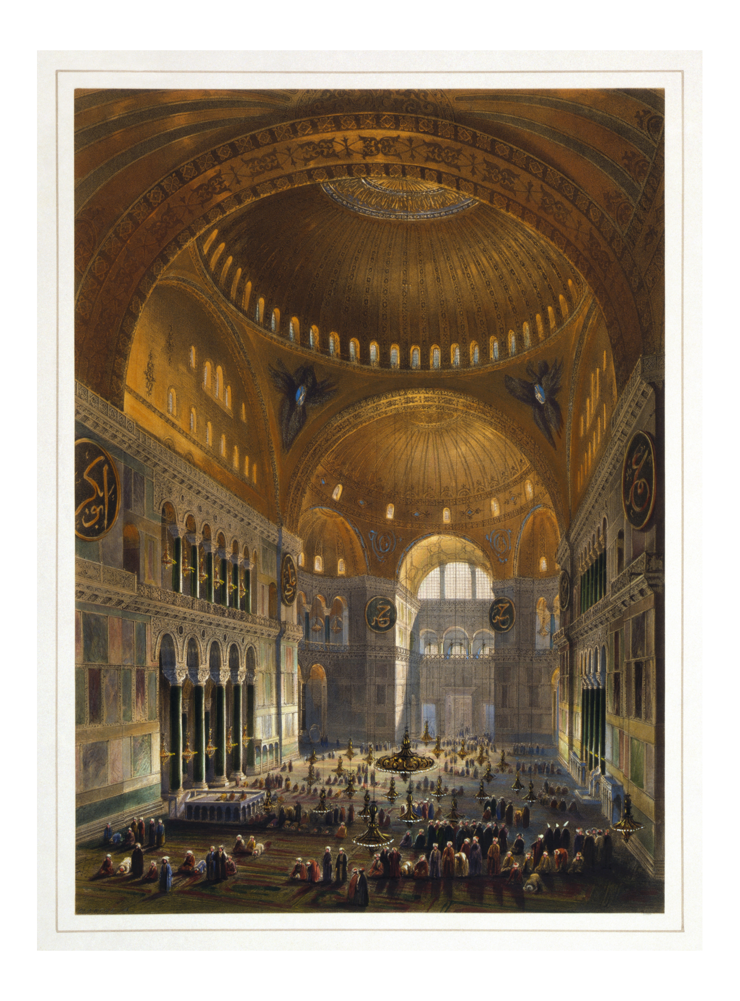
Inside Hagia Sophia
Hagia Sophia interior; lithograph by G. Fossati, 1852 (public domain).
© More Lessons Less Planning | morelessonslessplanning.com
Notes:
A real public-domain color lithograph of the interior of Hagia Sophia by Gaspare Fossati, published in 1852. Use it purely as a reference image to make the engineering slide concrete: point out the great dome, the ring of windows around its base that produces the 'floating' effect, the curved pendentives in the corners, and the half-domes that extend the space. Be honest about what students see: this 1852 view shows the building in its long period as a mosque, so the huge round calligraphic panels and the prayer rugs on the floor are Ottoman-era additions, and the dome shown is the REBUILT dome, not the 6th-century original. Describe it academically as a genuine 19th-century artifact; students are not asked to decode the image as evidence. Image: color lithograph, Gaspare Fossati, 1852, public domain (via Wikimedia Commons).

Slide 7
The Dome That Fell and Rose Again
The original dome was too flat
The first dome, finished in 537 CE, was wide and shallow, which pushed its weight dangerously outward on the walls.
✔
It collapsed after earthquakes
After earthquakes struck, part of the original dome collapsed in 558 CE, about twenty years after the church was finished.
✔
Rebuilt higher and steeper
Isidore the Younger rebuilt the dome higher and steeper, completed about 562 CE; that rebuilt dome is the one that still stands.
✔
Key Concept: The ORIGINAL dome collapsed in 558 CE and was rebuilt higher by ISIDORE THE YOUNGER - today's dome is not the first one.
© More Lessons Less Planning | morelessonslessplanning.com
Notes:
Here is a fact that students often get wrong, so make it clear. The dome that stands today is NOT the original one. The first dome, finished in 537, was daringly wide and shallow, and that flat shape pushed its huge weight outward against the supporting walls. After a series of earthquakes, part of that original dome collapsed in 558 CE, only about twenty years after the church opened. Justinian had it rebuilt - this time by Isidore the Younger, the nephew of the original Isidore - who raised the dome higher and made it steeper so its weight pressed down more safely. That rebuilt dome, completed around 562 CE, is essentially the one visitors see today. This matters for the primary source later: when the eyewitness Procopius marveled at the dome, he was describing the ORIGINAL dome, not the rebuilt one we can still see.

Slide 8
The Heart of Byzantine Life
The center of the faith
Where church and empire met
Hagia Sophia was the cathedral of Orthodox Christianity.
The patriarch, the leading bishop of Constantinople, was based here.
Its grand worship was designed to fill visitors with awe.
Emperors were crowned and celebrated inside the church.
Religion and government met together under its dome.
The building linked the empire's faith to its rulers.
Key Concept: Hagia Sophia was the center of ORTHODOX CHRISTIANITY and the seat of the PATRIARCH, where the empire's faith and rulers came together.
© More Lessons Less Planning | morelessonslessplanning.com
Notes:
Hagia Sophia was far more than an impressive building; it was the beating heart of Byzantine life. Religiously, it was the chief cathedral of Orthodox Christianity, the Christian tradition of the Byzantine east, and it was the seat of the patriarch - the leading bishop of Constantinople and head of the Orthodox Church in the empire. Its enormous, gold-lit interior and its solemn ceremonies were deliberately designed to overwhelm worshippers with a sense of awe and holiness. Politically, the church was also where the empire's rulers and its faith came together: emperors were crowned and honored beneath its dome, and great state and religious ceremonies filled the space. Present this academically: in the Byzantine world, religion and government were tightly woven together, and Hagia Sophia was the single place where that union was most visible.

Slide 9
Mosaics: Gold, Crosses, and Later Images
What a mosaic is
A mosaic is a picture or design made from many small pieces of colored glass or stone, set into walls and ceilings.
✔
The original decoration
Hagia Sophia's earliest decoration was largely non-figural - shimmering gold, patterns, and crosses rather than pictures of people.
✔
The famous images came later
Most famous figural mosaics (like the Virgin and Child) were added centuries later, after the dispute over religious images called Iconoclasm.
✔
Key Concept: Hagia Sophia's original MOSAICS were mostly gold and crosses; the famous figural mosaics were added centuries later.
© More Lessons Less Planning | morelessonslessplanning.com
Notes:
The inside of Hagia Sophia was covered in mosaics - pictures and designs built from thousands of tiny pieces of colored glass and stone, many backed with gold so the whole interior glowed with light. Here students need an honest correction they rarely hear. The building's earliest decoration was largely NON-figural: shimmering gold surfaces, geometric patterns, and crosses, rather than portraits of holy figures. The famous figural mosaics that appear in most photographs today - such as the great image of the Virgin and Child, or the imperial portraits - were added centuries LATER, after a long Byzantine dispute over whether religious images should be allowed, known as Iconoclasm (roughly the 8th and 9th centuries). So when we see a beautiful figural mosaic in Hagia Sophia, we should ask when it was made: many date from the 9th century or later, not from Justinian's original 6th-century church. Caption any mosaic honestly by its era.

Slide 10
How We Know: Procopius's Account
An eyewitness description
The historian Procopius saw Hagia Sophia and described its dome as seeming to hang from Heaven by a golden chain, floating in the air.
✔
But it was written to praise
Procopius wrote this in Buildings, a book meant to celebrate Justinian's construction projects, so its glowing praise is not neutral reporting.
✔
The same author also attacked Justinian
The same Procopius wrote the Secret History, which savagely attacks Justinian - one writer, opposite tones, depending on each book's purpose.
✔
Key Concept: PROCOPIUS praised the dome as if hung from Heaven - but his Buildings was written to flatter Justinian, so we read it critically.
© More Lessons Less Planning | morelessonslessplanning.com
Notes:
How do we know how people reacted to Hagia Sophia? One key source is the historian Procopius, who saw the church and described its great dome as seeming to hang from Heaven by a golden chain, floating in the air - one of the most famous descriptions of a building ever written. But students must read it critically, and this is the central sourcing lesson of the day. Procopius wrote that description in a book called Buildings, which was a panegyric - a work commissioned to praise and celebrate Emperor Justinian's construction projects. Its purpose was to flatter, so its glowing awe is evidence of how the church was MEANT to impress, not a neutral, balanced report. The proof that his tone depended on purpose is striking: the very same Procopius also wrote the Secret History, a book that savagely attacks Justinian and Theodora. One author, opposite tones - because the audience and purpose of each book were different. This is exactly the source students will analyze in the activity.

Slide 11
After Byzantium: Mosque, Museum, Mosque
From cathedral to mosque
Museum, then mosque again
In 1453 the Ottomans conquered Constantinople.
Hagia Sophia was converted into a mosque.
Minarets and calligraphic panels were added over time.
In 1935 the building became a secular museum.
In 2020 it was converted back into a mosque.
Through every change, the same great domed structure remained.
Key Concept: After 1453 Hagia Sophia became a mosque, in 1935 a museum, and in 2020 a mosque again - one building across many chapters of history.
© More Lessons Less Planning | morelessonslessplanning.com
Notes:
Finish the building's own story briefly and factually. Hagia Sophia served as the Orthodox cathedral for about 900 years. Then in 1453 the Ottomans conquered Constantinople, ending the Byzantine Empire, and they converted Hagia Sophia into a mosque, adding minarets outside and great calligraphic panels inside - the very features visible in the 1852 lithograph students saw earlier. In 1935 the modern Turkish republic turned the building into a secular museum, open to visitors of every background, and in 2020 it was converted back into a mosque. Keep this strictly factual and academic - it is a neat illustration of how one structure can pass through many different roles across history. The point for today is that through every change, the same great domed church built by Justinian's engineers has kept standing.

Slide 12
Hagia Sophia and Byzantine Culture
Wealth
Building so vast a church in five years, sheathed in marble and gold mosaic, shows the enormous wealth of the Byzantine Empire.
✔
Engineering
The pendentives and the ring of windows show Byzantine mastery of mathematics and daring engineering.
✔
Faith
As the Orthodox cathedral and seat of the patriarch, the building shows how central Christian faith was to Byzantine identity.
✔
Key Concept: Hagia Sophia reflects Byzantine culture in three ways at once - its WEALTH, its ENGINEERING, and its Orthodox Christian FAITH.
© More Lessons Less Planning | morelessonslessplanning.com
Notes:
Pull the whole lesson together with the big idea. Hagia Sophia is not just a beautiful building; it is a window into an entire civilization, because it reflects Byzantine culture in three ways at once. First, wealth: raising so enormous a church in only five years, and covering it in marble and glittering gold mosaic, was possible only because the Byzantine Empire was extraordinarily rich. Second, engineering: the pendentives that carry the round dome on a square base and the ring of windows that makes it seem to float reveal a culture that had mastered mathematics and dared to build at the very edge of what was possible - so much so that the first dome failed and had to be rebuilt. Third, faith: as the cathedral of Orthodox Christianity and the seat of the patriarch, where emperors were crowned, the building shows how completely Christian faith shaped Byzantine identity. Wealth, engineering, and faith - Hagia Sophia holds all three under one dome.

Slide 13
Key Takeaways
Hagia Sophia ('Holy Wisdom') was the Orthodox cathedral of Constantinople.
★
Justinian built it in 532-537 CE using the pendentive and a ring of windows.
★
The original dome collapsed in 558 and was rebuilt by Isidore the Younger.
★
The building reflects Byzantine wealth, engineering, and Orthodox faith.
★
© More Lessons Less Planning | morelessonslessplanning.com
Notes:
Let's recap what you now know about Hagia Sophia and Byzantine culture. First, what it was: Hagia Sophia, Greek for 'Holy Wisdom,' was the great cathedral of Orthodox Christianity at the heart of Constantinople and the seat of the patriarch. Second, how it was built: Emperor Justinian had it raised in only five years (532-537 CE) after the Nika riots, using the mathematician-architects Anthemius and Isidore, whose pendentives carried a round dome on a square base and whose ring of windows made the dome seem to float. Third, the honest details: the original dome was too flat and collapsed after earthquakes in 558, so the dome standing today is Isidore the Younger's rebuilt one - which means the eyewitness Procopius, whose glowing praise was written to flatter Justinian, described a dome we can no longer see. Fourth, the big idea: the building reflects Byzantine wealth, engineering, and Orthodox Christian faith all at once, which is why one church can teach us about a whole civilization.

