Slide 1
Great Zimbabwe - The Stone City
How a city of mortarless stone reveals a powerful, organized Shona kingdom in medieval southern Africa.
© More Lessons Less Planning | morelessonslessplanning.com
Notes:
Opening slide. Between about 1100 and 1450 CE, the ancestral Shona people of southern Africa built Great Zimbabwe, the stone-built capital of a rich and powerful kingdom. Set the frame from the first minute in a respectful, academic, evidence-based tone: this is the history of a real African civilization, described accurately from the ruins and the archaeology. The central honesty anchor runs through the whole lesson - Great Zimbabwe was built by the SHONA, an indigenous African people, and the old colonial claim that outsiders (Phoenicians, Arabs, or the Queen of Sheba) built it was a racist myth that modern archaeology has conclusively debunked. Do NOT sensationalize a 'mystery': the mystery framing IS the colonial myth, and this lesson subverts it with evidence. The payoff: massive mortarless stonework plus gold and Indian Ocean trade goods together reveal an organized, wealthy African kingdom.

Slide 2
Learning Targets
Explain that the Shona built Great Zimbabwe in dry stone, without mortar.
★
Describe the Great Enclosure, the conical tower, and the Indian Ocean trade.
★
Explain how the stonework, trade goods, and cattle reveal an organized kingdom.
★
Analyze de Barros's account and explain why the foreign-origin theory is a myth.
★
© More Lessons Less Planning | morelessonslessplanning.com
Notes:
Read the four learning targets. Keep two anchors in mind throughout. First, we treat Great Zimbabwe as the achievement of a real, indigenous African civilization, described accurately from evidence: the ancestral SHONA people built it, in dry stone without mortar. Second, we read our main written outside source - Joao de Barros's sixteenth-century description - critically, remembering he never saw the site and passed along coast-merchant guesses. Pay special attention to target two (the Great Enclosure, the conical tower, and the trade), because the monumental stonework and the imported glass beads, Chinese porcelain, and Persian ceramics are the memorable evidence of the lesson, and to target four (de Barros and the foreign-origin myth), because that source and that correction are what students analyze and explain in the activity.

Slide 3
A Powerful Shona Kingdom
The stone capital
Built by the Shona
Great Zimbabwe was a stone-built capital in southern Africa.
It was at its height from about 1100 to 1450 CE.
At its peak it was home to as many as 18,000 people.
The ancestral Shona people built and ruled Great Zimbabwe.
The Shona were an indigenous southern African people.
'Zimbabwe' comes from a Shona word for houses of stone.
Key Concept: GREAT ZIMBABWE was the stone-built capital of a powerful, organized SHONA kingdom in southern Africa, c.1100-1450 CE.
© More Lessons Less Planning | morelessonslessplanning.com
Notes:
Start by placing the kingdom and naming its builders honestly. GREAT ZIMBABWE was the stone-built capital of a powerful, organized kingdom in southern Africa (in the country that today takes its name), at its height from about 1100 to 1450 CE, when as many as 18,000 people may have lived there. Make the central point clearly and from the first content slide: it was built by the ancestral SHONA people - an indigenous southern African people, the ancestors of the Shona who still live in the region today. The very name 'Zimbabwe' comes from a Shona phrase meaning 'houses of stone' (dzimba dzemabwe). This is the honest, evidence-based foundation of the whole lesson: a great African stone city, built by Africans. Everything that follows - the walls, the tower, the gold trade - is the achievement of this Shona kingdom.

Slide 4
Building in Stone Without Mortar
Dry-stone building
The Shona fitted shaped granite blocks together using the dry-stone method, with no mortar.
✔
No mortar at all
No mortar, cement, or lime held the walls; the stones' weight and precise fit keep them standing.
✔
Skill and organized labor
Building mortarless walls this large took skilled masons, planning, and an organized workforce.
✔
Key Concept: Great Zimbabwe's walls used the DRY-STONE method - shaped stones fitted together with NO MORTAR to hold them.
© More Lessons Less Planning | morelessonslessplanning.com
Notes:
Now the building method that makes Great Zimbabwe famous. The Shona built its walls using the DRY-STONE method: they shaped local granite into even, brick-like blocks and fitted them together so carefully that the walls needed NO MORTAR, cement, or lime to hold them - the stones' own weight and precise fit keep them standing. Stress how demanding this is: dry-stone walls on this scale require skilled masons, careful planning, and a large, organized workforce directed over many years. Some walls rise several meters high and run for hundreds of meters, and much of it still stands after more than five hundred years without mortar. Point students toward the lesson's argument: a building method this skilled and this large is itself evidence of an organized, powerful kingdom able to command labor and expertise - the work of the Shona themselves.

Slide 5
The Great Enclosure and the Conical Tower
The Great Enclosure
The conical tower
The Great Enclosure is the largest structure at the site.
Its oval dry-stone wall stands up to 11 meters high.
It is the largest ancient stone building in sub-Saharan Africa.
Inside stands a solid, rounded conical tower of stone.
It is a famous symbol of Great Zimbabwe.
Its exact purpose is still debated by scholars.
Key Concept: The GREAT ENCLOSURE is a huge oval dry-stone wall (up to 11 m high), and inside it stands the famous CONICAL TOWER.
© More Lessons Less Planning | morelessonslessplanning.com
Notes:
Now the two most famous structures, shown on the next slide. The GREAT ENCLOSURE is the largest structure at Great Zimbabwe: a huge oval wall of dry stone, up to about 11 meters (36 feet) high and some 250 meters around, containing perhaps a million granite blocks. It is the largest ancient stone structure in sub-Saharan Africa, and it was probably a royal residence or a place for the ruling elite. Inside the Great Enclosure stands the CONICAL TOWER - a solid, rounded tower of stone about 9 meters (30 feet) tall, built like a giant grain bin. It is the single most famous symbol of Great Zimbabwe, but be honest about the limits of our knowledge: its exact purpose is still debated - scholars think it may have been a symbol of royal power, wealth, or the ruler's role in ensuring good harvests. Keep the tone accurate: these are real, documented monuments, and their scale points to an organized kingdom. The next slide is a photograph of the Great Enclosure.

Slide 6
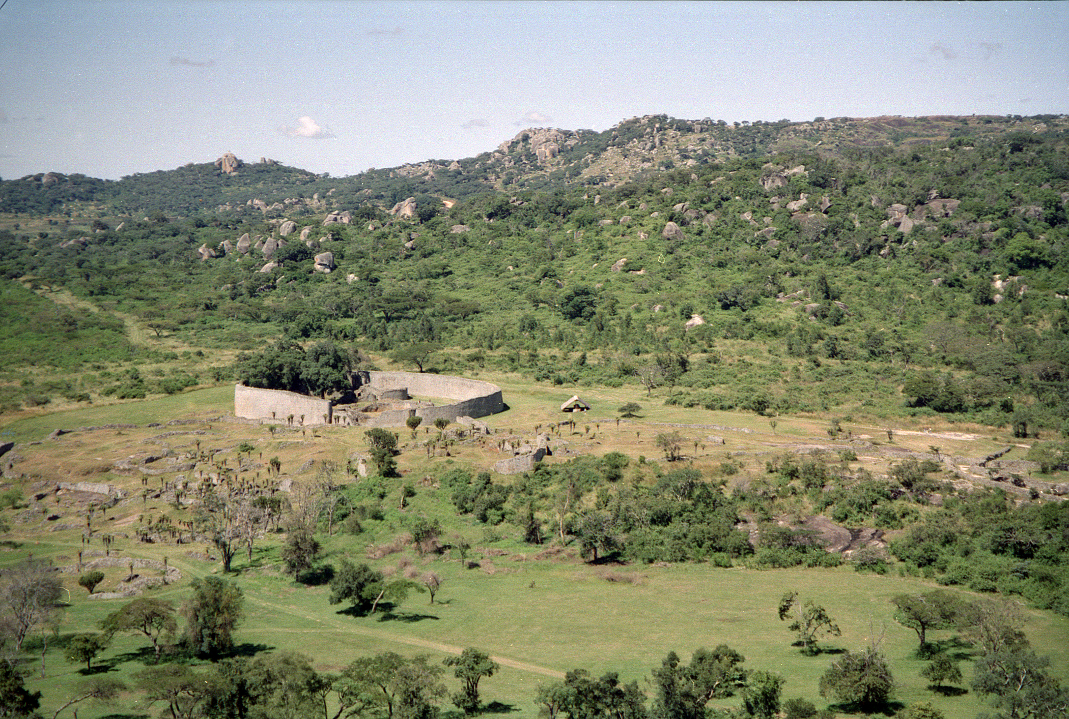
The Great Enclosure, Great Zimbabwe
The Great Enclosure at Great Zimbabwe, seen across the granite valley.
© More Lessons Less Planning | morelessonslessplanning.com
Notes:
A real public-domain photograph: the Great Enclosure at Great Zimbabwe, in present-day Zimbabwe, seen across the valley (Jan Derk, 1997). Use it purely as a reference image to make the monumental stonework concrete. Point out two things: the great OVAL WALL of the Great Enclosure curving across the middle of the view - this single dry-stone wall is the largest ancient stone structure in sub-Saharan Africa; and the GRANITE hills and boulders scattered across the landscape behind it, the local stone that Shona masons split into blocks to build the walls. Explain that the whole site once held a stone-walled capital of thousands of people, of which these walls are the surviving heart. Note honestly that this is the ruin as it survives today, weathered over centuries, not a reconstruction of the living city. Image: photograph of the Great Enclosure, Great Zimbabwe (Jan Derk, 1997), via Wikimedia Commons (public domain).
Reference labels (point to these chart features when teaching): Oval wall: the Great Enclosure; Granite hills: local stone

Slide 7
Gold and the Coast
Gold from the interior
Gold was mined in the lands around Great Zimbabwe and gathered by the kingdom.
✔
Carried to the coast
Gold was carried east to the Indian Ocean coast, to Swahili trading ports like Sofala and Kilwa.
✔
Wealth for the kingdom
Controlling the gold trade made Great Zimbabwe's rulers rich and powerful.
✔
Key Concept: GOLD mined inland was carried from Great Zimbabwe to the Indian Ocean COAST, a main source of the kingdom's wealth.
© More Lessons Less Planning | morelessonslessplanning.com
Notes:
Now the source of the kingdom's wealth. GOLD was mined in the lands around Great Zimbabwe and gathered under the control of its rulers. From the interior it was carried east, across the land, down to the Indian Ocean coast - to Swahili trading ports such as Sofala and Kilwa - where it entered the great Indian Ocean trade network. Controlling this flow of gold is a big part of what made Great Zimbabwe rich: whoever commanded the routes between the goldfields and the coast could tax and profit from one of the most valued goods in the medieval world. Set up the next slide by stressing the two-way nature of this trade: gold flowed out toward the ocean, and in return, remarkable goods from far across the Indian Ocean flowed inland to Great Zimbabwe.

Slide 8
Treasures From Across the Ocean
Goods from far away
What archaeologists found
In the Indian Ocean trade, gold was exchanged for foreign goods.
Those goods traveled back inland to Great Zimbabwe.
The city sat at the inland end of a vast trade network.
Glass beads from India and the Middle East.
Chinese porcelain and Persian ceramics.
These imports in the ruins prove long-distance trade.
Key Concept: Through the INDIAN OCEAN trade, gold was exchanged for glass beads, Chinese PORCELAIN, and Persian ceramics.
© More Lessons Less Planning | morelessonslessplanning.com
Notes:
Here is some of the most striking evidence of the kingdom's reach. In the INDIAN OCEAN trade, the gold that flowed out to the coast was exchanged for goods from astonishingly far away, and those goods traveled back inland to Great Zimbabwe. Archaeologists digging at the site have found imported treasures buried in the ruins: glass beads from India and the Middle East, Chinese PORCELAIN, and Persian ceramics and glass. Make the point vivid: a bowl made in China and a bead made in India ended up in a stone city deep in the interior of southern Africa, hundreds of miles from any ocean. That is powerful, physical proof that Great Zimbabwe was plugged into the vast Indian Ocean trade network that linked Africa, Arabia, Persia, India, and China. These imported objects are also honest evidence: they show contact and trade with the outside world, but they do NOT mean outsiders built the city - the builders were the Shona, and the foreign goods are things they traded FOR with their gold.

Slide 9
Cattle and Wealth
Herds as wealth
Cattle were a central measure of wealth and power for Great Zimbabwe's rulers.
✔
Feeding the capital
Large herds fed the thousands of people living in and around the stone city.
✔
Evidence in the ground
Cattle bones found at the site confirm how important herding was to the kingdom.
✔
Key Concept: CATTLE herds were a central measure of WEALTH and power for Great Zimbabwe's rulers, and fed the capital.
© More Lessons Less Planning | morelessonslessplanning.com
Notes:
Gold and foreign goods were not the only wealth. CATTLE - herds of livestock - were a central measure of wealth and power in Great Zimbabwe, as in many southern African societies. A ruler's power was measured partly in the size of his herds, and controlling cattle meant controlling food, followers, and prestige. Large herds also fed the thousands of people who lived in and around the stone city, so cattle were both a symbol of status and a practical basis of the capital's food supply. We know cattle mattered here because archaeologists have found large numbers of cattle bones in the ruins, especially in the elite areas - physical evidence of herding and feasting. Add cattle to the picture students are building: alongside monumental stonework and long-distance gold trade, great herds of cattle are another sign of an organized, wealthy kingdom.

Slide 10
What the Stonework Reveals
Signs of organization
A powerful state
Monumental stone walls required planned, organized labor.
A capital of thousands needed rulers and officials to run it.
Controlling gold and cattle meant a strong central authority.
Together these signs reveal an organized, powerful kingdom.
The ruling elite lived apart, in the walled stone enclosures.
Great Zimbabwe led a wide network of towns and trade.
Key Concept: The stonework, the gold and Indian Ocean trade, and the cattle wealth together reveal an ORGANIZED, powerful kingdom.
© More Lessons Less Planning | morelessonslessplanning.com
Notes:
Now pull the evidence together into the lesson's central argument. Ask students what it takes to build and run a place like Great Zimbabwe. The monumental dry-stone walls required PLANNED, ORGANIZED labor over many years - which means leaders who could direct thousands of workers. A capital of up to 18,000 people needed rulers, officials, and some structure of authority to feed, house, and govern it. Commanding the gold trade to the coast and holding great herds of cattle meant a strong central authority that could tax, control, and reward. And the ruling elite clearly lived apart, in the walled stone enclosures, set above the common people in their homes of clay and thatch. Put it plainly: the stonework and the trade goods are not just impressive objects - they are EVIDENCE. Together they reveal that Great Zimbabwe was an ORGANIZED, powerful kingdom at the head of a wide network of towns and trade, not a scattered village. This is the reasoning students will use in the activity to interpret the primary source.

Slide 11
Joao de Barros: An Outside Observer
Who de Barros was
An outside observer
Joao de Barros was a Portuguese royal chronicler.
He wrote about 'Symbaoe' (Great Zimbabwe) in the 1500s.
He never traveled to southeastern Africa himself.
He wrote from second-hand reports reaching the coast.
He is an outside observer, not an eyewitness.
His account reaches us through Theal's 1900 translation.
Remember: JOAO DE BARROS was an OUTSIDE observer - a Portuguese chronicler who never saw the site and wrote from second-hand reports.
© More Lessons Less Planning | morelessonslessplanning.com
Notes:
Before students read the primary source in the activity, they need to know exactly what kind of source it is - this is the sourcing anchor of the lesson. JOAO DE BARROS was a Portuguese royal chronicler who, in the 1500s, wrote one of the earliest European descriptions of the great stone building the coast people called 'Symbaoe' (Great Zimbabwe). But here is the key point: de Barros never traveled to southeastern Africa. He wrote in Lisbon, in Portugal, from second-hand reports, letters, and informants that reached the Portuguese trading posts on the Indian Ocean coast. That makes him an OUTSIDE OBSERVER at two removes - not an eyewitness, but someone recording what coast merchants and travelers told him. His account is valuable because it is one of the earliest written descriptions and preserves real details (the mortarless walls, the gold trade), but students must read it carefully: it also passes along coast-merchant guesses, including the false idea that ancient foreigners built the city. Students will read his words as translated by G. McCall Theal in 1900 - keep straight that de Barros is the chronicler and Theal is the later translator.

Slide 12
Who Really Built It?
The colonial myth
Colonial-era Europeans falsely claimed Phoenicians, Arabs, or the Queen of Sheba built it.
✔
Why the myth spread
It rested on the racist assumption that Africans could not have built monumental stonework.
✔
What archaeology proves
Radiocarbon dating, local Iron-Age finds, and Shona building traditions prove the Shona built it.
✔
Key Concept: The FOREIGN-ORIGIN MYTH that outsiders built it was a racist colonial claim; ARCHAEOLOGY proves the SHONA built it.
© More Lessons Less Planning | morelessonslessplanning.com
Notes:
This is the intellectual payoff of the lesson - handle it directly and honestly. For about a century, colonial-era Europeans (and later Rhodesian authorities) falsely claimed that Great Zimbabwe had been built by outsiders - Phoenicians, Arabs, or the biblical Queen of Sheba. This is the FOREIGN-ORIGIN MYTH, and it did not rest on evidence: it rested on the racist assumption that Africans could not have built monumental stonework, and it was used to justify colonial rule. Some colonial authorities even removed or ignored evidence that pointed to African builders. Now the correction, from the evidence: modern ARCHAEOLOGY has conclusively established that Great Zimbabwe was built by the ancestral SHONA people. Radiocarbon dating places it firmly in the medieval period (about 1100 to 1450 CE); the objects found there belong to the local Iron-Age material record of southern Africa; and the dry-stone building style continues local Shona traditions. Make the payoff explicit for students: the 'mystery' of who built Great Zimbabwe is not a real mystery at all - it is a colonial myth, and the evidence-based answer is clear and proud: the Shona built it themselves.

Slide 13
Key Takeaways
The ancestral Shona built Great Zimbabwe in dry stone, without mortar.
★
The Great Enclosure and conical tower are Africa's largest ancient stonework.
★
Gold and the Indian Ocean trade brought porcelain and beads inland.
★
Archaeology proves the Shona built it; the foreign-origin theory is a myth.
★
© More Lessons Less Planning | morelessonslessplanning.com
Notes:
Let us recap Great Zimbabwe. First, the kingdom and its builders: GREAT ZIMBABWE was the stone capital of a powerful, organized kingdom built by the ancestral SHONA people, using the DRY-STONE method - shaped stones fitted together without mortar. Second, the monuments: the GREAT ENCLOSURE is the largest ancient stone building in sub-Saharan Africa, and inside it stands the famous CONICAL TOWER. Third, the wealth and reach: GOLD from the interior was carried to the coast and exchanged in the INDIAN OCEAN trade for glass beads, Chinese PORCELAIN, and Persian ceramics found in the ruins, while great herds of CATTLE measured a ruler's wealth - together revealing an ORGANIZED, powerful kingdom. Fourth, the source and the correction: our earliest written outside description comes from JOAO DE BARROS, a Portuguese chronicler who never saw the site and wrote as an outside OBSERVER; and modern ARCHAEOLOGY has proven the Shona built it, exposing the colonial FOREIGN-ORIGIN MYTH (Phoenicians, Arabs, or the Queen of Sheba) as a racist claim with no basis. We have studied Great Zimbabwe respectfully and from evidence, as the achievement of a real and powerful African civilization.

