Slide 1
Globalization and the Modern World
How trade agreements and technology connected the world's economies after the Cold War
© More Lessons Less Planning | morelessonslessplanning.com
Notes:
Open by asking students to name one object in the room that probably crossed a national border to reach them. This lesson traces how trade agreements and technology tied the world's economies together after the Cold War, and asks students to weigh the costs of that connection against its benefits - not just describe it.

Slide 2
Learning Targets
Explain how NAFTA and the WTO reshaped the rules of global trade.
★
Trace how the EU and the euro tied Western Europe's economies together.
★
Describe how shipping containers and the Web changed how goods and info move.
★
Analyze Clinton's Dec. 8, 1993 remarks on signing NAFTA's Implementation Act.
★
Evaluate globalization's costs and benefits for workers and consumers.
★
© More Lessons Less Planning | morelessonslessplanning.com
Notes:
Point out that target four - analyzing Clinton's December 8, 1993 remarks - is the target the Activity's Primary Source Spotlight builds on, and target five - evaluating costs and benefits - is the target Part 5 Take a Position builds on.

Slide 3
What Is Globalization?
After the Cold War ended, trade and technology tied economies together
Globalization: trade agreements and technology connecting economies
A tariff is a tax a government places on goods imported from abroad
Lower tariffs and faster technology both accelerated global trade
This lesson asks you to evaluate the results, not just describe them
Key Concept: globalization is the process by which trade agreements and technology connected the world's economies after the Cold War.
© More Lessons Less Planning | morelessonslessplanning.com
Notes:
Globalization is not automatically good or bad - it is a process with real costs and real benefits, and the lesson's job is to evaluate both, not cheerlead for either side. Define tariff clearly: a tax a government places on goods imported from abroad, central to every trade agreement in this lesson.

Slide 4
NAFTA: Four Distinct Events
October 7, 1992
NAFTA is initialed by Bush, Salinas, and Mulroney - not yet signed.
✔
December 17, 1992
The three leaders formally sign NAFTA.
✔
September 14, 1993
Supplemental side agreements on labor and environment are signed.
✔
January 1, 1994
NAFTA finally takes effect - more than a year after it was signed.
✔
Important: NAFTA - the North American Free Trade Agreement among the United States, Canada, and Mexico - moved through four separate steps, not one.
© More Lessons Less Planning | morelessonslessplanning.com
Notes:
Walk through all four dates in order. Students routinely collapse 'NAFTA was signed' and 'NAFTA took effect' into a single 1994 date - this slide exists specifically to break the milestones apart. The September 14, 1993 side agreements and the December 8, 1993 Implementation Act signing (next slide) are two more distinct events still to come.

Slide 5
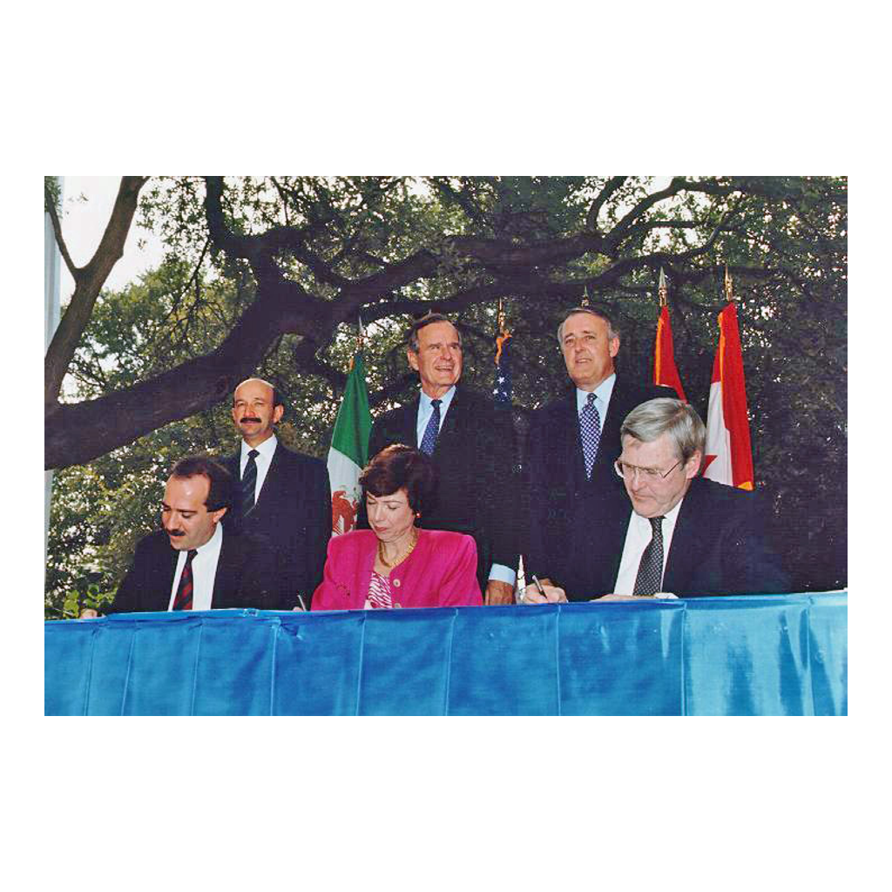
The NAFTA Initialing Ceremony, October 1992
The October 7, 1992 NAFTA initialing ceremony - not the Dec. 1993 signing.
© More Lessons Less Planning | morelessonslessplanning.com
Notes:
Ten seconds of silent looking. This is the initialing ceremony - a preliminary step, not the final signing. Ask students what a photograph like this can and cannot tell us about exactly which milestone we are looking at.
Reference labels (point to these chart features when teaching): Bush; Salinas

Slide 6
From Signing to Taking Effect
On September 14, 1993, supplemental side agreements are signed
These agreements covered labor rights and environmental protection
On December 8, 1993, Clinton signs the NAFTA Implementation Act into law
That law is the actual source you will read in the Activity
NAFTA does not take effect until January 1, 1994 - three weeks later
Key Concept: Congress had to pass an Implementation Act before NAFTA - a signed treaty - could become U.S. law.
© More Lessons Less Planning | morelessonslessplanning.com
Notes:
September 14, 1993 - supplemental (side) agreements on labor and environment are signed, with Ford, Carter, and Bush present alongside Clinton. December 8, 1993 - Clinton signs the NAFTA Implementation Act (H.R. 3450, Public Law 103-182) - this is the exact source students will read in the Activity's Primary Source Spotlight. NAFTA still does not take effect until January 1, 1994.

Slide 7
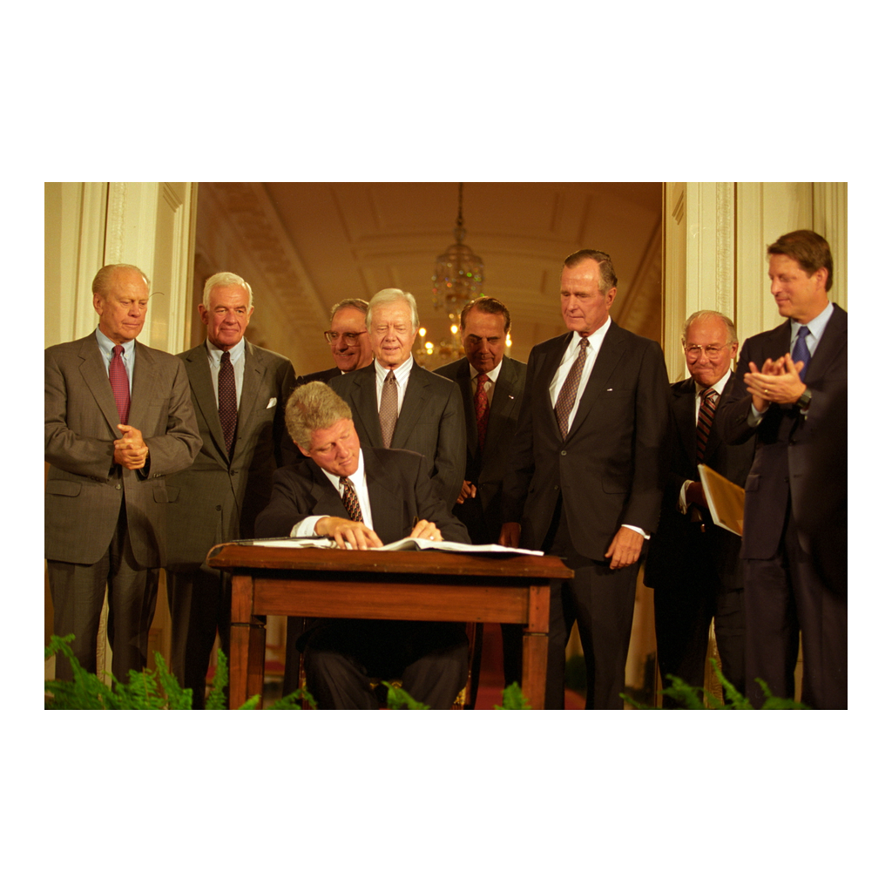
Signing the NAFTA Side Agreements, September 1993
Clinton signs the NAFTA side agreements, Sept. 14, 1993.
© More Lessons Less Planning | morelessonslessplanning.com
Notes:
Ten seconds of silent looking. Four presidents - one sitting, three former - in the same room signing side agreements, not the Implementation Act itself. Ask students why a president might want former presidents from both parties standing behind him for a trade signing.
Reference labels (point to these chart features when teaching): Clinton; Bush

Slide 8
GATT: The Old System
What GATT Was
Its Limits
GATT: General Agreement on Tariffs and Trade
Concluded in 1947, in force from 1948
Reduced tariffs among member nations
No standing organization to enforce the rules
Disputes were harder to resolve consistently
Set the stage for something more permanent
Key Concept: GATT (General Agreement on Tariffs and Trade) - in force from 1948 - reduced tariffs but had no permanent institution behind it.
© More Lessons Less Planning | morelessonslessplanning.com
Notes:
GATT, the General Agreement on Tariffs and Trade, was in force starting 1948 (concluded 1947). It reduced tariffs among member nations but was an agreement, not a permanent institution - it had no standing body to enforce its rules the way the WTO would later have.

Slide 9
The WTO Takes Over
Jan 1, 1995
The World Trade Organization (WTO) is established, succeeding GATT.
✔
A Permanent Body
Unlike GATT, the WTO is a standing institution with its own rules.
✔
Dec 11, 2001
China formally joins the World Trade Organization.
✔
Global Reach
WTO membership now covers most of the world's trading nations.
✔
Important: the WTO replaced GATT - it did not simply rename it; the WTO is a permanent institution.
© More Lessons Less Planning | morelessonslessplanning.com
Notes:
January 1, 1995 - the World Trade Organization is established, succeeding GATT as a permanent institution with its own dispute-resolution process. December 11, 2001 - China formally joins the WTO, a major expansion of its reach.

Slide 10
Building the European Union
The Maastricht Treaty is signed on February 7, 1992
It takes effect November 1, 1993, creating the European Union (EU)
The euro becomes an accounting currency on January 1, 1999
Euro notes and coins reach people's wallets on January 1, 2002
Two treaties, two currency dates - track them separately
Key Concept: the euro existed on paper in 1999, three years before anyone could hold a euro coin, in 2002.
© More Lessons Less Planning | morelessonslessplanning.com
Notes:
The Maastricht Treaty is signed February 7, 1992 and takes effect November 1, 1993, creating the European Union. The euro itself has two dates: an accounting/electronic currency starting January 1, 1999, and physical notes and coins starting January 1, 2002 - do not merge these two dates.

Slide 11
Containerization Changes Shipping
Before Containers
After Containers
Cargo loaded and unloaded piece by piece
Slow, labor-intensive, and expensive
Malcom McLean's ship Ideal-X sails April 26, 1956
Standardized steel boxes move ship to truck to train
Did You Know? Container shipping predates the Cold War's end by about 35 years - it is a cause of globalization, not a result.
© More Lessons Less Planning | morelessonslessplanning.com
Notes:
Malcom McLean's ship Ideal-X sailed April 26, 1956 - containerization, shipping goods in standardized steel boxes, predates the Cold War's end by about 35 years. It is a cause of late-century globalization, not a result of it - do not let students assume it started in the 1990s.

Slide 12
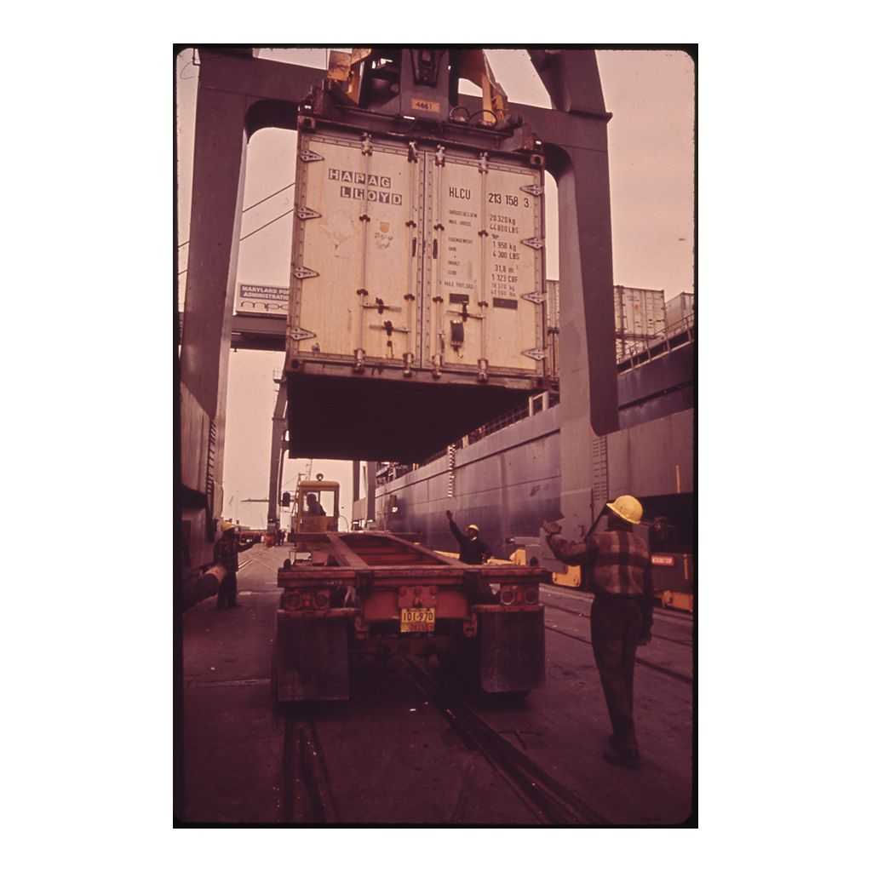
Container Cargo, Dundalk Marine Terminal, 1973
Container cargo unloaded at Dundalk Marine Terminal, Baltimore, April 1973.
© More Lessons Less Planning | morelessonslessplanning.com
Notes:
Ten seconds of silent looking. This is 1973 - seventeen years after the Ideal-X's first voyage and roughly two decades before the Cold War ended. Ask students what this photo tells us about how long containerization had already been standard practice by the time this lesson's other events happened.
Reference labels (point to these chart features when teaching): Baltimore, 1973

Slide 13
The Internet Is Not the Web
1969
ARPANET begins - the origin of today's internet, a packet-switched network.
✔
1989
Tim Berners-Lee proposes the World Wide Web at CERN - a system of linked documents.
✔
1991
The first website goes live.
✔
Apr 30, 1993
CERN places the Web software in the public domain.
✔
Key Concept: the internet is the network; the World Wide Web is a system built on top of it in 1989 - they are not the same thing.
© More Lessons Less Planning | morelessonslessplanning.com
Notes:
The internet, a packet-switched network, grew out of ARPANET starting in 1969. The World Wide Web is different - it is a system built on top of the internet, proposed by Tim Berners-Lee at CERN in 1989, with the first website in 1991. CERN placed the Web software in the public domain on April 30, 1993, which helped it spread quickly. This distinction is worth teaching explicitly - it is a genuine and common student misconception.

Slide 14
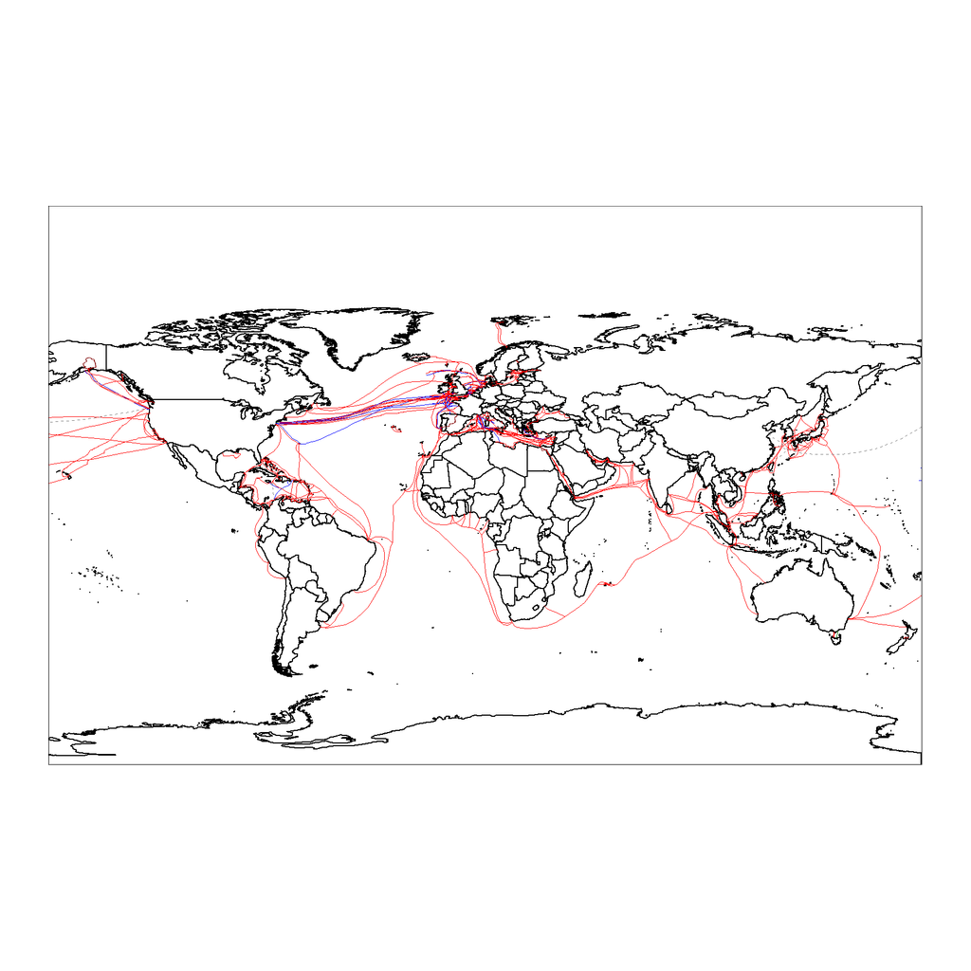
How the World Actually Connects: Undersea Cables
World map of undersea telecommunications cables, as of 2007.
© More Lessons Less Planning | morelessonslessplanning.com
Notes:
Ten seconds of silent looking. Most intercontinental internet traffic travels through cables like these on the ocean floor, not satellites. Ask students whether this map matches what they pictured when they think about how the internet 'travels' around the world.
Reference labels (point to these chart features when teaching): 2007 map

Slide 15
Who Pushed Back? Seattle WTO Protests
Not everyone welcomed these changes
Nov 30-Dec 3, 1999: massive protests surround the WTO meeting in Seattle
Known ever since as the 'Battle in Seattle'
Protesters cited job losses, wages, and environmental harm
Supporters cited cheaper goods and falling poverty in developing economies
Note: both sides of this debate have real evidence behind them - this lesson does not resolve it for you.
© More Lessons Less Planning | morelessonslessplanning.com
Notes:
November 30 to December 3, 1999 - massive protests surround the WTO meeting in Seattle, known ever since as the 'Battle in Seattle.' Present both sides honestly: protesters cited manufacturing job losses, downward wage pressure, and environmental and labor-standard concerns; supporters cited cheaper consumer goods and large poverty reduction in developing economies, especially East Asia. Do not resolve this debate for students - that is Part 5's job.

Slide 16
Weighing the Costs and Benefits
"We cannot stop global change... We can only harness the energy to our benefit." - President Clinton, Dec. 8, 1993
Key Concept: Clinton argued the U.S. must export more, not retreat from trade - the same speech you'll analyze in the Activity.
© More Lessons Less Planning | morelessonslessplanning.com
Notes:
This is the exact speech students will read in the Activity's Primary Source Spotlight. Clinton concedes real costs - 'for two decades, most people have worked harder for less,' 'seemingly secure jobs have been lost' - while still arguing the U.S. must compete rather than retreat. Preview Part 5's Take a Position: students will weigh this same tradeoff for themselves.

Slide 17
Key Takeaways
NAFTA was initialed (1992), signed (1992), and only took effect Jan. 1, 1994.
★
The WTO (1995) replaced GATT (1948) as a permanent trade institution.
★
The EU (1993) and the euro (1999/2002) tied Europe's economies together.
★
Containerization (1956) and the Web (1989) are technology, not just policy.
★
Globalization created real benefits and real costs - evaluate both.
★
© More Lessons Less Planning | morelessonslessplanning.com
Notes:
Close on the two halves students must hold together: trade agreements and technology both connected the world's economies after the Cold War, and that connection produced genuine winners and genuine losers at the same time. Bridge directly into the Activity's Primary Source Spotlight and Take a Position.

