Slide 1
Ghana and the Gold-Salt Trade
How the empire of Ghana grew rich by controlling and taxing the trans-Saharan gold-salt trade.
© More Lessons Less Planning | morelessonslessplanning.com
Notes:
Opening slide. Long before the modern nation of the same name, the empire of Ghana - called Wagadu by its own Soninke people - rose in the western Sahel of West Africa and became the region's first great empire. It did not do this by conquering everyone around it or by digging up mountains of its own gold. It grew rich by sitting between two things the world wanted - salt from the Sahara in the north and gold from the forests and goldfields of the south - and by controlling and taxing the trade that passed between them. Set the frame from the first minute, in a respectful, academic tone: this is the history of a real African empire's achievement, and we will describe it accurately. Two honest anchors run through the whole lesson. First, medieval Ghana is NOT the modern country of Ghana - it sat far to the northwest, in parts of what are now Mali and Mauritania; the modern nation simply borrowed the proud old name in 1957. Second, our most famous description of Ghana comes from al-Bakri, a geographer in Muslim Spain who never actually went there - so we read his vivid account as a valuable but secondhand source.

Slide 2
Learning Targets
Explain what the empire of Ghana (Wagadu) was and where it rose.
★
Describe the gold-salt trade: salt from the north, gold from the south.
★
Explain how Ghana grew rich as the middleman that taxed the trade.
★
Analyze al-Bakri's eleventh-century description of Ghana as a source.
★
© More Lessons Less Planning | morelessonslessplanning.com
Notes:
Read the four learning targets. Keep two anchors in mind throughout. First, we treat this as the achievement of a real West African empire, described accurately: Ghana grew rich by controlling and taxing trade, not by mining gold, and it sat in the western Sahel, not where the modern country of Ghana lies. Second, we read our main source - al-Bakri's famous description of the royal court and the taxation of gold and salt - critically, remembering that al-Bakri compiled it secondhand and never visited Ghana. Pay special attention to target three (Ghana as the middleman that controlled and taxed the trade), because it corrects the common misconception that Ghana was rich because it mined huge amounts of gold, and to target four (reading al-Bakri), because that description is the primary source students will analyze in the activity.

Slide 3
The Empire of Ghana (Wagadu)
West Africa's first great empire
Not the modern country
The empire of Ghana rose in the western Sahel of Africa.
Its own Soninke people called their state Wagadu.
'Ghana' was first the title of its king, then the kingdom.
Medieval Ghana sat in parts of modern Mali and Mauritania.
It was NOT where the modern country of Ghana lies today.
The modern nation took the name in 1957 to honor it.
Key Concept: The empire of GHANA (called WAGADU by its people) rose in the western Sahel - NOT where the modern country of Ghana lies today.
© More Lessons Less Planning | morelessonslessplanning.com
Notes:
Start with where and when. The empire of Ghana rose in the western Sahel of West Africa - the belt of grassland just south of the Sahara Desert - and by about the year 800 to 1000 CE it had become the region's first great empire. Two things need to be made clear and accurate right away. First, the people who built and lived in this state were mostly the Soninke, and their own name for their state was WAGADU. The word 'Ghana' was actually the TITLE of the king - it meant something like 'war chief' or 'ruler' - and Arab writers who heard about the kingdom began using that title as the name for the whole state, which is why we call it Ghana today. Second, and very important: this medieval empire is NOT the same place as the modern country of Ghana. The empire sat far to the northwest, in parts of what are now the countries of Mali and Mauritania. The modern nation of Ghana, on the Atlantic coast further south and east, simply took the proud old name in 1957, when it became independent, as a tribute to the historic empire. Hold both corrections firmly, because students very often assume the empire and the modern country are in the same spot.

Slide 4
The Gold-Salt Trade
Salt from the north
Gold from the south
Salt came from Saharan mines in the north, like Taghaza.
Salt was scarce and precious in the hot lands of the south.
People need salt to stay healthy and to preserve food.
Gold came from the goldfields of the south, like Bambuk.
Gold was plentiful in the south but wanted in the north.
North Africa and Europe paid dearly for West African gold.
Key Concept: In the GOLD-SALT TRADE, SALT came from the north and GOLD from the southern goldfields - each precious where the other was rare.
© More Lessons Less Planning | morelessonslessplanning.com
Notes:
Now the trade at the heart of the whole lesson: the gold-salt trade. The key to understanding it is that salt and gold were each abundant in one place and scarce in another, which made trading them enormously profitable. Salt came from the north - from mines out in the Sahara Desert, such as the famous salt-mining town of Taghaza, where salt was literally cut from the ground in great slabs. In the hot lands of the south, salt was scarce and precious: people need salt to stay healthy, especially in a hot climate where the body loses it through sweat, and salt was also used to preserve food. Gold, on the other hand, came from the south - from goldfields such as Bambuk and Boure, in the lands south of Ghana. There, gold was relatively plentiful; but in North Africa, and beyond it in Europe and the Middle East, gold was in high demand for coins, jewelry, and trade. So each side had what the other wanted: southerners wanted northern salt, and northerners wanted southern gold. That simple, powerful exchange - gold going north, salt coming south - is the gold-salt trade, and it is what made the whole region, and especially Ghana in the middle, so wealthy.

Slide 5
Ghana the Middleman
Ghana sat in the middle
Ghana lay between the salt of the Saharan north and the gold of the southern goldfields.
✔
It did NOT mine its own gold
Ghana did not dig its own gold; the goldfields lay to the south of the empire.
✔
Power came from control
Ghana grew rich as the middleman that controlled the exchange between north and south.
✔
Key Concept: Ghana did NOT mine its own gold - it grew rich as the MIDDLEMAN controlling the trade between northern salt and southern gold.
© More Lessons Less Planning | morelessonslessplanning.com
Notes:
This slide corrects the single most common misconception about Ghana, so make the point clearly and hold it. Students often assume Ghana was rich because it had huge gold mines of its own. That is not accurate. The goldfields - places like Bambuk and Boure - actually lay to the SOUTH of the empire of Ghana, outside its heartland; Ghana did not mine most of the gold itself. So how did Ghana get rich? By its POSITION and its CONTROL. Ghana sat right in the middle, between the salt coming down from the Sahara in the north and the gold coming up from the goldfields in the south. Traders carrying salt south and gold north had to pass through Ghana's territory. That made Ghana the MIDDLEMAN of the trade: the power that stood between the two sides and controlled the exchange. A middleman does not have to produce a good to profit from it - they profit by controlling the flow of goods between others. Ghana used its army and its position to keep the trade routes safe and under its control, and, as the next slide shows, it charged taxes on the goods that crossed its land. So the honest way to describe Ghana's wealth is: not a gold producer, but the middleman that controlled and taxed a trade in goods it mostly did not make.

Slide 6
Taxing the Trade
A tariff on trade goods
Ghana charged a tariff - a tax - on the goods that crossed its territory.
✔
Salt taxed coming and going
The king took one dinar of gold on each donkey-load of salt entering, and two dinars on each leaving.
✔
The king's gold
Gold nuggets from the mines belonged to the king; the people traded in gold dust.
✔
Key Concept: Ghana grew rich with a TARIFF (tax): one dinar of gold on each donkey-load of salt entering, and two dinars on each load leaving.
© More Lessons Less Planning | morelessonslessplanning.com
Notes:
Here is how Ghana turned its control of the trade into wealth: taxes. Ghana charged a TARIFF - that is, a tax on trade goods - on the caravans that crossed its territory. Our source, the geographer al-Bakri, gives us the actual figures, which students will read in the activity. For every donkey-load of salt that came INTO the country, the king took one dinar of gold; and for every load of salt that went OUT again, he took two dinars of gold. Other goods were taxed too - a load of copper paid a set amount, and a load of ordinary merchandise paid more. On top of this, al-Bakri tells us that the large nuggets of gold found in the mines of the kingdom belonged to the king himself, while ordinary people were allowed to trade in gold dust. Notice what this means: every time salt or gold or copper moved through Ghana, the king took a cut, paid in gold. Multiply that by the huge volume of the trans-Saharan trade, and you can see how the kings of Ghana became famous, as far away as Baghdad and Europe, for their astonishing wealth in gold. The wealth came from taxing the flow of trade - not from mining.

Slide 7
The Trans-Saharan Trade Routes
Crossing the desert
A network of routes
The gold-salt trade crossed the huge Sahara Desert.
Traders traveled in caravans of camels for safety.
Camels can cross dry desert far better than horses.
Routes linked North Africa to the West African Sahel.
Towns like Sijilmasa and Taghaza were key stops.
Ghana's capital anchored the southern end of the trade.
Did You Know? The gold-salt trade crossed the Sahara along the TRANS-SAHARAN trade routes - caravan trails linking North Africa to the Sahel.
© More Lessons Less Planning | morelessonslessplanning.com
Notes:
This slide sets up the geography and leads into the map on the next slide. The gold-salt trade did not happen over a short distance - it crossed the Sahara, one of the largest and harshest deserts on Earth. To make that crossing, traders traveled in CARAVANS: large groups of camels loaded with goods, moving together for safety against the heat, the distance, and the danger of raiders. The camel was the key: unlike horses, camels can go for long stretches without water and are built for desert travel, which is why they were called the 'ships of the desert.' These caravans followed established TRANS-SAHARAN trade routes - a network of trails, wells, and oasis stops that linked the cities of North Africa (like Sijilmasa in the north) to the salt town of Taghaza in the middle of the desert and on down to the trading cities and capital of the West African Sahel, including Ghana. The next slide shows a real map of these routes, so students can see how the salt of the north, the goldfields of the south, and Ghana's capital fit together geographically. Point out on the map how Ghana sat right where the desert routes met the lands of the south - exactly the middleman position we described.

Slide 8
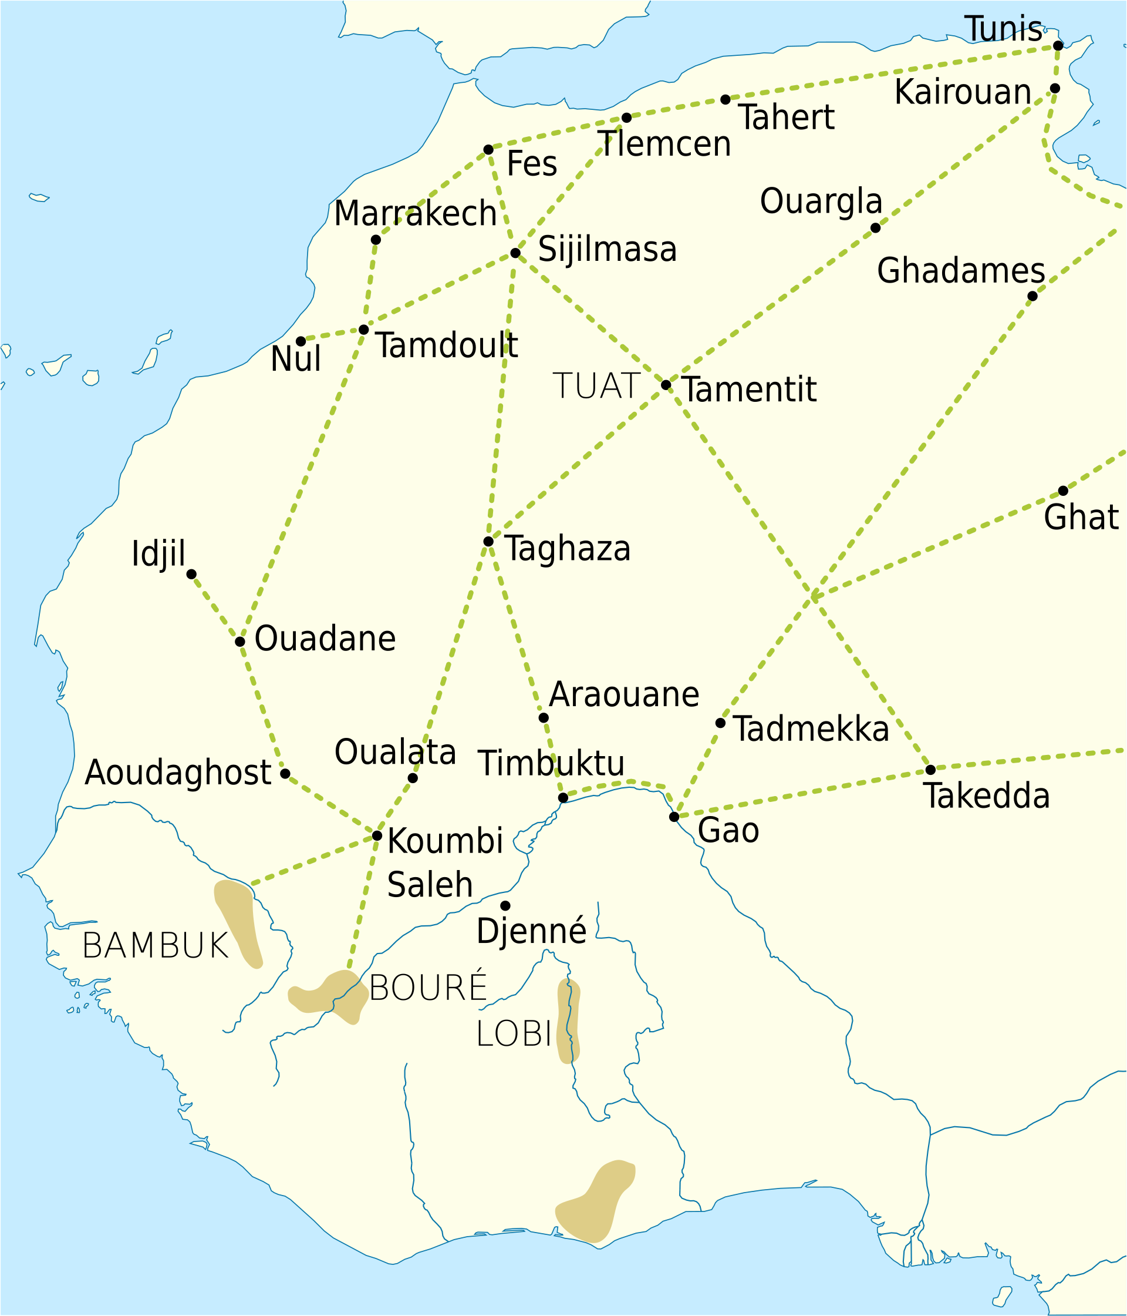
Trans-Saharan Trade Routes (Map)
Trans-Saharan routes: salt (north), gold (south), and Ghana's capital.
© More Lessons Less Planning | morelessonslessplanning.com
Notes:
A real public-domain / CC0 map of the early trans-Saharan trade routes, created as own work by the Wikimedia Commons user Aa77zz and released under the CC0 Public Domain Dedication. Use it purely as a reference image to make the geography of the gold-salt trade concrete. Point out three things: the Saharan salt-mining town of Taghaza in the middle of the desert (north); the shaded southern goldfields of Bambuk, Boure, and Lobi (south); and Ghana's royal capital, Koumbi Saleh, in the western Sahel, sitting where the desert routes met the lands of the south. Trace with students how a caravan might carry salt south from Taghaza through Koumbi Saleh and gold north the other way - showing exactly why Ghana's position made it the middleman. Note honestly that the map also shows later cities such as Timbuktu and Gao, which rose to prominence under the LATER empires of Mali and Songhai, not under Ghana. This is a map of geography and contains no image of any person. Image: early trans-Saharan trade routes map, CC0 public-domain dedication by its author (Wikimedia user Aa77zz), via Wikimedia Commons.
Reference labels (point to these chart features when teaching): Salt town: Taghaza (north); Goldfields: south (Bambuk)

Slide 9
The Royal Court of Ghana
A court rich in gold
al-Bakri described the king giving audience surrounded by gold - horses in cloth of gold.
✔
Signs of royal power
Pages held gold-mounted swords, and princes wore gold braided into their hair.
✔
Even the dogs
Guard dogs at the king's pavilion wore collars of gold and silver.
✔
Did You Know? al-Bakri described Ghana's royal court dripping with gold - horses in cloth of gold and dogs wearing collars of gold and SILVER.
© More Lessons Less Planning | morelessonslessplanning.com
Notes:
This slide previews the primary source students will read in the activity, and shows what Ghana's enormous trade wealth looked like at the royal court. Our description comes from al-Bakri, an eleventh-century geographer whose account students will analyze. He describes the king of Ghana giving a public audience - a session where the king listened to his people's complaints and settled disputes - and the scene drips with gold, a display of the wealth the gold-salt trade brought. According to al-Bakri, the king sat in a domed pavilion around which stood ten horses covered in cloth of gold. Behind the king stood pages, or young attendants, holding shields and gold-mounted swords. On his right sat the sons of the princes of his land, splendidly dressed, with gold braided into their hair. And guarding the door of the pavilion were dogs that hardly ever left the king's side, wearing collars of gold and SILVER. These vivid details are not just decoration for us: they are evidence of just how much wealth the trade brought to Ghana's rulers, and they are exactly the kind of concrete detail that makes al-Bakri's account so famous - while also reminding us, as the source slide will stress, that he was reporting what travelers told him, not what he saw himself.

Slide 10
The Capital: Koumbi Saleh and Its Twin Towns
Twin towns
The king's own faith
Ghana's capital was Koumbi Saleh, in the Sahel.
al-Bakri described it as two towns close together.
One was a Muslim merchants' and scholars' town.
The other town was the king's royal town.
The king was NOT Muslim; he kept the Soninke religion.
Muslims and non-Muslims lived and traded side by side.
Key Concept: Ghana's capital, KOUMBI SALEH, had twin towns - a MUSLIM merchants' town and the king's royal town; the king kept the Soninke religion.
© More Lessons Less Planning | morelessonslessplanning.com
Notes:
This slide describes Ghana's capital and handles the topic of religion carefully and respectfully. According to al-Bakri, Ghana's royal capital - which archaeologists identify with the site of Koumbi Saleh - was made up of two towns a few miles apart. One was a town of MUSLIM merchants and scholars: Muslim traders from North Africa had come south across the desert with the caravans, and a community of them settled near the capital, with mosques and learned men. The other town was the king's own royal town, the center of his government and traditional life. This detail matters for accuracy on two points. First, it shows that Islam had arrived in West Africa through TRADE - Muslim merchants brought their religion along the trans-Saharan routes - and that Muslims and non-Muslims lived and worked side by side in Ghana. Second, and importantly, the KING of Ghana was NOT himself Muslim: he and most of his people followed the traditional Soninke religion of the region. Present this factually and respectfully: Ghana was a place where different faiths met through trade, the king welcomed Muslim merchants and used some as officials because they were literate and connected to the trade network, but he kept his own traditional religion. This is a history of a diverse trading society, not a lesson about any one religion's beliefs.

Slide 11
al-Bakri: Our Main Source
Who al-Bakri was
al-Bakri was a Muslim geographer who lived in Cordoba, in Muslim Spain.
✔
He never visited Ghana
al-Bakri never traveled to Ghana; he compiled his account (~1068) from others' reports.
✔
A secondhand source
His account is secondhand - valuable, but based on merchants' and travelers' stories.
✔
Remember: AL-BAKRI, a geographer in Cordoba, Spain, NEVER visited Ghana - he compiled his famous account (~1068) secondhand from travelers' reports.
© More Lessons Less Planning | morelessonslessplanning.com
Notes:
Before students read al-Bakri's words in the activity, they need to understand exactly what kind of source he is - this is the sourcing anchor of the whole lesson. al-Bakri was a Muslim geographer and scholar who lived in the eleventh century in Cordoba, a great city in al-Andalus (Muslim Spain). Around the year 1068 CE, he wrote a large geography book that includes the most famous surviving description of the empire of Ghana - its court, its capital, and its taxes. Here is the crucial point: al-Bakri NEVER went to Ghana. He lived thousands of miles away in Spain, and he never made the journey across the Sahara. Instead, he compiled his description SECONDHAND, by carefully gathering the reports of merchants, travelers, and earlier writers who HAD been to or traded with West Africa. That makes his account a secondhand source, not an eyewitness one. This does not mean it is worthless - far from it. al-Bakri was a careful scholar, and because so few written sources on early Ghana survive, his account is one of the best we have, and much of it fits what archaeology has found. But a good historian reads it critically: some details may be exaggerated, secondhand impressions, or out of date, precisely because al-Bakri was writing down what others told him rather than what he saw. So when students read his vivid description of the golden court, they should remember to ask: how does he know this, and how sure can we be?

Slide 12
The Decline of Ghana
Ghana weakens
Mali rises next
By the 1200s the empire of Ghana was in decline.
Trade routes shifted and rival powers grew stronger.
Ghana lost its tight grip on the gold-salt trade.
The empire of Mali rose to power after Ghana.
Cities like Timbuktu grew great under Mali, not Ghana.
Ghana came first; Mali and Songhai came later.
Key Concept: Ghana declined by the 1200s, before the rise of MALI; famous cities like Timbuktu grew great under Mali and Songhai, NOT under Ghana.
© More Lessons Less Planning | morelessonslessplanning.com
Notes:
Close the story of Ghana and guard against a very common mix-up. No empire lasts forever, and by about the 1200s CE the empire of Ghana was in decline. Several things weakened it: the trans-Saharan trade routes shifted over time, rival and rising powers competed for control of the trade, and internal troubles loosened the kings' grip. As Ghana weakened, it lost the tight control over the gold-salt trade that had made it rich. What came NEXT is the point students most often confuse, so state it clearly. After Ghana declined, a new and even larger West African empire rose in roughly the same region: the empire of MALI, famous for rulers like Mansa Musa. It was under Mali, and later under the empire of Songhai, that trading cities such as TIMBUKTU grew into world-famous centers of trade and learning. Those cities and empires are NOT part of the Ghana story - they came AFTER Ghana. So the accurate sequence is: Ghana first (roughly 800 to 1200s), then Mali, then Songhai. Do not let students blur them together. The book our primary source comes from is even titled 'Timbuctoo the Mysterious,' but the passage students will read is about Ghana, in the era before Timbuktu's rise - a good reminder to keep these empires in order.

Slide 13
Key Takeaways
The empire of Ghana (Wagadu) rose in the western Sahel - not the modern nation.
★
The gold-salt trade exchanged Saharan salt for southern gold.
★
Ghana grew rich as the middleman that controlled and taxed the trade.
★
al-Bakri's famous account of Ghana is a valuable but secondhand source.
★
© More Lessons Less Planning | morelessonslessplanning.com
Notes:
Let us recap Ghana and the gold-salt trade. First, the empire: Ghana, called Wagadu by its Soninke people, rose in the western Sahel of West Africa and became the region's first great empire - and it is NOT the same place as the modern country of Ghana, which took the name in 1957. Second, the trade: the gold-salt trade exchanged salt, which came from Saharan mines in the north and was precious in the south, for gold, which came from the southern goldfields and was wanted in the north. Third, and most important, how Ghana grew rich: not by mining gold, but as the MIDDLEMAN that sat between north and south, controlled the trans-Saharan trade routes, and taxed the caravans - taking gold on every load of salt that crossed its land, as al-Bakri records. Fourth, the wealth on display: al-Bakri's famous description of the royal court, dripping with gold, and the twin-town capital of Koumbi Saleh, where Muslim merchants lived beside a non-Muslim king. And running through it all, the honest anchors: al-Bakri never visited Ghana, so we read him as a careful but secondhand source; and Ghana came first, before Mali and Songhai and the rise of Timbuktu. We have studied Ghana respectfully as the achievement of a real and wealthy West African empire.

