Slide 1
Genghis Khan and the Mongol Rise
How Temujin united the Mongol tribes and built the largest contiguous land empire in history.
© More Lessons Less Planning | morelessonslessplanning.com
Notes:
Opening slide. Temujin was born into a hard life on the Central Asian steppe, united the warring Mongol tribes, and in 1206 was proclaimed Genghis Khan - 'universal ruler.' Students will learn how he built and disciplined a new kind of army, issued the Yassa law code, and led conquests that created the largest contiguous land empire in history. Keep the tone factual: the Mongol conquests were both extraordinarily destructive and, later, connected Eurasia through trade. This lesson tells both sides honestly.

Slide 2
Learning Targets
Trace how Temujin united the Mongols and became Genghis Khan in 1206.
★
Explain how Genghis organized and disciplined the Mongol army.
★
Describe the scale of conquest and weigh its destruction against its trade.
★
Analyze a primary source on Mongol military discipline.
★
© More Lessons Less Planning | morelessonslessplanning.com
Notes:
Learning targets. Point out that target 3 is where the lesson refuses to simplify: the Mongol conquests killed enormous numbers of people AND the resulting Pax Mongolica made long-distance trade safer. Historians hold both facts at once.

Slide 3
Who Was Temujin?
TEMUJIN was the birth name of the boy who became Genghis Khan.
His father was a Mongol tribal chief, poisoned by rivals when Temujin was young.
After that, Temujin's family was abandoned by their clan on the open steppe.
They survived on roots, fish, and small game through brutal winters.
That hard childhood shaped a leader who valued loyalty above birth.
Key Concept: TEMUJIN was Genghis Khan's birth name; he rose from a hard, abandoned childhood to unite the Mongols.
© More Lessons Less Planning | morelessonslessplanning.com
Notes:
TEMUJIN was Genghis Khan's birth name; he rose from a hard childhood on the steppe to unite the Mongols. His father was a Mongol tribal CHIEF who was poisoned by rivals when Temujin was a boy. After the father's death, the family was ABANDONED by their own clan and left to survive alone on the open steppe, living on roots, fish, and whatever small game they could catch. Temujin's childhood - poverty, betrayal, and the constant threat of rival clans - shaped a leader who prized loyalty and ability over the family a person was born into. Keep it grounded: this is a real, documented hard-luck rise, not a legend.

Slide 4
The World of the Steppe
Land and Life
A People on Horseback
The STEPPE: vast grasslands stretching across Central Asia.
Too dry to farm, but perfect for grazing herds.
Mongols lived as NOMADS, moving with the seasons.
Herds of horses, sheep, goats, and cattle were their wealth.
Children learned to ride and shoot bows very young.
Rival tribes raided each other for animals and people.
Fact: The STEPPE was the vast grasslands of Central Asia, home to nomadic Mongol herders who lived on horseback.
© More Lessons Less Planning | morelessonslessplanning.com
Notes:
The STEPPE was the vast GRASSLANDS of Central Asia where the nomadic Mongol herders lived and raised horses. It was too dry to farm but ideal for grazing. A NOMAD is a person who moves from place to place with HERDS rather than settling in one town; the Mongols followed grass and water with their horses, sheep, goats, and cattle. Their herds were their wealth. Children learned to ride and shoot bows from horseback while very young - the same skills that later made Mongol soldiers so dangerous. Before Temujin, the tribes were divided and constantly raided one another for animals, goods, and people. Emphasize that Mongol military skill grew directly out of ordinary nomadic life.

Slide 5
Uniting the Warring Tribes
A divided people
The Mongols were split into rival tribes that raided each other constantly.
✔
Alliances and war
Temujin built alliances, then defeated or absorbed rival tribes one by one.
✔
Reward by merit
He promoted followers by loyalty and skill, not by the family they were born into.
✔
One people
By 1206 Temujin had united the Mongol tribes under a single leader for the first time.
✔
Note: Temujin united the warring Mongol tribes through alliances, war, and reward by loyalty and skill rather than birth.
© More Lessons Less Planning | morelessonslessplanning.com
Notes:
Before Temujin the Mongols were divided into rival TRIBES that raided each other for animals, goods, and people. Temujin united them through a mix of alliances, warfare, and a new idea: he rewarded followers by loyalty and SKILL rather than by the family they were born into. A talented commoner could rise; a disloyal noble could fall. He broke up conquered tribes and mixed their people into his own units so old tribal loyalties could not threaten him. By 1206 he had united the Mongol tribes under a single leader for the first time in their history. This unification is the foundation for everything that follows - the army, the law, and the conquests.

Slide 6
1206: The Kurultai
Kurultai
A great assembly of Mongol chiefs; the 1206 kurultai proclaimed Temujin as Genghis Khan.
Genghis Khan
The title meaning 'universal ruler,' taken by Temujin at the 1206 kurultai when the tribes were united under him.
Key Concept: At the 1206 KURULTAI, the chiefs proclaimed Temujin GENGHIS KHAN, meaning 'universal ruler.'
© More Lessons Less Planning | morelessonslessplanning.com
Notes:
In 1206 a KURULTAI - a great ASSEMBLY of Mongol chiefs - gathered and proclaimed Temujin the ruler of all the Mongols. There the chiefs gave him the title GENGHIS KHAN, which means 'UNIVERSAL ruler' (sometimes translated 'oceanic' or 'firm, resolute' ruler). Two things matter for students here. First, 'Genghis Khan' is a TITLE, not his birth name - his birth name was Temujin. Second, the kurultai was how the Mongols made big decisions collectively: choosing a khan, planning a war. The 1206 kurultai marks the moment the united Mongols became a state with a single supreme leader, ready to turn outward against their settled neighbors.

Slide 7
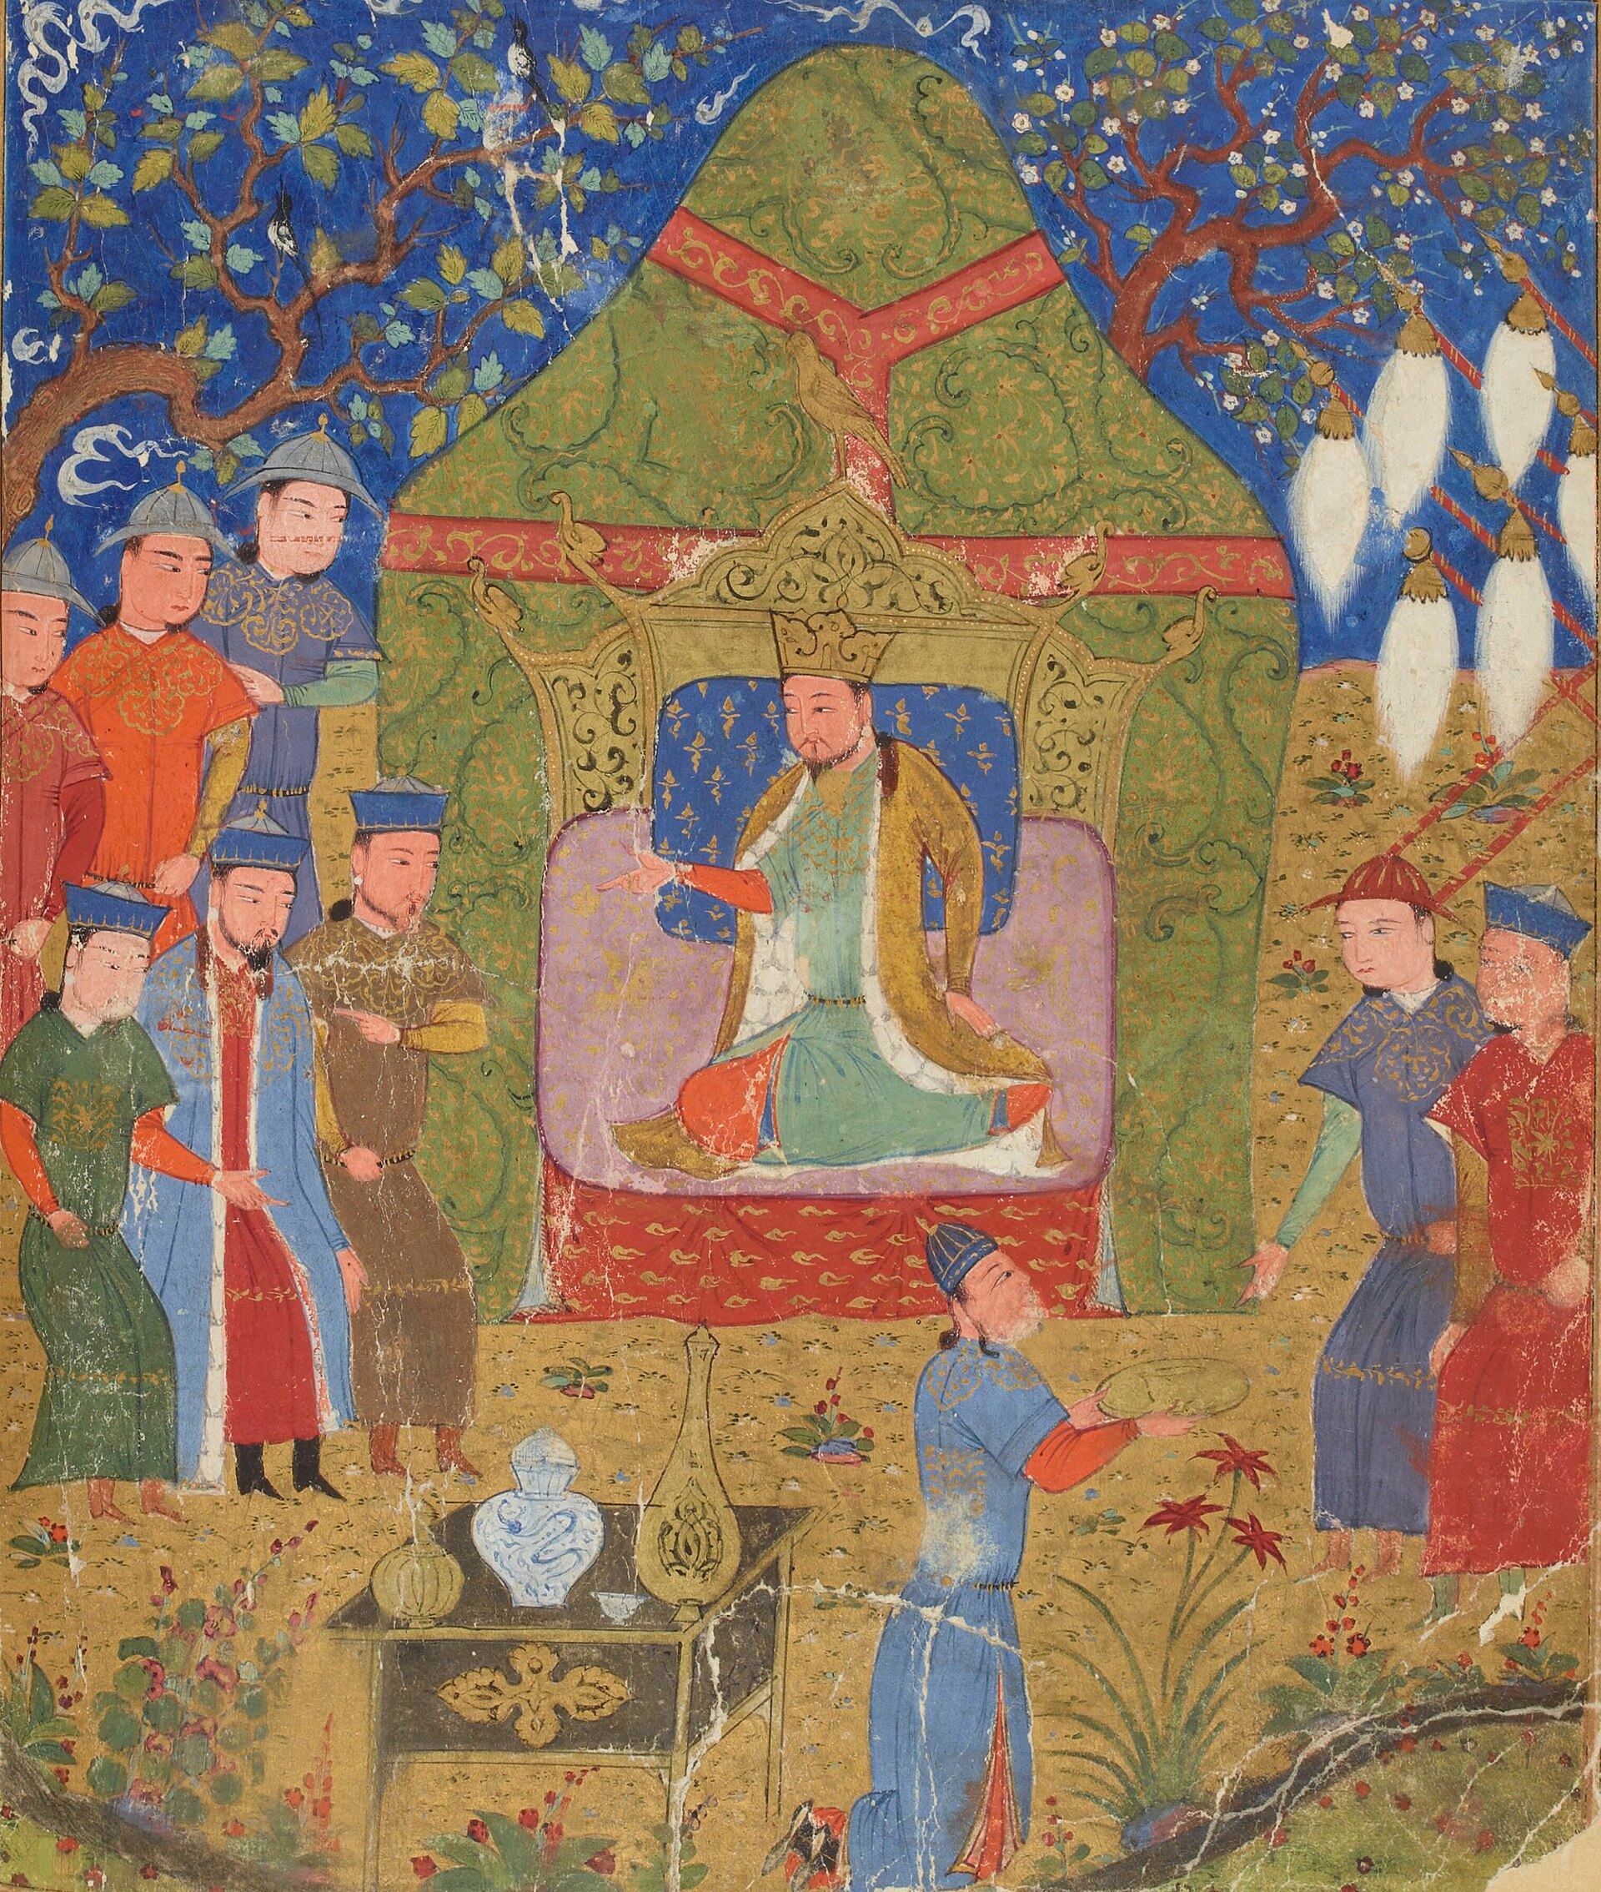
Genghis Khan Enthroned
Temujin enthroned as Genghis Khan (Persian manuscript, Herat, c. 1430).
© More Lessons Less Planning | morelessonslessplanning.com
Notes:
A Persian manuscript miniature from a Herat (c. 1430) illustrated copy of Rashid al-Din's Jami' al-tawarikh, the great early-14th-century history of the Mongols. It shows Genghis Khan enthroned inside a royal tent, surrounded by commanders and courtiers, with the white horse-tail standards of Mongol rulership at right. Point out that this image was painted by Persian artists more than a century after Genghis's death, working for the Mongol-descended rulers of Iran - it is how the empire chose to remember and honor its founder, not a photograph of the man.
Reference labels (point to these chart features when teaching): The khan enthroned in a tent; White standards at right

Slide 8
Building a New Kind of Army
Decimal Organization
The Mongol army system that divided troops into units of 10, 100, 1,000, and 10,000.
Tumen
The largest Mongol army unit: ten thousand soldiers.
Key Concept: DECIMAL ORGANIZATION divided the army into units of 10, 100, 1,000, and 10,000 (a TUMEN), giving a clear chain of COMMAND.
© More Lessons Less Planning | morelessonslessplanning.com
Notes:
The Mongol army used DECIMAL ORGANIZATION - troops divided into units of ten, a hundred, a thousand, and ten thousand - so orders could pass quickly down a clear chain of COMMAND. A unit of ten had a leader; ten of those made a hundred with its own leader; and so on up. A TUMEN was the largest unit: TEN thousand soldiers. This system did three things at once: it let a single leader control huge forces, it let commanders be promoted or replaced by merit at any level, and it made discipline enforceable because every soldier had a direct officer. Note for students: the exact same decimal structure is what the friar Carpini describes in the Primary Source Spotlight - our eyewitness confirms the textbook.

Slide 9
Discipline and the Keshig
The Imperial Guard
Rules That Held
The KESHIG was Genghis Khan's elite imperial bodyguard.
Members were chosen for loyalty and skill.
It also trained the empire's future commanders.
Officers were promoted by merit, not by noble birth.
Discipline was strict, and orders were obeyed at once.
Loyalty was rewarded; betrayal was punished harshly.
Fact: The KESHIG was Genghis Khan's elite imperial bodyguard, chosen for loyalty and skill and used to train commanders.
© More Lessons Less Planning | morelessonslessplanning.com
Notes:
The KESHIG was Genghis Khan's elite imperial BODYGUARD, chosen for loyalty and skill. It guarded the khan day and night, but it was more than a bodyguard: it was a school for leaders, where promising young men learned how the empire ran and were then sent out to command. Mongol officers were promoted by MERIT - ability and loyalty - not by the family they were born into. Discipline was strict: orders were obeyed at once, loyalty was rewarded, and betrayal was punished harshly. This is the human machinery behind the decimal army. Tell students the discipline is not a legend - the friar Carpini, an outsider, was struck by exactly how obedient and disciplined the Mongols were, as they will read in the Primary Source Spotlight.

Slide 10
The Yassa: Law for an Empire
Yassa
The Mongol law code issued by Genghis Khan; its full text does not survive and is known only from later accounts.
What it covered
Loyalty, military duty, treatment of animals and messengers, punishments for theft and betrayal, and religious tolerance.
Note: The YASSA was Genghis Khan's law code; its full text does not survive, so we know it only from later writers.
© More Lessons Less Planning | morelessonslessplanning.com
Notes:
The YASSA was the Mongol LAW code issued by Genghis Khan to govern the empire. Be careful and honest with students here: the full text of the Yassa does not SURVIVE. No complete original copy exists. We know it only from later writers who described pieces of it, so historians treat those descriptions with caution. From those accounts, the Yassa seems to have covered loyalty and military duty, harsh punishments for theft and betrayal, protection for messengers, rules for the fair treatment of animals, and - notably - broad religious tolerance across the empire's many faiths. The point for students: a law that applied to everyone, khan included, helped hold a huge, diverse empire together. Do not quote a 'Yassa text' as if it were preserved; frame it as reconstructed from later accounts.

Slide 11
How the Mongols Fought
Mongol warriors were expert mounted archers, shooting from a galloping horse.
Each rider led several horses, so the army moved with astonishing speed.
A favorite tactic was the feigned retreat: pretend to flee, then trap the enemy.
Scouts, signal flags, and messengers coordinated units over long distances.
They borrowed siege engines from Chinese and Persian engineers.
Key Concept: Mongol armies won through mounted archers, speed, the feigned retreat, and borrowed siege technology.
© More Lessons Less Planning | morelessonslessplanning.com
Notes:
Mongol warriors were expert mounted ARCHERS, able to shoot accurately from a galloping horse. Each rider led several spare horses, so the army could cover ground far faster than its enemies expected. A favorite tactic was the feigned RETREAT: pretend to flee in panic, draw the enemy into a disorganized chase, then wheel around and destroy them. Discipline made this work - a real retreat and a fake one look the same, so only a controlled army can pull it off. The Mongols coordinated far-flung units with scouts, signal flags, and fast messengers, and they learned siege warfare from Chinese and Persian engineers to crack walled cities. Speed, archery, discipline, and borrowed technology - not just numbers - explain the conquests.

Slide 12
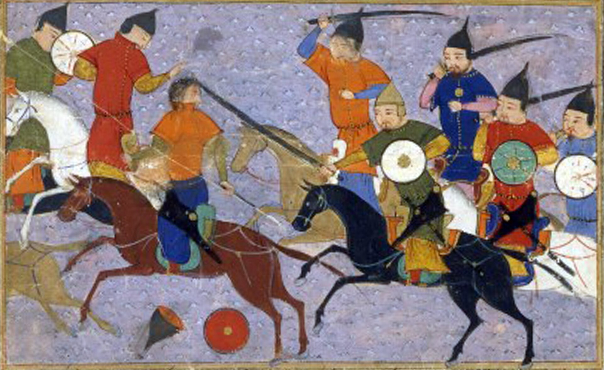
Mongol Cavalry in Battle
Mongol horsemen in battle (Persian manuscript, Herat, c. 1430).
© More Lessons Less Planning | morelessonslessplanning.com
Notes:
A Persian manuscript miniature from the same Herat (c. 1430) copy of Rashid al-Din's Jami' al-tawarikh, depicting the Mongols' 1211 war against the Jin dynasty of northern China. Have students look for the tools the previous slide described: bows drawn on horseback, curved swords, round shields, and fast horses. This is a stylized illustration painted long after the events, not a battlefield sketch - but it shows how mounted archers on maneuverable horses were the heart of the Mongol war machine.
Reference labels (point to these chart features when teaching): Riders with bows and swords; Round shields, fast horses

Slide 13
The Largest Land Empire
The Mongols built the largest contiguous land empire in history.
At its height it stretched from Korea and China to Eastern Europe.
The conquests were remarkably fast - vast lands taken in only a few decades.
Genghis took northern China, Central Asia, and much of Persia in his life.
His sons and grandsons pushed the borders still further after his death.
Big idea: The Mongols built the largest CONTIGUOUS land empire in history, and they built it remarkably fast.
© More Lessons Less Planning | morelessonslessplanning.com
Notes:
The Mongols built the largest CONTIGUOUS land empire in history, stretching from Korea and China across Central Asia and Persia to the edge of Eastern Europe. Be precise with the wording for students: it was the largest CONTIGUOUS land empire - one connected block of territory - which is why we say 'contiguous.' (Empires like the British were larger in total area, but scattered across the seas.) The conquests were remarkably FAST: the Mongols overran vast territories in only a few decades. In his own lifetime Genghis conquered northern China, Central Asia, and much of Persia; after his death in 1227 his sons and grandsons pushed the borders even further, into Russia, the Middle East, and China's south.

Slide 14
The Cost of Conquest
A Brutal Choice
The Death Toll
Cities that surrendered were often spared and taxed.
Cities that resisted were destroyed as a warning to others.
Terror was used deliberately, to make resistance seem hopeless.
At NISHAPUR and Merv, much of the population was killed.
Whole cities were leveled and their fields ruined.
Mongol conquest was extremely destructive - millions died.
Warning: Mongol conquest was extremely destructive; cities that resisted, like NISHAPUR and Merv, were largely killed.
© More Lessons Less Planning | morelessonslessplanning.com
Notes:
Teach this plainly and without softening it. Mongol conquest was extremely DESTRUCTIVE. The Mongols offered cities a choice: surrender and be taxed, or resist and be destroyed. When cities resisted, the Mongols made examples of them. At NISHAPUR and Merv, in Persia, much of the population was slaughtered, the cities leveled, and the irrigation that fed the fields wrecked. The Mongols used terror deliberately as a weapon - a destroyed city made the next city more likely to surrender without a fight. Historians debate the exact numbers (medieval chroniclers exaggerated), but the destruction was real and enormous, and whole regions took generations to recover. Do not let students leave thinking the Mongols were 'just traders': the empire was built on conquest and mass death.

Slide 15
Pax Mongolica: The Roads Reopen
Pax Mongolica
The 'Mongol Peace,' a period when Mongol control made Silk Road trade across Eurasia safer.
What moved
Merchants, goods, ideas, technologies, and even diseases traveled the roads between Asia and Europe.
Fact: The PAX MONGOLICA, or 'Mongol Peace,' made Silk Road trade across Eurasia safer once the empire was in place.
© More Lessons Less Planning | morelessonslessplanning.com
Notes:
This is the other side of the ledger, and it is just as real as the destruction. The PAX MONGOLICA, or 'Mongol PEACE,' was a period when Mongol control made Silk Road trade across Eurasia safer. Once one vast empire governed the roads from China to the Middle East, TRADERS could travel long distances under a single set of laws and protection. Merchants, goods, ideas, technologies (like paper and gunpowder moving west), and even diseases moved more freely between Asia and Europe. This is honest complexity for students: the same conquests that killed millions and destroyed cities also, once the fighting stopped, reconnected Eurasia and moved knowledge across it. The Mongol story is not simple, and students should not force it to be.

Slide 16
How Do We Know? Carpini and the Chroniclers
John of Plano Carpini was a Franciscan friar sent by the pope.
He traveled to the Mongol court in 1245-47 and wrote what he saw.
Carpini traveled AFTER Genghis Khan had already died in 1227.
So he described the empire and army Genghis built, not Genghis himself.
Historians also use Persian, Chinese, and Mongol sources to cross-check.
Tip: Carpini saw the Mongol EMPIRE in 1245-47, after Genghis died - a witness to the system, not to the man.
© More Lessons Less Planning | morelessonslessplanning.com
Notes:
John of Plano CARPINI was a Franciscan friar whom Pope Innocent IV sent east to learn about the Mongols. He traveled to the Mongol court in 1245-47 and wrote a careful report, the Historia Mongalorum. Here is the crucial sourcing point students must get right: Carpini traveled AFTER Genghis Khan had already DIED in 1227. He never met Genghis. What he describes is the EMPIRE and the ARMY that Genghis built - the decimal organization, the discipline, the obedience - as they still worked twenty years later. That makes him an excellent witness to the SYSTEM, not to the man. Historians combine Carpini with Persian historians (like Rashid al-Din), Chinese records, and the Mongols' own Secret History to cross-check. The lesson: match each source to what it can actually tell you.

Slide 17
Genghis Khan's Legacy
Death in 1227
Genghis Khan died in 1227, but his empire did not die with him.
✔
The empire grew
His sons and grandsons expanded it into Russia, the Middle East, and southern China.
✔
Systems that held
Mongol law, a fast postal relay system, and merit promotion held the empire together.
✔
A mixed legacy
Remembered for both mass destruction and for reconnecting Eurasia through trade.
✔
Note: Genghis died in 1227, but his law, army, and postal systems let his heirs rule a fourth of the world.
© More Lessons Less Planning | morelessonslessplanning.com
Notes:
Genghis Khan died in 1227, but his empire did not die with him. His sons and grandsons expanded it even further, into Russia, the Middle East, and southern China, until the Mongols ruled much of Eurasia. What held such a vast empire TOGETHER was the machinery Genghis built: the Yassa law, a fast postal relay system (the yam) that carried messages across thousands of miles, promotion by merit, and the decimal army. His legacy is genuinely mixed, and students should be able to state both halves: he was responsible for the deaths of millions in brutal conquests, and he built the system that reconnected Eurasia and moved goods and ideas across it during the Pax Mongolica. Hold both.

Slide 18
Key Takeaways
Temujin united the warring Mongol tribes and became Genghis Khan in 1206.
★
He rewarded loyalty and skill over noble birth - a merit-based system.
★
The decimal army, the keshig, and the Yassa law made the Mongols formidable.
★
The Mongols built the largest contiguous land empire in history.
★
The conquests were extremely destructive - cities like Nishapur were leveled.
★
The Pax Mongolica later made Silk Road trade across Eurasia safer.
★
© More Lessons Less Planning | morelessonslessplanning.com
Notes:
Close the loop. If students remember one thing, make it this: the Mongols conquered through ORGANIZATION and DISCIPLINE, not just numbers - the decimal army, promotion by merit, the keshig, and the Yassa. And make them hold the honest double truth: the empire was built on mass destruction AND it reconnected Eurasia through trade. Both are true, and a good history student can say both in the same breath.

