Slide 1
Furnishing on a Budget: Needs First
Learn how to furnish a first apartment without overspending - by buying the furniture you actually need first, choosing secondhand over new, and keeping the total under a budget cap.
© More Lessons Less Planning | morelessonslessplanning.com
Notes:
This is the 'don't buy it all new, and don't buy it all at once' lesson of Unit 9. When you move into a first apartment it can feel like you need everything immediately - a bed, a couch, a table, a TV, decorations - and buying it all new can cost thousands. Today students learn to furnish smart: sort furniture into needs and nice-to-haves, buy secondhand to save, and prioritize the needs first under a budget cap. Students will leave able to build a real furnishing plan for a first-time renter - Theo Castellano, coached by move-in advisor Rosa Nguyen - and see how secondhand can cut a $2,200 bill down to about $720.

Slide 2
Learning Targets
Tell a furniture need from a nice-to-have, and know why needs come first
★
Calculate the savings from buying secondhand (new price minus secondhand price)
★
Find the total furnishing cost and keep it under a budget cap
★
Use a new-vs-secondhand chart and avoid financing traps to furnish cheaply
★
© More Lessons Less Planning | morelessonslessplanning.com
Notes:
Read the four targets and connect them to the arc of the lesson. Target 1 is the vocabulary and the priority: what makes a piece of furniture a NEED versus a NICE-TO-HAVE, and why the needs come first. Target 2 is the first math skill: calculate the SAVINGS FROM SECONDHAND using SAVINGS FROM SECONDHAND = NEW PRICE - SECONDHAND PRICE. Target 3 is the second math skill plus the plan: find the TOTAL FURNISHING COST and keep it under a BUDGET CAP by prioritizing needs first. Target 4 is the judgment: read a bar chart of new versus secondhand prices and avoid furniture-financing traps like rent-to-own. By the end, students can build a furnishing plan for any first-time renter.

Slide 3
Needs First
Need
A NEED is essential furniture you cannot run a home without, like a bed or a kitchen table
Nice-to-have
A NICE-TO-HAVE is furniture that adds comfort but is not essential, like a coffee table or a TV stand
Furnish smart
Furnishing a first home means buying the needs first and adding nice-to-haves later
Meet Theo
Theo Castellano is furnishing his first apartment; advisor Rosa Nguyen helps him buy smart
Key Concept: Buy your NEEDS first - a bed and a table before a TV stand - so your money covers what a home actually requires.
© More Lessons Less Planning | morelessonslessplanning.com
Notes:
Frame the lesson with the core idea. A NEED is essential furniture you cannot run a home without - a bed to sleep on, a table to eat at, a dresser for clothes. A NICE-TO-HAVE is furniture that adds comfort but is not essential - a coffee table, a TV stand, decorations. The whole lesson is about buying the needs first and adding nice-to-haves later, as your budget allows. Introduce the persona and the real problem: Theo Castellano just signed a lease and is furnishing his first apartment; move-in advisor Rosa Nguyen is going to help him buy smart instead of putting a whole apartment of new furniture on a credit card. Key terms - Need: essential furniture. Nice-to-have: comfort, not essential.

Slide 4
Essential Furniture vs Nice-to-Have
The needs (buy first)
NEEDS are the essentials: a bed to sleep on, a table to eat at, and a dresser for clothes
✔
The nice-to-haves (buy later)
NICE-TO-HAVES add comfort: a couch, a TV stand, a coffee table, or decorations
✔
Ask one question
For each item ask: could I live in the apartment without it? If yes, it is a nice-to-have
✔
Why it matters
Buying needs first means a small budget still covers the furniture a home truly requires
✔
Key Concept: Sort every item into a NEED or a NICE-TO-HAVE before you spend - the needs come first.
© More Lessons Less Planning | morelessonslessplanning.com
Notes:
Give students a concrete way to sort furniture. NEEDS are the essentials that make an apartment livable: a bed to sleep on, a table to eat at, a dresser for clothes (and basics like a lamp and a trash can). NICE-TO-HAVES add comfort but you can live without them at first: a couch, a TV stand, a coffee table, decorations. Teach the one-question test: for each item, ask 'could I live in the apartment without it?' If the answer is yes, it is a nice-to-have and can wait. Make the money point: buying needs first means even a small budget covers the furniture a home truly requires, and the comfort items come later when there is money for them. Tell students Activity Part 5 asks them to sort a client's wish list into needs and nice-to-haves.

Slide 5
Secondhand and Free Sources
New price
The NEW PRICE is what an item costs brand new from a store
Secondhand / secondhand price
SECONDHAND means bought used from a previous owner; the SECONDHAND PRICE is what it costs used
Free source
A FREE SOURCE gets you furniture at no cost - curb finds, buy-nothing groups, or hand-me-downs
Where to look
Look on resale apps, thrift stores, and campus move-out piles for used furniture in good shape
Key Concept: The SECONDHAND PRICE is far below the NEW PRICE, and FREE SOURCES can cost nothing at all.
© More Lessons Less Planning | morelessonslessplanning.com
Notes:
Teach the three ways to get furniture and how much they cost. The NEW PRICE is what an item costs brand new from a store - the highest price. SECONDHAND means bought used from a previous owner instead of new, and the SECONDHAND PRICE is what that same item costs used, usually a fraction of new. A FREE SOURCE gets you furniture at no cost at all: curb finds on trash day, buy-nothing groups, campus move-out piles, and hand-me-downs from family. Make the practical move: check resale apps, thrift stores, and move-out piles for used furniture in good shape before paying full price. Teaching point: the same bed that is $600 new can be $250 secondhand or free from someone moving out - the biggest lever a first-time renter has is buying used instead of new. Tell students the chart in Part 4 shows the new price beside the secondhand price for five items.

Slide 6
Prioritizing Purchases
Your budget cap
Your BUDGET CAP is the most you can spend furnishing your home right now
✔
Prioritizing
PRIORITIZING means deciding which furniture to buy first, putting needs ahead of nice-to-haves
✔
Fit it under the cap
Add up your item prices and keep the total at or under your budget cap
✔
Defer the rest
If everything will not fit, buy the needs and defer the nice-to-haves until you save more
✔
Key Concept: PRIORITIZING means buying needs first and keeping your total under your BUDGET CAP - defer the rest.
© More Lessons Less Planning | morelessonslessplanning.com
Notes:
Teach how to make furnishing fit real money. Your BUDGET CAP is the most you can spend furnishing your home right now - the ceiling you will not cross (maybe $500 or $600 for a first apartment). PRIORITIZING means deciding which furniture to buy first, putting needs ahead of nice-to-haves, so the essentials are covered before any comfort items. Make it fit: add up your item prices and keep the total at or under your budget cap. And if everything will not fit, buy the needs and defer the nice-to-haves - wait to buy them until you have saved more. Teaching point: the budget cap turns a wish list into a plan, because it forces you to rank the items and stop at the essentials when the money runs out. Tell students the Activity capstone gives a client a fixed budget cap and asks them to prioritize needs first.

Slide 7
Spreading Costs Over Time - The Two Models
The savings model
SAVINGS FROM SECONDHAND = NEW PRICE - SECONDHAND PRICE - how much buying used saves
✔
The total-cost model
TOTAL FURNISHING COST = the sum of the item prices you buy
✔
Theo's numbers
Theo's couch saves $700 - $200 = $500 used; all five items used total $720 vs $2,200 new
✔
Spread it out
Buy needs now and add nice-to-haves over the next months as your budget allows
✔
Key Concept: SAVINGS FROM SECONDHAND = NEW - SECONDHAND. TOTAL FURNISHING COST = sum of items. Theo: five items used = $720 vs $2,200 new.
© More Lessons Less Planning | morelessonslessplanning.com
Notes:
These are the two central quantitative models - teach them explicitly and put them on the board under clear labels before students calculate. THE FIRST LABELED MODEL - SAVINGS FROM SECONDHAND = NEW PRICE - SECONDHAND PRICE - is how much buying an item used instead of new saves you: subtract the secondhand price from the new price. THE SECOND LABELED MODEL - TOTAL FURNISHING COST = the sum of the item prices you buy - is what a whole list costs, so you can check it against your budget cap. Work both with the persona: Theo's couch is $700 new and $200 secondhand, so SAVINGS FROM SECONDHAND = $700 - $200 = $500; and buying all five of his items secondhand totals $720, versus $2,200 new - a $1,480 saving. Teach 'spreading costs over time': you do not have to buy everything at once - buy the needs now and add the nice-to-haves over the next months as your budget allows. Tell students Activity Part 3 asks them to apply both models to Theo's furnishing list. Key terms - Savings from secondhand: new price minus secondhand price. Total furnishing cost: the sum of the item prices.

Slide 8
New vs Secondhand (Chart Intro)
Five items compared
The next chart shows the new price beside the secondhand price for five furniture items
The gap is your savings
The space between the two bars for each item is the savings from buying secondhand
Every item is cheaper used
For all five items the new price bar is taller than the secondhand price bar
The couch saves the most
The couch has the biggest gap - $700 new versus $200 used saves $500
Key Concept: On the chart, the taller bar is always the NEW PRICE; the gap down to the secondhand bar is what you save.
© More Lessons Less Planning | morelessonslessplanning.com
Notes:
Set up the chart by teaching what it will show: for five furniture items, the new price is drawn as one bar and the secondhand price as a second bar right beside it, so students can compare the two prices at a glance. Teach what to look for: the space between the two bars for each item is the savings from buying secondhand - the bigger the gap, the more you save. Preview the pattern. For all five items the new price bar is taller than the secondhand price bar, so every item is cheaper used. Point out the standout: the couch has the biggest gap - $700 new versus $200 used saves $500. Teaching point: the chart makes the whole argument for secondhand at a glance - every bar pair leans the same way, and the savings pile up across the list. Tell students Activity Part 4 asks them to read each item's two bars, find the savings, and total up new versus secondhand.

Slide 9
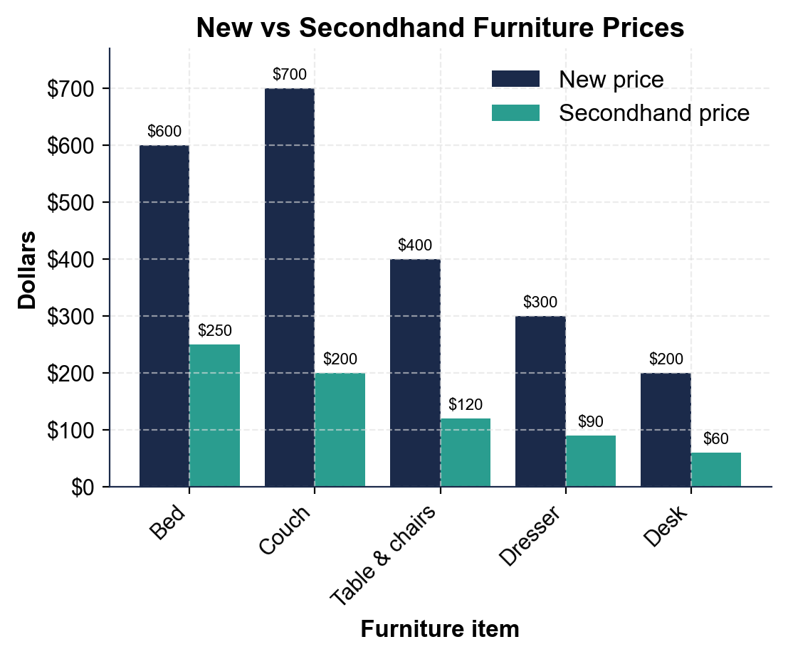
New vs Secondhand Furniture Prices
Every item's new bar tops its secondhand bar; the couch saves the most at $500.
© More Lessons Less Planning | morelessonslessplanning.com
Notes:
Give students a moment to read the two bars per item before discussing. The grouped bar chart shows, for five furniture items, the new price and the secondhand price side by side: Bed new $600 vs used $250; Couch new $700 vs used $200; Table & chairs new $400 vs used $120; Dresser new $300 vs used $90; Desk new $200 vs used $60. Work the takeaways live. For every item the new price bar is taller than the secondhand price bar, so buying used saves money on all five (savings $350, $500, $280, $210, $140). The couch is the biggest single saver at $500 off. Add up the columns: buying all five new costs $2,200, but secondhand it is only $720 - a $1,480 saving. Connect to the persona: this is Theo's furnishing list, and buying it used instead of new leaves him $1,480 for rent, food, or savings. This is the chart Activity Part 4 reads; students read each pair of bars, find the savings, and total new versus secondhand. Remind students these are average examples, not fixed amounts.
Reference labels (point to these chart features when teaching): Couch: new $700 vs used $200; Total: new $2,200 vs used $720

Slide 10
Avoiding Furniture-Financing Traps
Rent-to-own
RENT-TO-OWN lets you take furniture home for small weekly payments, but the total is far higher
✔
Do the math
A couch at $40 a week for 52 weeks costs $2,080 - almost three times the $700 new price
✔
Store financing too
Store cards and financing add interest, so you pay more than the sticker price
✔
The smart move
Buy secondhand or save up and pay once, instead of financing furniture over time
✔
Key Concept: RENT-TO-OWN and financing can cost two to three times the price - a $700 couch becomes $2,080.
© More Lessons Less Planning | morelessonslessplanning.com
Notes:
Warn students about the most expensive way to furnish a home: financing it. RENT-TO-OWN stores let you take furniture home for small weekly payments with no credit check, which feels easy - but the total is far higher than the item is worth. Do the math together: a couch at $40 a week for 52 weeks costs $40 x 52 = $2,080, almost three times the $700 new price and more than ten times the $200 secondhand price. Store credit cards and financing plans work the same way: they add interest, so you pay more than the sticker price, sometimes for years. The smart move is the opposite of financing: buy secondhand or save up and pay once, so the price you see is the price you pay. Teaching point: financing turns a one-time cost into a long, expensive stream of payments - the buyers who can least afford furniture end up paying the most for it. Never rent-to-own furniture you could buy used for a fraction of the price.

Slide 11
Build a Furnishing Plan
Step 1 - List and sort
List every item and sort each into a NEED or a NICE-TO-HAVE
✔
Step 2 - Price it used
Find the secondhand price for each item and figure the savings from secondhand
✔
Step 3 - Add up the needs
Add the needs' prices for the total furnishing cost and check it against your budget cap
✔
Step 4 - Fit and defer
Buy the needs first; if a nice-to-have does not fit the cap, defer it until you save more
✔
Key Concept: List and sort, price it used, add up the needs, then buy needs first and defer what does not fit.
© More Lessons Less Planning | morelessonslessplanning.com
Notes:
Give students the exact repeatable process they use in the Activity capstone. Step 1 - LIST AND SORT: write down every item and sort each into a need or a nice-to-have. Step 2 - PRICE IT USED: find the secondhand price for each item and figure the savings from secondhand (new price minus secondhand price). Step 3 - ADD UP THE NEEDS: add the needs' prices to get the total furnishing cost, and check that total against your budget cap. Step 4 - FIT AND DEFER: buy the needs first; if a nice-to-have does not fit under the cap, defer it until you have saved more. Walk students through the Activity's Part 5, where advisor Rosa Nguyen has a client - Maya Osei - with a $600 budget cap and a wish list, and students sort the list, total the needs secondhand, and decide what Maya buys now and what she defers. Tell students the pattern they will find: the three needs fit under Maya's cap, but the couch (a nice-to-have) has to wait.

Slide 12
Key Takeaways
Buy needs first; a bed and a table come before a couch or a TV stand
★
SAVINGS FROM SECONDHAND = NEW PRICE - SECONDHAND PRICE; $700 - $200 = $500
★
TOTAL FURNISHING COST = sum of item prices; keep it under your budget cap
★
Secondhand saves on the whole list: $2,200 new drops to about $720 used
★
Avoid rent-to-own and financing - a $700 couch can become $2,080
★
© More Lessons Less Planning | morelessonslessplanning.com
Notes:
Read each takeaway and connect it back to the learning targets. T1 (need vs nice-to-have) -> buy needs first; a bed and a table come before a couch or a TV stand. T2 (model 1) -> SAVINGS FROM SECONDHAND = NEW PRICE - SECONDHAND PRICE; the couch saves $700 - $200 = $500 used. T3 (model 2) -> TOTAL FURNISHING COST = the sum of the item prices; keep that total under your budget cap by prioritizing needs first. T4 (the payoff) -> secondhand saves on the whole list, cutting a $2,200 new-furniture bill down to about $720. T5 (the trap) -> avoid rent-to-own and financing, because a $700 couch financed can balloon to $2,080. Close by returning to the opening idea: students can now build a real furnishing plan that covers a first home's needs first, buys secondhand, and stays under budget.

