Slide 1
From Villages to Civilization
How farming, food surplus, and permanent villages set the stage for the world's first civilizations.
© More Lessons Less Planning | morelessonslessplanning.com
Notes:
Capstone lesson for Unit 1. Students pull together the whole unit - toolmaking, farming, permanent settlement, and monuments - to answer one big question: how did humans get from small farming villages to complex civilizations? Skara Brae, a real Neolithic village in Orkney, Scotland, is the concrete anchor.

Slide 2
Learning Targets
Explain how a farming food surplus allowed permanent settlements.
★
Describe how Skara Brae shows a settled, organized Neolithic village.
★
Explain how surplus led to specialization, trade, and social hierarchy.
★
Explain how villages set the stage for the first civilizations.
★
© More Lessons Less Planning | morelessonslessplanning.com
Notes:
Read the four learning targets. Today's lesson is a chain of causes: farming produces surplus, surplus allows settlement, settlement allows specialization and social hierarchy, and together those set the stage for civilization.

Slide 3
The Big Question
For most of history, humans were foragers who moved to follow food.
The Neolithic Revolution was the shift from foraging to farming and herding.
Farming let people stay in one place instead of chasing wild food.
Staying in one place changed almost everything about human society.
Our question: how did small farming villages become civilizations?
Key Concept: The NEOLITHIC REVOLUTION was the shift from hunting and gathering to farming and herding that let people settle in one place.
© More Lessons Less Planning | morelessonslessplanning.com
Notes:
For most of human history, people were foragers who moved from place to place to follow wild food. The NEOLITHIC REVOLUTION was the shift from hunting and gathering to farming and herding that let people settle in one place. Once people could grow their own food, they no longer had to chase it - and that single change set off a chain of effects that would eventually produce the world's first civilizations. Today we trace that chain, step by step.

Slide 4
Step 1: Farming Creates a Food Surplus
Foraging
Farming
Gather only what you can eat soon
Little or no food left over
Must keep moving to find more
Domesticate plants and animals
Harvest more than you need now
Store the extra as a food surplus
Key Concept: A FOOD SURPLUS is extra food beyond what people need right away - made possible by the DOMESTICATION of plants and animals.
© More Lessons Less Planning | morelessonslessplanning.com
Notes:
The first link in the chain is a FOOD SURPLUS - extra food produced beyond what people need to eat right away, which can be stored for later or used to support others. Farming produces surplus because of DOMESTICATION - the process of taming wild plants and animals so people can raise them for food and other uses. A forager gathers only what can be eaten soon, but a farmer can harvest far more than one family needs and store the extra. That stored surplus is the foundation everything else is built on.

Slide 5
Step 2: Surplus Allows Permanent Settlement
Stay near the fields
Farmers must live beside their crops and stored food year-round.
✔
Build to last
People build permanent homes of stone or mud brick instead of temporary shelters.
✔
Villages grow
Families cluster together into permanent settlements, the first true villages.
✔
Key Concept: A PERMANENT SETTLEMENT is a place where people live year-round instead of moving from place to place.
© More Lessons Less Planning | morelessonslessplanning.com
Notes:
The second link is the PERMANENT SETTLEMENT - a place where a group of people lives year-round instead of moving from place to place. Once you have fields to tend and surplus food to guard and store, you cannot wander - you must stay put. So Neolithic farmers built lasting homes of stone or mud brick and clustered together into the first true villages. Skara Brae, which we look at next, is one of the best-preserved of these early permanent settlements anywhere in the world.

Slide 6
A Real Neolithic Village: Skara Brae
Skara Brae sits on the Bay of Skaill in Orkney, Scotland.
It was a farming and herding village around 3100 BCE.
A storm uncovered its stone houses from the sand in 1850.
It is older than Stonehenge and the Egyptian pyramids.
Did You Know: Skara Brae was buried in sand for thousands of years, which is why its stone houses survived so well.
© More Lessons Less Planning | morelessonslessplanning.com
Notes:
Skara Brae is a real Neolithic village on the Bay of Skaill in Orkney, Scotland, lived in around 3100 BCE - older than Stonehenge and the Egyptian pyramids. Its people farmed, herded animals, and fished. For thousands of years the village lay buried under sand, until a great storm in 1850 stripped away the dunes and revealed the stone houses beneath. Because it was sealed in sand, Skara Brae is one of the best-preserved farming villages in the world. The next slide shows the excavated village.

Slide 7
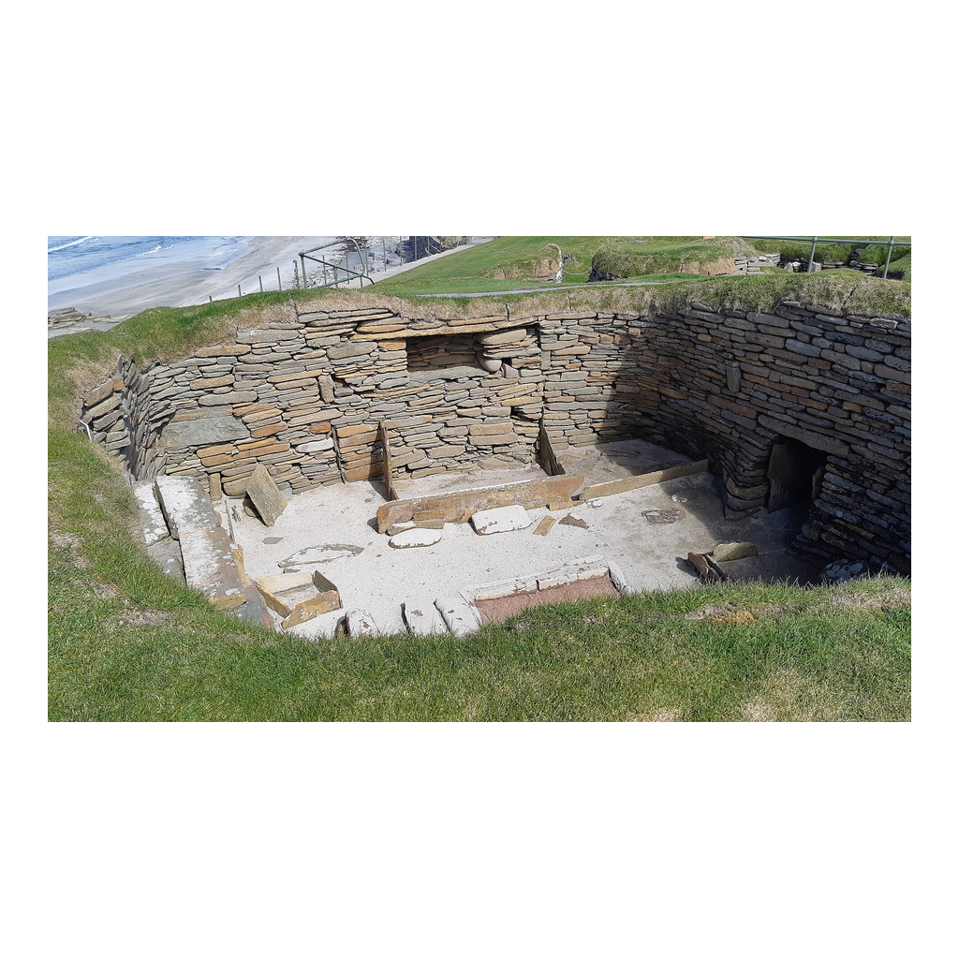
The Stone Village of Skara Brae
The excavated stone houses of Skara Brae, Orkney, Scotland.
© More Lessons Less Planning | morelessonslessplanning.com
Notes:
Public-domain photograph of the excavated village of Skara Brae. Give students a moment to notice the cluster of stone-walled houses set close together and the low passages connecting them - evidence of a planned, permanent community rather than scattered shelters.
Reference labels (point to these chart features when teaching): Stone house walls; Connecting passages

Slide 8
Inside the Stone Houses
Stone furniture
Each house has a stone dresser, stone bed frames, and a central hearth.
✔
Built-in storage
Small stone cupboards and boxes were set into the walls and floors.
✔
Middens all around
Heaps of bones, ash, and broken pottery show long-term, settled life.
✔
Key Concept: A MIDDEN is a heap of household refuse - bones, ash, and broken pottery - that builds up where people live for a long time.
© More Lessons Less Planning | morelessonslessplanning.com
Notes:
Inside each Skara Brae house, everything was built of stone: a stone dresser (a shelf unit) against the back wall, stone bed frames along the sides, and a hearth in the middle of the floor. Small stone cupboards and boxes were set into the walls. Around the houses archaeologists found large MIDDENS - heaps of household refuse such as bones, ash, and broken pottery that build up where people live for a long time. The middens are proof that families lived here for generations, not just a season. The next slide shows the inside of one of these houses.

Slide 9
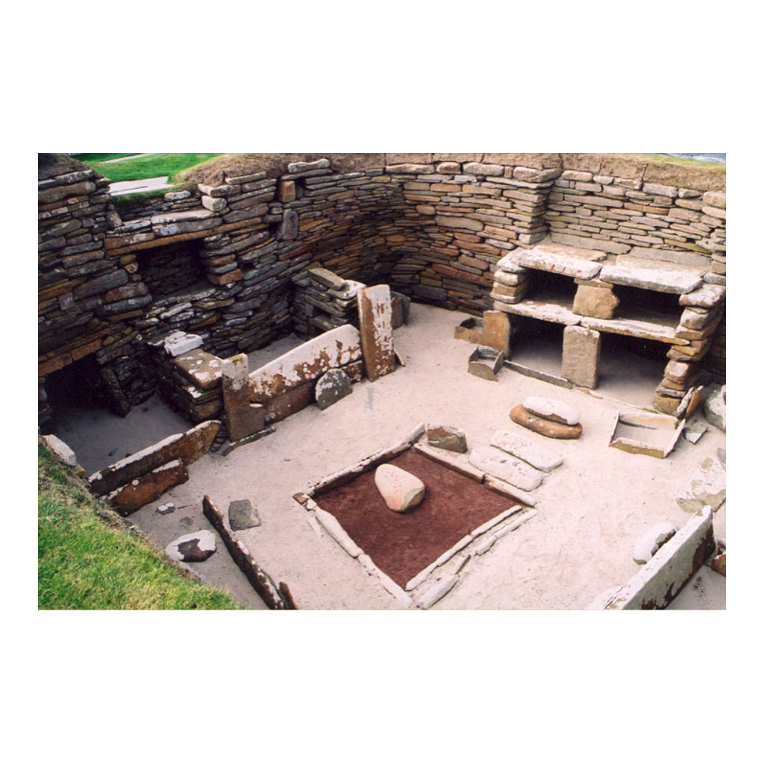
A House Frozen in Stone
Inside a Skara Brae house: the stone dresser, bed frames, and central hearth.
© More Lessons Less Planning | morelessonslessplanning.com
Notes:
Public-domain photograph of the interior of a Skara Brae house. Give students a moment to find the stone dresser against the back wall, the stone bed frames along the sides, and the square hearth in the center - the same layout repeated in house after house.
Reference labels (point to these chart features when teaching): Stone dresser (shelves); Central hearth

Slide 10
Step 3: Specialization of Labor
Without surplus
With surplus
Everyone must find food
No time for other work
Few new skills develop
Some people are freed from farming
They become potters, toolmakers, builders
Skills and crafts grow quickly
Key Concept: SPECIALIZATION OF LABOR is when people do different specific jobs instead of everyone farming - made possible by a food surplus.
© More Lessons Less Planning | morelessonslessplanning.com
Notes:
The third link is SPECIALIZATION OF LABOR - when people do different specific jobs instead of everyone doing the same work, made possible by a food surplus. When a village grows more food than it needs, not everyone has to farm. Some people can spend their days making pottery, tools, or clothing, or building houses. At Skara Brae, the carved stone objects and finely made grooved pottery are evidence that some villagers had become skilled specialists rather than full-time farmers.

Slide 11
Step 4: Trade and Social Hierarchy
Barter begins
Some gain more
Ranks appear
Specialists trade goods they make
A potter swaps pots for grain
This direct swapping is called barter
Those who control surplus grow richer
Skilled or lucky families gather wealth
Not everyone ends up equal
Society splits into higher and lower groups
This ranking is a social hierarchy
Leaders and elites emerge
Key Concept: A SOCIAL HIERARCHY is a ranking of people by wealth, power, or status - and BARTER is trading goods directly for other goods.
© More Lessons Less Planning | morelessonslessplanning.com
Notes:
The fourth link brings trade and inequality. As specialists make goods, they exchange them through BARTER - trading goods directly for other goods without using money. A potter might swap bowls for a farmer's grain. But not everyone gains equally: families who control surplus food or valuable crafts grow wealthier and more powerful. Over time society splits into ranked groups, producing a SOCIAL HIERARCHY - a ranking of people in a society by wealth, power, or status, with some groups above others. This is a major break from the rough equality of small foraging bands.

Slide 12
Step 5: From Village to Civilization
As villages grew and traded, some became towns and then cities.
Larger populations needed organized government to keep order.
Specialists, surplus, and hierarchy all scaled up together.
Record-keeping and writing emerged to manage it all.
This complex package of features is called a civilization.
Key Concept: A CIVILIZATION is a complex society with cities, organized government, specialized workers, and usually record-keeping.
© More Lessons Less Planning | morelessonslessplanning.com
Notes:
The final link completes the chain. Where farming villages grew large, traded widely, and developed ranked societies, some eventually became towns and then cities. Bigger populations needed organized government to keep order and manage shared resources, and record-keeping - often early writing - emerged to track surplus, trade, and taxes. All the pieces from this lesson scaled up together into a CIVILIZATION - a complex society with cities, organized government, specialized workers, and usually record-keeping. Skara Brae itself never became a city, but it shows the village-level foundations on which the first civilizations, like Sumer, would later be built.

Slide 13
How We Know: Reading the Evidence
Artifacts
Written accounts
Objects people made or used
Pots, tools, carved stone
Show skills and daily life
Petrie's 1867 excavation report
Describes the houses and furniture
A primary source to combine with ruins
Key Concept: An ARTIFACT is an object made or used by people in the past that archaeologists study as evidence.
© More Lessons Less Planning | morelessonslessplanning.com
Notes:
How do we know all this? Archaeologists read two kinds of evidence. The first is ARTIFACTS - objects made or used by people in the past that archaeologists study as evidence, like Skara Brae's pottery, tools, and carved stone. The second is written accounts. In 1867 the antiquarian George Petrie published a careful description of the newly excavated Skara Brae houses, their beds, and their stone dressers. In the activity you will read Petrie's own words as a primary source and combine them with the physical village to explain how farming villages set the stage for civilization.

Slide 14
Key Takeaways
Farming creates a food surplus - the foundation of everything that follows.
★
Surplus allows permanent settlements like the village of Skara Brae.
★
Surplus frees specialists and produces trade and social hierarchy.
★
Together these changes set the stage for the first civilizations.
★
© More Lessons Less Planning | morelessonslessplanning.com
Notes:
Recap the chain: farming creates a food surplus; surplus allows permanent settlement; settlement and surplus free up specialists and produce barter and social hierarchy; and all of these together set the stage for the first civilizations. Skara Brae shows the village-level beginning of that story in stone.

