Slide 1
Franklin's Philadelphia
US History - Unit 2: Colonial America
© More Lessons Less Planning | morelessonslessplanning.com
Notes:
Open by asking what a seventeen-year-old with no money and no connections could possibly build in a city that was not his own.

Slide 2
Learning Targets
Describe what daily life was like in a colonial city.
★
Explain how Franklin turned a club into a public library.
★
Explain how a subscription paid for books no one could buy alone.
★
Name three civic institutions Franklin helped start.
★
Explain how Franklin built the city and also enslaved people.
★
Judge how much to trust Franklin's story about himself.
★
© More Lessons Less Planning | morelessonslessplanning.com
Notes:
Read targets five and six aloud twice - they ask students to judge, not just recall.

Slide 3
A Port City on the Delaware
A planned city
A busy young port
Founded in 1682 by William Penn on the Delaware River.
Laid out on a strict grid between two rivers.
Named for the Greek words for 'brotherly love.'
Ships loaded flour, wheat, and lumber for England.
New arrivals landed often, looking for work.
By the 1720s, it was one of the busier colonial ports.
Did You Know: Philadelphia's name means 'brotherly love' in Greek.
© More Lessons Less Planning | morelessonslessplanning.com
Notes:
Set the scene fast - a planned, growing port, not a sleepy village. Franklin is about to walk into this city with nothing.

Slide 4
Runaway to Philadelphia, 1723
Born in Boston
Benjamin Franklin was born in Boston in 1706, the tenth son of a candlemaker.
✔
Bound to his brother
At twelve, he was bound by contract to his older brother James, a Boston printer, for nine years.
✔
Apprentice
A young worker bound by contract to serve a master for a set number of years while learning a trade.
✔
Runs away, 1723
Franklin broke that contract and ran away, landing in Philadelphia in October 1723 at seventeen.
✔
Note: Walking away from a signed work contract was against the law in 1723.
© More Lessons Less Planning | morelessonslessplanning.com
Notes:
Land on the definition of apprentice before moving past it - this is the slide's Guided Notes anchor.

Slide 5
Setting Type for a Living
printing press
A machine that presses inked metal type onto paper to make many copies of the same page.
pamphlet
A short printed work, cheap to make and pass around, used to argue a case to the public.
Did You Know: Franklin bought the Pennsylvania Gazette in 1729 and built it into a leading colonial newspaper.
© More Lessons Less Planning | morelessonslessplanning.com
Notes:
Both terms sit on the Activity Reference Guide. Keep this slide brisk - it is groundwork for almanac and Junto.

Slide 6
Words That Traveled
Poor Richard's Almanack
Franklin began publishing it every year, starting in 1732.
✔
Wide reach
It sold widely across the colonies and made 'Richard Saunders' a household name.
✔
Almanac
A cheap yearly book of calendars, weather guesses, and sayings that most colonial households bought.
✔
Not always original
Franklin collected and reworded many of the sayings he printed there.
✔
Did You Know: For many colonial households the yearly almanac was the one book they bought all year.
© More Lessons Less Planning | morelessonslessplanning.com
Notes:
Ask who can quote a Poor Richard saying before you reveal the term - most students already know one without knowing where it came from.

Slide 7
A Club for Mutual Improvement
Junto
The club of young tradesmen Franklin formed in 1727 to debate questions and help one another get ahead.
Key Concept: The club's meeting rules required calm debate, not fighting to win.
© More Lessons Less Planning | morelessonslessplanning.com
Notes:
This is the engine slide - point back to it every time a later slide starts with 'members proposed' or 'the club decided.'

Slide 8
From Club Shelf to Public Shelf
Members share their own books
Club members brought books from home to a shared shelf at meetings.
✔
The shared shelf fails
Books were damaged or lost, and members grew unwilling to add more.
✔
Franklin proposes something bigger
Open a real collection to any paying member, not only club members.
✔
Subscription library
A library paid for by members who each contribute money and may borrow from the shared collection.
✔
Remember: The first plan failed before the better one worked.
© More Lessons Less Planning | morelessonslessplanning.com
Notes:
Walk this as a sequence, in order. It is the plot of the excerpt students will read in the Activity.

Slide 9
Turning a Promise Into a Contract
conveyancer
A person who writes up legal papers that transfer property or bind people to an agreement.
Did You Know: Franklin named a real conveyancer, Charles Brockden, who wrote up the library's founding agreement.
© More Lessons Less Planning | morelessonslessplanning.com
Notes:
This is where a spoken plan becomes something signable. Brockden is a real, named person in the primary source.

Slide 10
Fifty Subscribers, Forty Shillings
What was needed | The number | Why it mattered
Subscribers needed to start the library | Fifty people | One person alone could not buy a real book collection
Payment each subscriber put in at the start | Forty shillings | Enough money, pooled, to order the first books
Yearly payment after that | Ten shillings | Kept new books coming after the first purchase
People in Franklin's club | About a dozen | Far short of the fifty the plan actually needed
Remember: It took real effort to find fifty strangers willing to trust a plan on paper.
© More Lessons Less Planning | morelessonslessplanning.com
Notes:
Have a student read the yearly payment line aloud - it is the detail students most often miss on a first read.

Slide 11
Made Permanent, 1731
charter
A legal grant that gives an organization official standing and lets it outlive its first members.
Did You Know: The library's founding articles of agreement are dated July 1, 1731.
© More Lessons Less Planning | morelessonslessplanning.com
Notes:
Separate the two ideas cleanly: the 1731 agreement is what made the plan binding; a charter is the broader legal concept.

Slide 12
Buckets, Bags, and Thirty Men
How it started
Franklin wrote an essay in 1735 warning Philadelphia about fire; thirty men joined together in December 1736.
✔
How it worked
Each man kept leather buckets and linen bags ready at home for a fire.
✔
Volunteer fire company
A group of neighbors who agree to keep firefighting gear ready and answer one another's fires without pay.
✔
It spread
Other companies across Philadelphia copied the same plan.
✔
Warning: 'Volunteer' did not mean free of rules - missed duties still cost you.
© More Lessons Less Planning | morelessonslessplanning.com
Notes:
Same method, new problem. Ask the class to name it before you say it: pool resources, agree to rules, cover each other.

Slide 13
A City of Joined Efforts
Civic institution
An organization built and paid for by ordinary residents to serve a whole town rather than one owner.
✔
A hospital
Philadelphia's first hospital grew out of the same joining-together method.
✔
An academy
An academy for young men later grew into a university.
✔
Paved and lit streets
Neighbors pooled money to pave, clean, and light city streets.
✔
Key Concept: Franklin's real invention was the method, used again and again.
© More Lessons Less Planning | morelessonslessplanning.com
Notes:
Name all three follow-on projects, but do not let the class get lost in dates - the point is the repeated method, not a timeline.

Slide 14
Who Was Left Out
Franklin built Philadelphia's civic life - and was also a slaveholder.
Franklin and his wife Deborah enslaved at least seven people over the years.
His newspaper ran ads selling enslaved people and hunting those who escaped.
A rival Philadelphia printer refused those same ads as morally wrong.
He later led an abolition society but never freed the people he enslaved.
Remember: This lesson does not let one fact erase the other.
© More Lessons Less Planning | morelessonslessplanning.com
Notes:
Say this plainly and move on with the same tone used for any other documented fact - do not soften it and do not dwell on it as spectacle.

Slide 15
Franklin Writing About Franklin
What the source is
Why to read it carefully
Written in 1784, more than fifty years later.
The events described happened around 1730-1731.
Franklin was about 78; he was 24 when it happened.
A memoir is not a transcript of events.
Franklin chose what to include and leave out.
The library numbers match outside records.
Tip: A memoir written decades later is still a primary source - just one written with hindsight.
© More Lessons Less Planning | morelessonslessplanning.com
Notes:
This slide is the reasoning skill target six actually grades. Push students past 'it's biased so it's useless.'

Slide 16
A City Worth Engraving
By the 1760s, Philadelphia was one of Britain's busiest ports.
A London publisher had a wide city view engraved and sold in 1768.
That is over four decades after Franklin arrived there broke.
Engravings like this sold to English readers curious about the colonies.
Philadelphia still followed the same grid Penn laid out in 1682.
Did You Know: This piece was made and sold in London, not Philadelphia.
© More Lessons Less Planning | morelessonslessplanning.com
Notes:
Bridge slide before the visual - remind the class this is the same grid city from slide 3, four decades on.

Slide 17
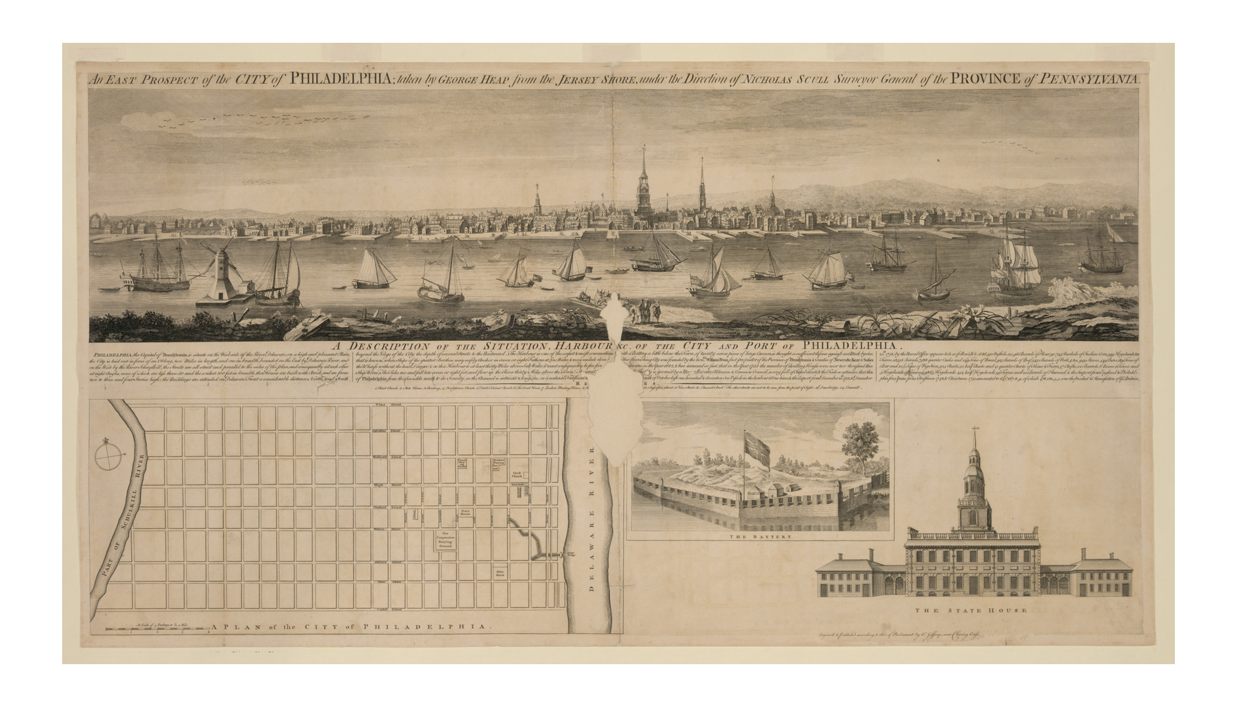
An East Prospect of the City of Philadelphia, 1768
An East Prospect of Philadelphia, engraved for sale in London, 1768.
© More Lessons Less Planning | morelessonslessplanning.com
Notes:
Give the class a quiet moment with it, then ask what looks the same as the grid city from slide 3 and what looks different eighty years on.
Reference labels (point to these chart features when teaching): Ships on the Delaware River; City grid between two rivers

Slide 18
Key Takeaways
Franklin ran away to Philadelphia in 1723 with almost nothing.
★
His printing trade gave him money, readers, and a public voice.
★
A failed club shelf became a real library once strangers agreed to pay in.
★
The same joining-together method built a fire company and more.
★
Franklin built civic life and enslaved people in the same years.
★
© More Lessons Less Planning | morelessonslessplanning.com
Notes:
Close by pointing back at target six: how much do we trust a story someone tells about their own younger self?

