Slide 1
Fixed vs Variable Expenses: What You Can Actually Cut
Some bills are locked in and some you can flex - learn which is which, and find the spending you can actually cut.
© More Lessons Less Planning | morelessonslessplanning.com
Notes:
Open with the hook: people try to cut spending but aim at the wrong costs. The bills that are LOCKED IN (fixed) barely budge, while the spending that CHANGES month to month (variable) is where almost all of your real cutting power lives. Today students sort expenses into fixed and variable, read a pie chart of the split, and find what can actually be cut.

Slide 2
Learning Targets
Define fixed and variable expenses and tell them apart by the amount
★
Sort real expenses into fixed and variable, including gray-area items
★
Read a pie chart comparing the fixed and variable shares of a budget
★
Find what can actually be cut by targeting variable (flexible) spending
★
© More Lessons Less Planning | morelessonslessplanning.com
Notes:
Read the four targets aloud. Tell students the activity puts them in the role of Devon, a first-year warehouse associate with $2,400 a month take-home, sorting his real expenses into fixed and variable, reading a pie chart of the split, and figuring out exactly where he can cut to free up money to save.

Slide 3
Two Kinds of Expenses
Why the Split Matters
Fixed vs Variable
Every expense is either FIXED or VARIABLE
TAKE-HOME PAY is your net income after taxes
A BUDGET splits your take-home pay across both
Knowing which is which tells you what you can cut
A FIXED EXPENSE stays the same amount every month
A VARIABLE EXPENSE changes from month to month
Fixed costs are locked by a contract or commitment
Variable costs are where the FLEXIBLE SPENDING lives
Key Concept: A FIXED EXPENSE stays the same every month; a VARIABLE EXPENSE changes month to month. The split is about the AMOUNT, not the need.
© More Lessons Less Planning | morelessonslessplanning.com
Notes:
Frame the big idea: every expense lands in one of two buckets. A FIXED EXPENSE stays the same amount every month - it is locked in by a contract or commitment, so it barely budges. A VARIABLE EXPENSE changes from month to month. The split is about the AMOUNT (does it stay the same or change?), not about whether you need it. TAKE-HOME PAY is your net income - the money actually deposited after taxes are taken out - and a BUDGET splits that take-home pay across both kinds of expense. Variable costs are where the FLEXIBLE SPENDING lives - the part you can actually cut.

Slide 4
Fixed Expenses: Rent, Car, Phone
Fixed expense
A cost that stays the same amount every month, locked in by a contract or commitment - rent, a car payment, insurance
Recurring bill
A charge that comes every month, like a phone plan or gym membership; a recurring bill is fixed when the amount stays the same
Why fixed costs are hard to cut
You signed a lease, a loan, or a contract, so the amount is locked - you cannot just decide to pay less this month
Devon's fixed costs
Rent $900, car payment $260, insurance $190, phone plan $50, gym membership $40 = $1,440 every month
Tip: A FIXED EXPENSE is locked in - the same amount every month. To change it you must break a contract, so fixed costs are the hardest to cut.
© More Lessons Less Planning | morelessonslessplanning.com
Notes:
Teach the FIXED EXPENSE. A FIXED EXPENSE stays the same amount every month because it is locked in by a contract or commitment - rent $900, a car payment $260, insurance $190. A RECURRING BILL is a charge that comes every month, like a phone plan $50 or a gym membership $40; a recurring bill is fixed when the amount stays the same. Fixed costs are the hardest to cut because you signed a lease, a loan, or a contract, so the amount is locked - you cannot just decide to pay less. Devon's fixed costs total $1,440 every month.

Slide 5
Variable Expenses: Food, Gas, Utilities
Variable expense
A cost that changes from month to month - groceries, gas, eating out, entertainment, utilities
Necessity
A must-pay essential like groceries or gas; a necessity can still be VARIABLE because the amount changes month to month
Utilities are variable
A utility bill (electric, water) is VARIABLE - it changes month to month, even though many people wrongly assume any bill is fixed
Devon's variable costs
Groceries $360, eating out $200, gas $180, entertainment $120, utilities $100 = $960, and the amount changes each month
Did You Know? A NECESSITY can still be VARIABLE. You must buy groceries and gas, but the AMOUNT changes month to month - so they are variable.
© More Lessons Less Planning | morelessonslessplanning.com
Notes:
Teach the VARIABLE EXPENSE. A VARIABLE EXPENSE changes from month to month - groceries, gas, eating out, entertainment, utilities. A key nuance: a NECESSITY (a must-pay essential like groceries or gas) can still be VARIABLE because the AMOUNT changes month to month. Call out utilities explicitly: a utility bill (electric, water) is VARIABLE - it changes month to month - even though many students wrongly assume any bill is fixed. Devon's variable costs total $960, and that amount changes each month.

Slide 6
Which Can You Actually Cut?
Where the Cutting Power Is
Easiest to Cut First
You can rarely cut a FIXED cost this month
FLEXIBLE SPENDING is variable you can raise or lower
Almost all cutting power lives in variable costs
Start with DISCRETIONARY SPENDING you choose
DISCRETIONARY SPENDING: eating out, entertainment
A SPENDING CUT lowers a variable expense on purpose
Every dollar you cut is a dollar you can save
Devon can flex his $960 of variable spending
Key Concept: FLEXIBLE SPENDING is variable spending you can raise or lower - where your cutting power lives. Start with DISCRETIONARY SPENDING.
© More Lessons Less Planning | morelessonslessplanning.com
Notes:
Teach where the cutting power is. You can rarely cut a FIXED cost in a given month because it is locked by contract. FLEXIBLE SPENDING is variable spending you can raise or lower month to month - it is where almost all of your real cutting power lives. The easiest place to start is DISCRETIONARY SPENDING - optional spending you choose, like eating out and entertainment. A SPENDING CUT means lowering a variable expense on purpose to free up money to save - every dollar you cut is a dollar you can save. Devon can flex his $960 of variable spending; his $1,440 of fixed costs barely move.

Slide 7
The Danger of Too Many Fixed Costs
Fixed costs lock up money
Every fixed cost you add is money you cannot reach in a tight month - it is committed before the month even starts
Too many contracts = no flexibility
Stacking car payments, subscriptions, and memberships turns flexible income into locked-in fixed bills
A GRAY-AREA EXPENSE can flip
A phone plan flat one month but overage-charged the next is a gray-area expense - fixed when flat, variable when it changes
Watch what you sign up for
Before adding a fixed bill, ask: am I trading flexible spending I could cut for a contract I cannot?
Tip: The more of your pay that is FIXED, the less you can cut in a tight month. Every contract you sign moves money to the locked-in side.
© More Lessons Less Planning | morelessonslessplanning.com
Notes:
Teach the danger of too many fixed costs. Every FIXED cost you add is money you cannot reach in a tight month - it is committed before the month even starts. Stacking car payments, subscriptions, and memberships turns flexible income into locked-in fixed bills, so you lose the ability to cut. A GRAY-AREA EXPENSE can flip between fixed and variable - a phone plan that is flat one month but overage-charged the next is fixed when flat and variable when it changes. The takeaway: before adding a fixed bill, ask whether you are trading flexible spending you could cut for a contract you cannot.

Slide 8
Flexing Variable Spending
Step 1: Find your variable total
Devon's variable spending is $960: groceries $360, eating out $200, gas $180, entertainment $120, utilities $100
✔
Step 2: Target discretionary first
DISCRETIONARY SPENDING - eating out $200 and entertainment $120 - is the easiest to flex without skipping a necessity
✔
Step 3: Make a SPENDING CUT
Cut eating out $200 to $100 and entertainment $120 to $60 - a $160 SPENDING CUT that drops variable from $960 to $800
✔
Step 4: Save the freed-up money
The $160 you cut is $160 you can now save - a 25% cut of the $960 variable would free $240, dropping it to $720
✔
Tip: A SPENDING CUT of $160 (eating out + entertainment) drops Devon's variable from $960 to $800 - and that $160 becomes savings.
© More Lessons Less Planning | morelessonslessplanning.com
Notes:
Teach flexing variable spending using Devon's $960 variable total. Step 1: find the variable total - $960 (groceries $360, eating out $200, gas $180, entertainment $120, utilities $100). Step 2: target DISCRETIONARY SPENDING first - eating out $200 and entertainment $120 - because it is the easiest to flex without skipping a necessity. Step 3: make a SPENDING CUT - cut eating out $200 to $100 and entertainment $120 to $60, a $160 cut that drops variable from $960 to $800. Step 4: the $160 you cut is $160 you can save. A 25% cut of the $960 variable would free $240, dropping variable to $720. All figures verified against pf_calc.

Slide 9
Devon's Fixed vs Variable as a Pie Chart
The two slices
Devon's $2,400 take-home splits into FIXED $1,440 (60%) and VARIABLE $960 (40%)
✔
The fixed slice
Fixed $1,440 (60%) - the larger slice: rent, car payment, insurance, phone, gym, locked in
✔
The variable slice
Variable $960 (40%) - the smaller slice: groceries, eating out, gas, entertainment, utilities, flexible
✔
What the picture shows
Fixed ($1,440) is bigger, but the smaller variable slice ($960) is the part Devon can actually cut
✔
Key Concept: As a pie, the fixed slice ($1,440, 60%) is bigger, but the variable slice ($960, 40%) is the part Devon can actually cut.
© More Lessons Less Planning | morelessonslessplanning.com
Notes:
Set up the pie chart on the next slide. Devon's $2,400 take-home splits into two slices: FIXED $1,440 (60%) and VARIABLE $960 (40%). The fixed slice is the larger one, but the variable slice is the part he can actually cut. Seen as a pie, students can read each slice's dollar amount and percent and confirm the two slices total $2,400.

Slide 10
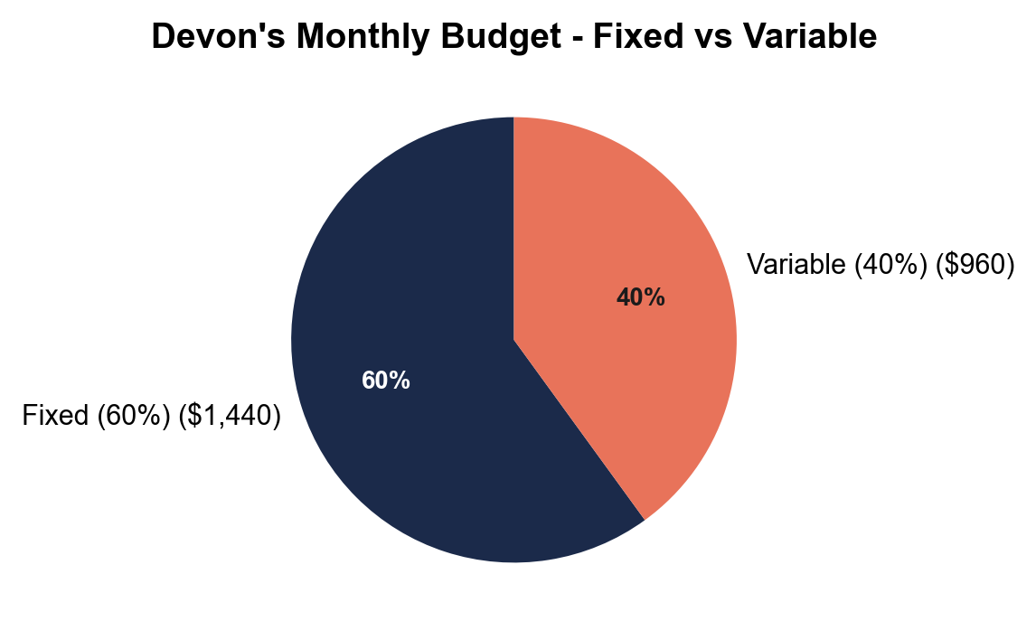
Note: Devon's Monthly Budget - Fixed vs Variable
Devon's $2,400 split into fixed ($1,440, 60%) and variable ($960, 40%).
© More Lessons Less Planning | morelessonslessplanning.com
Notes:
Have students read the pie chart. The fixed slice (rent $900, car payment $260, insurance $190, phone $50, gym $40) totals $1,440 and is 60% of Devon's $2,400 pay - the larger slice. The variable slice (groceries $360, eating out $200, gas $180, entertainment $120, utilities $100) totals $960 and is 40% - the smaller, cuttable slice. The two slices total $2,400. This is the chart Activity Part 3 reads.
Reference labels (point to these chart features when teaching): Fixed: $1,440 (60%); Variable: $960 (40%)

Slide 11
Sort: Fixed or Variable?
Clear Calls
Watch-Out Calls
Rent $900 -> FIXED (same every month, leased)
Car payment $260 -> FIXED (loan locks it)
Groceries -> VARIABLE (amount changes)
Eating out -> VARIABLE (discretionary, easy to cut)
Utilities -> VARIABLE (a bill can still change)
Phone plan -> GRAY AREA (flat vs overage months)
Gym on a 12-month contract -> FIXED (locked)
Ask: does the AMOUNT stay the same or change?
Did You Know? Most mistakes come from calling a utility bill fixed or forgetting a contract locks a cost. Ask: does the AMOUNT stay the same?
© More Lessons Less Planning | morelessonslessplanning.com
Notes:
Practice sorting. Clear fixed: rent $900 (leased), car payment $260 (loan locks it), insurance. Clear variable: groceries (amount changes), eating out (discretionary, easy to cut), gas. Watch-out calls: a utility bill is VARIABLE because the amount changes; a phone plan is a GRAY-AREA EXPENSE - fixed when flat, variable when overage fees hit; a gym membership on a 12-month contract is FIXED because the contract locks the amount. The single test settles every call: does the AMOUNT stay the same every month (fixed) or change (variable)?

Slide 12
Key Takeaways
A FIXED EXPENSE stays the same every month; a VARIABLE EXPENSE changes
★
The split is about the AMOUNT, not the need - a necessity can be variable
★
Watch out: a utility bill is variable, and a contract can lock a cost as fixed
★
FLEXIBLE SPENDING is where almost all of your real cutting power lives
★
Make a SPENDING CUT on variable (discretionary) spending and save what you free
★
© More Lessons Less Planning | morelessonslessplanning.com
Notes:
Read each takeaway and connect to the learning targets. T1 (define fixed vs variable) -> Activity Parts 1-2 and the card sort in Part 5. T2 (sort real expenses incl. gray area) -> Part 5 cards. T3 (read the pie chart) -> Part 3. T4 (find what can be cut) -> Part 4 math. Tell students the activity puts them in Devon's shoes sorting his real expenses, reading the pie chart of the split, and making a spending cut on the variable side to free up money to save.

