Slide 1
Fire, Tools, and Survival
The technologies early humans invented to survive - and to spread across the world.
© More Lessons Less Planning | morelessonslessplanning.com
Notes:
Opening slide. Early humans had no thick fur, no claws, and no great speed. What they had was technology: fire, stone tools, and shelter. Today students learn how these inventions let early humans survive harsh environments and spread across the globe.

Slide 2
Learning Targets
Identify the key survival technologies: fire, stone tools, and shelter.
★
Explain how controlling fire changed diet, safety, and daily life.
★
Describe how stone tools were made and improved over time.
★
Explain how technology let humans adapt and spread into new environments.
★
© More Lessons Less Planning | morelessonslessplanning.com
Notes:
Read the four learning targets. Today connects a survival story (fire, tools, shelter) with a history skill: explaining how new technology reshaped how and where people could live.

Slide 3
Surviving a Harsh World
Technology
The tools, methods, and knowledge people invent to solve problems and survive.
Adaptation
A change in behavior or technology that helps a group survive in its environment.
Key Concept: Early FORAGERS survived by inventing TECHNOLOGY and making each ADAPTATION fit their world.
© More Lessons Less Planning | morelessonslessplanning.com
Notes:
Early humans were FORAGERS - people who survived by gathering wild plants and hunting animals rather than farming. To survive cold, hunger, and danger they relied on TECHNOLOGY: the tools, methods, and knowledge people invent to solve problems and meet their needs. Each new invention was an ADAPTATION - a change in behavior or technology that helps a group survive in its environment.

Slide 4
Making Fire
Friction fire
Rubbing wood against wood fast until the heat makes a glowing ember.
✔
The hearth
A fire pit where early humans burned wood for heat, light, and cooking.
✔
Key Concept: Early humans made FRICTION FIRE by hand and kept it burning in a HEARTH.
© More Lessons Less Planning | morelessonslessplanning.com
Notes:
One of the greatest early technologies was making fire on purpose. FRICTION FIRE means making fire by rubbing wood against wood fast enough to create heat and a glowing ember. People spun or rubbed a wooden drill against a baseboard until the wood-dust caught fire. Once lit, the fire was kept burning in a HEARTH - a fire pit or fireplace where early humans burned wood for heat, light, and cooking. The next slide shows a person making fire by friction.

Slide 5
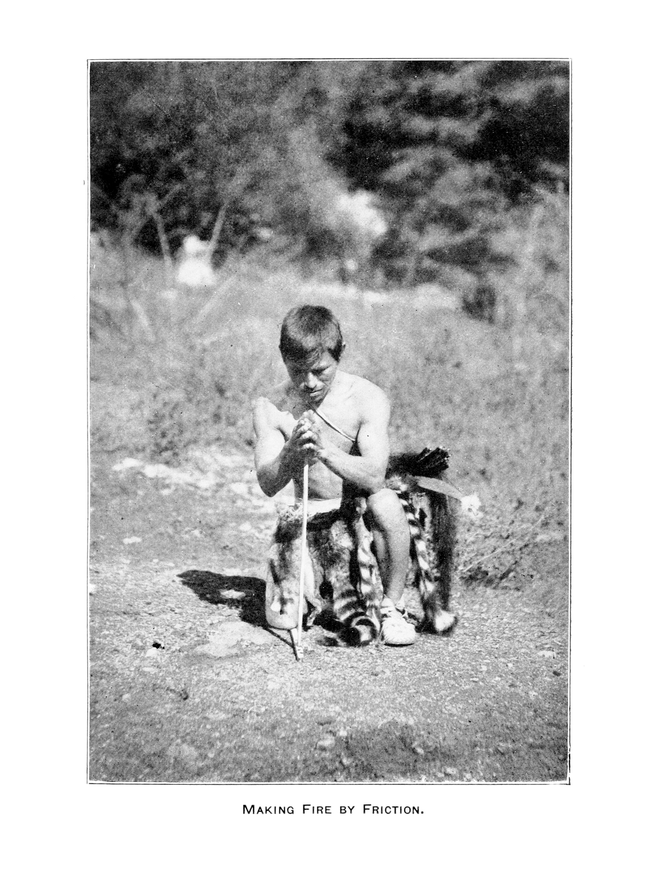
Making Fire by Friction
A person makes fire with a wooden hand-drill using only friction.
© More Lessons Less Planning | morelessonslessplanning.com
Notes:
Public-domain Smithsonian photograph (Walter Hough, 1922) of a person making fire by friction with a wooden hand-drill spun against a baseboard - the same technology Tylor describes in the activity's primary source. Give students a moment to notice how fire was made from nothing but wood, friction, and skill.
Reference labels (point to these chart features when teaching): Wooden hand-drill; Making fire by friction

Slide 6
Fire Changed Everything
Cooking made food safer to eat and easier to digest.
Fire gave warmth that let people survive cold nights and winters.
Flames scared away predators and lit up the dark.
A shared hearth became a place where the group gathered.
Did You Know? COOKING food with fire may have helped early human brains grow larger over time.
© More Lessons Less Planning | morelessonslessplanning.com
Notes:
Fire did far more than keep people warm. COOKING means using fire to heat food so it is safer to eat and easier to digest - cooked meat and roots gave people more energy from the same food. Fire also gave warmth for cold nights, scared away predators, and lit up the dark so people could work and gather after sunset. The shared hearth became the center of group life.

Slide 7
Shaping Stone Tools
Knapping
Striking one stone against another to flake off sharp edges and shape a tool.
Hand-axe
A teardrop-shaped stone tool with sharp edges used to cut, chop, and dig.
Key Concept: By KNAPPING stone, early humans made the HAND-AXE - a sharp, all-purpose tool.
© More Lessons Less Planning | morelessonslessplanning.com
Notes:
Early humans shaped their own cutting tools through KNAPPING - shaping stone into tools by striking one stone against another to flake off sharp edges. The best-known result was the HAND-AXE, a teardrop-shaped stone tool with sharp edges used to cut, chop, and dig. Over hundreds of thousands of years toolmaking improved: later hand-axes are more symmetrical, sharper, and better shaped than the earliest ones. The next slide shows a stone hand-axe.

Slide 8
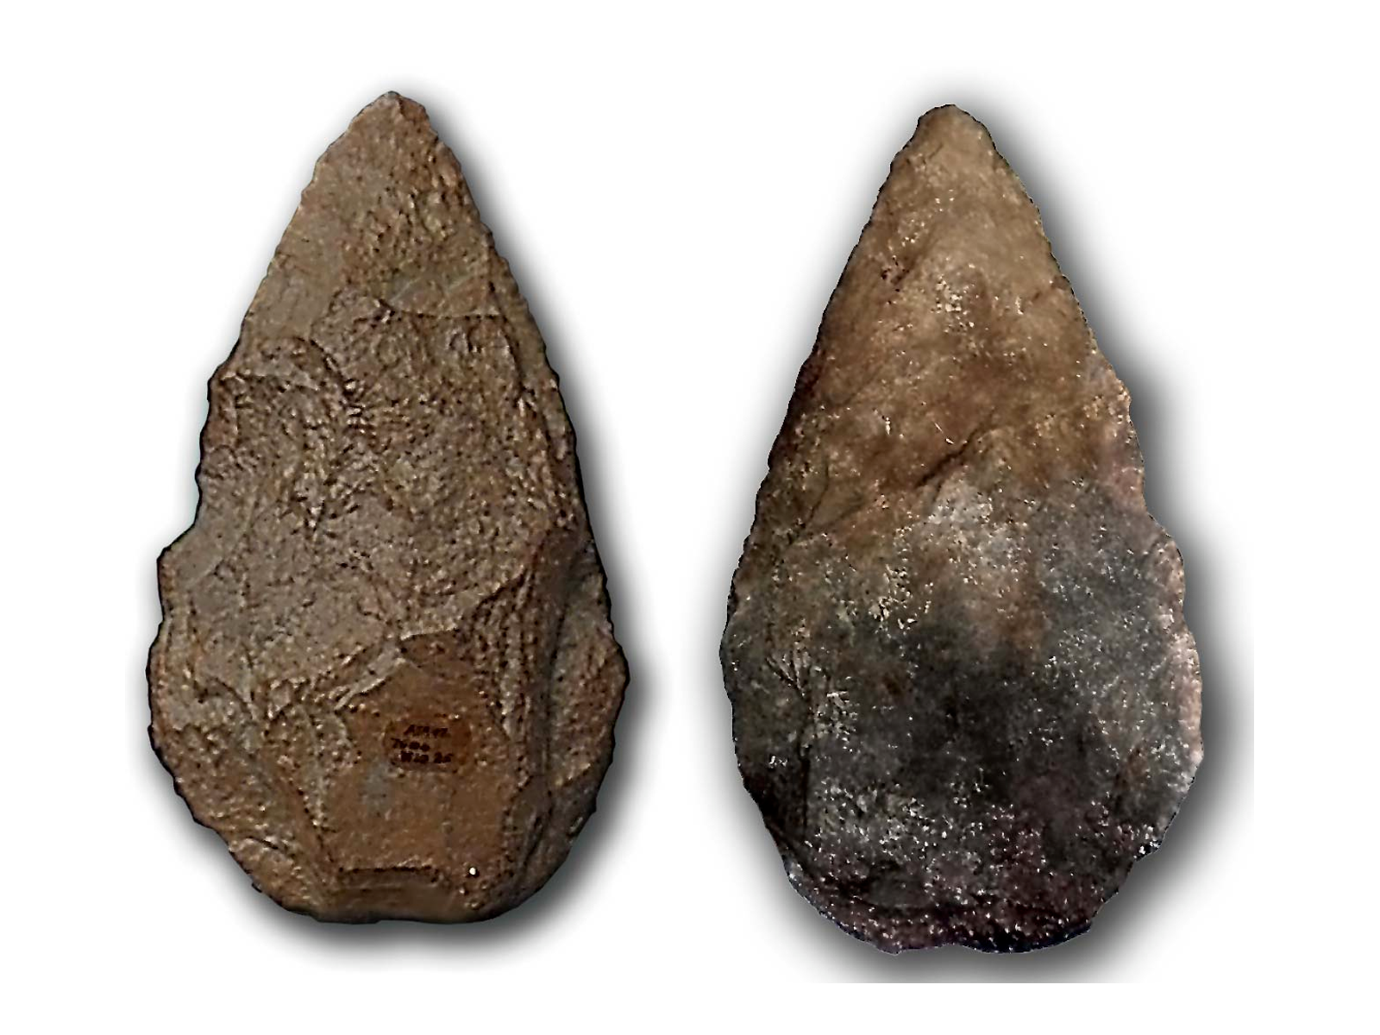
A Stone Hand-Axe
Two views of a teardrop-shaped stone hand-axe with knapped edges.
© More Lessons Less Planning | morelessonslessplanning.com
Notes:
Public-domain photo of a stone hand-axe from Atapuerca, shown from both faces (a teardrop-shaped biface). Point out the teardrop shape and the flaked, sharpened edges that show careful knapping.
Reference labels (point to these chart features when teaching): Knapped sharp edges; Teardrop shape

Slide 9
Finding Shelter
Shelter
A cave, hut, or tent that protects people from weather and danger.
✔
Fire and clothing
A hearth inside a shelter, plus animal-hide clothing, added warmth.
✔
Key Concept: SHELTER protected early humans from cold, rain, wind, and predators.
© More Lessons Less Planning | morelessonslessplanning.com
Notes:
To survive harsh weather, early humans needed SHELTER - a structure such as a cave, hut, or tent that protects people from weather and danger. Some sheltered in caves; others built huts from wood, hides, or even mammoth bones. A hearth inside the shelter kept it warm, and clothing made from animal hides added even more protection. Shelter, fire, and clothing together let people live in places that were once too cold to survive.

Slide 10
Spreading Across the World
Migration moved early humans out of Africa into new regions.
Fire, tools, and shelter let people survive colder, harsher climates.
Each new environment required a new adaptation to survive.
Technology, not thick fur, is what let humans spread nearly everywhere.
Key Concept: MIGRATION and ADAPTATION, powered by technology, spread humans across the globe.
© More Lessons Less Planning | morelessonslessplanning.com
Notes:
Carrying their technology with them, early humans spread across the world. MIGRATION is the movement of people from one region to another to find food, safety, or better living conditions. As people moved into colder, harsher places, fire, tools, and shelter kept them alive, and each new environment required a new ADAPTATION - a change in behavior or technology suited to that place. It was technology, not thick fur or claws, that let humans settle nearly every kind of environment on Earth.

Slide 11
How We Know
Campsites and tools
Archaeologists dig up hearths, ash, bones, and stone tools left behind.
✔
Written accounts
Edward Tylor described friction fire-making among foraging peoples in 1865.
✔
Key Concept: We reconstruct early survival from campsites and tools - and from written accounts like Tylor's.
© More Lessons Less Planning | morelessonslessplanning.com
Notes:
How do we know how early humans survived? Archaeologists dig up ancient campsites and study the hearths, ash, charred bones, and stone tools people left behind. Historians also read written accounts. In 1865 Edward TYLOR described how foraging peoples still made friction fire by rubbing wood, giving us a living picture of an ancient technology. In the activity you will read Tylor's own words as a primary source.

Slide 12
Key Takeaways
Technology - fire, stone tools, and shelter - let early humans survive.
★
Fire brought cooking, warmth, protection, and light.
★
Knapping stone made sharp hand-axes, and toolmaking improved over time.
★
Migration and adaptation spread humans across almost every environment.
★
© More Lessons Less Planning | morelessonslessplanning.com
Notes:
Recap the four takeaways. The big idea: it was invented technology - fire, tools, and shelter - not fur or claws, that let humans survive harsh worlds and spread across the entire planet.

