Slide 1
Financial Goals: Short, Medium and Long Term
The seventh lesson of Unit 10 - set SMART goals across short, medium, and long time horizons and build a monthly plan to reach them.
© More Lessons Less Planning | morelessonslessplanning.com
Notes:
This is the seventh lesson of Unit 10 (Smart Consumer & Financial Safety). Most people who never reach their money goals do not fail because they earn too little - they fail because the goal is vague ('save more') and has no deadline and no monthly plan. This lesson fixes that. Students learn to set SMART financial goals, sort them into short-, medium-, and long-term time horizons, and do the two-model math that turns a big target into a monthly amount they can actually save. Everything is worked through the coach Priya Nair, a financial goals coach, and the recurring case of Devon, a young worker whose goals are too vague to reach. By the end, students can set their own financial goals and know exactly what to save each month.

Slide 2
Learning Targets
Explain what a financial goal is and make it SMART
★
Sort goals into short-, medium-, and long-term horizons
★
Calculate a goal's monthly amount and its timeline
★
Prioritize goals you cannot fund all at once
★
© More Lessons Less Planning | morelessonslessplanning.com
Notes:
Read the four targets and connect them to the arc of the lesson. Target 1 is the foundation: know what a financial goal is and how to make it SMART. Target 2 is the sorting skill: put goals into short-, medium-, and long-term time horizons based on how far away they are. Target 3 is the core math: calculate the monthly amount a goal needs (target amount divided by months) and the goal timeline (target divided by monthly amount). Target 4 is the judgment skill: when you cannot fund every goal at once, prioritize and build a plan. By the end, students can set their own financial goals and know exactly what to save each month.

Slide 3
What Is a Financial Goal?
Financial goal
A FINANCIAL GOAL is a specific money target you plan and save for
SMART goal
A SMART GOAL is a goal that is Specific, Measurable, Achievable, Relevant, and Time-bound
Vague wishes do not work
'Save more' is a wish, not a goal - it has no amount and no deadline
A goal names the amount and the date
A real goal names the target amount AND the deadline, so you can build a plan
Key Concept: A FINANCIAL GOAL is a specific money target you plan and save for - and the best goals are SMART.
© More Lessons Less Planning | morelessonslessplanning.com
Notes:
Frame the whole lesson. A FINANCIAL GOAL is a specific money target you plan and save for - not a vague hope. Contrast a wish with a goal: 'save more' is a wish because it has no amount and no deadline, so you can never tell if you are on track or done. A real financial goal names the target amount AND the date, so you can build a plan. Introduce the tool that makes a goal reachable: a SMART GOAL is one that is Specific, Measurable, Achievable, Relevant, and Time-bound - the next slide breaks down each letter. Introduce the running case: Devon keeps saying 'I want to save more' and 'someday I'll buy a car,' but never reaches either because they are wishes, not SMART goals. Over the lesson, students help Priya Nair turn Devon's wishes into goals. Key terms - Financial goal: a specific money target you plan and save for. SMART goal: a goal that is Specific, Measurable, Achievable, Relevant, and Time-bound.

Slide 4
Making Goals SMART
S - Specific
Name exactly what you are saving for, like 'an emergency fund,' not just 'money'
✔
M - Measurable
Put a dollar target on it - a Measurable goal names the amount, like $600
✔
A and R - Achievable and Relevant
It should fit your income (Achievable) and actually matter to you (Relevant)
✔
T - Time-bound
A Time-bound goal has a deadline, like 6 months, so you know your monthly amount
✔
Key Concept: SMART = Specific, Measurable, Achievable, Relevant, Time-bound. Measurable + Time-bound give you the math.
© More Lessons Less Planning | morelessonslessplanning.com
Notes:
Break down the SMART formula letter by letter, because it turns a wish into a goal you can plan. S - Specific: name exactly what you are saving for, like 'an emergency fund' or 'a used car,' not just 'money.' M - Measurable: put a dollar target on it - a Measurable goal names the amount, like $600, so you can track progress and know when you are done. A - Achievable: it fits your income, so it is realistic, not a fantasy. R - Relevant: it actually matters to you and to your life right now. T - Time-bound: it has a deadline, like 6 months or 5 years, so it is not 'someday.' Make the key connection to the math coming up: the Measurable part (the dollar amount) and the Time-bound part (the deadline) are exactly the two numbers you need to compute your monthly amount. Tie it to the case: Devon's 'save more' becomes 'save $600 for an emergency fund in 6 months' - Specific, Measurable ($600), Time-bound (6 months) - and now it can be planned.

Slide 5
Time Horizons: Short, Medium, Long
Time horizon
A TIME HORIZON is how long you have until a goal's deadline
Short-term goal
A SHORT-TERM GOAL is a goal you aim to reach in under a year (about 12 months or less)
Medium-term goal
A MEDIUM-TERM GOAL is a goal you aim to reach in about one to five years
Long-term goal
A LONG-TERM GOAL is a goal you aim to reach in five or more years
Key Concept: A goal's TIME HORIZON - short (under a year), medium (1-5 years), or long (5+ years) - shapes the plan.
© More Lessons Less Planning | morelessonslessplanning.com
Notes:
Teach the second big idea: goals are not all the same distance away, and the distance changes the plan. A TIME HORIZON is how long you have until a goal's deadline. Sort goals into three horizons. A SHORT-TERM GOAL is one you aim to reach in under a year (about 12 months or less) - like an emergency starter fund or holiday gifts. A MEDIUM-TERM GOAL is one you aim to reach in about one to five years - like a reliable used car or a big move. A LONG-TERM GOAL is one you aim to reach in five or more years - like a house down payment or retirement. Make the point that the horizon matters: a long horizon gives you more months to spread the cost, so even a huge target can become a smaller monthly amount - which is exactly what the chart later proves. Tie it to the case: Devon's emergency fund is short-term, the car is medium-term, and the down payment is long-term. Key terms - Time horizon: how long you have until a goal's deadline. Short-term goal: under a year. Medium-term goal: one to five years. Long-term goal: five or more years.

Slide 6
Short-Term Goals
Under a year
A short-term goal is due in under a year - about 12 months or less
✔
Emergency fund
An EMERGENCY FUND is savings set aside for unexpected costs, usually the first short-term goal
✔
Other short-term goals
Holiday gifts, a new phone, or car repairs are common short-term goals
✔
Small amounts, close deadline
Short-term goals need saving to start now, because the deadline is close
✔
Key Concept: Short-term goals are due in under a year - and the first one should usually be an EMERGENCY FUND.
© More Lessons Less Planning | morelessonslessplanning.com
Notes:
Zoom in on short-term goals - the ones due in under a year, about 12 months or less. The most important short-term goal for almost everyone is an EMERGENCY FUND: savings set aside for unexpected costs (a car repair, a medical bill, a missed paycheck), usually the first short-term goal a person should build. Explain why it comes first: without a small cushion, one surprise expense forces you into debt and wrecks every other goal. Other common short-term goals are holiday gifts, a new phone, or planned car repairs. Make the pacing point: because the deadline is close, short-term goals need you to start saving right now - there are not many months to spread the cost. Tie it to the case: Priya has Devon build a $600 emergency fund in 6 months first, before the car or the down payment, so a surprise bill will not knock him off track. Key term - Emergency fund: savings set aside for unexpected costs, usually the first short-term goal.

Slide 7
Medium-Term Goals
One to five years
A medium-term goal is one you aim to reach in about one to five years
Bigger targets
Medium-term goals are usually bigger - a used car, a big move, or paying off a loan
Steady monthly saving
You have a few years, so a steady monthly amount does the work
Watch the pace
A big target on a shorter medium timeline can still need a large monthly amount
Key Concept: Medium-term goals (1-5 years) are bigger - a steady monthly amount over a few years gets you there.
© More Lessons Less Planning | morelessonslessplanning.com
Notes:
Zoom in on medium-term goals - the ones you aim to reach in about one to five years. These are usually bigger targets than short-term goals: a reliable used car, a big move to a new city, or paying off a loan. Because you have a few years, a steady monthly amount does the work - you do not need to save it all at once. But add the caution students will see on the chart: a big target on the SHORTER end of the medium range can still need a large monthly amount. Devon's used car is a good example: $9,600 is a big target, and giving it only 24 months means $400 a month - the steepest monthly amount of his three goals, even though it is not his biggest target. This sets up the chart's surprise. Tie it to the case: Devon's medium-term car is the one that squeezes his budget the most each month.

Slide 8
Long-Term Goals
Five or more years
A long-term goal is one you aim to reach in five or more years
✔
The biggest targets
Long-term goals are usually the biggest - a house down payment or retirement
✔
The horizon is the lever
A long horizon spreads a huge target across many months into a smaller monthly amount
✔
Start early
Starting a long-term goal early makes each month's amount smaller and easier
✔
Key Concept: Long-term goals (5+ years) are the biggest - but the long horizon spreads them into a smaller monthly amount.
© More Lessons Less Planning | morelessonslessplanning.com
Notes:
Zoom in on long-term goals - the ones you aim to reach in five or more years. These are usually the biggest targets a person saves for: a house down payment or retirement. Here is the powerful idea, and the heart of the lesson: the long time horizon is the lever. A long horizon spreads a huge target across many months, so even an $18,000 goal becomes a manageable monthly amount. Devon's down payment is $18,000 - his biggest target by far - but over a 60-month (5-year) horizon it is only $300 a month, LESS than his $400-a-month car. This is the chart's big surprise: the biggest target is not the steepest monthly amount, because time does the heavy lifting. Make the practical point: starting a long-term goal early makes each month's amount smaller and easier, which is why long-term goals reward getting started now. Tie it to the case: Devon's scary $18,000 down payment feels impossible until Priya spreads it over 5 years and it becomes $300 a month.

Slide 9
The Goal Math: Monthly Amount and Timeline
Target amount
The TARGET AMOUNT is the total dollar amount a goal requires
Monthly amount
The MONTHLY AMOUNT is how much you set aside each month: target amount divided by months
Model 1: the monthly amount
MONTHLY AMOUNT = TARGET AMOUNT / MONTHS
Model 2: the goal timeline
GOAL TIMELINE = TARGET AMOUNT / MONTHLY AMOUNT
Key Concept: MONTHLY AMOUNT = TARGET AMOUNT / MONTHS, and GOAL TIMELINE = TARGET AMOUNT / MONTHLY AMOUNT.
© More Lessons Less Planning | morelessonslessplanning.com
Notes:
This is the core math of the lesson - two labeled models that turn any SMART goal into a plan. First define the pieces. The TARGET AMOUNT is the total dollar amount a goal requires - the Measurable part of a SMART goal. The MONTHLY AMOUNT is how much you set aside each month toward the goal. Put the first labeled model on the board: MODEL 1 - MONTHLY AMOUNT = TARGET AMOUNT / MONTHS. Work it: a $600 emergency fund due in 6 months is $600 / 6 = $100 a month. Now the inverse question - 'if I can only save so much, how long will it take?' Put the second labeled model up: MODEL 2 - GOAL TIMELINE = TARGET AMOUNT / MONTHLY AMOUNT. Work it: a $9,600 car saved at $400 a month takes $9,600 / $400 = 24 months, but at $300 a month it takes 32 months. Make the big point: Model 1 finds your monthly amount when you set a deadline; Model 2 finds your deadline when you set a monthly amount - they are two sides of the same relationship. Students use both on the chart in Activity Part 4. Key terms - Target amount: the total dollar amount a goal requires. Monthly amount: how much you set aside each month (target amount divided by months).

Slide 10
Comparing Goals by Monthly Amount
Three goals, three horizons
The chart shows Devon's three goals - one short-term, one medium-term, one long-term
Each bar is a monthly amount
Each bar is that goal's monthly amount - the target amount divided by its months
The car is the steepest
The medium-term car needs the most each month at $400 - the tallest bar
Biggest target is not steepest
The long-term down payment has the biggest target but only $300 a month - the horizon spreads it
Key Concept: On the chart, the medium car needs the MOST per month ($400) - the biggest target (down payment) does not.
© More Lessons Less Planning | morelessonslessplanning.com
Notes:
Set up the chart students are about to read. The chart shows Devon's three goals - one per time horizon: the short-term emergency fund, the medium-term used car, and the long-term down payment. Each bar is that goal's monthly amount - the target amount divided by the number of months. Preview the punchline so students know what to look for: the medium-term car needs the MOST each month, at $400 - the tallest bar - because a $9,600 target in only 24 months is steep. And the surprise: the long-term down payment has the biggest target of all ($18,000) but needs only $300 a month, because its 60-month horizon spreads the cost. So the biggest target is not the steepest monthly amount. The next slide is the chart itself; give students a moment to read all three bars. Activity Part 4 asks them to read this exact chart. These are realistic, illustrative teaching amounts, not any one person's real budget.

Slide 11
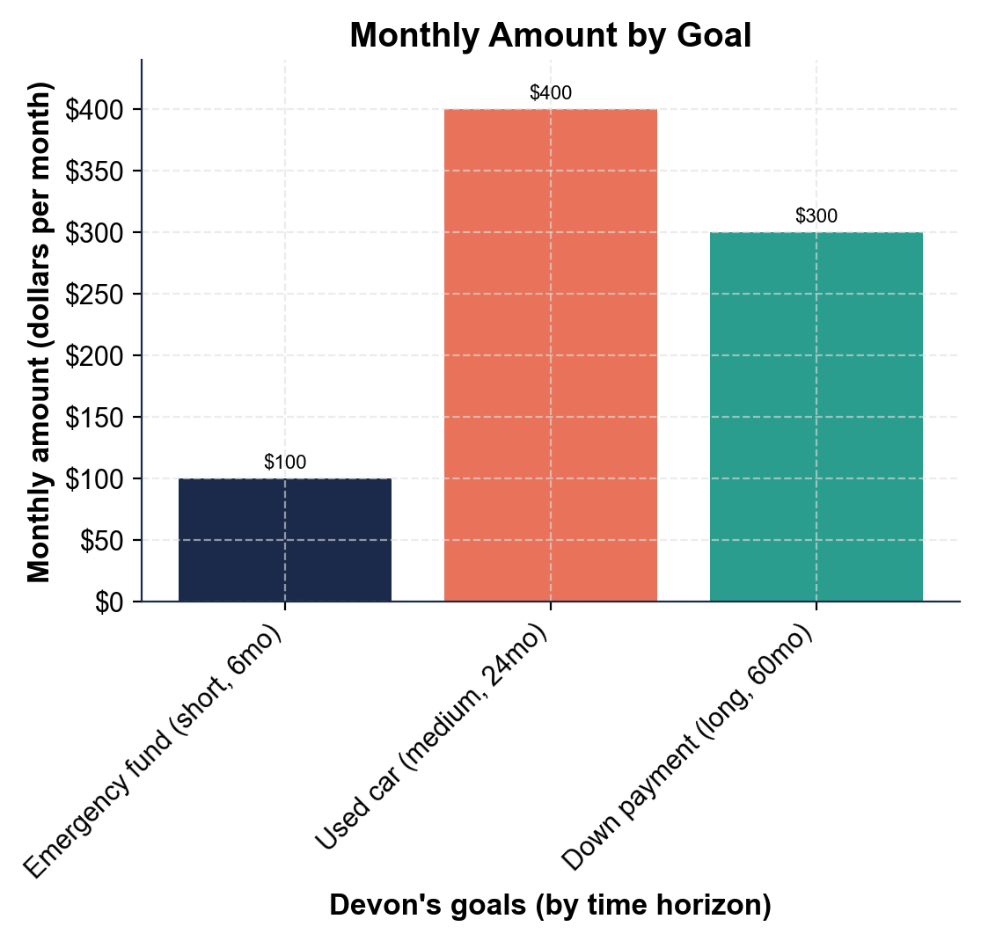
Monthly Amount by Goal
The medium car needs the most per month ($400); the down payment only $300.
© More Lessons Less Planning | morelessonslessplanning.com
Notes:
Give students a moment to read all three bars before discussing. The bar chart shows the monthly amount - dollars per month - for each of Devon's three goals: the short-term emergency fund ($600 in 6 months) at $100 a month, the medium-term used car ($9,600 in 24 months) at $400 a month, and the long-term down payment ($18,000 in 60 months) at $300 a month. Work the takeaways live. The medium-term car (coral bar) is the tallest at $400 a month, so it needs the most each month. Now the surprise: the long-term down payment (teal bar) is the biggest target - $18,000, three times the car's target - but its bar is only $300 a month, LOWER than the car, because the 60-month horizon spreads the cost. The short-term emergency fund (navy bar) is only $100 a month because $600 is small. Point out the gaps: the car needs $400 - $300 = $100 more a month than the down payment, and $400 - $100 = $300 more a month than the emergency fund. Then make the planning point: if Devon tried to fund all three at once it would be $100 + $400 + $300 = $800 a month, more than his $500 budget - so he has to prioritize. This is the chart Activity Part 4 reads. These are realistic, illustrative teaching amounts, not any one person's real budget.
Reference labels (point to these chart features when teaching): Steepest: car $400/month; Down payment: $300/month

Slide 12
Prioritizing Your Goals
Prioritizing
PRIORITIZING is deciding which goals come first when you cannot fund them all at once
✔
Emergency fund first
Fund the emergency fund first, so one surprise cost does not wreck your other goals
✔
Stack, do not stall
Finish a short goal, then roll that monthly amount into the next goal
✔
Or stretch the timeline
If money is tight, stretch a goal's timeline so its monthly amount fits your budget
✔
Key Concept: PRIORITIZING means funding the emergency fund first, then stacking or stretching goals to fit your budget.
© More Lessons Less Planning | morelessonslessplanning.com
Notes:
Solve the problem the chart just raised: Devon's three goals add up to $800 a month, but his budget is only $500. You cannot fund every goal at once, so you have to prioritize. PRIORITIZING is deciding which goals come first when you cannot fund them all at once. Give students a clear order of operations. First, fund the emergency fund first - it is small and it protects every other goal, because one surprise cost with no cushion pushes you into debt. Second, stack, do not stall: once a short goal is done, roll that same monthly amount into the next goal instead of spending it. Devon finishes the $600 emergency fund in 6 months at $100 a month, then rolls that $100 into the car. Third, if money is still tight, stretch the timeline: a goal's monthly amount comes down when you give it more months (Model 2), so stretching the car from 24 to 32 months drops it from $400 to $300 a month. Make the point: prioritizing is not giving up on goals - it is sequencing and pacing them so they fit real money. Key term - Prioritizing: deciding which goals come first when you cannot fund them all at once.

Slide 13
Putting It Together: Set Your Own Financial Goals
Make it SMART
Name the goal, put a dollar target on it, and give it a deadline
✔
Sort by time horizon
Decide if it is short-term, medium-term, or long-term
✔
Do the monthly-amount math
Use MONTHLY AMOUNT = TARGET AMOUNT / MONTHS to find what to save each month
✔
Prioritize and plan
Rank the goals, fund the emergency fund first, and fit the rest to your budget
✔
Key Concept: Make it SMART, sort by horizon, do the monthly-amount math, then prioritize and plan.
© More Lessons Less Planning | morelessonslessplanning.com
Notes:
Set up the Activity capstone: helping Devon set his own financial goals. Teach the repeatable four-step move students will use. First, make it SMART - name the goal, put a dollar target on it (the target amount), and give it a deadline. Second, sort by time horizon - decide whether it is short-term (under a year), medium-term (one to five years), or long-term (five or more years). Third, do the monthly-amount math with MODEL 1 - MONTHLY AMOUNT = TARGET AMOUNT / MONTHS - to find what to save each month, or use MODEL 2 to find the timeline if the monthly amount is set. Fourth, prioritize and plan: rank the goals, fund the emergency fund first, and fit the rest to your budget by stacking or stretching. Tell students the Activity ends with working several of Devon's goals - classifying them by horizon, making them SMART, computing monthly amounts and timelines, prioritizing, and then writing a goal plan a real person could follow. Everything they need is on the slides, in their Guided Notes, and on the monthly-amount chart.

Slide 14
Key Takeaways
A FINANCIAL GOAL is a specific money target - make it SMART
★
Sort goals by TIME HORIZON: short, medium (1-5 yr), long (5+ yr)
★
MONTHLY AMOUNT = TARGET / MONTHS; TIMELINE = TARGET / MONTHLY
★
The biggest target is not always the steepest monthly amount
★
PRIORITIZING means funding the emergency fund first
★
© More Lessons Less Planning | morelessonslessplanning.com
Notes:
Read each takeaway and connect it back to the learning targets. T1 (the foundation) -> a financial goal is a specific money target, and the best goals are SMART. T2 (sorting) -> sort goals by time horizon: short-term under a year, medium-term one to five years, long-term five or more years. T3 (the math) -> the two labeled models: monthly amount = target amount / months, and goal timeline = target amount / monthly amount. T4 (the signature idea) -> the biggest target is not always the steepest monthly amount; on our chart the long-term down payment ($18,000) was only $300 a month while the medium car ($9,600) was $400, because the long horizon spread the cost. T5 (the judgment) -> prioritizing means funding the emergency fund first and fitting the rest to your budget by stacking or stretching. Close by returning to the case: students can now help Devon turn 'save more' and 'someday a car' into SMART goals with real monthly amounts and a plan - which they practice in the Activity.

