Slide 1
Feudalism and the Manor System
How land, loyalty, and labor organized medieval Europe.
© More Lessons Less Planning | morelessonslessplanning.com
Notes:
Open with the hook. After the Roman Empire fell in the west, there was no strong central government to protect people or settle disputes. In its place a new system grew up across Europe: feudalism, built on land and loyalty. Today students learn the feudal pyramid - king, lords, knights, and peasants - and the manor system that organized everyday farming life. They will finish by analyzing a real entry from the Domesday Book, the survey William the Conqueror ordered in 1086.

Slide 2
Learning Targets
Explain feudalism as land (fiefs) exchanged for loyalty and military service
★
Describe the feudal pyramid and how the manor organized daily life and labor
★
Analyze how a serf differed from a slave and how the two systems connected
★
© More Lessons Less Planning | morelessonslessplanning.com
Notes:
Read each target aloud. Target 1 maps to slides 3-6 (what feudalism was, the fief-vassal bargain, and the pyramid). Target 2 maps to slides 7-13 (knights, the manor, the demesne, obligations, the three-field system, and daily life). Target 3 maps to slide 11 (serf vs. slave) and slide 15 (feudalism vs. manorialism) and drives the Primary Source Spotlight analysis of the Domesday manor entry.

Slide 3
What Was Feudalism?
The Feudal Deal
Why It Arose
FEUDALISM = land exchanged for loyalty and service
A LORD granted land to a VASSAL
The vassal owed military service and loyalty
A two-way (reciprocal) relationship
Rose in Europe after Rome fell (c. 800-1000)
Kings could not defend or govern all their land
No strong central government or police
Land and loyalty held society together
Key Concept: FEUDALISM was a reciprocal deal - a lord gave land in exchange for a vassal's loyalty and military service.
© More Lessons Less Planning | morelessonslessplanning.com
Notes:
Define the core idea. FEUDALISM was the exchange of land for loyalty and military service. A LORD granted land to a VASSAL, and in return the vassal owed the lord loyalty and military service - a two-way, reciprocal relationship. Feudalism arose in Europe roughly between 800 and 1000 CE, after the Western Roman Empire had fallen and the empire of Charlemagne broke apart. Kings could not defend or govern all their territory, and there was no strong central government or police. Land and personal loyalty became the glue that held society together and kept people safe.

Slide 4
The Feudal Bargain: Fief, Vassal, Homage
Fief
A FIEF was the grant of land a lord gave a vassal in exchange for military service and loyalty
Vassal
A VASSAL was a noble who received a fief and owed his lord loyalty and military service
Homage
HOMAGE was the formal ceremony in which a vassal knelt and pledged loyalty to his lord
Fealty
FEALTY was the sworn oath of faithfulness a vassal gave his lord to seal the bargain
Key Concept: A vassal received a FIEF (land) and, through HOMAGE, swore loyalty and military service to his lord.
© More Lessons Less Planning | morelessonslessplanning.com
Notes:
Nail down the vocabulary of the feudal bargain. A FIEF was the grant of land a lord gave a vassal in exchange for military service and loyalty - land was the currency of feudalism. A VASSAL was the noble who received the fief and owed his lord loyalty and military service in return. The deal was sealed with two rituals: HOMAGE, the formal ceremony in which the vassal knelt and pledged loyalty to his lord, and FEALTY, the sworn oath of faithfulness. These were personal, binding promises - breaking them was one of the worst things a medieval noble could do.

Slide 5
The Feudal Pyramid
Level | Who | What They Gave or Owed
Top | King (monarch) | Claimed all the land; granted large fiefs to lords
Nobles | Lords / nobles | Held land from the king; granted fiefs to knights
Warriors | Knights (vassals) | Held land from lords; owed military service
Base | Peasants and serfs | Worked the land; owed labor, crops, and rent
Big Idea: The FEUDAL PYRAMID ran from the king at the top, down through lords and knights, to the peasants and serfs at the base.
© More Lessons Less Planning | morelessonslessplanning.com
Notes:
Lay out the standard feudal pyramid. At the top sat the KING, who claimed all the land and granted large fiefs to his most powerful nobles. Below him came the LORDS (nobles), who held land from the king and in turn granted fiefs to knights. Next came the KNIGHTS, the mounted warriors who served as vassals, holding land from lords and owing military service. At the base were the PEASANTS AND SERFS, the vast majority of the population, who worked the land and owed labor, crops, and rent. Notice the pattern: at every level except the top, a person held land from someone above and owed service in return.

Slide 6
A Model, Not a Photograph
The Standard Model
The Messier Reality
The neat pyramid is a useful teaching model
It shows how land and loyalty were exchanged
Everyone owed service to someone above them
It helps organize a complex society
Real feudalism varied across Europe
A lord could be a vassal to more than one king
Ties were often tangled, not a clean ladder
The tidy pyramid came later, as a simplification
Note: The feudal pyramid is a helpful MODEL, but real medieval society was messier and varied from place to place.
© More Lessons Less Planning | morelessonslessplanning.com
Notes:
Add an honest caveat. The clean feudal pyramid is a useful teaching MODEL: it shows how land and loyalty were exchanged and how nearly everyone owed service to someone above them. But it is a simplification. Real feudalism varied a great deal across Europe and across the centuries. A single lord could be a vassal to more than one king at the same time, which created tangled and even contradictory loyalties. The relationships were often a messy web rather than a clean ladder. The tidy pyramid diagram was actually drawn up by later historians to make sense of a complicated reality. Students should use the model - but know it is a model.

Slide 7
Knights and the Warrior Class
Knight
A KNIGHT was a mounted, armored warrior who served a lord as a vassal in exchange for a fief
Military service
In return for land, a knight owed his lord a set number of days of military service each year
Chivalry
CHIVALRY was the code of honor knights were expected to follow - bravery, loyalty, and protecting the weak
The cost of war
Armor, weapons, and warhorses were expensive, so knighthood belonged to the noble class
Key Concept: Knights were the warrior vassals of feudalism - they received land and owed their lord military service.
© More Lessons Less Planning | morelessonslessplanning.com
Notes:
Cover the warrior class that feudalism organized. A KNIGHT was a mounted, armored warrior who served a lord as a vassal in exchange for a fief. In return for that land, a knight owed his lord a set number of days of military service each year - usually around forty days. Knights were expected to follow CHIVALRY, a code of honor emphasizing bravery, loyalty to one's lord, and the protection of the weak (though the ideal and the reality often differed). Becoming a knight was expensive: armor, weapons, and a trained warhorse cost a fortune, so knighthood belonged to the noble class. This is the key link - feudalism was, at its heart, a system for organizing warriors.

Slide 8
What Was the Manor?
The Manor
What a Manor Held
MANORIALISM was the economy of the countryside
The MANOR was the lord's estate, worked by peasants
Each manor was largely SELF-SUFFICIENT
It produced nearly all it needed to survive
The lord's manor house or castle
Farmland, meadow, pasture, and woodland
A village where the peasants lived
A church, a mill, and simple workshops
Key Concept: MANORIALISM organized the rural economy; the MANOR was a mostly self-sufficient estate run by a lord.
© More Lessons Less Planning | morelessonslessplanning.com
Notes:
Switch from the warriors to the economy. While feudalism organized the nobles and knights, MANORIALISM was the economic system that organized the countryside where most people lived. The MANOR was the lord's estate, worked by the peasants and serfs who lived on it. The defining feature of a manor was that it was largely SELF-SUFFICIENT - it produced nearly everything its people needed, so there was little need to trade with the outside world. A typical manor held the lord's manor house or castle, farmland divided into fields, meadow, pasture, and woodland, a village where the peasants lived, and a church, a mill, and simple workshops. It was a small, self-contained world.

Slide 9
The Demesne and the Peasants' Strips
Part of the Manor | Who Used It | How It Worked
The demesne | The lord | Land farmed for the lord; peasants worked it for free
Peasant holdings | Peasant families | Scattered strips peasants farmed to feed themselves
The commons | The whole village | Shared pasture and woodland for grazing and firewood
Open fields | The village together | Large fields split into many narrow strips
Key Concept: The lord kept the DEMESNE (his own land, worked by peasants), while peasants farmed strips to feed their families.
© More Lessons Less Planning | morelessonslessplanning.com
Notes:
Explain how manor land was divided. The DEMESNE was the land farmed directly for the lord - and here is the key point, the peasants had to work the lord's demesne for free as part of their obligations. The PEASANT HOLDINGS were the scattered strips of land that peasant families farmed to feed themselves. Land was not held in neat blocks: the manor's large OPEN FIELDS were split into many narrow strips, and a family's strips were spread out so everyone shared the good and bad soil. The COMMONS was shared pasture and woodland that the whole village used for grazing animals and gathering firewood. This mix of the lord's demesne, family strips, and shared commons is how a manor divided its land.

Slide 10
Serfs and Their Obligations
Serf
A SERF was a peasant bound to the manor who could not leave without the lord's permission
Villein
A VILLEIN was the most common kind of serf, holding land in exchange for labor and rent
Labor obligation
Serfs owed the lord several days of work each week, and extra work at harvest time
Rent and dues
Peasants also paid rent in crops and animals, plus fees to use the lord's mill and oven
Key Concept: A SERF was bound to the manor and owed the lord labor, crops, and rent in exchange for land and protection.
© More Lessons Less Planning | morelessonslessplanning.com
Notes:
Detail who worked the land and what they owed. A SERF was a peasant bound to the manor who could not leave without the lord's permission. The most common kind of serf was the VILLEIN, who held land on the manor in exchange for labor and rent. Serfs owed the lord several days of work each week - often three - plus extra work at harvest time when every hand was needed. On top of that labor, peasants paid rent in the form of crops and animals, and they paid fees to use the lord's mill to grind grain and his oven to bake bread. In exchange for all this, the serf received land to farm and the lord's protection. It was a hard bargain, but in a dangerous world protection was worth a great deal.

Slide 11
A Serf Was Not a Slave
A Serf Was Bound
But a Serf Was Not a Slave
A serf was tied to the land, not free to leave
Serfs owed labor and rent to the lord
They could not marry or move without permission
Their bound status passed to their children
Serfs could not be bought or sold as people
They could not be sold away from the land
They had customary rights the lord respected
They kept their own homes, tools, and plots
Important: A SERF was bound to the land but was NOT a slave - serfs had customary rights and could not be sold apart from the land.
© More Lessons Less Planning | morelessonslessplanning.com
Notes:
This is the critical distinction slide and an anchor for the analysis. A serf's life was hard and unfree in real ways: a serf was tied to the land and not free to leave, owed labor and rent to the lord, could not marry or move away without the lord's permission, and passed that bound status down to his children. But a serf was NOT a slave, and the difference is real and testable. Serfs could not be bought and sold as people the way enslaved people were, and they could not be sold away from the land they worked. They held customary rights - long-standing traditions the lord was expected to respect - and they kept their own homes, tools, and family plots. A serf belonged to the land; an enslaved person was owned as property. Students must hold this distinction precisely.

Slide 12
The Three-Field System
Field | Planted With | Purpose
Field 1 | Autumn crops (wheat or rye) | Grain for bread, planted in the fall
Field 2 | Spring crops (oats, beans, peas) | Food and crops that enrich the soil
Field 3 | Nothing - left fallow | Rested so the soil could recover
Each year | The fields rotate | The fallow field changes every year
Big Idea: The THREE-FIELD SYSTEM rotated crops so two fields grew food while one rested, raising the harvest.
© More Lessons Less Planning | morelessonslessplanning.com
Notes:
Explain the farming innovation. The THREE-FIELD SYSTEM was a method that divided a manor's farmland into three large fields and rotated their use. One field was planted with autumn crops like wheat or rye for bread. A second field was planted with spring crops like oats, beans, and peas - and the beans and peas actually helped enrich the soil. The third field was left fallow, meaning it was planted with nothing and allowed to rest so its soil could recover. Each year the fields rotated, so the fallow field changed. The advantage was big: two-thirds of the land could grow food each year instead of only half, as in the older two-field system. More food meant a growing population - a quiet but powerful medieval breakthrough.

Slide 13
Daily Life on the Manor
A Year of Labor
A Self-Sufficient World
Peasant life followed the farming seasons
Plowing and sowing in spring and autumn
Haymaking and harvest through the summer
Threshing grain and mending tools in winter
Most peasants never traveled far from the manor
The village grew its food and made its own goods
The lord's mill ground the village grain for a fee
Life was hard, but the manor met most needs
Did You Know: Most medieval peasants spent their whole lives on one manor, following the same round of seasonal farm work.
© More Lessons Less Planning | morelessonslessplanning.com
Notes:
Bring the manor to life before the image. Peasant life followed the farming SEASONS in a steady round. Plowing and sowing came in spring and autumn; haymaking and the grain harvest filled the summer; and winter meant threshing the harvested grain, mending tools, and indoor work. It was a self-sufficient world: most peasants never traveled far from the manor where they were born, the village grew its own food and made most of its own goods, and the lord's mill ground the village grain for a fee. Life was hard and the work never really stopped, but the manor met most of a peasant's needs. The next slide shows a medieval painting of peasants doing exactly this kind of field work.

Slide 14
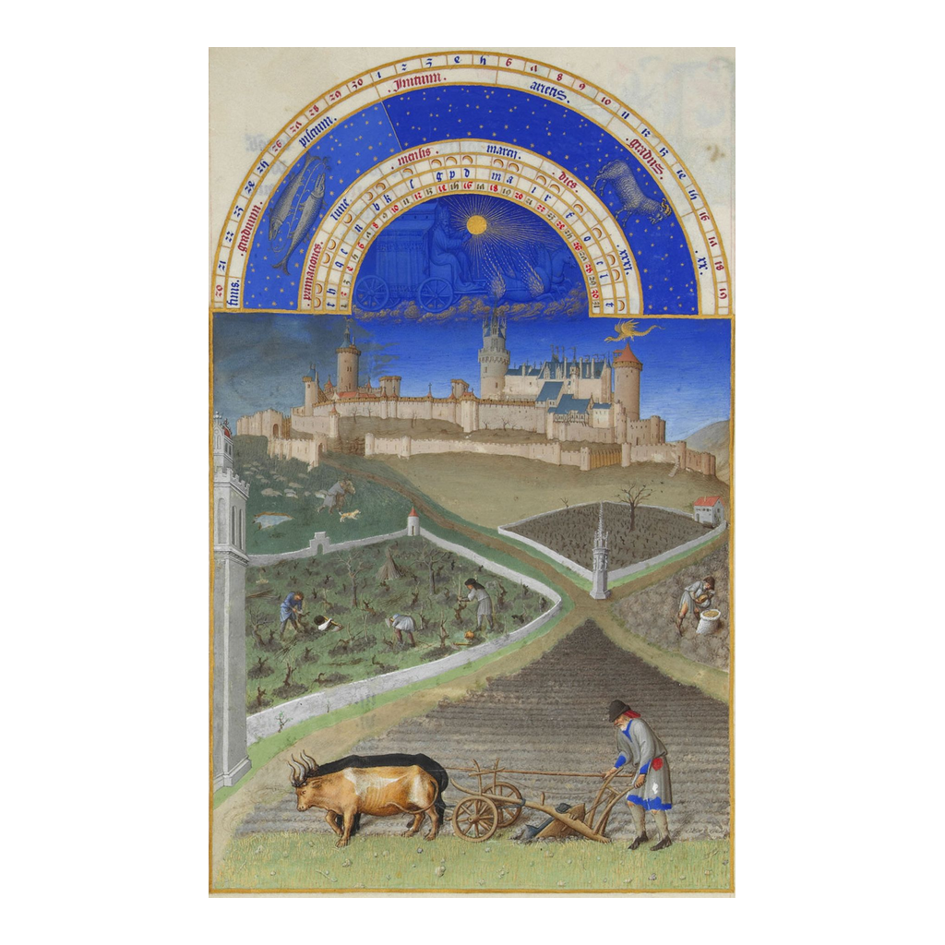
Medieval Peasants at Work in the Fields
Medieval peasants plowing and working a lord's fields
© More Lessons Less Planning | morelessonslessplanning.com
Notes:
Show the manuscript illumination. This is a real medieval painting from an illustrated calendar (a book of hours) showing peasants at work in the fields below a lord's manor or castle. Have students look for the tools and animals - the ox-drawn plow, the hand tools - and the strips of farmland stretching across the picture, with the lord's house or castle set apart in the background. This single image captures the whole manor world of the lesson: the peasants doing the labor at the base of the feudal pyramid, and the lord's home above them, all on one self-sufficient estate.
Reference labels (point to these chart features when teaching): peasants at work; the manor beyond

Slide 15
Feudalism vs. Manorialism
Feature | Feudalism | Manorialism (the Manor)
What it organized | The warrior and noble class | The farming economy and daily labor
Main relationship | Lord and vassal (knight) | Lord and peasants / serfs
What was exchanged | Land (fiefs) for military service | Land and protection for labor and rent
Based on | Loyalty and military duty | Farming and self-sufficiency
Big Idea: FEUDALISM organized the warriors and nobles; MANORIALISM organized the peasants and farmland - two connected systems.
© More Lessons Less Planning | morelessonslessplanning.com
Notes:
Tie the two halves of the lesson together - this table maps onto the activity's comparison part. FEUDALISM and MANORIALISM were two connected systems that together organized medieval society. Feudalism organized the WARRIOR AND NOBLE class: its main relationship was between a lord and his vassal (a knight), it exchanged land (fiefs) for military service, and it was based on loyalty and military duty. Manorialism organized the FARMING ECONOMY: its main relationship was between a lord and his peasants or serfs, it exchanged land and protection for labor and rent, and it was based on farming and self-sufficiency. The link is the lord, who stood in both systems at once - a vassal to the king above him through feudalism, and the master of the manor below him through manorialism. Keep them distinct, but see how they fit together.

Slide 16
Key Takeaways
FEUDALISM traded land (fiefs) for loyalty and military service
★
The feudal pyramid ran from king to lords to knights to serfs
★
The MANOR was a self-sufficient estate worked by peasants and serfs
★
A SERF was bound to the land but was NOT a slave
★
© More Lessons Less Planning | morelessonslessplanning.com
Notes:
Close the lesson. Review the four takeaways aloud. Students should be able to (a) explain feudalism as a reciprocal exchange of land for loyalty and military service, (b) lay out the feudal pyramid from king to serf, (c) describe the manor as a self-sufficient estate and name peasant obligations like labor on the demesne and the three-field system, and (d) explain precisely how a serf differed from a slave. The activity's Primary Source Spotlight will ask them to read a real Domesday Book manor entry and connect it to everything on these slides.

