Slide 1
Externalities: When Markets Hurt Others
Why markets ignore the side effects (pollution, vaccines, secondhand smoke), and how a Pigouvian tax or subsidy fixes the gap.
© More Lessons Less Planning | morelessonslessplanning.com
Notes:
Open with the question: 'When a coal plant burns coal to make electricity, who pays for the asthma in the kid living downwind?' The answer in a free market: nobody - the kid's family pays in doctor bills, missed school, and lower house values. The market price of coal-fired electricity does NOT include those costs because the kid is a THIRD PARTY who never agreed to the deal. Today's lesson teaches the economic concept of EXTERNALITIES (side effects on third parties), distinguishes negative from positive externalities, walks through the social-cost vs private-cost graph that shows WHY markets overproduce pollution and underproduce vaccines, and ends with the Pigouvian tax/subsidy fix that economists recommend.

Slide 2
Learning Targets
Define externalities; distinguish POSITIVE from NEGATIVE
★
Identify pollution and vaccines as the textbook cases
★
Evaluate Pigouvian taxes and subsidies as the standard fix
★
© More Lessons Less Planning | morelessonslessplanning.com
Notes:
Read each target aloud. Target 1 maps to slides 3-5 (definition + the two types). Target 2 maps to slides 4-5 (pollution as negative, vaccines as positive). Target 3 maps to slides 11-12 (the Pigouvian tax/subsidy fix). The practical capstone is the Activity Part 4 case where students prescribe the right Pigouvian fix for five real externality cases (carbon emissions, vaccines, education, secondhand smoke, basic research).

Slide 3
What Is an Externality?
Definition
Two Types
A side effect on a THIRD PARTY
The third party did NOT buy or sell
The market price IGNORES this side effect
So the WRONG quantity gets produced
NEGATIVE: side effect HARMS a third party
POSITIVE: side effect BENEFITS a third party
Both are MARKET FAILURES
Both call for a government fix
Key Concept: An EXTERNALITY is a side effect on a THIRD PARTY that the market price ignores - so the market produces the wrong quantity.
© More Lessons Less Planning | morelessonslessplanning.com
Notes:
Define EXTERNALITY in plain English. An externality is a SIDE EFFECT of a market transaction that falls on a THIRD PARTY - someone who is not the buyer or seller. Example: when you buy gasoline and burn it in your car, the buyer (you) gets the trip and the seller (Shell) gets the revenue, but the THIRD PARTY (everyone breathing your tailpipe exhaust) bears a side effect they never agreed to. Two types: NEGATIVE externalities harm third parties (pollution, traffic, secondhand smoke); POSITIVE externalities benefit third parties (vaccines, education, basic research). Both are MARKET FAILURES - the market price ignores the side effect, so the market produces too much (negative case) or too little (positive case). The lesson teaches the graph that proves this and the Pigouvian tax/subsidy fix that solves it.

Slide 4
Negative Externalities: Pollution, Traffic, Secondhand Smoke
Pollution from a factory
Steel factory dumps waste into air and river; HARMS downstream residents who never pay for the dead fish.
Traffic congestion
You drive; every other driver moves SLOWER because of you. Your gas price ignores the time you cost.
Secondhand smoke
Smoker buys cigarettes; nearby people inhale smoke that HARMS their lungs. The price ignores their asthma.
Carbon emissions
Coal plant burns coal for electricity; CO2 HARMS future generations through climate change.
Loud music at 2 a.m.
You play music for fun; neighbors lose sleep. Your speaker never charged for the sleep you cost.
Big Idea: Every example has a THIRD PARTY who pays a HIDDEN COST that buyers and sellers ignore.
© More Lessons Less Planning | morelessonslessplanning.com
Notes:
Walk through five negative externality examples that students recognize. POLLUTION FROM A FACTORY: a steel mill produces steel (private good), dumps waste into a river (harms downstream fishermen, residents, ecosystem). TRAFFIC: you drive your car (private benefit), every other driver moves slower (harms them with delays). SECONDHAND SMOKE: a smoker buys cigarettes (private good), bystanders inhale tobacco smoke (harms their lungs). CARBON EMISSIONS: a coal plant burns coal (private good = electricity), CO2 enters the atmosphere (harms future generations). LOUD MUSIC: you play music at 2 a.m. (private benefit), neighbors lose sleep (harmed). All five share the same structure: a THIRD PARTY (downstream resident, other driver, bystander, future generation, neighbor) pays a HIDDEN COST that the buyer and seller ignore. This is why markets OVERPRODUCE goods with negative externalities.

Slide 5
Positive Externalities: Vaccines, Education, R&D
Vaccines (herd immunity)
You get vaccinated; neighbors who cannot be vaccinated gain HERD IMMUNITY. Price ignores that gain.
Education
You finish high school for a better job; your community gains productivity and CIVIC engagement.
Basic research
A firm patents a discovery; the published basic chemistry BENEFITS every other LAB worldwide.
Renovating your house
You renovate your kitchen; neighbors' house VALUES rise. Renovation cost ignores that gain.
Bee-keeping near orchards
Beekeeper sells honey; bees pollinate the orchard next door for FREE. Price ignores the pollination.
Big Idea: Every example has a THIRD PARTY who gets a HIDDEN BENEFIT that buyers and sellers ignore.
© More Lessons Less Planning | morelessonslessplanning.com
Notes:
Walk through five positive externality examples. VACCINES: you get vaccinated for your own protection (private benefit), but you also reduce disease spread to neighbors who cannot be vaccinated (immunocompromised, infants) - this is HERD IMMUNITY, the textbook positive externality. EDUCATION: you finish high school for a better job (private benefit), but you also raise the productivity and civic engagement of your community (employers benefit, government benefits, neighbors benefit). BASIC RESEARCH: a pharma company discovers a new molecule for its own products (private benefit), publishes the basic chemistry, every other lab worldwide can use it (positive externality). RENOVATING YOUR HOUSE: you renovate your kitchen for your own enjoyment (private benefit), the neighbors' house values rise because the block looks better (positive externality). BEE-KEEPING: the beekeeper makes honey (private good), the bees pollinate the orchard next door for free (positive externality). All five share the same structure: a THIRD PARTY (neighbor, employer, scientist, orchard owner) gets a HIDDEN BENEFIT that the buyer and seller ignore. This is why markets UNDERPRODUCE goods with positive externalities.

Slide 6
Why Markets Ignore Externalities
The Buyer's Decision
The Seller's Decision
Buyer compares PRICE to OWN benefit
Buyer ignores side effects on others
Why? They are not paying for them
Why? They are not collecting them
Seller compares PRICE to OWN cost
Seller ignores side effects on others
Why? They are not paying the cleanup
Why? They are not collecting the third-party benefit
Key Concept: Markets ignore externalities because PRICES only carry information between BUYER and SELLER - third parties have no voice.
© More Lessons Less Planning | morelessonslessplanning.com
Notes:
Explain WHY markets ignore externalities. The buyer of gasoline compares the PRICE ($3.50/gallon) to her OWN benefit (a 30-mile trip). She does NOT add in the asthma she triggers in the kid downwind, because she does not pay for that. The seller of gasoline compares the PRICE to his OWN cost (drilling, refining, distribution). He does NOT add in the climate damage from CO2, because he does not pay for that either. PRICES ONLY CARRY INFORMATION BETWEEN BUYER AND SELLER - third parties have no voice. This is the core reason markets fail with externalities. The fix has to come from OUTSIDE the market: a government tax or subsidy that forces the buyer or seller to internalize the side effect on third parties.

Slide 7
Private Cost vs Social Cost (Negative Case)
Private cost
What the FACTORY pays directly: coal, labor, machinery, electricity. These set the price of steel.
External cost
Borne by THIRD PARTIES: dead fish, asthma downwind, lost recreational use of the lake. Factory does not pay.
Social cost
TOTAL cost to society = Private cost + External cost. What steel SHOULD cost from society's view.
The gap = market failure
Firms see only PRIVATE cost, so they make MORE steel than is efficient: too much pollution.
The fix
A Pigouvian TAX equal to the external cost. Raises private cost to the social cost and efficient quantity.
Tip: SOCIAL COST = PRIVATE COST + EXTERNAL COST. The market price ignores the external part.
© More Lessons Less Planning | morelessonslessplanning.com
Notes:
Build the negative-externality framework. PRIVATE COST is the cost the factory pays directly: coal, labor, machinery, electricity - these costs go into the market price of steel. EXTERNAL COST is the cost borne by third parties: dead fish in the river, asthma cases downwind, lost recreational use of the lake - the factory does not pay these. SOCIAL COST is the total cost to society = PRIVATE + EXTERNAL. This is what the steel SHOULD cost from a societal perspective. THE GAP DRIVES THE MARKET FAILURE: because firms only see PRIVATE cost, they produce MORE steel than is socially efficient. Result: too much pollution, too much steel, too much harm to third parties. THE FIX: a Pigouvian TAX equal to the external cost. Raises the private cost to match the social cost, so the market produces the efficient quantity. The next slide shows this on a supply-demand graph.

Slide 8
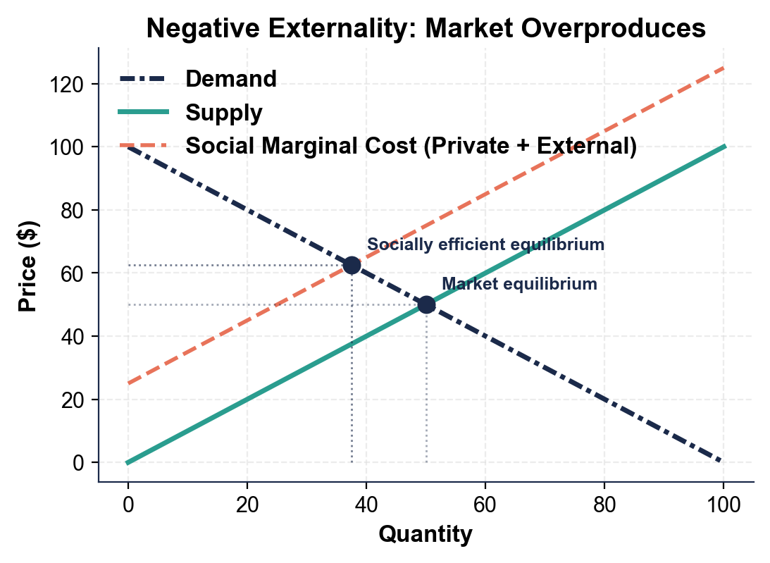
Negative Externality Graph (Overproduction)
Note: external cost shifts supply, market overproduces.
© More Lessons Less Planning | morelessonslessplanning.com
Notes:
Display the negative-externality supply-demand graph. The SOLID supply curve is PRIVATE marginal cost (what the factory pays). The DASHED supply curve is SOCIAL marginal cost = private cost + external cost (what the steel really costs society). The DASHED curve is HIGHER (further LEFT) because external cost is added on top. The market equilibrium (where solid supply meets demand) is at a LOWER price and HIGHER quantity than the socially efficient equilibrium (where dashed social cost meets demand). The QUANTITY GAP between market Q and efficient Q is the OVERPRODUCTION caused by ignoring the external cost. The price gap shows how much the social cost exceeds the market price.
Reference labels (point to these chart features when teaching): Market Q (too high); Efficient Q (lower)

Slide 9
Private Benefit vs Social Benefit (Positive Case)
The Benefit Decomposition
Why the Market Fails
Private benefit: what the BUYER gets directly
External benefit: what THIRD PARTIES get
Social benefit = Private + External
Vaccine: your immunity + neighbor herd immunity
Buyers ignore the external benefit
So they buy LESS than is socially efficient
Too few vaccines, too little education
Fix: Pigouvian SUBSIDY = external benefit
Tip: SOCIAL BENEFIT = PRIVATE BENEFIT + EXTERNAL BENEFIT. The market ignores the external part.
© More Lessons Less Planning | morelessonslessplanning.com
Notes:
Build the positive-externality framework (mirror image of slide 7). PRIVATE BENEFIT is what the buyer gets directly: your own immunity from a measles vaccine, your own better job from a college degree. EXTERNAL BENEFIT is what third parties get: herd immunity for unvaccinated neighbors, productivity gains for your future employer, civic engagement for your community. SOCIAL BENEFIT = private + external. THE GAP DRIVES THE MARKET FAILURE: because buyers only see PRIVATE benefit, they buy LESS than is socially efficient. Result: too few vaccinations, too little education, too little basic research. THE FIX: a Pigouvian SUBSIDY equal to the external benefit. Lowers the price to consumers so they buy more, until the market reaches the efficient quantity. The next slide shows this on a supply-demand graph.

Slide 10
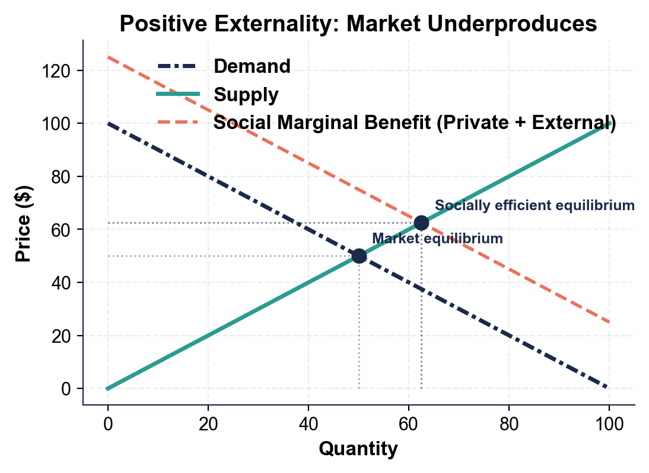
Positive Externality Graph (Underproduction)
Note: external benefit shifts demand, market underproduces.
© More Lessons Less Planning | morelessonslessplanning.com
Notes:
Display the positive-externality supply-demand graph. The SOLID demand curve is PRIVATE marginal benefit (what the buyer gets). The DASHED demand curve is SOCIAL marginal benefit = private + external (what the vaccine or the degree is really worth). The DASHED curve is HIGHER (further RIGHT) because external benefit is added on top. The market equilibrium (where solid demand meets supply) is at a LOWER quantity than the socially efficient equilibrium (where dashed social benefit meets supply). The QUANTITY GAP is the UNDERPRODUCTION caused by ignoring the external benefit.
Reference labels (point to these chart features when teaching): Market Q (too low); Efficient Q (higher)

Slide 11
Pigouvian Taxes (For Negative Externalities)
What it is
A tax on a NEGATIVE externality equal to the EXTERNAL COST. Raises the buyer's price to include the harm.
How it fixes the market
Buyer pays the full SOCIAL COST and buys LESS, down to the efficient quantity. Externality INTERNALIZED.
Carbon tax
~30 countries use one (Sweden $130/ton CO2, Canada ~$65/ton). Internalizes climate damage.
Cigarette tax
U.S. federal ~$1/pack; state $0.17 (MO) to $5.35 (NY). Internalizes secondhand smoke costs.
Gas tax
Federal $0.184/gallon; state $0.09 (Alaska) to $0.59 (California). Also covers pollution.
Big Idea: Pigouvian TAX = External Cost per unit. Pollution costs MORE, so producers and consumers do LESS of it.
© More Lessons Less Planning | morelessonslessplanning.com
Notes:
Drill the Pigouvian TAX fix for negative externalities. Named after British economist Arthur Pigou (1920). The idea: tax the producer or consumer of the polluting good by an amount equal to the EXTERNAL COST per unit. This raises the private cost up to the social cost, so the market reaches the efficient quantity. Real examples: CARBON TAX (about 30 countries: Sweden ~$130/ton CO2, Canada ~$65/ton, EU ETS ~$80/ton; recommended by economists across the political spectrum); CIGARETTE TAX (U.S. federal ~$1/pack, state from $0.17 in Missouri to $5.35 in NY; internalizes secondhand smoke and public health costs); GAS TAX (federal $0.184/gallon, state $0.09-$0.59; originally for road maintenance, now also internalizes pollution). The mechanism: when buyers pay the full social cost, they buy less. The externality is INTERNALIZED.

Slide 12
Pigouvian Subsidies (For Positive Externalities)
What it is
A subsidy on a POSITIVE externality equal to the EXTERNAL BENEFIT. Lowers the buyer's price.
How it fixes the market
Buyer pays a LOWER price (government covers the gap); more buyers buy, externality INTERNALIZED.
Vaccine subsidy
U.S. Vaccines for Children covers ~50% of childhood vaccines at no cost. Internalizes herd immunity.
Education vouchers
Pell Grants, state college subsidies, K-12 public funding ($800B/yr). Internalizes productivity.
R&D tax credits
Federal R&D credit (~$15B/yr) + NSF/NIH/DOE grants ($200B/yr). Internalizes research spillovers.
Big Idea: Pigouvian SUBSIDY = External Benefit per unit. Vaccines get CHEAPER, so more people get them.
© More Lessons Less Planning | morelessonslessplanning.com
Notes:
Drill the Pigouvian SUBSIDY fix for positive externalities (mirror of slide 11). The idea: subsidize the buyer or producer of the beneficial good by an amount equal to the EXTERNAL BENEFIT per unit. This lowers the private cost so consumers buy more, until the market reaches the efficient quantity. Real examples: VACCINE SUBSIDY (U.S. Vaccines for Children program covers ~50 percent of all U.S. childhood vaccines for free; vaccination rates jumped to 90+ percent); EDUCATION VOUCHERS (Pell Grants ~$30B/year, state college subsidies, K-12 public funding ~$800B/year - internalizes the productivity and civic-engagement benefits of an educated workforce); R&D TAX CREDITS (federal R&D tax credit ~$15B/year plus NSF/NIH/DOE grants ~$200B/year - internalizes the cross-firm benefits of basic research). The mechanism: when buyers pay a lower price, more of them buy. The externality is INTERNALIZED.

Slide 13
Key Takeaways
The Big Five
What You Should Be Able to Do
Externality = side effect on a THIRD PARTY
Negative = HARM (pollution, traffic, smoke)
Positive = BENEFIT (vaccines, education, R&D)
Markets OVERPRODUCE negatives, UNDERPRODUCE positives
Pigouvian tax/subsidy INTERNALIZES the externality
Spot the THIRD PARTY in any market transaction
Classify any externality as positive or negative
Explain why social cost differs from private cost
Prescribe a Pigouvian TAX or SUBSIDY for any case
Big Idea: NEGATIVE externality -> Pigouvian TAX. POSITIVE externality -> Pigouvian SUBSIDY. The gap is the external cost or benefit.
© More Lessons Less Planning | morelessonslessplanning.com
Notes:
Wrap up the lesson. Five anchor takeaways: (1) an externality is a SIDE EFFECT on a THIRD PARTY that the market ignores; (2) NEGATIVE externalities harm third parties (pollution, traffic, secondhand smoke); (3) POSITIVE externalities benefit third parties (vaccines, education, R&D); (4) markets OVERPRODUCE negative externalities and UNDERPRODUCE positive ones; (5) Pigouvian TAX (for negatives) and Pigouvian SUBSIDY (for positives) INTERNALIZE the externality. Skills students should leave with: spot the THIRD PARTY in any transaction; classify any externality; explain social cost vs private cost; prescribe the right Pigouvian fix. The clinching test: explain in two sentences why a carbon tax raises gas prices but cuts pollution - if students can do that with vocabulary, they have it.

