Slide 1
Discovering Neanderthals
How could a single skull, dug from a German cave in 1856, force scientists to rethink what it means to be human?
© More Lessons Less Planning | morelessonslessplanning.com
Notes:
Opening slide. In 1856, quarry workers in Germany's Neander Valley found a strange, thick skullcap and a few bones. Nobody was sure what they were. That one discovery would change how scientists understood human origins and launch the study of human ancestry.

Slide 2
Learning Targets
Describe the 1856 Neander Valley discovery and why it surprised scientists.
★
Identify the Neanderthal skull's features and what they suggested.
★
Analyze how the find changed ideas about human origins.
★
Evaluate how Thomas Huxley used evidence to revise old assumptions.
★
© More Lessons Less Planning | morelessonslessplanning.com
Notes:
Read the four learning targets. Today combines a discovery story (a strange skull from a cave) with a history-of-science skill: watching scientists revise their ideas as new physical evidence appears.

Slide 3
A Strange Discovery in 1856
Neanderthal
An extinct early human first identified from bones found in the Neander Valley in 1856.
✔
Feldhofer Grotto
The limestone cave in the Neander Valley where quarry workers dug out the bones.
✔
Fossil
The preserved remains of a once-living thing, such as ancient bone.
✔
Key Concept: In 1856, workers found the first NEANDERTHAL bones - fossil remains - in the FELDHOFER GROTTO cave in Germany's Neander Valley.
© More Lessons Less Planning | morelessonslessplanning.com
Notes:
In 1856, quarry workers were clearing the FELDHOFER GROTTO, a limestone cave in Germany's Neander Valley, when they dug out a thick skullcap and a few limb bones. These bones were FOSSILS - the preserved remains of a once-living thing, in this case ancient bone. Scientists later named this kind of early human the NEANDERTHAL, after the valley where the bones were found. At the time, no one had a clear way to explain what these strange bones were.

Slide 4
Who Were the Neanderthals?
Early humans
A kind of early human - not apes, and not the same as people today.
When and where
They lived across Ice Age Europe and western Asia, long before writing.
Key Concept: Neanderthals were early humans who lived across Ice Age Europe long before written history - known to us only from fossils.
© More Lessons Less Planning | morelessonslessplanning.com
Notes:
Before we study the skull, it helps to know who the Neanderthals were. They were a kind of early human - not apes, and not exactly the same as people today. They lived across Europe and western Asia during the Ice Age, tens of thousands of years before written history began. Because they left no writing, everything we know about them comes from the fossils and the stone tools they left behind. That is why the 1856 skull mattered so much: it was some of the first physical evidence of these ancient people.

Slide 5
A Skull Unlike Any Other
The 1856 find was a skullcap - the domed upper part of the skull.
It has a heavy brow ridge, a thick bony ridge over the eyes.
Behind the brow the forehead is low and sloping, not upright like ours.
The next slide shows a Neanderthal skull up close.
Key Concept: The SKULLCAP has a heavy BROW RIDGE over the eyes and a low, sloping forehead unlike living people.
© More Lessons Less Planning | morelessonslessplanning.com
Notes:
The 1856 find was a SKULLCAP - the domed upper part of the skull - plus a few limb bones. Two features stood out. First, a heavy BROW RIDGE, the thick bony ridge over the eyes, far larger than in living people. Second, behind that ridge the forehead was low and sloping, not upright and rounded like ours. These features made the skull look partly familiar and partly strange, which is exactly what puzzled the scientists who first studied it. The next slide is a real photograph of a Neanderthal skull.

Slide 6
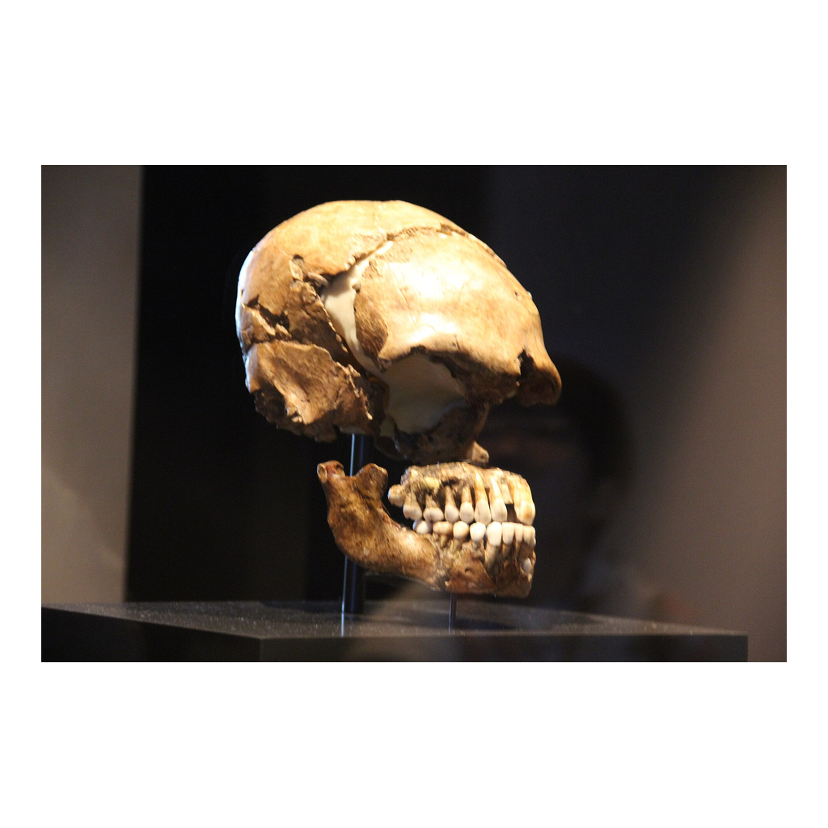
The Neanderthal Skull
A Neanderthal skull: heavy brow ridge and low, sloping forehead.
© More Lessons Less Planning | morelessonslessplanning.com
Notes:
Real public-domain photograph of a Neanderthal skull. Give students a moment to locate the heavy brow ridge over the eye sockets and the low, backward-sloping forehead before discussing what those features meant to early scientists.
Reference labels (point to these chart features when teaching): Heavy brow ridge over the eyes; Low, sloping forehead

Slide 7
Was It Even Human?
Species
A group of living things alike enough to be classed together.
✔
The debate
Was it a diseased modern person, an ancient race, or a new human species?
✔
Anatomy
The physical structure of the body; scientists studied it to judge the bones.
✔
Key Concept: Scientists studied the bones' ANATOMY to argue whether the Neanderthal was a distinct human SPECIES.
© More Lessons Less Planning | morelessonslessplanning.com
Notes:
When the bones were shown, scientists could not agree on what they were. Some said the skull belonged to a diseased or deformed modern person. Others said it was an ancient race of humans. A few argued it was a distinct human SPECIES - a group of living things alike enough to be classed together. To settle the question they studied the ANATOMY of the bones, the physical structure of the body, comparing the skull and limbs to those of living people. With only one skullcap and a handful of bones, the debate was fierce and hard to resolve.

Slide 8
Huxley Reads the Bones (1863)
Naturalist
A scientist who studies the natural world; Thomas Huxley was one.
✔
His method
He carefully measured the skull and compared its anatomy to apes and people.
✔
His conclusion
Ape-like in shape, yet still human, with a large braincase.
✔
Key Concept: The NATURALIST Thomas Huxley concluded in 1863 the skull was ape-like in shape yet still HUMAN, with a large braincase.
© More Lessons Less Planning | morelessonslessplanning.com
Notes:
A NATURALIST is a scientist who studies the natural world. In 1863 the English naturalist Thomas HUXLEY published a careful study of the Neanderthal bones. He measured the skull and compared its anatomy to both apes and living people. Huxley called it the most ape-like human skull he had seen, because of its huge brow ridge and low forehead. But he was careful: he concluded the skull was still HUMAN, not an ape and not a halfway creature, because it held room for a large brain. It was an extreme, ancient human type - but human all the same.

Slide 9
A New Science of Human Origins
Paleoanthropology
The study of ancient humans and their ancestors through fossils.
Extinct
No longer existing anywhere on Earth, like the Neanderthals.
Key Concept: The discovery opened PALEOANTHROPOLOGY - the study of ancestry through fossils - and named an EXTINCT early human.
© More Lessons Less Planning | morelessonslessplanning.com
Notes:
The Neanderthal discovery did more than add one skull to a shelf. It opened a whole new science: PALEOANTHROPOLOGY, the study of ancient humans and their ancestors through fossils. It showed that EXTINCT kinds of early humans - no longer existing anywhere on Earth - had once lived in Europe long before written history. For the first time, scientists could study human origins with physical evidence dug from the ground, reading the earliest chapters of the human story in stone and bone rather than guessing from written records that did not exist.

Slide 10
How Science Revises Itself
Show vs mean
Good science separates what the bones show from what they mean.
✔
Follow the evidence
When new evidence appears, scientists change an old idea.
✔
Why it matters
The Neanderthal debate is a model of self-correcting science.
✔
Key Concept: Good science separates what the bones SHOW from what they MEAN, and scientists CHANGE old ideas when new evidence appears.
© More Lessons Less Planning | morelessonslessplanning.com
Notes:
The Neanderthal story is a model of how science works. Careful scientists like Huxley separated what the bones SHOW - a huge brow ridge, a low forehead, a large braincase - from what they MEAN. Some early guesses (a diseased modern person) were wrong, and scientists had to CHANGE their minds as more bones and better methods arrived. That willingness to revise is a strength, not a weakness: it is how science corrects itself. The same skull that once looked like a puzzle became the first clue in the long study of human ancestry.

Slide 11
Key Takeaways
In 1856, workers found the first Neanderthal bones in Germany's Neander Valley.
★
A heavy brow ridge and low forehead made the skullcap look part human.
★
Huxley (1863) judged it ape-like in shape yet still human.
★
The discovery opened paleoanthropology and reshaped ideas about human origins.
★
© More Lessons Less Planning | morelessonslessplanning.com
Notes:
Recap the four takeaways. The big skills: reading physical evidence when there is no writing, and watching science revise its ideas about human origins as evidence improved.

