Slide 1
Deflation: Why Falling Prices Are Bad
Falling prices sound nice - until they freeze the economy and trap an entire generation
© More Lessons Less Planning | morelessonslessplanning.com
Notes:
Open with the counterintuitive hook: lower prices sound good, so why do central bankers lose sleep over deflation? The answer is that sustained price decline freezes spending, magnifies debt burdens, and forces wages and jobs to absorb the adjustment. Today we will define deflation, distinguish it from disinflation, walk the debt-deflation spiral and deferred-spending trap, trace Japan's 35-year lost decades, examine the Great Depression deflation, and learn what tools central banks have to fight it. Frame the activity persona: Renee Acosta, a junior analyst at the New York Fed, building a brief for the FOMC vice chair on March 2026 deflation risk.

Slide 2
Learning Targets
Define deflation and distinguish it from disinflation (slowing inflation)
★
Explain why deflation is dangerous (deferred spending + debt deflation)
★
Trace Japan and the Great Depression; explain why the Fed fears deflation
★
© More Lessons Less Planning | morelessonslessplanning.com
Notes:
Read the three targets aloud. T1 (define + distinguish) sets up the precision work - deflation and disinflation are NOT the same. T2 (explain why dangerous) is the analytical core - deferred spending and debt deflation are the two mechanisms. T3 (trace + explain why Fed fears it) is the historical and policy payoff - Japan and the Great Depression are the case studies. The activity Part 5 memo asks students to apply T3 to a 2026 U.S. deflation-risk scenario.

Slide 3
Deflation Defined - Sustained Negative Inflation
What Counts as Deflation
Not Just a Bargain
Deflation = SUSTAINED decline in the general price level
Annual CPI is NEGATIVE for months or years, not one month
The opposite of inflation (rising prices)
Affects ALL prices on average, not just one good
If your favorite phone drops in price = price change, not deflation
Deflation means EVERYTHING falls - wages, rents, debts, savings
Annual CPI under 0% on average for 6+ months is the standard
Brief negative prints are noise; sustained pattern is deflation
Key Concept: Deflation = sustained negative inflation. One month of -0.1% is noise. Six months of -1% is the deflation pattern.
© More Lessons Less Planning | morelessonslessplanning.com
Notes:
The textbook definition of deflation is a sustained decline in the general price level, measured by annual CPI being negative for months or years. The critical qualifiers are SUSTAINED (one month doesn't count) and GENERAL (it affects all prices on average, not just one good or sector). The opposite of inflation. A single product dropping in price - like smartphones falling 10% in 2026 versus 2025 - is a relative price change, not deflation. Deflation means the AVERAGE price level falls; nominal wages, rents, debts, and asset prices all need to be rethought. The conventional threshold most economists use: annual CPI under 0% on average for 6+ months is the standard. Brief negative prints are noise (especially when driven by short-term commodity moves); a sustained pattern is what counts as deflation.

Slide 4
Deflation vs Disinflation - The Precise Distinction
Inflation
Prices RISING. Annual CPI positive. Example: 2024 U.S. CPI = +3.0% year-over-year.
✔
Disinflation
Inflation SLOWING but still positive. Example: 2022-2024 U.S. went from +9.1% to +3.0% - that's disinflation.
✔
Deflation
Prices FALLING. Annual CPI negative. Example: 2009 Japan CPI = -1.4%; 1932 U.S. CPI = -9.9%.
✔
Hyperinflation
Prices rising 50%+ per MONTH. Example: 1923 Weimar peak = 29,500% monthly. (Covered in TK 58.)
✔
Key Concept: Disinflation is good news (inflation cooling). Deflation is bad news (prices reversing). Many students confuse them - precision matters.
© More Lessons Less Planning | morelessonslessplanning.com
Notes:
Four different states. INFLATION is the default - sustained rising prices, annual CPI positive (the 2024 U.S. reading of +3.0%). DISINFLATION is the slowdown - inflation still positive but the rate is falling. The U.S. 2022-2024 path from +9.1% to +3.0% is disinflation, NOT deflation; prices were still rising, just less fast. DEFLATION is sustained negative CPI. Japan 2009 was -1.4%, U.S. 1932 was -9.9%. HYPERINFLATION is the extreme high end - 50%+ inflation per month (Cagan threshold, TK 58). Many students collapse disinflation and deflation into 'falling inflation' or 'falling prices' - they are not the same. Disinflation is good news (the Fed cooling the economy). Deflation is bad news (the economy stalling out). The terminology precision matters because the policy response is opposite: disinflation = stay the course; deflation = emergency easing.

Slide 5
Why Deflation Is Bad - The Deferred Spending Trap
Wait to buy
Wait to hire
Demand drops
Households delay big purchases
Firms delay investment and new hires
Aggregate spending falls; prices fall more
Key Concept: When everyone expects prices to fall further, everyone postpones buying. Aggregate demand collapses - a self-reinforcing freeze.
© More Lessons Less Planning | morelessonslessplanning.com
Notes:
The first reason deflation is bad: deferred spending. If you expect a $30,000 car to cost $28,500 next year, you wait. Multiply by every household making every large purchase decision - cars, appliances, houses, vacations, college tuition. Aggregate demand collapses. Firms see falling sales, so they delay capital investment (why buy a factory whose output will sell for less?) and they delay hiring (or actively cut staff). Falling demand pushes prices down further. The deferred-spending trap is self-reinforcing: expectations of falling prices CREATE falling prices. The economist Irving Fisher called the broader phenomenon debt deflation; this slide is the consumer-side mechanism, the next slide is the debtor-side mechanism. Both feed into the same doom loop. The mild Japanese deflation of -0.1% to -1.4% feels small until you realize Japan stayed near zero growth for 35 years - the deferred-spending trap was the structural drag.

Slide 6
The Debt Deflation Spiral - Irving Fisher 1933
1. Prices fall
Sustained CPI decline - the deflation begins
✔
2. Real debt burden rises
A $200K mortgage is still $200K - but in lower-priced dollars; the REAL value of debt rises
✔
3. Borrowers cut spending or default
Households slash consumption; firms slash investment; some default outright
✔
4. Bank failures and bankruptcies
Loan defaults hit bank balance sheets; credit shrinks across the economy
✔
5. Prices fall more
Less spending, more bankruptcies, less credit - deflation deepens. The doom loop.
✔
Key Concept: Fisher 1933 - in deflation the real burden of debt RISES while the dollar amount is unchanged. Debtors crash; banks fail.
© More Lessons Less Planning | morelessonslessplanning.com
Notes:
Irving Fisher's 1933 paper 'The Debt-Deflation Theory of Great Depressions' is the canonical mechanism. The five steps: (1) Prices fall - sustained CPI decline. (2) Real debt burden rises - a $200,000 mortgage signed in 1929 is still $200,000 in 1932, but each dollar now buys MORE goods (prices have fallen 25% cumulative 1929-1933), so the REAL value of the debt has risen by about 30%. The borrower owes more, in real terms, than they borrowed. (3) Borrowers cut spending or default. Households slash consumption to make debt payments; firms slash investment; some borrowers default outright. (4) Bank failures and bankruptcies. Loan defaults hit bank balance sheets; about 9,000 U.S. banks failed 1930-1933, deepening the deflation by collapsing the money supply (M2 fell about 30%). (5) Prices fall more. Less spending, fewer firms operating, less credit - deflation accelerates. Fisher's insight: this is a DOOM LOOP. The same deflation that started by mild contraction can spiral into catastrophe through the debt channel. The defining mechanism of the Great Depression.

Slide 7
Japan's Lost Decades - Since 1990
The Trigger and the Trap
The Failed Fight
1989: Nikkei stock peak at 38,915 (Dec 29)
1990-1992: Asset crash - stocks lose 60%, real estate 70%
1995: First year of outright negative CPI (-0.1%)
1995-2012: about 11 years of negative annual CPI in the 18-year window
BoJ cut rates to 0% by 1999 - first ZLB in modern history
Invented modern QE in 2001 (called Quantitative Easing)
2009 deflation trough at -1.4%
2013 Abenomics: massive easing - partial recovery
Did You Know? Japan's nominal GDP in 2025 is still BELOW its 1995 peak in yen. The lost decades = 35-year deflation case study.
© More Lessons Less Planning | morelessonslessplanning.com
Notes:
Japan is the modern textbook case of a deflation trap. The trigger was the 1989-1992 asset crash. The Nikkei 225 stock index peaked at 38,915 on December 29, 1989. By 2003 it had fallen below 8,000 - a roughly 80% peak-to-trough decline. Real-estate prices fell about 70% from peak. The wealth destruction broke household and bank balance sheets. The Bank of Japan was slow to cut rates - it took until February 1999 for the policy rate to hit zero (the first modern zero lower bound). By then deflation had taken hold: 1995 was the first year of outright negative annual CPI (-0.1%). The deflationary band extended through 2012 with eight outright negative-CPI years (1995, 1999, 2000, 2002, 2005, 2009, 2010, 2011, 2012; the 2009 trough at -1.4% was the deepest). The Bank of Japan invented modern Quantitative Easing in March 2001 - buying long-term Japanese government bonds to push down long rates after the short rate hit zero. QE was the first lever past the ZLB; it kept inflation expectations from falling further but did not restore positive inflation. In 2013 Prime Minister Shinzo Abe launched Abenomics - massive monetary easing combined with fiscal stimulus and structural reform. Inflation lifted modestly (0.4% to 2.7% range) but never sustainably hit the 2% target. The 2022-2023 global inflation surge pushed Japan's CPI to about 3.3% (2023 peak) - the first sustained positive inflation in decades. Even so, Japan's nominal GDP in 2025 is still BELOW its 1995 peak in yen. The lost decades are the cautionary tale every central banker studies.

Slide 8
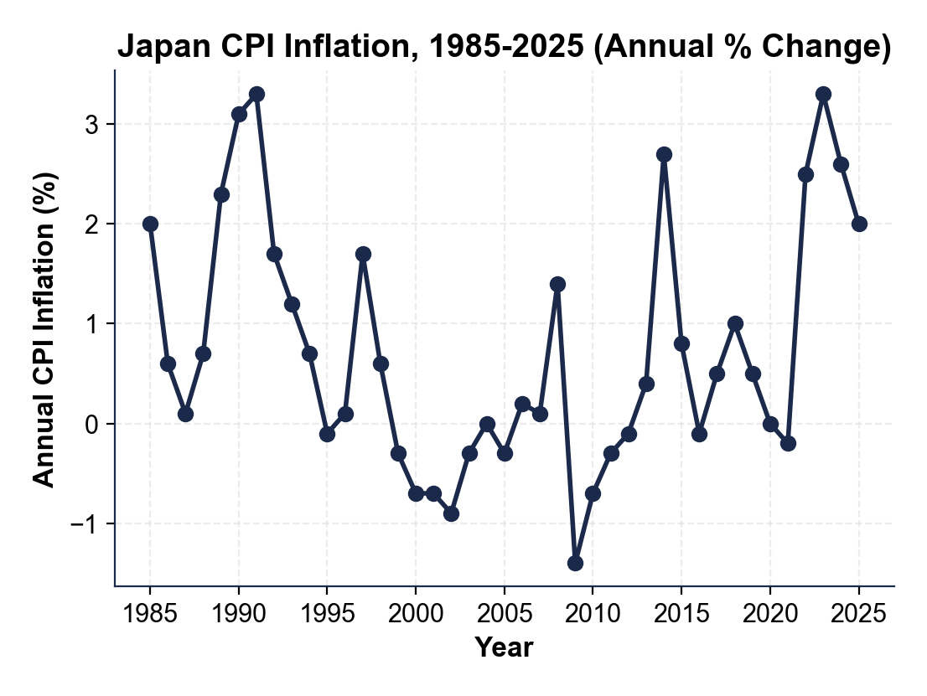
Note: Japan CPI Inflation 1985-2025
Bubble peak 1991 +3.3%; deepest deflation 2009 -1.4%; about 11 negative years.
© More Lessons Less Planning | morelessonslessplanning.com
Notes:
Have students trace Japan's annual CPI from the 1991 bubble peak (3.3%) through the long deflationary band 1995-2012 and into the partial Abenomics recovery and the 2023 post-pandemic overshoot (3.3% briefly). Drive home the EIGHT explicit negative-CPI years: 1995, 1999, 2000, 2002, 2005, 2009, 2010, 2011, 2012. The 2009 trough at -1.4% is the deepest. The post-2013 Abenomics period lifted CPI but did not sustain 2%. The 2022-2023 global inflation surge - not Bank of Japan policy alone - pushed CPI back above zero meaningfully. Compare to the linear scale: unlike hyperinflation, deflation data are small absolute numbers (-2% to +4%), so a linear chart is appropriate. The zero line is the critical visual landmark.
Reference labels (point to these chart features when teaching): 1991 peak: +3.3%; 2009 trough: -1.4%

Slide 9
Why the Fed Fears Deflation More Than Mild Inflation
Inflation Tools Are Powerful
Deflation Tools Hit a Wall
Fed CAN raise rates without limit (Volcker hit 19% in 1981)
Higher rates always cool demand and slow inflation
Pain is real but the tool works
Mild inflation (2-3%) is comfortable territory
Fed CANNOT cut rates below about 0% (Zero Lower Bound)
QE and forward guidance are weaker substitutes
Deferred spending and debt deflation are self-reinforcing
Once deflation expectations set in, it can last decades (Japan)
Key Concept: The Fed targets 2% (not zero); 2% is the FLOOR, not the ceiling, away from the ZLB.
© More Lessons Less Planning | morelessonslessplanning.com
Notes:
Central banks have asymmetric tools. Against INFLATION, the policy rate can rise without a hard limit - Paul Volcker pushed the federal funds rate to 19% in 1981 to break the 1970s inflation. The pain is real (recession, unemployment) but the tool always works. Against DEFLATION, the policy rate cannot fall below approximately 0% without breaking the banking system. Banks earn money on the spread between deposit rates (~0%) and lending rates; if the policy rate goes negative, deposits leak to physical cash. The Zero Lower Bound (ZLB) is the wall where traditional rate cuts stop working. After hitting zero, central banks turn to weaker substitutes: Quantitative Easing (buying long-term bonds), forward guidance (committing to low rates), and at the extreme negative interest rates on bank reserves (BoJ at -0.1%, ECB at -0.5%). Each of these works but only partially. Meanwhile the deflationary forces - deferred spending and debt deflation - are SELF-REINFORCING. Mild inflation, by contrast, is comfortable territory: the Fed targets 2% (not zero) explicitly because 2% is the buffer that keeps it away from the ZLB. Why 2% and not zero? Because Fed forecasters expect periodic recessions; if inflation is 2%, the Fed has 200 basis points of cushion before it hits zero on the next downturn. Targeting zero would mean any recession instantly triggers the ZLB. This is why the Fed FEARS deflation more than mild inflation - deflation puts the central bank in a position where its strongest tools are blunted.

Slide 10
The Great Depression Deflation - 1929-1933
-25%
-9.9%
9,000
Cumulative price decline 1929-1933
Worst single year (1932)
U.S. banks failed 1930-1933
Did You Know? The U.S. money supply (M2) fell about 30% between 1929 and 1933 - the largest peacetime monetary contraction in modern history.
© More Lessons Less Planning | morelessonslessplanning.com
Notes:
The Great Depression deflation is the canonical American case. CPI was flat in 1929. The October stock market crash triggered the downturn. 1930: CPI -2.3%. 1931: CPI -9.0% (the worst year up to that point in modern U.S. history). 1932: CPI -9.9% (still the worst single year ever recorded in the modern CPI series). 1933: CPI -5.1% as FDR took office in March, ended dollar convertibility into gold in April, and signed New Deal monetary and fiscal expansion. Cumulative price decline 1929-1933: about 25%. The deflation was driven by collapsing money supply (M2 fell about 30%, the largest peacetime monetary contraction in modern history) caused by about 9,000 U.S. banks failing 1930-1933 - when banks failed, the deposits they had created vanished. Wage stickiness meant nominal wages fell less than prices, which compressed profit margins and forced layoffs - unemployment hit 25% by 1933. Debt deflation amplified the slump: mortgages, business loans, and farm debts taken on in the 1920s became crushing in real terms by 1932. Recovery started after FDR's policy pivot in 1933: gold-standard exit released the monetary brake; Glass-Steagall and the FDIC stabilized banks; New Deal fiscal expansion added demand. CPI swung to +3.1% in 1934 and the deflation broke. A SECONDARY deflation in 1938 (-2.1%) during the recession-within-the-Depression was caused by premature monetary tightening - a critical lesson for the post-2008 Fed: do not declare victory too early.

Slide 11
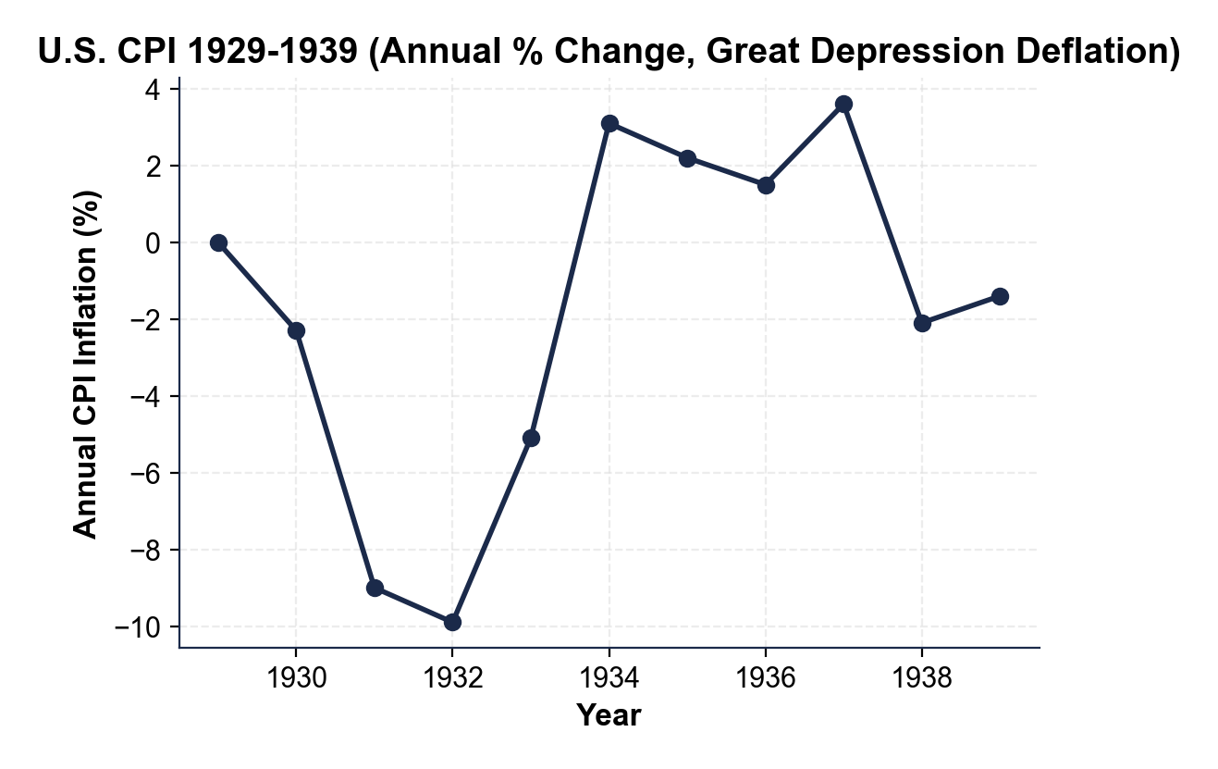
Note: U.S. CPI 1929-1939 (Great Depression Deflation)
1932 trough -9.9%; cumulative 25% decline 1929-1933; 1933 gold-exit pivot.
© More Lessons Less Planning | morelessonslessplanning.com
Notes:
Have students trace U.S. CPI from 1929 (0%) through the deflation deepening to the 1932 trough at -9.9%, the 1933 turn at -5.1%, the 1934 swing to +3.1% inflation, the 1934-1937 partial recovery, and the 1938 secondary deflation at -2.1%. The zero line is the critical landmark. Walk through what each step represents: 1929 = pre-crash baseline; 1930-1932 = the Fisher debt-deflation spiral in full motion; 1933 = the FDR gold-standard exit; 1934-1937 = the New Deal recovery; 1938 = premature tightening triggers secondary deflation. The cumulative price decline 1929-1933 was about 25% - meaning a dollar held in cash bought about a third more goods by 1933. Drive home that deflation ends not because prices spontaneously turn around, but because of a deliberate POLICY PIVOT (here: gold-standard exit + fiscal expansion + bank stabilization).
Reference labels (point to these chart features when teaching): 1932: -9.9% (deepest); 1934: +3.1% (recovery)

Slide 12
How to Fight Deflation - Tools 1-3 (Monetary)
1. Cut rates aggressively (before ZLB)
Cut to zero fast - do not wait for confirmation. Speed matters.
✔
2. Quantitative Easing (QE)
Buy long-term bonds to push down long rates after the short rate hits zero. (Japan 2001, U.S. 2008, ECB 2015)
✔
3. Forward guidance
Publicly commit to low rates for years; reshape inflation expectations.
✔
Key Concept: Monetary tools 1-3. Cut rates, then expand the balance sheet with QE, then shape expectations with forward guidance.
© More Lessons Less Planning | morelessonslessplanning.com
Notes:
The first three tools in the central banker's deflation-fighting toolkit are all monetary. (1) CUT RATES AGGRESSIVELY before the ZLB is binding - the Bank of Japan's biggest mistake was waiting until 1999. Speed matters. (2) QUANTITATIVE EASING - buying long-term government bonds to push down long-term rates after the short rate hits zero. Japan invented modern QE in March 2001; the U.S. Fed launched QE1 in November 2008; the ECB followed in 2015. (3) FORWARD GUIDANCE - publicly committing to keep rates low for an extended period, reshaping inflation expectations and lowering long-term real rates. Used heavily by the Fed 2008-2015. These three tools are the standard monetary deflation-fight response.

Slide 13
How to Fight Deflation - Tools 4-5 (Fiscal + Last Resort)
4. Coordinated fiscal expansion
Government runs deficits to add demand directly (FDR New Deal, 2020 COVID checks, Abenomics fiscal arrow).
✔
5. Negative interest rates (last resort)
Charge banks for excess reserves (BoJ -0.1%, ECB -0.5%) - works modestly, has side effects.
✔
Key Concept: Monetary alone is not enough at the ZLB. Fiscal expansion is the heavy artillery; negative rates are the last resort.
© More Lessons Less Planning | morelessonslessplanning.com
Notes:
After the three monetary tools, the deflation-fight escalates. (4) COORDINATED FISCAL EXPANSION - government runs deficits to add demand directly. FDR's New Deal 1933-1937 is the canonical case; the 2020 COVID stimulus checks are the modern parallel; Abenomics included a fiscal arrow alongside its monetary arrow. Monetary alone is not enough at the ZLB; fiscal coordination is the heavy artillery. (5) NEGATIVE INTEREST RATES - charging banks for excess reserves (BoJ at -0.1% since 2016, ECB at -0.5% from 2019-2022). Works modestly but has side effects on bank profitability and money-market funds. A last resort. The OVERALL LESSON: act fast, act early, escalate aggressively. Japan's delay cost it two decades of growth. The post-2008 U.S. response - aggressive QE, near-zero rates, fiscal stimulus, and bank rescues - is widely credited with preventing a second Great Depression.

Slide 14
Key Takeaways
Deflation = sustained negative CPI; NOT the same as disinflation
★
Two mechanisms: deferred spending + Fisher 1933 debt-deflation spiral
★
Japan lost decades: about 11 negative-CPI years 1995-2012; trough -1.4% (2009)
★
U.S. Great Depression: cumulative -25%; worst -9.9% (1932); ended 1933
★
Fed fears deflation more: rate cuts hit the Zero Lower Bound near 0%
★
© More Lessons Less Planning | morelessonslessplanning.com
Notes:
Read each takeaway and connect to learning targets. T1 (define + distinguish) -> takeaway 1. T2 (explain why dangerous) -> takeaway 2. T3 (trace + explain Fed fear) -> takeaways 3, 4, 5. The activity puts students in the Renee Acosta seat - a junior New York Fed analyst writing a March 2026 brief on whether the U.S. should pre-position for deflation risk. They will pull evidence from the Japan chart, the U.S. Great Depression chart, and the Fisher debt-deflation framework to defend their recommendation.

