Slide 1
Decolonization in Asia
How British India became two nations in 1947
© More Lessons Less Planning | morelessonslessplanning.com
Notes:
Open by asking students to picture a map of Asia in 1945. Britain, France, and the Netherlands still ruled most of the south and southeast of the continent. Within five years, most of that map had changed. This lesson zooms in on the largest and most consequential of those changes: the division of British India in August 1947.

Slide 2
Learning Targets
Explain why British rule in India ended after World War II.
★
Describe how the 1947 partition split British India into two nations.
★
Trace the mass migration that followed the 1947 partition.
★
Analyze how the partition boundary was drawn and by whom.
★
Evaluate the lasting consequences of partition in South Asia.
★
© More Lessons Less Planning | morelessonslessplanning.com
Notes:
Point out that target four - how the boundary was drawn and by whom - is the one the Activity's Primary Source Spotlight builds on. Students will read a real October 1947 telegram sent by the U.S. Ambassador in New Delhi about the people caught on the wrong side of that boundary.

Slide 3
Asia After 1945
World War II shattered European control across South and Southeast Asia
Japan's wartime occupation had shown the empires could be pushed out
Independence movements across Asia demanded power now, not later
Britain came out of the war exhausted and deeply in debt
Between 1946 and 1949 six Asian nations became self-governing
Key Concept: decolonization is a process across many countries, not one moment in one country.
© More Lessons Less Planning | morelessonslessplanning.com
Notes:
decolonization - the process by which colonies won independence from European empires and became self-governing nations. Between 1946 and 1949 the Philippines, India, Pakistan, Burma, Ceylon, and Indonesia all became self-governing nations. This lesson zooms in on the biggest of those transfers: British India in August 1947.

Slide 4
Why Britain Decided to Leave India
War Debt
Britain finished the war nearly bankrupt and could not police an empire.
✔
A New Government
The 1945 Labour government campaigned on leaving India.
✔
Mass Pressure
Decades of Indian organizing had made British rule unworkable.
✔
The Announcement
In February 1947 Britain said it would transfer power by June 1948.
✔
Did You Know: Britain then moved the date up by ten months, to August 1947.
© More Lessons Less Planning | morelessonslessplanning.com
Notes:
Prime Minister Clement Attlee announced on February 20, 1947 that Britain would hand over power in India no later than June 1948. Lord Louis Mountbatten arrived in March 1947 as the last British Viceroy, decided that waiting would make matters worse, and moved the date up to August 1947.

Slide 5
Two Visions for India's Future
Indian National Congress
Muslim League
The main Indian nationalist party, pushing for one united independent India
Led by Jawaharlal Nehru, with Mohandas Gandhi as its moral voice
Argued a single nation could protect people of every religion
The party arguing India's Muslims needed a separate nation of their own
Led by Muhammad Ali Jinnah, a lawyer and former Congress member
Feared Muslims would be a permanent minority in a Hindu-majority India
Note: both sides wanted the British out. They disagreed about what came after.
© More Lessons Less Planning | morelessonslessplanning.com
Notes:
Indian National Congress - the main Indian nationalist party, which pushed for independence and a single united India. Muslim League - the party that argued India's Muslims needed a separate nation of their own. Muhammad Ali Jinnah - the lawyer who led the party demanding a separate Muslim nation and became Pakistan's first governor-general. Jinnah had actually been a Congress member earlier in his career and was once called an ambassador of Hindu-Muslim unity.

Slide 6
1946: The Talks Break Down
A 1946 British plan proposed one India with strong provincial powers
Congress and the Muslim League could not agree on how it would work
Communal violence spread through Calcutta, Bihar, and Punjab into early 1947
Mohandas Gandhi walked from village to village appealing for calm
By early 1947 few British officials believed one India could hold
Warning: by 1947 the question had shifted from whether to divide to how to divide.
© More Lessons Less Planning | morelessonslessplanning.com
Notes:
Mohandas Gandhi - the nationalist leader whose nonviolent campaigns built a mass independence movement and who argued against dividing the country. The 1946 Cabinet Mission plan proposed a single Indian union in which grouped provinces held most of the power. Congress and the Muslim League read the plan differently and the agreement collapsed. Communal violence followed in Calcutta in August 1946 and then in Bihar and Punjab through 1946 and early 1947. Gandhi spent months walking through affected districts appealing for calm, and he opposed partition to the end. Report this material factually and move on; it does not need elaboration.

Slide 7
The Decision to Divide
March 1947
Lord Mountbatten arrives in Delhi as the last British Viceroy.
✔
June 3, 1947
Britain announces British India will be divided into two states.
✔
July 18, 1947
The Indian Independence Act becomes law in Britain.
✔
The Deadline
Power transferred on August 15, 1947 - about ten weeks after the June 3 announcement.
✔
Key Concept: partition is the 1947 division of British India into two independent nations.
© More Lessons Less Planning | morelessonslessplanning.com
Notes:
partition - the 1947 division of British India into two independent nations, India and Pakistan. Mountbatten arrived in March 1947, announced the plan to divide on June 3, and the Indian Independence Act received royal assent on July 18, 1947. From the June announcement to the transfer of power was about ten weeks.

Slide 8
Drawing the Line
A British lawyer, Cyril Radcliffe, was given the job of drawing the border
He had never been to India before and arrived in July 1947
He had about five weeks to divide Punjab and Bengal
He worked from census tables and maps, not from the districts themselves
The border was not published until August 17, two days after independence
Did You Know: millions of people learned which country they lived in only after the fact.
© More Lessons Less Planning | morelessonslessplanning.com
Notes:
Radcliffe Line - the border drawn in 1947 by British lawyer Cyril Radcliffe to divide Punjab and Bengal between India and Pakistan. Radcliffe chaired the boundary commissions for both provinces. He arrived in India on July 8, 1947, had roughly five weeks, and worked mostly from census figures and maps. The awards were finished before August 15 but were held back until August 17, so independence was celebrated before anyone outside the process knew exactly where the line ran.

Slide 9
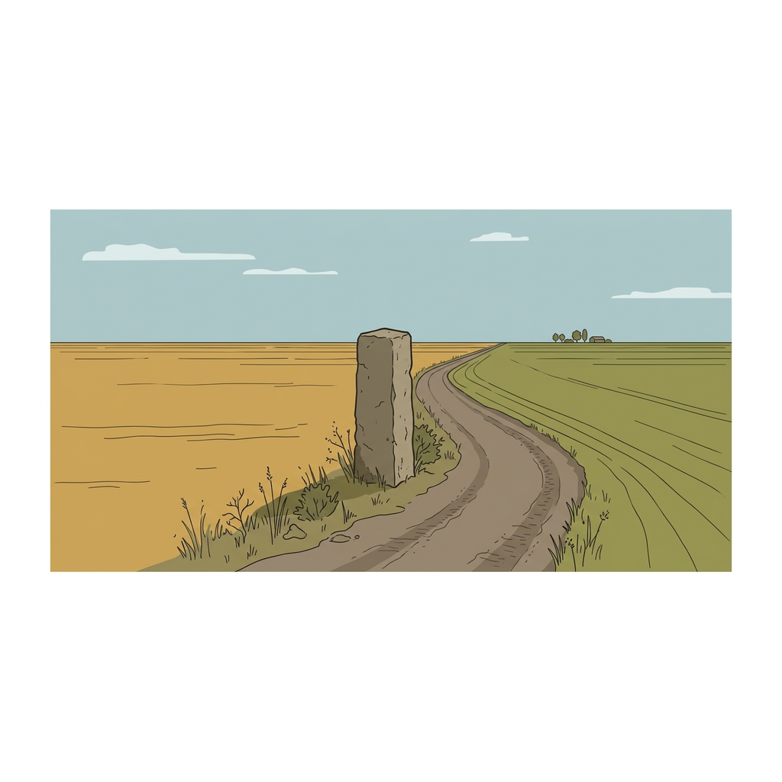
A Line on a Map Becomes a Border on the Ground
Illustration: a boundary marker of the kind used to fix a new border.
© More Lessons Less Planning | morelessonslessplanning.com
Notes:
Ten seconds of silent looking. A boundary commission's decision arrives in a village as something physical - a marker, a fence, a checkpoint. Ask what changes for a farmer whose fields end up on the other side of it.
Reference labels (point to these chart features when teaching): boundary pillar; farm field

Slide 10
August 1947: Two Nations
August 14, 1947
Pakistan becomes independent, with Muhammad Ali Jinnah as governor-general - its first head of state.
✔
August 15, 1947
India becomes independent, with Jawaharlal Nehru as its first prime minister.
✔
Two Wings
Pakistan was created in two pieces, over a thousand miles apart.
✔
One Empire, Two States
British India ended; India and Pakistan took its place.
✔
Note: East Pakistan later became the independent nation of Bangladesh in 1971.
© More Lessons Less Planning | morelessonslessplanning.com
Notes:
Jawaharlal Nehru - the Indian National Congress leader who became independent India's first prime minister. Pakistan was created as two separate territories, West Pakistan and East Pakistan, with about a thousand miles of Indian territory between them. East Pakistan became the independent country of Bangladesh in 1971.

Slide 11
The Largest Migration of the Century
Between 10 and 15 million people crossed the new border within months
A refugee is a person forced to flee home for safety, often across a border
Hindus and Sikhs moved east into India; Muslims moved west into Pakistan
Trains, road caravans, and camps carried and held people on both sides
Estimates of the death toll range from several hundred thousand to two million
Note: historians still debate the toll because no one was counting at the time.
© More Lessons Less Planning | morelessonslessplanning.com
Notes:
refugee - a person forced to flee their home for safety, often across a border. The 1947 migration displaced roughly 10 to 15 million people in a matter of months, one of the largest movements of people in modern history. Estimates of the number who died range from several hundred thousand to two million, and no reliable count was made at the time. Handle this factually and briefly - state it once, do not dwell on it, and do not add detail beyond what is on the slide.

Slide 12
The Princely States and Kashmir
Princely States
Over 500 states had to choose India or Pakistan in 1947.
✔
Kashmir
The state whose future was contested by both India and Pakistan from 1947 onward.
✔
October 1947
Fighting broke out and Kashmir's ruler acceded to India.
✔
A Frozen Line
A ceasefire in January 1949 left Kashmir divided, and it still is.
✔
Key Concept: Kashmir was the cause of the first India-Pakistan war of 1947-48.
© More Lessons Less Planning | morelessonslessplanning.com
Notes:
Kashmir - the princely state claimed by both India and Pakistan, and the cause of their first war in 1947-48. Under the Indian Independence Act the princely states had to accede to India or to Pakistan. Kashmir's Maharaja Hari Singh delayed, then acceded to India in October 1947 after fighting began. The United Nations helped arrange a ceasefire that took effect on January 1, 1949 and left the state divided along a ceasefire line.

Slide 13
India Chooses Not to Choose
The Cold War was starting just as India and Pakistan became independent
Nehru refused to line India up with Washington or Moscow
He called that policy nonalignment and urged other new nations to join
India still needed food, machinery, and development money from abroad
Nehru visited President Truman in Washington in October 1949
Tip: nonalignment did not mean having no opinions - it meant refusing to join a bloc.
© More Lessons Less Planning | morelessonslessplanning.com
Notes:
Nonalignment meant refusing to take a side with either the United States or the Soviet Union. Nehru argued that a nation that had just won its independence should not immediately hand its foreign policy to somebody else. He visited the United States in October 1949, met President Harry Truman in Washington, and asked for food aid and development help while declining to join an American alliance.

Slide 14
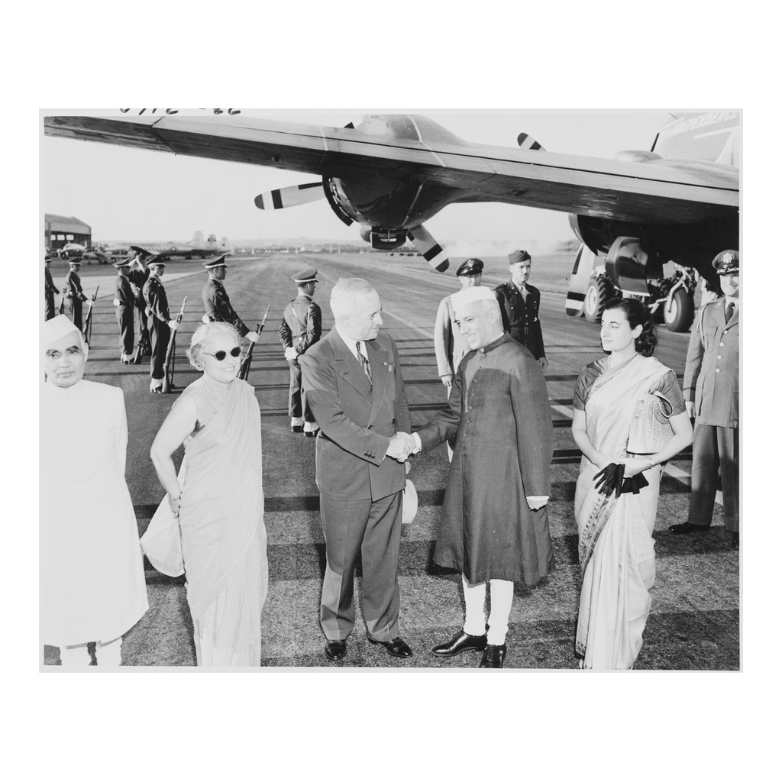
Nehru in Washington, October 1949
President Truman greets Prime Minister Nehru on his arrival, October 1949.
© More Lessons Less Planning | morelessonslessplanning.com
Notes:
Ten seconds of silent looking. Two years after independence, India's prime minister is being received at the White House. Ask students what each side wanted out of this meeting before you move on.
Reference labels (point to these chart features when teaching): Truman; Nehru

Slide 15
Pakistan Looks West
A Weaker Start
Pakistan began with less industry, less revenue, and a divided territory.
✔
Security First
Kashmir and a far larger neighbor pushed Pakistan to seek outside backing.
✔
May 1950
Prime Minister Liaquat Ali Khan visited President Truman in Washington.
✔
The 1950s
Pakistan joined U.S.-led alliances; India stayed nonaligned.
✔
Did You Know: within a decade the two new neighbors sat on opposite sides of the Cold War.
© More Lessons Less Planning | morelessonslessplanning.com
Notes:
Liaquat Ali Khan was Pakistan's first prime minister. He visited the United States in May 1950 and met President Truman in Washington. Over the following decade Pakistan joined the U.S.-led SEATO and Baghdad Pact alliances, while India kept to nonalignment. Two countries created on the same weekend ended up on opposite sides of the Cold War.

Slide 16
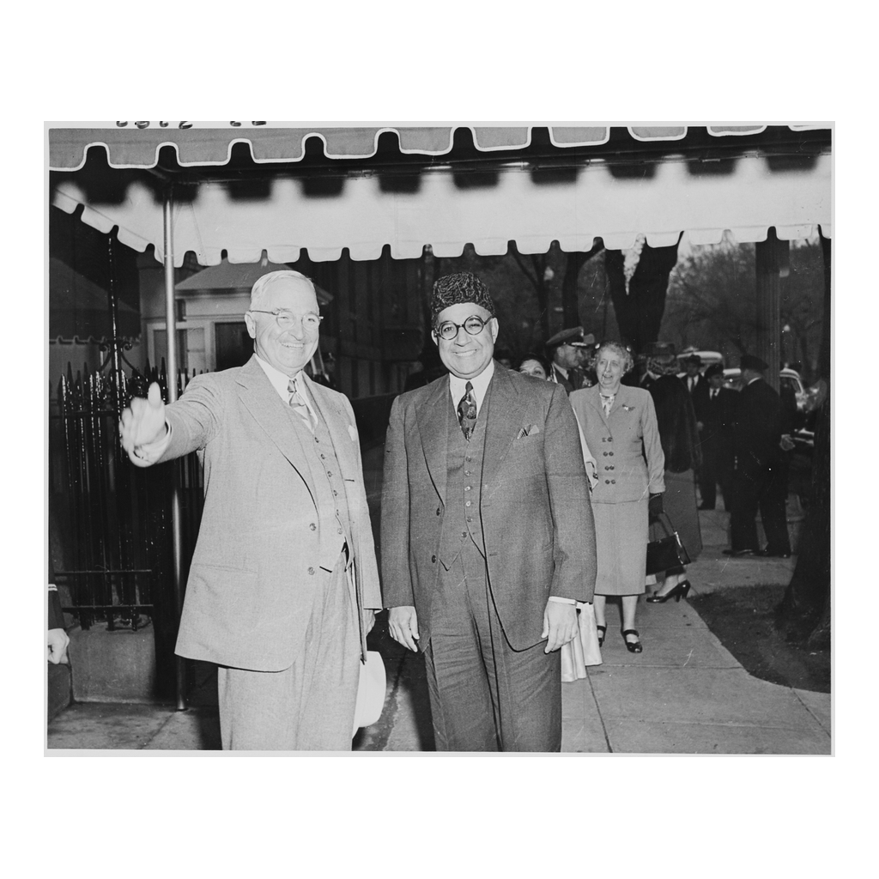
Liaquat Ali Khan in Washington, May 1950
President Truman with Pakistan's first prime minister, Liaquat Ali Khan.
© More Lessons Less Planning | morelessonslessplanning.com
Notes:
Ten seconds of silent looking. Seven months after Nehru stood in the same city, Pakistan's prime minister does too. Ask students what it means that both new nations came to Washington first.
Reference labels (point to these chart features when teaching): Truman; Liaquat Ali Khan

Slide 17
The Wave Across Asia
The Philippines became independent from the United States in July 1946
India and Pakistan followed in August 1947
Burma became independent in January 1948; Ceylon followed in February
The Netherlands transferred sovereignty to Indonesia in December 1949
In under four years most of South and Southeast Asia was self-governing
Note: not every transfer was peaceful - Indonesia fought a four-year war first.
© More Lessons Less Planning | morelessonslessplanning.com
Notes:
Philippine independence came on July 4, 1946. Pakistan and India followed on August 14 and 15, 1947. Burma became independent on January 4, 1948, and Ceylon, now Sri Lanka, on February 4, 1948. Indonesia declared independence in 1945, but the Netherlands did not transfer sovereignty until December 27, 1949, after four years of fighting and negotiation.

Slide 18
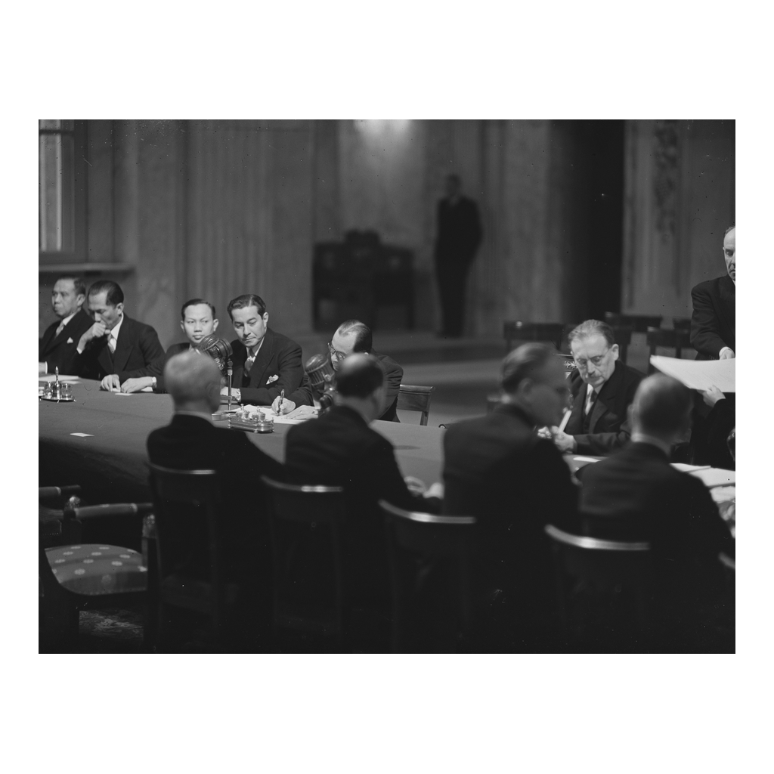
Indonesia, December 1949
Delegates sign the transfer of sovereignty to Indonesia, December 1949.
© More Lessons Less Planning | morelessonslessplanning.com
Notes:
Ten seconds of silent looking. The last of the 1940s transfers, and the one that took a four-year war to reach. Ask students to compare this scene with the one on the Nehru slide.
Reference labels (point to these chart features when teaching): signing table; delegates

Slide 19
What Partition Left Behind
Two Nations
India and Pakistan are today two of the world's largest countries.
✔
A Divided Kashmir
The 1949 ceasefire line is still disputed more than 75 years later.
✔
Family Memory
Millions of families still trace their history to a 1947 crossing.
✔
A Warning
Speed and secrecy in drawing the border made the human cost worse.
✔
Key Concept: 1947 brought independence for millions and displacement for millions.
© More Lessons Less Planning | morelessonslessplanning.com
Notes:
Independence was won by decades of Indian political organizing, not handed over as a favor. Partition was the compromise that let the transfer happen on the agreed schedule. Both statements are true at the same time, and students should be able to hold both.

Slide 20
Key Takeaways
British rule ended because Britain was broke and Indians were organized.
★
Partition split British India into India and Pakistan on August 14 and 15, 1947.
★
The Radcliffe Line was drawn in five weeks and published after independence.
★
Between 10 and 15 million people crossed the new border within months.
★
India chose nonalignment; Pakistan looked west; Kashmir is still divided.
★
© More Lessons Less Planning | morelessonslessplanning.com
Notes:
Close on the two halves students must hold together: independence was won by Indian organizing, and partition was the cost written into how that independence was delivered.

