Slide 1
Decolonization in Africa
How African nations won independence during the Cold War
© More Lessons Less Planning | morelessonslessplanning.com
Notes:
Open by asking students to picture a world map from 1945: almost the entire continent of Africa is colored as somebody else's territory. Then tell them that within twenty years most of that map had changed. This lesson is about how that happened, who made it happen, and what came next.

Slide 2
Learning Targets
Explain how World War II weakened Europe's empires in Africa.
★
Describe how Ghana in 1957 and the 1960 Year of Africa spread independence.
★
Trace the Congo from Belgian rule to independence and into crisis.
★
Analyze how Cold War rivalry shaped the choices new African leaders faced.
★
Evaluate what independence required beyond lowering a colonial flag.
★
© More Lessons Less Planning | morelessonslessplanning.com
Notes:
Point out that target four is the one the Activity's Primary Source Spotlight assesses: students read an actual July 1960 U.S. embassy telegram about the Congo and explain what it reveals about how American officials were thinking.

Slide 3
Empires Under Strain After 1945
World War II left Britain, France, and Belgium exhausted and in debt
African soldiers fought for those empires and came home wanting change
The 1945 United Nations Charter endorsed self-determination
Decolonization is the process of colonies becoming independent nations
Holding colonies now cost more than the empires could easily afford
Key Concept: a people that governs itself and chooses its own government has self-determination.
© More Lessons Less Planning | morelessonslessplanning.com
Notes:
decolonization - the process by which colonies won independence from European empires and became self-governing nations. self-determination - the principle that a people should govern themselves and choose their own government. These two terms frame the whole lesson: the first names the process, the second names the principle behind it.

Slide 4
Africans Demand a Say in Their Own Future
Pan-Africanism
The idea that African peoples should unite and help each other.
✔
New Leaders
Educated organizers built mass political parties across Africa.
✔
Pressure
Strikes, boycotts, and protests made colonial rule expensive.
✔
The Demand
Independence now, not on some distant colonial timetable.
✔
Key Point: Africans did not simply receive independence - they organized and demanded it.
© More Lessons Less Planning | morelessonslessplanning.com
Notes:
Pan-Africanism - the idea that African peoples share common interests and should unite and support one another. Pan-Africanist congresses in Manchester in 1945 and in Accra in 1958 connected organizers across the continent, so a win in one colony encouraged movements in the next one.

Slide 5
Ghana Goes First, 1957
On March 6, 1957, the British Gold Coast became independent Ghana
Kwame Nkrumah led that movement and became its first prime minister
Ghana was the first sub-Saharan colony to win its independence
Nkrumah later served as Ghana's president as well
Ghana's success became a model other African movements studied
Fact: the new nation took the name of a medieval West African kingdom instead of its colonial name.
© More Lessons Less Planning | morelessonslessplanning.com
Notes:
Kwame Nkrumah - the independence leader who became Ghana's first prime minister in 1957 and later its president. Ghana's independence on March 6, 1957 mattered far beyond Ghana: it proved a sub-Saharan African colony could take power without a war, and organizers in dozens of other colonies pointed to it as proof it could be done.

Slide 6
1960: The Year of Africa
Seventeen Nations
In 1960 alone, seventeen African nations gained independence.
✔
Year of Africa
The name given to 1960 because so many colonies became nations.
✔
Mostly Negotiated
Britain and France transferred power by agreement in most cases.
✔
Algerian War
Algeria fought France from 1954 to 1962 to win its independence.
✔
Fact: at the start of 1960 most of Africa was ruled from Europe; by 1965 most of it was not.
© More Lessons Less Planning | morelessonslessplanning.com
Notes:
Year of Africa - the name given to 1960, when seventeen African nations gained independence in a single year. Algerian War - the eight-year war, from 1954 to 1962, in which Algeria won independence from France. Algeria was different because roughly a million French settlers lived there and France treated it as part of France itself, so independence came only after a long and costly war.

Slide 7
The Congo: Independence in Six Months
Belgium ruled the Congo and allowed almost no African self-government
Riots in Leopoldville in January 1959 shocked the Belgian government
Belgian and Congolese leaders met in Brussels in January 1960
They set independence for June 30, 1960 - barely six months away
Almost no Congolese had been trained to run a national government
Important: Belgium had planned a slow handover, then agreed to leave in under six months.
© More Lessons Less Planning | morelessonslessplanning.com
Notes:
Belgium's policy had been to keep Congolese out of higher education and out of senior government and army posts. So when the Brussels Round Table Conference set independence for June 30, 1960, the new country had almost no trained administrators, officers, or engineers of its own.

Slide 8
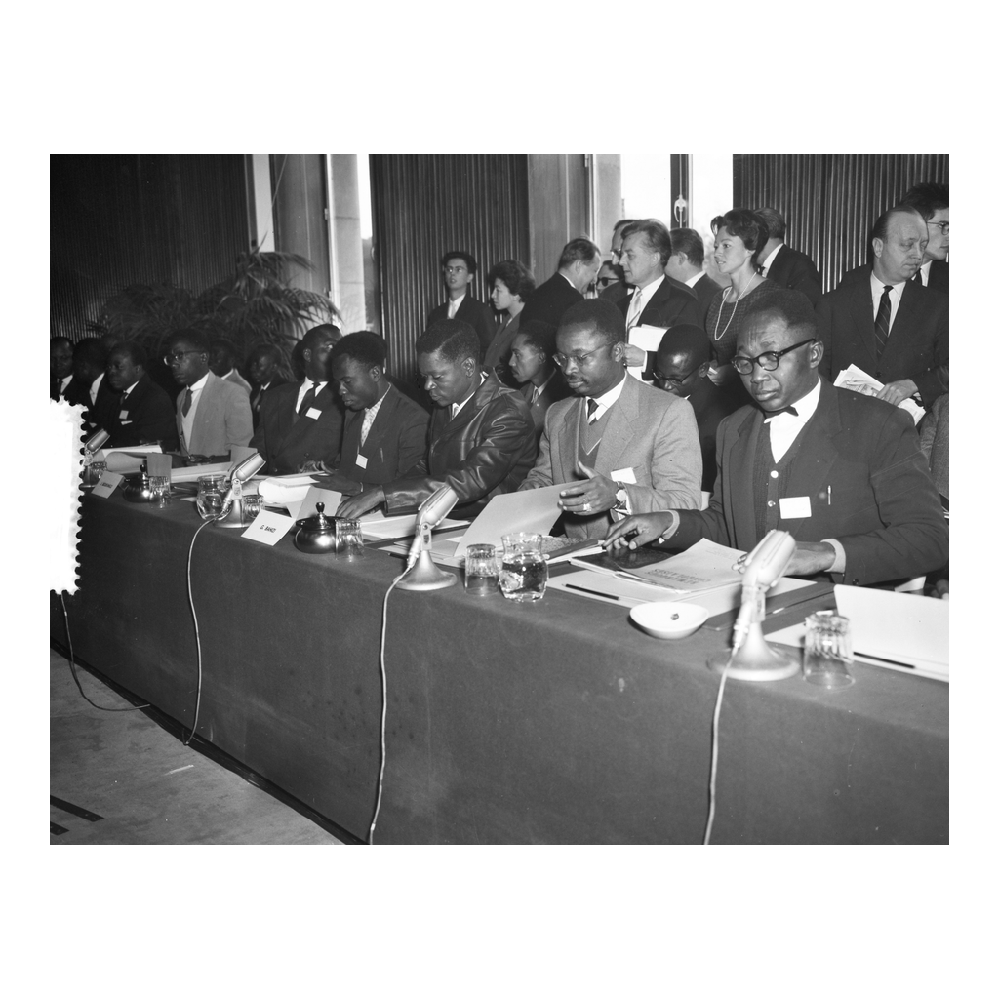
The Brussels Talks, January 1960
Congolese delegates at the Brussels conference, January 1960
© More Lessons Less Planning | morelessonslessplanning.com
Notes:
Give students ten seconds to look before narrating. Point out that these are Congolese delegates seated at the conference table with nameplates and documents - independence was negotiated, not simply handed over. This is a reference image, not an evidence task.

Slide 9
Independence Day, June 30, 1960
June 30, 1960
The Belgian Congo became an independent nation.
✔
Patrice Lumumba
The new nation's first prime minister took office.
✔
Joseph Kasavubu
A rival independence leader became the president.
✔
The Hard Part
A flag changed, but the country still had to be run.
✔
Key Point: independence day was the beginning of the work, not the end of it.
© More Lessons Less Planning | morelessonslessplanning.com
Notes:
Patrice Lumumba - the first prime minister of the independent Congo, sworn in on June 30, 1960. Lumumba and President Joseph Kasavubu came from rival parties and disagreed about how much power the central government should hold, which mattered enormously once the crisis began days later.

Slide 10
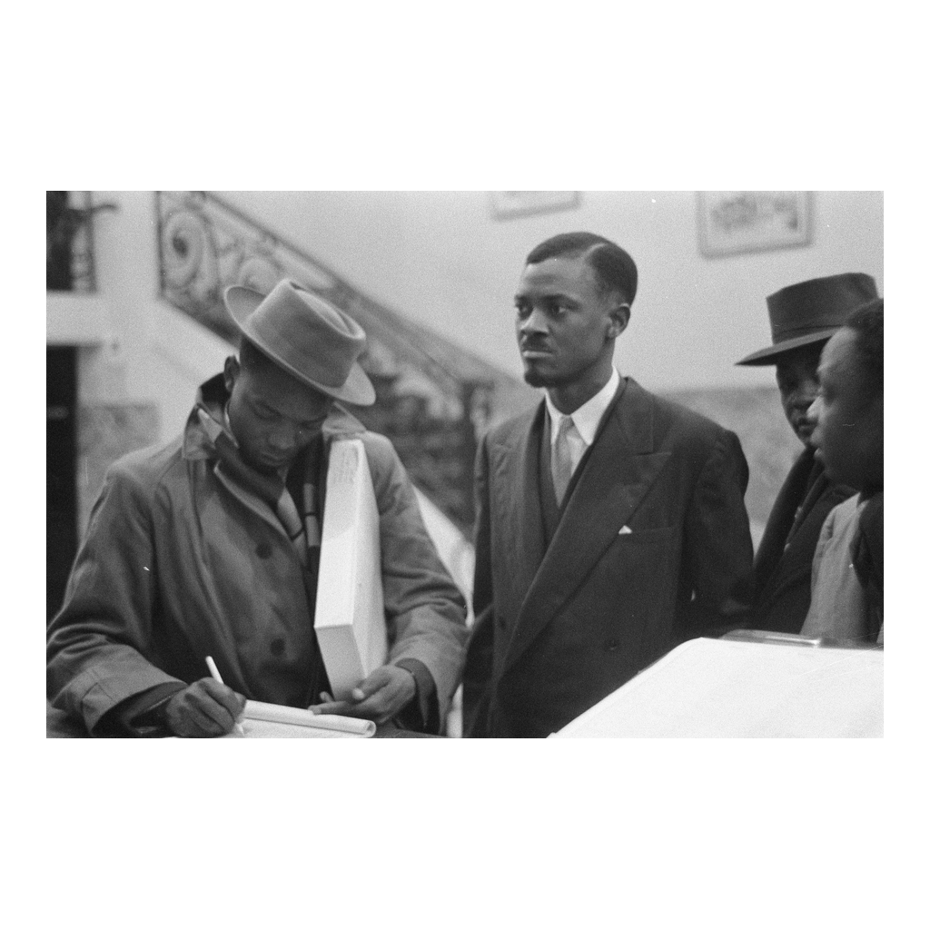
Patrice Lumumba, 1960
Lumumba in Brussels during the independence talks, January 1960
© More Lessons Less Planning | morelessonslessplanning.com
Notes:
Give students ten seconds to look before narrating. This is the man whose words they will read in the Activity's Primary Source Spotlight, photographed months before he became prime minister. This is a reference image, not an evidence task.

Slide 11
The Congo Crisis
July 5, 1960
The Congolese army mutinied against its Belgian officers.
✔
July 11, 1960
The mineral-rich province of Katanga declared secession.
✔
July 14, 1960
The United Nations voted to send troops into the Congo.
✔
What Followed
Lumumba was removed in September 1960 and killed in January 1961.
✔
Important: the Congo Crisis began within one week of independence day.
© More Lessons Less Planning | morelessonslessplanning.com
Notes:
Congo Crisis - the breakdown of order in the Congo within days of independence, involving an army mutiny, the secession of Katanga, and United Nations intervention. Lumumba appealed to the United Nations and then to the Soviet Union for help against the Katanga secession. He was removed from office in September 1960 and murdered in January 1961; responsibility for his death is still debated by historians and is not settled by any single document.

Slide 12
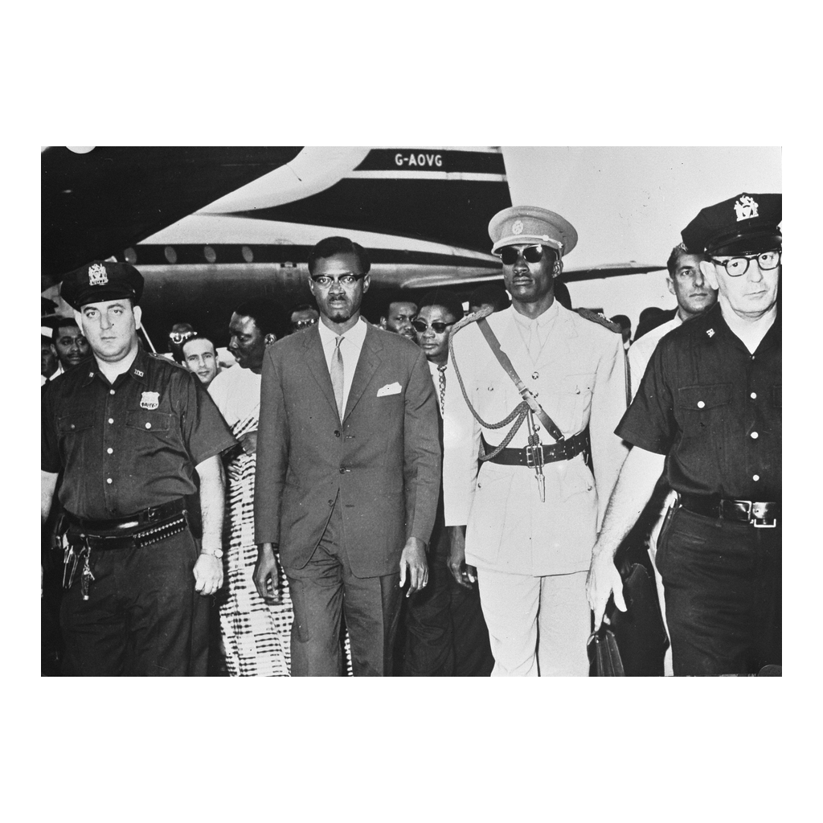
Lumumba Looks Abroad for Help, July 1960
Lumumba arrives in New York in July 1960 to seek help at the UN
© More Lessons Less Planning | morelessonslessplanning.com
Notes:
Give students ten seconds to look before narrating. Point out that the Congo's prime minister is walking through an American airport under police escort three weeks after his country became independent. This is a reference image, not an evidence task.

Slide 13
Two Superpowers Come Calling
The U.S. and the Soviet Union both offered aid to new African nations
Each superpower wanted new nations on its side of the Cold War
Aid, equipment, and loans came with expectations attached
African leaders could use that rivalry, but it was risky
A leader who leaned one way could lose the other side's support
Key Concept: Cold War rivalry gave new nations leverage and danger at the same time.
© More Lessons Less Planning | morelessonslessplanning.com
Notes:
Both superpowers treated newly independent African nations as ground to be won. American officials worried that Soviet aid would buy influence, and Soviet officials made the same calculation in reverse. The Primary Source Spotlight in the Activity is a U.S. embassy telegram making exactly that argument about the Congo in July 1960.

Slide 14
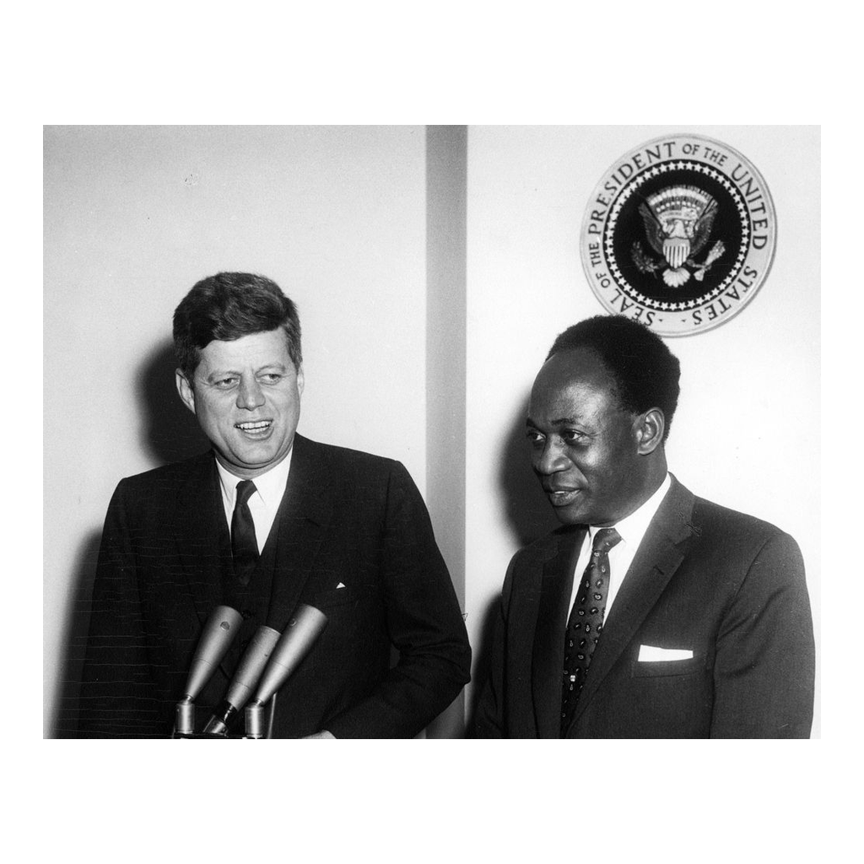
A New African Leader at the White House, 1961
President Kennedy meets Ghana's Kwame Nkrumah, March 1961
© More Lessons Less Planning | morelessonslessplanning.com
Notes:
Give students ten seconds to look before narrating. Point out the presidential seal on the wall behind the two men. Four years after Ghana's independence, an American president is making a public show of the relationship. This is a reference image, not an evidence task.

Slide 15
Choosing Not to Choose
Nonalignment
Refusing to take a side with either superpower in the Cold War.
✔
Bandung, 1955
Asian and African leaders met and rejected picking a side.
✔
Belgrade, 1961
The Non-Aligned Movement held its first summit of members.
✔
Harder Than It Sounds
Both superpowers pressured leaders to commit anyway.
✔
Key Point: nonalignment was a claim to independence in foreign policy, not neutrality about everything.
© More Lessons Less Planning | morelessonslessplanning.com
Notes:
nonalignment - a policy of refusing to take a side with either the United States or the Soviet Union in the Cold War. Kwame Nkrumah of Ghana, Gamal Abdel Nasser of Egypt, and Jawaharlal Nehru of India were among its best-known advocates. Lumumba used the same idea, a neutral position, in the July 1960 telegram students read in the Activity.

Slide 16
What Independence Actually Required
New nations inherited borders drawn in Europe, not by Africans
Few Africans had been allowed to train as officials or engineers
Economies were built to export raw materials, not to feed people
Armies, courts, and schools had to be staffed almost overnight
Foreign aid filled the gaps, and came with foreign expectations
Key Point: lowering one flag and raising another was the easiest part of independence.
© More Lessons Less Planning | morelessonslessplanning.com
Notes:
This slide is the lesson's analytical core: independence was a legal event that happened on one day, but building a working state was a project measured in decades. Colonial governments had deliberately limited African education and administration, so new governments started with borders they did not draw and institutions they did not build.

Slide 17
Organizing Across Borders
May 1963
Thirty-two states met in Addis Ababa, Ethiopia.
✔
Organization of African Unity
Founded to promote cooperation among independent states.
✔
Borders
Members agreed in 1964 to accept the colonial borders they inherited.
✔
Still Fighting
The OAU also backed colonies still under European rule.
✔
Fact: the Organization of African Unity became the African Union in 2002.
© More Lessons Less Planning | morelessonslessplanning.com
Notes:
Organization of African Unity - the organization founded in 1963 in Addis Ababa to promote cooperation among independent African states. Members accepted the colonial borders they had inherited because redrawing them looked more dangerous than living with them, a decision that shaped African politics for decades.

Slide 18
What Decolonization Left Behind
By 1965 most of Africa was independent of European rule
Independence was won by African organizing, not given as a gift
Cold War rivalry shaped, and sometimes distorted, new choices
The Congo shows how fast independence could turn into crisis
Ghana shows how fast a movement could win power peacefully
Big idea: the flags changed quickly; building the new states took decades.
© More Lessons Less Planning | morelessonslessplanning.com
Notes:
This is the analysis slide before Key Takeaways. Push students to hold both halves at once: African movements really did win independence themselves, AND the Cold War world they entered shaped what they could do with it. Neither half alone is the whole story, and the Essential Question asks for both.

Slide 19
Key Takeaways
World War II weakened Europe's empires while African movements pressed
★
Ghana went first in 1957; seventeen more nations followed in 1960
★
The Congo won independence June 30, 1960 and fell into crisis in days
★
Cold War rivalry shaped the choices every new African nation faced
★
© More Lessons Less Planning | morelessonslessplanning.com
Notes:
Close by returning to the opening image of the 1945 map. The map changed because Africans organized and demanded it, and the world those new nations entered was a Cold War world that immediately started competing for them.

