Slide 1
Daoism and the Tao Te Ching
An academic look at the Daoist ideas of the Dao ('the Way') and wu wei, and how they contrast with Confucian social order.
© More Lessons Less Planning | morelessonslessplanning.com
Notes:
Opening slide. This lesson studies Daoism academically - as a Chinese philosophy and belief system, not a devotional practice or a call to belief. Students learn that Daoism grew from ideas linked to the semi-legendary Laozi and gathered in the Tao Te Ching, and that its central concepts - the Dao ('the Way') and wu wei (effortless, non-forcing action) - offer a very different approach to life and social order than Confucianism. Set a neutral, scholarly tone from the first minute: we describe what Daoism teaches and how it differs from Confucianism, comparing belief systems to understand them accurately, and we never endorse, rank, or ask anyone to practice a tradition.

Slide 2
Learning Targets
Explain who the semi-legendary Laozi was and what Daoism is.
★
Define the Dao ('the Way') and wu wei (effortless action).
★
Contrast Daoism with Confucianism on nature and social order.
★
Read an excerpt from the Tao Te Ching as a primary source.
★
© More Lessons Less Planning | morelessonslessplanning.com
Notes:
Read the four learning targets. Today pairs a set of ideas with a comparison: the Daoist concepts of the Dao and wu wei, and how they contrast with the Confucian focus on active social order. Keep the neutral, academic stance in mind throughout: our goal is to understand and describe the ideas accurately and to compare Daoism with other belief systems, not to decide whether it is right or to practice it. Pay special attention to defining the Dao and wu wei precisely, and to the honesty notes - Laozi is semi-legendary, the Tao Te Ching was likely compiled over time, and wu wei is effortless action, not laziness.

Slide 3
Who Was Laozi? What Is Daoism?
Laozi, the 'Old Master'
Daoism, a way of harmony
Laozi ('Old Master') is the semi-legendary founder of Daoism.
Scholars debate whether he was one real historical person.
He is the traditional author of the Tao Te Ching.
Daoism teaches living in harmony with the Dao, 'the Way'.
It values simplicity, nature, and effortless action (wu wei).
We study it academically here, not as personal belief.
Key Concept: DAOISM teaches harmony with the DAO ('the Way'); LAOZI is its semi-legendary founder.
© More Lessons Less Planning | morelessonslessplanning.com
Notes:
Begin with the person and the tradition. Laozi ('Old Master') is the semi-legendary figure traditionally regarded as the founder of Daoism and the traditional author of the Tao Te Ching; scholars debate whether he was a single historical person, so we call him semi-legendary rather than a documented author. Daoism is a Chinese philosophical and religious tradition that teaches living in harmony with the Dao ('the Way') through simplicity, naturalness, and wu wei (effortless action). The Tao Te Ching ('Classic of the Way and Virtue') is the foundational Daoist text, traditionally attributed to Laozi. Note the academic framing: Daoism is studied here as a philosophy and belief system - it is about how to live in harmony with nature - not a religion we practice or endorse. On the next slide you will see a traditional painting of Laozi riding an ox.

Slide 4
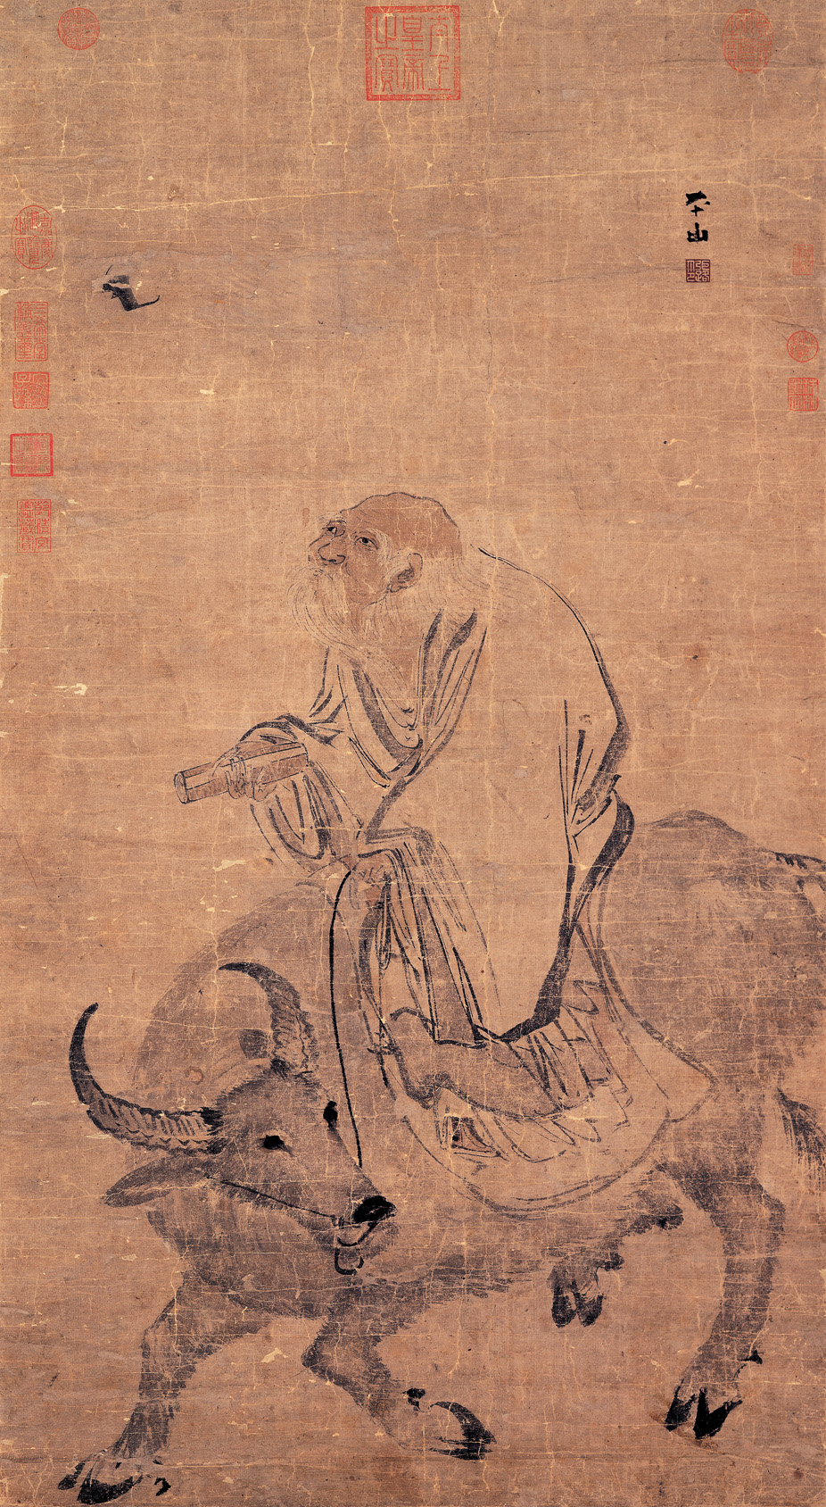
Laozi Riding an Ox
Laozi Riding an Ox, by Zhang Lu (Ming dynasty), National Palace Museum.
© More Lessons Less Planning | morelessonslessplanning.com
Notes:
Public-domain reproduction of a traditional Chinese ink painting, 'Laozi Riding an Ox,' by the Ming-dynasty painter Zhang Lu (c. 1464-1538), held by the National Palace Museum (Taipei) and public domain by age. Use it purely as a reference image to make the previous slide concrete: in legend, Laozi rode west on an ox and, at the border, was asked to write down his wisdom - which tradition says became the Tao Te Ching. Describe it respectfully and academically as a historical artwork and a legend; students are not asked to decode the image as evidence.

Slide 5
The Dao: The Way
The Dao
The Dao ('the Way') is the natural, nameless source and order of the universe.
✔
Beyond words
The text says the Dao that can be told is not the eternal Dao - it is ineffable.
✔
Not a god
The Dao is a concept or principle to live in harmony with, not a god to worship.
✔
Key Concept: The DAO ('the Way') is the ineffable natural order of the universe - a concept, not a god.
© More Lessons Less Planning | morelessonslessplanning.com
Notes:
The central concept of Daoism is the Dao ('the Way') - the natural, nameless order and source of the universe. The Tao Te Ching opens by saying that 'The Dao that can be told is not the eternal Dao,' meaning the true Dao is beyond words, or ineffable: any Dao you can fully name or describe is not the real, unchanging one. Just as important for our academic study: the Dao is presented as a principle or natural order to live in harmony with, not as a deity to be worshipped. Describe this neutrally as the core Daoist idea.

Slide 6
Wu Wei: Effortless Action
What wu wei is
What wu wei is NOT
Wu wei means 'effortless action' or 'non-forcing'.
It means acting in harmony with the natural flow of things.
Like water, it accomplishes much without struggle or force.
Wu wei is NOT laziness, passivity, or doing nothing at all.
The ideal: nothing is forced, yet nothing is left undone.
A wise ruler interferes as little as possible with people.
Key Concept: WU WEI is effortless, non-forcing action in harmony with nature - NOT laziness or inaction.
© More Lessons Less Planning | morelessonslessplanning.com
Notes:
The second core Daoist idea is wu wei - the ideal of effortless, non-forcing action. Wu wei means acting in harmony with the natural flow of things rather than struggling or forcing against them. This is the lesson's most important honesty point: wu wei does NOT mean literal inaction, passivity, or laziness. The Daoist paradox is that when a person stops forcing, 'nothing is left undone' - things still get accomplished, just naturally and without struggle. Water is the classic image: it benefits all things and takes the low place without striving, yet it is powerful. Applied to government, wu wei suggests a ruler who interferes as little as possible and lets people follow their natural course. Describe this neutrally as a Daoist ideal, and correct any reading of wu wei as simply 'being lazy.'

Slide 7
Nature's Balance: Simplicity and Yin and Yang
Simplicity
Simplicity means reducing desires and interference and returning to a plain, natural life.
✔
Naturalness
Naturalness (ziran) means letting things follow their own spontaneous course.
✔
Yin and yang
Yin and yang are complementary forces whose balance forms the natural order.
✔
Key Concept: Daoism values SIMPLICITY, NATURALNESS, and the balance of YIN AND YANG.
© More Lessons Less Planning | morelessonslessplanning.com
Notes:
Around the Dao and wu wei, Daoism gathers a set of related values. Simplicity is the Daoist value of reducing desires and interference and returning to a plain, natural way of life close to the Dao. Naturalness, from the Chinese ziran ('self-so'), is the ideal of letting things follow their own spontaneous course without artificial forcing - it is closely tied to wu wei. Yin and yang are the two complementary forces in Chinese thought - such as dark and light, soft and hard, still and active - whose balance and interplay make up the natural order; Daoism prizes keeping them in harmony. Present all three neutrally as Daoist values and Chinese concepts.

Slide 8
The Tao Te Ching
The Daoist classic
How it came to be
The Tao Te Ching is the foundational text of Daoism.
Its title means 'Classic of the Way and Virtue'.
It is short: about 81 brief, poetic chapters.
It is traditionally attributed to the semi-legendary Laozi.
Scholars think it was compiled and edited over time.
Likely composed around the 4th-3rd century BCE.
Key Concept: The TAO TE CHING is Daoism's short, poetic classic, traditionally linked to Laozi, likely compiled over time.
© More Lessons Less Planning | morelessonslessplanning.com
Notes:
The foundational Daoist text is the Tao Te Ching, whose title means 'Classic of the Way and Virtue.' It is short - about 81 brief, poetic chapters full of paradoxes about the Dao and wu wei. It is important to be honest about how it came to be: the text is traditionally attributed to Laozi, but most scholars think it was not written by one author at one time. Instead it was likely compiled and edited over time by many hands, probably taking shape around the 4th-3rd century BCE. So we call it 'traditionally attributed to Laozi' and treat it as a composite text, not the certain work of one man. Describe this neutrally as what scholars understand about the text.

Slide 9
Daoism and Confucianism: A Contrast
Confucianism
Confucianism builds social order actively through ritual, hierarchy, and defined roles.
✔
Daoism
Daoism seeks harmony with nature through simplicity and minimal interference.
✔
The contrast
Confucians actively cultivate society; Daoists step back and follow the natural way.
✔
Key Concept: CONFUCIANISM actively orders society; Daoism aligns with nature and interferes less.
© More Lessons Less Planning | morelessonslessplanning.com
Notes:
Because this unit compares belief systems, the sharpest contrast for Daoism is Confucianism, studied earlier in the unit. Confucianism is the Chinese ethical-social system based on Confucius that stresses actively cultivating social order through ritual (li), hierarchy, and clearly defined roles - people fulfilling their duties keeps society in order. Daoism points the other way: it seeks harmony with nature through simplicity, naturalness, and wu wei, and it favors minimal interference. Put simply, Confucians actively build and cultivate society, while Daoists step back and follow the natural way. Present both fairly and without caricature: this is a difference in emphasis between two respected traditions, described academically, never ranked.

Slide 10
Philosophical and Religious Daoism
Philosophical Daoism
Religious Daoism
Philosophical Daoism (Daojia) studies the Dao as a way to live.
It centers on texts like the Tao Te Ching.
This lesson focuses on philosophical Daoism.
Later religious Daoism (Daojiao) added gods and rituals.
It included a search for long life or immortality.
It grew from, but differs from, the earlier philosophy.
Key Concept: PHILOSOPHICAL DAOISM studies the Dao as a way of living; religious Daoism added gods and ritual.
© More Lessons Less Planning | morelessonslessplanning.com
Notes:
One more distinction keeps our study accurate. Philosophical Daoism (in Chinese, Daojia) is the study of the Dao as a way of thinking and living, centered on texts like the Tao Te Ching - this is what our lesson focuses on. Over the centuries, a separate strand called religious Daoism (Daojiao) developed: it added gods and organized rituals and included a search for long life or physical immortality. Religious Daoism grew out of the earlier philosophy but differs from it in important ways. Keeping the two apart helps us read the Tao Te Ching for its philosophy without confusing it with the later temple religion. Present both neutrally and academically.

Slide 11
Daoism Among the World's Belief Systems
One of China's traditions
Daoism is a major Chinese belief system, alongside Confucianism and Buddhism.
✔
A lasting influence
Its love of harmony with nature shaped Chinese art, poetry, and medicine.
✔
Studied academically
We describe Daoism neutrally and never endorse, practice, or rank belief systems.
✔
Key Concept: Daoism is studied academically as one of the world's major belief systems.
© More Lessons Less Planning | morelessonslessplanning.com
Notes:
Finally, place Daoism among the world's belief systems studied in this unit. Daoism is one of China's major traditions, standing alongside Confucianism and Buddhism, and its central value is living in harmony with nature. Its ideas have had a lasting influence far beyond religion: they shaped Chinese landscape painting, poetry, traditional medicine, and garden design, all of which prize naturalness and balance. Throughout, we study Daoism academically: we describe its ideas neutrally, compare it with other traditions to understand each one accurately, and we never endorse a belief system, ask anyone to practice it, or rank it against another. This neutral, comparative stance is how the whole unit treats every tradition.

Slide 12
Key Takeaways
Daoism teaches harmony with the Dao ('the Way'), the natural order.
★
Wu wei is effortless, non-forcing action - not laziness or inaction.
★
Laozi is semi-legendary; the Tao Te Ching was likely compiled over time.
★
Daoism favors nature and less interference; Confucianism, active order.
★
© More Lessons Less Planning | morelessonslessplanning.com
Notes:
Let's recap what you now know about Daoism, described academically. First, the core ideas: Daoism teaches living in harmony with the Dao ('the Way'), the natural, nameless order of the universe, and its central practice is wu wei - effortless, non-forcing action, which is NOT laziness or doing nothing. Second, the honesty notes: Laozi, the 'Old Master,' is a semi-legendary figure whose historicity scholars debate, and the Tao Te Ching, though traditionally attributed to him, was likely compiled and edited over time. Third, the comparison: Daoism favors simplicity, naturalness, and minimal interference, which contrasts sharply with Confucianism's active cultivation of social order through ritual, hierarchy, and roles. You also read an excerpt from the Tao Te Ching as a primary source. Throughout, we described Daoism neutrally, as one of the world's belief systems, and never ranked it against another.

