Slide 1
D-Day and the Liberation of Europe
June 6, 1944 and the Road Back Into France
© More Lessons Less Planning | morelessonslessplanning.com
Notes:
Ask students what it would take to put an army onto a beach that the enemy has spent four years fortifying. The lesson is the answer to that question.

Slide 2
Learning Targets
Explain why the Allies needed a cross-Channel invasion of France in 1944.
★
Describe how deception and planning prepared the way for the landings.
★
Compare the five landing beaches and explain why Omaha cost the most.
★
Trace the advance from the Normandy beachhead to the freeing of Paris.
★
Use Eisenhower's June 6, 1944 Order of the Day as historical evidence.
★
© More Lessons Less Planning | morelessonslessplanning.com
Notes:
Target three is the one students remember: the same morning, the same plan, and five very different results. Point at it now so they listen for the difference.

Slide 3
Europe Under German Occupation
By 1940 Germany held France, Belgium, the Netherlands, and Norway.
Britain stood alone in the west until the United States entered the war.
The Soviet Union fought the German army almost by itself in the east.
Millions of people in occupied Europe lived under Nazi rule for four years.
Freeing Western Europe meant landing an army on a defended coast.
Key Concept: Germany had held the coast of Western Europe for four years.
© More Lessons Less Planning | morelessonslessplanning.com
Notes:
Start with the map in students' heads, not with the landing. Everything the Allies did in 1944 was shaped by the fact that they had no army anywhere on the continent.

Slide 4
Why an Invasion, and Why 1944
Why the Allies Had to Land
Why It Took Until 1944
Germany could not be driven out of France from the air
The Soviets had demanded a western battlefront since 1942
Italy alone was too slow a route into Germany
Occupied France was the shortest road to the German border
The Allies needed thousands of landing craft first
Air forces had to beat the German fighter force
Troops had to be trained for a landing under fire
A coastal invasion needs tide, moon, and calm weather
Note: A 1942 raid on the French port of Dieppe lost more than half its force.
© More Lessons Less Planning | morelessonslessplanning.com
Notes:
The right column is the honest answer to the question students always ask, which is why the Allies waited so long. Dieppe in 1942 is the evidence that the answer was not cowardice.

Slide 5
Making Germany Look the Wrong Way
The problem
Germany knew an invasion was coming but not where it would land
✔
The trick
A fake army of dummy tanks and radio traffic gathered opposite Calais
✔
The name
The deception plan was code-named Operation Fortitude
✔
The result
Germany held its strongest divisions at Calais for weeks after June 6
✔
Big Idea: The invasion worked partly because Germany kept waiting for a second landing that never came.
© More Lessons Less Planning | morelessonslessplanning.com
Notes:
Walk the four rows in order. The deception did not stop at dawn on June 6; it kept working for weeks, and that is what made the beachhead survivable.

Slide 6
The Plan in Three Words
Operation Overlord
The code name for the Allied invasion of Nazi-occupied France in 1944
Operation Fortitude
The deception plan that convinced Germany the invasion would hit Calais
Second Front
The western battlefront the Soviets urged the Allies to open in Europe
Key Concept: The largest seaborne invasion in history rested on a lie about where it would land.
© More Lessons Less Planning | morelessonslessplanning.com
Notes:
Two of these three words are code names and one is a description. Ask students which is which before you explain, and the difference between a plan and a purpose lands on its own.

Slide 7
June 6, 1944: The Longest Day
After midnight
Paratroopers and glider troops landed behind the German coastal defenses
✔
Dawn
Warships and bombers opened fire on the beach defenses of Normandy
✔
6:30 a.m.
Ramps dropped at Utah and Omaha, then an hour later at Gold, Juno, and Sword
✔
By nightfall
About 132,000 troops were ashore and none of the beaches had been lost
✔
Fact: More than 5,000 ships and 11,000 aircraft supported the landings.
© More Lessons Less Planning | morelessonslessplanning.com
Notes:
Have students put a finger on each row in order. The whole day is four moves, and the fourth one is the only one that mattered by the end: they were still there at dark.

Slide 8
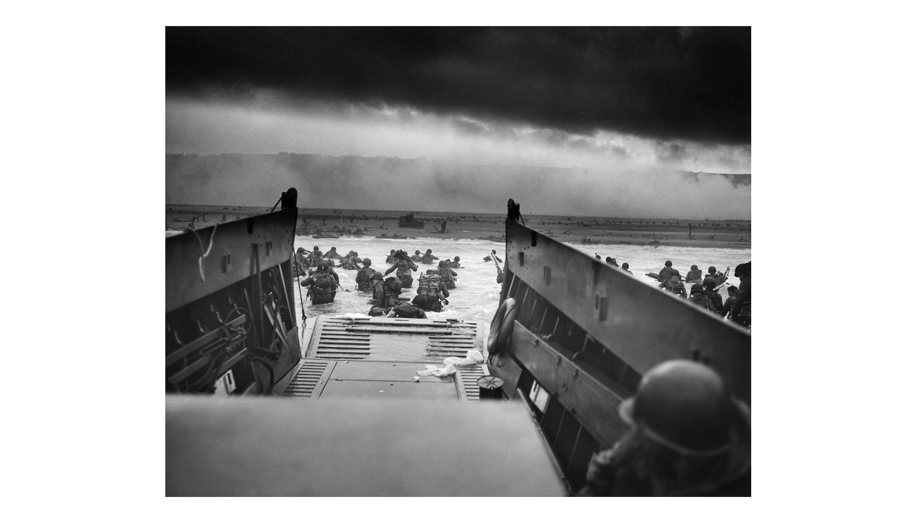
Troops Wade Ashore at Omaha Beach, June 6, 1944
Note: Coast Guard photo.
© More Lessons Less Planning | morelessonslessplanning.com
Notes:
The photographer was standing in the landing craft with the men, which is why we see their backs. Say that out loud: nobody in this picture is posing, and nobody in it knows what is about to happen.
Reference labels (point to these chart features when teaching): Ramp of a landing craft; Wading toward the beach

Slide 9
The Five Beaches
Beach | Landing force | Troops ashore | Casualties June 6
Utah | United States | About 23,000 | About 200
Omaha | United States | About 34,000 | About 2,000
Gold | Britain | About 25,000 | About 400
Juno | Canada | About 21,000 | About 1,200
Sword | Britain | About 29,000 | About 630
Key Concept: Four of the five beaches were taken at close to the expected cost; one was not.
© More Lessons Less Planning | morelessonslessplanning.com
Notes:
Do not solve the arithmetic here. Students meet this exact table again in the Activity, where they have to work with it.

Slide 10
Why Omaha Was the Costly One
What Went Wrong
What Turned It
High bluffs rose 100 feet directly behind the sand
The air bombardment fell inland and missed the defenses
Twenty-seven of 32 swimming tanks sank in rough water
A full-strength German division held the ground above
Small groups climbed the bluffs between the strongpoints
Destroyers came close inshore and fired on the bunkers
Engineers blew gaps in the beach obstacles under fire
By evening the Americans held a thin strip a mile deep
Note: About 2,000 Americans were killed, wounded, or missing at Omaha on June 6.
© More Lessons Less Planning | morelessonslessplanning.com
Notes:
Read the left column, then stop and read the right one. The point is not that Omaha was a disaster; it is that a disaster was turned around by small groups of people making decisions on the sand.

Slide 11
The Landing in Three Words
D-Day
June 6, 1944, the day Allied forces landed on the beaches of Normandy
Normandy
The region of northern France where the Allies came ashore in June 1944
Omaha Beach
The American landing beach where high bluffs made the fighting costliest
Remember: You will use all three of these words again in the Activity packet.
© More Lessons Less Planning | morelessonslessplanning.com
Notes:
D-Day is a date, Normandy is a place, and Omaha is one beach inside that place. Students who keep those three levels straight stop mixing them up on the quiz.

Slide 12
Three Things That Made the Landing Work
Surprise
Firepower
Numbers
Germany expected Calais.
The weather looked wrong.
Rommel was away from the coast.
Warships shelled the defenses.
Allied aircraft owned the sky.
Bridges inland were bombed out.
132,000 troops landed by sea.
Over 5,000 ships crossed.
Supplies followed within days.
In practice: No one of these three would have been enough on its own.
© More Lessons Less Planning | morelessonslessplanning.com
Notes:
Ask which card students would give up if they had to. Nobody gives up firepower, but the honest answer is that removing any one of the three probably loses the beachhead.

Slide 13
From the Beachhead to Paris
June 1944
The five landings joined into one beachhead about 50 miles wide
✔
June-July
Six weeks of hedgerow fighting ground forward toward Saint-Lo
✔
July 25
The breakout began west of Saint-Lo and opened the road out of the hedgerows
✔
August 1944
A German army was trapped in the Falaise pocket and Paris was free on August 25
✔
Note: Paris was free 80 days after the landings, not the few weeks the planners hoped for.
© More Lessons Less Planning | morelessonslessplanning.com
Notes:
The middle two rows are the part students never hear about. Getting ashore took one day; getting out of the hedgerows took six weeks and cost more than the landing did.

Slide 14
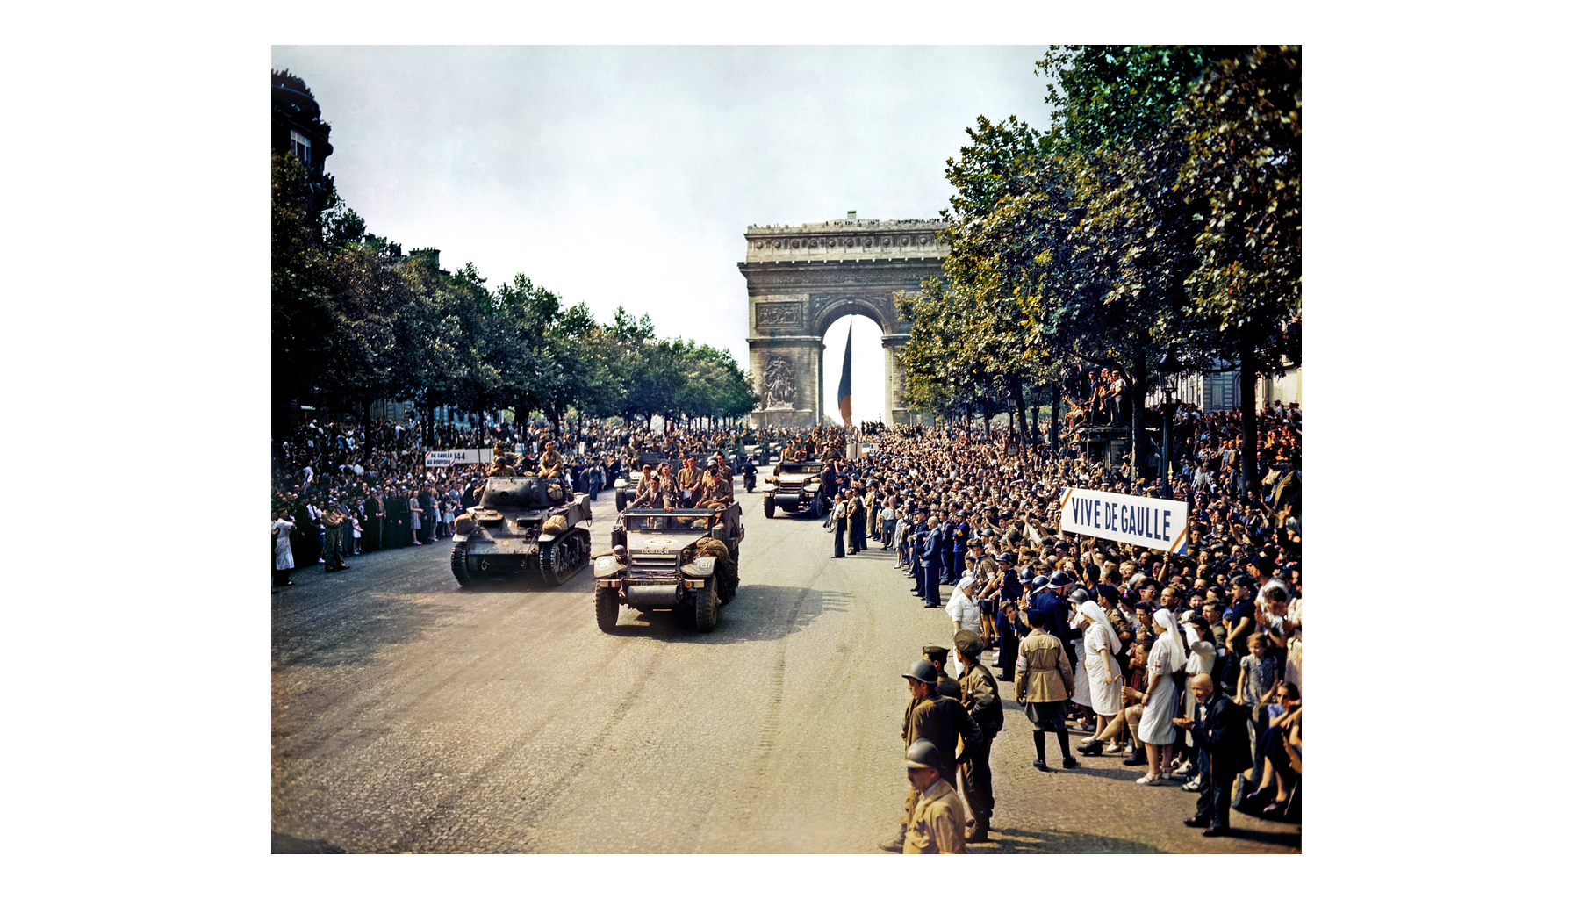
Crowds Fill the Champs-Elysees After Paris Is Freed, August 1944
Note: U.S. OWI photo.
© More Lessons Less Planning | morelessonslessplanning.com
Notes:
Point at the crowds rather than the vehicles, and at the VIVE DE GAULLE banner on the right. Every person on that pavement had lived under German occupation for four years. Say that this is real color film from 1944, not a colorized picture.
Reference labels (point to these chart features when teaching): Crowds along the avenue; Arc de Triomphe behind

Slide 15
D-Day by the Numbers
Measure | Figure
Ships and landing craft | About 5,000
Aircraft flown on June 6 | About 11,000
Troops landed by sea | About 132,000
Troops landed by air | About 23,000
Allied casualties, all forces | About 10,000
Key Concept: About one Allied soldier in fifteen who landed on June 6 became a casualty.
© More Lessons Less Planning | morelessonslessplanning.com
Notes:
The last row is larger than the five beach figures on slide 9 because it counts the airborne landings, the naval losses, and the fighting inland as well as the beaches themselves.

Slide 16
The Liberation in Four Words
Airborne Troops
Soldiers dropped behind enemy lines by parachute or by landing glider
Atlantic Wall
Germany's line of bunkers, guns, and beach obstacles along the coast
Beachhead
A strip of captured enemy shoreline held so more troops can land safely
Liberation of Paris
The Allied and French entry into the French capital on August 25, 1944
Remember: Two of these four words are about getting ashore and two about what came after.
© More Lessons Less Planning | morelessonslessplanning.com
Notes:
Ask students to sort the four into before, during, and after the landing. Doing that sort out loud fixes the sequence better than repeating the definitions does.

Slide 17
The Push Toward Germany
Allied armies crossed France and Belgium in the autumn of 1944.
A German counterattack in the Ardennes was stopped in January 1945.
The Allies crossed the Rhine into Germany in March 1945.
Soviet armies pushed toward Berlin from the east at the same time.
Germany surrendered on May 8, 1945, eleven months after D-Day.
Fact: Freeing Western Europe took eleven months, from the Normandy beaches to the German surrender.
© More Lessons Less Planning | morelessonslessplanning.com
Notes:
This slide is deliberately fast. The Ardennes counterattack, the camps, and the fall of Berlin each get their own lesson later in the unit.

Slide 18
Eisenhower Speaks to the Invasion Force
You are about to embark upon the Great Crusade, toward which we have striven these many months. The eyes of the world are upon you.
— General Dwight D. Eisenhower, Order of the Day, June 6, 1944
Eisenhower issued this order in writing to every soldier, sailor, and airman of the invasion force before the landings began.
Remember: You will read this whole order in Activity Part 4.
© More Lessons Less Planning | morelessonslessplanning.com
Notes:
Frame this as evidence, not as narration. This is what the commander chose to say to men who were about to get into landing craft, and the wording is part of what students are analyzing.

Slide 19
Why D-Day Mattered
The Allies put an army back into Western Europe and kept it there.
Germany now had to fight full-scale wars in the east and the west.
France was freed from four years of German occupation.
The western Allies, not the Soviets, freed France and Belgium.
Eleven months later the war in Europe was over.
Big Idea: D-Day did not win the war by itself, but nothing after it went Germany's way.
© More Lessons Less Planning | morelessonslessplanning.com
Notes:
Bullet four is the one historians argue about hardest, and it is the argument students take a side on in Activity Part 5. Read it slowly.

Slide 20
Key Takeaways
Germany held Western Europe for four years before the Allies landed.
★
Deception convinced Germany the invasion would come at Calais.
★
On June 6, 1944 about 132,000 troops came ashore on five beaches.
★
Omaha cost about ten times what Utah cost on the same morning.
★
Paris was free by August 25 and Germany surrendered in May 1945.
★
© More Lessons Less Planning | morelessonslessplanning.com
Notes:
Ask which takeaway students would defend in the Activity's written verdict. Picking a side out loud makes the paragraph much easier to write.

