Slide 1
Cuneiform: The First Writing
How Mesopotamia invented writing - and how we learned to read it again.
© More Lessons Less Planning | morelessonslessplanning.com
Notes:
Open with the hook. About 5,000 years ago, in the land between the Tigris and Euphrates rivers, people invented something no one had ever had before: writing. But it did not begin with poems or history. It began with accounting - keeping track of sheep, grain, and jars of oil. Today students trace how simple clay tokens grew into full cuneiform script, how scribes wrote it, how the script was lost for centuries, and how 19th-century scholars cracked the code. The lesson ends with the real words of George Smith, who in the 1870s decoded a Babylonian flood story from broken clay tablets.

Slide 2
Learning Targets
Explain how and why writing developed in Mesopotamia, from tokens to cuneiform
★
Describe how cuneiform was written and used - stylus, clay, and scribes
★
Analyze how scholars decoded cuneiform and what it revealed
★
© More Lessons Less Planning | morelessonslessplanning.com
Notes:
Read each target aloud. Target 1 maps to slides 3-6 (the accounting origin and the token-to-cuneiform evolution). Target 2 maps to slides 7-10 (the wedge and stylus, scribes and schools, and what cuneiform recorded). Target 3 maps to slides 11-13 (the loss of the script and the 19th-century decipherment) and drives the Primary Source Spotlight on George Smith. The quiz and activity test all three.

Slide 3
Why Writing Began: The Accounting Problem
The Problem
The Setting
In SUMER, southern MESOPOTAMIA, cities grew large
Temples and traders had to track grain, animals, goods
Human memory could not keep every count straight
They needed a permanent way to record amounts
MESOPOTAMIA = the land between two rivers
The Tigris and Euphrates fed rich farmland
Surplus food built the first cities, like Uruk
More trade meant more records to keep
Key Concept: Writing did not begin with stories - it began as accounting, a way to record how much grain, oil, and livestock people owned and traded.
© More Lessons Less Planning | morelessonslessplanning.com
Notes:
Set up why writing was invented. MESOPOTAMIA means the 'land between the rivers' - the Tigris and Euphrates - where rich farmland produced surplus food. That surplus built the world's first cities in SUMER, the region of southern Mesopotamia, including the great city of Uruk. As cities and trade grew, temples and merchants had to track huge amounts of grain, animals, and goods, and human memory simply could not keep every count straight. They needed a permanent, reliable way to record amounts. That practical accounting problem - not poetry or history - is what drove people to invent writing.

Slide 4
Clay Tokens: The First Records
Clay token
A CLAY TOKEN was a small shaped piece of clay used to count and record goods before writing existed; it was the earliest step toward writing.
One token, one item
Each token stood for one thing - a cone might mean a measure of grain, a sphere a jar of oil
How they were used
Traders and temple officials kept tokens to track what was owed, stored, or shipped
The limitation
Tokens could count things, but they could not record words, names, or ideas
Note: A CLAY TOKEN was a small shaped piece of clay that stood for one item - the very first step from counting toward writing.
© More Lessons Less Planning | morelessonslessplanning.com
Notes:
Introduce the first record-keeping tool. Long before writing, Mesopotamians used the CLAY TOKEN - a small shaped piece of clay used to count and record goods. Each token stood for one item: a cone shape might mean a measure of grain, a sphere might mean a jar of oil, a disk might mean an animal. Traders and temple officials kept collections of these tokens to track what was owed, stored, or shipped. Tokens were a real accounting system, and they were the earliest step toward writing. But they had a hard limit: tokens could count things, but they could not record words, names, or ideas. Solving that limit is the story of the next slides.

Slide 5
From Tokens to Sealed Clay
Sealing the Tokens
The Big Idea
Tokens were sealed inside hollow clay balls
This kept a deal from being changed or cheated
But you had to break the ball to count inside
So they pressed the tokens onto the outside first
The marks on the surface recorded the amount
People realized: the marks alone were enough
The tokens could be dropped - just keep the marks
Big Idea: When people saw that marks pressed in clay could replace the tokens themselves, writing was born - a record made of signs, not objects.
© More Lessons Less Planning | morelessonslessplanning.com
Notes:
Explain the crucial leap from objects to signs. To keep a deal honest, Mesopotamians began sealing tokens inside hollow clay balls, so no one could add or remove tokens after an agreement. But that created a problem: to check the count, you had to break the ball open. The clever solution was to press each token onto the soft outside surface before sealing it in, so the marks on the outside showed what was inside. Then came the breakthrough: people realized the marks alone were enough. You did not need the tokens at all - just the marks pressed into a flat piece of clay. That shift, from three-dimensional objects to two-dimensional signs, is the birth of writing.

Slide 6
Pictographs: Pictures Become Signs
Pictograph
A PICTOGRAPH was an early written sign that was a simple picture of the object it stood for; pictographs came before cuneiform.
Picture of a thing
A drawing of a head of grain meant grain; a drawing of an ox head meant an ox
The next leap
Signs began to stand for SOUNDS, not just objects, so any spoken word could be written
Why it mattered
Once signs stood for sounds, writing could record names, verbs, and whole sentences
Key Concept: A PICTOGRAPH is a picture of a thing. When signs also stood for SOUNDS, writing could capture spoken language.
© More Lessons Less Planning | morelessonslessplanning.com
Notes:
Trace the next stage. The earliest true written signs were PICTOGRAPHS - simple pictures of the objects they stood for. A drawing of a head of grain meant grain; a drawing of an ox head meant an ox. This was a real writing system, but it still mostly recorded things, not language. The crucial next leap was when signs began to stand for SOUNDS, not just objects. Once a sign could represent a sound or syllable, scribes could spell out any spoken word - including names, actions, and abstract ideas that have no picture. That is when writing became able to record real sentences, and the pictographs gradually turned into the wedge-shaped signs of cuneiform.

Slide 7
Cuneiform: The Wedge and the Stylus
What Cuneiform Is
How It Was Made
CUNEIFORM = the world's first writing system
Wedge-shaped marks pressed into wet clay
Developed in Mesopotamia around 3200 BCE
The name means 'wedge-shaped' in Latin
Scribes used a reed STYLUS with a wedge tip
They pressed it into a soft CLAY TABLET
Different wedge patterns made different signs
Baked or dried, tablets lasted thousands of years
Key Concept: CUNEIFORM is wedge-shaped writing pressed into wet clay with a STYLUS - the world's first writing system.
© More Lessons Less Planning | morelessonslessplanning.com
Notes:
Define the central term. CUNEIFORM is the world's first writing system: wedge-shaped marks pressed into wet clay, developed in Mesopotamia around 3200 BCE. The name comes from the Latin word for 'wedge.' Scribes made it with a STYLUS, a reed tool with a wedge-shaped tip, pressed into a soft CLAY TABLET. By combining wedges in different patterns and directions, they could make hundreds of different signs. Wet clay was cheap and everywhere in Mesopotamia, and once a tablet was baked in a fire or dried in the sun it became rock-hard - which is why so many cuneiform tablets have survived for thousands of years for us to read today.

Slide 8
Scribes and Scribal Schools
Scribe
A SCRIBE was a specially trained person who could read and write cuneiform and kept records for temples, palaces, and merchants.
Scribal school (edubba)
The SCRIBAL SCHOOL, or edubba ('tablet house'), was where boys trained for years, copying signs over and over, to become scribes.
Hard to learn
Cuneiform had hundreds of signs, so only a few people ever mastered it
A powerful skill
Because so few could write, scribes held respected, powerful positions in society
Did You Know: A SCRIBE trained for years at a SCRIBAL SCHOOL (edubba) - literacy was a rare, powerful skill.
© More Lessons Less Planning | morelessonslessplanning.com
Notes:
Explain who actually wrote. A SCRIBE was a specially trained person who could read and write cuneiform and kept records for temples, palaces, and merchants. Because cuneiform had hundreds of signs, learning it took years. Boys (and it was almost always boys) attended a SCRIBAL SCHOOL, called an edubba or 'tablet house,' where they copied signs over and over on practice tablets until they mastered them. Very few people ever learned to read and write, which made scribes rare and important. A scribe could get a respected government job, keep the accounts of a temple, or write letters for a king. Literacy was not common like today - it was a specialized, powerful skill held by a small trained class. The next slide shows a real cuneiform tablet, including the kind students practiced on.

Slide 9
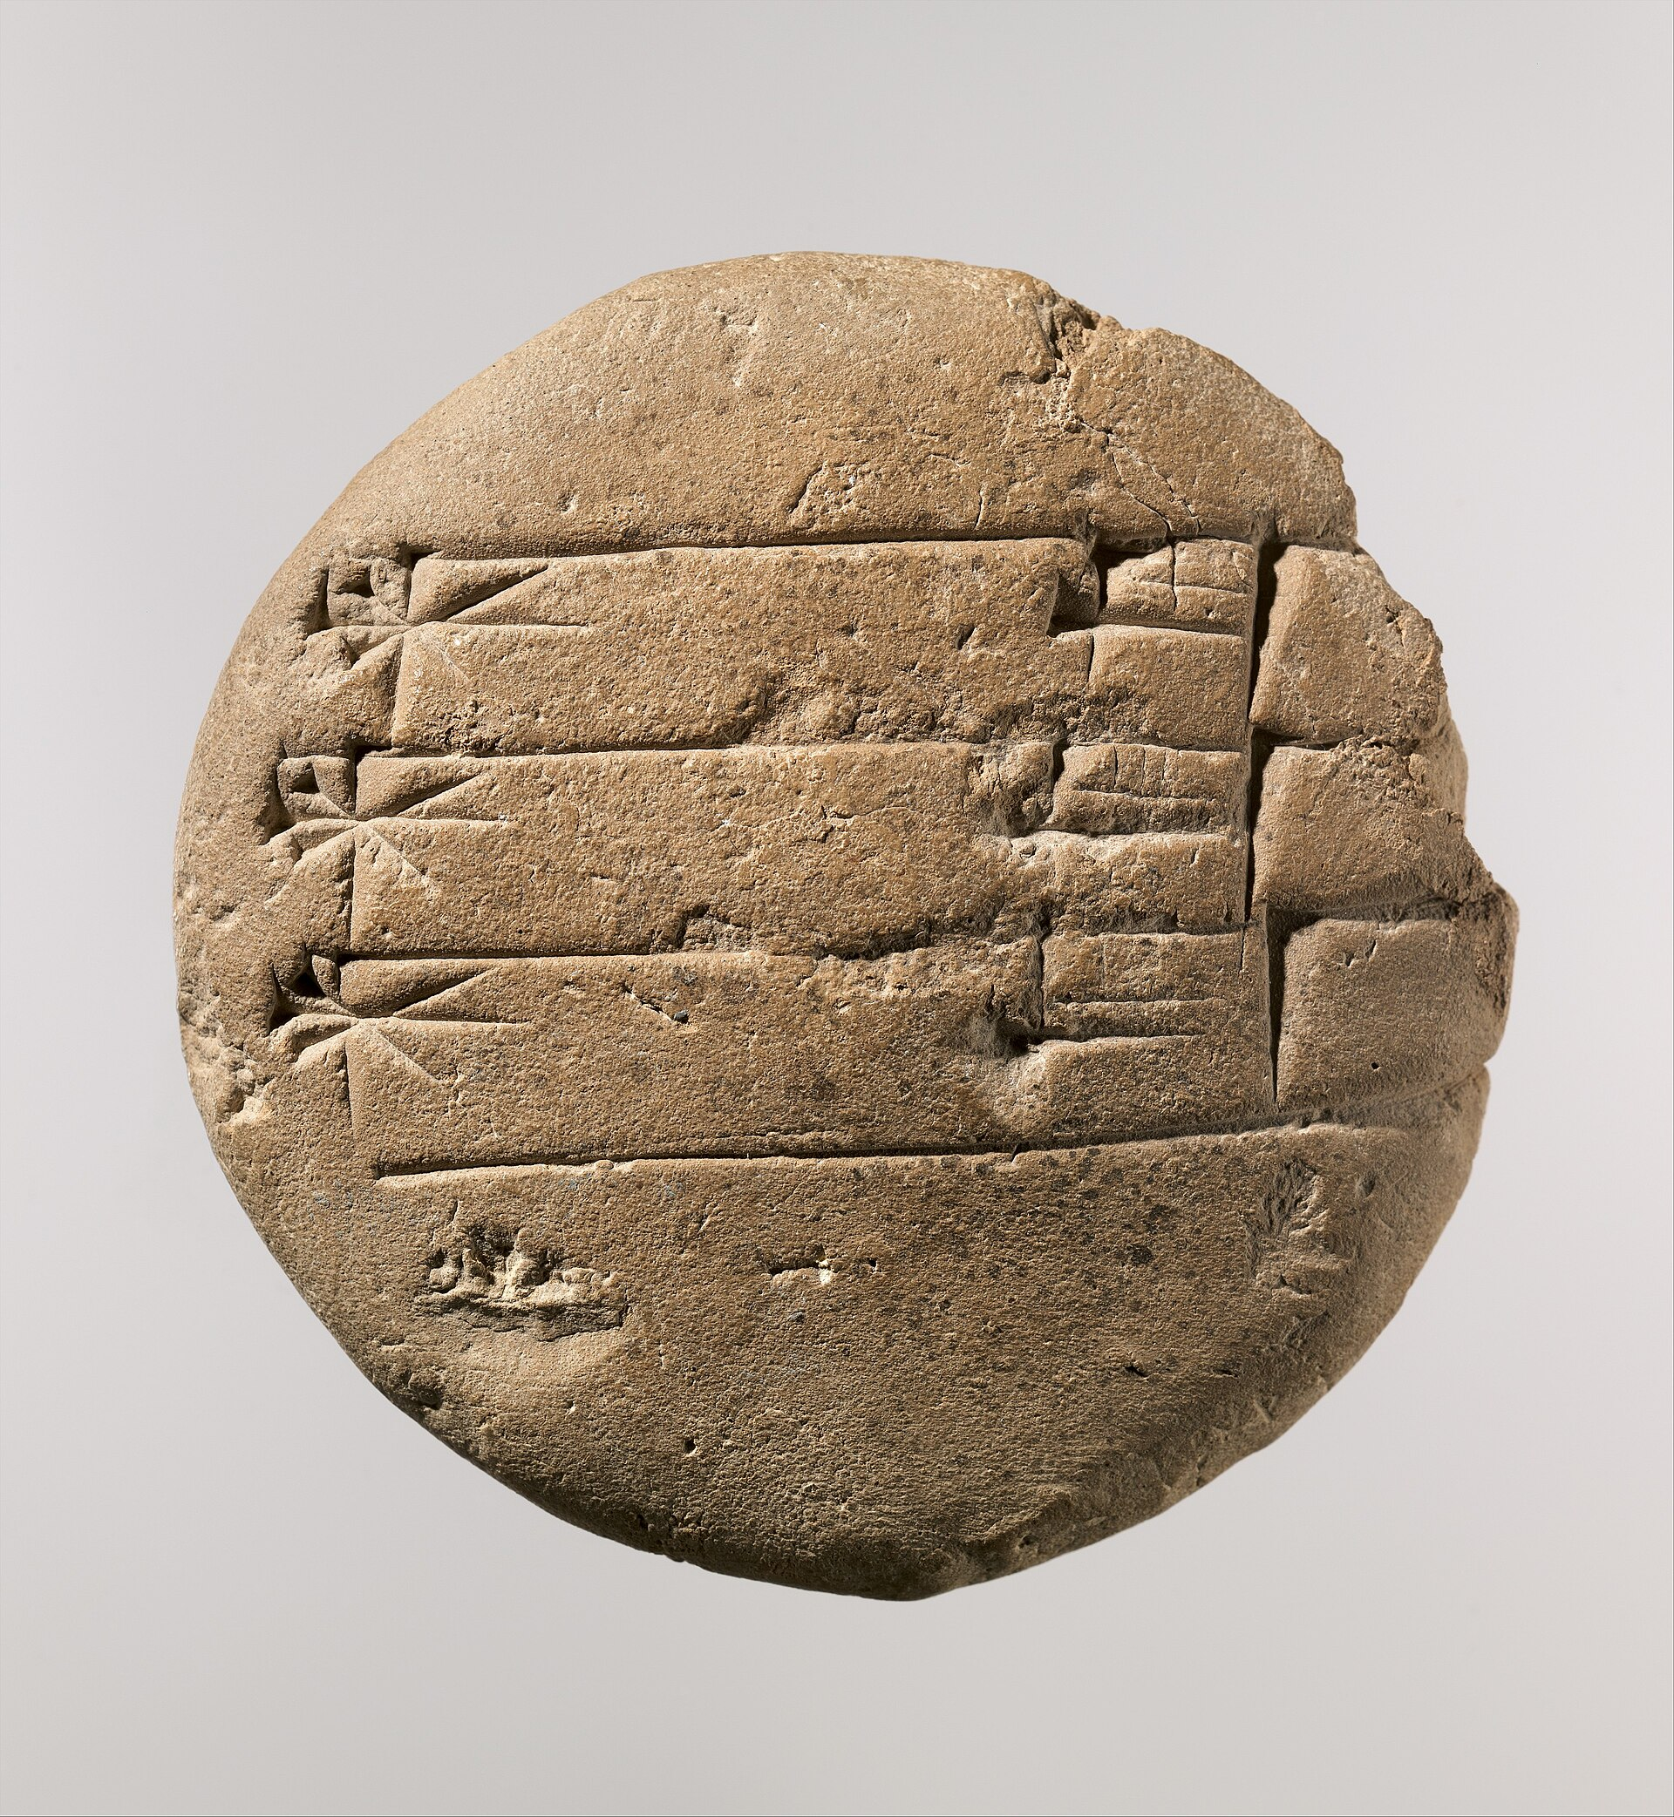
A Real Cuneiform Tablet
A scribe's clay tablet covered in wedge-shaped cuneiform signs
© More Lessons Less Planning | morelessonslessplanning.com
Notes:
Show a real cuneiform tablet. This is an actual clay tablet from ancient Mesopotamia, covered in the wedge-shaped signs of cuneiform - the kind of tablet a scribe or a scribal student would have written. Have students notice the tightly packed rows of little wedge marks. Every one of those signs was pressed into wet clay with a reed stylus, then dried hard. This is what the world's first writing physically looked like: not ink on paper, but wedges in clay. It connects directly to the scribes slide - this is the medium they spent years mastering.
Reference labels (point to these chart features when teaching): wedge-shaped signs; rows of writing

Slide 10
What Cuneiform Recorded
Type of record | Example | Why it mattered
Receipts and accounts | Lists of grain, sheep, and goods | The original reason writing was invented
Laws | Rules and punishments for the city | Everyone could be held to the same written rule
Letters | Messages between kings and officials | People could communicate across distance
Literature | The Epic of Gilgamesh and other stories | The first written poems, myths, and history
Big Idea: Cuneiform started as receipts, but grew to record laws, letters, and even the EPIC OF GILGAMESH.
© More Lessons Less Planning | morelessonslessplanning.com
Notes:
Show how far writing grew from its accounting roots. Cuneiform began as simple RECEIPTS AND ACCOUNTS - lists of grain, sheep, and goods - which was the original reason writing was invented. But once people could record spoken language, they used cuneiform for far more. Cities wrote down LAWS, so everyone could be held to the same written rule. Kings and officials sent LETTERS across long distances. And scribes recorded LITERATURE, including the EPIC OF GILGAMESH, one of the oldest written stories in the world. In just a few centuries, writing went from a bookkeeping tool to the way an entire civilization recorded its rules, its news, and its imagination.

Slide 11
A Script That Was Lost
Cuneiform fades
As new languages and alphabets spread, fewer people learned cuneiform
The last writers
By about 2,000 years ago, the last scribes who could read cuneiform died out
Completely forgotten
For centuries, the wedge marks on ruined tablets were a mystery no one could read
Buried and rediscovered
Cities like Nineveh lay buried until archaeologists dug up thousands of tablets in the 1800s
Note: Cuneiform was so completely forgotten that for centuries no living person could read a single sign.
© More Lessons Less Planning | morelessonslessplanning.com
Notes:
Explain how the script died out. Cuneiform lasted an astonishing 3,000 years, but nothing lasts forever. As new languages and simpler alphabets spread across the ancient world, fewer and fewer people bothered to learn the difficult wedge script. By about 2,000 years ago, the last scribes who could read cuneiform had died out, and the knowledge was completely lost. For centuries afterward, the wedge marks on broken tablets and ruined monuments were a total mystery - beautiful, clearly deliberate, but unreadable. The great Mesopotamian cities like Nineveh lay buried under mounds of earth until European archaeologists began digging them up in the 1800s and pulled out thousands of clay tablets that no one alive could read. Setting up that mystery is what makes the decoding story on the next slide so dramatic.

Slide 12
Cracking the Code: Decoding Cuneiform
Decipherment
DECIPHERMENT is the process of figuring out how to read a lost or unknown script, as 19th-century scholars did with cuneiform.
Behistun Inscription
The BEHISTUN INSCRIPTION was a giant cuneiform inscription carved in three languages that Henry Rawlinson used as a key to decode cuneiform.
Same text, three scripts
Because one language could already be read, scholars used it to work out the others
Years of patient work
Scholars matched signs to sounds one at a time until the wedge script could be read again
Key Concept: DECIPHERMENT means cracking a lost script - the trilingual BEHISTUN INSCRIPTION was the key.
© More Lessons Less Planning | morelessonslessplanning.com
Notes:
Explain how the code was cracked. DECIPHERMENT is the process of figuring out how to read a lost or unknown script. The key breakthrough for cuneiform came from the BEHISTUN INSCRIPTION - a giant text carved high on a cliff in Persia that repeated the same message in three different languages, all written in cuneiform. Henry Rawlinson, a British officer and scholar, copied it down at great personal risk. Because one of the three languages (Old Persian) could partly be worked out, scholars could compare it to the others and slowly match signs to sounds - the same trick that let the Rosetta Stone unlock Egyptian hieroglyphs. It took years of patient, sign-by-sign work by several scholars, but by the mid-1800s cuneiform could finally be read again after nearly 2,000 years of silence.

Slide 13
George Smith and the Flood Tablet
Who He Was
The Flood Tablet
GEORGE SMITH: a self-taught British scholar
Worked with the Nineveh tablets at the British Museum
Taught himself to read cuneiform
Made one of history's great discoveries in 1872
He pieced together broken clay fragments
They told a Babylonian story of a great flood
It matched the flood story people already knew
Part of the EPIC OF GILGAMESH, written long before
Did You Know: In 1872 GEORGE SMITH read a 2,500-year-old Babylonian flood story from broken clay tablets.
© More Lessons Less Planning | morelessonslessplanning.com
Notes:
Introduce the primary-source author. GEORGE SMITH was a self-taught British scholar who worked with the thousands of cuneiform tablets brought from the ruined city of Nineveh to the British Museum. Remarkably, he taught himself to read cuneiform. In 1872, while piecing together broken clay fragments, he realized he was reading a Babylonian account of a great flood - a man warned to build a ship, birds sent out to find dry land - strikingly similar to the flood story already familiar to his audience. The text was part of what we now call the EPIC OF GILGAMESH, written long before. The discovery made Smith instantly famous and showed the world just how much the newly decoded cuneiform could reveal about ancient history. In the activity, students read Smith's own 1876 account of this moment.

Slide 14
Why Cuneiform Matters
What It Gave the World
Why We Can Know It
The first writing system in human history
A way to record law, trade, and knowledge
The first written literature and history
The foundation later writing systems built on
Clay tablets survived for thousands of years
Decoded cuneiform lets us read the actual records
We hear the ancient world in its own words
History began when writing did
Big Idea: Historians say history begins with writing - and writing begins with cuneiform. Decoding it let the ancient world speak.
© More Lessons Less Planning | morelessonslessplanning.com
Notes:
Frame the significance. Cuneiform was the first writing system in human history, and its importance is hard to overstate. It gave people a way to record law, trade, and knowledge; it produced the first written literature and history; and it became the foundation that many later writing systems built on. Just as important, because Mesopotamians wrote on clay that survived for thousands of years, and because 19th-century scholars decoded that clay, we can now read the actual records of the world's first cities - not later legends about them, but their own words: their receipts, their laws, their letters, and their stories. This is why historians often say that history itself begins with writing. Before writing we have only objects and bones; with cuneiform, the ancient world finally speaks for itself.

Slide 15
Key Takeaways
Writing began in MESOPOTAMIA as accounting - clay tokens to track goods
★
CUNEIFORM was wedge-shaped signs pressed into clay with a STYLUS
★
SCRIBES trained for years; cuneiform recorded law, letters, and literature
★
Cuneiform was lost, then DECIPHERED in the 1800s; Smith read a flood story
★
© More Lessons Less Planning | morelessonslessplanning.com
Notes:
Close the lesson. Review the four takeaways aloud. Students should be able to (a) explain that writing began as accounting and trace the token-to-cuneiform evolution, (b) describe how cuneiform was written and who wrote it, (c) explain that the script was lost and then decoded in the 1800s. The activity's Primary Source Spotlight asks them to analyze George Smith's own account of decoding the Flood Tablet - the moment the ancient world spoke again.

