Slide 1
Cryptocurrency: Bitcoin, Ethereum & the Crypto Crash
Crypto in plain English.
© More Lessons Less Planning | morelessonslessplanning.com
Notes:
Open with the hook: 'In November 2021 Bitcoin hit $69,000 and crypto was being called the future of money. One year later Bitcoin was at $16,000 and the second-largest crypto exchange in the world (FTX) had collapsed with $8 billion of customer money missing. So what is cryptocurrency, how does it actually work, and what did the 2022 crash teach us?' This toolkit explains crypto in plain English - blockchain, Bitcoin, Ethereum, centralized exchanges, the 2022 crash, and where crypto stands today. We connect it to Unit 5 themes: trust, intermediaries, and bank runs.

Slide 2
Learning Targets
Explain what cryptocurrency and blockchain are in plain English.
★
Compare Bitcoin and Ethereum on purpose, supply, and consensus mechanism.
★
Trace the 2022 crash and evaluate 'not your keys, not your coins.'
★
© More Lessons Less Planning | morelessonslessplanning.com
Notes:
Read each target aloud. Target 1 is EXPLANATION - blockchain and crypto basics in plain language. Target 2 is COMPARISON - the two largest cryptos (Bitcoin and Ethereum) on three concrete dimensions. Target 3 is EVALUATION - the 2022 crash timeline and the central lesson about custody and trust.

Slide 3
What Is Cryptocurrency?
Digital money recorded on a DECENTRALIZED network, not a bank
First cryptocurrency: Bitcoin, launched January 2009
No central issuer - no Fed, no Treasury, no bank in the middle
Ledger maintained by thousands of computers running open-source code
Transactions are recorded publicly and (mostly) cannot be reversed
Big Idea: Crypto replaces the BANK with a shared LEDGER no institution runs.
© More Lessons Less Planning | morelessonslessplanning.com
Notes:
Define cryptocurrency in plain language. Cryptocurrency is DIGITAL MONEY recorded on a DECENTRALIZED network rather than on the books of a bank or central bank. The first cryptocurrency, Bitcoin, was launched in January 2009 by an anonymous developer using the pen name Satoshi Nakamoto. The defining feature: there is NO CENTRAL ISSUER. No Fed. No Treasury. No bank in the middle. Instead, the ledger is maintained by thousands of independent computers worldwide running the same open-source software and following the same consensus rules. Transactions are recorded publicly and, once confirmed, cannot be reversed - which is very different from a bank transaction that can be charged back. Today there are more than 20,000 cryptocurrencies; Bitcoin and Ethereum together account for the majority of total crypto market value.

Slide 4
Blockchain in Plain English
What a blockchain is
Why it is tamper-evident
A shared digital LEDGER of every transaction
Transactions grouped into BLOCKS in order
Each block has a HASH (digital fingerprint)
Each new block stores the previous block's hash
Change one transaction -> that block's hash changes
The change cascades down the whole chain
Thousands of independent copies disagree
Cheating is effectively impossible
Key Concept: A blockchain is a LEDGER LINKED BY HASHES - tampering breaks every copy.
© More Lessons Less Planning | morelessonslessplanning.com
Notes:
Explain blockchain in plain English. A blockchain is a SHARED DIGITAL LEDGER that records every transaction. Transactions are grouped into BLOCKS in chronological order. Each block has a HASH - a unique digital fingerprint generated from the block's contents. The chain is built by including the PREVIOUS block's hash inside every NEW block. WHY THAT MAKES IT TAMPER-EVIDENT: if anyone tried to change a transaction from, say, six months ago, the hash of that old block would change. That changed hash would no longer match the hash stored in the next block, which would change THAT block's hash, and the change would cascade down the entire chain. Meanwhile, thousands of OTHER computers around the world hold copies of the ORIGINAL chain - so any tampered copy would immediately stick out and be rejected. To successfully cheat, a bad actor would have to rewrite every block from the tampered point forward AND outvote thousands of honest copies AT THE SAME TIME. That is effectively impossible at Bitcoin or Ethereum scale.

Slide 5
Bitcoin: Digital Scarcity
Launched January 2009 - the first cryptocurrency
Designed as DIGITAL SCARCITY - max supply 21 MILLION coins, ever
New coins released on a fixed schedule that HALVES every ~4 years
Consensus mechanism: PROOF OF WORK (miners burn electricity)
Use case today: 'digital gold' - store of value, not daily payments
Big Idea: Bitcoin's 21 million coin hard cap - the original 'digital scarcity' design.
© More Lessons Less Planning | morelessonslessplanning.com
Notes:
Drill Bitcoin's design. Launched January 2009 by Satoshi Nakamoto, Bitcoin is the FIRST cryptocurrency. The design centers on DIGITAL SCARCITY: the total supply is hard-capped at 21 MILLION coins, FOREVER. As of mid-2025, about 19.9 million coins have been mined; the final coin will be issued around the year 2140. New coins are released on a fixed schedule that HALVES every roughly four years (the 'halving') - this controls inflation by predictably tightening new supply over time. Halvings happened in 2012, 2016, 2020, and April 2024. CONSENSUS: Bitcoin uses PROOF OF WORK. Miners run specialized computers competing to solve a cryptographic puzzle; the winner adds the next block and earns the block reward in newly issued Bitcoin. The work is real - it consumes electricity - and that energy cost is the security mechanism that prevents double-spending. USE CASE TODAY: most people who hold Bitcoin treat it like 'digital gold' - a store of value that no central bank can dilute - rather than as cash for daily payments.

Slide 6
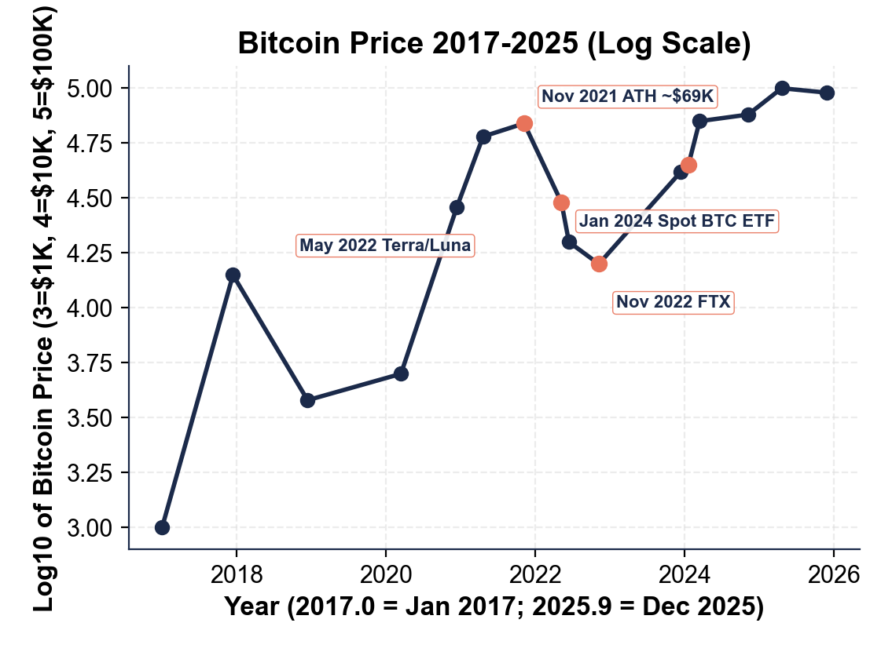
Bitcoin Price 2017-2025 (Log Scale)
Note: log scale
© More Lessons Less Planning | morelessonslessplanning.com
Notes:
Display the Bitcoin price history chart. The y-axis is on a LOG10 scale because Bitcoin price spans roughly two orders of magnitude over this window ($1K in 2017 to about $100K in 2025). On a log scale, equal vertical distance represents equal percentage change - so the 2017 bull run from $1K to $14K and the 2024 rally from $42K to $100K look comparable in size, which they roughly are in percentage terms. Four annotations mark key events. NOV 2021: Bitcoin hits its all-time high near $69,000 amid pandemic stimulus and ETF speculation. MAY 2022: Terra/Luna algorithmic stablecoin collapses, triggering the broader crypto crash. NOV 2022: FTX collapses, marking the trough near $16,000. JAN 2024: SEC approves spot Bitcoin ETFs, kicking off the 2024-2025 rally that pushes Bitcoin past $100,000. Have students notice the dramatic 75 percent peak-to-trough drawdown in 2022 - this kind of volatility is normal in Bitcoin's history.

Slide 7
Ethereum: Programmable Money and Smart Contracts
What Ethereum adds
How it differs from Bitcoin
Launched 2015 by Vitalik Buterin
Programmable blockchain running SMART CONTRACTS
Powers DeFi, NFTs, decentralized exchanges
No hard supply cap (unlike Bitcoin)
Consensus: PROOF OF STAKE since Sept 2022
Validators stake ETH instead of mining
~99.95% less energy than Bitcoin
Use case: digital infrastructure, not gold
Key Concept: Bitcoin is a coin. Ethereum is a COMPUTER that runs self-executing code.
© More Lessons Less Planning | morelessonslessplanning.com
Notes:
Drill Ethereum. Launched in 2015 by Vitalik Buterin (then 21 years old), Ethereum is the SECOND-LARGEST cryptocurrency by market value. The key innovation: Ethereum is a PROGRAMMABLE BLOCKCHAIN. Where Bitcoin only records transfers of Bitcoin, Ethereum can run SMART CONTRACTS - self-executing code stored on the chain that runs automatically when its conditions are met. Smart contracts power the entire DeFi (decentralized finance) ecosystem: decentralized exchanges, lending protocols, NFTs (non-fungible tokens), stablecoins, and more. UNLIKE Bitcoin, Ethereum has no hard supply cap. CONSENSUS DIFFERS TOO: Ethereum switched from proof of work to PROOF OF STAKE in September 2022 (an event called 'The Merge'). Instead of miners burning electricity, validators STAKE ETH (lock it up as collateral); the protocol randomly selects validators to propose blocks. Bad behavior (proposing a fake block) costs the validator their stake - real economic skin in the game without the electricity. Energy use dropped by about 99.95 percent after the Merge. USE CASE: think of Ethereum less as 'digital gold' and more as 'digital infrastructure' - a global computer that runs financial code without permission.

Slide 8
Centralized Exchanges: FTX, Coinbase, Binance
How most people actually buy crypto: through an EXCHANGE
Examples: Coinbase (US), Binance (largest), FTX (collapsed Nov 2022)
Exchanges hold customer funds in POOLED accounts on internal ledgers
If you leave coins on the exchange, the EXCHANGE holds your private key
Convenience cost: you trust the exchange not to fail, freeze, or commit fraud
Big Idea: Centralized exchanges reintroduce the SAME counterparty risk crypto removed.
© More Lessons Less Planning | morelessonslessplanning.com
Notes:
Drill the centralized exchange model. Bitcoin and Ethereum are DECENTRALIZED at the protocol level - but most people do not buy crypto by running their own software. They buy it through a CENTRALIZED EXCHANGE - a company that lets you sign up, deposit dollars, and buy crypto in your web browser. Examples: Coinbase (U.S.-based, publicly traded since 2021), Binance (largest globally), Kraken, and FTX (collapsed November 2022). HOW EXCHANGES WORK: customers deposit dollars and crypto; the exchange holds the funds in POOLED ACCOUNTS and tracks who owns what on an INTERNAL company ledger - not on the public blockchain. When you 'sell Bitcoin' on Coinbase, no Bitcoin actually moves on the chain - Coinbase just updates its internal ledger. WHAT THIS MEANS: when crypto sits on an exchange, the EXCHANGE holds the PRIVATE KEY for those coins, not the customer. The exchange is functioning exactly like a bank - and bringing all the same risks: the exchange could fail, freeze withdrawals, or commit fraud. The 2022 crypto crash was almost entirely a CENTRALIZED EXCHANGE problem. Bitcoin and Ethereum themselves kept producing blocks normally throughout 2022 - the chains never broke. What broke were the companies in the middle.

Slide 9
The 2022 Crash - May, June, November
May 2022: Terra/LUNA/UST collapse
Algorithmic stablecoin breaks $1 peg. ~$40B gone in 1 week.
✔
June 2022: Celsius and 3AC fail
Crypto lender Celsius and hedge fund 3AC: both insolvent.
✔
July 2022: Voyager bankruptcy
Broker Voyager loaned ~$670M to 3AC - dragged down.
✔
November 2022: FTX collapses
FTX freezes withdrawals; ~$8B customer funds missing.
✔
Bitcoin: $69K Nov 2021 -> $16K Nov 2022
Trough about 16 thousand; market lost ~$2 trillion.
✔
Big Idea: The 2022 crash was CONTAGION - losses cascaded across crypto firms.
© More Lessons Less Planning | morelessonslessplanning.com
Notes:
Walk through the 2022 crash chronologically. MAY 2022 - TERRA / LUNA / UST: the trigger. Terra USD (UST) was an algorithmic stablecoin trying to hold a $1 peg through an arbitrage mechanism with its sister coin LUNA. On May 8, 2022, large UST withdrawals broke the peg. The arbitrage mechanism failed and a death spiral began - UST fell from $1 to under $0.10 within days, and LUNA fell from $80 to fractions of a penny. About $40 BILLION of value was destroyed in roughly one week. JUNE 2022 - CELSIUS AND THREE ARROWS CAPITAL: crypto lender Celsius (an unregulated entity offering 10-18% yields on crypto deposits) had heavy LUNA exposure. So did Three Arrows Capital (3AC), a Singapore-based crypto hedge fund. Both became insolvent within weeks of the LUNA collapse. JULY 2022 - VOYAGER DIGITAL: a U.S.-based crypto broker that had loaned about $670 million to 3AC. Voyager filed for bankruptcy after 3AC stopped making payments. NOVEMBER 2022 - FTX: the largest U.S. crypto exchange after Coinbase. On November 2, 2022, news leaked that FTX's sister trading firm Alameda Research held most of its balance sheet in FTX-issued FTT tokens (essentially circular collateral). Customers rushed to withdraw. By November 8 FTX froze withdrawals. By November 11 FTX filed for bankruptcy with about $8 BILLION in customer funds missing. BITCOIN HEADLINE: Bitcoin went from ~$69K in November 2021 to ~$16K in November 2022 - a roughly 75 percent peak-to-trough drawdown. The total crypto market lost about $2 TRILLION in market value.

Slide 10
The FTX Collapse - November 2022
FTX before the fall
What broke
Founded 2019 by Sam Bankman-Fried (SBF)
Peak: $32B valuation, ~$10B/day volume
Major Super Bowl ads (Tom Brady, Larry David)
Sister trading firm: Alameda Research
Alameda held mostly FTX's own FTT token
FTX loaned ~$8B customer deposits to Alameda
Nov 6-8: withdrawal run overwhelmed FTX
Nov 11: bankruptcy; ~$8B in customer money gone
Warning: FTX was a CENTRALIZED exchange run - same mechanics as a classic bank run.
© More Lessons Less Planning | morelessonslessplanning.com
Notes:
Drill the FTX collapse. BEFORE THE FALL: FTX was founded in 2019 by Sam Bankman-Fried, then a 27-year-old former MIT physics student and Jane Street trader. By 2021-2022, FTX was valued at $32 billion, handled about $10 BILLION in daily trading volume, and had won major Super Bowl ads with Tom Brady and Larry David. Sam Bankman-Fried (SBF) was widely profiled as the crypto industry's youngest billionaire. FTX had a SISTER TRADING FIRM, Alameda Research, also founded by SBF. WHAT BROKE: On November 2, 2022, the crypto news outlet CoinDesk published Alameda Research's balance sheet, which showed that the majority of Alameda's assets were FTT - the token issued by FTX itself. In other words, FTX's sister trading firm was holding mostly its own affiliate's tokens as collateral. The next day, Binance CEO Changpeng Zhao announced Binance would sell its FTT holdings. FTT crashed, FTX customers panicked, and a CLASSIC RUN ensued. Customer withdrawal requests overwhelmed the exchange between November 6-8. By November 8 FTX froze withdrawals. By November 11 FTX filed Chapter 11 bankruptcy. INVESTIGATION REVEALED FTX had loaned approximately $8 BILLION of CUSTOMER DEPOSITS to Alameda Research - in direct violation of FTX's terms of service, which stated customer funds would never be lent out. SBF was indicted on seven federal fraud charges, convicted November 2023, and sentenced to 25 years in prison March 2024.

Slide 11
'Not Your Keys, Not Your Coins'
If you hold crypto on an exchange, the EXCHANGE holds the private key
Self-custody: hold the private key yourself in a wallet you control
Removes counterparty risk - but if you lose the key, the coins are gone
FTX customers: ~$8 billion of crypto was effectively gone overnight
Bitcoin and Ethereum protocols never failed - intermediaries did
Key Concept: The 'crypto crash' was a CENTRALIZED INTERMEDIARY crash. Protocols held.
© More Lessons Less Planning | morelessonslessplanning.com
Notes:
Drill the central lesson of the 2022 crash. 'NOT YOUR KEYS, NOT YOUR COINS' is a crypto-industry shorthand for the rule that if you do NOT control the PRIVATE KEY, you do NOT really own the coins. WHAT THIS MEANS IN PRACTICE: when crypto sits on a centralized exchange, the EXCHANGE holds the private key on your behalf. You see a balance on the exchange's website but you do not have direct cryptographic control of the coins. If the exchange fails, freezes, or commits fraud, you are a CREDITOR in a bankruptcy proceeding - not the holder of the coins. SELF-CUSTODY is the alternative: holding your own private key in a wallet you control (a hardware device, a phone app, a written seed phrase). Self-custody REMOVES counterparty risk - no exchange to fail. But it creates a NEW RISK: if you lose the private key (lose the hardware wallet, forget the seed phrase), the coins are gone FOREVER. There is no password reset on a blockchain. FTX OUTCOME: about $8 BILLION of customer crypto was effectively gone overnight when FTX froze withdrawals. Bankruptcy proceedings have recovered some funds through asset sales, but customers waited years to get partial recovery. WHAT IS REMARKABLE: the decentralized PROTOCOLS - Bitcoin and Ethereum - did exactly what they were designed to do throughout 2022. The chains kept producing blocks. The cryptographic guarantees held. What failed were the CENTRALIZED COMPANIES (Terra, Celsius, 3AC, FTX) running on top of and beside those protocols. The lesson is precise: crypto eliminates counterparty risk at the protocol level only.

Slide 12
Where Crypto Stands Today
Bitcoin spot ETFs approved Jan 2024
SEC approved BlackRock, Fidelity, others. >$50B in year 1.
✔
Bitcoin past $100,000 in 2024-2025
Institutional adoption + halving + ETF flows = new ATH.
✔
Ethereum spot ETFs approved May 2024
Smaller flows than BTC ETFs but parallel milestone.
✔
Stablecoin volume rivals Visa
USDC and USDT on-chain volume now rivals or exceeds Visa by some measures.
✔
Regulation still patchwork
SEC enforcement; EU MiCA in effect 2024; state-level US rules.
✔
Key Concept: Crypto is mainstream now - but the rules are still being written.
© More Lessons Less Planning | morelessonslessplanning.com
Notes:
Walk through where crypto stands today (mid-2025). The 2022-2023 crypto winter was followed by a remarkable institutional pivot. BITCOIN SPOT ETFS approved by the SEC on January 10, 2024 - the first ETFs that directly hold Bitcoin and trade on stock exchanges like regular stocks. Major Wall Street firms (BlackRock IBIT, Fidelity FBTC) collectively accumulated more than $50 BILLION in assets within the first year. The ETFs effectively gave traditional investors a familiar wrapper to hold Bitcoin without needing to deal with exchanges or wallets. BITCOIN PAST $100,000: the combination of institutional ETF flows, the fourth halving in April 2024, and the late-2024 macroeconomic environment pushed Bitcoin past $100,000 for the first time in late 2024 and into 2025. ETHEREUM SPOT ETFS approved in May 2024 - smaller flows than Bitcoin ETFs but a parallel institutional milestone. STABLECOINS: dollar-pegged stablecoins like USDC and USDT have become major rails for cross-border payments and crypto trading. By some measures, stablecoin annual on-chain transfer volume now rivals or exceeds Visa's annual card volume - though most of that is automated trading and crypto-to-crypto activity. REGULATION: still a patchwork. The SEC continues to bring enforcement actions against exchanges and projects it argues are unregistered securities. The European Union's MiCA framework (Markets in Crypto-Assets Regulation) came into effect in 2024 and is the most comprehensive regulatory regime so far. In the United States, federal crypto legislation has been debated but not passed; states like New York and Wyoming have their own licensing rules.

Slide 13
Key Takeaways
Crypto = digital money on a decentralized blockchain - no central issuer
Bitcoin = digital scarcity (21M cap, PoW); Ethereum = programmable (PoS)
Centralized exchanges (FTX, Coinbase) reintroduce counterparty risk
2022 crash: Terra (May) -> Celsius/3AC (June) -> FTX (Nov); ~$2T lost
'Not your keys, not your coins' - protocols held, intermediaries failed
Remember: Bitcoin and Ethereum protocols held in 2022. The intermediaries failed.
© More Lessons Less Planning | morelessonslessplanning.com
Notes:
Close the lesson by drilling the five takeaways. Have students recite the crash timeline aloud: 'May Terra, June Celsius, November FTX.' Then drill the core comparison: Bitcoin is digital scarcity. Ethereum is programmable money. These facts will appear on the quiz and the exit ticket. Students will apply them in the activity (Devon Patel, financial-literacy reporter). Close with the central message: the 2022 crash was NOT a failure of the decentralized protocols (Bitcoin and Ethereum kept producing blocks normally throughout). It was a failure of the CENTRALIZED INTERMEDIARIES (Terra, Celsius, 3AC, FTX) - and the same kind of run mechanics that brought down Silicon Valley Bank four months later in March 2023.

