Slide 1
Credit Scores: The Number That Runs Your Life
The 3-digit number that decides whether you get the apartment, the car, and the phone plan.
© More Lessons Less Planning | morelessonslessplanning.com
Notes:
Open with the hook: 'Your credit score is one of the most important numbers in your life - more important than your GPA, more important than your SAT, more important than your salary. It controls whether you can rent an apartment, buy a car, get a cell phone without a $600 deposit, or even get hired for some jobs. And most people graduate high school never knowing how it works.' Set the stakes. Today students learn the five factors that BUILD the score, how the score is used against young adults with no credit history, and how to build credit from scratch with no income and no history.

Slide 2
Learning Targets
Identify the FIVE factors of a FICO score and their weights (35/30/15/10/10).
★
Explain how each factor MOVES a score - what hurts it, what helps it.
★
Apply credit-building strategies a young adult with no credit history can use.
★
© More Lessons Less Planning | morelessonslessplanning.com
Notes:
Read each target aloud. Target 1 is identification - the five factors and their percentages. Target 2 is mechanism - how each factor moves the score up or down. Target 3 is application - what a teen with no credit history can DO this year to start building a score. The activity asks students to do all three: analyze 4 fictional credit profiles, recommend specific improvement moves, and write a personal 12-month credit-building action plan.

Slide 3
What Is a Credit Score (and Why It Controls Your Life)?
A 3-digit number from 300 to 850 that predicts if you will repay borrowed money
Lenders, landlords, and cell phone companies check it before they say yes
Higher score = lower risk = better deals (lower rates, smaller deposits)
Built from your credit report - every loan and card you have ever had
Three credit bureaus track it: Experian, Equifax, and TransUnion
Big Idea: Your credit score is the SHORTHAND lenders use to decide if you are trustworthy. No history = no shorthand = risky by default.
© More Lessons Less Planning | morelessonslessplanning.com
Notes:
Define what a credit score actually IS. A credit score is a 3-digit number between 300 and 850 that predicts how likely you are to pay back borrowed money on time. It is built from your credit report - a detailed history of every loan, credit card, and credit application you have ever had. Three companies (credit bureaus) maintain that report: Experian, Equifax, and TransUnion. Lenders, landlords, cell phone companies, insurance companies, and sometimes even employers check your score before they say yes or no to you. The number functions as SHORTHAND: a bank cannot interview every applicant for a car loan, so it uses the score to predict risk. Higher score = lower predicted risk = better deal for you (lower interest rate, smaller security deposit, lower premiums). Lower score = higher predicted risk = worse deal (higher interest rate, bigger deposit, sometimes outright denial). The cruel part: someone with NO credit history at all looks risky by default - because the bank has no shorthand for you, it assumes the worst.

Slide 4
The FICO Score Basics - 300 to 850
Range | Label | What it gets you
300 - 579 | Poor | Most lenders deny. Highest rates and biggest deposits.
580 - 669 | Fair | Qualifies at WORSE rates. May need a co-signer.
670 - 739 | Good | Most lenders approve at standard rates.
740 - 799 | Very Good | Lower rates. Premium card offers arrive.
800 - 850 | Excellent | Best rates available. Top-tier rewards cards.
Tip: U.S. average FICO is around 717 (Good range). Goal for most adults: stay above 700. Goal for teens building from zero: get to 670+ in 18 months.
© More Lessons Less Planning | morelessonslessplanning.com
Notes:
Walk through the FICO score ranges and what each one ACTUALLY gets you in the real world. POOR (300-579): hard to get approved for anything. If approved for a car loan, expect 15-20 percent interest instead of 5 percent. If approved for an apartment, expect a double security deposit. Cell phone plans often require a $500+ pre-paid deposit. FAIR (580-669): qualifies for most things but at worse rates. Apartments may demand a co-signer. Auto loan rates 9-12 percent. GOOD (670-739): the default 'safe' zone. Most lenders approve at standard rates. Auto loan rates 5-7 percent. Apartments approve with a normal one-month deposit. VERY GOOD (740-799): lower interest rates across the board. Premium credit card offers (Chase Sapphire, Amex Gold) start arriving in the mail. Auto loan rates 4-5 percent. EXCELLENT (800-850): the best rates available anywhere. Top-tier rewards cards. Pre-approval for almost any product. Auto loan rates 3-4 percent. The U.S. average FICO is about 717 (Good range). A realistic goal for an adult is to stay above 700. A realistic goal for a teen starting from zero credit history is to get above 670 within 18 months of opening the first credit account.

Slide 5
The Five Factors and Their Weights
Payment History (35%)
Do you pay your bills ON TIME? The single largest factor. One late payment can drop a score 60-100 points.
Credit Utilization (30%)
How much of your available credit are you using? Keep BELOW 30 percent. Below 10 percent is best.
Length of History (15%)
How long have your accounts been open? Older = better. Do NOT close your oldest card.
Credit Mix (10%)
Variety of credit types - cards (revolving) plus loans (installment). Do not chase the mix; let it grow.
New Credit (10%)
How many new accounts and hard inquiries recently? Opening 3 cards in 30 days looks desperate.
Key Concept: 35 + 30 + 15 + 10 + 10 = 100. Payment history + utilization = 65 percent. Get those two right and the rest matters less.
© More Lessons Less Planning | morelessonslessplanning.com
Notes:
Walk through the FIVE FICO factors and their weights. PAYMENT HISTORY (35%) - the single largest factor. Tracks whether you paid your bills on time, every time. A single 30-day-late payment can drop your score by 60-100 points. CREDIT UTILIZATION (30%) - how much of your available credit you are using right now. If you have a $1,000 limit and a $300 balance, your utilization is 30 percent. Keep this below 30 percent. Below 10 percent is even better. LENGTH OF CREDIT HISTORY (15%) - how long you have had credit accounts open. Older is better. The score uses your oldest account, your newest account, and the average age of all accounts. This is why you should NOT close your oldest credit card - it shortens your history. CREDIT MIX (10%) - the variety of credit types you use. Credit cards (revolving credit) plus loans like a car loan or student loan (installment credit). Lenders like to see you can handle both kinds. Do not open accounts just for the mix; let it grow naturally over time. NEW CREDIT (10%) - how many new accounts you have opened recently and how many hard inquiries are on your report. Opening 3 cards in 30 days looks desperate. Each hard inquiry drops your score 5-10 points and stays for 2 years. The big takeaway: Payment History + Credit Utilization = 65 percent of your score. Get those two right and the other three matter much less.

Slide 6
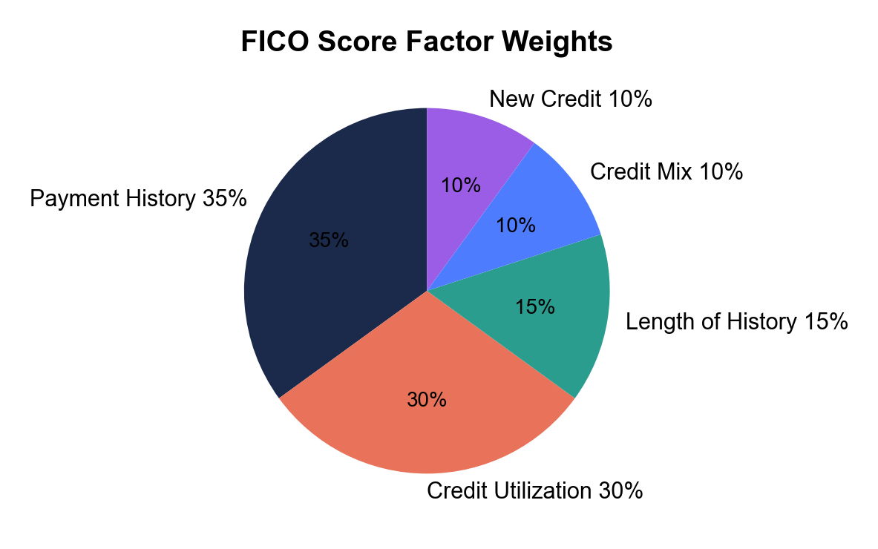
FICO Factor Weights at a Glance
Note: Payment + Utilization = 65 percent of the pie. Fix those two first.
© More Lessons Less Planning | morelessonslessplanning.com
Notes:
Display the FICO factor weights pie chart. Five slices: Payment History 35 percent (largest slice, navy), Credit Utilization 30 percent (second largest, coral), Length of History 15 percent (teal), Credit Mix 10 percent (smaller slice), New Credit 10 percent (smallest slice). The visual makes the dominance of Payment History + Utilization obvious - together they are almost two thirds of the pie. Students should notice the size GAP between the top two slices and the bottom three: this is why payment history and utilization deserve the most attention when building or repairing credit.
Reference labels (point to these chart features when teaching): Payment + Utilization = 65%

Slide 7
Factor 1: Payment History (35%)
What hurts payment history
What helps payment history
Paying a bill 30+ days late: drops score 60-100 points
Account sent to collections: drops score 100+ points
Bankruptcy: drops score 200+ points, stays 7-10 years
Pattern of late payments: compounds the damage
Pay EVERY bill on time, every month, no exceptions
Set up autopay for at least the minimum payment
If you slip, pay BEFORE 30 days late (not reported)
Time heals: late payments fall off after 7 years
Warning: A single 30-day late payment can drop your score by 60-100 points. The damage is BIGGER than most people think. Set up autopay today.
© More Lessons Less Planning | morelessonslessplanning.com
Notes:
Drill the biggest factor in the score - PAYMENT HISTORY at 35 percent. WHAT HURTS: paying a bill 30 or more days late drops your score 60-100 points. An account sent to collections drops your score 100+ points. A bankruptcy drops your score 200+ points and stays on your report for 7 to 10 years. A PATTERN of late payments (3 in a year) is worse than a single late payment - the score model treats repeat offenders harder. WHAT HELPS: pay every bill on time, every month, no exceptions. Set up AUTOPAY for at least the minimum payment on every credit card. If you ever slip and forget a payment, pay it BEFORE you cross the 30-day mark - lenders do not REPORT late payments to the bureaus until you are 30 days past due. A payment that is 5 days late is annoying but not on your credit report. A payment that is 30 days late hits your report hard. Time eventually heals: late payments fall off your credit report after 7 years. The single biggest move you can make to protect a young credit history is to set up autopay on every card the day you open it.

Slide 8
Factor 2: Credit Utilization (30%)
What hurts utilization
What helps utilization
Maxing out a card (100% utilization): crushes the score
Carrying balances above 30% of any single card limit
Closing a card you do not use: shrinks your total limit
High utilization at the MOMENT the bureau reports
Keep total utilization BELOW 30 percent (below 10% is best)
Pay the balance BEFORE the statement date (not just the due date)
Ask for a credit limit INCREASE - same balance, lower utilization
Spread spending across multiple cards instead of one
Big Idea: Utilization = balance / credit limit. $300 on $1,000 limit = 30 percent. Keep this number LOW every month.
© More Lessons Less Planning | morelessonslessplanning.com
Notes:
Drill the second-biggest factor - CREDIT UTILIZATION at 30 percent. Utilization = how much of your available credit you are using right now. Math: balance divided by credit limit. If you have a $1,000 limit and a $300 balance, your utilization is 30 percent. If you have a $1,000 limit and a $900 balance, your utilization is 90 percent (very bad for your score even if you pay it off on time). WHAT HURTS: maxing out a card to 100 percent crushes the score by 50+ points instantly. Carrying balances above 30 percent of any single card limit hurts even if your total utilization is low. Closing a credit card you do not use shrinks your total available credit and can push your utilization up automatically. High utilization at the MOMENT the bureau reports (usually the day after the statement closes) is what gets recorded - not your average for the month. WHAT HELPS: keep total utilization below 30 percent at all times; below 10 percent is even better. PAY THE BALANCE BEFORE THE STATEMENT DATE, not just before the due date - the balance reported to the bureau is the statement balance. Ask the issuer for a credit limit INCREASE (same balance, larger limit = lower utilization) - they often grant this after 6-12 months of on-time payments. Spread spending across multiple cards instead of running one card up.

Slide 9
Factors 3, 4, 5: Length, Mix, New Credit
Length of History (15%)
Credit Mix (10%)
New Credit (10%)
Older = better - keep your oldest card OPEN
Score uses oldest + newest + average age
Closing your first card shortens your history
Teens: history starts with your first card
Variety helps - cards (revolving) plus loans (installment)
Credit card + car loan + student loan = good mix
Do NOT chase mix - let it grow naturally
Student loans count, even while deferred
Each hard inquiry drops score 5-10 points (2 years)
Opening 3+ cards in 30 days = desperate signal
Soft inquiries (checking your own) do NOT count
Rate-shop one car loan within 14 days
Tip: These three are only 35 percent total. Get them roughly right and focus your energy on Payment History + Utilization (the 65 percent).
© More Lessons Less Planning | morelessonslessplanning.com
Notes:
Walk through the three smaller factors. LENGTH OF HISTORY (15 percent): older is better. The score uses your oldest account, your newest account, and the average age of all accounts. Keep your oldest credit card OPEN even if you do not use it - closing it shortens your history and can drop your score. For teens, the clock starts the day you open your first card. CREDIT MIX (10 percent): variety helps. A combination of REVOLVING credit (credit cards) and INSTALLMENT credit (car loans, student loans, mortgages) demonstrates you can handle both kinds. A typical strong mix: one or two credit cards plus a student loan plus a car loan. DO NOT chase mix - never open a car loan you do not need just to improve mix. Let the mix grow naturally over years as you take on real obligations. Student loans count for this category even if they are deferred and not yet in repayment. NEW CREDIT (10 percent): how many new accounts and hard inquiries are on your report. Each HARD INQUIRY (when a lender pulls your full report because you applied for credit) drops your score 5-10 points and stays on your report for 2 years. Opening 3 or more cards in 30 days looks DESPERATE to lenders. SOFT INQUIRIES (when you check your own credit, or a card company pre-qualifies you for an offer) do NOT count and do NOT affect your score. SPECIAL RULE for big purchases: if you rate-shop for ONE car loan or mortgage by applying to multiple lenders within a 14-day window, FICO treats them as ONE inquiry - so you do not get punished for shopping around.

Slide 10
How to Build a Score From Scratch
1. Authorized user on a parent's old card
Their history + on-time payments add to YOUR report.
✔
2. Open a secured card ($200-$500)
Capital One or Discover Secured. Converts to unsecured in 6-12 months.
✔
3. Set up autopay for the full balance
Removes human error. Protects Payment History (35%).
✔
4. Keep utilization under 10 percent
On $500 limit, keep balance under $50. Pay before statement date.
✔
5. Wait 6-12 months before opening more
Length needs time. New Credit penalizes pile-ons.
✔
Big Idea: A teen with no credit can get to a 670+ FICO in 12-18 months using these 5 steps. No income required - just a deposit and patience.
© More Lessons Less Planning | morelessonslessplanning.com
Notes:
The application slide - how a teen with NO credit history at all can build a score from scratch. STEP 1: become an AUTHORIZED USER on a parent or trusted adult's existing credit card. The card's full history (length + on-time payments) gets added to YOUR credit report - even if you never use the card. This is the FASTEST legal way to start a credit history. Only works if the parent's card is in good standing (no late payments). STEP 2: open a SECURED CREDIT CARD. You put down a cash deposit (usually $200-$500) and the issuer gives you a credit limit equal to your deposit. Use it for ONE SMALL recurring bill (Netflix subscription, gas, one tank of gas a month). Capital One Platinum Secured and Discover it Secured are the standard starter cards. After 6-12 months of on-time payments, the issuer often graduates you to a normal unsecured card and returns your deposit. STEP 3: set up AUTOPAY for the full balance the day you open the card. Payment History is 35 percent of your score - autopay removes the human error that destroys credit. STEP 4: keep utilization UNDER 10 PERCENT every month. On a $500 secured card limit, keep your reported balance under $50. If you spend more than that in a month, pay it down BEFORE the statement closes so the bureau records a low balance. STEP 5: WAIT. Do not open more credit cards for at least 6-12 months. Length of History (15 percent) needs time to grow. New Credit (10 percent) penalizes multiple new accounts in a short period. Patience is the cheapest credit-building tool. Following these 5 steps, a teen with zero credit history can typically reach a 670+ (Good) FICO score within 12-18 months.

Slide 11
Key Takeaways
Credit score = 300-850. Higher = lower rates, smaller deposits, more approvals.
Five factors: Payment 35, Utilization 30, Length 15, Mix 10, New Credit 10.
Payment History + Utilization = 65 percent of your score. Fix those first.
30 days late drops your score 60-100 points and stays for 7 years. Use autopay.
Keep utilization under 30 percent (under 10 is best). Pay before statement date.
Build from scratch: authorized user + secured card + autopay + patience.
Remember: Start building credit BEFORE you need it. By the time you need to rent an apartment, it is too late to build a history.
© More Lessons Less Planning | morelessonslessplanning.com
Notes:
Close the lesson by drilling the six takeaways. Have students recite the five factor weights aloud: 'Thirty-five, thirty, fifteen, ten, ten.' Then drill the rule: 'Payment history plus utilization equals 65 percent.' These two facts will appear on the quiz and the exit ticket. Students will apply them in the activity (Credit Score Detective - 4 fictional young-adult profiles + personal action plan). Close with the central message: start building credit BEFORE you need it. By the time you need to rent an apartment or buy a car, it is too late to build a history.

