Slide 1
Cosigning and Co-Borrowing - Sharing the Risk
Cosigning is not a favor without risk: if the borrower misses payments, the full debt and credit damage can become yours.
© More Lessons Less Planning | morelessonslessplanning.com
Notes:
Open with the big idea: cosigning is one of the most misunderstood favors in personal finance. Many people think cosigning just means 'I promise this person is good for it' - but legally, a COSIGNER is 100% responsible for the full loan balance the moment the borrower stops paying. Students follow MARCUS BELL, whose cousin DEVON asks him to cosign an $18,000 auto loan at 9% for 5 years so Devon can buy a car. Marcus wants to help family, but he needs to understand the risk first. This lesson teaches what a cosigner is and does, how it differs from a co-borrower, why the cosigner is fully (not half) responsible - a rule called joint-and-several liability - how the loan shows up on the cosigner's own credit report, and when it is smart to say no. As the eighth toolkit of Unit 5 (Loans & Debt), it protects students from a favor that can quietly wreck their finances.

Slide 2
Learning Targets
Explain what a cosigner is and does, and how it differs from a co-borrower
★
Explain shared liability - why a cosigner is 100% responsible, not half
★
Describe how cosigning affects the cosigner's own credit report
★
Explain the risks of cosigning and decide when to say no
★
© More Lessons Less Planning | morelessonslessplanning.com
Notes:
Read the four targets aloud. Tell students the lesson follows Marcus Bell, who is asked to cosign an $18,000 car loan for his cousin Devon. Target 1 is the definition: a COSIGNER promises to repay a loan if the borrower does not, and usually does not use the money - which is different from a CO-BORROWER, who takes out the loan jointly and shares the money or asset. Target 2 is the core legal idea: SHARED LIABILITY (joint-and-several liability) means the lender can demand the ENTIRE balance from the cosigner, not just half. Target 3 is the CREDIT IMPACT: the loan appears on the cosigner's credit report too, so every late payment or default hurts the cosigner's credit and counts against the cosigner's debt-to-income ratio. Target 4 is the payoff: know the risks and be able to decide when cosigning is smart and when to say no.

Slide 3
Sharing the Risk
Cosigning is a favor with teeth
When you COSIGN, you promise a lender you will repay a loan if the main BORROWER does not - it is a legal promise, not just a good word
✔
You share the risk, not the reward
The cosigner usually does not use the money and is not on the title, but takes on the full risk if the borrower stops paying
✔
Marcus's decision
Devon asks Marcus to cosign an $18,000 car loan at 9% for 5 years; Marcus never drives the car, but his name is on the debt
✔
Why it matters
A cosigner who does not understand the risk can end up paying thousands for a loan they never benefited from, and hurting their own credit
✔
Key Concept: A COSIGNER makes a legal promise to repay a loan if the BORROWER does not - sharing all the risk while getting none of the reward.
© More Lessons Less Planning | morelessonslessplanning.com
Notes:
Set up the whole lesson by framing cosigning as sharing risk. When you COSIGN a loan, you make a legal promise to the lender: if the main BORROWER does not pay, you will. It is a real, enforceable promise, not just telling the bank 'this person is trustworthy.' The catch is that the cosigner shares all the RISK but usually gets none of the REWARD - the cosigner does not use the money and is not on the title (they do not own the car), yet they are on the hook for the debt. Ground it in the scenario: Marcus Bell's cousin Devon asks Marcus to cosign an $18,000 car loan at 9% for 5 years so Devon can buy a car. Marcus never drives that car, but his name is on the loan. Why does this matter? Because a cosigner who does not understand what they signed can end up paying thousands of dollars for a loan they never benefited from - and damaging their own credit in the process. This lesson makes sure students know exactly what cosigning means before anyone ever asks them to do it.

Slide 4
What a Cosigner Does
Cosigner
Co-borrower
Promises to repay the loan ONLY if the borrower does not
Usually does NOT use the money and is NOT on the title
Added because the borrower cannot qualify alone
Still 100% responsible if the borrower stops paying
Takes out the loan JOINTLY and shares the money or asset
Is on the title - a couple buying a car together, for example
Both make the payments and both own what the loan bought
Also 100% responsible for the whole debt
Key Concept: A COSIGNER backs a loan they do not use; a CO-BORROWER shares the loan and the asset - but both are 100% responsible for the full debt.
© More Lessons Less Planning | morelessonslessplanning.com
Notes:
Draw the line between the two roles students confuse. A COSIGNER promises to repay the loan ONLY if the main borrower does not. The cosigner usually does NOT use the money and is NOT on the title - Marcus would not own or drive Devon's car. Lenders add a cosigner when the borrower cannot qualify on their own (too little credit history or income), because the cosigner's stronger credit reassures the lender. But make the key point loud: even though the cosigner gets nothing, they are still 100% responsible if the borrower stops paying. A CO-BORROWER is different: a co-borrower takes out the loan JOINTLY and shares the money or the asset - think of a married couple buying a car together, both on the title, both making payments, both owning the car. A co-borrower is also 100% responsible for the whole debt. The difference students must hold onto: a co-borrower shares the benefit AND the debt, while a cosigner shares only the debt. Either way, both people are fully on the hook - which sets up the next idea, shared liability.

Slide 5
Why Lenders Want a Cosigner
It lowers the lender's risk
A cosigner gives the lender a second person to collect from, so the lender is far more likely to be repaid even if the borrower defaults
✔
It helps a weak borrower qualify
Lenders ask for a cosigner when the borrower has thin credit, low income, or a short history - Devon may not qualify for the car loan alone
✔
The cosigner's credit is the real collateral
The lender is really lending against the COSIGNER's good credit and income, using it to back a borrower who could not get the loan otherwise
✔
That is exactly why it is risky for you
If the lender needs a cosigner to feel safe making the loan, the loan is risky - and that risk is transferred straight to the cosigner
✔
Key Concept: Lenders want a cosigner to LOWER their own risk - which means the loan was risky, and that risk shifts onto the cosigner.
© More Lessons Less Planning | morelessonslessplanning.com
Notes:
Explain the lender's motive so students see the warning sign. Lenders ask for a cosigner to LOWER their own risk: a cosigner gives them a second person to collect from, so they are far more likely to get repaid even if the borrower defaults. Lenders require a cosigner specifically when the borrower is weak on paper - thin credit history, low or unstable income, or a short track record. In the scenario, Devon may not qualify for the $18,000 car loan on his own, which is exactly why he needs Marcus. Here is the insight students should take away: the cosigner's good credit and income are the real COLLATERAL. The lender is essentially lending against Marcus's strong credit to fund a loan for Devon, who could not get it alone. And that leads to the warning sign: if a lender needs a cosigner before it will feel safe making the loan, the loan is risky by definition - and cosigning transfers that risk straight onto you. When someone asks you to cosign, the request itself is a signal that a professional lender looked at the borrower and decided they needed a backup. That should make any potential cosigner think hard.

Slide 6
The Cosigner Is Fully Liable
Shared liability, not split
SHARED (joint-and-several) LIABILITY means the lender can demand the ENTIRE balance from either person - a cosigner owes 100%, not half
The default scenario
Devon makes 12 payments, then loses his job and stops; the unpaid balance is $15,015.09 that the lender can now collect
Marcus owes the whole thing
The lender can demand the full $15,015.09 from Marcus - not half ($7,507.55) - and usually pursues the cosigner because that is the point
The 'half' idea is a myth
Many people think a cosigner owes 50%; the lender does not split the debt - it collects the whole balance from whoever it can
Key Concept: SHARED LIABILITY means the cosigner owes the FULL balance, not half - if Devon defaults, Marcus can be forced to pay all $15,015.09.
© More Lessons Less Planning | morelessonslessplanning.com
Notes:
Teach the single most important - and most misunderstood - idea in the lesson: the cosigner is 100% liable. The legal rule is SHARED LIABILITY, also called joint-and-several liability: when two people are on one loan, the lender can demand the ENTIRE balance from EITHER person. A cosigner owes 100% of the debt, not half. Walk the default scenario. Devon makes 12 payments on the $18,000 loan, then loses his job and stops paying. At that point the unpaid balance is $15,015.09. Because Marcus cosigned, the lender can now demand the full $15,015.09 from Marcus - not half, not $7,507.55, the whole thing - and lenders usually go straight after the cosigner, because collecting from the cosigner is the entire reason they wanted one. Kill the myth directly: many people believe a cosigner is only responsible for 'their half.' That is false. The lender does not split the debt; joint-and-several liability lets it collect the full balance from whoever it can reach. The next slide shows this as a chart so students can see that the borrower's bar and the cosigner's bar are the same full amount, while the 'half' bar is just a myth.

Slide 7
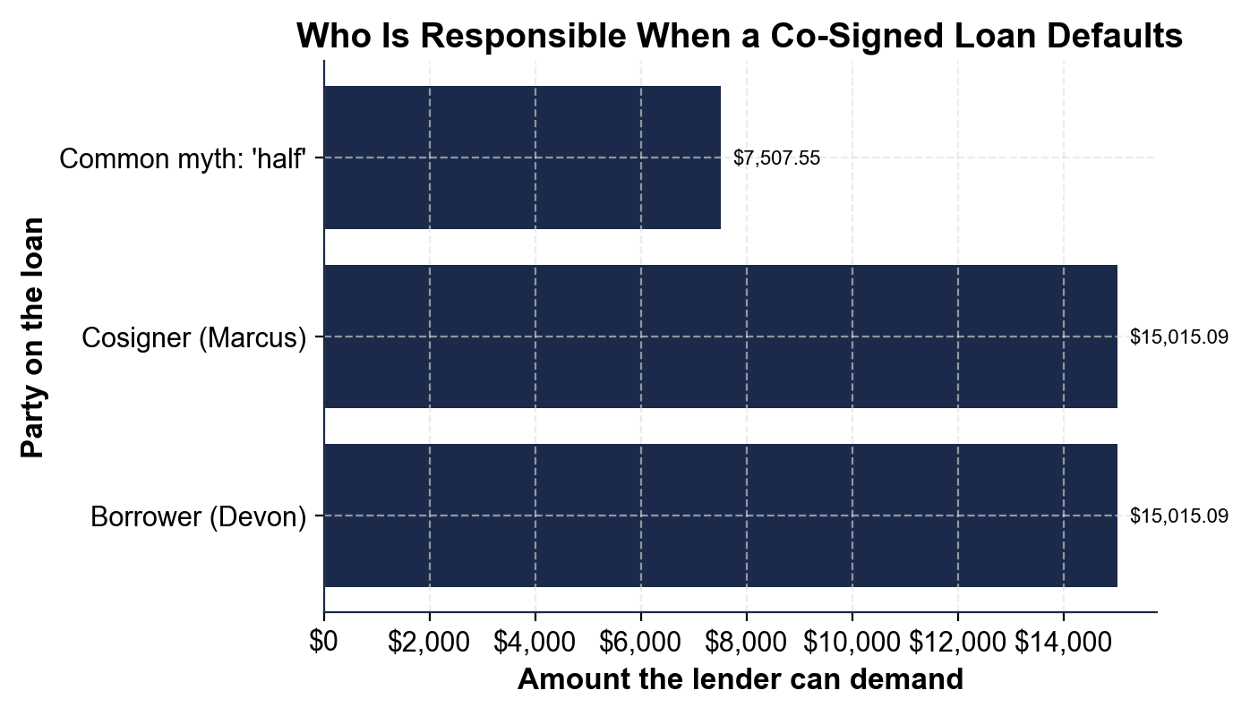
Who Is Responsible When a Co-Signed Loan Defaults
Borrower and cosigner each owe the full $15,015.09 - not half.
© More Lessons Less Planning | morelessonslessplanning.com
Notes:
Have students read the bar chart. Each bar shows how much of Devon's $15,015.09 unpaid balance that party can be forced to pay after the default. The Borrower (Devon) bar and the Cosigner (Marcus) bar are the SAME full height - $15,015.09 - because under joint-and-several liability both are 100% responsible for the entire balance. The third bar, labeled the common myth 'half' ($7,507.55), is shorter to show what people wrongly assume a cosigner owes. The picture makes the lesson obvious: the lender does not cut the debt in half between the two signers; it can collect the whole balance from either one, and usually goes after the cosigner. This is the chart Activity Part 3 reads.
Reference labels (point to these chart features when teaching): Borrower: $15,015.09; Cosigner: $15,015.09

Slide 8
Impact on the Cosigner's Credit
It Is on Your Credit Report
It Counts Against You
The cosigned loan appears on BOTH people's credit reports
Every late payment the borrower misses hurts the cosigner's credit
A default can drop the cosigner's credit score sharply
The cosigner often does not find out until the damage is done
The loan's payment counts in the cosigner's DEBT-TO-INCOME ratio
That can block the cosigner from their own car loan or mortgage
You can rarely get out - a RELEASE CLAUSE is uncommon
You look like you owe $18,000 even though you never spent a cent
Key Concept: A cosigned loan lives on the cosigner's own credit report and DEBT-TO-INCOME ratio - the borrower's mistakes become yours.
© More Lessons Less Planning | morelessonslessplanning.com
Notes:
Show students the quieter cost that hits even when nothing dramatic happens. First, the CREDIT IMPACT: the cosigned loan appears on BOTH people's credit reports. Every time Devon makes a late payment, it lands on Marcus's credit report too, and a default can drop Marcus's score sharply. Worse, the cosigner often does not find out about the missed payments until the damage is already done, because the borrower is the one getting the bills. Second, the DEBT-TO-INCOME hit: the loan's monthly payment counts in Marcus's DEBT-TO-INCOME RATIO - the share of his monthly income that goes to debt payments - and, because he is legally on the hook, lenders treat him as if he owes the whole $18,000. Even though Marcus never spent a cent of it, that treatment can block him from getting his own car loan or mortgage when he needs one. And getting out is hard: a RELEASE CLAUSE, which would let a cosigner be removed after the borrower makes a set number of on-time payments, is uncommon and often has strict conditions. The takeaway: cosigning is not a one-time favor you can forget about - it lives on your credit report and your borrowing power for the entire life of the loan.

Slide 9
When to Say No
Only cosign what you could repay yourself
If you could not comfortably pay the full loan on your own, do not cosign it - because you might have to pay all $15,015.09 that is left
✔
Say no if the borrower's history worries you
If the borrower has a pattern of missed payments or unstable income, the lender's caution is your warning too - politely decline
✔
Protect your own goals first
If cosigning would raise your debt-to-income ratio and block your own car loan or mortgage, your future comes first
✔
If you do cosign, protect yourself
Get copies of every statement, ask for online access to watch for late payments, and ask whether a release clause is possible
✔
Key Concept: Only cosign a loan you could afford to repay yourself, for someone you trust to pay - and if you do, watch the account closely.
© More Lessons Less Planning | morelessonslessplanning.com
Notes:
Give students a clear decision rule they can actually use. Rule one: only cosign an amount you could comfortably repay entirely on your own, because you really might have to - if Devon defaults, Marcus could owe the full $15,015.09. If paying that off yourself would hurt, that is a no. Rule two: say no if the borrower's history worries you. If the borrower has a pattern of missed payments or unstable income, remember that a professional lender already flagged them as risky - that caution is your warning too, and it is okay to politely decline. Rule three: protect your own goals first. If cosigning would push up your debt-to-income ratio and block your own future car loan or mortgage, your own plans come first - saying no is not selfish, it is responsible. Rule four: if you decide to cosign anyway - sometimes for close family it is the right call - protect yourself. Get copies of every statement so you know if a payment is missed, ask the lender for online access to the account, and ask up front whether a release clause is possible so you have a path out. Frame the whole slide as empowerment: students are not being told 'never cosign,' they are being told to cosign with their eyes open.

Slide 10
Scenario: Should You Cosign?
Marcus's Situation
Weigh It Out
Devon needs a cosigner for an $18,000 car loan at 9%
Devon has missed payments before and has an unstable income
Marcus is saving for his own mortgage in two years
If Devon defaults, Marcus owes the full $15,015.09 balance
Could Marcus repay the whole loan himself? That is the real test
The loan's payment would raise Marcus's debt-to-income ratio
That could block Marcus's own mortgage in two years
A cautious answer: say no, or offer a smaller cash gift instead
Key Concept: Apply the rules - given Devon's history and Marcus's mortgage goal, cosigning the full risk is likely a no; there are safer ways to help.
© More Lessons Less Planning | morelessonslessplanning.com
Notes:
Pull the whole lesson together by walking the real decision, the way students will in Activity Part 5. Lay out Marcus's situation: Devon needs a cosigner for an $18,000 car loan at 9%; Devon has missed payments before and has an unstable income; Marcus is saving to buy his own home in two years; and if Devon defaults, Marcus is on the hook for the full $15,015.09 remaining balance. Now weigh it against the rules from the last slide. The real test - could Marcus comfortably repay the entire loan himself if he had to? If not, that alone is a strong reason to decline. Next, the loan's payment would raise Marcus's debt-to-income ratio (and lenders would treat him as owing the whole $18,000), and that could block the mortgage he is planning to get in two years - so cosigning could cost Marcus his own goal. Given Devon's shaky history and Marcus's own plans, a cautious, defensible answer is to say no to cosigning - and to offer a safer way to help instead, like a smaller one-time cash gift Marcus can actually afford, helping Devon find a cheaper car, or helping Devon build his own credit first. The point students should leave with: saying no to cosigning is not the same as refusing to help - it is choosing a way to help that does not put your own finances at risk.

Slide 11
Key Takeaways
A COSIGNER repays the loan if the borrower does not - and gets no reward
★
A CO-BORROWER shares the money and the asset; both signers are 100% responsible
★
SHARED LIABILITY: the cosigner owes the FULL balance, not half ($15,015.09)
★
The loan hits the cosigner's own CREDIT REPORT and debt-to-income ratio
★
Only cosign what you could repay yourself - and it is okay to say no
★
© More Lessons Less Planning | morelessonslessplanning.com
Notes:
Read each takeaway and connect it to the learning targets. T1 (define) -> a COSIGNER promises to repay a loan if the borrower does not, usually without using the money, so they share the risk but not the reward; a CO-BORROWER takes the loan jointly and shares both the money and the asset, and both signers are 100% responsible. T2 (shared liability) -> SHARED LIABILITY (joint-and-several) means the lender can demand the FULL balance from the cosigner, not half - if Devon defaults after 12 payments, Marcus can be forced to pay all $15,015.09. T3 (credit impact) -> the cosigned loan appears on the cosigner's own credit report and counts in their debt-to-income ratio, so the borrower's late payments become the cosigner's problem and can block the cosigner's own future loans. T4 (risks and saying no) -> only cosign an amount you could comfortably repay yourself, for someone you trust to pay, and it is okay - often wise - to say no and help in a safer way instead. The spine of the lesson: cosigning is a legal promise to take on someone else's full debt and risk, so treat the decision as seriously as taking out the loan yourself.

