Slide 1
Consumer Rights: When a Purchase Goes Wrong
The third lesson of Unit 10 - learn your rights when a purchase goes wrong and the steps that get your money back.
© More Lessons Less Planning | morelessonslessplanning.com
Notes:
This is the third lesson of Unit 10 (Smart Consumer & Financial Safety). Sooner or later every shopper hits it: the item arrives broken, never shows up, or is not what was promised, and the seller stops answering. This lesson teaches students what their consumer rights are, how refunds, returns, and warranties work, how a credit card chargeback reverses a bad charge, how to file a complaint with the FTC, and when small claims court is the last resort. Everything is worked through the persona Marcus Reed, a consumer-rights advisor at a community help desk, and the recurring case of Leah, whose $180 headphones arrived broken and whose seller has gone silent. By the end, students can climb the escalation ladder one step at a time to fix a bad purchase.

Slide 2
Learning Targets
Explain what your consumer rights are when a purchase goes wrong
★
Describe how refunds, returns, and warranties protect a buyer
★
Use the escalation ladder to pick the right step to fix a bad purchase
★
File a chargeback or FTC complaint; small claims court is the last resort
★
© More Lessons Less Planning | morelessonslessplanning.com
Notes:
Read the four targets and connect them to the arc of the lesson. Target 1 is the foundation: know what your consumer rights are when a purchase goes wrong. Target 2 covers the everyday tools: refunds, returns, and warranties that protect a buyer. Target 3 is the core skill: use the escalation ladder to pick the right step - starting with the seller and moving up only if you must. Target 4 covers the heavier tools: file a chargeback with your card, file a complaint with the FTC, and know that small claims court is the last resort. By the end, students can fix a bad purchase without getting stuck.

Slide 3
When a Purchase Goes Wrong
Consumer rights
CONSUMER RIGHTS are the protections a buyer has when a purchase goes wrong
When it goes wrong
A purchase goes wrong when an item arrives broken, never arrives, or is not what was described
Receipt (proof of purchase)
A RECEIPT (proof of purchase) is the record that shows what you bought, when, and for how much
Proof wins disputes
Keep every receipt, order number, and message, because proof is what wins a dispute
Key Concept: CONSUMER RIGHTS are the protections a buyer has when a purchase goes wrong - and your RECEIPT is the proof that backs them up.
© More Lessons Less Planning | morelessonslessplanning.com
Notes:
Frame the whole lesson. CONSUMER RIGHTS are the protections a buyer has when a purchase goes wrong - the law and store policies are on your side more than most shoppers realize. Name the three ways a purchase 'goes wrong': the item arrives broken or defective, it never arrives at all, or it is not what was described (wrong size, fake, or missing features). Then teach the one habit that backs up every right: a RECEIPT (proof of purchase) is the record that shows what you bought, when, and for how much - keep every receipt, order confirmation, order number, and message with the seller, because proof is what wins a dispute. Introduce the running case: Leah bought $180 headphones online that arrived with a cracked earcup, and the seller has stopped answering - she has a right to a fix, and her order confirmation is her proof. Key terms - Consumer rights: the protections a buyer has when a purchase goes wrong. Receipt (proof of purchase): the record of what you bought, when, and for how much.

Slide 4
Your Basic Consumer Rights
The right to what you paid for
You have a right to get the product you actually paid for, working and as described
The right to a refund or fix
If a product is broken, missing, or not as described, you have a right to a refund, replacement, or repair
Warranty
A WARRANTY is a company's promise to repair or replace a product that breaks within a set time
Return policy
A RETURN POLICY is a store's rules for when and how you can bring an item back
Key Concept: You have a right to what you paid for; a WARRANTY promises a repair or replacement, and a RETURN POLICY sets the rules for returns.
© More Lessons Less Planning | morelessonslessplanning.com
Notes:
Teach the specific rights every buyer has. First, the core right: you have a right to get the product you actually paid for - working, complete, and as described - not a broken, fake, or missing version. Second, the remedy: if a product is broken, missing, or not as described, you have a right to a refund, a replacement, or a repair. Then teach the two tools that spell those rights out. A WARRANTY is a company's promise to repair or replace a product that breaks within a set time (for example, a one-year warranty on Leah's headphones) - so a defect that shows up inside the warranty period gets fixed for free. A RETURN POLICY is a store's rules for when and how you can bring an item back (the deadline, condition, and whether you need a receipt) - so before you buy, and especially before you complain, know the policy. Tie it to the case: Leah's headphones arrived broken, so both her return policy and any warranty give her a right to a refund or replacement. Key terms - Warranty: a promise to repair or replace a product that breaks in a set time. Return policy: a store's rules for bringing an item back.

Slide 5
Refunds and Returns
Refund
A REFUND is getting your money back for a returned or defective product
✔
Return window
Most return policies give you a return window - a set number of days to bring an item back
✔
Keep it returnable
To return an item you usually need the receipt and the item in its original, unused condition
✔
Start with the seller
For a refund or return, always start by contacting the seller - most problems are fixed at this first step
✔
Key Concept: A REFUND gets your money back - start with the seller, inside the return window, with your receipt and the item in original condition.
© More Lessons Less Planning | morelessonslessplanning.com
Notes:
Teach the everyday fix most bad purchases need. A REFUND is getting your money back for a returned or defective product - the most common remedy when something goes wrong. Teach the three things that make a return actually work. First, the return window: most return policies give you a set number of days (often 14, 30, or 90) to bring an item back, so act quickly. Second, condition and proof: to return an item you usually need the receipt (or order confirmation) and the item in its original, unused condition - defective items are the exception, since a broken product does not have to be 'unused.' Third, and most important for the whole lesson: for a refund or return, always START by contacting the seller. Most problems are fixed at this very first step - a quick, polite message explaining the problem and asking for a refund or replacement. Tie it to the case: Leah's first move is to email the seller, attach her order confirmation and a photo of the cracked earcup, and ask for a refund or replacement. Key term - Refund: getting your money back for a returned or defective product.

Slide 6
The Escalation Ladder
Escalation ladder
The ESCALATION LADDER is the step-by-step order for fixing a bad purchase, from contacting the seller up to court
✔
Climb one rung at a time
Start at the bottom (contact the seller), and move up only if the step below did not fix the problem
✔
The six rungs
1 contact the seller, 2 escalate to a manager, 3 credit card chargeback, 4 FTC complaint, 5 state office / BBB, 6 small claims court
✔
Lower is faster
The lower rungs are the fastest and easiest, so start there - jumping straight to court just costs you weeks
✔
Key Concept: The ESCALATION LADDER puts the fixes in order - contact the seller first and climb one rung at a time up to small claims court.
© More Lessons Less Planning | morelessonslessplanning.com
Notes:
This is the core skill of the lesson: the ESCALATION LADDER - the step-by-step order for fixing a bad purchase, from the simplest, fastest step up to the most formal. Teach the rule: climb ONE rung at a time, starting at the bottom, and move up only if the step below did not fix the problem. Walk the six rungs students will use all lesson: (1) contact the seller and ask for a refund, return, or replacement; (2) escalate to a manager or customer service if the front line says no; (3) dispute the charge with your credit card - a chargeback; (4) file a complaint with the FTC (and your state consumer office); (5) file with the state consumer protection office or the Better Business Bureau; (6) small claims court, the last resort for a money dispute. Make the payoff explicit with the chart on the next slide: the lower rungs are by far the fastest - contacting the seller typically resolves in about 3 days, while small claims court takes about 90 - so you start low and escalate only if you must. Jumping straight to court when a quick refund request or a chargeback would work just costs you weeks. The next slide shows a chart of how long each rung typically takes; Activity Part 4 reads it. Key term - Escalation ladder: the step-by-step order for fixing a bad purchase.

Slide 7
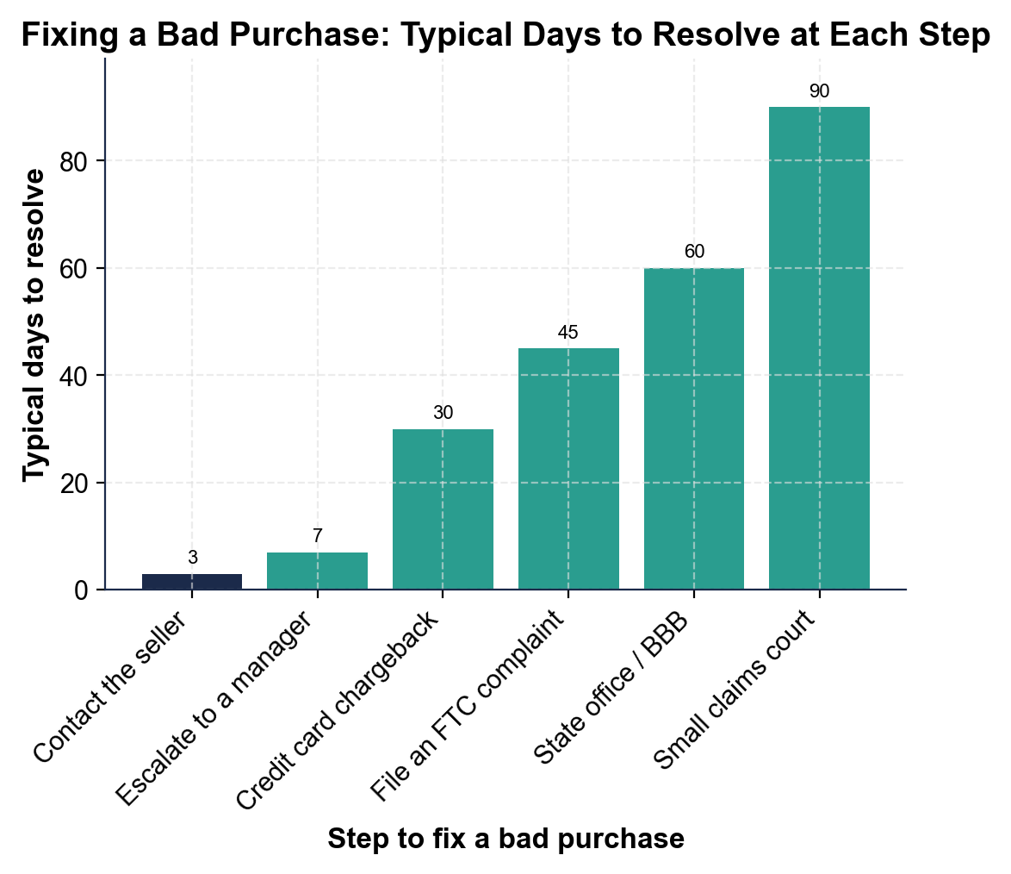
Fixing a Bad Purchase: Typical Days to Resolve at Each Step
Contact the seller (3 days) is fastest; small claims court (90) is slowest.
© More Lessons Less Planning | morelessonslessplanning.com
Notes:
Give students a moment to read the six bars before discussing. The bar chart shows how long each step of fixing a bad purchase typically takes, in days: Contact the seller 3, Escalate to a manager 7, Credit card chargeback 30, File an FTC complaint 45, State office / BBB 60, Small claims court 90. Work the takeaways live. Contacting the seller is by far the fastest step at about 3 days - the shortest bar - which is exactly why it is rung 1: you start there. Small claims court is the tallest bar at about 90 days - the slowest, which is why it is the last resort. The difference between the slowest step (90) and the fastest (3) is 87 days. Small claims court (90) takes 3x as long as a chargeback (30), and a chargeback (30) takes 10x as long as simply contacting the seller (3). Drive the pattern home: the bars rise as you climb the ladder, so every rung up costs more time - start low and escalate only if you must. Note that these are ALTERNATIVE steps you climb one at a time, so we never add the bars to a total; we read, rank, and compare them. This is the chart Activity Part 4 reads. These are illustrative, rounded teaching figures, not exact official timelines.
Reference labels (point to these chart features when teaching): Contact seller: 3 days; Small claims: 90 days

Slide 8
Chargebacks
Chargeback
A CHARGEBACK is asking your credit card company to reverse a charge for a bad purchase
Dispute
To DISPUTE is to formally challenge a charge or a seller's decision
When to use it
Use a chargeback when the item never arrived, arrived broken, or was not as described - and the seller will not fix it
Why cards are powerful
A credit card gives you chargeback protection that cash and debit often do not, so a card is safer for big or risky buys
Key Concept: A CHARGEBACK asks your credit card company to reverse a charge for a bad purchase - a strong way to DISPUTE a seller who will not fix it.
© More Lessons Less Planning | morelessonslessplanning.com
Notes:
Teach the most powerful everyday tool on the ladder. A CHARGEBACK is asking your credit card company to reverse a charge for a bad purchase - your card company pulls the money back from the seller and puts it on your side of the fight. Pair it with the term for the action: to DISPUTE is to formally challenge a charge or a seller's decision, and filing a chargeback is one way to dispute. Teach when a chargeback is the right rung: use it when the item never arrived, arrived broken, or was not as described AND the seller will not fix it after you have contacted them - it is rung 3, after the seller and a manager, not your first move. Make the bigger money lesson explicit: a credit card gives you chargeback protection that cash and debit cards often do not, which is exactly why paying by credit card is safer for big or risky purchases (like Leah's $180 online headphones). Tie it to the case: because the seller ignored Leah's refund emails, and she paid by credit card, her next rung is a chargeback - she calls her card company, explains the headphones arrived broken, and asks them to reverse the $180 charge. Key terms - Chargeback: asking your card company to reverse a charge for a bad purchase. Dispute: formally challenging a charge or a decision.

Slide 9
Filing an FTC Complaint
FTC (Federal Trade Commission)
The FTC (Federal Trade Commission) is the federal agency that protects consumers from unfair or deceptive business practices
✔
How to file
You report a scam or bad business for free at ReportFraud.ftc.gov, describing what happened and attaching your proof
✔
What it does
The FTC does not usually get your money back, but your report helps build cases against repeat bad actors
✔
Why report anyway
Reporting protects the next shopper, and a pattern of complaints is how scammers get shut down
✔
Key Concept: The FTC is the federal agency that protects consumers - file a free complaint at ReportFraud.ftc.gov to help shut down repeat bad actors.
© More Lessons Less Planning | morelessonslessplanning.com
Notes:
Teach the government tool on the ladder. The FTC (Federal Trade Commission) is the federal agency that protects consumers from unfair or deceptive business practices - the national watchdog for scams and dishonest sellers. Teach how to use it: you report a scam or a bad business for free at ReportFraud.ftc.gov, describing what happened and attaching your proof (receipts, messages, screenshots). Set an honest expectation so students are not disappointed: the FTC usually does NOT get your individual money back - that is what a chargeback or small claims court is for - but your report helps the FTC build cases against repeat bad actors and spot patterns of fraud. So why report anyway? Because reporting protects the next shopper, and a pattern of complaints is exactly how scammers and dishonest businesses get investigated and shut down. Tie it to the case: even after Leah's chargeback gets her $180 back, filing an FTC report about the seller who ignored her helps protect the next buyer. Key term - FTC (Federal Trade Commission): the federal agency that protects consumers from unfair or deceptive business practices.

Slide 10
Small Claims Court
Small claims court
SMALL CLAIMS COURT is a simple, low-cost court for settling money disagreements without a lawyer
The last resort
It is the top rung of the ladder - you use it only after the seller, a chargeback, and complaints have failed
How it works
You pay a small filing fee, bring your proof, and explain your case to a judge yourself - no lawyer needed
When it is worth it
It fits money disputes up to a set dollar limit, so it is worth it when the amount is large enough for the time
Key Concept: SMALL CLAIMS COURT is a simple, low-cost court for settling money disputes without a lawyer - the last resort on the ladder.
© More Lessons Less Planning | morelessonslessplanning.com
Notes:
Teach the top rung of the ladder. SMALL CLAIMS COURT is a simple, low-cost court for settling money disagreements without a lawyer - designed so an ordinary person can bring a case on their own. Place it on the ladder: it is the TOP rung, the last resort, used only after you have contacted the seller, escalated to a manager, tried a chargeback, and filed complaints without getting your money back. Teach how it works so it is not intimidating: you pay a small filing fee, bring your proof (receipts, messages, photos), and explain your case to a judge yourself - no lawyer required. Set the boundary: small claims fits money disputes up to a set dollar limit (often a few thousand dollars, depending on the state), so it is worth it when the amount is large enough to be worth the time and the roughly 90 days it takes. Tie it to the case: if Leah's chargeback had failed and the seller still refused, small claims court would be her last resort to recover the $180 - though for that amount, the time cost means a chargeback is the smarter rung. Key term - Small claims court: a simple, low-cost court for settling money disagreements without a lawyer.

Slide 11
Dispute a Bad Purchase
The move
For any bad purchase, name your right, gather your proof, then pick the right rung on the escalation ladder
✔
Start low
Contact the seller first; escalate to a manager, then a chargeback, only if a step does not fix it
✔
Match the tool to the problem
A chargeback reverses a bad charge; an FTC complaint reports a scam; small claims court is the last resort
✔
Keep your proof
At every step, bring your receipt, order number, photos, and messages - proof is what wins a dispute
✔
Key Concept: Name your right, gather your proof, and climb the escalation ladder one rung at a time - starting with the seller.
© More Lessons Less Planning | morelessonslessplanning.com
Notes:
Set up the Activity capstone: disputing a bad purchase. Teach the repeatable move students will use: for any bad purchase, name your right (a refund, replacement, or repair), gather your proof (receipt, order number, photos, messages), and then pick the right rung on the escalation ladder. Review the ladder one more time so it is fresh: START LOW by contacting the seller; escalate to a manager, then a chargeback, only if a step does not fix it; and save the FTC and small claims court for when the lower rungs fail. Then teach students to match the tool to the problem: a chargeback reverses a bad charge on your credit card; an FTC complaint reports a scam or dishonest business to the government; and small claims court is the last resort for a money dispute large enough to be worth it. Close with the habit that runs through the whole lesson: at every step, keep and bring your proof, because proof is what wins a dispute. Tell students the Activity ends with taking a stack of real bad-purchase situations, naming the right step for each, and writing a consumer-advocate action plan a shopper could follow.

Slide 12
Key Takeaways
You have CONSUMER RIGHTS when a purchase goes wrong - your receipt is your proof
★
A REFUND, return, or WARRANTY fixes most bad purchases - start with the seller
★
Climb the ESCALATION LADDER one rung at a time - escalate only if needed
★
A CHARGEBACK reverses a bad charge; the FTC reports scams for the next shopper
★
SMALL CLAIMS COURT is the last resort - keep your proof at every step of the way
★
© More Lessons Less Planning | morelessonslessplanning.com
Notes:
Read each takeaway and connect it back to the learning targets. T1 (the foundation) -> you have consumer rights when a purchase goes wrong, and your receipt (proof of purchase) is what backs them up. T2 (the everyday tools) -> a refund, a return, or a warranty fixes most bad purchases, and you always start by contacting the seller. T3 (the core skill) -> climb the escalation ladder one rung at a time - contact the seller, a manager, a chargeback, the FTC, a state office, small claims - and escalate only if a step does not work. T4 (the heavier tools) -> a chargeback asks your credit card company to reverse a bad charge, and an FTC complaint reports a scam to protect the next shopper. T5 (the last resort and the habit) -> small claims court is the last resort for a money dispute, and at every step, proof is what wins. Close by returning to the opening case: students can now tell Leah exactly what to do about her broken $180 headphones - contact the seller, then file a chargeback - and they will practice that in the Activity.

