Slide 1
Consumer Confidence: Why It Predicts the Future
A survey-based number that tells economists where the economy is HEADED. When confidence collapses, retail sales slow down 3-6 months later.
© More Lessons Less Planning | morelessonslessplanning.com
Notes:
Open with a hook. Ask: 'If you wanted to PREDICT whether the economy was about to go into a recession, what would you measure?' Most students will say unemployment, GDP, or stocks. Reveal: the most-watched LEADING indicator is the CONSUMER CONFIDENCE INDEX - a monthly survey of how households FEEL about the economy. When confidence collapses, consumer spending slows 3-6 months later (consumer spending is 70% of GDP). The June 2022 reading was the lowest ever recorded in the University of Michigan series - lower than 2008, lower than 2020, lower than the 1980s.

Slide 2
Learning Targets
Define consumer confidence and explain why it predicts spending
★
Distinguish the Conference Board and University of Michigan indexes
★
Evaluate consumer sentiment as a real-time indicator
★
© More Lessons Less Planning | morelessonslessplanning.com
Notes:
Read each target aloud. Target 1 (define + why it predicts spending) maps to slides 3, 6. Target 2 (distinguish the two indexes) maps to slides 4-5. Target 3 (evaluate as real-time indicator) maps to slides 7-12 and 14.

Slide 3
What Is Consumer Confidence?
Definition
A SURVEY-BASED measure of how households FEEL about the economy now and over the next 6-12 months
Two main U.S. indexes
Conference Board CCI (1985 = 100) and University of Michigan ICS (1966 = 100)
Why it matters
Consumer spending is about 70% of U.S. GDP - how households feel drives the economy
Type of data
SOFT data (feelings) - different from HARD data like GDP or retail sales
Who watches it
The Federal Reserve, investors, politicians, and retailers - to predict the economy
Big Idea: Consumer confidence is SOFT data (how households feel). It is a LEADING indicator that often moves BEFORE the hard data does.
© More Lessons Less Planning | morelessonslessplanning.com
Notes:
Define consumer confidence. It is a SURVEY-BASED measure of how households FEEL about the economy. Two main U.S. indexes: the Conference Board Consumer Confidence Index (CCI; baseline 1985 = 100) and the University of Michigan Index of Consumer Sentiment (ICS; baseline 1966 = 100). The Michigan survey is the longer-running of the two - it has been published continuously since 1946. The Conference Board survey started in 1967. Both are published MONTHLY. The reason consumer confidence matters so much is that CONSUMER SPENDING accounts for about 70% of U.S. GDP - so how households feel drives the whole economy. Confidence is SOFT data (survey-based feelings) - very different from HARD data like GDP or retail sales (actual measured activity).

Slide 4
How the Surveys Work
Conference Board CCI
Michigan ICS
Monthly survey of about 3,000 U.S. households
Asks 5 questions about current and future conditions
Mailed survey; results published last Tuesday of month
Baseline: 1985 = 100 (above 100 = bullish era)
Monthly survey of about 600 U.S. households (telephone)
Asks 5 questions about household finances and economy
Published mid-month (preliminary) and end of month (final)
Baseline: 1966 Q1 = 100 (longer-running series)
Tip: Both surveys ask about CURRENT conditions AND EXPECTATIONS for 6-12 months ahead. The expectations half is what makes them leading indicators.
© More Lessons Less Planning | morelessonslessplanning.com
Notes:
Explain how each survey works. The Conference Board CCI is a MAILED survey of about 3,000 U.S. households conducted each month. It asks 5 questions about current business conditions, current job availability, expectations for business 6 months out, expectations for jobs 6 months out, and expectations for family income 6 months out. The Conference Board CCI baseline is 1985 = 100, so a reading of 130 means confidence is 30% above the 1985 level. The Michigan ICS is a TELEPHONE survey of about 600 households conducted continuously since 1946 - the longest-running consumer sentiment series in the world. It also asks 5 questions but focuses more on household finances. The Michigan baseline is 1966 Q1 = 100. Both indexes have a present-situation half AND an expectations half - the expectations half is what makes them LEADING indicators (they move before the rest of the economy).

Slide 5
Conference Board vs Michigan: Why They Differ
Conference Board focus
Asks about JOBS and BUSINESS conditions - sensitive to the LABOR MARKET
Michigan focus
Asks about HOUSEHOLD FINANCES and PRICES - sensitive to INFLATION
Sample size
Conference Board ~3,000 households/month; Michigan ~600/month (more volatile)
When they DIVERGE
2022: Michigan crashed to 50.0 on inflation; Conference Board held up as jobs stayed strong
When they AGREE
Both crashed in 2008 (recession + job loss) and both recovered by 2024
Key Concept: The two indexes can DIVERGE when one half of the economy is bad (jobs vs prices). 2022 is the textbook case: jobs strong, prices high.
© More Lessons Less Planning | morelessonslessplanning.com
Notes:
Compare the two indexes and explain when they DIVERGE. The Conference Board CCI is more sensitive to the LABOR MARKET - it asks specifically about jobs and business conditions. The Michigan ICS is more sensitive to INFLATION and household finances - it asks about prices and buying conditions for big-ticket items. So in 2022 - when inflation was 9% but unemployment was a historic low 3.6% - the Michigan ICS crashed to its lowest reading in history (50.0 in June) while the Conference Board CCI held up much better (fell from 128 in January 2022 to about 95 in July - a big drop but nowhere near record lows). When BOTH halves of the economy are bad - like 2008, when jobs collapsed AND prices fell - both indexes crash together. The lesson: pick the index that matches your question. Worried about jobs? Use Conference Board. Worried about inflation? Use Michigan.

Slide 6
Why Consumer Sentiment Predicts Spending
The Mechanism
The Evidence
People who feel BAD about the economy cut spending
They postpone big purchases (car, house, appliance)
They save more, just in case of job loss
Retail sales slow down 3-6 months later
1980: confidence crashed; recession followed
2008: confidence crashed in 2007; Great Recession 2008
2020: confidence crashed in March; spending crashed April
2022: confidence crashed; retail sales slowed late 2022
Big Idea: Confidence is a LEADING indicator. It moves first; hard data (retail sales, GDP) moves 3-6 months later.
© More Lessons Less Planning | morelessonslessplanning.com
Notes:
Walk through WHY consumer sentiment predicts spending. The mechanism is straightforward: people who feel BAD about the economy CUT SPENDING. They postpone big-ticket purchases (cars, houses, appliances, vacations). They save more, just in case they lose a job. This shift typically shows up in retail sales 3-6 months AFTER the confidence reading drops. The historical evidence: 1980 confidence crashed and the 1980-1982 recession followed. 2007-2008 confidence crashed BEFORE Lehman Brothers collapsed in September 2008. 2020 March confidence collapsed and retail sales collapsed in April. 2022 confidence collapsed in spring and retail sales growth slowed sharply in late 2022. The exception: 1990-1991 and 2001 (mild recessions where confidence and spending moved together rather than confidence leading). So confidence is a leading indicator MOST of the time - not always.

Slide 7
Consumer Confidence Over Time (2000-2026)
How to read the chart
Each point plots the Conference Board CCI for that year. Above 100 = bullish era; below 60 = recession territory.
2000-2001
Dot-com peak ~140; collapse to ~85 after 9/11 and the 2001 recession
2007-2009
Long decline from ~110 to a 2009 trough near 25 - the lowest reading in series history
2018-2019
Peak near 130 - the strong pre-pandemic expansion
2022
Sharp drop from January peak ~128 to mid-year trough ~95 (inflation collapse)
Tip: Conference Board readings above 100 = bullish; 60-100 = mixed; below 60 = recession territory. The 2009 trough of 25 was the all-time low.
© More Lessons Less Planning | morelessonslessplanning.com
Notes:
Frame the long-run chart. Each point plots the monthly Conference Board CCI from 2000 to 2026. Above 100 means confidence is higher than the 1985 baseline (a bullish era). Below 60 typically signals recession territory. The chart tells the story of three decades: 2000 dot-com peak near 140; collapse after 9/11 and the 2001 recession to ~85; recovery through the mid-2000s housing boom to ~110; long decline starting in 2007 to the all-time trough of about 25 in early 2009 (the Great Recession); slow recovery through the 2010s; pre-pandemic peak near 130 in 2018-2019; brief collapse to ~85 during 2020 COVID; rapid recovery to a new peak of ~128 in January 2022; sharp drop to ~95 during the 2022 inflation crisis; partial recovery to ~100-105 by mid-2024 and into 2026. Students will use this chart in Activity Part 3 Q1 to read specific values off the y-axis.

Slide 8
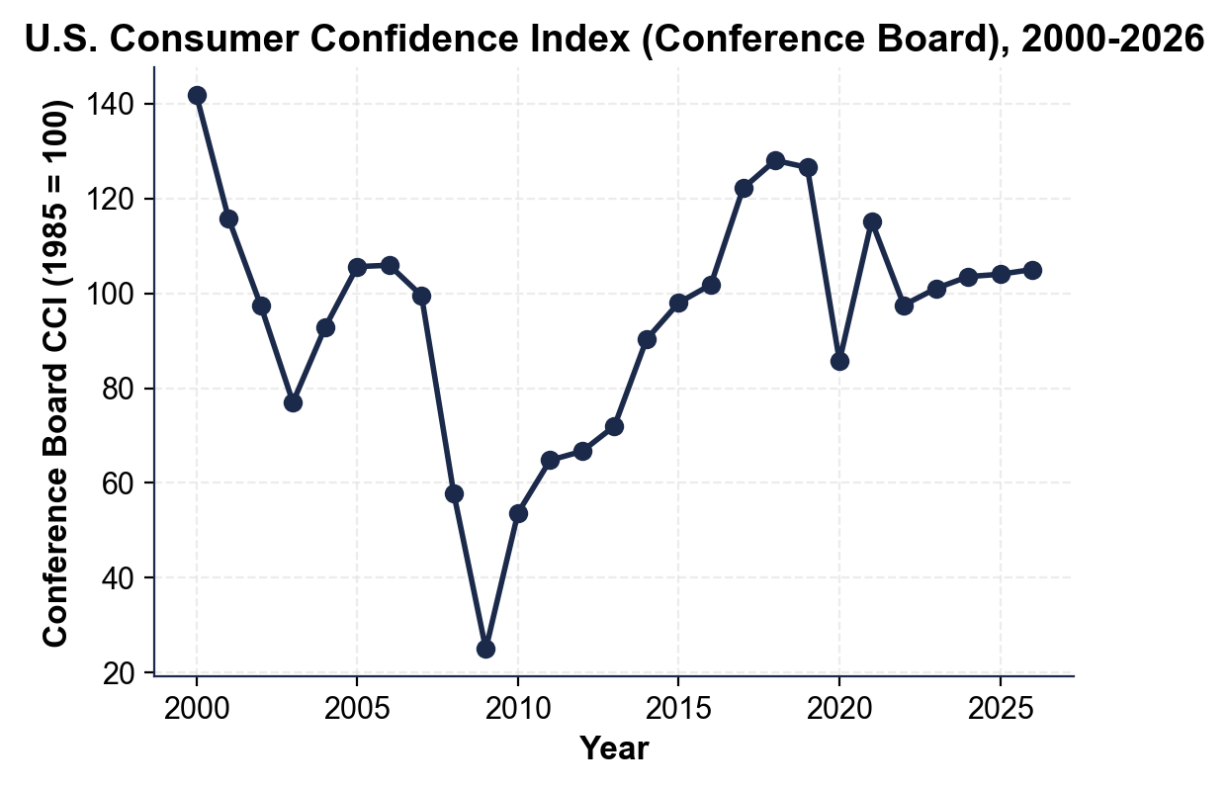
U.S. Consumer Confidence Index, 2000-2026
Conference Board CCI, annual. 2009 trough ~25; 2018-19 peak ~128.
© More Lessons Less Planning | morelessonslessplanning.com
Notes:
Read the chart. The line starts at the 2000 dot-com peak (~140), drops after 9/11 to about 85, recovers through the mid-2000s, then crashes through 2008 to its all-time trough of about 25 in early 2009 (Great Recession). The line climbs slowly through the 2010s to a 2018-2019 pre-pandemic peak near 130. Brief 2020 COVID dip. Rapid recovery to a new peak of about 128 in January 2022, then sharp drop to about 95 by mid-2022 (inflation crisis). By 2024-2026 the index has recovered to about 100-105. Students use this chart in Activity Part 3 Q1 to read specific values.
Reference labels (point to these chart features when teaching): 2009 trough ~25; 2020 COVID dip ~86

Slide 9
The 2022 Confidence Collapse
The Cause
The Numbers
CPI inflation hit 9.1% in June 2022 - a 40-year high
Gas prices peaked above $5/gallon nationally
Real wages were FALLING despite job growth
Russia invaded Ukraine in Feb 2022; energy surged
Michigan ICS hit 50.0 in June 2022 - all-time low
Lower than 2008 (55), 2020 (71), or 1980 (51.7)
Conference Board CCI fell from 128 (Jan) to 95 (Jul)
Inflation expectations rose to 5.4% (a 40-year high)
Warning: The 2022 Michigan reading of 50.0 was the LOWEST in the entire 76-year history of the series. Lower than 2008. Lower than 1980 stagflation.
© More Lessons Less Planning | morelessonslessplanning.com
Notes:
Walk through the 2022 collapse. The cause was straightforward: CPI inflation hit 9.1% in June 2022 - a 40-year high. Gas prices peaked above $5/gallon nationally. Real wages were FALLING even though job growth was strong (nominal wages were rising less than inflation). Russia invaded Ukraine in February 2022, sending energy and food prices surging. The numbers were dramatic: the Michigan ICS hit 50.0 in June 2022 - the all-time low in the entire 76-year history of the series. Lower than 2008 (55), lower than 2020 COVID (71), lower than 1980 stagflation (51.7). The Conference Board CCI - which is more sensitive to jobs than to prices - fell from 128 in January 2022 to about 95 by July, a big drop but nowhere near its all-time low (25 in 2009). Inflation expectations from the Michigan survey rose to 5.4% - a 40-year high. The divergence between the two indexes is the lesson: Michigan crashed because of inflation; Conference Board held up because jobs stayed strong.

Slide 10
The 2024 Partial Recovery
The Drivers
The Numbers
CPI inflation fell from 9.1% to ~3% by late 2023
Gas prices dropped back below $4/gallon
Real wages turned POSITIVE in mid-2023
Unemployment stayed at 3.5-4.0% throughout
Michigan ICS climbed from 50 (Jun 2022) to ~70-75 (2024)
Conference Board CCI climbed from 95 (Jul 2022) to ~100-105
Still BELOW pre-pandemic peaks (130 vs 100-105)
Inflation expectations fell back to ~3% (near normal)
Key Concept: The 2024 recovery was PARTIAL - sentiment came back but did not return to 2018-2019 peaks. Memory of inflation lingers.
© More Lessons Less Planning | morelessonslessplanning.com
Notes:
Walk through the 2024 partial recovery. The drivers were the inverse of the 2022 collapse: CPI inflation fell from 9.1% in June 2022 to about 3% by late 2023 and 2.5-3% through 2024. Gas prices dropped back below $4/gallon. Real wages turned POSITIVE in mid-2023 (nominal wage growth started exceeding inflation). Unemployment stayed at a historic-low 3.5-4.0% throughout the recovery period. The numbers: the Michigan ICS climbed from its June 2022 low of 50.0 to about 70-75 by mid-2024. The Conference Board CCI climbed from its July 2022 low of 95 to about 100-105. Both indexes recovered partially but did NOT return to their 2018-2019 pre-pandemic peaks (Michigan ~100, Conference Board ~130). The lingering damage: even with inflation back to 3%, the MEMORY of the 9% inflation period kept sentiment below pre-pandemic norms through 2024 and into 2026. This is the soft-landing-with-scars story: hard data recovered, soft data did not fully.

Slide 11
Does Confidence Actually Predict Retail Sales?
The Hypothesis
If confidence leads, low confidence should predict slower retail sales 6 months later
The Chart
Plots Conference Board CCI against retail sales growth 6 months later
What to expect
A POSITIVE correlation - higher confidence predicts faster retail sales
The Verdict
Yes, but loosely - other factors (Fed rates, oil, wages) also drive retail sales
The Surprise
2022: confidence collapsed but retail sales slowed only modestly (jobs stayed strong)
Tip: Sentiment is one signal, not the only signal. The 2022 case shows you can have a confidence collapse WITHOUT a recession.
© More Lessons Less Planning | morelessonslessplanning.com
Notes:
Frame the scatter plot. The hypothesis is that consumer confidence is a TRUE leading indicator - meaning low confidence in a given year should predict slower retail sales six months later. The scatter plot tests this. Each dot is one year: the x-axis is the Conference Board CCI that year, and the y-axis is the year-over-year change in retail sales SIX MONTHS LATER. If the hypothesis is right, the dots should slope upward (higher confidence predicts faster retail sales growth). The verdict from the data: YES, confidence DOES predict retail sales six months later - but loosely. The correlation is real but not tight, because many OTHER factors also drive retail sales (Fed interest rates, gas prices, wage growth, stock market). The 2022 case is the most interesting outlier: confidence collapsed in mid-2022 but retail sales slowed only MODESTLY in late 2022 - because jobs stayed strong and wage growth continued, so people kept spending even though they felt bad about the economy. Students will read the scatter in Activity Part 4 Q1.

Slide 12
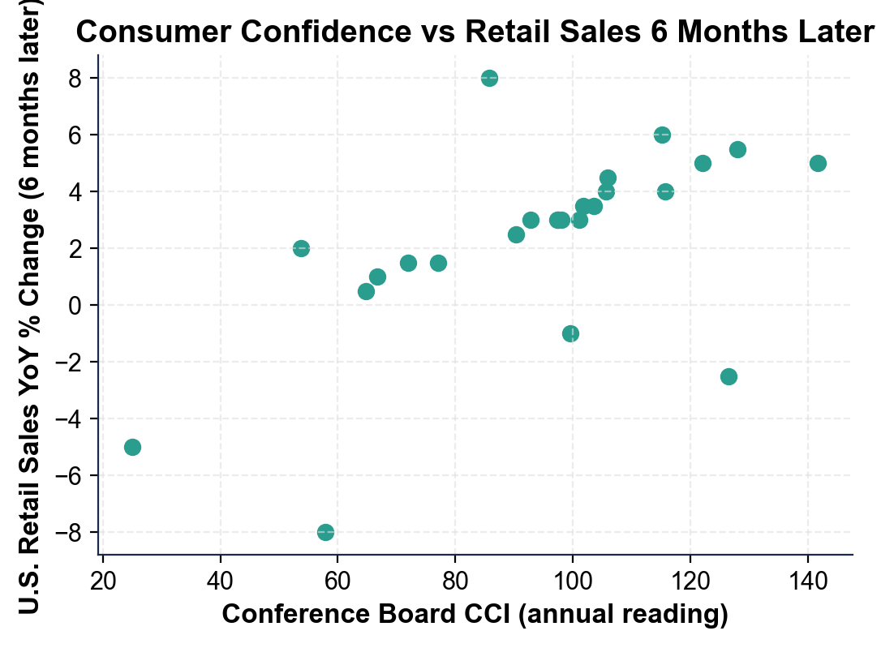
Confidence This Month vs Retail Sales 6 Months Later
Each dot = one year. Confidence loosely predicts retail sales 6 mo later.
© More Lessons Less Planning | morelessonslessplanning.com
Notes:
Read the scatter plot. Each dot is one year between 2000 and 2024. The x-axis is the Conference Board CCI that year. The y-axis is the year-over-year change in U.S. retail sales SIX months later. The pattern: an UPWARD slope - higher confidence today predicts faster retail sales six months out. The correlation coefficient (r) is about 0.5 to 0.6 - a moderate positive correlation, not a tight one. There is real predictive content, but lots of noise from other factors. Students use this chart in Activity Part 4 Q1 to identify the slope direction and explain what the dots in the upper-right vs the lower-left mean.
Reference labels (point to these chart features when teaching): Moderate upward slope; Outliers: 2019, 2020

Slide 13
How Investors and Politicians Use It
Federal Reserve
Investors
Politicians
Retailers
Tracks Michigan inflation expectations monthly
Rising expectations can prompt rate hikes
Forecast retail earnings from confidence
Reports can move markets within minutes
High confidence suggests policy is working
Low confidence suggests failure
Plan inventory about 6 months ahead
Confidence guides orders and hiring
Did You Know: Consumer-confidence releases can move stock prices within minutes.
© More Lessons Less Planning | morelessonslessplanning.com
Notes:
Explain who uses consumer confidence data and how. FEDERAL RESERVE: watches the Michigan inflation expectations component monthly. If expectations rise above 3-4%, the Fed worries that high inflation could become PERMANENT (anchored expectations) and hikes interest rates to push expectations down. In 2022, Fed Chair Jerome Powell explicitly cited rising Michigan inflation expectations as justification for the 0% to 5.25% hiking cycle. INVESTORS: use confidence data to predict retail earnings. Low confidence = sell retail stocks (Walmart, Target, consumer-discretionary names). Low confidence + high savings rate = good for utility stocks and consumer staples. The Conference Board CCI release at 10:00 AM Eastern moves the S&P 500 by 0.2-0.5% on average in the first minute after publication. POLITICIANS: cite confidence data when it supports their narrative. Biden's opponents in 2022 cited the Michigan 50.0 reading as evidence of policy failure. Trump in 2018 cited the Conference Board peak of 130 as evidence of his economic success. RETAILERS: plan inventory 6 months ahead using confidence trends. Low confidence = cancel orders; high confidence = expand.

Slide 14
Limits of Sentiment Data
What Sentiment MISSES
Survey Quality Issues
Sentiment can DIVERGE from spending behavior
2022: confidence crashed but spending stayed OK
Survey may capture mood, not action
Sample sizes are small (600-3,000 households)
Response rates have FALLEN since the 1990s
Political polarization affects answers (R vs D)
Same economy = different reading by political party
Hard data (retail sales) is more reliable than feelings
Warning: Since 2016, the gap between how Republican vs Democratic households rate the economy has DOUBLED. Same economy, different feelings.
© More Lessons Less Planning | morelessonslessplanning.com
Notes:
Critique consumer confidence as an indicator. The biggest problem: sentiment can DIVERGE from spending behavior. The 2022 case is the textbook example - the Michigan ICS hit an all-time low of 50.0 in June 2022, but retail sales slowed only modestly in the following 6 months. People said they felt terrible about the economy but kept spending (because jobs were strong and wages were rising). The survey may capture MOOD, not ACTION. Sample sizes are small: the Michigan survey is only 600 households per month; the Conference Board is 3,000. Survey response rates have FALLEN sharply since the 1990s - more like 10-15% today versus 30-40% in the 1990s, which raises questions about whether the samples are representative. Political polarization has affected answers since 2016: Republicans rate the economy much higher when a Republican is president, and Democrats do the same when a Democrat is president - the gap has doubled. Same economy, different feelings. Hard data (retail sales, GDP, employment) is more reliable than survey feelings - but feelings still matter because they predict future spending decisions.

Slide 15
Practice: Interpreting Consumer Confidence
Month | CB CCI | Michigan ICS | What It Signals
Feb 2009 | 25 | 56.3 | Recession trough; all-time CCI low
Sep 2018 | 138 | 100.1 | Pre-pandemic peak (Trump 1st term)
Apr 2020 | 85 | 71.8 | COVID shock; brief but sharp
Jan 2022 | 128 | 67.2 | Michigan warned on inflation; CCI did not
Jun 2022 | 98 | 50.0 | Michigan all-time low; CCI moderate drop
Aug 2024 | 103 | 67.9 | Partial recovery; both below pre-pandemic
Key Concept: The two indexes can tell DIFFERENT stories. Jan 2022 is the case to remember: Michigan saw inflation coming; CCI did not.
© More Lessons Less Planning | morelessonslessplanning.com
Notes:
Walk through the practice table. February 2009: Conference Board CCI hit its all-time low of 25 during the Great Recession trough; Michigan ICS at 56.3. September 2018: Conference Board CCI peaked at 138 (the pre-pandemic high); Michigan ICS at 100.1. April 2020: Conference Board CCI fell to 85 during the COVID shock; Michigan ICS at 71.8. January 2022: Conference Board CCI still high at 128, but Michigan ICS already at 67.2 - Michigan saw inflation coming before CCI did. June 2022: Conference Board CCI at 98 (moderate drop); Michigan ICS at 50.0 - the all-time low in the 76-year Michigan series. August 2024: Conference Board CCI at 103; Michigan ICS at 67.9 - partial recovery, both below pre-pandemic. The lesson: the two indexes can DIVERGE, and January 2022 is the case to remember. Michigan's focus on prices caught the inflation crisis 6 months before Conference Board's focus on jobs did.

Slide 16
Key Takeaways
Consumer confidence is SURVEY-based data; it measures how households FEEL
★
Two main U.S. indexes: Conference Board CCI and Michigan ICS
★
It is a LEADING indicator - it moves 3-6 months before retail sales
★
2022 collapse: Michigan hit 50.0 (all-time low); CCI fell to 95
★
2024 partial recovery; both still below pre-pandemic peaks
★
© More Lessons Less Planning | morelessonslessplanning.com
Notes:
Wrap up. Connect each takeaway to a learning target. Target 1 (define + predict spending) = takeaways 1, 3. Target 2 (distinguish the two indexes) = takeaway 2. Target 3 (evaluate as real-time indicator) = takeaways 4, 5. Preview the activity: students will play CONSUMER ANALYST role, interpret real CCI and Michigan readings from 2020-2024, build a vocabulary reference guide, write an analysis explaining the 2022 collapse, and produce a recommendation for an investor client.

