Slide 1
Confucianism and Social Order
An academic look at how Confucian ideas about family, respect, and proper relationships shaped Chinese society and government.
© More Lessons Less Planning | morelessonslessplanning.com
Notes:
Opening slide. This lesson studies Confucianism academically - as a philosophy and ethical-social system, not a devotional practice. Students learn that Confucianism grew from the teachings of Confucius (Kong Qiu, c. 551 to 479 BCE), collected in the Analects, and that its core ideas - filial piety, the five relationships, the virtues of ren and li, and the ideal of the junzi - were meant to produce social harmony from the family up to the government. Set a neutral, scholarly tone from the first minute: we describe what Confucianism teaches and how it shaped China, comparing it with other belief systems in the unit, and we never endorse or rank belief systems.

Slide 2
Learning Targets
Explain who Confucius was and what Confucianism is.
★
Define filial piety, the five relationships, ren, li, and the junzi.
★
Explain how Confucian ideas shaped Chinese government and society.
★
Read part of the Analects as a primary source.
★
© More Lessons Less Planning | morelessonslessplanning.com
Notes:
Read the four learning targets. Today pairs a set of moral ideas with their social effects: Confucian teachings about respect and proper relationships, and the way those teachings shaped how China was governed for over 2,000 years. Keep the neutral, academic stance in mind throughout: our goal is to understand and describe the ideas accurately and to compare Confucianism with other belief systems, not to decide whether it is right. Pay special attention to defining each key term precisely - filial piety, the five relationships, ren, li, and the junzi - because you will use all of them in the activity.

Slide 3
Who Was Confucius? What Is Confucianism?
Confucius, the teacher
Confucianism, a system of ethics
Confucius (Kong Qiu, c. 551 to 479 BCE) was a Chinese teacher and philosopher.
He lived in a time of disorder and taught how to restore order through morality.
His collected sayings, written down by followers, are known as the Analects.
Confucianism is an ethical and philosophical system based on his teachings.
It stresses moral conduct, respect within the family, and proper relationships.
Its goal is an orderly, peaceful society - not the worship of gods.
Key Concept: CONFUCIANISM is the ethical system based on CONFUCIUS's teachings, collected in the ANALECTS.
© More Lessons Less Planning | morelessonslessplanning.com
Notes:
Begin with the person and the system. The Chinese teacher and philosopher (Kong Qiu, c. 551 to 479 BCE) whose ideas about morality, family, and social order became the foundation of Confucianism. He lived during a period of political disorder and taught that order could be restored through personal morality and respect, not force. The collected sayings of Confucius, written down by his followers after his death; it is the central text for understanding Confucian ideas. An ethical and philosophical system based on the teachings of Confucius that stresses moral conduct, respect within the family, and proper relationships as the foundation of an orderly society. Note the academic framing: Confucianism is studied here as a philosophy and ethical-social system - it focuses on how to live and govern well - rather than as the worship of gods. On the next slide you will see a traditional portrait painting of Confucius.

Slide 4
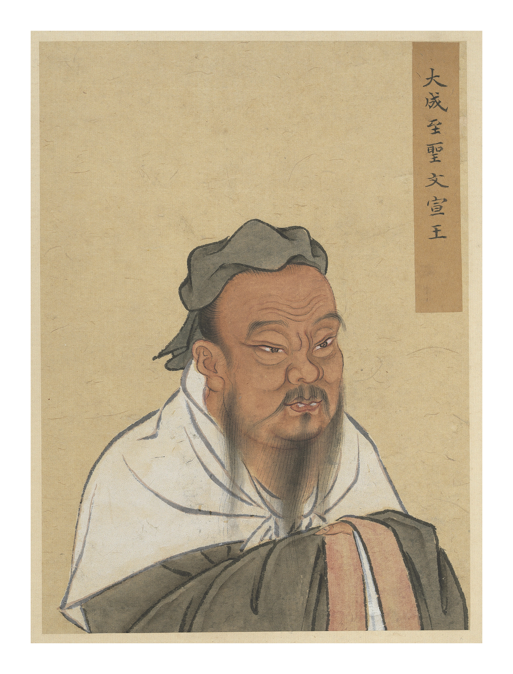
A Traditional Portrait of Confucius
Traditional Chinese portrait of Confucius (National Palace Museum).
© More Lessons Less Planning | morelessonslessplanning.com
Notes:
Public-domain reproduction of a traditional Chinese ink-and-color portrait painting of Confucius, held by the National Palace Museum (Taipei) and public domain by age. Use it purely as a reference image to make the previous slide concrete: this is how Confucius has long been depicted in Chinese portrait tradition. Describe it respectfully and academically as a historical artwork; students are not asked to decode the image as evidence.

Slide 5
Filial Piety: Respect Begins at Home
Filial piety
Filial piety is the duty of respect, obedience, and care that children owe to their parents and elders.
✔
The root of virtue
Confucians taught that filial piety is the root of all other virtues - learning to honor parents teaches a person to honor everyone.
✔
From home to society
A person who respects their family learns to respect elders, teachers, and rulers, spreading order outward.
✔
Key Concept: FILIAL PIETY - respect, obedience, and care for parents and elders - is the root virtue of Confucian life.
© More Lessons Less Planning | morelessonslessplanning.com
Notes:
The most basic Confucian idea starts inside the family. The Confucian duty of respect, obedience, and care that children owe to their parents and elders; Confucians saw it as the root of all other virtues. Confucius taught that this respect is not just about feeding or supporting parents - it must include genuine reverence. Filial piety was seen as the training ground for all other virtues: a person who learns to honor their parents and elders learns to honor teachers, rulers, and the wider community, so order spreads outward from the family to society as a whole. Describe this neutrally as a Confucian value.

Slide 6
The Five Relationships and Hierarchy
The Five Relationships
Hierarchy and duty
The five relationships are the key bonds that keep society in order.
Ruler-subject, father-son, husband-wife, elder-younger, and friend-friend.
In four of them one person guides and the other respects; friends are equals.
Hierarchy means people are ranked by status and role.
Order comes when each person accepts their place and its duties.
The superior owes care; the junior owes respect - duty runs both ways.
Key Concept: The FIVE RELATIONSHIPS order society through HIERARCHY, where each role carries duties in both directions.
© More Lessons Less Planning | morelessonslessplanning.com
Notes:
Confucius extended filial piety into a whole social map. The five key social relationships in Confucian thought - ruler and subject, father and son, husband and wife, elder and younger sibling, and friend and friend - that were meant to keep society in order. In four of the five, one person is senior and guides while the other is junior and respects; only friend and friend are equals. A system in which people are ranked by status and role; Confucianism taught that when each person accepts their place and duties, society stays orderly. The key Confucian point is that hierarchy is not one-sided tyranny: duty runs both ways - the senior owes care and good example, and the junior owes respect and obedience. When everyone honors their role, society stays orderly. Present this as a description of Confucian thought.

Slide 7
Ren and Li: How a Good Person Acts
Ren - benevolence
Ren is the virtue of benevolence, or humaneness: treating others with kindness and empathy.
✔
Li - proper conduct
Li is proper conduct, ritual, and courtesy: behaving correctly according to one's role and to custom.
✔
Feeling and action
Ren gives a person the right feelings toward others; li gives them the right actions and manners.
✔
Key Concept: REN is benevolence (kindness toward others); LI is proper conduct, ritual, and courtesy.
© More Lessons Less Planning | morelessonslessplanning.com
Notes:
Confucianism describes two virtues that turn respect into daily behavior. The Confucian virtue of benevolence, or humaneness - treating others with kindness and empathy. The Confucian ideal of proper conduct, ritual, and courtesy - behaving correctly according to one's role and to custom. The two work together: ren is the inner attitude of caring about others, and li is the outward practice of treating them correctly and courteously according to one's role. A truly good person, in Confucian thought, has both - genuine kindness and proper conduct. Describe both terms neutrally as Confucian ideals.

Slide 8
The Junzi: The Confucian 'Gentleman'
The junzi
What the junzi does
The junzi is the Confucian ideal of the 'superior person' or 'gentleman'.
It is not about noble birth - anyone can become a junzi through moral effort.
The junzi is honest, respectful, and dignified.
The junzi does what is right rather than what is profitable.
The junzi makes demands on himself, not on others.
The junzi is dignified but not proud.
Key Concept: The JUNZI is the morally cultivated 'gentleman' who does what is right, not merely what is profitable.
© More Lessons Less Planning | morelessonslessplanning.com
Notes:
Confucianism sets a clear model of the ideal person: the junzi. The Confucian ideal of the 'superior person' or 'gentleman': a morally cultivated person who is honest, respectful, and dignified, and who does what is right rather than what is profitable. A crucial point is that the junzi is defined by character, not by noble birth - Confucius taught that anyone could become a junzi through study and moral effort. In the Analects, the junzi is contrasted with the 'small-minded person': the junzi understands what is right and makes demands on himself, while the small-minded person understands only profit and makes demands on others. Describe this as the Confucian ideal of moral character.

Slide 9
Social Harmony: From Family to State
Social harmony
Social harmony is the Confucian goal of a peaceful, orderly society.
✔
How it is achieved
Harmony comes when people fulfill their roles, honor the five relationships, and practice ren and li.
✔
Family to state
A well-ordered family becomes the model for a well-ordered state.
✔
Key Concept: SOCIAL HARMONY - a peaceful, orderly society - is the goal that filial piety and the relationships work toward.
© More Lessons Less Planning | morelessonslessplanning.com
Notes:
All the Confucian ideas point toward one goal. The Confucian goal of a peaceful, orderly society, achieved when people fulfill their roles, respect the relationships, and practice virtues like ren and li. Confucius taught that harmony is not forced from above; it grows when each person fulfills the duties of their role, honors the five relationships, and practices the virtues of ren and li. The family is the model: a household in which children show filial piety and parents show care is a small picture of a well-ordered state. Scale the family up, and you get a peaceful society and government. Present this as the aim of Confucian ethics.

Slide 10
How Confucianism Shaped Government
Confucianism and government
Rule by scholar-officials
Confucian ideas shaped Chinese government for over 2,000 years.
Rulers were expected to govern by moral example, not just by force.
Officials were expected to be educated and virtuous, like the junzi.
Government posts were filled by scholar-officials chosen for learning.
Candidates studied Confucian texts such as the Analects.
The ideal was a government of moral, educated men serving social harmony.
Key Concept: Confucian ideas shaped China's government - rule by educated, moral SCHOLAR-OFFICIALS who served social harmony.
© More Lessons Less Planning | morelessonslessplanning.com
Notes:
Confucian ethics did not stay inside the household - they shaped how China was governed for more than two thousand years. Rulers were expected to lead by moral example and to earn the people's trust, not simply to command by force. Government officials were expected to be like the junzi: educated, honest, and devoted to duty. Over time, China filled many government posts with scholar-officials - men chosen for their learning, who had studied Confucian texts such as the Analects. The ideal was a government staffed by moral, educated officials working to preserve social harmony. Describe this as the historical influence of Confucian ideas.

Slide 11
Confucianism Among the World's Belief Systems
A philosophy, not a worship of gods
Confucianism is studied as a philosophy and ethical-social system; it focuses on how to live and govern well, not on worshipping gods.
✔
Alongside other belief systems
In this unit, Confucianism sits beside traditions like Hinduism and Buddhism as one of the world's major belief systems.
✔
A lasting influence
Its ideas about family, respect, and social order still shape many East Asian societies today.
✔
Key Concept: Confucianism is best described as a PHILOSOPHY and ethical-social system, studied academically among the world's belief systems.
© More Lessons Less Planning | morelessonslessplanning.com
Notes:
Because this is a unit on world religions and belief systems, it helps to place Confucianism beside the other traditions studied here. Scholars usually describe Confucianism as a philosophy and ethical-social system rather than a religion of gods: its focus is on how people should live, treat one another, and govern, more than on worship of a deity. This is one reason it is often compared with, but distinguished from, religions like Hinduism and Buddhism that are also part of this unit. Confucianism's influence has been enormous and lasting: its ideas about family duty, respect, and social order still shape many East Asian societies today. Describe these comparisons neutrally - we note similarities and differences to understand each tradition accurately, never to rank them.

Slide 12
Key Takeaways
Confucianism is an ethical system based on Confucius, collected in the Analects.
★
Filial piety, respect for parents, is the root Confucian virtue.
★
Ren, li, and the junzi describe how a good person should feel and act.
★
Hierarchy and social harmony shaped Chinese government for centuries.
★
© More Lessons Less Planning | morelessonslessplanning.com
Notes:
Let's recap what you now know about Confucianism, described academically. First, the person and the system: Confucianism is an ethical and philosophical system based on the teachings of Confucius (c. 551 to 479 BCE), collected in the Analects. Second, the core ideas: filial piety - respect and care for parents and elders - is the root virtue, and it extends outward through the five relationships and hierarchy; the virtues of ren (benevolence) and li (proper conduct) and the ideal of the junzi (the 'gentleman') describe how a good person should feel and act. Third, the payoff: Confucian ideas of hierarchy and social harmony shaped Chinese government for over 2,000 years, including rule by educated scholar-officials. You also read part of the Analects as a primary source. Throughout, we described Confucianism neutrally, as one of the world's belief systems, and never ranked it against another.

