Slide 1
Columbus's Voyage to the Americas
Reading the 1492 log of first contact with the Taino
© More Lessons Less Planning | morelessonslessplanning.com
Notes:
Open by naming the source at the center of the lesson: Columbus's own log. The facts come from that log, and so does one man's point of view.

Slide 2
Learning Targets
Explain what the log reports, using accurate wording (reached, not discovered).
★
Analyze how Columbus describes the Taino and his own intentions.
★
Correct the flat-earth myth and name the log's limits as a source.
★
© More Lessons Less Planning | morelessonslessplanning.com
Notes:
Use the targets to preview the factual, source-analysis, and misconception-repair work students will do.

Slide 3
What the log records about the voyage
The fleet left Spain on Friday, August 3, 1492, from the bar of Saltes.
It sailed west across the Atlantic for weeks.
Land was sighted two hours after midnight on October 12, 1492.
Rodrigo de Triana was the first to see land.
The log records these facts in the admiral's daily entries.
Key Point: Every date and name here comes from Columbus's own ship's log.
© More Lessons Less Planning | morelessonslessplanning.com
Notes:
Anchor the voyage facts in the log itself. The dates and the name Rodrigo de Triana are drawn from the record, not from later legend.

Slide 4
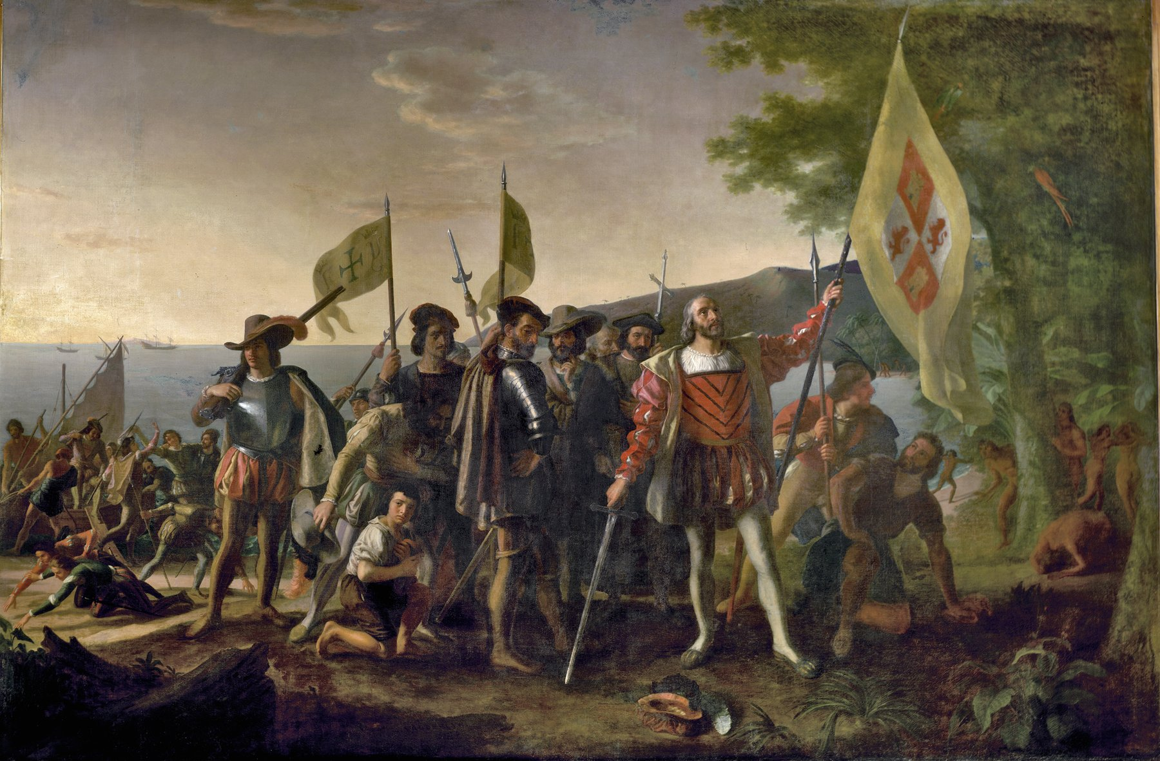
A later painting, not a record of the event
Vanderlyn, Landing of Columbus (1847) - painted 355 years after 1492.
© More Lessons Less Planning | morelessonslessplanning.com
Notes:
Frame the painting honestly: it was made in 1847, more than three centuries after 1492. It shows how later Americans imagined the scene, not what a witness saw. The Taino are painted as background; the lesson treats them as people.

Slide 5
The flat-earth story is a myth
Common story
What the evidence supports
People in 1492 thought the earth was flat.
Columbus proved it was round.
Educated Europeans already knew the earth is a sphere.
The real debate was the ocean's width, which Columbus underestimated.
The flat-earth myth was spread by Washington Irving in 1828.
Key Point: The 1492 debate was ocean distance, not the shape of the earth.
© More Lessons Less Planning | morelessonslessplanning.com
Notes:
Do not just say the myth is wrong; give students the accurate replacement. Trace the flat-earth story to Washington Irving's 1828 biography.

Slide 6
Reached, not discovered
People were already here
The Taino already lived on the islands Columbus reached.
✔
Others crossed earlier
Norse sailors reached the Americas around the year 1000 CE.
✔
Renaming the island
Columbus renamed Guanahani as San Salvador.
✔
Claiming for Spain
On landing he took possession of the island for the Sovereigns.
✔
Key Point: Say Columbus reached the Americas, where the Taino already lived.
© More Lessons Less Planning | morelessonslessplanning.com
Notes:
Use accurate verbs. Millions of people already lived in the Americas, and Norse sailors had crossed centuries earlier, so reached is more accurate than discovered.

Slide 7
What kind of source is this log?
A ship's log is a captain's daily record of a voyage.
The admiral, Columbus, kept this log himself.
The original log is now lost.
It survives as Las Casas's handwritten abstract.
The abstract marks where it quotes the admiral's own words.
Remember: We read a later copy of one man's daily record, not the original.
© More Lessons Less Planning | morelessonslessplanning.com
Notes:
Establish the source chain: Columbus wrote it, the original is lost, and we read Las Casas's abstract. This is why the log is one perspective, carefully preserved but not neutral.

Slide 8
Voyage and command vocabulary
ship's log
A captain's daily record of a voyage.
admiral
A fleet commander; Columbus's title.
Sovereigns
The King and Queen, Ferdinand and Isabella of Spain.
league
An old distance unit; at sea about three miles.
Taino
The Indigenous people of the Caribbean islands.
Key Point: These terms name the record, the commander, and the people.
© More Lessons Less Planning | morelessonslessplanning.com
Notes:
Have students connect each definition to a claim they will use later in the activity and quiz.

Slide 9
Trade and claiming vocabulary
barter
Trading goods directly without money.
royal standard
The monarch's flag, planted to claim land.
possession
Formally claiming control of land.
maravedi
A small Spanish coin of the 1400s.
the Indies
Europe's name for Asia's spice lands.
Key Point: Columbus thought he had reached the Indies, meaning Asia.
© More Lessons Less Planning | morelessonslessplanning.com
Notes:
Clarify that Columbus believed he had sailed to the Indies, Europe's name for Asia. That belief is why he called the people by a name meant for Asia.

Slide 10
First contact, as the log describes it
Columbus gave
The Taino brought
What happened
Red caps.
Glass beads for their necks.
Small bells and things of little value.
Parrots.
Cotton thread in skeins.
Darts and many other things.
The two sides traded, or bartered.
They exchanged goods for goods.
No money changed hands.
Remember: This exchange is barter - trading goods directly without money.
© More Lessons Less Planning | morelessonslessplanning.com
Notes:
Keep the goods concrete and drawn from the excerpt. Name the exchange as barter so students connect the vocabulary term to the primary source.

Slide 11
Columbus's stated intentions, in his words
What he says he wanted
How to read it
To form great friendship with the people.
To convert them by love rather than by force.
These are Columbus's own stated goals.
He calls the trade goods things of little value.
The log gives his view, not the Taino's.
Key Point: Read his stated goals as one side's words, framed honestly.
© More Lessons Less Planning | morelessonslessplanning.com
Notes:
Quote his intentions briefly and with framing. Do not celebrate or condemn; identify the words as Columbus's stated goals and note the missing Taino perspective.

Slide 12
A line that shows the log's one-sidedness
I would take six of them to Spain, that they may learn to speak.
— Columbus's log, paraphrasing the October 1492 entry (Fact F5)
The Taino did not record their own view; the log speaks only for Columbus.
Remember: The people written about here left no written account of their own.
© More Lessons Less Planning | morelessonslessplanning.com
Notes:
Use this line to make the one-sided nature of the source concrete. Columbus plans to take people to Spain; the log never records what the Taino wanted.

Slide 13
Reading the log critically
The log is the earliest written record of this meeting.
It gives only Columbus's perspective, not the Taino's.
The Taino left no written account of this meeting.
We read Las Casas's abstract, since the original is lost.
Even the barter is described using Columbus's valuation.
Key Point: A source can be valuable and still be one-sided.
© More Lessons Less Planning | morelessonslessplanning.com
Notes:
Model the difference between dismissing a source and reading it critically. The log is useful evidence, but it is one perspective preserved through a later copy.

Slide 14
Building a precise description
Facts: dates and named actors come from the log.
Wording: Columbus reached the Americas, where the Taino lived.
Evidence: name one traded good or one quoted phrase.
People: describe the Taino as people, not as scenery.
Limit: the log gives one side and survives only as an abstract.
Remember: Precision means naming both the evidence and its limits.
© More Lessons Less Planning | morelessonslessplanning.com
Notes:
Prepare students to write the activity's final description. A precise account uses the facts, accurate verbs, specific evidence, and an honest note about the source.

Slide 15
Key Takeaways
Columbus reached the Americas, where the Taino already lived.
★
The flat-earth story is a myth traced to Irving in 1828.
★
The log is one-sided and survives only as Las Casas's abstract.
★
First contact is described as barter, in Columbus's words.
★
© More Lessons Less Planning | morelessonslessplanning.com
Notes:
Close by returning to the essential question and asking students for one precise, source-aware description of the meeting.

