Slide 1
Cliff Palace and the Ancestral Puebloans
How a Stone Village Was Engineered Inside a Colorado Cliff
© More Lessons Less Planning | morelessonslessplanning.com
Notes:
Two men looking for stray cattle in December 1888 stopped at the rim of a canyon and saw a stone village standing empty in the cliff opposite. Open with that. Then say the harder part: the people who built it left no writing, so every word ever written about this place was written by a stranger who arrived centuries late.

Slide 2
Learning Targets
Name the materials used to build Cliff Palace inside a cliff hollow.
★
Explain how builders dealt with a sloping floor and little level ground.
★
Explain why the room counts for Cliff Palace kept changing over time.
★
Explain how tree rings dated beams the first diggers could not date.
★
Judge what an outside report can and cannot prove about these people.
★
© More Lessons Less Planning | morelessonslessplanning.com
Notes:
Targets one and two are the engineering. Targets three, four, and five are the historical thinking. Point at target five and say out loud that this lesson ends with a question that is still open.

Slide 3
A Village Built Inside a Cliff
Cliff Palace stands in a wide hollow worn into rock above a canyon.
Sandstone, mortar, and wooden beams were the three main materials.
Each block was shaped with harder stones from nearby river beds.
Rooms rise two and three stories; one tower rises four stories.
Key Concept: Every block, every beam, and every load of soil had to be carried into the alcove by hand.
© More Lessons Less Planning | morelessonslessplanning.com
Notes:
Walk the materials slowly. Sandstone shaped on the spot, mortar mixed from local soil, water and ash, and roof beams carried in. Ask what it would take to get one beam up a cliff face without a road.

Slide 4
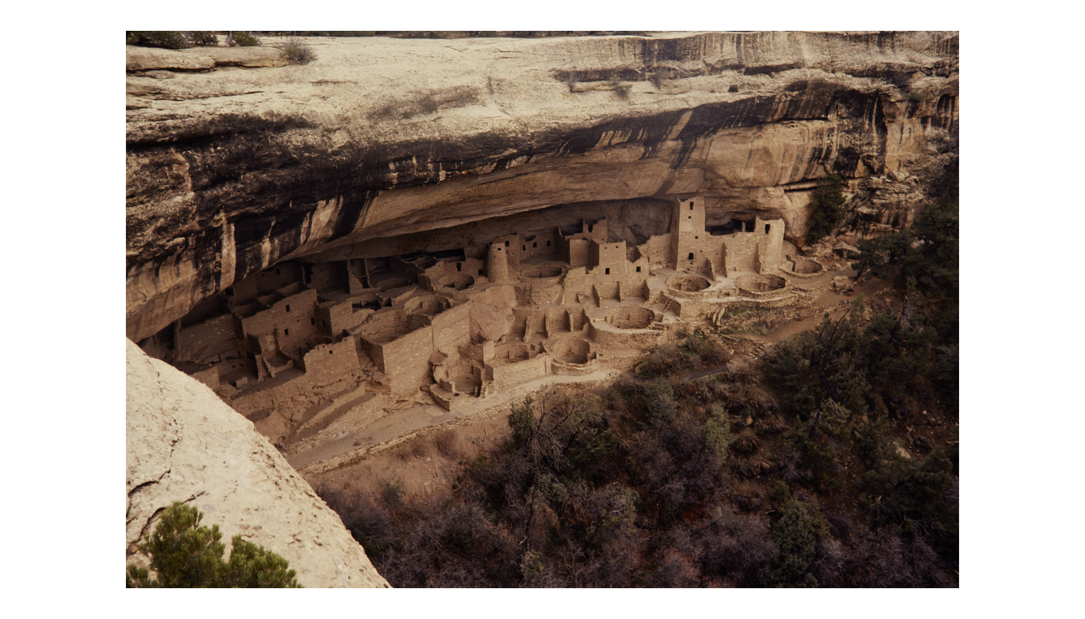
Cliff Palace, Mesa Verde
The whole village sits under one overhang.
© More Lessons Less Planning | morelessonslessplanning.com
Notes:
Give the class twenty silent seconds with the photograph before you say anything. Then ask where the roof is, and let somebody point at the cliff.
Reference labels (point to these chart features when teaching): Stacked stone rooms; Round kivas in front

Slide 5
Three Words for the Walls
Alcove
A wide hollow worn back into a cliff face, deep enough to shelter a whole village
Masonry
Walls built from shaped blocks of stone laid up by hand and held together with mud
Mortar
A mixture of local soil, water, and ash used to hold the sandstone blocks together
Key Concept: The mixture holding these blocks together is local soil, water, and ash - not cement.
© More Lessons Less Planning | morelessonslessplanning.com
Notes:
Say the third definition twice. Students hear mortar and picture a bag of cement from a hardware store. This is dirt, water, and ash mixed on site, which is exactly why the overhang mattered.

Slide 6
Three Problems in the Alcove, and How They Were Solved
The Floor Slanted
Ground Space Was Scarce
The Boulders Left Gaps
The floor slanted from the back to the front.
Huge angular boulders had fallen from the roof.
Builders erected terraces and filled the irregular places.
Level ground fit for building was at a premium.
Second, third, and even fourth story rooms were added.
Six distinct terrace levels resulted.
Open spaces between boulders were excellent for kivas.
Less digging was needed there to sink a round room.
A flat kiva roof turned the space above into a level court.
Key Concept: The shape of the hollow decided the shape of the village.
© More Lessons Less Planning | morelessonslessplanning.com
Notes:
This is the engineering slide. Every one of these three moves is described in the 1937 park booklet. Draw the slanting floor on the board and let a student show you where they would put the first room.

Slide 7
Three Words for the Structure
Chinking
Tiny stone chips pressed into the wet joints between blocks to fill gaps and steady a wall
Kiva
A round ceremonial room sunk below the courtyard floor, roofed flat and entered from above
Terrace
A level platform built up over the uneven rock floor to create flat ground to build on
Key Concept: A round room sunk below the court is a kiva. The flat platform it sits in is a terrace.
© More Lessons Less Planning | morelessonslessplanning.com
Notes:
Chinking is the detail that gives away a careful builder. Those chips fill the gaps in the wet joints and hold a wall plumb long after the mud has weathered out of the face.

Slide 8
Counting the Same Village, Again and Again
Who counted, and when | Rooms | Ceremonial rooms | How the count was made
Nordenskiold map, before digging | 102 | 17 | Drawn from surface indications
Morley-Kidder map, before digging | 105 | 18 or 19 | Drawn from surface indications
House of Representatives report, before digging | 146 | 5 | A printed figure Fewkes said was wrong on the kivas
Fewkes, after the 1909 dig | no total of his own | at least 23 | Counted after a season of excavation
Park service today | 150 | 23 | Recent studies
Warning: Fewkes corrected the KIVA count, not the room count. He replaced a reported 5 kivas with at least 23 and left the 146-room figure standing.
© More Lessons Less Planning | morelessonslessplanning.com
Notes:
Read the warning callout aloud. This is the single fact students most often get backwards. Fewkes complained in a footnote that the wrong KIVA number had already been given wide circulation; he said nothing against the 146 rooms.

Slide 9
Emptied Before It Was Studied
A Smithsonian crew arrived in 1909, after 20 years of digging here.
Fewkes wrote the ruin was almost completely rifled of its contents.
Pick, shovel, and even dynamite were used to recover artifacts.
Much of the 1909 summer was spent on earth others had already dug.
Key Concept: What an object was lying beside is often the only record of what a room was for. That record was already gone.
© More Lessons Less Planning | morelessonslessplanning.com
Notes:
The damage was not only to the walls. Lifting a pot out of a room without writing down where it sat destroys the one thing that could have said what the room was used for.

Slide 10
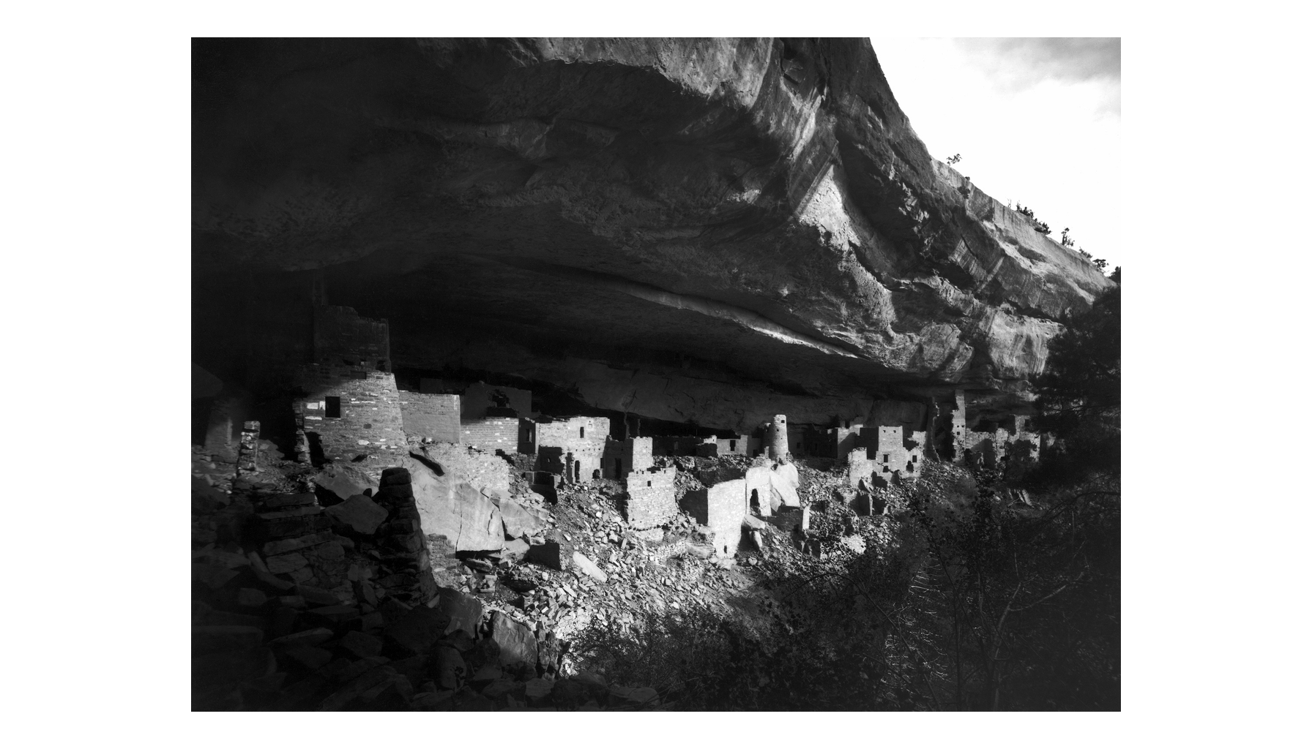
Cliff Palace in 1891, Before the Digging
Photographed in 1891 by Gustaf Nordenskiold.
© More Lessons Less Planning | morelessonslessplanning.com
Notes:
This is the village eighteen years before the Smithsonian crew arrived, photographed by Gustaf Nordenskiold - the same man whose ground plan is the first row of the Activity Part 3 counts table. Point out the rubble banked across the front and ask how a mapmaker standing here could ever have counted the rooms buried under it.
Reference labels (point to these chart features when teaching): Rubble across the front; Standing room blocks

Slide 11
Three Words for Reading a Report
Excavation
The careful digging of a site to record what is buried there and exactly where it lay
Observation
Something an investigator can point at, measure, and write down
Inference
A conclusion an investigator reaches about something nobody was there to watch
Key Concept: Both sit in the same paragraph. The test is whether a second person standing there could have checked it.
© More Lessons Less Planning | morelessonslessplanning.com
Notes:
Model the split on one sentence before students try it. A report can say a room measured eight feet across and then say what the room was for. Only the first half is something anybody else could check.

Slide 12
The Excavator Could Not Date the Village
No decisive evidence bearing on that point has been produced.
— Jesse Walter Fewkes, Bureau of American Ethnology Bulletin 51, 1911
Some writers had called the village five hundred years old, and others had added five more centuries to that guess. Fewkes judged that the available evidence did not warrant such extreme antiquity.
Note: Students read a longer passage from this same report in Activity Part 4.
© More Lessons Less Planning | morelessonslessplanning.com
Notes:
Notice what an honest report looks like. The man who had just dug the place said in print that the evidence in hand did not fix a date for it. Two published guesses differed by a factor of two, which is a fair measure of how little the stones alone could settle.

Slide 13
Tree Rings Put Dates on the Beams
A wet year grows a wide ring; a dry year grows a narrow one.
Tree-ring dating fixes the year a roof timber was cut.
It matches the timber's ring pattern to a regional record of years.
Dr. A. E. Douglass built the tree-ring chronology for the Southwest.
By 1937 the park could print calendar years Fewkes could only guess.
Key Concept: The stones did not change. The method did.
© More Lessons Less Planning | morelessonslessplanning.com
Notes:
This is the hinge of the lesson. The same village that could not be dated in one decade carried a calendar in its roof timbers as soon as somebody learned how to read the rings.

Slide 14
The 1937 Table of Beam Dates
Cliff dwelling | Tree-ring dates (A.D.)
Mug House | 1066
Cliff Palace | 1073-1273
Oak Tree House | 1112-84
Balcony House | 1190-1272
Long House | 1204-11
Spruce Tree House | 1230-74
Buzzard House | 1273
Warning: The booklet says these dates are not final. Every date in that table stops just short of the drought that began in A.D. 1276.
© More Lessons Less Planning | morelessonslessplanning.com
Notes:
Read the warning callout carefully with the class. The 1937 booklet makes its 'falls just short of the drought' claim about its own published table, and in the same breath admits more samples were unexamined and the dates were not final. Do not let the claim grow into 'every timber in the park.'

Slide 15
What a Felling Date Settles, and What It Does Not
What the date establishes
What it cannot establish
The year the tree was cut down
That people were building or repairing in that year
An occupancy of about 200 years for Cliff Palace
When a room was first used
How long a family lived in it
When the last of them walked out
Key Concept: A beam can be reused, and a room outlasts its roof.
© More Lessons Less Planning | morelessonslessplanning.com
Notes:
The left column is close to observation and the right column is where the inferences start. Ask which column the 200-year occupancy really belongs in; it is the booklet's arithmetic on the span of dates, not a thing anybody watched.

Slide 16
Why People Left, and What Is Still Argued
The 1911 Report
The 1937 Booklet
The Park Service Today
No sign of a sudden catastrophe in the village
A gradual desertion by one clan after another
A change of climate shrank the water and failed the crops
A 24-year drought began in A.D. 1276
It caused a move to regions with steadier water
The booklet states the drought as the cause
People left over the course of several decades
Persistent drought, limited resources, social change
The reasons likely varied from individual to individual
Warning: These are three accounts written a century apart, not three settled answers.
© More Lessons Less Planning | morelessonslessplanning.com
Notes:
All three agree on the shape of the leaving: not one event but many departures. Where they differ is how much weight to hang on the drought. Do not let the class settle on one card.

Slide 17
The People Did Not Disappear
The Pueblo and Hopi people are the direct descendants of the builders.
Their ancestors made new villages along the Rio Grande and elsewhere.
Twenty-seven Pueblos, Tribes, and Nations are tied to Mesa Verde today.
Tribal members work on park staff; descendants visit to pay respects.
Key Concept: The village was left. The people were not lost. Say moved, not vanished.
© More Lessons Less Planning | morelessonslessplanning.com
Notes:
Say this one plainly. The village was left; the people were not lost. Their descendants can be named, they can be visited, and they take part in how the park is run today. Correct the word vanished the first time it comes up in your room.

Slide 18
A Descendant Speaks
“Even though we physically moved away, the spirits of my ancestors are still here.”
— TJ Atsye, Laguna Pueblo, quoted by the National Park Service
Her words are testimony from a living Pueblo person about her own ancestors, not a finding read out of stone.
Note: These are one person's exact words. Keep them inside quotation marks and attributed.
© More Lessons Less Planning | morelessonslessplanning.com
Notes:
Read the line aloud and then say who said it and when. This is testimony from a descendant, not a finding read out of stone, and the difference is the whole point of the lesson. Never paraphrase it as if it were the toolkit's own voice.

Slide 19
What These Documents Cannot Settle
What the builders called themselves
They left no writing, and the name Cliff Palace was given by two cattlemen in 1888.
✔
Who lived in which room
Objects were lifted without a record of where they lay, so that link is gone.
✔
How many people slept here
The 1937 figures of 400 and 600 are arithmetic on room counts, not a head count.
✔
Why each family left
The park service says the reasons likely varied from individual to individual.
✔
Key Concept: Naming the limits of the record is part of doing history well, not a failure.
© More Lessons Less Planning | morelessonslessplanning.com
Notes:
Work down the list and ask what each one would take to answer. That question is exactly what Activity Part 5 asks students to answer in writing.

Slide 20
Key Takeaways
Cliff Palace is shaped sandstone, mud mortar, and beams, up to four stories.
★
Builders used terraces and sunken kivas to beat a sloping, rocky floor.
★
Fewkes corrected the kiva count from a reported 5 to at least 23.
★
Tree-ring dating fixed years for beams the 1909 dig could not date.
★
The village was left, but the Pueblo and Hopi descendants remain.
★
© More Lessons Less Planning | morelessonslessplanning.com
Notes:
Ask which takeaway students would defend in Activity Part 5. Picking a side out loud makes the written verdict much easier to start.

