Slide 1
Cities and Slums
How rapid industrial growth built overcrowded, disease-ridden cities, and how reformers fought back
© More Lessons Less Planning | morelessonslessplanning.com
Notes:
Open with the human question: what was it like to live in one of the crowded new factory cities? Preview the arc: why cities grew so fast (urbanization), the overcrowded slums and their bad housing, the collapse of sanitation and the spread of disease like cholera, the sharp class divide, and the public-health reforms that slowly answered the problem.

Slide 2
Learning Targets
Explain what urbanization was and why people moved into the industrial cities
★
Describe the overcrowded slums and the bad housing the poor lived in
★
Explain what sanitation was like and how fouled water spread disease
★
Describe the class divide between the wealthy suburbs and the worker slums
★
Explain how reformers won the Public Health Act of 1848
★
© More Lessons Less Planning | morelessonslessplanning.com
Notes:
The five targets keep the lesson centered on urbanization, the overcrowded slums and their housing, sanitation and disease, the class divide, and the public-health reform response.

Slide 3
Why Cities Grew So Fast
Before the change, most people lived and worked on farms out in the countryside.
New machines and larger farms meant fewer hands were needed to work the land.
Factories in the growing cities offered new jobs and steady wages.
This rapid move from the countryside into cities is called urbanization.
Cities like Manchester and London grew faster than anyone had planned.
Key Concept: Urbanization was the rapid movement of people from the countryside into fast-growing industrial cities in search of factory work.
© More Lessons Less Planning | morelessonslessplanning.com
Notes:
Before the change, most people lived and worked on farms in the countryside. New machines and larger farms meant fewer hands were needed to work the land. At the same time, factories in the growing cities offered new jobs and steady wages. This rapid movement of people from the countryside into the cities is called urbanization. Cities like Manchester and London grew faster than anyone had planned.

Slide 4
Overcrowding and Bad Housing
Too Many People, Too Few Homes
Where the Poor Lived
Cities grew so fast that housing could not keep up with the crowds
The poorest districts became crowded, run-down slums
Families were packed into every available room
Many rented cheap back-to-back houses that shared a back wall
The very poorest families lived in damp cellar dwellings below the street
Rows of houses opened onto narrow courts sharing one privy and water tap
Key Concept: Housing could not keep up, so the poor crowded into slums, back-to-back houses, damp cellar dwellings, and narrow courts.
© More Lessons Less Planning | morelessonslessplanning.com
Notes:
Cities grew so fast that housing could not keep up with the crowds, and the poorest districts became crowded, run-down slums where families were packed into every available room. Many families rented cheap back-to-back houses that shared a back wall and had no through air. The very poorest lived in damp cellar dwellings below the street. Rows of houses opened onto narrow courts that shared one privy and one water tap.

Slide 5
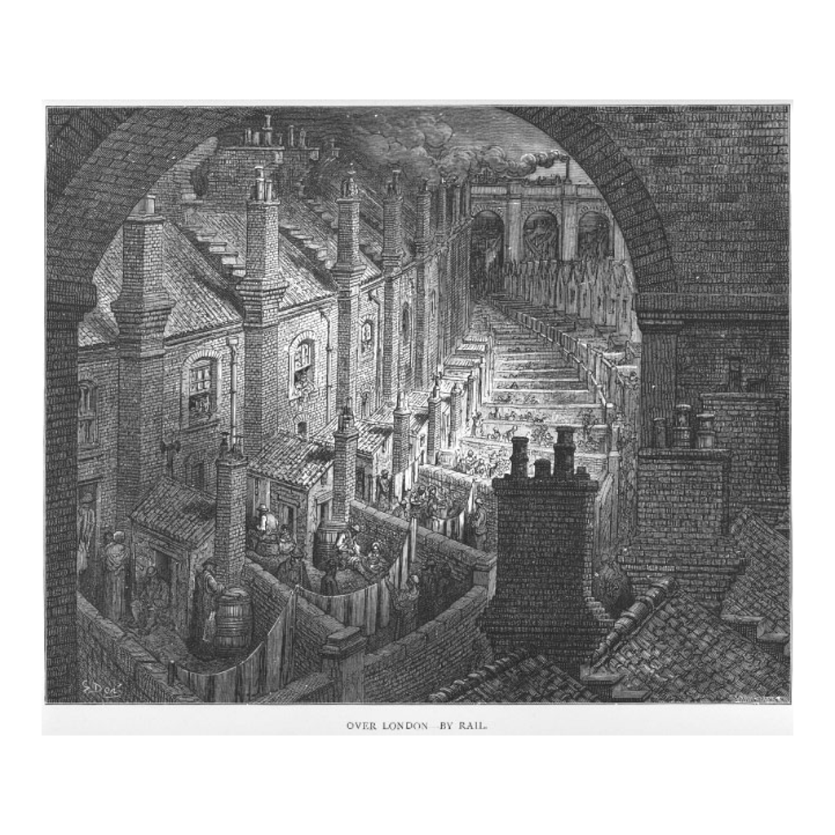
A Crowded City Slum
Over London by Rail, a Gustave Dore engraving of crowded slum housing (1872)
© More Lessons Less Planning | morelessonslessplanning.com
Notes:
This is Gustave Dore's 1872 engraving 'Over London by Rail,' showing the crowded back yards of packed slum housing. It is an artist's illustration, not a photograph, so use it as a reference image to picture the overcrowded slums, not as proof of exactly how one street looked.

Slide 6
Sanitation: No Sewers, Bad Water
Sanitation means the systems for clean water and safely removing waste.
The new slums were built with almost no sewers or drains underground.
Many families shared a single outdoor privy in the court.
Human waste collected in open pits called cesspools near the houses.
Cesspools often leaked into the wells and pumps that people drank from.
Key Concept: The slums had almost no sanitation; shared privies and overflowing cesspools fouled the water families drank.
© More Lessons Less Planning | morelessonslessplanning.com
Notes:
Sanitation means the systems for clean water and safely removing waste. The new slums were built with almost no sewers or drains, and many families shared a single outdoor privy in the court. Human waste collected in open pits called cesspools near the houses, and these cesspools often leaked into the wells and pumps that people drank from.

Slide 7
Disease in the Slums
Crowded rooms and dirty water let disease spread quickly.
Cholera was a deadly disease spread through water fouled by waste.
Cholera swept through the industrial cities and killed thousands of people.
Typhus and other fevers also spread in the packed courts.
Death rates in the worst slums were far higher than in the countryside.
Key Concept: Crowding and fouled water spread deadly disease; cholera swept the slums and killed thousands in the industrial cities.
© More Lessons Less Planning | morelessonslessplanning.com
Notes:
Crowded rooms and dirty water let disease spread quickly. Cholera was a deadly disease spread through water fouled by waste, and it swept through the industrial cities and killed thousands of people. Typhus and other fevers also spread in the packed courts. Death rates in the worst slums were far higher than in the countryside.

Slide 8
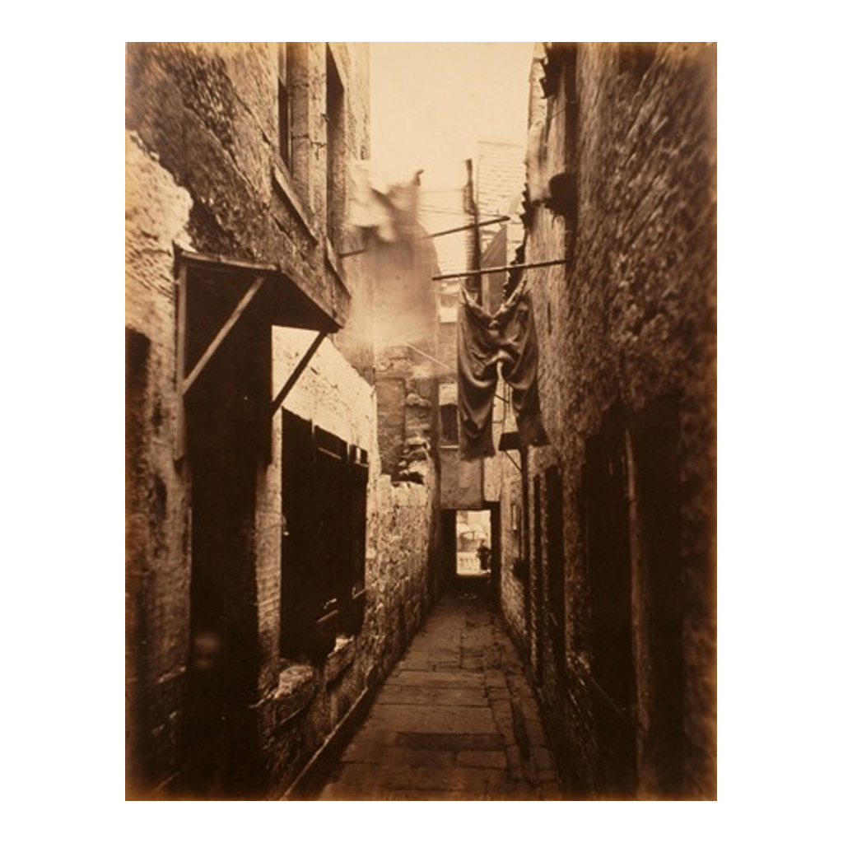
Inside a Slum Court
A photograph of a crowded, run-down city slum court, about 1871
© More Lessons Less Planning | morelessonslessplanning.com
Notes:
This is a period photograph of a crowded, run-down slum court from about 1871, the kind of packed, poorly drained yard where disease spread easily. Use it as a reference image to picture the courts described in the lesson, not as evidence for any specific claim.

Slide 9
A City Divided
Two Different Cities
Worlds Apart
The rich and the poor lived very different lives in the same city
Wealthy factory owners and the middle class moved to clean suburbs
Their streets had fresh air, gardens, and private water
Workers stayed behind in the crowded, smoky slums near the factories
This sharp separation between rich and poor was the class divide
Many well-off families rarely saw how the poor actually lived
Key Concept: A sharp class divide split the industrial city; the wealthy lived in clean suburbs while workers stayed in the crowded slums.
© More Lessons Less Planning | morelessonslessplanning.com
Notes:
The rich and the poor lived very different lives in the same city. Wealthy factory owners and the middle class moved to clean suburbs, where their streets had fresh air, gardens, and private water. Workers stayed behind in the crowded, smoky slums near the factories. This sharp separation between rich and poor was the class divide, and many well-off families rarely saw how the poor actually lived.

Slide 10
Manchester: A Shock City
The First Factory City
A Warning to the World
Manchester grew from a small town into a huge factory city in only decades
Visitors were shocked by its size, smoke, and crowded slums
Writers came from across Europe to see the new industrial world
Manchester showed both the wealth and the misery of industry
Its slums, like Little Ireland, became famous examples of the problem
What happened in Manchester warned other cities what fast growth could bring
Key Concept: Manchester was the shock city of the age, growing so fast that its wealth and its slums both stunned visitors from across Europe.
© More Lessons Less Planning | morelessonslessplanning.com
Notes:
Manchester grew from a small town into a huge factory city in only decades, and visitors were shocked by its size, smoke, and crowded slums. Writers came from across Europe to see the new industrial world. Manchester showed both the wealth and the misery of industry, and its slums, like Little Ireland, became famous examples of the problem. What happened in Manchester warned other cities what fast growth could bring.

Slide 11
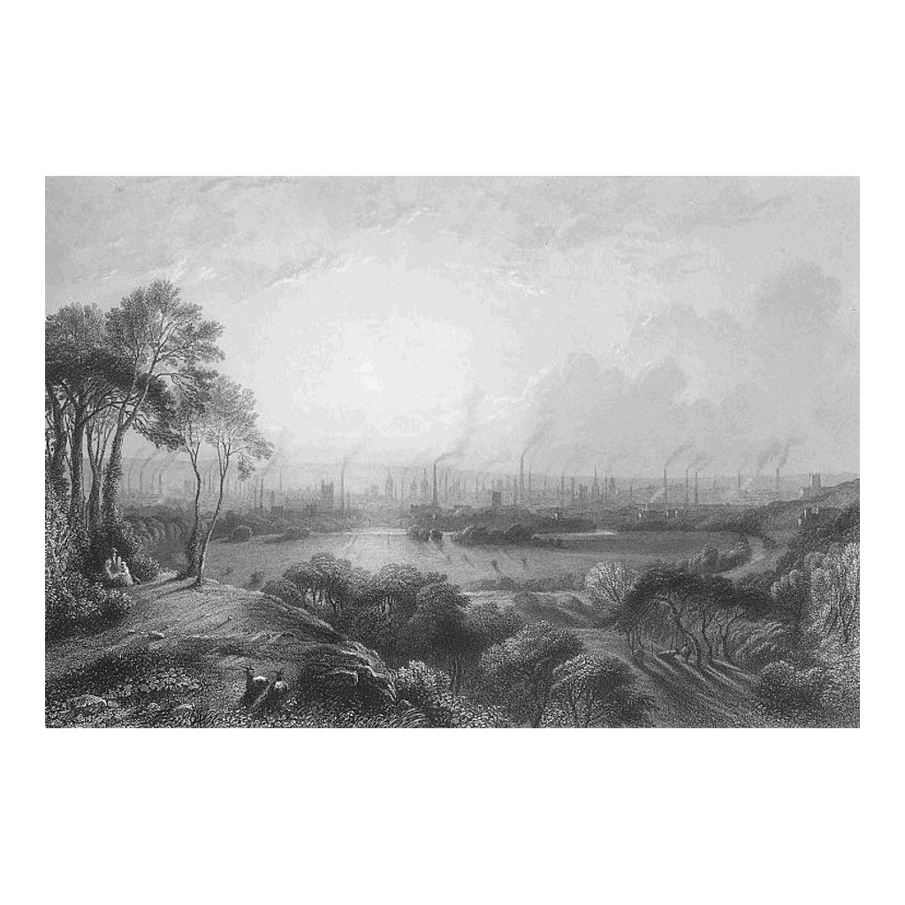
The Shock City of Manchester
Manchester as an industrial city, in a period engraving
© More Lessons Less Planning | morelessonslessplanning.com
Notes:
This is a period engraving of Manchester as an industrial city, showing rows of mills and smoking chimneys. It is an artist's illustration, not a photograph, so use it as a reference image to picture the crowded, smoky shock city, not as proof of exactly how the skyline looked.

Slide 12
The Push for Reform
Reformers began to investigate why so many city workers were dying.
In 1842 Edwin Chadwick published a famous report on sanitary conditions.
His report showed that filth and bad water were making people sick.
Chadwick argued that clean water and sewers would save lives and money.
His evidence helped convince Parliament that the government must act.
Key Concept: In 1842 Edwin Chadwick's sanitary report used evidence to show that filth and bad water were killing the poor, pushing Parliament to act.
© More Lessons Less Planning | morelessonslessplanning.com
Notes:
Reformers began to investigate why so many city workers were dying. In 1842 Edwin Chadwick published a famous report on the sanitary conditions of the poor, showing that filth and bad water were making people sick. Chadwick argued that clean water and sewers would save both lives and money. His evidence helped convince Parliament that the government must act.

Slide 13
The Public Health Act of 1848
In 1848 Parliament passed the Public Health Act as an early step toward reform.
Public health means government action to protect people's health.
The Act let towns set up boards to manage water and waste.
Over time, cities built proper sewers and supplied cleaner water.
These changes slowly made the industrial cities safer places to live.
Key Concept: The Public Health Act of 1848 began public health reform, letting towns manage water and waste and build proper sewers.
© More Lessons Less Planning | morelessonslessplanning.com
Notes:
In 1848 Parliament passed the Public Health Act as an early step toward reform. Public health means government action to protect people's health. The Act let towns set up boards to manage water and waste. Over time, cities built proper sewers and supplied cleaner water, and these changes slowly made the industrial cities safer places to live. It was a first step, not a complete fix, but it showed that evidence could win real reform.

Slide 14
Reference Guide: The Growing City and Its Slums
urbanization
The rapid movement of people from the countryside into fast-growing industrial cities.
slum
A crowded, run-down city district where the poorest workers lived in bad housing.
back-to-back house
A cheap row house that shared its back wall with the next, so air and light could not pass through.
cellar dwelling
A damp basement room below street level that was rented out as housing for the poorest families.
court
A small enclosed yard of packed houses reached through a narrow alley, sharing one privy and water tap.
Tip: These five terms name the move into the cities, the poor districts, and the three kinds of bad housing the poor lived in.
© More Lessons Less Planning | morelessonslessplanning.com
Notes:
Review the first five terms exactly as defined: urbanization, the slum, the back-to-back house, the cellar dwelling, and the court. Students use these definitions to complete the Reference Guide in the Activity.

Slide 15
Reference Guide: Sanitation, Disease, and Reform
sanitation
The systems for supplying clean water and safely removing human and household waste.
cesspool
A pit that collected human waste and often overflowed near homes and drinking water.
cholera
A deadly disease spread through water fouled by waste, which killed thousands in the industrial cities.
class divide
The sharp separation between wealthy factory owners and poor workers, seen in where each group lived.
public health
Government action to protect people's health, such as building sewers and providing clean water.
Tip: These five terms name the broken water systems, the disease they spread, the split between rich and poor, and the reform that answered it.
© More Lessons Less Planning | morelessonslessplanning.com
Notes:
Review the next five terms exactly as defined: sanitation, the cesspool, cholera, the class divide, and public health. Students use these definitions to complete the Reference Guide in the Activity.

Slide 16
Key Takeaways
Urbanization packed people into fast-growing industrial cities like Manchester.
★
Housing could not keep up, so the poor crowded into slums and cellars.
★
With almost no sanitation, cesspools fouled the water families drank.
★
Fouled water and crowding spread deadly disease, and cholera killed thousands.
★
A sharp class divide split the clean suburbs from the crowded worker slums.
★
Reformers like Chadwick used evidence to win the Public Health Act of 1848.
★
© More Lessons Less Planning | morelessonslessplanning.com
Notes:
Close with the essential question of how rapid industrial growth created overcrowded, disease-ridden cities and how reformers used evidence to change the law. Each takeaway connects urbanization and housing, sanitation and disease, the class divide, and the public-health reform response.

