Slide 1
Christianity: Origins and Spread
How a faith that began as a small movement within Judaism spread across the Roman Empire - Jesus and the apostles, persecution and martyrs, and the road from Constantine's Edict of Milan to becoming Rome's official religion.
© More Lessons Less Planning | morelessonslessplanning.com
Notes:
Opening slide. This lesson studies Christianity academically - describing what the tradition teaches and how the faith spread as history, never judging any belief as true or false. Students learn that Christianity began as a movement WITHIN Judaism, centered on Jesus, and gradually became a distinct religion; that it spread across the Roman Empire despite periods of persecution; and that under the emperor Constantine the Edict of Milan (313 CE) legalized it, before the emperor Theodosius later made it the official religion. Set a respectful, neutral tone from the first minute: we describe what Christians believe and how historians explain the faith's spread; we do not rank or judge religions.

Slide 2
Learning Targets
Explain that Christianity began within Judaism, centered on Jesus.
★
Explain why the faith spread - message, apostles, Roman roads, martyrs.
★
Describe the Edict of Milan (313 CE) and what Constantine's law did.
★
Explain that Theodosius later made Christianity the official religion.
★
© More Lessons Less Planning | morelessonslessplanning.com
Notes:
Read the four learning targets. Today pairs an origins story - a movement within Judaism centered on Jesus - with a big historical question: how and why did this faith spread across the whole Roman Empire? Keep the neutral, academic stance in mind throughout: our goal is to understand and describe the history and beliefs, not to decide whether the religion is right. Pay special attention to precision on the Edict of Milan: it legalized Christianity and granted toleration to all faiths, but it did NOT make Christianity the official religion - that came later under Theodosius.

Slide 3
Origins: A Movement Within Judaism
Where it began
Becoming distinct
Christianity is a monotheistic religion centered on Jesus's life and teachings.
It began as a small movement, or sect, within Judaism in Roman Judea.
Jesus and his first followers were Jews living under Roman rule.
At first, followers were a group within Judaism, not a separate religion.
Over time, the movement gradually became a distinct religion of its own.
This is why we say Christianity began WITHIN Judaism, not apart from it.
Key Concept: CHRISTIANITY is a monotheistic religion, centered on Jesus, that began as a movement (sect) within Judaism and became distinct.
© More Lessons Less Planning | morelessonslessplanning.com
Notes:
Let's begin with origins, described as history. CHRISTIANITY is a monotheistic religion centered on the life and teachings of Jesus. Crucially, it did not appear out of nowhere as a separate religion: it began as a small movement - a sect - WITHIN Judaism, in the Roman province of Judea. Jesus and his first followers were Jews living under Roman rule, and early followers thought of themselves as part of the Jewish tradition. Only gradually, over decades, did the movement become a distinct religion of its own. Describe this neutrally, as historians do. The key honesty point to establish now, and to hold all lesson: Christianity grew out of Judaism gradually - it was not an instant, separate religion.

Slide 4
Jesus, the Messiah, and the Good News
The idea of the Messiah
In Jewish tradition, the Messiah is a promised deliverer, or 'anointed one'; early Christians believed Jesus was this Messiah (Christ in Greek).
✔
The Gospel: 'good news'
The Gospel is a word meaning 'good news' - the message about the life and teachings of Jesus that early Christians spread.
✔
A message for everyone
Christians taught that the message was open to all people - rich or poor, enslaved or free - which drew many followers.
✔
Key Concept: Early Christians believed Jesus was the MESSIAH (Christ); they spread the GOSPEL, a word meaning 'good news' about his teachings.
© More Lessons Less Planning | morelessonslessplanning.com
Notes:
At the center of the movement is Jesus and two key ideas. First, the MESSIAH: in Jewish tradition, the Messiah is a promised deliverer, or 'anointed one.' Early Christians believed that Jesus was this Messiah - and the Greek word for Messiah is 'Christ,' which is where the name Christian comes from. Describe this as belief: Christians believed Jesus was the Messiah. Second, the GOSPEL: the word Gospel means 'good news.' It refers to the message about the life and teachings of Jesus that early Christians spread, and later to the written accounts of it. A big reason the message attracted followers is that Christians taught it was open to everyone - rich or poor, enslaved or free. Keep the framing academic: these are the tradition's central beliefs and the message it carried, described neutrally.

Slide 5
The Apostles Carry the Message
Who the apostles were
Why they mattered
An apostle is an early follower of Jesus sent out to spread his message.
Well-known apostles include Paul and Peter.
They traveled far beyond Judea to share the message with new communities.
The apostles founded and encouraged new communities of followers.
Paul's letters helped connect and guide scattered groups across the empire.
Their missionary journeys turned a local movement into a wider network.
Key Concept: An APOSTLE is an early follower of Jesus sent out to teach and spread his message - figures such as Paul and Peter.
© More Lessons Less Planning | morelessonslessplanning.com
Notes:
How did the message travel? Largely through the APOSTLES. An apostle is an early follower of Jesus sent out to teach and spread his message. The best-known apostles include Paul and Peter, who traveled far beyond Judea - across the eastern Mediterranean and toward Rome itself - to share the message with new communities. The apostles matter because they did more than preach: they founded and encouraged new communities of followers, and figures like Paul wrote letters that helped connect and guide scattered groups across the empire. In other words, the apostles' missionary journeys turned a small local movement into a wider, connected network. Describe this as the historical mechanism of the faith's early spread.

Slide 6
Why Christianity Spread So Widely
An appealing message
The message of hope and dignity, taught as open to all people, led many across the empire to convert.
✔
Roman roads and networks
Apostles and travelers used Roman roads, sea routes, and common languages to carry the message quickly across the empire.
✔
A shared empire
A single empire with trade networks and relative peace made it easier for new ideas to travel far.
✔
Key Concept: Christianity spread via its message, the apostles, and Roman roads, drawing many to CONVERSION (adopting a new faith).
© More Lessons Less Planning | morelessonslessplanning.com
Notes:
Why did Christianity spread so widely? Several reasons worked together, and it is worth naming more than one. First, the message itself: a message of hope and dignity, taught as open to all people regardless of wealth or status, led many across the empire to CONVERSION - the act of adopting a new religion. Second, the Roman infrastructure: apostles and travelers used the famous Roman roads, sea routes, and common languages (Greek and Latin) to carry the message quickly from city to city. Third, the shared empire itself: a single empire with busy trade networks and long stretches of relative peace made it easier for new ideas to travel far. So the spread was not one thing - it was an appealing message moving along the arteries of the Roman world, one convert and one community at a time. Describe this as the historical explanation for the faith's growth.

Slide 7
Rome and the Persecution of Christians
Rome's religious world
Why clashes came
Rome was religiously pluralistic - it usually tolerated many gods and cults.
But Romans expected everyone to honor the state gods and the emperor.
Christians, being monotheistic, refused to worship the emperor or Roman gods.
Refusing emperor worship was seen by Rome as disloyal, even dangerous.
At times this led to persecution - punishment because of their beliefs.
Persecution was periodic and local, not constant everywhere.
Key Concept: PERSECUTION is punishment of a group for their beliefs; Rome punished Christians for refusing to worship the emperor.
© More Lessons Less Planning | morelessonslessplanning.com
Notes:
Christianity's spread was not smooth - it sometimes met PERSECUTION. Persecution is the mistreatment or punishment of a group because of their beliefs. To understand why it happened, picture Rome's religious world: Rome was usually pluralistic and tolerated many gods and cults, but it expected everyone to also honor the state gods and to show loyalty by honoring the emperor. Because Christians were monotheistic - worshiping one God - they refused to worship the emperor or the Roman gods. Rome often read that refusal as disloyalty, even as a danger to the community, and at times responded with persecution. Be precise and academic here: the persecution was periodic and local, flaring under certain emperors, not a single constant everywhere. Describe it as history, and keep the tone neutral.

Slide 8
Martyrs and the Catacombs
What a martyr is
A martyr is a person who is killed for refusing to give up their religious beliefs.
✔
Why martyrs mattered
The courage of martyrs impressed onlookers, and their example often helped the faith grow rather than disappear.
✔
The catacombs
Early Christians sometimes met and buried their dead in underground catacombs outside Rome, decorated with some of the earliest Christian art.
✔
Key Concept: A MARTYR is a person killed for refusing to give up their beliefs; martyrs' courage often helped the faith grow.
© More Lessons Less Planning | morelessonslessplanning.com
Notes:
During times of persecution, some Christians became MARTYRS. A martyr is a person who is killed for refusing to give up their religious beliefs. Historians note a striking pattern: rather than stamping out the faith, the courage of martyrs often impressed onlookers, and the example of those who would die rather than abandon their beliefs frequently helped the faith grow. This is why an early Christian writer famously suggested that persecution watered the movement rather than killing it. Christians of this era also left physical traces: they sometimes met and buried their dead in underground CATACOMBS outside Rome, whose walls carry some of the earliest surviving Christian art. On the next slide you will see a real photograph of one such fresco. Describe all of this respectfully and academically, as the history of a faith enduring hardship.

Slide 9
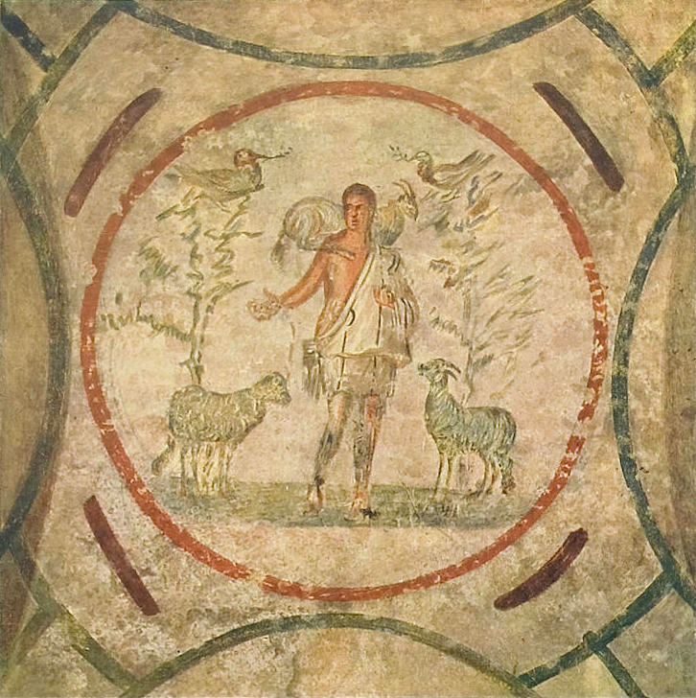
Early Christian Fresco: The Good Shepherd
Good Shepherd fresco, Catacomb of Priscilla, Rome (3rd century CE).
© More Lessons Less Planning | morelessonslessplanning.com
Notes:
Public-domain photograph of the Good Shepherd fresco on the ceiling of the 'Velatio' cubicle in the Catacomb of Priscilla, Rome, second half of the 3rd century CE (via Wikimedia Commons, File:Good shepherd 01 small.jpg; public domain by age). Use it purely as a reference image to make the previous slide's point concrete: early Christians met and buried their dead in the catacombs, whose walls carry some of the earliest Christian art. The Good Shepherd - a figure carrying a sheep - was one of the most common early Christian images. Describe it respectfully and academically; students are not asked to decode the image as evidence.

Slide 10
Constantine and the Edict of Milan (313 CE)
Constantine's turn
What the edict did
Constantine was the Roman emperor who legalized and favored Christianity.
In 313 CE he and Licinius issued the Edict of Milan.
Constantine favored the faith; tradition places his baptism at his death (337).
The Edict of Milan granted religious toleration to ALL faiths.
It legalized Christianity - Christians could now worship openly.
It did NOT make Christianity the official religion of the empire.
Key Concept: CONSTANTINE's EDICT OF MILAN (313 CE) granted toleration to all faiths and legalized Christianity, not official status.
© More Lessons Less Planning | morelessonslessplanning.com
Notes:
Now comes the turning point. CONSTANTINE was the Roman emperor who legalized and favored Christianity. In 313 CE, Constantine and his co-emperor Licinius issued the EDICT OF MILAN. Here is where precision matters most in this whole lesson. The Edict of Milan did two things: it granted religious TOLERATION to ALL faiths, and it legalized Christianity, so that Christians could now worship openly and even recover property that had been taken. What the edict did NOT do is just as important: it did NOT make Christianity the official religion of the empire. It made Christianity legal and protected, alongside other religions - not required. And while Constantine clearly favored the faith, the common claim that he instantly 'converted the empire' is an oversimplification; tradition places his own baptism only near his death in 337. Students will read the actual text of this edict in the Activity, so hold it to a high standard of accuracy.

Slide 11
From Toleration to Official Religion
313 CE: toleration
The Edict of Milan legalized Christianity and granted toleration to all faiths - a legal, protected religion, not the official one.
✔
c. 380-392 CE: official
The emperor Theodosius made Christianity the official religion of the Roman Empire and restricted other public worship.
✔
The whole arc
In under a century, Christianity moved from a persecuted movement to a tolerated faith to the empire's official religion.
✔
Key Concept: THEODOSIUS (c. 380-392 CE) made Christianity the OFFICIAL religion of Rome - a later step than the Edict of Milan's toleration.
© More Lessons Less Planning | morelessonslessplanning.com
Notes:
Let's put the two big legal steps in order, because students often blur them. Step one, in 313 CE: the Edict of Milan legalized Christianity and granted toleration to all faiths. At that point Christianity was legal and protected, but it was one permitted religion among many - not the official one. Step two came about two generations later: around 380 to 392 CE, the emperor THEODOSIUS made Christianity the official religion of the Roman Empire and restricted other public worship. So the honest sequence is toleration first (Constantine, 313), then official status later (Theodosius, c. 380-392). Step back and notice the whole arc: in under a century, Christianity moved from a sometimes-persecuted movement, to a legally tolerated faith, to the official religion of the very empire that had once punished it. Describe this as history, precisely and neutrally.

Slide 12
Key Takeaways
Christianity began as a movement within Judaism, centered on Jesus.
★
It spread through its message, the apostles, Roman roads, and martyrs.
★
The Edict of Milan (313 CE) legalized it and gave toleration to all faiths.
★
Theodosius later (c. 380-392 CE) made it the empire's official religion.
★
© More Lessons Less Planning | morelessonslessplanning.com
Notes:
Let's recap what you now know about Christianity's origins and spread, described academically. First, origins: Christianity began as a small movement, or sect, WITHIN Judaism, centered on Jesus, whom early Christians believed to be the Messiah; only gradually did it become a distinct religion. Second, the spread: the faith spread through an appealing message taught as open to all, the missionary work of the apostles like Paul and Peter, the Roman roads and networks that carried ideas, and the example of martyrs during periods of persecution. Third, the legal turning points, kept in the right order: the Edict of Milan in 313 CE, under Constantine, granted toleration to all faiths and legalized Christianity - it did NOT make it official - and only later, around 380 to 392 CE, did Theodosius make Christianity the official religion of the empire. You also analyzed the text of the Edict of Milan itself. Throughout, we described the history and the beliefs with respect, never judging the faith and never ranking religions.

